Slide 1
ML Results
For CA Report

Slide 2
Training Datasets Breakdown
 | Constrained | NCombined | Unique Normal | Unique Normal Options Random
Config Violation: Trafo1 | 0 | 0 | 0 | 1294
Config Violation: Trafo2 | 0 | 0 | 0 | 1686
Config Violation: Trafo3 | 0 | 0 | 0 | 1671
Config Violation: Feeder1 | 0 | 239 | 5 | 128
Config Violation: Feeder2 | 0 | 208 | 567 | 1034
Config Violation: Feeder3 | 0 | 239 | 589 | 953
Lines over 80% | 7914 | 582 | 2016 | 2445
Load Lost > 20% | 0 | 1783 | 5442 | 1772
Transformers over 80% | 1428 | 275 | 5653 | 5624
More than 8 open switches | 3247 | 699 | 2176 | 407
bus PU violated | 0 | 0 | 140 | 170
No anomaly | 7411 | 15975 | 59953 | 28497
Total | 20000 | 20000 | 76541 | 45681

Slide 3
Testing Datasets Breakdown
 | Unconstrained | Attack | Special
Config Violation: Trafo1 | 5002 | 65536 | 0
Config Violation: Trafo2 | 586 | 16384 | 0
Config Violation: Trafo3 | 83 | 4096 | 0
Config Violation: Feeder1 | 10112 | 131072 | 0
Config Violation: Feeder2 | 3705 | 32768 | 0
Config Violation: Feeder3 | 446 | 8192 | 0
Lines over 80% | 6 | 0 | 8361
Load Lost > 20% | 0 | 0 | 0
Transformers over 80% | 0 | 0 | 6639
More than 8 open switches | 56 | 0 | 0
bus PU violated | 1 | 0 | 0
No anomaly | 3 | 4096 | 5000
Total | 20000 | 262144 | 20000

Slide 4
ML Results
Trained using Constrained, Tested on Unconstrained
+VE: 19997, -VE: 3
Model | TN | TP | FN | FP | Overall statistics | Overall statistics
 |  |  |  |  | Accuracy | Precision | Recall | F1 score
Logistic Regression | 3 | 5479 | 14518 | 0 | 27.41% | 1 | 0.2739 | 0.4301
Decision Tree | 2 | 19873 | 124 | 1 | 99.37% | 0.9999 | 0.9937 | 0.9968
Random Forest | 2 | 19990 | 7 | 1 | 99.96% | 0.9999 | 0.9996 | 0.9997
AdaBoost | 2 | 19987 | 10 | 1 | 99.94% | 0.9999 | 0.9994 | 0.9997
XGBoost | 2 | 19987 | 10 | 1 | 99.94% | 0.99994 | 0.9994 | 0.9997

Slide 5
ML Results
Trained using NCombined, Tested on Unconstrained
+VE: 19997, -VE: 3
Model | TN | TP | FN | FP | Overall statistics | Overall statistics
 |  |  |  |  | Accuracy | Precision | Recall | F1 score
Logistic Regression | 3 | 3774 | 16223 | 0 | 18.88% | 1 | 0.1887 | 0.3175
Decision Tree | 2 | 19707 | 290 | 1 | 98.54% | 0.9994 | 0.9854 | 0.9926
Random Forest | 0 | 19991 | 6 | 3 | 99.95% | 0.9998 | 0.9996 | 0.9997
AdaBoost | 0 | 19996 | 0 | 3 | 99.98% | 0.9998 | 1 | 0.9999
XGBoost | 0 | 19997 | 0 | 3 | 99.98% | 0.9998 | 1 | 0.9999

Slide 6
ML Results
Trained using Unique Normal, Tested on Unconstrained
+VE: 19997, -VE: 3
Model | TN | TP | FN | FP | Overall statistics | Overall statistics
 |  |  |  |  | Accuracy | Precision | Recall | F1 score
Logistic Regression | 2 | 18702 | 1295 | 1 | 93.52% | 0.9999 | 0.9350 | 0.9665
Decision Tree | 2 | 19439 | 558 | 1 | 97.20% | 0.9999 | 0.9720 | 0.9858
Random Forest | 2 | 199983 | 14 | 1 | 99.92% | 0.9994 | 0.9992 | 0.9996
AdaBoost | 1 | 19994 | 3 | 2 | 99.97% | 0.9998 | 0.9998 | 0.9998
XGBoost | 0 | 19997 | 0 | 3 | 99.98% | 0.9998 | 1 | 0.9999

Slide 7
ML Results
Trained using UNOR, Tested on Unconstrained
+VE: 19997, -VE: 3
Model | TN | TP | FN | FP | Overall statistics | Overall statistics
 |  |  |  |  | Accuracy | Precision | Recall | F1 score
Logistic Regression | 3 | 11217 | 8780 | 0 | 56.10% | 1 | 0.5609 | 0.7187
Decision Tree | 1 | 19868 | 129 | 2 | 99.34% | 0.9998 | 0.9935 | 0.9967
Random Forest | 0 | 19996 | 1 | 3 | 99.98% | 0.9998 | 0.9999 | 0.9998
AdaBoost | 0 | 19996 | 1 | 3 | 99.98% | 0.9998 | 0.9999 | 0.9998
XGBoost | 0 | 19997 | 0 | 3 | 99.98% | 0.9998 | 1 | 0.9999

Slide 8
ML Results
Trained using Constrained, Tested on Attack
+VE: 258048, -VE: 4096
Model | TN | TP | FN | FP | Overall statistics | Overall statistics
 |  |  |  |  | Accuracy | Precision | Recall | F1 score
Logistic Regression | 4080 | 1895 | 256153 | 16 | 2.27% | 0.9916 | 0.007345 | 0.01457
Decision Tree | 0 | 258048 | 0 | 4096 | 98.43% | 0.9843 | 1 | 0.9921
Random Forest | 0 | 258048 | 0 | 4096 | 98.43% | 0.9843 | 1 | 0.9921
AdaBoost | 0 | 258048 | 0 | 4096 | 98.43% | 0.9843 | 1 | 0.9921
XGBoost | 0 | 258048 | 0 | 4096 | 98.43% | 0.9843 | 1 | 0.9921

Slide 9
ML Results
Trained using NCombined, Tested on Attack
+VE: 258048, -VE: 4096
Model | TN | TP | FN | FP | Overall statistics | Overall statistics
 |  |  |  |  | Accuracy | Precision | Recall | F1 score
Logistic Regression | 4096 | 61160 | 196888 | 0 | 24.89% | 1 | 0.2370 | 0.3831
Decision Tree | 3072 | 235144 | 22904 | 1024 | 90.87% | 0.9956 | 0.9112 | 0.9515
Random Forest | 0 | 258048 | 0 | 4096 | 98.43% | 0.9843 | 1 | 0.9921
AdaBoost | 0 | 258048 | 0 | 4096 | 98.43% | 0.9843 | 1 | 0.9921
XGBoost | 0 | 258048 | 0 | 4096 | 98.43% | 0.9843 | 1 | 0.9921

Slide 10
ML Results
Trained using Unique Normal, Tested on Attack
+VE: 258048, -VE: 4096
Model | TN | TP | FN | FP | Overall statistics | Overall statistics
 |  |  |  |  | Accuracy | Precision | Recall | F1 score
Logistic Regression | 4096 | 4844 | 253204 | 0 | 3.41% | 1 | 0.01877 | 0.03685
Decision Tree | 4096 | 206319 | 51729 | 0 | 80.26% | 1 | 0.7995 | 0.8886
Random Forest | 4096 | 225739 | 32309 | 0 | 87.67% | 1 | 0.8747 | 0.9332
AdaBoost | 0 | 258048 | 0 | 4096 | 98.43% | 0.9843 | 1 | 0.9308
XGBoost | 4096 | 237739 | 20309 | 0 | 92.25% | 1 | 0.9212 | 0.9590

Slide 11
ML Results
Trained using UNOR, Tested on Attack
+VE: 258048, -VE: 4096
Model | TN | TP | FN | FP | Overall statistics | Overall statistics
 |  |  |  |  | Accuracy | Precision | Recall | F1 score
Logistic Regression | 3133 | 196758 | 61290 | 963 | 76.25% | 0.9951 | 0.7624 | 0.8634
Decision Tree | 4096 | 249530 | 8518 | 0 | 96.75% | 1 | 0.9669 | 0.9832
Random Forest | 4096 | 253795 | 4252 | 0 | 98.37% | 1 | 0.9835 | 0.9916
AdaBoost | 4096 | 237739 | 20309 | 0 | 92.25% | 1 | 0.9212 | 0.9590
XGBoost | 4096 | 256456 | 1592 | 0 | 99.39% | 1 | 0.9938 | 0.9969

Slide 12
ML Results
Trained using XGBoost, Tested on Attack
+VE: 258048, -VE: 4096
Model | TN | TP | FN | FP | Overall statistics | Overall statistics
 |  |  |  |  | Accuracy | Precision | Recall | F1 score
Constrained | 0 | 258048 | 0 | 4096 | 98.43% | 0.9843 | 1 | 0.9921
NCombined | 0 | 258048 | 0 | 4096 | 98.43% | 0.9843 | 1 | 0.9921
Unique Normal | 4096 | 249530 | 8518 | 0 | 96.75% | 1 | 0.9669 | 0.9668
UNOR | 4096 | 256456 | 1592 | 0 | 99.39% | 1 | 0.9938 | 0.9969

Slide 13
ML Results
Trained using Constrained, Tested on Special
+VE: 15000, -VE: 5000
Model | TN | TP | FN | FP | Overall statistics | Overall statistics
 |  |  |  |  | Accuracy | Precision | Recall | F1 score
Logistic Regression | 5000 | 6838 | 8162 | 0 | 59.19% | 1 | 0.4558 | 0.6262
Decision Tree | 106 | 14524 | 476 | 4894 | 73.15% | 0.7479 | 0.9628 | 0.8439
Random Forest | 4982 | 13402 | 1598 | 18 | 91.92% | 0.9986 | 0.8934 | 0.9431
AdaBoost | 1582 | 13915 | 1085 | 3418 | 77.48% | 0.8028 | 0.9276 | 0.8607
XGBoost | 4923 | 14785 | 215 | 77 | 98.54% | 0.9948 | 0.9856 | 0.9902

Slide 14
ML Results
Trained using NCombined, Tested on Special
+VE: 15000, -VE: 5000
Model | TN | TP | FN | FP | Overall statistics | Overall statistics
 |  |  |  |  | Accuracy | Precision | Recall | F1 score
Logistic Regression | 5000 | 5 | 14995 | 0 | 25.02% | 1 | 0.0003 | 0.0006664
Decision Tree | 5000 | 4130 | 10870 | 0 | 45.65% | 1 | 0.2753 | 0.4317
Random Forest | 5000 | 8351 | 6649 | 0 | 66.75% | 1 | 0.5567 | 0.7152
AdaBoost | 5000 | 3 | 14997 | 0 | 25.01% | 1 | 0.0002 | 0.0003999
XGBoost | 5000 | 11565 | 3435 | 0 | 82.82% | 1 | 0.7710 | 0.8706

Slide 15
ML Results
Trained using Unique Normal, Tested on Special
+VE: 15000, -VE: 5000
Model | TN | TP | FN | FP | Overall statistics | Overall statistics
 |  |  |  |  | Accuracy | Precision | Recall | F1 score
Logistic Regression | 5000 | 135 | 14865 | 0 | 25.67% | 1 | 0.009 | 0.01783
Decision Tree | 4983 | 4163 | 10837 | 17 | 45.73% | 0.9959 | 0.2775 | 0.4340
Random Forest | 5000 | 11809 | 3191 | 0 | 84.04% | 1 | 0.7872 | 0.8809
AdaBoost | 5000 | 0 | 15000 | 0 | 25.00% | 0 | 0 | 0
XGBoost | 4979 | 14424 | 576 | 21 | 97.01% | 0.9985 | 0.9616 | 0.9797

Slide 16
ML Results
Trained using UNOR, Tested on Special
+VE: 15000, -VE: 5000
Model | TN | TP | FN | FP | Overall statistics | Overall statistics
 |  |  |  |  | Accuracy | Precision | Recall | F1 score
Logistic Regression | 4959 | 7492 | 7508 | 41 | 62.25% | 0.9945 | 0.4994 | 0.6649
Decision Tree | 4346 | 10943 | 4057 | 654 | 76.44% | 0.9436 | 0.7295 | 0.8228
Random Forest | 4949 | 14477 | 523 | 51 | 97.13% | 0.9964 | 0.9651 | 0.9805
AdaBoost | 5000 | 6657 | 8343 | 0 | 58.28% | 1 | 0.4438 | 0.6147
XGBoost | 4966 | 14483 | 517 | 34 | 97.24% | 0.9976 | 0.9655 | 0.9813

Slide 17
ML Results
Trained using XGBoost, Tested on Special
+VE: 15000, -VE: 5000
Training Dataset | TN | TP | FN | FP | Overall statistics | Overall statistics
 |  |  |  |  | Accuracy | Precision | Recall | F1 score
Constrained | 4923 | 14785 | 215 | 77 | 98.54% | 0.9948 | 0.9856 | 0.9902
NCombined | 5000 | 11565 | 3435 | 0 | 82.82% | 1 | 0.7710 | 0.8706
Unique Normal | 4979 | 14424 | 576 | 21 | 97.01% | 0.9985 | 0.9616 | 0.9797
UNOR | 4966 | 14483 | 517 | 34 | 97.24% | 0.9976 | 0.9655 | 0.9813

Slide 18
ML Results
Trained using UNOR, Tested on Unconstrained, Attack and Special
ANN: best_params = {"n_layers":4, "first_layer_nodes":256, "last_layer_nodes":4, "activation_func":"relu" ,"loss_func":"binary_crossentropy", "epochs": 100, "batch_size": 100}
Test Dataset | TN | TP | FN | FP | Overall statistics | Overall statistics
 |  |  |  |  | Accuracy | Precision | Recall | F1 score
Unconstrained | 2 | 19117 | 880 | 1 | 0.956 | 0.9999 | 0.956 | 0.9775
Attack | 4096 | 255903 | 2145 | 0 | 0.9918 | 1 | 0.9917 | 0.9958
Special | 4954 | 14846 | 154 | 46 | 0.99 | 0.9908 | 0.9699 | 0.9802

Slide 19
ML Results with weights
Trained using UNOR, Tested on Unconstrained, Attack and Special
ANN: best_params = {"n_layers":4, "first_layer_nodes":256, "last_layer_nodes":4, "activation_func":"relu" ,"loss_func":"binary_crossentropy", "epochs": 100, "batch_size": 100}
With more weights on negatives: p > 0.012 → positive
Test Dataset | TN | TP | FN | FP | Overall statistics | Overall statistics
 |  |  |  |  | Accuracy | Precision | Recall | F1 score
Unconstrained | 2 | 19346 | 651 | 1 | 0.9674 | 0.9999 | 0.9674 | 0.9834
Attack | 4087 | 252659 | 5389 | 9 | 0.9794 | 0.9978 | 0.9791 | 0.9894
Special | 4507 | 14999 | 1 | 493 | 0.9753 | 0.9014 | 0.9998 | 0.948

Slide 20
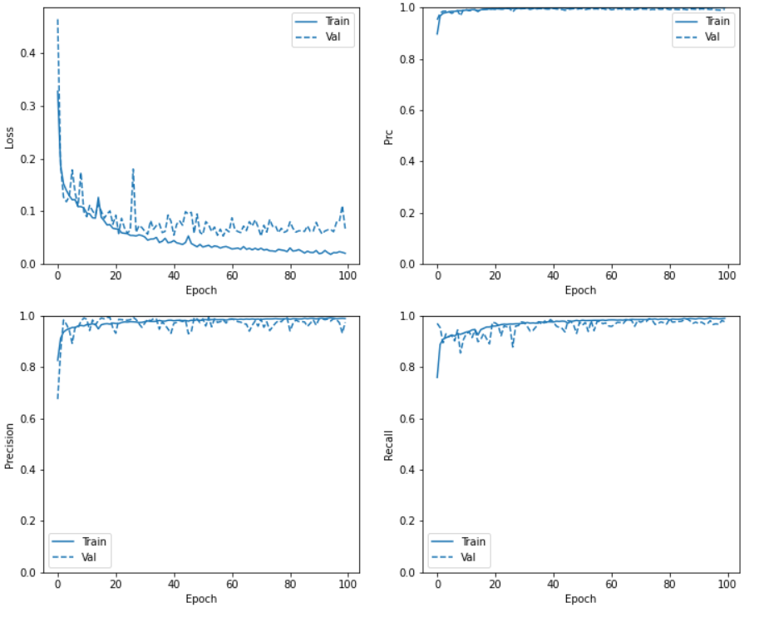
Unique_Normal_Options_Random

Slide 21
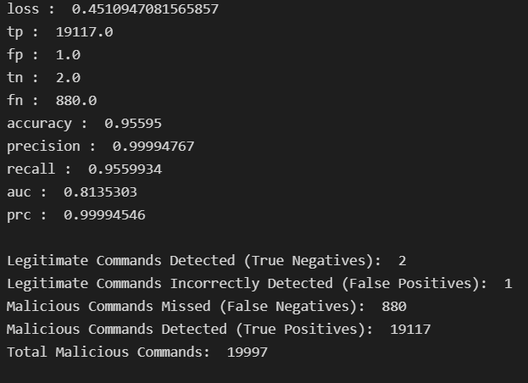
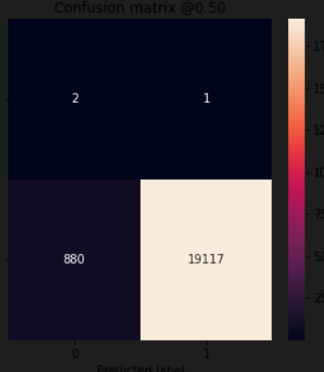
ANN: Train(Unique_Normal_Options_Random) + Test(Unconstrained)

Slide 22
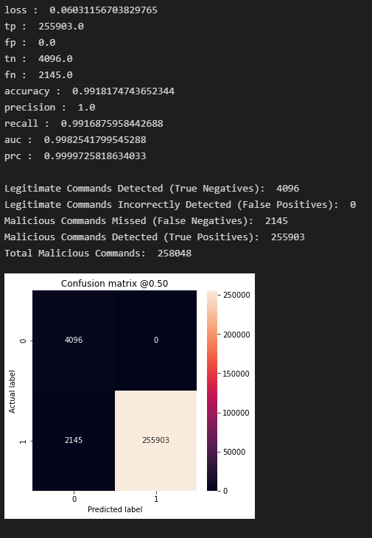
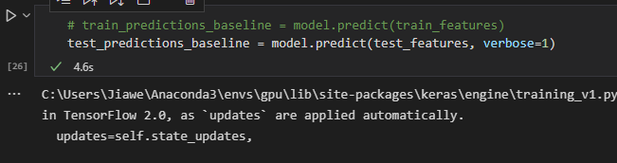
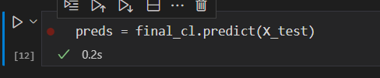
ANN: Train(Unique_Normal_Options_Random) + Test(Attack)

Slide 23
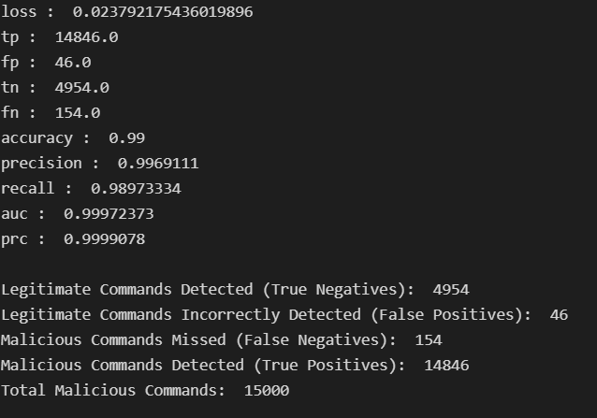
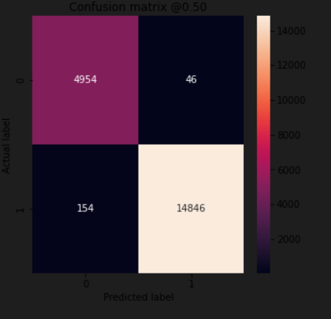
ANN: Train(Unique_Normal_Options_Random) + Test(Special)

Slide 24
Feature Importance
Using XGBoost Built-in Feature Importance

Slide 25
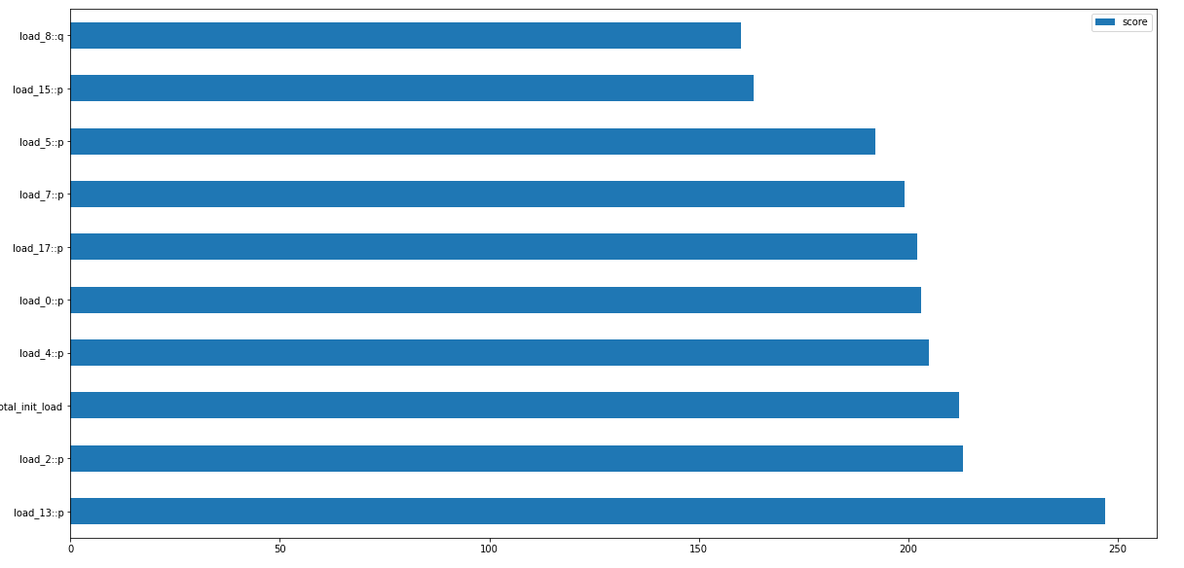
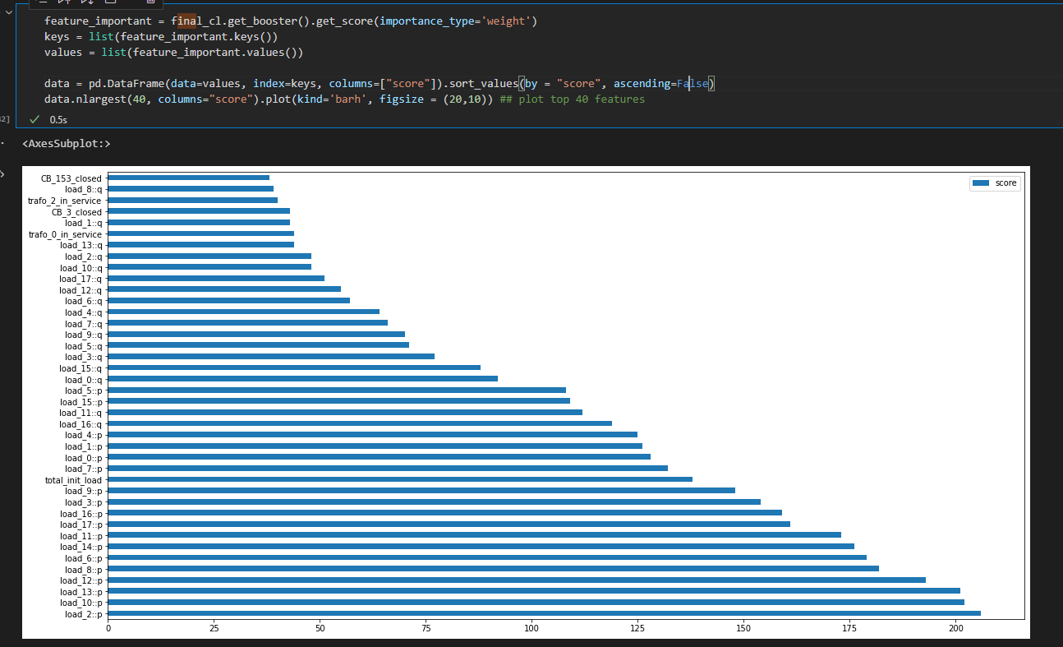
XGBoost: Train(Unique_Normal_Options_Random) + Test(Attack) Using XGBoost inbuilt importance score

Slide 26
Feature Importance
SHAP (SHapley Additive exPlanations) is a game theoretic approach to explain the output of any machine learning model. It connects optimal credit allocation with local explanations using the classic Shapley values from game theory and their related extensions

Slide 27
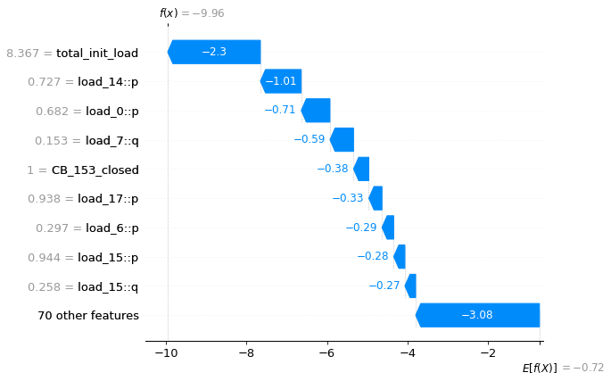
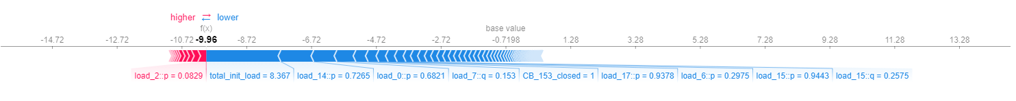
XGBoost: Train(Unique_Normal_Options_Random) + Test(Attack) Using SHAP
The diagram shows features each contributing to push the model output from the base value (the average model output over the training dataset we passed) to the model output. Features pushing the prediction higher are shown in red, those pushing the prediction lower are in blue. Another way to visualize the same explanation is to use a force plot (these are introduced in our Nature BME paper)
Just for 1st Datapoint
shap.plots.waterfall(shap_values[0])
shap.plots.force(shap_values[0])
Notes:
SHAP (SHapley Additive exPlanation) values attribute to each feature the change in the expected model prediction when conditioning on that feature. They explain how to get from the base value E[f(z)] that would be predicted if we did not know any features to the current output f(x). This diagram shows a single ordering. When the model is non-linear or the input features are not independent, however, the order in which features are added to the expectation matters, and the SHAP values arise from averaging the φi values across all possible orderings.

Slide 29
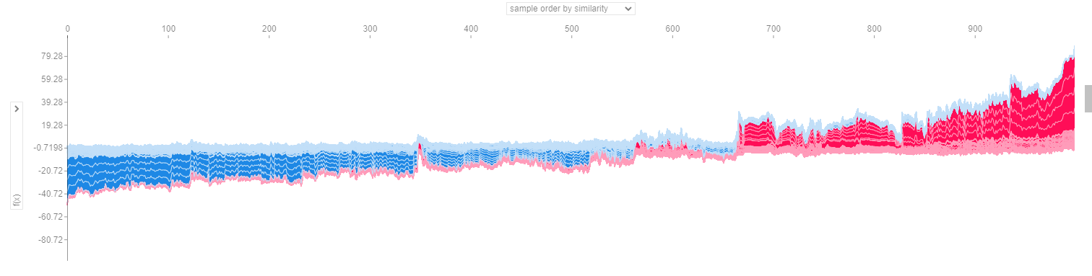
XGBoost: Train(Unique_Normal_Options_Random) + Test(Attack) Using SHAP
shap.plots.force(shap_values[0:1000])

Slide 30
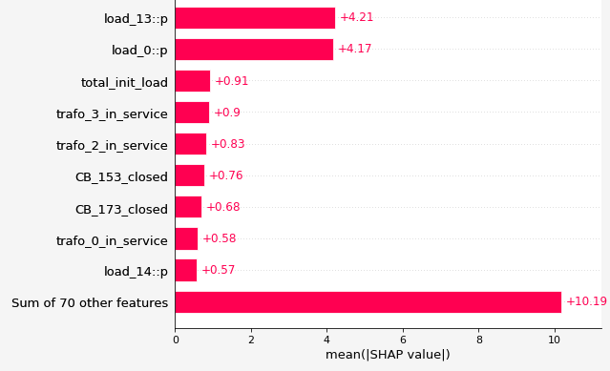
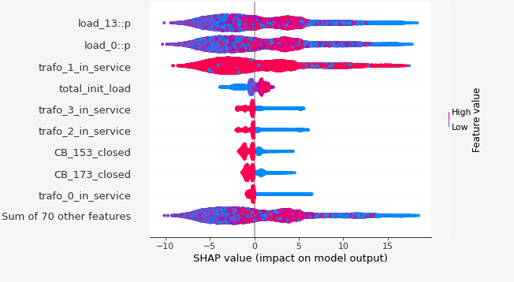
XGBoost: Train(Unique_Normal_Options_Random) + Test(Attack) Using SHAP
shap.plots.bar(shap_values)
shap.plots.beeswarm(shap_values)

Slide 31
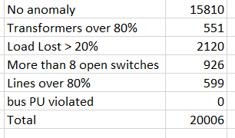
NCombined

Slide 32
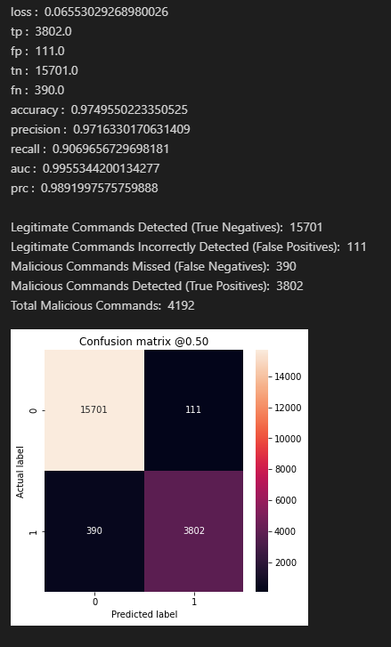
Ncombined Test
{'activation_func': 'tanh', 'batch_size': 1024, 'epochs': 100, 'first_layer_nodes': 256, 'last_layer_nodes': 4, 'loss_func': 'binary_crossentropy', 'n_layers': 4}

Slide 33
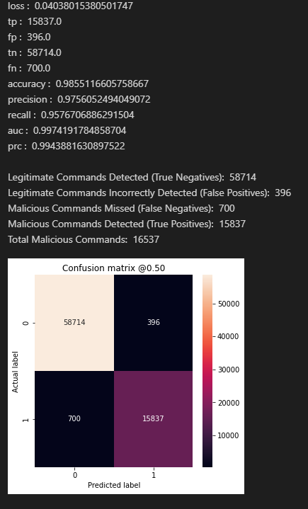
Unique_Normal Test

Slide 34
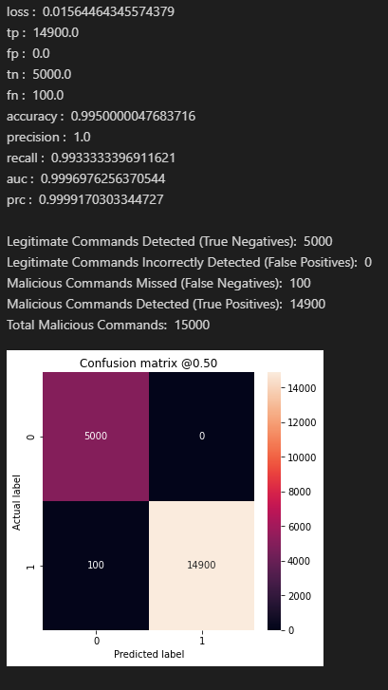
Special Test

Slide 35
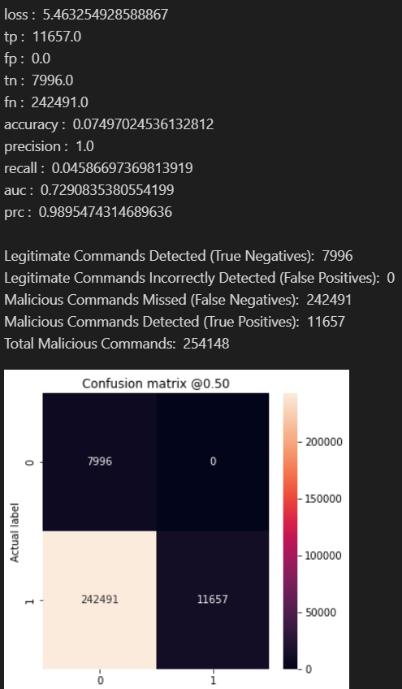
Attack Test

Slide 36
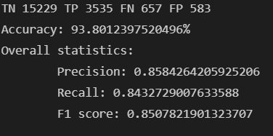
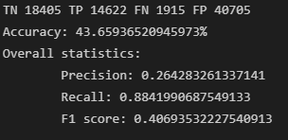
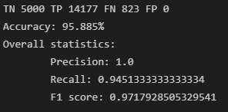
XGBoost: Train(Ncombined):
Test(Ncombined)
Test(Unique_Normal)
Test(Special_New)

Slide 37
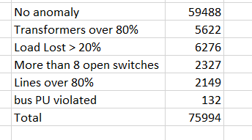
Unique Normal

Slide 38
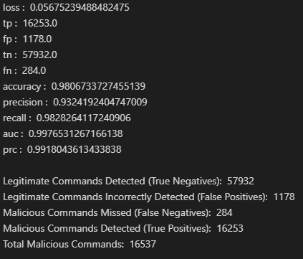
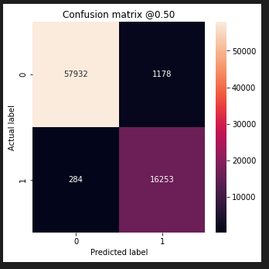
ANN: Train(Unique_Normal) + Test(Unique_Normal)
{'activation_func': 'tanh', 'batch_size': 1024, 'epochs': 100, 'first_layer_nodes': 256, 'last_layer_nodes': 4, 'loss_func': 'binary_crossentropy', 'n_layers': 4}

Slide 39
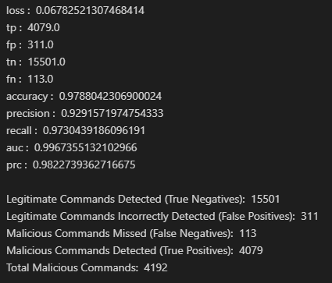
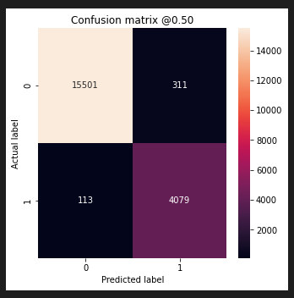
ANN: Train(Unique_Normal) + Test(NCombined)

Slide 40
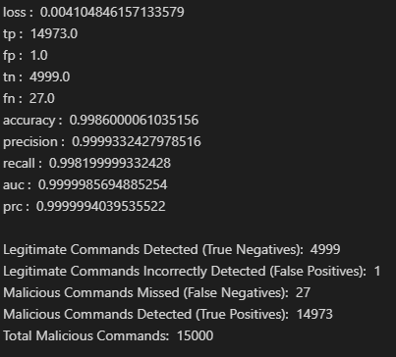
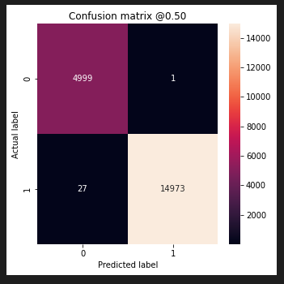
ANN: Train(Unique_Normal) + Test(Special_New)

Slide 41
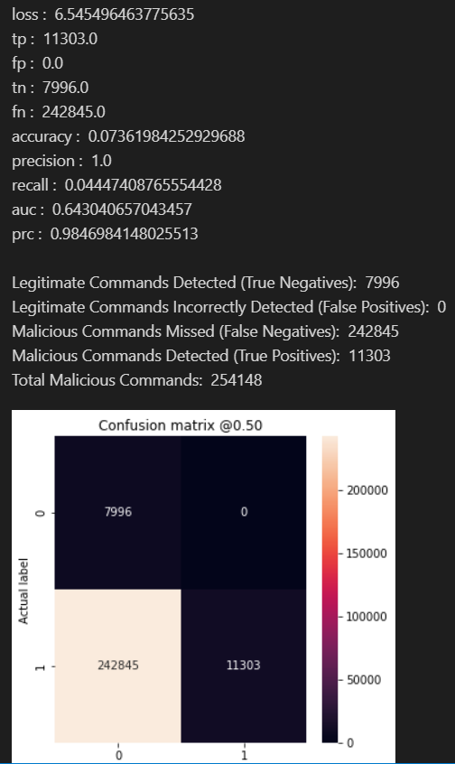
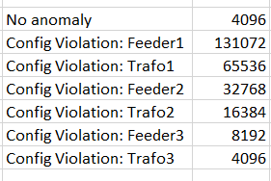
ANN: Train(Unique_Normal) + Test(Attack)

Slide 42
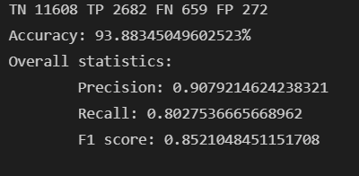
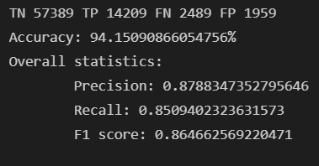
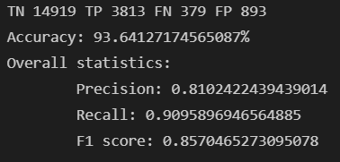
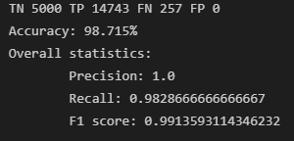
XGBoost: Train(Unique_Normal) + Test(Unique_Normal)
Same dataset with Train_Test_Split
(80% Train Data, 20% Test Data)
Test(New dataset)
Test(NCombined)
Test(Special_New)

Slide 43
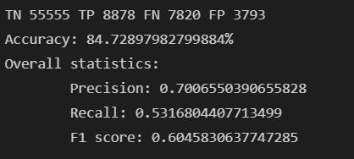
XGBoost: Train(Unique_Normal) + Test (Unique_Normal)
Using only Grid Configurations:

Slide 44
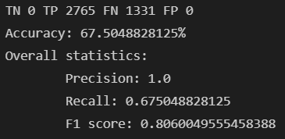
XGBoost: Train(Unique_Normal) + Test (Attack_Dataset)
Using only Grid Configurations:

Slide 45
Unique_Normal_Options_Random + Placing more weights on FN
Notes:
Remember that your neural network outputs probabilities, not classifications. It is up to you to use the probabilities to make classifications. The software default is to use a threshold of 0.50.5 to determine classification, but that might not be the right number for you.
While there are two outcomes, there is likely a third option in the decision-making process of your medical application: “inconclusive, collect more information.” Perhaps you will want something like below 0.30.3 is category 00, above 0.70.7 is category 11, and between 0.30.3 and 0.70.7 is inconclusive.

Slide 46
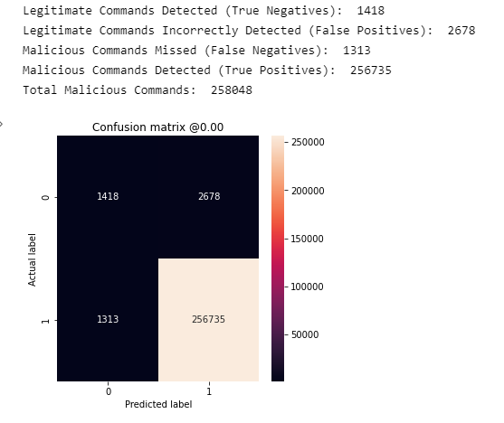
ANN: Train(Unique_Normal_Options_Random) + Test(Attack)
p = 0.012

Slide 47
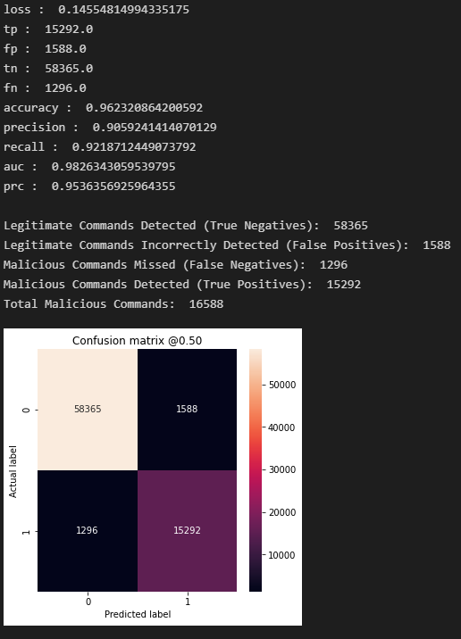
ANN: Train(Unique_Normal_Options_Random) + Test(Unique_Normal)

Slide 48
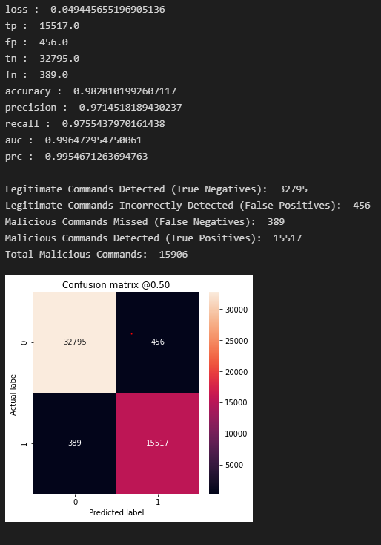
ANN: Train(Unique_Normal_Options_Random) + Test(Unique_Normal_Random)

Slide 49
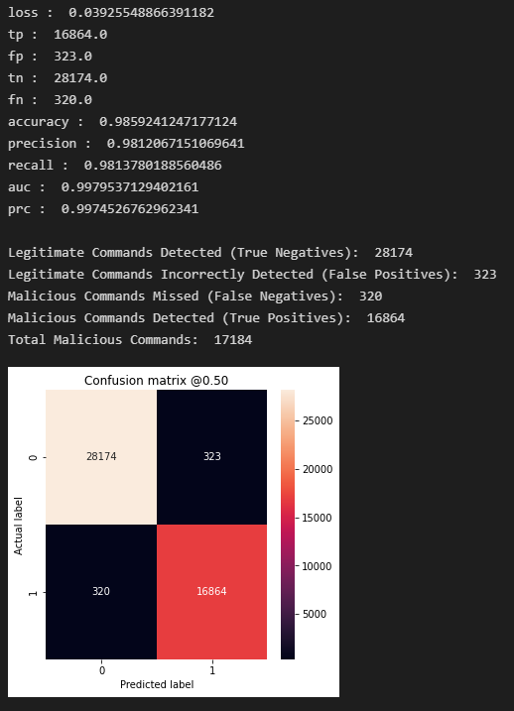
ANN: Train(Unique_Normal_Options_Random) + Test(Unique_Normal_Options_Random)

Slide 50
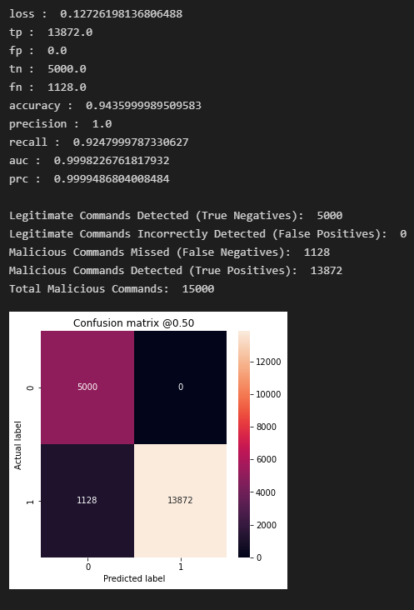
ANN: Train(Unique_Normal_Random) + Test(Special)

Slide 51
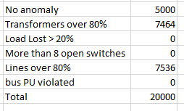
Special New

Slide 52
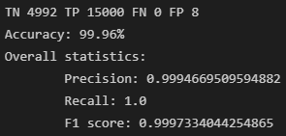
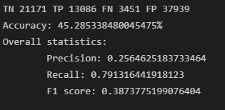
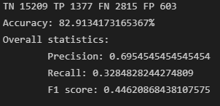
XGBoost: Train(Special_New)
Test(Special_New)
Test(Unique_Normal)
Test(NCombined)

Slide 53
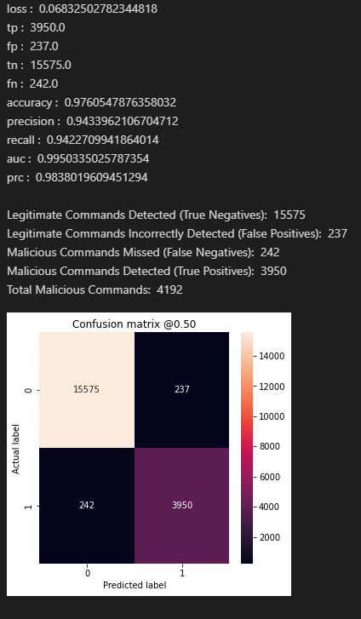
Ncombined Test
{'activation_func’: sigmoid', 'batch_size': 1024, 'epochs': 100, 'first_layer_nodes': 256, 'last_layer_nodes': 4, 'loss_func': 'binary_crossentropy', 'n_layers’: 2}

Slide 54

Unique_Normal Test

Slide 55
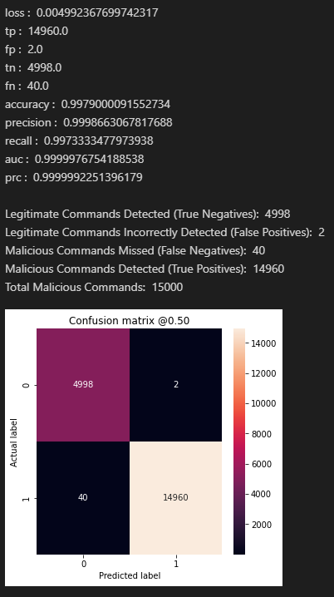
Special Test

Slide 56
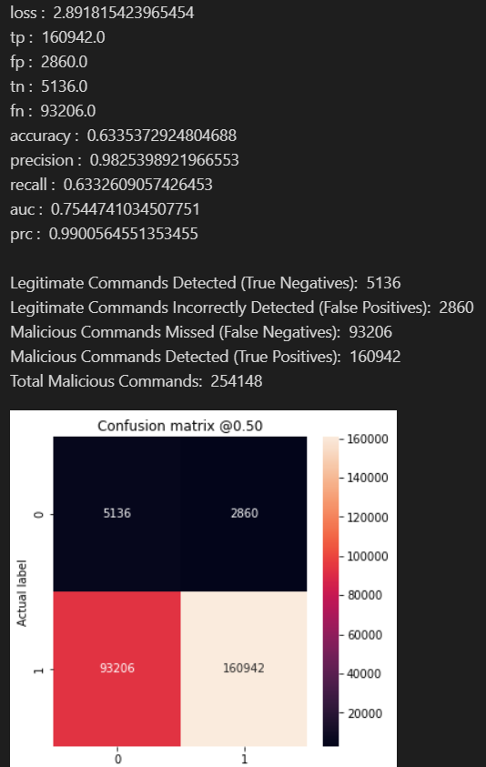
Attack Test

Slide 57
Unconstrained/Constrained/Special

Slide 58



ANN: Train(Constrained) + Test(Constrained)
best_params = {'activation_func': 'relu', 'batch_size': 100, 'epochs': 100, 'first_layer_nodes': 16, 'last_layer_nodes': 4, 'loss_func': 'binary_crossentropy', 'n_layers': 4}

Slide 59



ANN: Train(Constrained) + Test(Special 75% +VE)

Slide 60



ANN: Train(Constrained) + Test(Special 50% +VE)

Slide 61



ANN: Train(Special 75% +VE) + Test(Constrained)
best_params = {'activation_func': 'sigmoid', 'batch_size': 100, 'epochs': 100, 'first_layer_nodes': 256, 'last_layer_nodes': 4, 'loss_func': 'binary_crossentropy', 'n_layers': 2}

Slide 62



ANN: Train(Special 75% Malicious Command) + Test(Special 75% +VE)

Slide 63

ANN: Train(Special 75% +VE) + Test(Special 50% +VE)

Slide 64



ANN: Train(Special 50% +VE) + Test(Constrained)
best_params = {'activation_func': 'sigmoid', 'batch_size': 100, 'epochs': 60, 'first_layer_nodes': 256, 'last_layer_nodes': 4, 'loss_func': 'binary_crossentropy', 'n_layers': 3}

Slide 65



ANN: Train(Special 50% +VE) + Test(Special 75% +VE)

Slide 66



ANN: Train(Special 50% +VE) + Test(Special 50% +VE)

Slide 67

XGBoost: Train(Constrained) + Test(Constrained)

Slide 68

XGBoost: Train(Constrained) + Test(Special 75% +VE)

Slide 69

XGBoost: Train(Constrained) + Test(Special 50% +VE)

Slide 70

XGBoost: Train(Special 75% +VE) + Test(Constrained)

Slide 71

XGBoost: Train(Special 75% +VE) + Test(Special +75% +VE)

Slide 72

XGBoost: Train(Special 75% +VE) + Test(Special 50% +VE)

Slide 73

XGBoost: Train(Special 50% +VE) + Test(Constrained)

Slide 74

XGBoost: Train(Special 50% +VE) + Test(Special +75% +VE)

Slide 75

XGBoost: Train(Special 50% +VE) + Test(Special 50% +VE)

Slide 76
Evaulation
Train on constraint → Overall better results than Train on special
Test on constraint → Use constraint dataset to train for best performance
Test on special → Use special dataset to train for best performance
ANN and XGBoost performance very similar
Train on special remarks: Using this to test on constraint dataset or special dataset will always lead to 0 False negatives → Good thing as malicious commands will always be detected
However, using this to test on constraint leads to many false positives (>10k) → very low accuracy → will have to double check using PSME always
Train on constraint remarks: Generally Okay performance when testing on constraint/special.
Have a number of FNs and FPs (100-300) when testing on constraint
Have 0 False Positives when testing on special, but False Negatives range from 1000-4000 → Will always detect a non-malicious command correct

Slide 77
Generation of Datasets
Normal without disturbance:

Slide 78


Mapping
fb = [0,2,2,2,1,3,3]
lb = [2,4,5,3,3,6,7]
length = [0.05, 2, 1.5, 0.05, 0.05, 1.5, 2] # Increased distance for 4 lines.
for i in range(7):
self.create_line_with_switch(l_index=i, first_bus=fb[i], last_bus=lb[i], length_km=length[i], std_type=std_types[0])
fb = [8, 8, 8, 8, 9, 9, 9]
lb = [10, 11, 12, 9, 13, 14, 15]
length = [0.3, 0.2, 0.1, 0.005, 0.2, 0.3, 0.1]
for i in range(7):
self.create_line_with_switch(l_index=i+7, first_bus=fb[i], last_bus=lb[i], length_km=length[i], std_type=std_types[1])
Bus_0
Bus_1
Bus_2
CB_0
CB_4
Bus_3
CB_3
CB_1
CB_2
CB_5
CB_6
trafo_0_in_service
trafo_1_in_service
Bus_8
Bus_9
CB_7
CB_8
CB_9
CB_10
CB_11
CB_12
CB_13
Load 0 Load 1 Load 2 Load 3 Load 4 Load 5 Bus 10-15
CB_151
CB_152
CB_171
CB_172
Bus_5
Bus_6
Bus_4
Bus_7
CB_153
CB_173
trafo_2_in_service
trafo_3_in_service
trafo_4_in_service
trafo_5_in_service
CB_158
CB_178
Bus_17
Bus_18
Bus_19
Bus_16
CB_22
CB_23
CB_24
CB_25
CB_15
CB_14
CB_16
CB_17
CB_19
CB_18
CB_20
CB_21
Load14 Load15 Load16 Load17 Bus_28-31
Load6 Load7 Load8 Load9 Load10 Load11 Load12 Load13 Bus_20-27

Slide 79
GRID
Bus_0
Feeder0
Feeder1
Bus_1
GRID
s
S/S-1
Line L0
Line L4
110kV
Bus_2
CB-0
CB-4
Bus_3
110kV
CB-1
CB-2
CB-5
CB-6
Options: ['feeder_0', 'feeder_1', 'feeder_2', 'trafo_0', 'trafo_1', 'trafo_2', 'switch_7', 'switch_8', 'switch_9', 'switch_11', 'switch_12', 'switch_13', 'switch_14', 'switch_15', 'switch_16', 'switch_17', 'switch_18', 'switch_19', 'switch_20', 'switch_21', 'switch_22', 'switch_23', 'switch_24', 'switch_25’]
Explain Dataset generation with flowchart/code
Normal with disturbance → Apply options to create disturbance
Normal without disturbance → Using constrained
Combined both above then test
Use imodels to interpret results
Compare the different features importance in different datasets.
Good to mention that we utilize gpu and set it up
CB-3
T0
T1
Line L1
Line L2
Line L5
Line L6
10kV
Bus_8
Bus_9
10kV
CB-7
CB-8
CB-9
CB-10
CB-11
CB-12
CB-13
Line L7
Line L8
Line L9
Line L11
Line L12
Line L13
load0
load1
load2
load3
load4
load5
S/S-2
Bus 10-15
S/S-3
CB-151
CB-152
CB-171
CB-172
110kV
Bus_5
CB-153
110kV
110kV
CB-173
110kV
Bus_6
Bus_4
Bus_7
T2
T3
T4
T5
CB-158
CB-178
10kV
Bus_16
Bus_17
10kV
10kV
Bus_18
Bus_19
10kV
CB-15
CB-17
CB-19
CB-21
CB-14
CB-16
CB-18
CB-20
CB-22
CB-23
CB-24
CB-25
L14
L15
L16
L17
L18
L19
L20
L21
L22
L23
L24
L25
load6
load8
load10
load12
load14
load15
load16
load17
load7
load9
load11
load13
Bus 28 - 31
Bus 20 -27
Notes:
Not compressed

Slide 80


Load before multiplying with load factor
Load after multiplying with load factor (2.8)

Slide 81
NCombined

Slide 82



ANN: Train(Ncombined) + Test(Ncombined)

Slide 83


ANN: Train(Ncombined) + Test(Ncombined) + Oversampling

Slide 84


ANN: Train(Ncombined) + Test(Constrained)

Slide 85


ANN: Train(Constrained) + Test(NCombined)

Slide 86


ANN: Train(Constrained) + Test(NCombined) + Oversampling

Slide 87

XGBoost: Train(Ncombined) + Test(Constrained)

