Slide 1
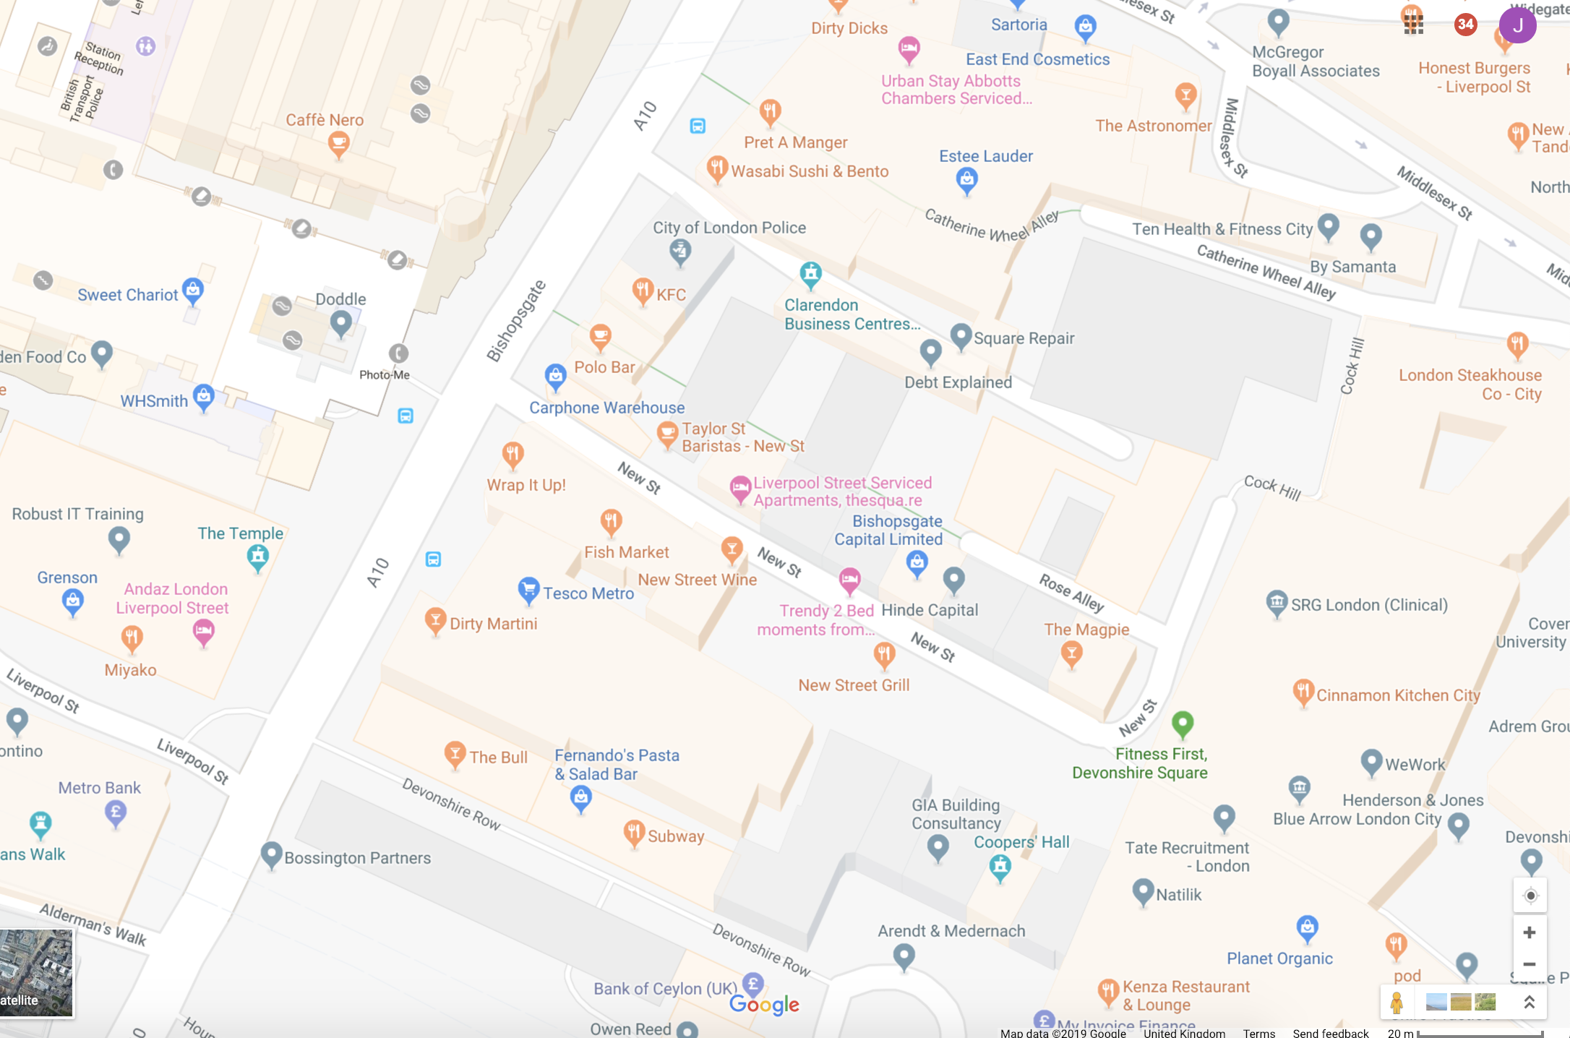
67 offences occurred in this region for the year 2017

Slide 2
