Slide 1
HUAWEI JS TEST TRAINING
^{js uNIT TEsT 102}
XIE JIA

Slide 2
Agenda
如何写可测试的代码
小练习

Slide 3
如何写可测试的代码

Slide 4
^{框架？}
Notes:
单页面应用，前后端分离，胖前端瘦后端，那适合用框架。

Slide 5
^{可测？}
Notes:
document.ready里面一堆代码， 如何测？
逻辑淹没在DOM操作中，如何测？
覆盖率要追求百分百吗？是不是所有代码都需要测？

Slide 6
组件化

Slide 7
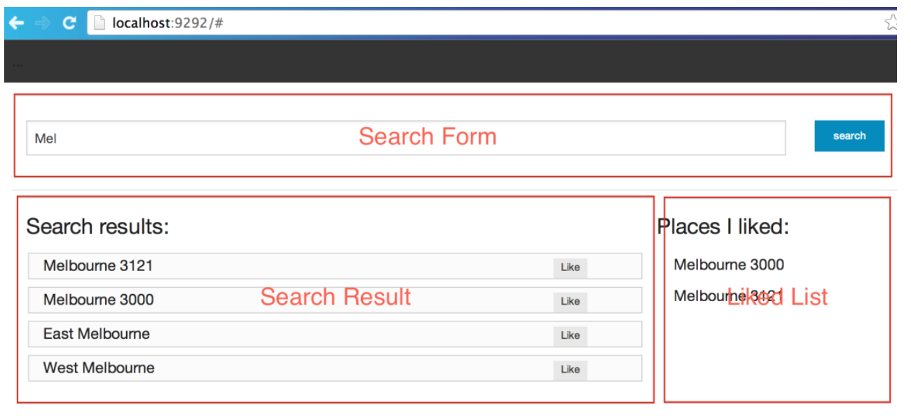
组件化
搜索框
结果集
喜欢的结果集
Notes:
更好的封装和分离，
更容易复用
职责分离

Slide 8
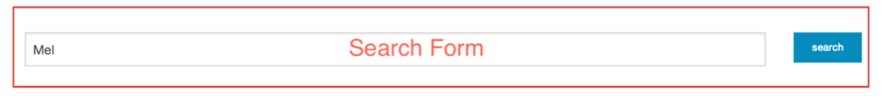
组件化
搜索框
输入框
提交按钮
发送请求
var SearchForm = function(form) {
this.$element = $(form);
this.$element.on('click', '.submit', _.bind(this._bindSubmit,
this)); };
SearchForm.prototype._bindSubmit = function(e) {
var text = this.$element.find('input[type="text"]').val(); $(document).trigger('search', [text]);
};
Notes:
当在“页面”上点击 submit 时,我们可以看到它触发了一个 search 的全局事件。至于 谁来捕获这个事件,则可以交由下一个组件来处理。

Slide 9
组件化
搜索框测试
describe("search form", function() {
var form =
$("<div><input type='text' /><input class='submit'/></div>");
var searchForm;
beforeEach(function () {
searchForm = new SearchForm(form);
});
it("should construct a new form", function () {
expect(searchForm).toBeDefined();
});
it("should trigger search when I click submit", function () {
var spyEvent = spyOnEvent(document, 'search');
form.find('.submit').click();
expect(spyEvent).toHaveBeenTriggered();
});
});
Notes:
describe测试的名字定义了一个应用组件，可能是一个类，一个函数， 也可以是一个函数的多种分支情况。
it是测试的最小单元，它描述了一个场景，或者一个功能点。比如，你期望hello world这个组件在第一个场景中可以say hello。
断言，期望执行的结果与期望结果之间有某种的匹配关系。

Slide 10
组件化
搜索
var Search = function () {
};
Search.prototype.fetch = function (query) {
return $.ajax('/locations?location=' + query, {dataType: 'json'}).then(function (resp) {
return resp;
});
};

Slide 11
组件化
搜索测试
var search;
beforeEach(function () {
spyOn($, ‘ajax').and.callFake(function (e) {
return {
then: function () {
}
}
});
search = new Search();
});
it("should create new search", function () {
expect(search).toBeDefined();
});
it("should fetch data from remote", function () {
search.fetch("Melbourne");
expect($.ajax).toHaveBeenCalled();
expect($.ajax.mostRecentCall.args[0]).toContain(“Melbourne");
});

Slide 12
组件化
结果集
var SearchResults = function (element) {
this.$element = $(element);
this.$element.on('click', '.like', _.bind(this._bindClick,
this));
};
SearchResults.prototype._bindClick = function (e) {
var name = $(e.target).closest('.title').find('h4').text();
$(document).trigger('like', [name]);
};
SearchResults.prototype.setResults = function (locations) {
var template = $.get('templates/location-detail.tmpl');
var that = this;
template.then(function (tmpl) {
var html = _.template(tmpl, {locations: locations});
that.$element.html(html);
});
};

Slide 13
组件化
结果集测试
it("should set search result", function () {
searchResults.setResults(results);
waitsFor(function () {
return ul.find("li").length > 0;
}, 1000);
runs(function () {
expect(ul.find("li").length).toBe(3);
var location =
$.trim(ul.find("li").eq(0).find(".title").text());
expect(location).toContain("Richmond");
});
});
it("should like one of the search results", function () {
searchResults.setResults(results);
var spyEvent = spyOnEvent(document, 'like');
waitsFor(function () {
return ul.find("li").length > 0;
}, 1000);
runs(function () {
ul.find('li').first().find('.like').click();
expect(spyEvent).toHaveBeenTriggered();
});
});

Slide 14
组件化
喜欢的结果集
var Like = function (element) {
this.$element = $(element);
return this;
};
Like.prototype.add = function (item) {
var element = $("<li></li>", {text: item}).addClass('like');
element.appendTo(this.$element);
};

Slide 15
组件化
喜欢的结果集测试
describe("like list", function () {
var ul;
var like;
beforeEach(function () {
ul = $("<ul></ul>");
like = new Like(ul);
});
it("should add new item", function () {
like.add(“jane");
expect(ul.find("li").length).toBe(1);
expect(ul.find("li").eq(0).text()).toEqual("jane");
});
});

Slide 16
组件化
启动代码
$(function () {
var searchForm = new SearchForm("#searchForm");
var searchResults = new SearchResults("#searchResults ul");
var liked = new Like("#likedPlaces ul");
var search = new Search();
$(document).on('search', function (event, query) {
search.fetch(query).then(function (locations) {
searchResults.setResults(locations);
});
});
$(document).on('like', function (e, name) {
liked.add(name);
});
});

Slide 17
MVC

Slide 18
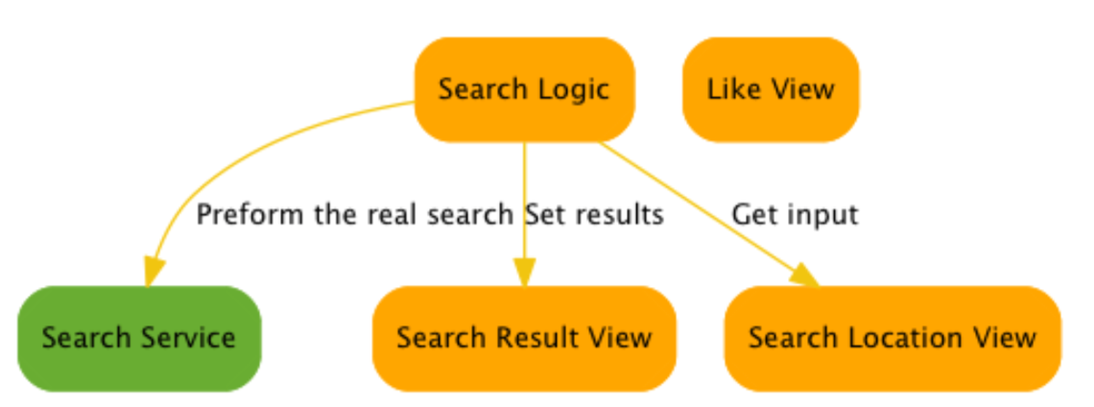
关注分离点
逻辑
服务
视图

Slide 19
关注分离点
搜索服务
function SearchService(url) {
this.search = function (location, successcb, errorcb) {
$.ajax({
url: url + location, dataType: 'json', success: successcb, error: errorcb
});
};
};

Slide 20
关注分离点
搜索结果视图
function SearchResultView(container) {
this.render = function (data) {
$(container).html('');
$(data).each(function (index, loc) {
var li = $("<li></li>").html(loc.name);
$(container).append(li);
li.on('click', function (e) {
var loc = $(e.target).text();
$(document).trigger('like', [loc]);
});
});
};
this.renderError = function () {
$(container).text("something went wrong");
};
}

Slide 21
关注分离点
搜索框视图
function SearchLocationView() {
this.getLocation = function () {
return $("#location").val();
};
this.addSearchHandler = function (callback) {
$("#search").on('click', callback);
};
}

Slide 22
关注分离点
搜索逻辑
function SearchLocationLogic(formView, resultView, service) {
this.launch = function () {
formView.addSearchHandler(this.updateSearchResults);
};
this.updateSearchResults = function () {
var location = formView.getLocation();
if (location) {
service.search(location, resultView.render, resultView.renderError);
}
};
}

Slide 23
关注分离点
程序入口
$(function () {
var searchResults = new SearchResultView("#searchResults ul");
var searchLocation = new SearchLocationView();
var searchService = new SearchService("http://localhost:9292/locations/");
var searchLogic = new SearchLocationLogic(searchLocation, searchResults, searchService);
searchLogic.launch();
var liked = new LikeView("#liked ul");
$(document).on('like', function (e, loc) {
liked.render(loc);
});
});

Slide 24
关注分离点
Like视图
function LikeView(container) { this.render = function(data) {
var li = $("<li></li>").text(data);
$(container).append(li); };
}

Slide 25
关注分离点
更容易测试的逻辑
var formView;
var searchResultView;
var searchService;
beforeEach(function () {
formView = jasmine.createSpyObj('SearchLocationView',
['getLocation']);
searchResultView = jasmine.createSpyObj('SearchResultView',
['render', 'renderError']);
searchService = jasmine.createSpyObj('SearchService',
['search']);
});

Slide 26
关注分离点
更容易测试的逻辑
it("do search logic", function () {
var logic = new SearchLocationLogic(formView, searchResultView,
searchService);
logic.updateSearchResults();
expect(formView.getLocation).toHaveBeenCalled();
});

Slide 27
关注分离点
更容易测试的逻辑
it("search for something", function () {
formView = jasmine.createSpy('SearchLocationView');
formView.getLocation =
jasmine.createSpy('getLocation').andCallFake(function () {
return "Melbourne";
});
var logic = new SearchLocationLogic(formView, searchResultView, searchService);
logic.updateSearchResults();
expect(searchService.search).toHaveBeenCalled();
expect(searchService.search.mostRecentCall.args[0]).toEqual("Melbourne");
expect(searchService.search.mostRecentCall.args[1]).toEqual(searchResultView.render);
expect(searchService.search.mostRecentCall.args[2]).toEqual(searchResultView.renderError);
});

Slide 28
关注分离点
搜索模块
describe("search service", function () {
it("call ajax underline", function () {
spyOn($, 'ajax');
var service = new SearchService("http://whatsoever.service");
service.search("terms");
expect($.ajax).toHaveBeenCalled();
});
});

Slide 29
练习
Notes:
BDD enhancement of TDD， 业务价值 over 实现细节， LiveDocument

Slide 30
练习题目
重新组织你的代码，让它更可测

Slide 31
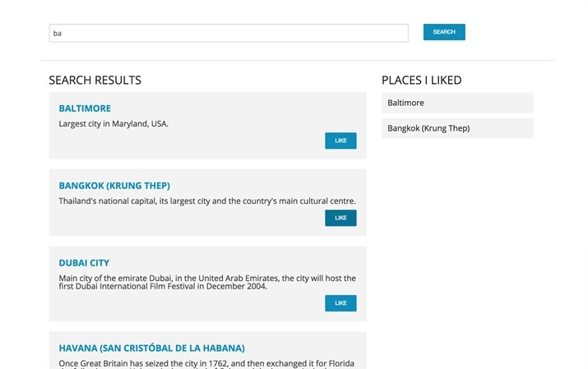
练习题目

Slide 32
启动代码
代码：UITraining/tw-testable-javascript
安装nodeJS 0.12.7
npm install
bower install
服务：
启动 ./server.sh
访问服务 localhost:8080/index.html
跑测试：
localhost:8080/SpecRunner.html
karma start

Slide 33
代码展示

Slide 34
thank you
有问题请联系
XIE JIA
jiaxie@thoughtworks.com

