Slide 1
Homework Assignment #4 Race Condition & Mutex

Slide 2
Outline
Race Condition
Mutex Locks
Application Programming Interface
Exercise 3.20 API
Exercise 4.28 API
Pthread Mutex
Homework Assignment #3
Reference

Slide 3
Race Condition
A situation that several threads access the same data concurrently and the outcome depends on the uncontrollable sequence.
Thread 1 | Thread 2 | bitmap/300/ | Pid_th1 | Pid_th2
if( bitmap/300/ == 0 ) |  | 0 | NULL | NULL
 | if( bitmap/300/ == 0 ) | 0 | NULL | NULL
bitmap/300/ = 1 |  | 0 |  | NULL
 | bitmap/300/ = 1 | 0
1
300
1
300
300
Race Condition
3
Notes:
3

Slide 4
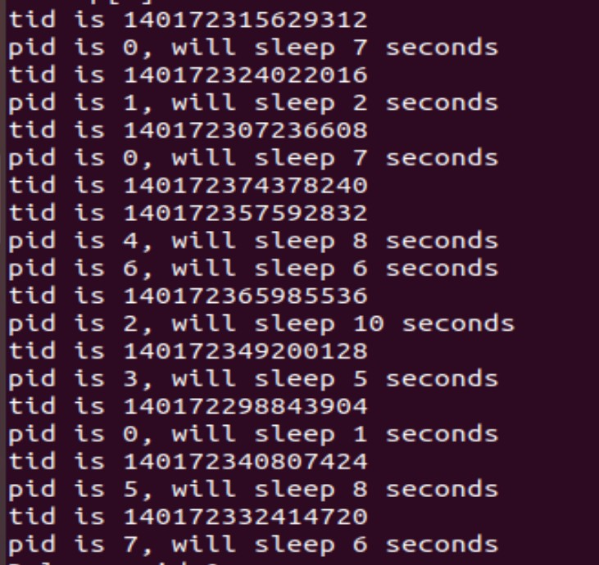
Race Condition
4

Slide 5
Outline
Race Condition
Mutex Locks
Application Programming Interface
Exercise 3.20 API
Exercise 4.28 API
Pthread Mutex
Homework Assignment #3
Reference

Slide 6
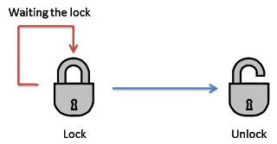
Mutex Locks
We use the mutex lock to protect critical sections and thus prevent race conditions.
A process must acquire the lock before entering a critical section; it releases the lock when it exits the critical section.
A mutex lock has a boolean variable whose value indicates if the lock is available or not.
no
critical
section
Can
acquire
Lock?
yes
process
process
Lock
Unlock
6

Slide 7
Outline
Race Condition
Mutex Locks
Application Programming Interface
Exercise 3.20 API
Exercise 4.28 API
Pthread Mutex
Homework Assignment #3
Reference

Slide 8
Exercise 3.20 API
We have used three APIs in homework#1.
int allocate map( void )：
Initializes a data structure for representing pids;
returns −1 if unsuccessful, 1 if successful
int allocate pid( void )：
Allocates and returns a pid; returns −1 if unable to allocate a pid (all pids are in use)
void release pid( int pid )：
Releases a pid
8

Slide 9
Exercise 4.28 API
We have used three Pthreads APIs in homework#3.
#include <pthread.h>
int pthread_create(pthread_t *thread, const pthread_attr_t *attr,void *(*start_routine) (void *), void *arg);
Create a thread
int pthread_join(pthread_t thread, void **value_ptr); Wait for a thread
Causes the caller to wait for the specified thread to exit
int pthread_exit(void *value_ptr);
Exit a thread without exiting process
9

Slide 10

Pthread Mutex Locks
There is a whole set of library calls associated with mutex locks, most of whose names start with pthread_mutex
To use these library calls, we must include the file pthread.h, and link with the pthread library using –pthread
10

Slide 11
Pthread Mutex Locks
We will use the following four functions
int pthread_mutex_init()
Initialize a mutex.
int pthread_mutex_lock()
Lock the critical section.
int pthread_mutex_unlock()
Unlock the critical section.
int pthread_mutex_destroy()
Release the resource and destroy a mutex.
11

Slide 12
Pthread Mutex Locks
pthread_mutex_init
Initializes the mutex lock.
#include<pthread.h>
int pthread_mutex_init(pthread_mutex_t *mutex,
const pthread_mutexattr_t *mattr);
EX: pthread_mutex_init(& mutex , NULL);
mutex: Pointer to the mutex to be initialized.
mattr: Use the attributes to initialize the mutex. NULL for the default values.
On success, returns 0. On error, one of the following values is returned : EAGAIN, EINVAL , EFAULT , ENOMEM
12
Notes:
12

Slide 13
Pthread Mutex Locks
pthread_mutex_lock
Lock the critical section.
int pthread_mutex_lock( pthread_mutex_t* mutex );
EX: pthread_mutex_lock(& mutex );
mutex: A pointer to the pthread_mutex_t object that you want to lock.
The pthread_mutex_lock() locks the mutex object referenced by mutex.
If the mutex is already locked, then the calling thread blocks until it has acquired the mutex.
On success, returns 0. On error, one of the following values is returned : EAGAIN, EINVAL , EFAULT , ENOMEM
13
Notes:
13

Slide 14
Pthread Mutex Locks
pthread_mutex_unlock
Unlock the critical section.
int pthread_mutex_unlock( pthread_mutex_t* mutex );
EX: pthread_mutex_unlock(& mutex );
mutex: A pointer to the pthread_mutex_t object that you want to unlock.
The pthread_mutex_unlock() unlocks the mutex.
If mutex has been locked more than once, it must be unlocked the same number of times before the next thread is given ownership of the mutex.
On success, returns 0. On error, one of the following values is returned : EAGAIN, EINVAL , EFAULT , ENOMEM
14
Notes:
14

Slide 15
Pthread Mutex Locks
pthread_mutex_destroy
Destroys a previously declared mutex.
int pthread_mutex_destroy(pthread_mutex_t *mutex);
EX: pthread_mutex_destroy (& mutex );
mutex: Pointer to the mutex to be destroyed.
The mutex mustn’t be used after it has been destroyed.
On success, returns 0. On error, one of the following values is returned : EAGAIN , EINVAL , EFAULT , ENOMEM
15
Notes:
15

Slide 16
Pthread Mutex Locks_Example
#include <stdio.h>
#include <stdlib.h>
#include <pthread.h>
#define MAXPID 100000
pthread_mutex_t mutex; // Declare the name of pthread_mutex_t .
int glob=0;
//This is thread function
void *threadFunc() {
int i=0;
printf("---------------------------------\n");
printf("This is thread function\n");
printf("thread ID: %lu\n", pthread_self());
printf("Mutex Lock the critical section.\n");
//critical section start
pthread_mutex_lock( &mutex ); //Lock the critical section.
while(i<MAXPID){
i++;
glob++;
}
pthread_mutex_unlock ( &mutex); //Unlock the critical section.
//critical section end
printf("Mutex unlock the critical section.\n");
printf("sum : %d\n", i);
printf("---------------------------------\n");
pthread_exit(NULL);
}
void *threadFunc2() {
int i=0;
printf("---------------------------------\n");
printf("This is thread2 function\n");
printf("thread ID: %lu\n", pthread_self());
printf("Mutex Lock the critical section.\n");
//critical section start
pthread_mutex_lock( &mutex ); //Lock the critical section.
while(i<MAXPID){
i++;
glob++;
}
pthread_mutex_unlock ( &mutex); //Unlock the critical section.
//critical section end
printf("Mutex unlock the critical section.\n");
printf("sum : %d\n", i);
printf("---------------------------------\n");
pthread_exit(NULL);
}
16

Slide 17
Pthread Mutex Locks_Example(cont.)
int main(int argc, char** argv)
{
pthread_t thread,thread2;
pthread_mutex_init(& mutex , NULL ); //Initializes the mutex.
int rc, t=100;
void *reBuf;
rc = pthread_create(&thread, NULL, threadFunc, NULL);
rc = pthread_create(&thread2, NULL, threadFunc2, NULL);
if(rc)
{
printf("ERROR; return code from pthread_create() is %d\n", rc);
exit(-1);
}
pthread_join(thread, &reBuf);
pthread_join(thread2, &reBuf);
//Release the resource and destroy a mutex.
pthread_mutex_destroy (& mutex );
printf("%d\n",glob);
return 0;
}
17

Slide 18
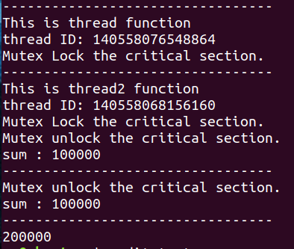
Pthread Mutex Locks_Example(cont.)
18

Slide 19
Outline
Race Condition
Mutex Locks
Application Programming Interface
Exercise 3.20 API
Exercise 4.28 API
Pthread Mutex
Homework Assignment #4
Reference

Slide 20
Homework Assignments #3
Use Pthreads API to create 100 threads.
For each thread
Step1. Use Mutex Lock to protect PID manager, which can allocate
PID for each thread. (PID range : 0~99)
Step 2. Use Mutex Unlock after allocating PID.
Step 3. Let thread sleep for 1~3 seconds.
Step 4. When the thread wake up, using Mutex Lock to protect PID
manager, which can release its PID.
Step 5. Use Mutex Unlock after releasing PID.
Step 6. Terminate the thread and Destroy the mutex.
20

Slide 21
Mutex Lock Flowchart
Create
thread
pthread_create()
pthread_mutex_lock()
Mutex Lock
Critical Section
allocate_pid()
pthread_mutex_unlock()
Mutex Unlock
Thread sleep
sleep()
Thread wake up
pthread_mutex_lock()
Mutex Lock
Critical Section
release_pid()
pthread_mutex_unlock()
Mutex Unlock
Terminate
thread
pthread_exit()
Notes:
21

Slide 22
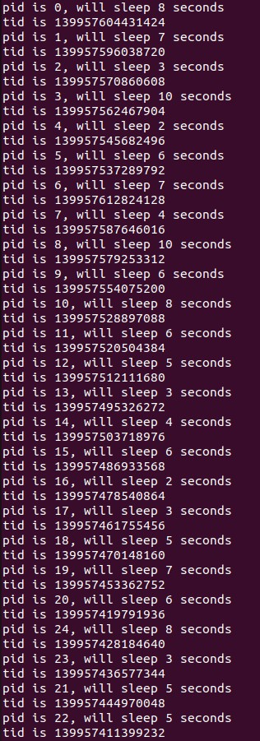
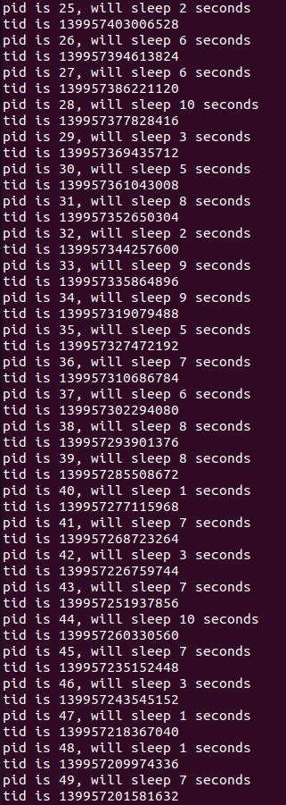
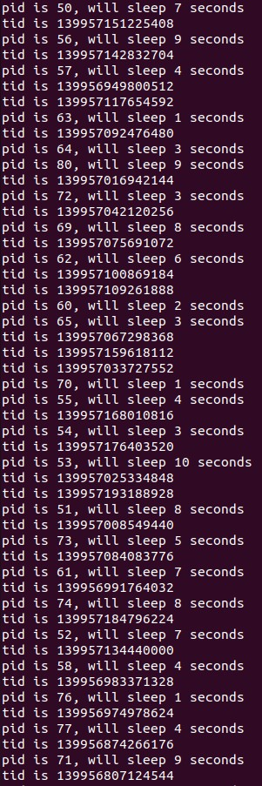
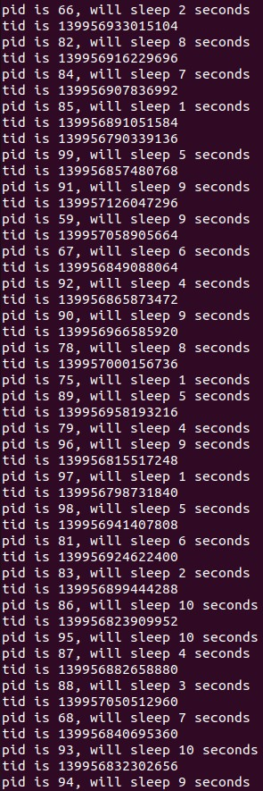
Result
22
Notes:
22

Slide 23
Outline
Race Condition
Mutex Locks
Application Programming Interface
Exercise 3.20 API
Exercise 4.28 API
Pthread Mutex
Homework Assignment #4
Reference

Slide 24

Reference
Operating System Concepts, 10th Edition
24

Slide 25
Turn in
Deadline
2023/12/26 PM.11:59:59
Upload to iLearning
File name
HW4_ID.zip (e.g. HW4_4106056000.zip)
Source code
.c file
Word
If you don’t hand in your homework on time, your score will be deducted 10 points every day.
25

Slide 26
TA
Name：Gang, Yang
Email：pupss96162@gmail.com
Title format : OS HW#4 - [your name]
Lab: OSNET(1001)
26

