Slide 1
COMP 4331 Tut 3
Jiaxin Xie

Slide 2
Outline
Brief introduction to Kaggle
Brief introduction to Pandas
Demonstration of using pandas to preprocess the raw data
Brief introduction to sklearn
Review various plots

Slide 3
What is Kaggle
Kaggle is a competition platform, where you can find data, examples, tutorials, even courses.
Free
Some of the projects even provide computing environments
You can ask people there
For more information, you can refer to: https://www.kaggle.com

Slide 4
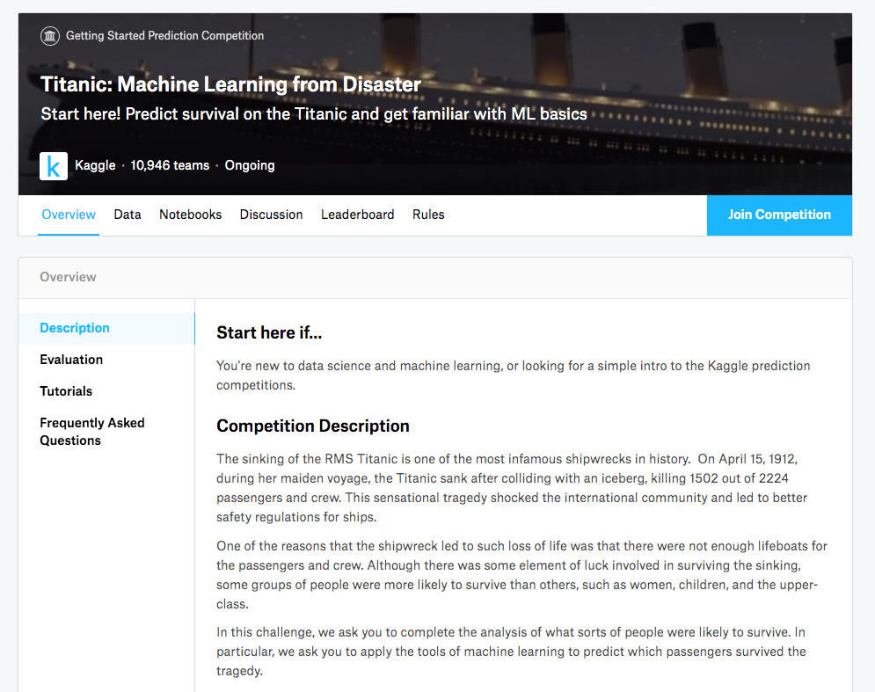
Titanic
https://www.kaggle.com/c/titanic/overview

Slide 5
Experiment setup
Start the Jupyter Notebook (jupyter notebook)
Connect to it via your notebook via your browser.
Create a new ipynb file (click ‘new’ button)
In the first box, copy and paste all the codes in next slides to load used packages
Press shift+enter to execute this box. (PS: you may get error saying that you cannot find a package, please install it in your server with “pip install [package name]”)

Slide 6
Experiment setup
import numpy as np
import pandas as pd
from sklearn import tree
from sklearn.metrics import accuracy_score
from sklearn.model_selection import KFold
from sklearn.model_selection import cross_val_score
from IPython.display import Image as PImage
from subprocess import check_call
# import all the needed package

Slide 7
Introduction to Pandas
Powerful and productive python data analysis and management library.
Short name of Panel Data System
Open sourced by AQR capital management, LLC in late 2009
Used by both academic and industry.

Slide 8
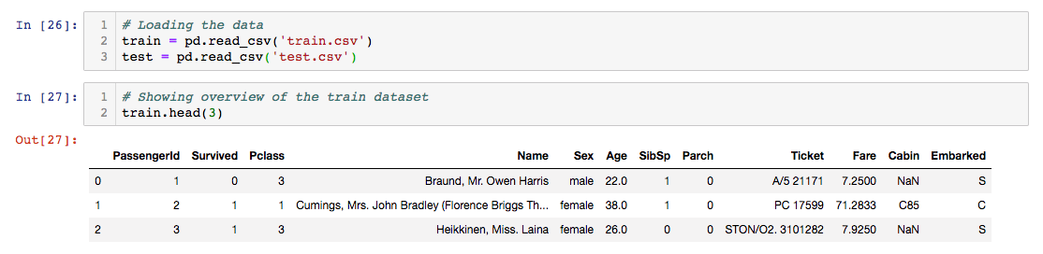
Load data with pandas
Load the train and test data
Show the first three data example

Slide 9
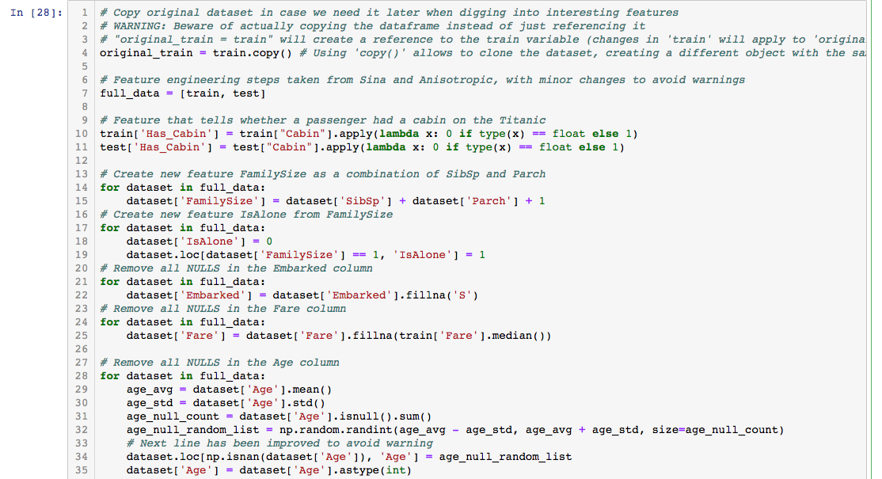
Preprocess data with Pandas (1)
Put the train and test data together
Convert “family size” feature to integer
Create a new feature “IsAlone”
Replace empty data with average

Slide 10
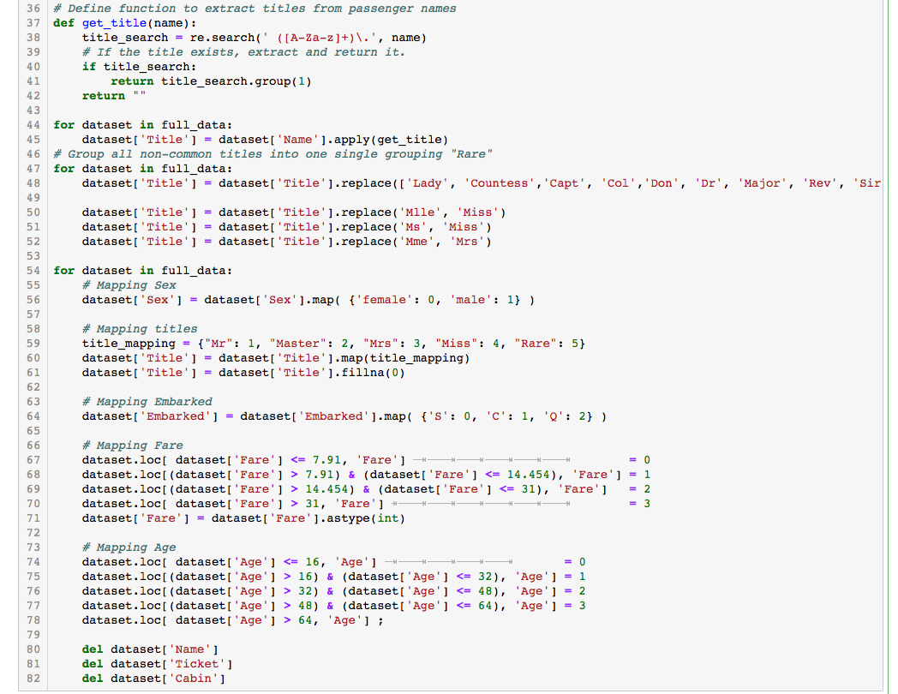
Preprocess data with Pandas (2)
Define a function to clean the data
Clean all the title feature
Replace all the feature with number

Slide 11
Introduction to scikit-learn (sklearn)
Extensions to Scipy (Scientific Python) are called Scikits. Scikie-learn provides machine learning algorithm.
Algorithms for supervised and unsupervised learning
Built on Scipy and Numpy
Standard Python API interface
Sits on top of c libraries, LAPACK, LibSVM, and Cython
Open Source
For more information, you can refer to: https://scikit-learn.org/stable/

Slide 12
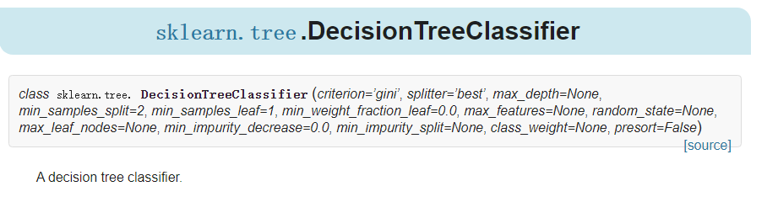
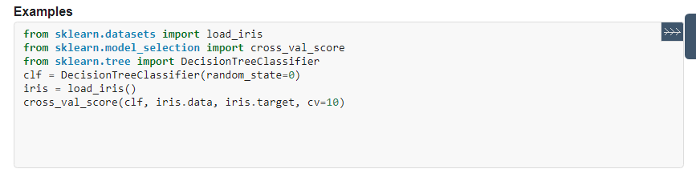
Build a decision tree model with sklearn

Slide 13
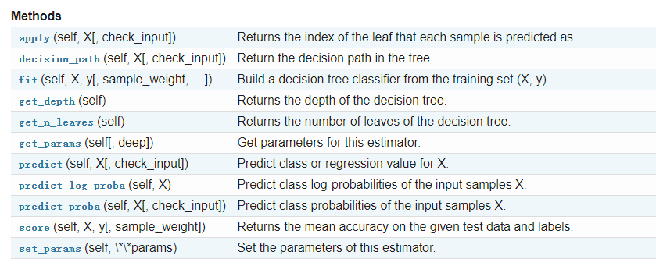
Build a decision tree model with sklearn

Slide 14
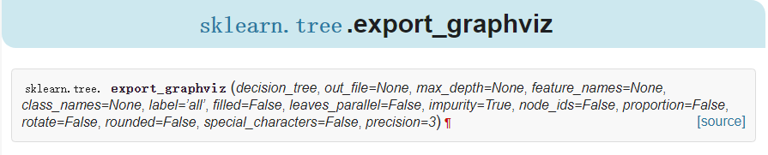
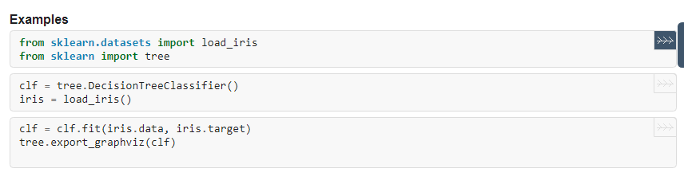
Visualize Decision Tree

Slide 15
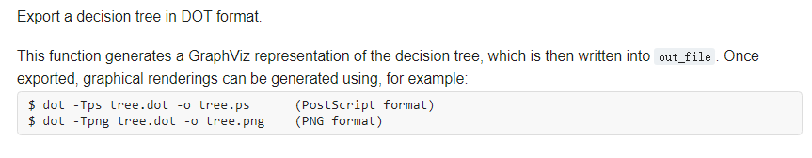
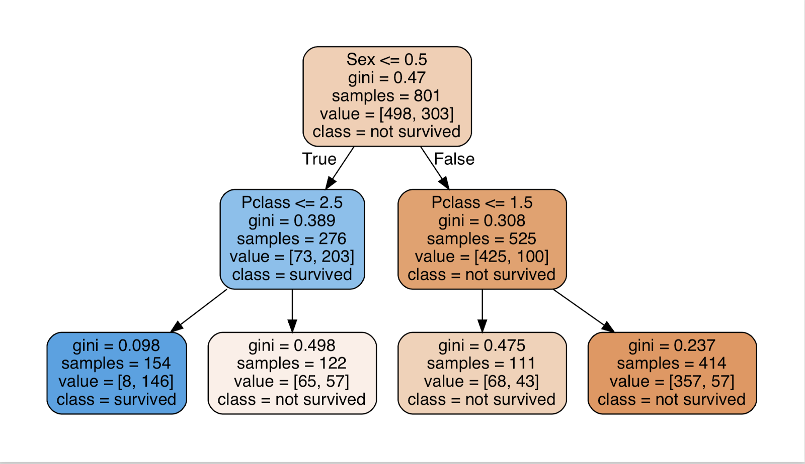
Visualize Decision Tree

Slide 16
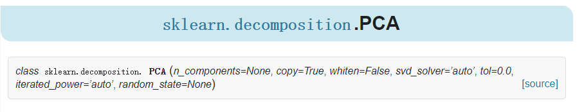
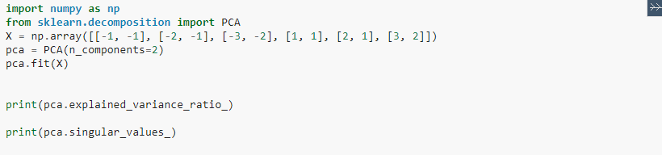
Implement PCA
In tutorial 1, we also release code to implement PCA.

Slide 17
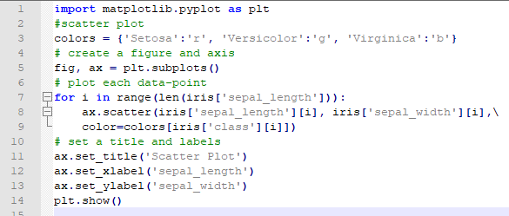
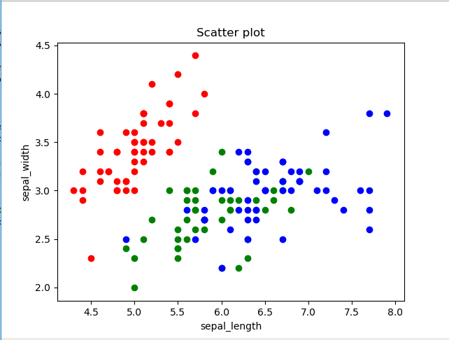
Scatter plot
How to draw a scatter plot with sepal_length for the x-axis and petal_length for the y_axis?

Slide 18
Scatter plot
How to draw a scatter plot with sepal_length for the x-axis and petal_length for the y_axis?

Slide 19
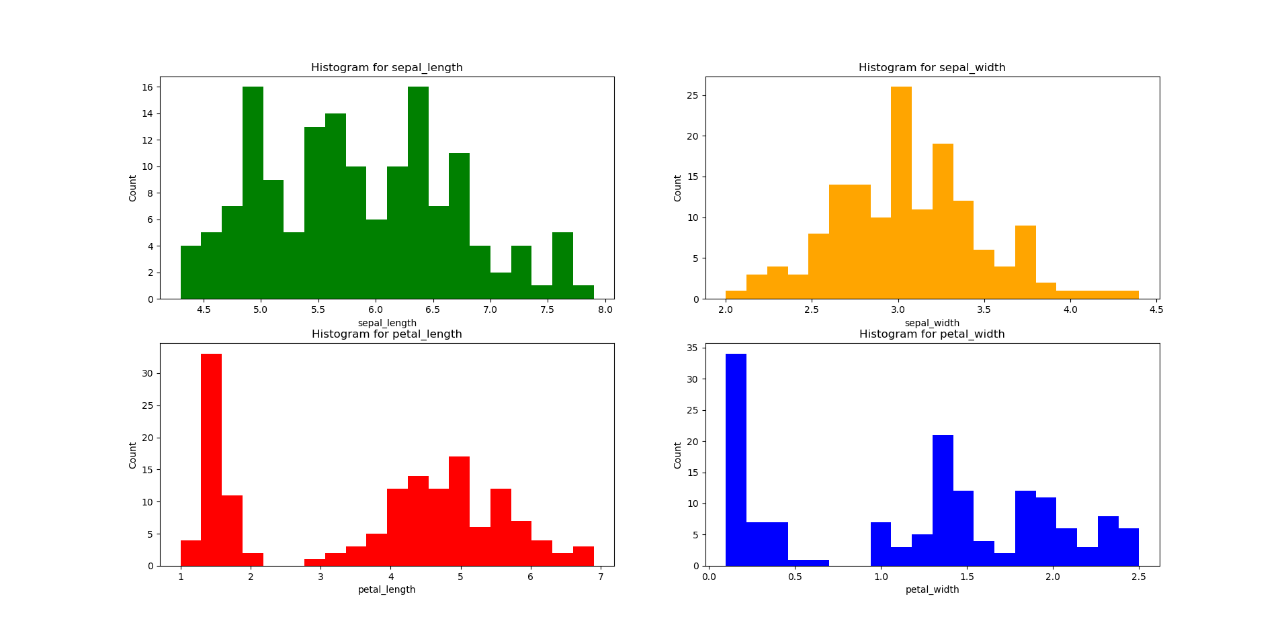
Histogram

Slide 20
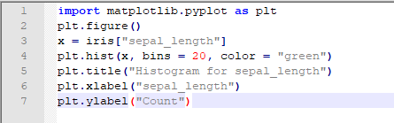
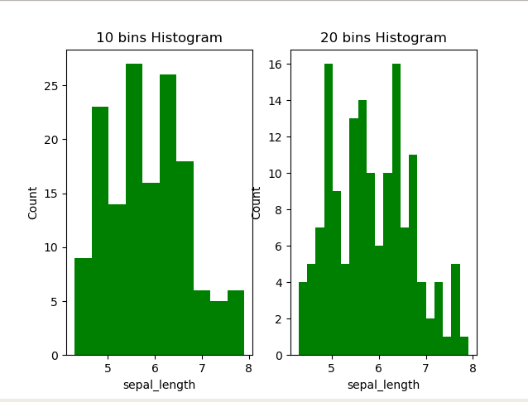
Histogram
Function: matplotlib.pyplot.hist More details plz see https://matplotlib.org/3.1.1/api/_as_gen/matplotlib.pyplot.hist.html
Change bins? plt.hist(x, bins = 10, color = "green")
Try to change other parameters, such as range.

Slide 21
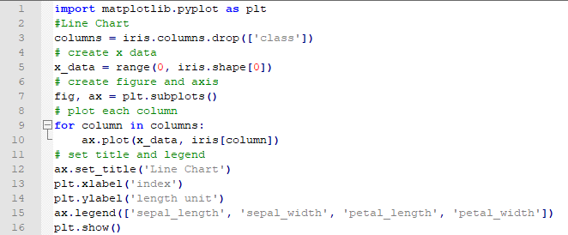
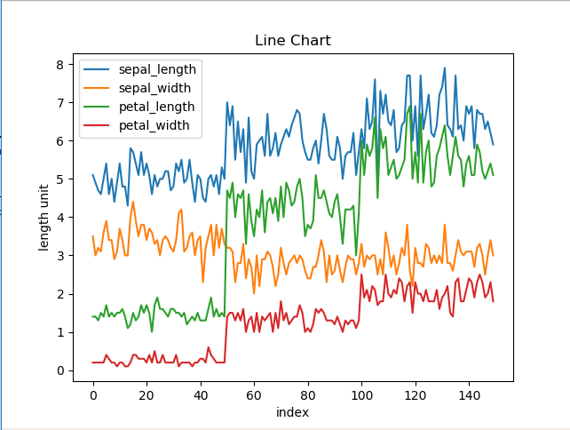
Line Chart
How to draw a Line Chart if we only want to plot sepal_length and sepal_width?

Slide 22
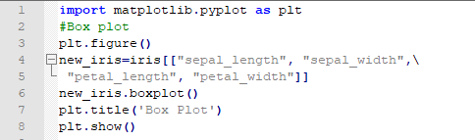
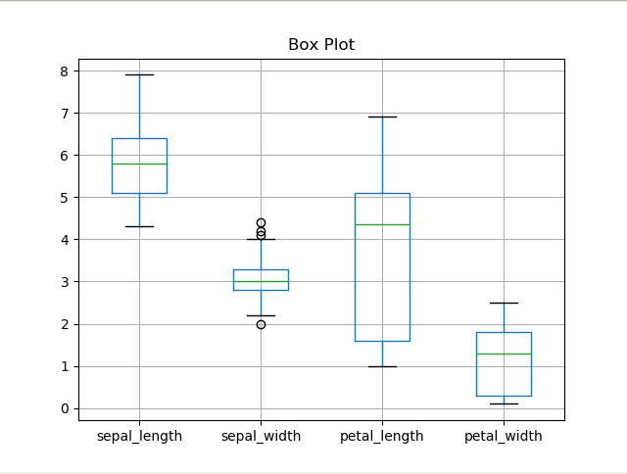
Box Plot
Same question as Line Chart. if we only want to include sepal_length and sepal_width?

