Slide 1
COMP 4331 Tut 3
Jiaxin Xie

Slide 2
Outline
Brief introduction to Kaggle
Brief introduction to Pandas
Demonstration of using pandas to preprocess the raw data
Brief introduction to sklearn
Using sklearn to train a decision tree

Slide 3
What is Kaggle
Kaggle is a competition platform, where you can find data, examples, tutorials, even courses.
Free
Some of the projects even provide computing environments
You can ask people there
For more information, you can refer to: https://www.kaggle.com

Slide 4
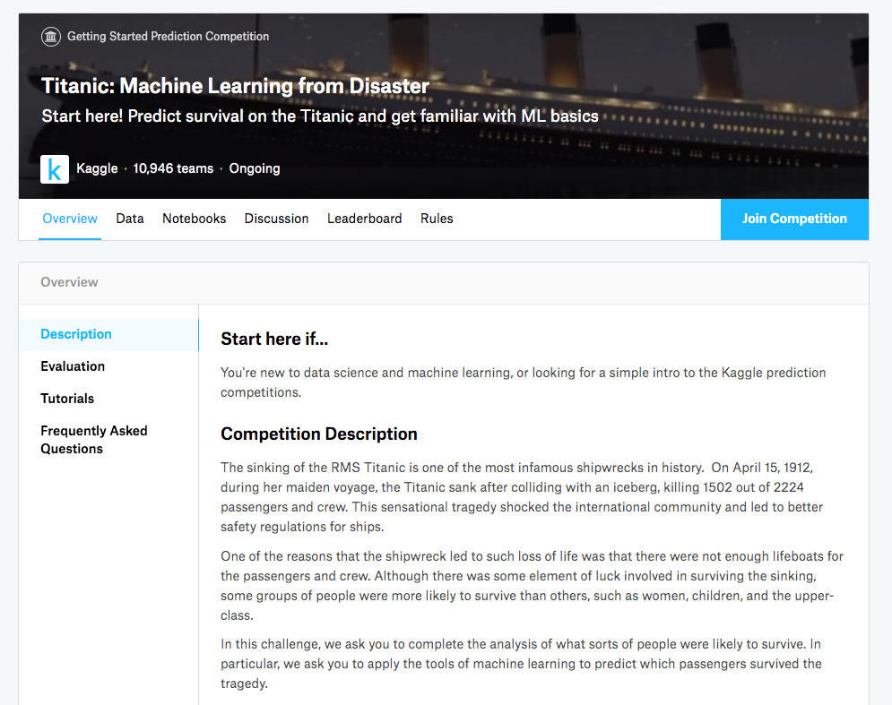
Titanic
https://www.kaggle.com/c/titanic/overview

Slide 5
Preparation
Ssh to the server
Create the folder for this tut: (1) mkdir comp4331; (2) cd comp4311; (3) mkdir tut3.

Slide 6
Download the dataset
Download the datasets (train.csv and test.csv) and save them to the same folder you want to start your Jupyter notebook.
(If you are using aws) you need to upload the downloaded file to the server by following steps:
(1) move downloaded file to the folder of your pem file;
(2) upload train file (scp -i "comp4331.pem" train.csv ubuntu@ec2-3-15-204-231.us-east-2.compute.amazonaws.com:~/comp4331/tut3/)
(3) upload test file (scp -i "comp4331.pem" test.csv ubuntu@ec2-3-15-204-231.us-east-2.compute.amazonaws.com:~/comp4331/tut3/)

Slide 7
Experiment setup
Start the Jupyter Notebook (jupyter notebook)
Connect to it via your notebook via your browser.
Create a new ipynb file (click ‘new’ button)
In the first box, copy and paste all the codes in next slides to load used packages
Press shift+enter to execute this box. (PS: you may get error saying that you cannot find a package, please install it in your server with “pip install [package name]”)

Slide 8
Experiment setup
import numpy as np
import pandas as pd
import re
import xgboost as xgb
import seaborn as sns
import matplotlib.pyplot as plt
%matplotlib inline
import plotly.offline as py
py.init_notebook_mode(connected=True)
import plotly.graph_objs as go
import plotly.tools as tls
from sklearn import tree
from sklearn.metrics import accuracy_score
from sklearn.model_selection import KFold
from sklearn.model_selection import cross_val_score
from IPython.display import Image as PImage
from subprocess import check_call
from PIL import Image, ImageDraw, ImageFont
# import all the needed package

Slide 9
Introduction to Pandas
Powerful and productive python data analysis and management library.
Short name of Panel Data System
Open sourced by AQR capital management, LLC in late 2009
Used by both academic and industry.

Slide 10
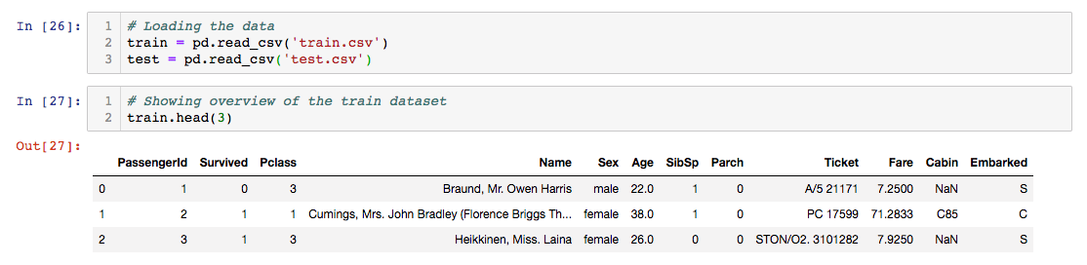
Load data with pandas
Load the train and test data
Show the first three data example

Slide 11
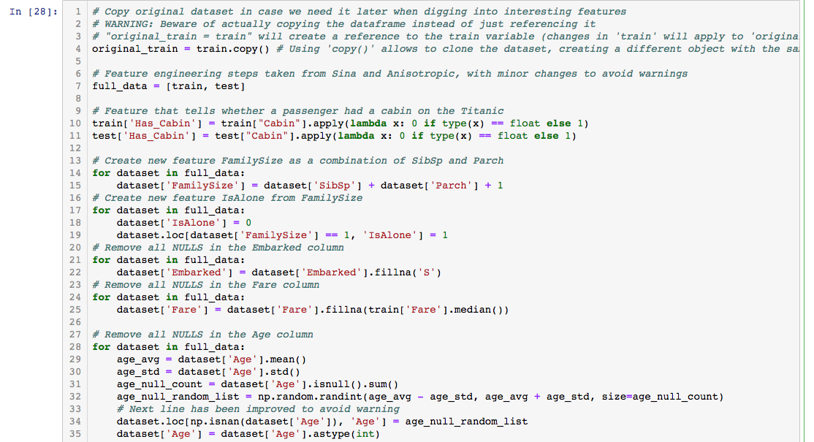
Preprocess data with Pandas (1)
Put the train and test data together
Convert “family size” feature to integer
Create a new feature “IsAlone”
Replace empty data with average

Slide 12
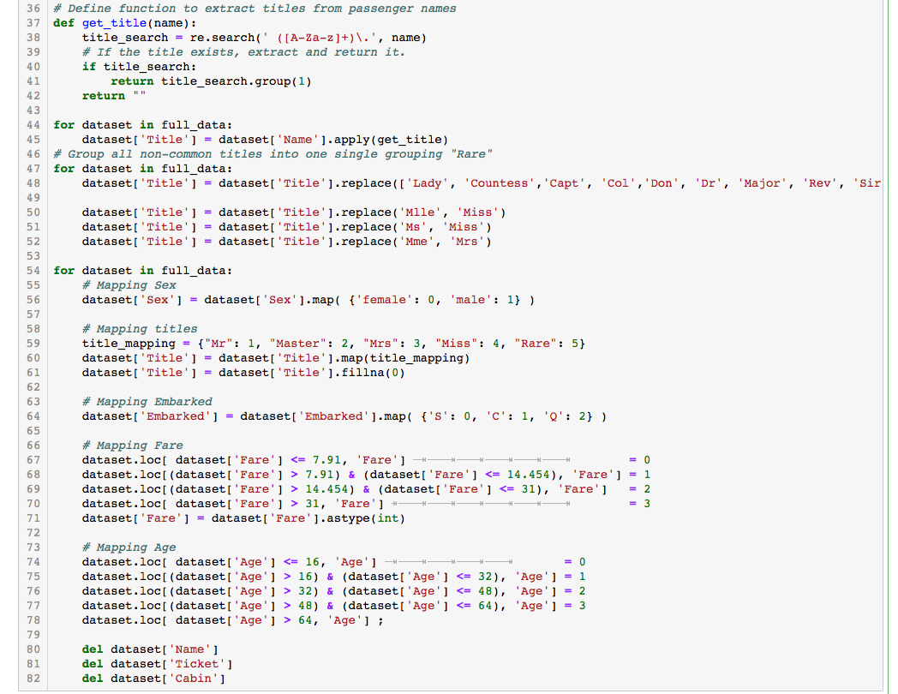
Preprocess data with Pandas (2)
Define a function to clean the data
Clean all the title feature
Replace all the feature with number

Slide 13
Introduction to scikit-learn (sklearn)
Extensions to Scipy (Scientific Python) are called Scikits. Scikie-learn provides machine learning algorithm.
Algorithms for supervised and unsupervised learning
Built on Scipy and Numpy
Standard Python API interface
Sits on top of c libraries, LAPACK, LibSVM, and Cython
Open Source
For more information, you can refer to: https://scikit-learn.org/stable/

Slide 14
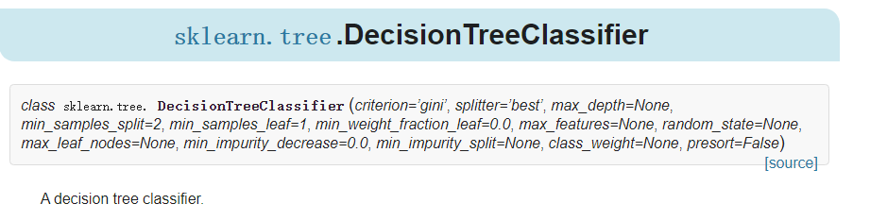
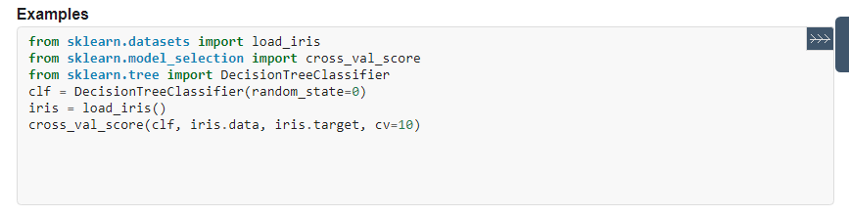
Build a decision tree model with sklearn

Slide 15
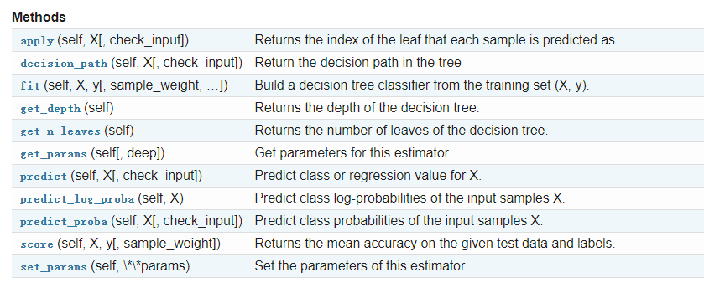
Build a decision tree model with sklearn

Slide 16
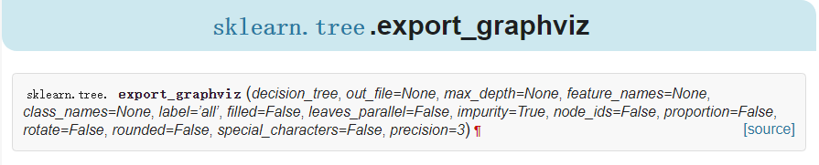
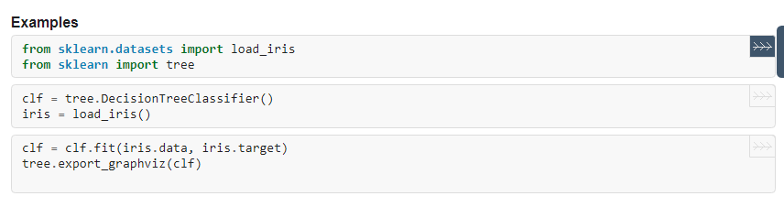
Visualize Decision Tree

Slide 17
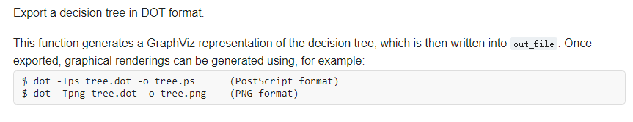
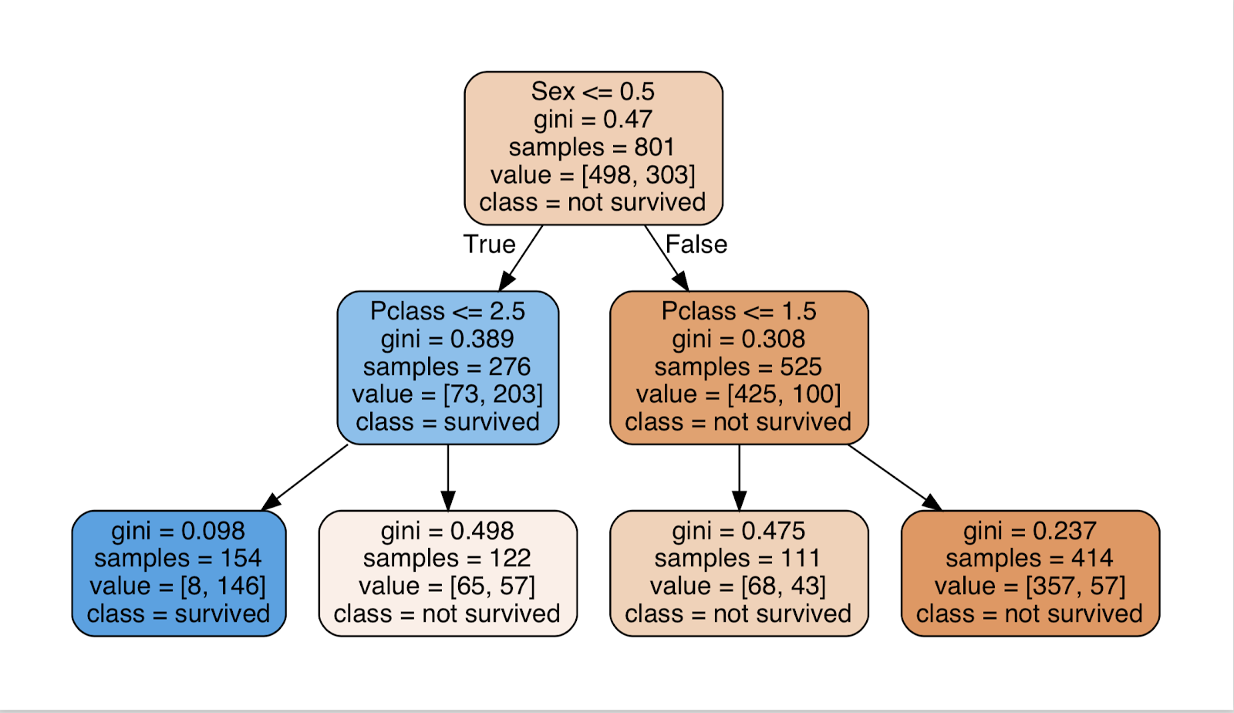
Visualize Decision Tree

Slide 18
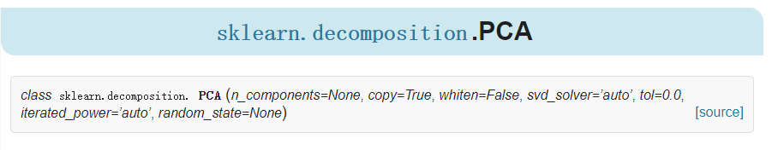
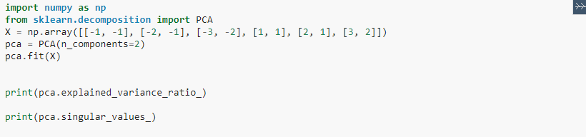
Implement PCA
In tutorial 1, we also release code to implement PCA.

