Slide 1
COMP 4331 Tut 2
Hongming Zhang

Slide 2
Outline
Brief introduction to anaconda
How to install anaconda in AWS server
Brief introduction to Jupter Notebook
How to install Jupter Notebook in AWS server

Slide 3
What is Anaconda
Anaconda is a Python distribution that is particularly popular for data analysis and scientific computing
Open source project developed by Continuum Analytics, Inc
Available for Windows, Mac OS X and Linux
Includes many popular packages: NumPy, SciPy, Matplotlib, Pandas, IPython, Cython
Includes Spyder, a Python development environment
Includes conda, a platform-independent package manager

Slide 4
Why do we need Anaconda
Simplifies installation of Python packages
Platform-independent package manager
Doesn’t require administrative privileges
Installs non-Python library dependencies (MKL, HDF5, Boost)
Provides ”virtual environment” capabilities
Many channels exist that support additional packages
For more information, you can refer to: https://www.anaconda.com/

Slide 5
How to install anaconda in AWS server
Connect to the server via ssh (ssh -i ”your own key file“ ubuntu@ec2-[your own address].us-east-2.compute.amazonaws.com)
Download the anaconda file (curl -O https://repo.anaconda.com/archive/Anaconda3-5.2.0-Linux-x86_64.sh)
Check the downloaded file (sha256sum Anaconda3-5.2.0-Linux-x86_64.sh)
Install the anaconda (bash Anaconda3-5.2.0-Linux-x86_64.sh)
Follow the instructions, choose yes for all the choices except the last one. (we do not need to install the VS code)

Slide 6
How to use Anaconda
Create a new environment (conda create -n comp4331 python=3.6)
Activate the environment (source activate comp4331)
Install any package you want (e.g., pip install pandas/torch)
Deactivate the environment when you finish (source deactivate)
For more information, you can refer to: https://docs.conda.io/projects/conda/en/latest/user-guide/tasks/manage-environments.html

Slide 7
What is Jupyter Notebook
A notebook combines the functionality of
a word processor — handles formatted text
a "shell" or "kernel" — executes statements in a programming language and includes output inline
a rendering engine — renders HTML in addition to plain text

Slide 8
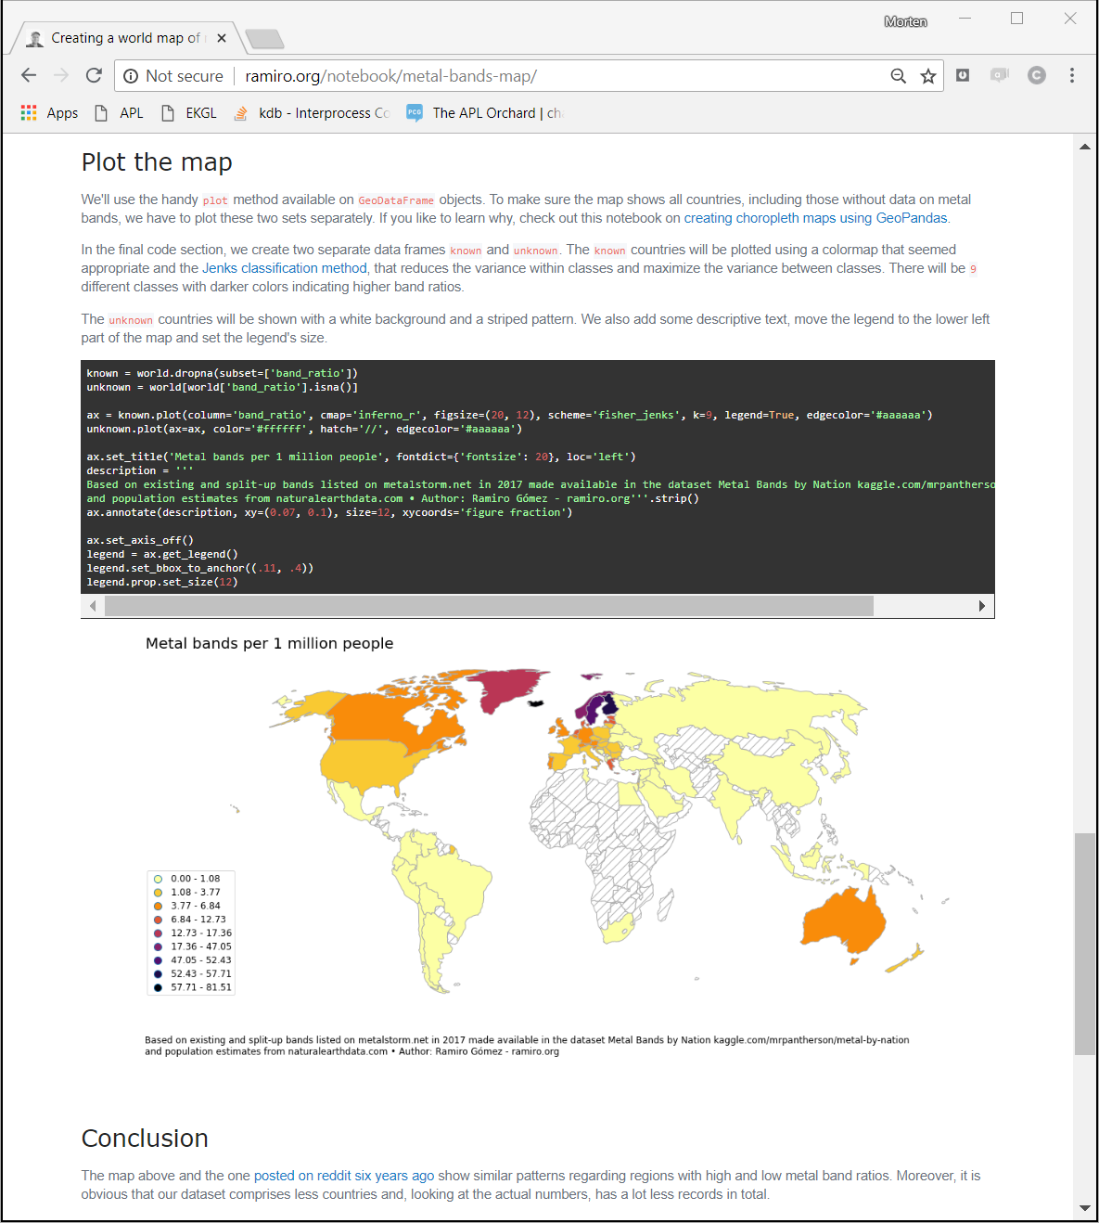
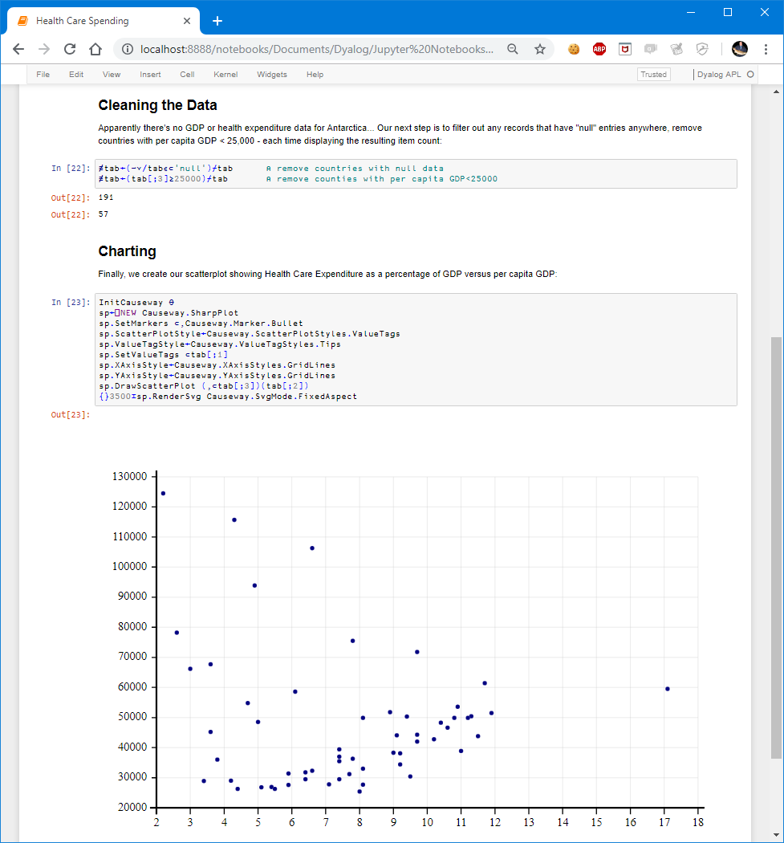
Jupyter Notebook Example

Slide 9
How to install it in aws
SSH to the server like we did before (ssh -i ”your own key file“ ubuntu@ec2-[your own address].us-east-2.compute.amazonaws.com)
Enter the python terminal (ipython)
Generate your own key (from IPython.lib import passwd; passwd()) and save the generated key to you local PC.
Exit the python terminal (exit())

Slide 10
How to install it in aws
Generate the config file
jupyter notebook --generate-config
mkdir certs
cd certs
openssl req -x509 -nodes -days 365 -newkey rsa:1024 -keyout mycert.pem -out mycert.pem
cd ~/.jupyter/

Slide 11
How to install it in aws
Modify the config file by (vim jupyter_notebook_config.py), Copy the following text and paste them to the front of the config file.
c = get_config()
c.IPKernelApp.pylab = 'inline’
c.NotebookApp.certfile = u'/home/ubuntu/certs/mycert.pem'c.NotebookApp.ip = '*’
c.NotebookApp.open_browser = False
# Your password below will be whatever you copied earlier c.NotebookApp.password = u’[the key you just saved]’
c.NotebookApp.port = 8888
How to operate in Vim: (1) type ‘i’; (2) paste all the above staff; (3) type ‘Esc’ to enter the control mode; (4) type ‘:wq’ to save the modification and exit.

Slide 12
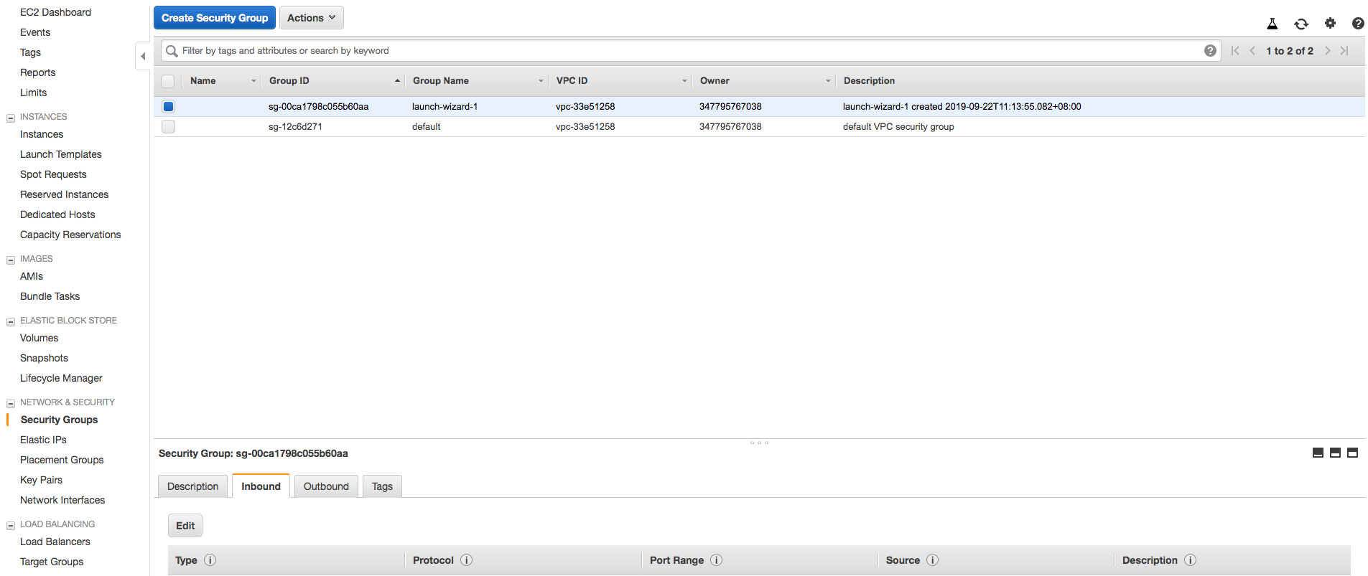
How to open port 8888 in aws
2
1
3
4

Slide 13
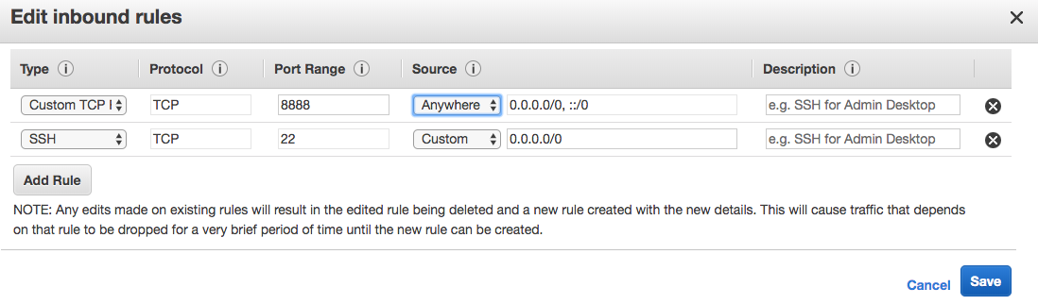
How to open port 8888 in aws
1
2

Slide 14
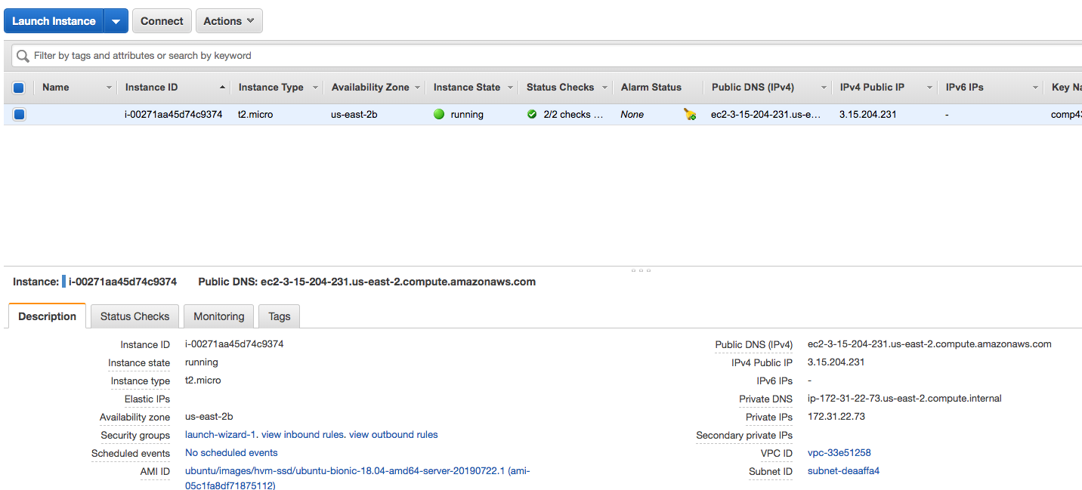
Start the server
In the terminal (jupyter notebook)
In your own browser (https://[your ip address]:8888/)
The IP address of your aws server

Slide 15
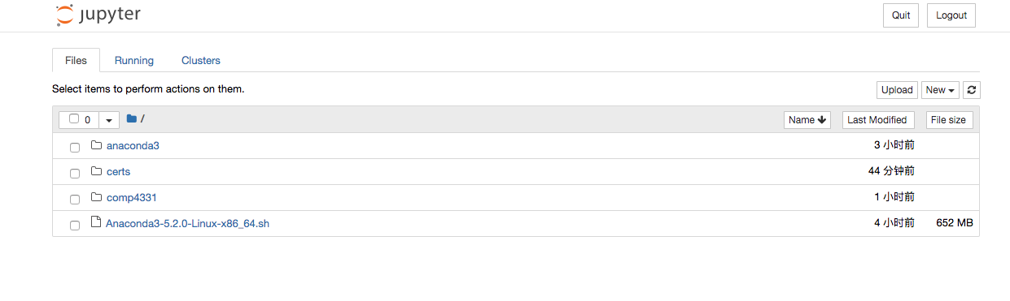
The end
After typing your password, you should get something like this.
For more information, you can refer to: https://medium.com/@GalarnykMichael/aws-ec2-part-4-starting-a-jupyter-ipython-notebook-server-on-aws-549d87a55ba9#.ylckaikgc
PS: the only difference between my instruction with this blog is that I didn’t use sudo for the openssl command. Do it following me instead of the blog. This is important.

