Slide 1
COMP 4331 Tut 2
Hongming Zhang

Slide 2
Outline
Brief introduction to anaconda
How to install anaconda in AWS server
Brief introduction to Jupter Notebook
How to install Jupter Notebook in AWS server

Slide 3
What is Anaconda
Anaconda is a Python distribution that is particularly popular for data analysis and scientific computing
Open source project developed by Continuum Analytics, Inc
Available for Windows, Mac OS X and Linux
Includes many popular packages: NumPy, SciPy, Matplotlib, Pandas, IPython, Cython
Includes Spyder, a Python development environment
Includes conda, a platform-independent package manager

Slide 4
Why do we need Anaconda
Simplifies installation of Python packages
Platform-independent package manager
Doesn’t require administrative privileges
Installs non-Python library dependencies (MKL, HDF5, Boost)
Provides ”virtual environment” capabilities
Many channels exist that support additional packages
For more information, you can refer to: https://www.anaconda.com/

Slide 5
How to install anaconda in AWS server
Connect to the server via ssh (ssh -i ”your own key file“ ubuntu@ec2-[your own address].us-east-2.compute.amazonaws.com)
Download the anaconda file (curl -O https://repo.anaconda.com/archive/Anaconda3-5.2.0-Linux-x86_64.sh)
Check the downloaded file (sha256sum Anaconda3-5.2.0-Linux-x86_64.sh)
Install the anaconda (bash Anaconda3-5.2.0-Linux-x86_64.sh)
Follow the instructions, choose yes for all the choices except the last one. (we do not need to install the VS code)

Slide 6
How to use Anaconda
Create a new environment (conda create -n comp4331 python=3.6)
Activate the environment (source activate comp4331)
Install any package you want (e.g., pip install pandas/torch)
Deactivate the environment when you finish (source deactivate)
For more information, you can refer to: https://docs.conda.io/projects/conda/en/latest/user-guide/tasks/manage-environments.html

Slide 7
What is Jupyter Notebook
A notebook combines the functionality of
a word processor — handles formatted text
a "shell" or "kernel" — executes statements in a programming language and includes output inline
a rendering engine — renders HTML in addition to plain text

Slide 8
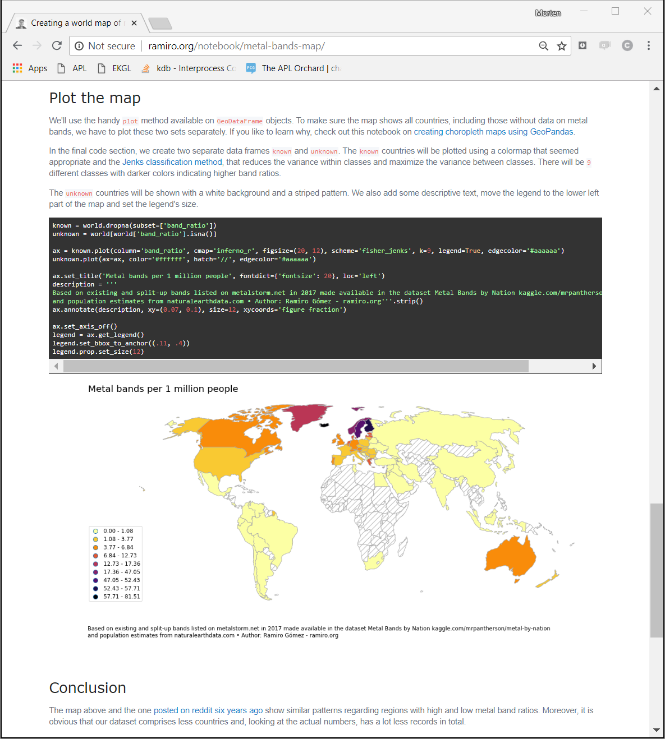
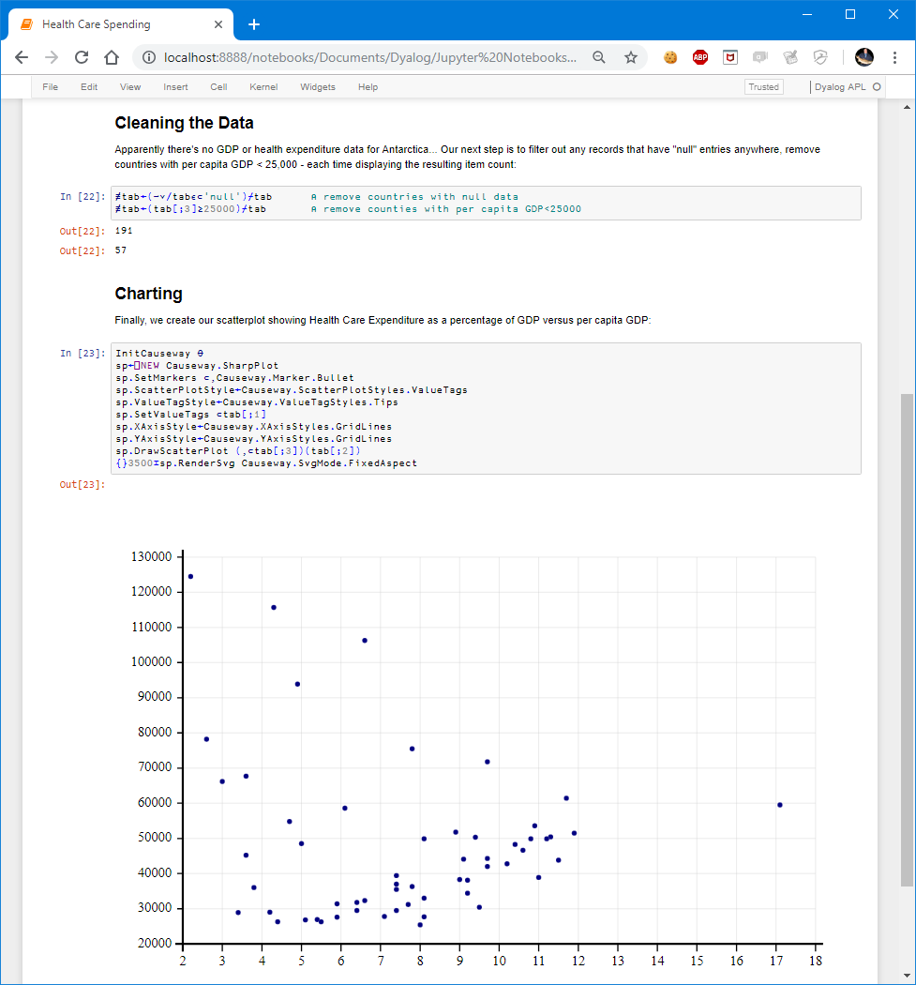
Jupyter Notebook Example

Slide 9
How to install it in aws
SSH to the server like we did before (ssh -i ”your own key file“ ubuntu@ec2-[your own address].us-east-2.compute.amazonaws.com)
Enter the python terminal (ipython)
Generate your own key (from IPython.lib import passwd; passwd()) and save the generated key to you local PC.
Exit the python terminal (exit())

Slide 10
How to install it in aws
Generate the config file
jupyter notebook --generate-config
mkdir certs
cd certs
openssl req -x509 -nodes -days 365 -newkey rsa:1024 -keyout mycert.pem -out mycert.pem
cd ~/.jupyter/

Slide 11
How to install it in aws
Modify the config file by (vim jupyter_notebook_config.py), Copy the following text and paste them to the front of the config file.
c = get_config()
c.IPKernelApp.pylab = 'inline’
c.NotebookApp.certfile = u'/home/ubuntu/certs/mycert.pem'c.NotebookApp.ip = '*’
c.NotebookApp.open_browser = False
# Your password below will be whatever you copied earlier c.NotebookApp.password = u’[the key you just saved]’
c.NotebookApp.port = 8888
How to operate in Vim: (1) type ‘i’; (2) paste all the above staff; (3) type ‘Esc’ to enter the control mode; (4) type ‘:wq’ to save the modification and exit.

Slide 12
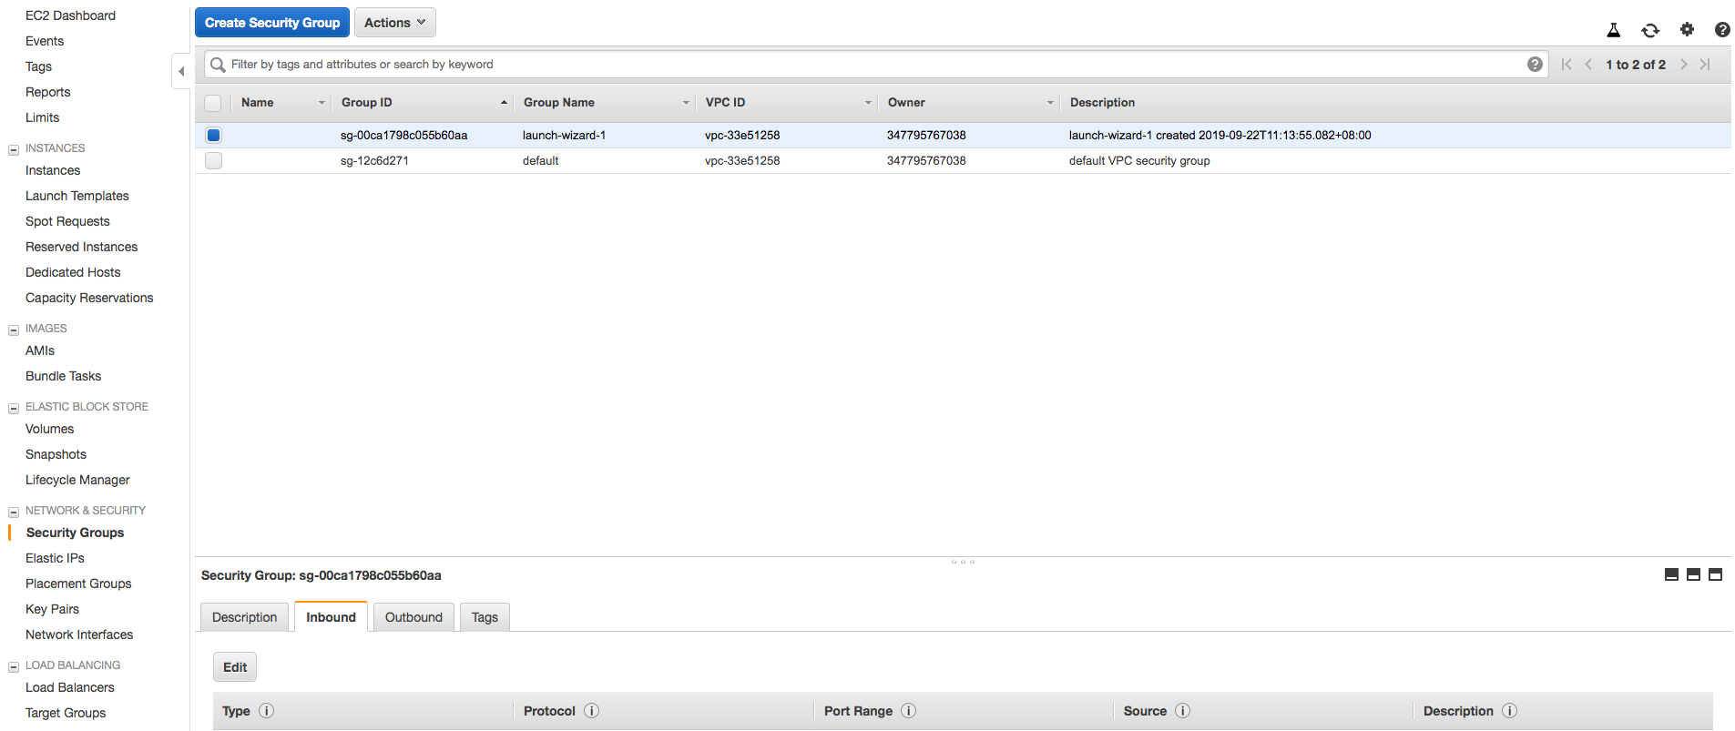
How to open port 8888 in aws
2
1
3
4

Slide 13
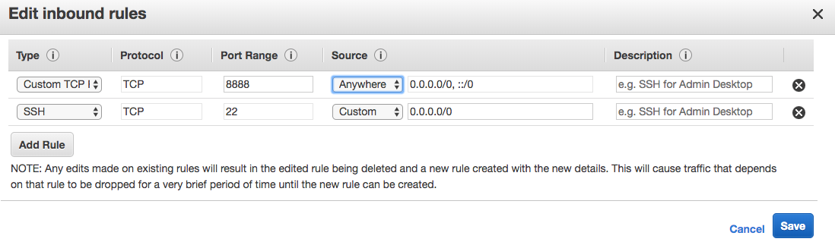
How to open port 8888 in aws
1
2

Slide 14
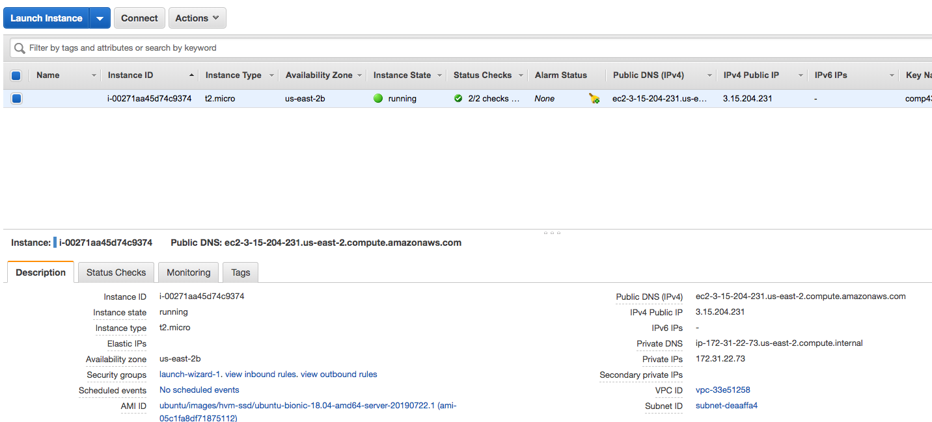
Start the server
In the terminal (jupyter notebook)
In your own browser (https://[your ip address]:8888/)
The IP address of your aws server

Slide 15
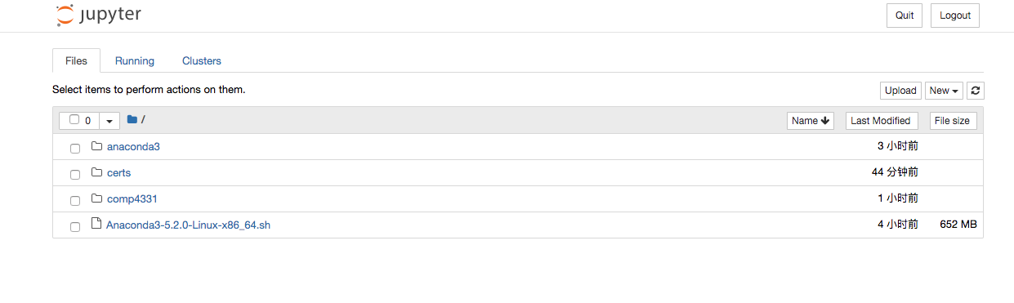
The end
After typing your password, you should get something like this.
For more information, you can refer to: https://medium.com/@GalarnykMichael/aws-ec2-part-4-starting-a-jupyter-ipython-notebook-server-on-aws-549d87a55ba9#.ylckaikgc
PS: the only difference between my instruction with this blog is that I didn’t use sudo for the openssl command. Do it following me instead of the blog. This is important.

Slide 16
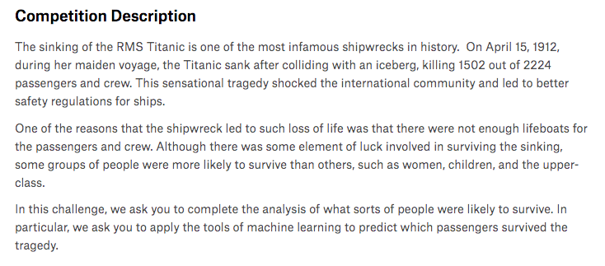
Practice (optional for this tutorial)
Kaggle Titanic competition
You can download the dataset and see the full code here: https://www.kaggle.com/dmilla/introduction-to-decision-trees-titanic-dataset

Slide 17
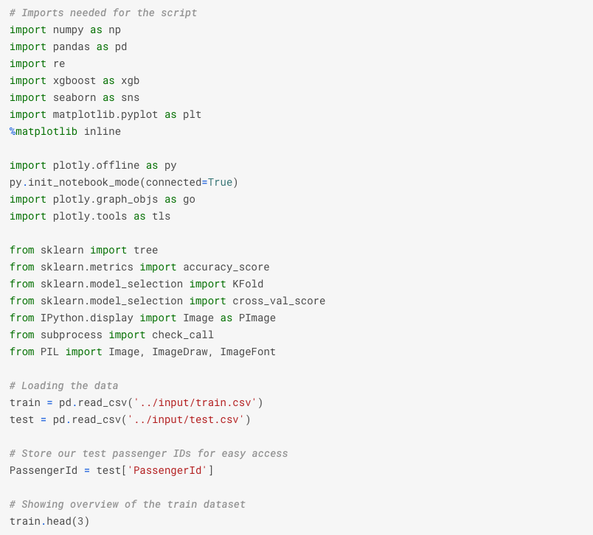
Load data

Slide 18
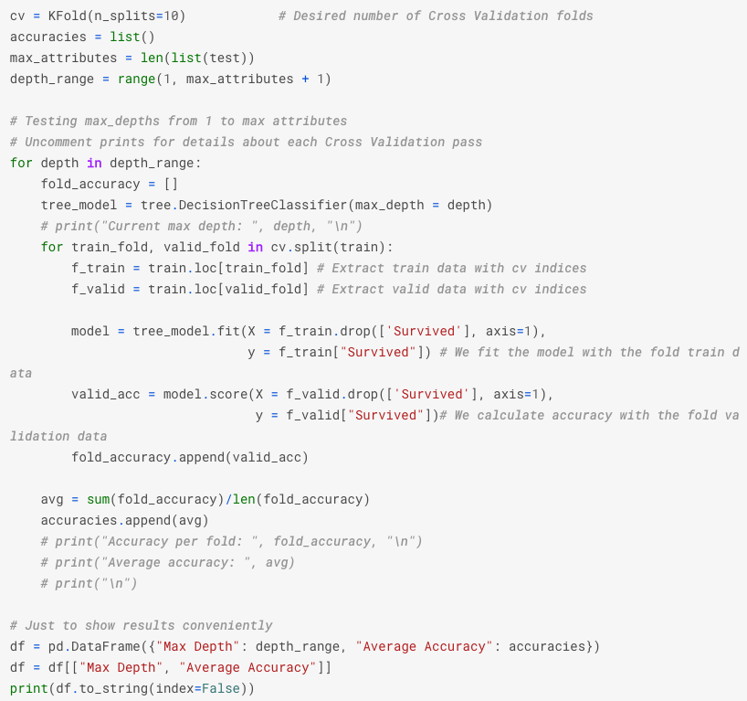
Get a decision tree model

