Slide 1
COMP 4331 Tut 7
jiaxin Xie

Slide 2
Outline
A demo of finite mixture model
Generating data
EM algorithm

Slide 3
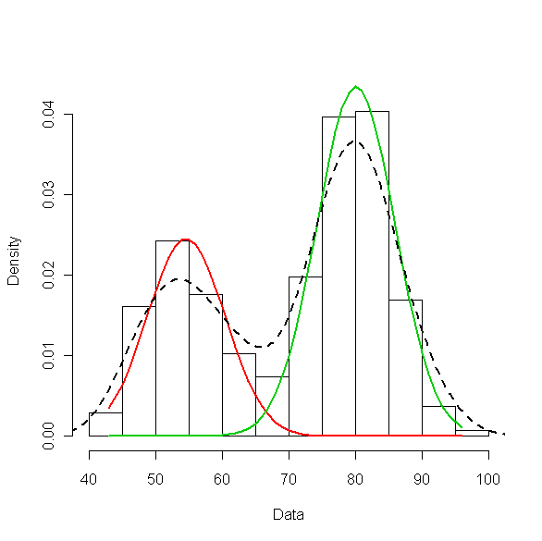
finite mixture model
One dimensional Gaussian mixtures Our data is just points along one dimensions, but coming from K Gaussian distributions. It means that we have one variable about one property, and we have several data points and we do not know to which cluster they belong, i.e. from which Gaussian distribution they are coming from. Here we use a Maximum likelihood estimate to infer the unknown classes of the data points.

Slide 4
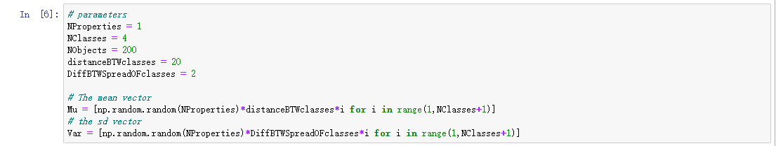
finite mixture model
Generating data with known parameters
Here, we have just one property, 4 classes, and 200 data points. The data points are generated from 4 different Gaussian distributions with certain means and variance. Our objective is to infer the clusters or groups for data points. Thus we want to infer the parameters of the Gaussian distributions from which the data was generated, and to infer for each data point that to which cluster they belong.
First, we set these known parameters: 𝜇 - vector of the means; Σ - the vector of the variances

Slide 5
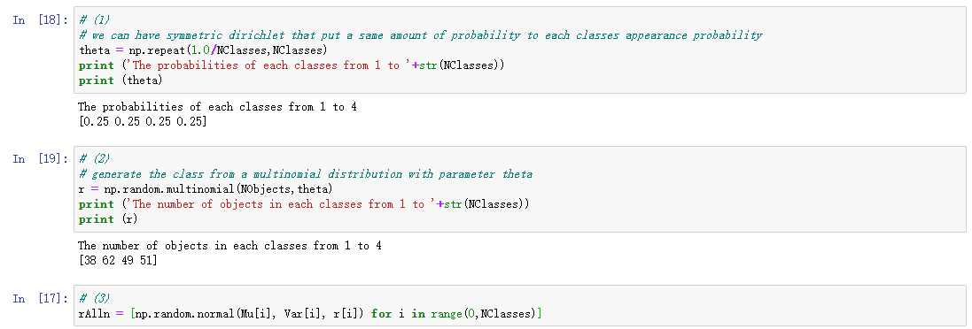
finite mixture model
In order to generate data from these classes along this one property we need to define a probability distribution over the classes. That will be a multinomial distribution, which have the parameter 𝜔 which is a vector of the probability of each class.
(1) We take samples from the dirichlet distribution. It as one parameter: 𝛼 . This sample will be the 𝜔 values for the multinomial distribution;
(2) We generate the number of points in the classes with the parameter 𝜔 from the multinomial distribution;
(3) We generate the given number of points from our Gaussian distributions for each classes with the previously defined 𝜇 and Σ vectors.

Slide 6
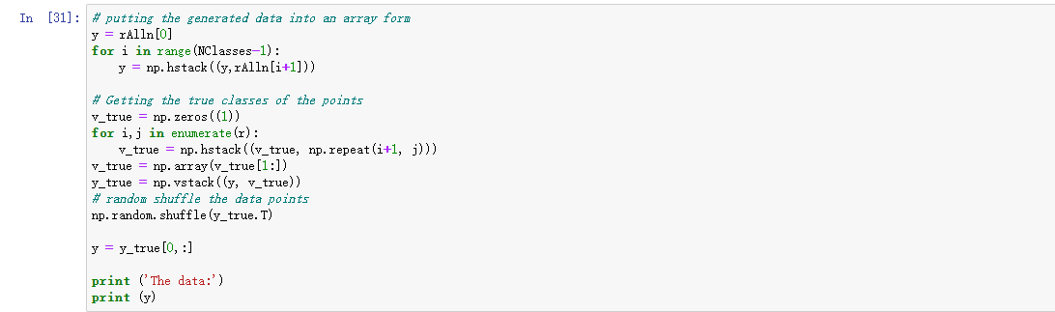
finite mixture model

Slide 7
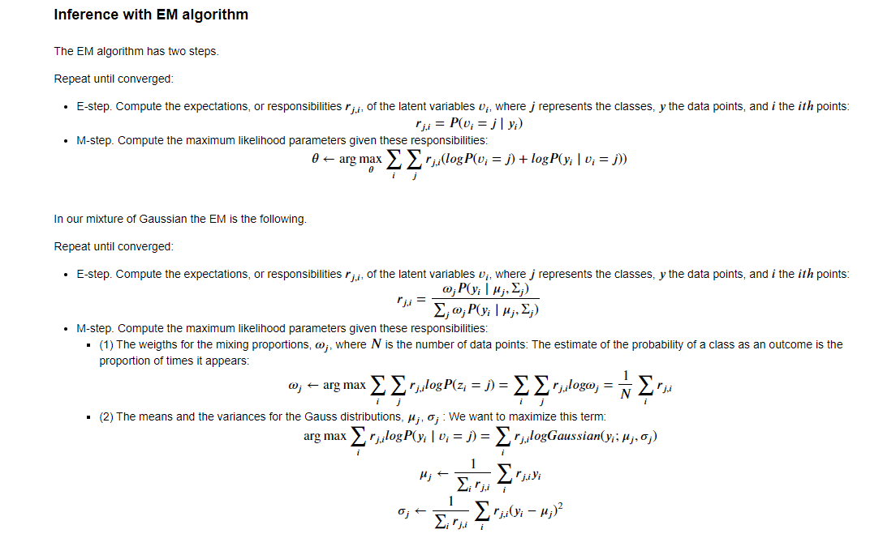
finite mixture model

Slide 8
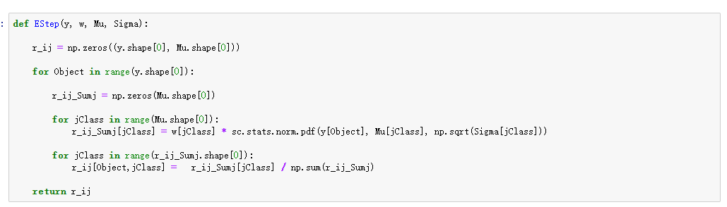
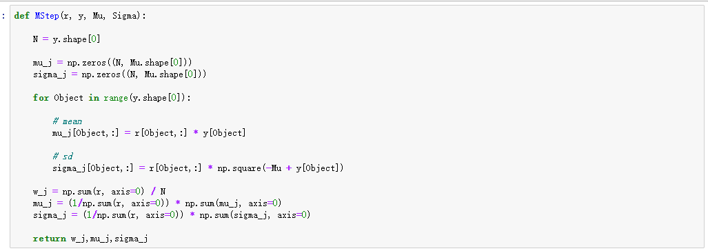
EM algorithm

Slide 9
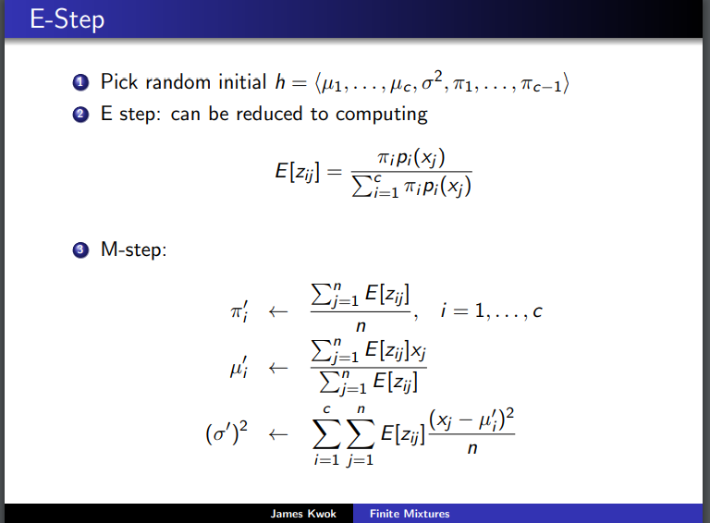
Any difference?

