Slide 1
Attention Engineering
Recommendation Systems in Social Media Platforms
Elysia Jewel Lee | 33592861
Kylie Tan Sze Qi | 32825544
Lee Zhi Ming | 32377479
Teh Jia Xuan | 32844700
Yap Eng Han | 32140088
Yew Jin Ruo | 33343276
Yoong Qian Xin | 32846517
Notes:
Speaker: Yoong Qian Xin
Good morning everyone, we are group Antifragile.
(Introduction of members and topic)

Slide 2
Presentation Outline
01
02
04
05
06
03
Background
Problems
Prototype
Background of Attention Engineering and how it affects us
What, Why, How
Prototype methodology
and techniques
Proposed solution
Prototype
demonstration
Summary
Conclusion of
our research
Proposed solution to
the problems on
Attention Engineering
How our prototype works
Notes:
Speaker: Yoong Qian Xin
Outline of our presentation (Presentation flow)

Slide 3
Background
Spend unhealthy amount of time on the phone
Recommendation system algorithms affect
user behavior
Privacy of Internet user threatened
Social media anxiety disorder, 'Compare and Despair'
eg. Influencing users towards pricier alternatives than
their original intentions.
Notes:
Speaker: Yoong Qian Xin
Nowadays, it is common to see people glued to their screens while walking or waiting in line. But, Do you ever found that you actually spend an unhealthy amount of time on the phone? Sometimes you feel irresistible to surf the social media. This is because the algorithms implemented within the application always suggest posts according to the user’s preferences and interests. It keeps you engaged with the content, thereby grabbing your attention.
To illustrate, when a teenager researching a new phone, Facebook's recommendation system shows advertisements for iPhone 14 Pro Max and ongoing promotions like Shopee Super Brand Day Sales. The recommendation system keeps encouraging users to upgrade to higher-priced products instead of their initial choices. That actually creates a sense of urgency for the teenagers, prompting them to buy immediately for a discounted price. So now I believe you should have some idea on what attention engineering is. And now I will bring up Zhi Ming, who will talk about the problems of our topic.

Slide 4
Problem Statement
What
Why
How
Attention engineering negatively impacts users
Decisions and mentality manipulated by algorithms
Cause
unwanted harm, raising ethical issues
Notes:
Slide 4: Problem Statement
Speaker: Lee Zhi Ming
Speaker Notes:
Thank you. I will be presenting the following 2 slides, namely the problem statement and the prototype methodology.
The problem that occurs from attention engineering can be broken down into 3 parts, which is the what, why and how.
First of all, what. What is the problem? The problem at hand is that attention engineering negatively impacts users.
So why. Why is this a problem? This is because decisions and mentality can be manipulated by the algorithm used by attention engineering. An example of this would be a teenager buying a product after seeing it on social media even though they do not need it.
But how is this a problem? It is a problem because it causes unwanted harm and will raise ethical issues. For example, attention engineering promotes materialism, which is harmful to the society as a whole. It keeps a culture that values high-end products and material possessions.
It is crucial to address these issues and understand the potential harm caused by attention engineering. We will move on to the next slide now.

Slide 5
Prototype Methodology
A Prototype provides
Improvement (is the implementation the best?)
Clarity (demonstrates functionality)
Validation (gain feedback from users -> identify issues)
Notes:
Slide 5: Prototype Methodology
Speaker: Lee Zhi Ming
Speaker Notes:
What is a prototype methodology? A prototype methodology is a structured approach used to create and evaluate prototypes. Using a prototype methodology can offer significant benefits and will provide improvement, clarity and validation.
Firstly, a prototype enable us to see the implementation of improvements in the recommendation algorithm or user interface design.
Secondly, a prototype enhances clarity as it can demonstrate the intended functionality and user experience of the recommendation system. It provides a representation of the proposed changes.
Lastly, a prototype enables validation of the proposed changes by gathering feedback and user testing. It allows for the assessment of the system's effectiveness, user satisfaction, and identification of any potential issues.
By employing a prototype methodology, we can strive for more ethical platforms.
That is it for my part. The next speaker will be Kylie.

Slide 6
Prototype Methodology
Prototyping development stages
Information gathering
Delegation of tasks
Build persona
Build scenario
Research for methods
Research for tools
Prototype
Testing
Reflection
Notes:
Prototyping Development Stages:
Speaker: Kylie Tan Sze Qi
Information gathering - the team collects relevant data and insights to understand the project requirements and user needs and extract all the information written in Assignment 2A report
Delegation of tasks - the tasks are delegated among team members. – research, persona, scenario, testing, prototyping, design flow of features
Build persona - then proceeds to build a persona, creating a fictional representation of the target user to better empathize with their goals and challenges. For this assignment we built a persona who comes across ethical issues related to attention engineering while using social media platforms.
Build scenario - builds a scenario that outlines a typical user interaction with the product created and how it solves the issue it faced earlier.
Research for methods - Research is conducted to explore various methods and approaches that can be applied during the prototyping process.
Research for tools - the team researches tools and technologies available to support the development of the prototype.
Prototype - creating a tangible representation of the product idea. After the prototype is built, thorough testing is conducted to identify any issues or areas for improvement.
Testing - using the Persona and Scenarios created to let the testing team use and try experiencing what the users would experience in a real-life setting
Reflection - reflects on the entire prototyping process, evaluating the successes, challenges, and lessons learned, which helps in refining and enhancing the prototype before moving forward with further development.

Slide 7
Prototype Methodology
Low fidelity – how can it be used to demonstration our solutions?
Visual representations– let us see what features are added
Wireframes- let us see the UI of end product
Persona/scenario- Simulate user experience
Notes:
Speaker: Elysia Jewel Lee
In essence, our team’s solution revolves around Transparency in Algorithms.
We have chosen the low fidelity method to demonstrate our solutions because:
Visual representations of the product allows everyone here to see for themselves, what features are added and how the features help to solve the problem at hand, which is transparency in attention engineering.
Wireframes in turn, allow users to see the UI of the end product.
While by creating persona and scenario , we can simulate users’ experience so that all of you here know how our prototype works.

Slide 8
Proposed Solution
Transparency in attention engineering algorithms
Censorship mechanisms
Alert system
Hide sensitive content
Filtering
Track contents consumed by users
Sends out an alert for over-consumptions
Transparency reports
Show users which part of data are used to suggest the given content
Notes:
Speaker: Elysia Jewel Lee
In the previous part of our assignment, we have introduced 3 possible solutions, which are…
However, in actual prototype developed later, we only implemented 2 of them:
Transparency reports
Alert system
For transparency reports, we want to create a mechanism that will…., so our idea is to… -> panel at the bottom which will show users the specific data collected from them
For alert system, the idea is to create a system that will automatically track the contents consumed daily by users. If the system detects that a user has been overly consuming a certain content, it will prompt an alert message to the user, which allows the user to take actions accordingly like taking a break/refreshing their news feed.
-Transparency reports alert system -> track topics most frequently viewed by user -> user prompted to take action

Slide 9
Prototype Implementation Workflow
Feature 2:
Alert System
Alert users that they are consuming too much of a specific topic
(Click to refresh content)
User login to Facebook
Get user information
to generate content
Generate random short clips and ads
User continues to scroll
System asks to access personal info
User finds the topics interesting
Negative effects
Feature 1:
Transparency report
Show types of personal info used to generate content
Notes:
Speaker: Yew Jin Ruo
General process of how a user scrolls through social media:
User login -> System prompt for access to personal data -> Generate associated advertisements and short clips ->
User finds topics interesting -> Keep scrolling -> Negative effects (e.g. addiction)
Flow of implementation of our features:
Where and why do the features come in the process?
How does it affect the original process?
1. Transparency report
When: After advertisements start popping up on user’s feed
Why: User would want to know – What did the system know about themselves for the system to suggest this type of content?
2. Alert system
When: After system detects that user has been consuming too much on a specific topic
Why: User needs to know the risks – might be manipulated -> needs to stop and get diversity in content consumed

Slide 10
Delegated team roles
Elysia Jewel Lee | Kylie Tan Sze Qi | Lee Zhi Ming | Teh Jia Xuan | Yap Eng Han | Yew Jin Ruo | Yoong Qian Xin
Persona Testing | Design Flow of Features Testing | Research Testing | Design UI of Prototype Design Flow of Features Testing | Design Flow of Features Scenario Testing | Design Flow of Features Research Testing | Scenario Research Testing
Notes:
Speaker: Yew Jin Ruo
How we delegated tasks among group members?
Each member took 2-3 parts where they had the confidence they could contribute most to
Made our preparations for assignment 2b more efficient with effective teamwork
Task Overview of all Roles:
Research:
Collect information on methods and tools
Choosing the best option to showcase our prototype
Persona:
Create a persona that best fits the image of the majority of users of social media
Scenario:
Come up with various settings that would influence the user
Testing:
Identify how the implemented features help in these situations, give feedback and make improvements to the prototype
Design UI of Prototype:
Design of user interface, lets users know what is implemented in systems (visually)
Design Flow of Features:
Let the team know the flow of features in a classic user scrolling through social media and where the features are implemented
Easy to make changes after every member is clear on the flow of the prototype

Slide 11
Integration of Output
Output | Integration
Research of methods | Low fidelity Showcase features using graphics Let users get an idea of the product & functionality
Research of tools | Tool used: Mockups Used to create wireframes
Prototype Implementation Flow | Flow of user interaction with social media Clear on how the process works Shows how added features are used
UI Design | Enhance user visual experience How features are shown to users
Persona & Scenarios | Persona: fictional characters of users Scenario: setting that gives user experience Used as input to test + reflect + improve
Notes:
Speaker: Yew Jin Ruo
Integration of group outputs into prototype:
Research of methods:
Decided to use low fidelity
A low fidelity prototype represents a simple and incomplete version of the solution
Gives a more visual outlook of the product solution to users
Easy and less complicated for users to understand
Research of tools:
Using tool: Mockups to create wireframes of our user interface design
Implementing our features on the interface allows us to show users the functionality of the prototype
Prototype Implementation Flow:
Describes how a user typically scrolls through social media
Giving insight on when/which stage of the process that the mechanisms are implemented
Helps in refining the flow of the final product and make changes in the flow to improve
UI Design:
Users can see the improvements made themselves
Issues are made clear to users
Enhance user experiences
Persona & Scenarios:
Persona of a user that uses social media often was created to test out the solution under different settings (scenarios)
Let us know how the user reacts in these situations/scenarios
Implemented to collect user feedback and make improvements
Repetitive testing & reflection to refine the final product

Slide 12
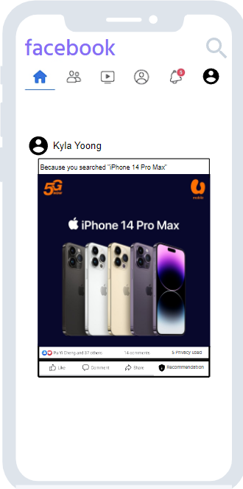
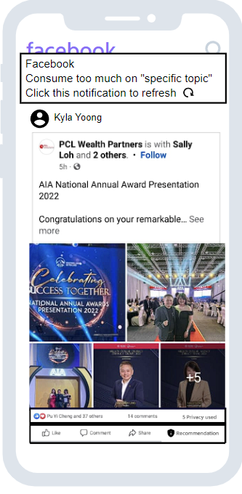

Prototype Demonstration
Notification to alert
Brief description data used
Random content
Click in Machine website
Using Umobile services
Using Oppo A9
Search Iphone 14 pro max
Browsing history
Details of data used
Number of data used
Notes:
Speaker: Teh Jia Xuan
Demonstrating the 2 features implemented in our prototype:
Idea of the prototype features:
Transparency report:
- Not a fully original idea, our group interpreted this idea from the considerations of Twitter to make their algorithms open-source.
However, most users do not know how to code or read code (not everyone using social media is a computer scientist/software engineer!)
We decided to implement open-sourcing of algorithms on the UI of our prototype
2. Alert system:
Our group originated this idea from the actions of TikTok China, where they sent reminders to remind users that it was past bedtime and encouraged them to sleep early.
We thought that a reminder to alert users of consuming too much of one specific topic could be dangerous – prone to manipulation
Suggest refreshing the recommendation algorithm by clicking the notification
What we implemented in the UI to support these features?
First feature is acknowledging user what data the algorithm is used to generate this content.
The content's top bar provides a concise overview, summarizing the most significant data point employed in generating the content.
At the bottom of the content, you will find a bar that displays number of privacy data used in this algorithm. Additionally, there is a “recommendation” button for user to interact. When user clicks on the button a speech bubble will appear and list down all the data the algorithm used to generate this content
2. The second feature includes an alert system that notifies users when they are consuming too much on a specific topic.
It suggests the user click on the notification to restart the recommendation algorithm, which will then recommend content that is completely opposite to the previous topic.
This functionality aims to prevent any negative effects that may arise from excessive consumption of a single topic.
Why our prototype is better than the existing ones?
Open sourcing of algorithms by Twitter only lets users have access to what code is used in algorithms
Consider that most users are not computer scientists/software engineers
Our solution that brings open-sourcing transparency from the back-end development of social media apps to the interface
Clearer for users to see what the algorithm uses and does
Compared to reading/learning to read lengthy code
More user friendly
The existing one only briefly describes why this content is recommended
We added a recommendation button where it lists down all the data that is used for this content
Added number of privacy used for this content
More detail and understandable
2. Alert systems of TikTok China are only for reminders for sleep time
We extended the idea to help with alerting dangerous/manipulating content
Click to refresh the recommendation system to suggest topics that are completely different from the original one
More comprehensive
Enhances usability of the original system

Slide 13
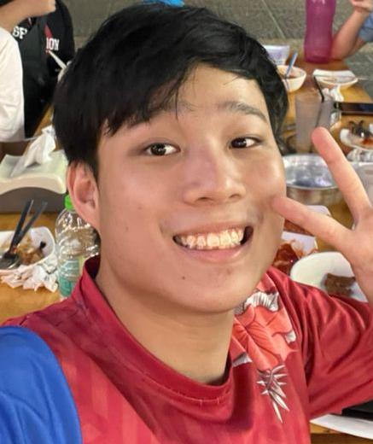
Persona | Scenario
IMAGE
1.
While Sean had a conversation with his friend, an ad appeared on his screen related to the discussion, even though he didn't search for it.
2.
Sean is exposed to a particular topic for a long time and the topic has a strong influence on his mindset
Name : Sean Wong
Age : 20
Nationality: Malaysian
Religion: Christian
District: Petaling, Selangor
Occupation: Student
Hobby: Scrolling through social media, gossip
Personality: high curiosity, can be influenced easily, low self-esteem, insecure.
3.
Sean wanted to verify whether his data had been misused without his consent or awareness
Notes:
Speaker: Teh Jia Xuan
Persona named Sean Wong
He is a 20-year-old student
He likes to scroll through social media and engage in gossip
He has high curiosity, can be influenced easily, low self-esteem and insecure
Here are the scenarios we chose for Sean:
First scenario is when Sean had a conversation with his friend and an advertisement appeared on his screen related to the discussion, even though he didn’t search for it.
Second scenario would be Sean exposed to a specific topic and it has strongly influenced his mindset.
Third scenario is as Sean has a high level of curiosity and wants to verify whether his data is misused without his consent or awareness.

Slide 14
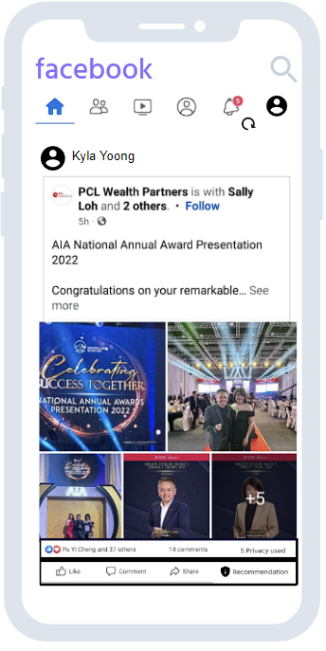
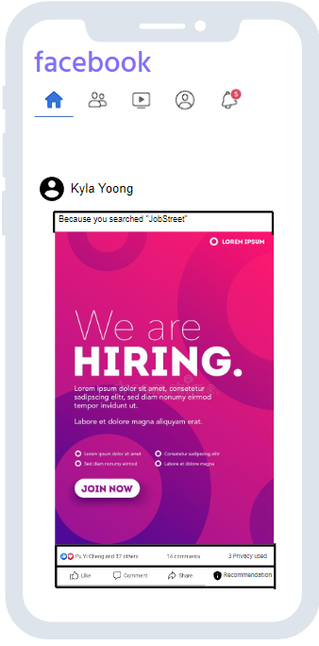



Scenario
Click in Machine website
Using Umobile services
Using Oppo A9
Search Iphone 14 pro max
Browsing history
Searched“JobStreet”
Fresh graduate student
Login to Jobstreet, 3 days ago
1. While Sean was having a conversation with his friend, an ad appeared on his screen related to the discussion, even though he hadn't searched for it.
2. Sean is exposed to a particular topic for a long time and it has a strong influence on his mindset
3. Sean wanted to verify whether his data had been misused without his consent or awareness
Notes:
Speaker: Teh Jia Xuan
So how do our features solve the problems in all these scenarios?
For the first scenario, Sean wanted to check whether the algorithm was spying on him by using the microphone on his phone.
So, Sean can click on the recommendation button at the bottom of the content to check what data is used to generate this content and make sure the algorithm wasn’t spying on him.
For the second scenario, Sean is exposed to -a specific topic like an Insurance agency or property agency posting about a million-dollar income per month and asking them to join their team.
Sean is easily influenced and might consider quitting school to join the agency.
To address the situation when the algorithm detects Sean excessively consuming this topic. The notification will prompt Sean to refresh the algorithm by clicking on it.
This action could let Sean expose to a wider range of topics instead of focusing on one topic and prevent any negative consequences.
For the third scenario, Sean can randomly select a post and click on the recommendation button to inspect all the data used in generating the content. By doing so, Sean can ensure that the algorithm is utilising the data that is obtained permission from him.

Slide 15
Prototype Overview
Transparency enables user to acknowledge usage of their data
Transparency regarding topics they are over-consuming
How does our prototype support our solution?
Suggests refreshing the recommendation algorithm to prevent negative consequences
Notes:
Speaker: Yap Eng Han
Overview of our prototype:
Remind the problem itself. e.g. Attention engineering. Gathering user's attention using all means possible.
Then, start by talking about the relevance of our solution to the problem.
Transparency: => showing why the application shows certain posts. History, preferences, past liked posts => alert when user overconsumes a certain topic => refreshing the recommendation algorithm, to prevent a rabbit hole.

Slide 16
Summary
Methodology
Proposed Solution
Low fidelity
Wireframes
Show user visual example of product
Shows how we built the prototype
Delegation of tasks
How our team outputs were integrated into the final product
Demonstration
Future Works
Using persona and scenarios to highlight features of our solution in the prototype
How the prototype matches with our solution?
Improvements on the original solution
Implement fully as a usable system
Notes:
Speaker: Yap Eng Han
Summary of presentation:
We started with the methodology, presenting the method used: low fidelity & why we used the method compared to high fidelity -> Clearer to present to users
Wireframes were used as a medium of presenting our UI to users and show a visual representation of our product.
Then, we presented our main idea: Transparency in Algorithms and how we used this idea to produce our prototype.
The implementation workflow discussed before, showed the process of how our prototype works.
Each member committed in different parts of creating the prototype and team-efforts were integrated in the final product as shown.
Next, we did a demonstration of our prototype.
Using the personas and scenarios to highlight our 2 main features: alert system and transparency report and their relevance to our solution - transparency.
Which were derived from existing ideas to obtain a goal of the features being more user friendly.
People could know clearly how we implemented the system and its algorithms.
In the future, we would like to improve on our solution.
As it still has flaws: e.g. Considering that an attacker knows too much about the algorithm, would it compromise the security of the system?
Giving too much information to the public -> might risk security
We intend to work on that and make improvements to our system.

Slide 17
Thank you
Any questions? Please feel free to approach us!
elee0081@student.monash.edu
ktan0150@student.monash.edu
zlee0052@student.monash.edu
jteh0015@student.monash.edu
eyap0007@student.monash.edu
jyew0006@student.monash.edu
qyoo0001@student.monash.edu
Notes:
Speaker: Yap Eng Han
Concluding words + Thanks + QnA session

