Slide 1
Kaggle LLM Classification Finetuning
Team Members：Jiaxuan Yue，Leying Deng，Linsen Song，Fan Zhang
Reporter：Jiaxuan Yue
Date：2025/09/19

Slide 2

Competition Background and Requirements
Analysis of Project Training Dataset
Task Process (Deep Learning Baseline)
Task Process (Based on Llama3 - 7b)
Cross - Validation and Multi - Model Comparison
GitHub Repository and Open Source
01
02
03
04
05
06

Slide 3
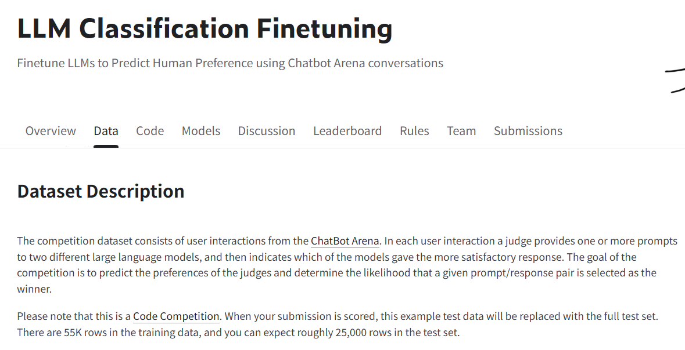
Competition Background and Requirements
Participants are required to fine - tune Large Language Models (LLMs) based on the dialogue data from Chatbot Arena and complete a sequence classification task — that is, to predict human users' preference between "Model A's response" and "Model B's response" according to the responses generated by different LLMs to user prompts.

Slide 4
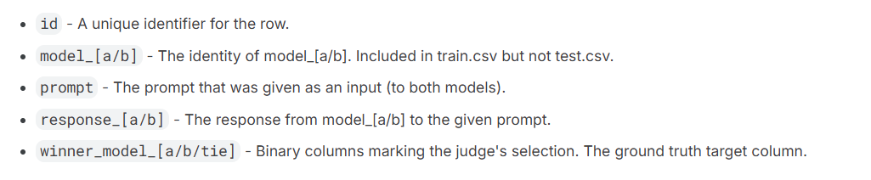
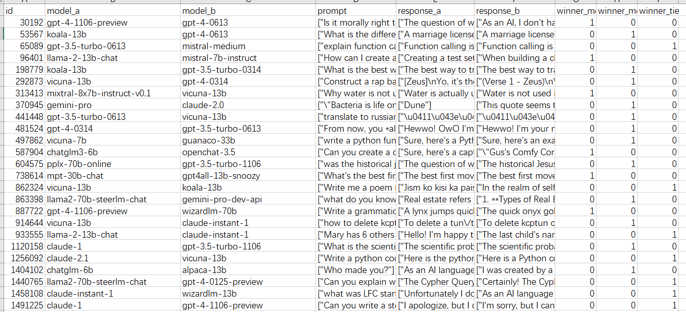
Analysis of Project Training Dataset

Slide 5
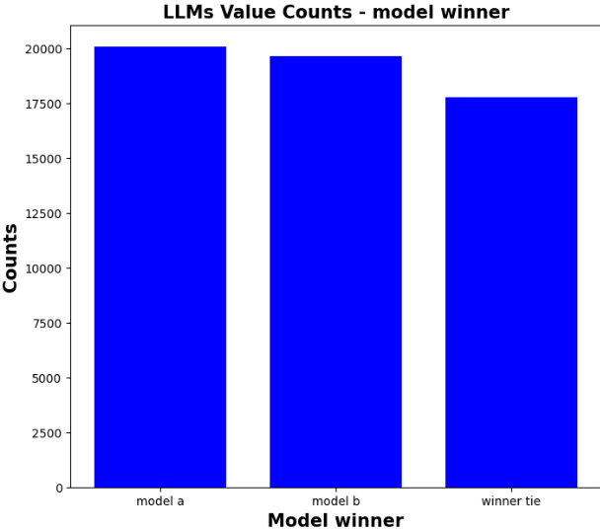
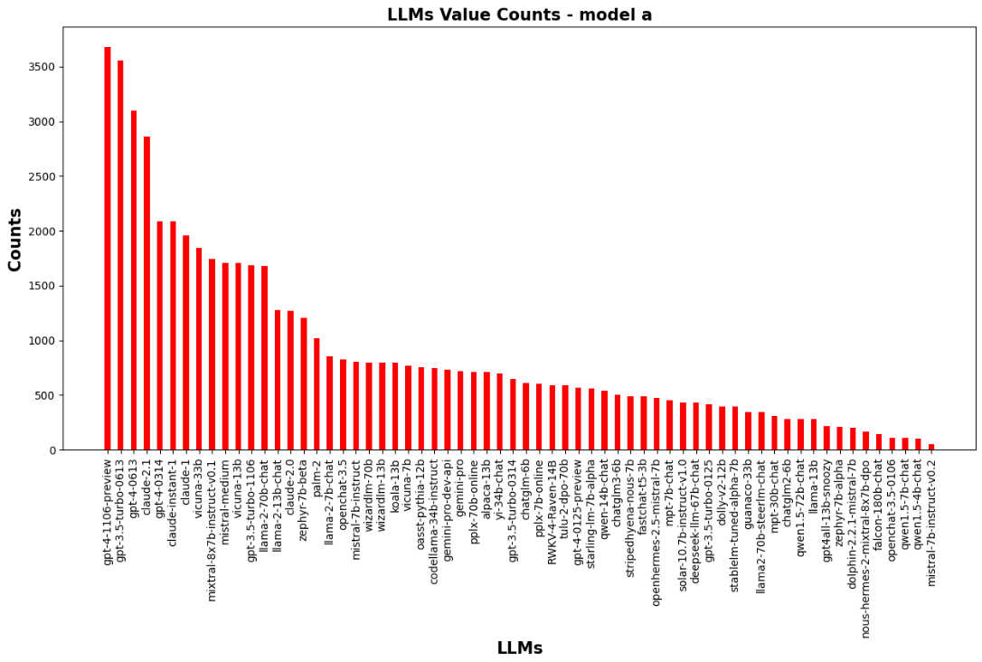
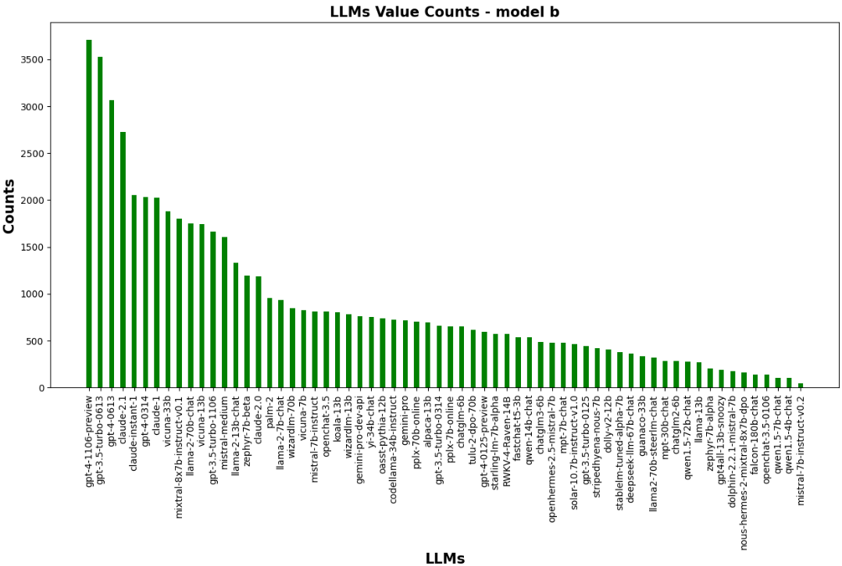
Analysis of Project Training Dataset
There are a total of 57,477 pieces of data.
Invalid samples (such as blank, garbled, and duplicate content) are removed;
Annotation errors are corrected.
The format is unified.
The training set, validation set, and test set are divided in an 8:1:1 ratio (and five - fold cross - validation is also adopted).
Training set (80%): used for model parameter learning;
Validation set (10%): used to monitor training effects, implement early stopping, and tune hyperparameters;
Test set (10%): used for the final evaluation of generalization ability (not involved in training throughout the process).）

Slide 6
Task Process (Deep Learning Baseline)
Item | Method | Explanation
Text Feature Extraction | Bidirectional LSTM (Bi-LSTM) + Attention Mechanism | Capture the contextual dependence of dialogue text (such as "the matching degree between user needs and model responses"), and the attention layer enhances the weight of key semantics.
Deep Classification Model | Multilayer Perceptron (MLP) + BatchNorm | Learn the nonlinear mapping from features to labels. BatchNorm alleviates overfitting and accelerates convergence.
Word Embedding | Word2Vec (Pre-trained) + Random Initialization and Fine-tuning | Use pre-trained Word2Vec outside the domain to obtain basic word vectors, and then fine-tune them with task data to adapt to the dialogue scene.
Optimizer | Adam (Adaptive Learning Rate) | Suitable for small-sample deep learning training.
Loss Function | Cross-Entropy Loss (with Class Weights) | Adapt to 3-class classification tasks, and class weights solve the imbalance problem of "few samples with 'tie' labels".

Slide 7
Take "user prompt + dual-model responses" as input to perform supervised fine-tuning on lightweight Large Language Models (LLMs) such as Qwen and Llama-3-7B-chat.
Task Process
First, obtain the original data (including user questions, responses from two models, and human preference labels);
Preprocess the data (clean invalid content and split into training/validation/test sets);
Initialize a lightweight LLM (preferring Llama-3-7B due to the English scenario);
Perform supervised fine-tuning using the training set (with cross-entropy loss and AdamW optimization);
Evaluate the model using the validation set (checking accuracy and F1 score), implement five-fold cross-validation, and adopt an early stopping strategy;
Finally, use the test set for inference to generate preference labels and output the submission results in the required CSV format;
Select the fine-tuned model from the previous step as the teacher model, obtain probability outputs by predicting on the training set as soft labels, and then use the student model to learn from both the original data and the new data.

Slide 8
Take "user prompt + dual-model responses" as input to perform supervised fine-tuning on lightweight Large Language Models (LLMs) such as Qwen and Llama-3-7B-chat.
Task Process
Load the pre-trained model: Initialize with official weights (avoid using weights from secondary fine-tuning to prevent "inherited bias").
Key parameters (taking LoRA as an example):
- Learning Rate (LR): For lightweight fine-tuning, 1e-4 ~ 5e-4 is commonly used; for full-parameter fine-tuning, 1e-5 ~ 3e-5 is typical (excessively high values cause training instability, while excessively low values lead to slow convergence).
- Batch Size: Set according to memory capacity. Prioritize using "Gradient Accumulation" to simulate large batches (e.g., 4 accumulations = Batch Size × 4) to improve training stability.
- Number of Epochs: Usually 3 to 10 epochs (too many may cause overfitting, too few may result in underfitting). "Early Stopping" can be adopted — training stops when validation set metrics (such as Perplexity (PPL), task accuracy) do not improve for 3 consecutive epochs.
Overfitting: Incorporate regularization (such as Dropout, Weight Decay = 1e-4), apply data augmentation (such as text synonym replacement, random punctuation insertion), and reduce the number of training epochs.
Gradient explosion/vanishing: Use gradient clipping (e.g., clip_value = 1.0) and adopt adaptive optimizers (such as AdamW, which is more stable than SGD).

Slide 9
Cross - Validation and Multi - Model Comparison
Improve model stability through 5-fold cross-validation and conduct a horizontal comparison of the performance of different pre-trained models
5-Fold Cross Validation
Comparison of Model Performance (Validation Macro F1)
Model | Fold 1 | Fold 2 | Fold 3 | Fold 4 | Fold 5 | Average
1111 | 0.892 | 0.895 | 0.891 | 0.894 | 0.893 | 0.893
2222 | 0.901 | 0.904 | 0.899 | 0.903 | 0.902 | 0.902
3333 | 0.905 | 0.907 | 0.903 | 0.906 | 0.904 | 0.905
4444 | 0.885 | 0.888 | 0.884 | 0.887 | 0.886 | 0.886
Divide the training set into 5 subsets, then take turns using 4 subsets for training and 1 subset for validation. Finally, integrate the prediction results of the 5 models, which can effectively improve the model's robustness.
Ensemble Strategy
Average the prediction probabilities of the five models to obtain a more stable and reliable final prediction result.

Slide 10
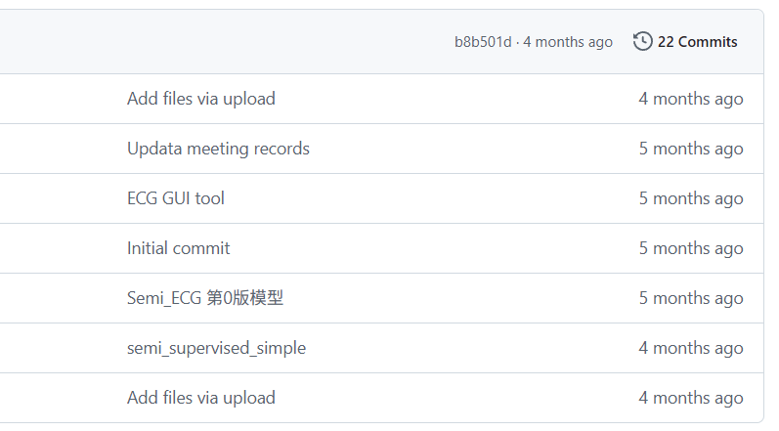
GitHub Repository and Open Source
Open source is the "second competition arena" of the contest, whose influence goes beyond the rankings themselves. Moreover, collaboration is an even more important lesson we can learn beyond the competition.
Repository Structure
data/
models/
scripts/
notebooks/
README.md
Reproduction
The README includes detailed environment configuration, a dependency list, and one-click run commands, ensuring that reviewers or teammates can reproduce the same scores within 30 minutes in a new environment

Slide 11
THANKS!
Reporter：Jiaxuan Yue
Date：2025/09/19

