Slide 1
Kaggle LLM Classification Finetuning
Team Members：Jiaxuan Yue，Leying Deng，Linsen Song，Fan Zhang
Reporter：Jiaxuan Yue
Date：2025/09/26

Slide 2
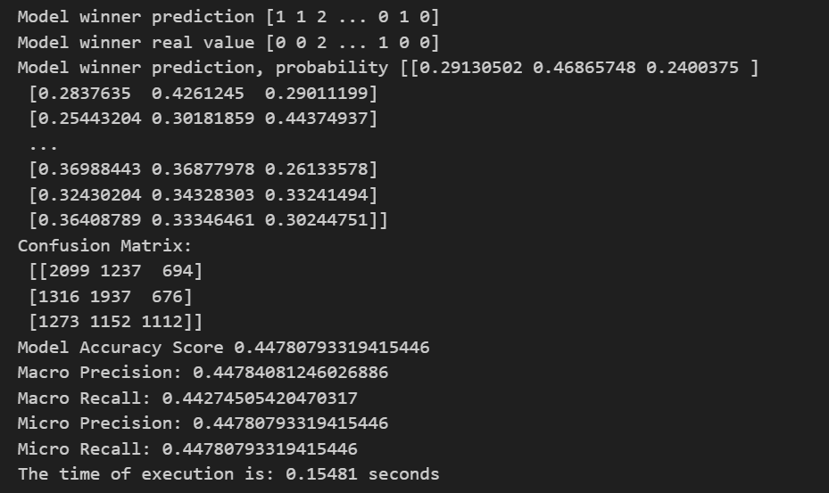
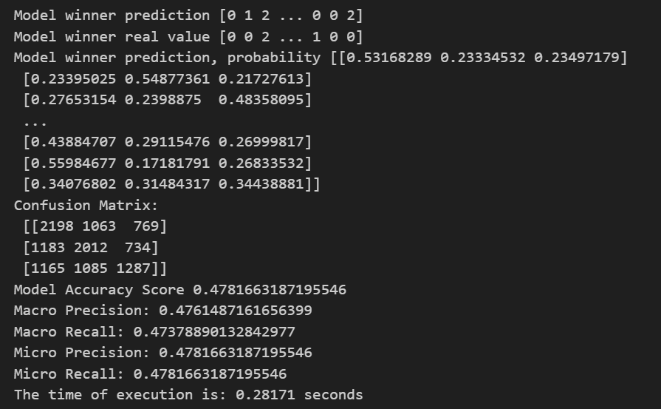
Task1
Traditional Logistic Regression Classification Model
The text feature engineering has established a text feature extraction process based on TF-IDF:
Combine "user questions + Model A answers + Model B answers" into unified text features.
Convert text into numerical features using TfidfVectorizer (with a default dimension of 5000) to adapt to the input requirements of logistic regression.
The classification model training and inference have implemented a complete logistic regression classification pipeline:
Initialize the model and handle class imbalance (set class_weight="balanced").
Encapsulate the train_lr_model training function and lr_predict inference function.
Support fast prediction of new samples based on the trained model.
Linkage with the LLM Solution
The two solutions share data processing logic to ensure consistency:
They can output the prediction results of both Ollama and logistic regression simultaneously, facilitating comparative analysis.

Slide 3

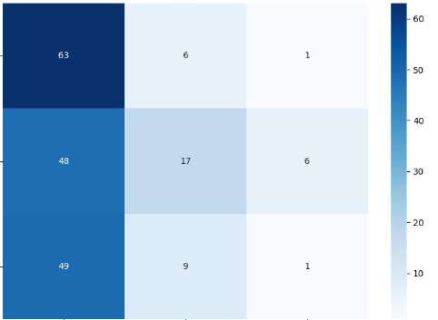
Task2
Ollama Inference Testing System
The local LLM calling framework has implemented the complete logic for invoking local large language models (e.g., llama3:8b) via the Ollama tool.
It includes the following features:
Encapsulates the ollama_predict function, which interacts with the Ollama service through HTTP API requests to http://localhost:11435/api/generate.
Supports specifying the model name via the --ollama_model parameter; by default, it uses the locally installed llama3:8b model.
Automatically processes the input prompt format (integrating user questions and answers from Model A/Model B) and outputs classification results (0/1/2).
Sample Size Control Mechanism
Optimized for testing efficiency, it implements two sample truncation methods:
"Brute-force truncation": Directly retains the first 100 samples using df.head(100) to quickly verify the workflow.
"Parameter control": Adds the --test_sample_num command-line parameter to support dynamic specification of the number of test samples (e.g., --test_sample_num 50 uses only 50 samples).
Batch Testing and Progress Tracking
Implements the logic for iterating through sample data, including:
Real-time output of progress (e.g., "Processed: 50/100") to facilitate tracking of the test status.
Next Week's Plan
Incorporate adjustments for LoRA parameters.
{
"total_samples": 1000,
"test_samples": 200,
"accuracy": 0.405,
"f1_score": 0.3177295666034538
}
分类报告:
precision recall f1-score support
0 0.3937 0.9000 0.5478 70
1 0.5312 0.2394 0.3301 71
2 0.1250 0.0169 0.0299 59
accuracy 0.4050 200
macro avg 0.3500 0.3855 0.3026 200
weighted avg 0.3633 0.4050 0.3177 200

Slide 4

Task3
Reserved Testing Process for Hugging Face: Supporting Multi-Model Comparison
Core Description
We have reserved a Hugging Face-based testing process in the solution, which enables the following capabilities:
Rapid Multi-Model Integration
It allows for convenient loading of mainstream open-source models from the Hugging Face Hub (e.g., Llama3, Mistral). There is no need for manual handling of model weight formats, enabling quick initiation of testing for different models.
Unified Process for Comparison
Leveraging tool libraries such as transformers from the Hugging Face ecosystem, a consistent testing process (including data processing, inference calling, and other logics) can be applied to different models. This ensures fairness and efficiency in multi-model testing and comparison, facilitating subsequent horizontal comparative analysis with results from solutions like Ollama, logistic regression, or other models.
Flexible Experiment Expansion
It supports further experiments such as model fine-tuning based on the Hugging Face ecosystem, providing a technical foundation for subsequent model performance optimization and exploration of better solutions.

Slide 5
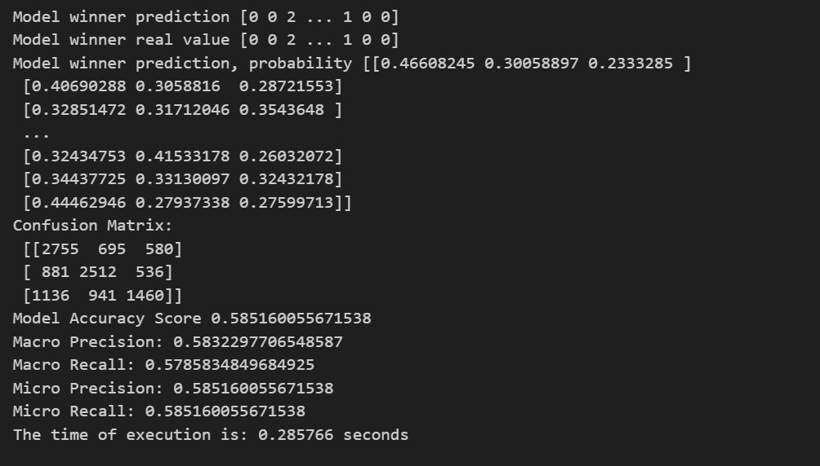
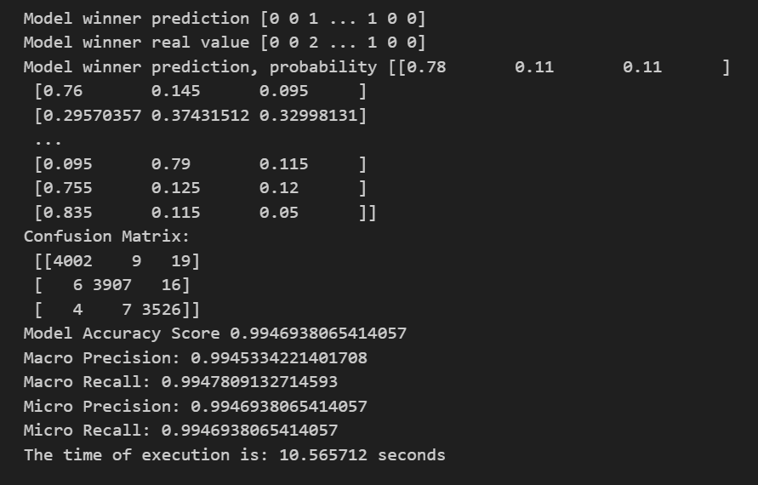
Task4
XGBoost
Random Forest

Slide 6
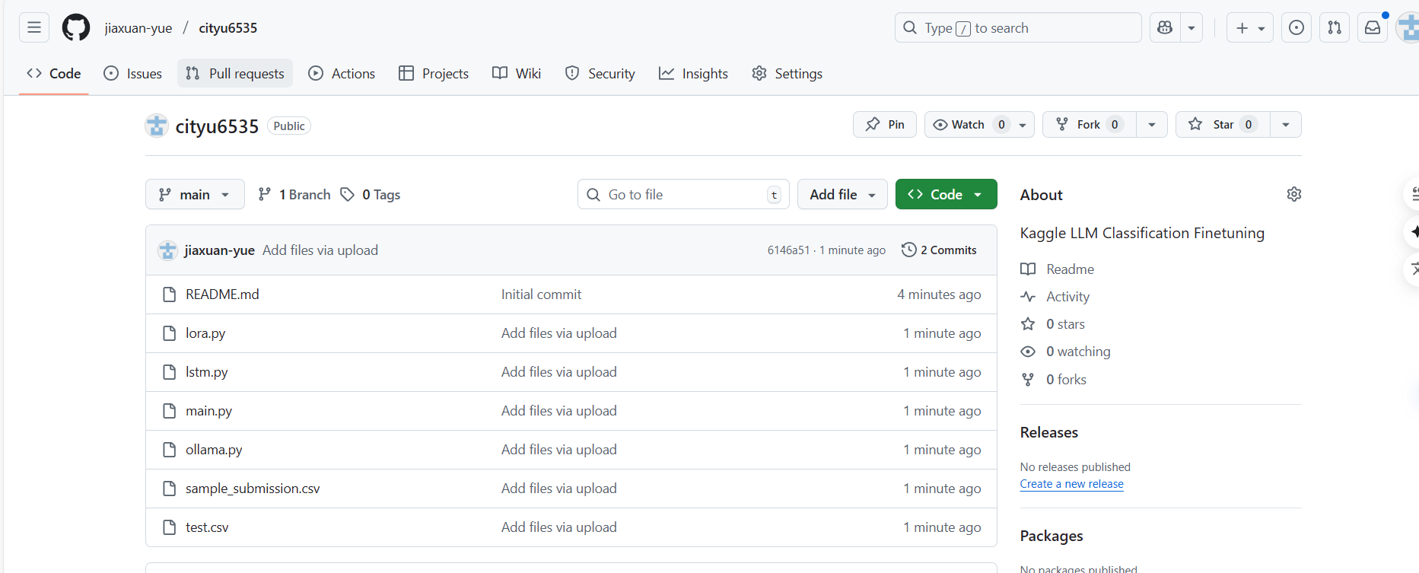

cooperation & exchange

Slide 7
THANKS!
Reporter：Jiaxuan Yue
Date：2025/09/19

