Slide 1
Kaggle LLM Classification Finetuning
Team Members：Jiaxuan Yue，Leying Deng，Linsen Song，Fan Zhang
Reporter：ZHANG FAN
Date：2025/10/10

Slide 2
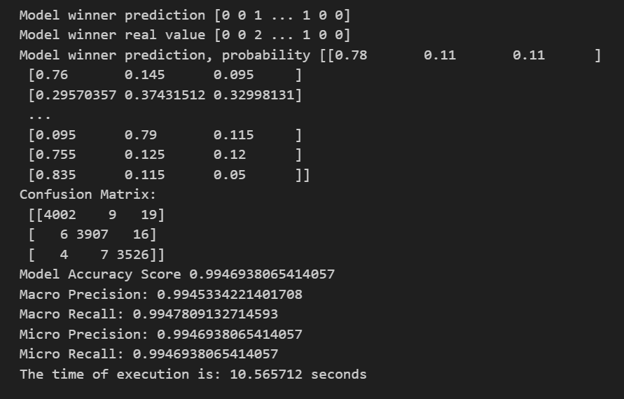
Task1
Random Forest

Slide 3
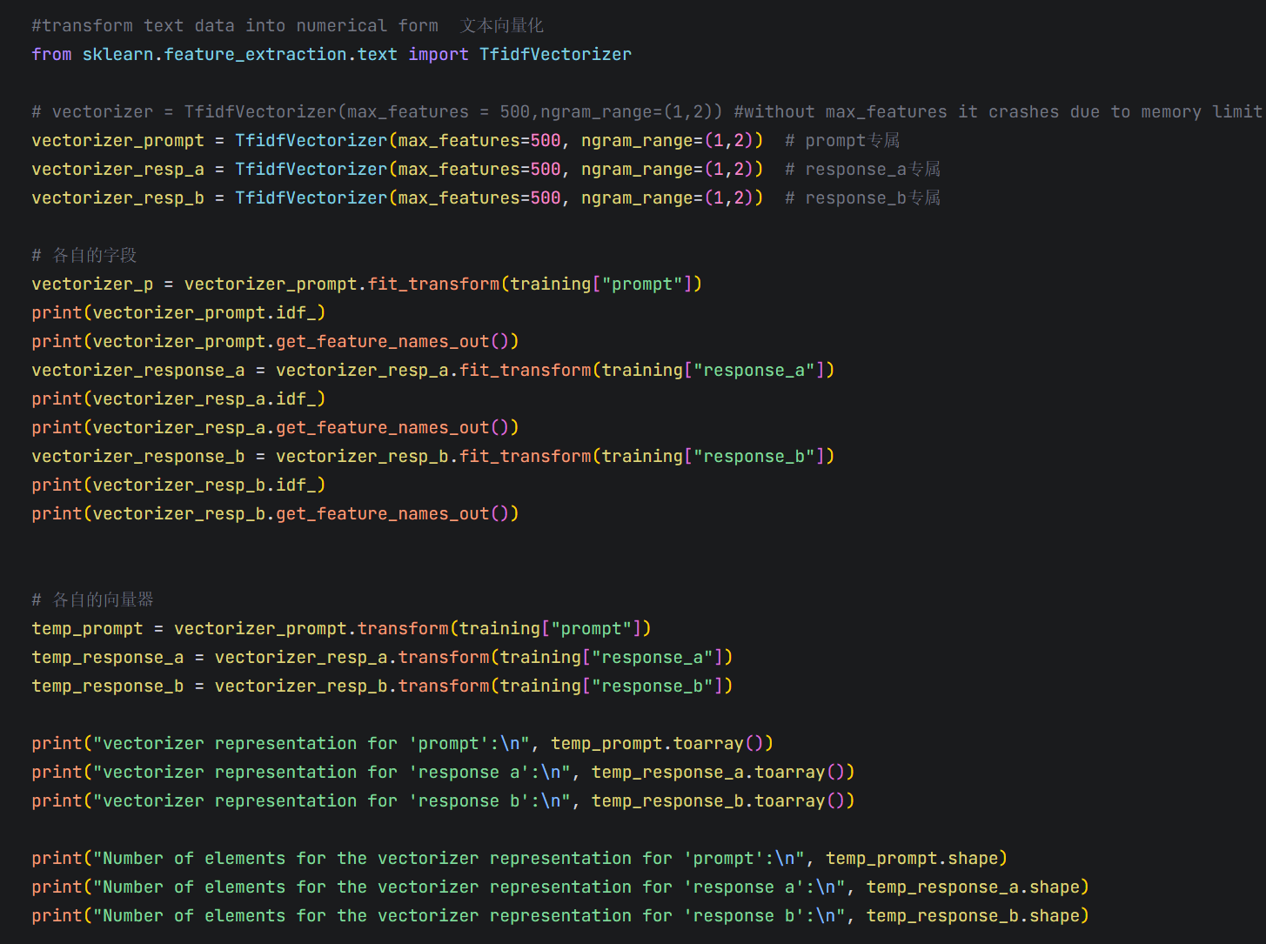
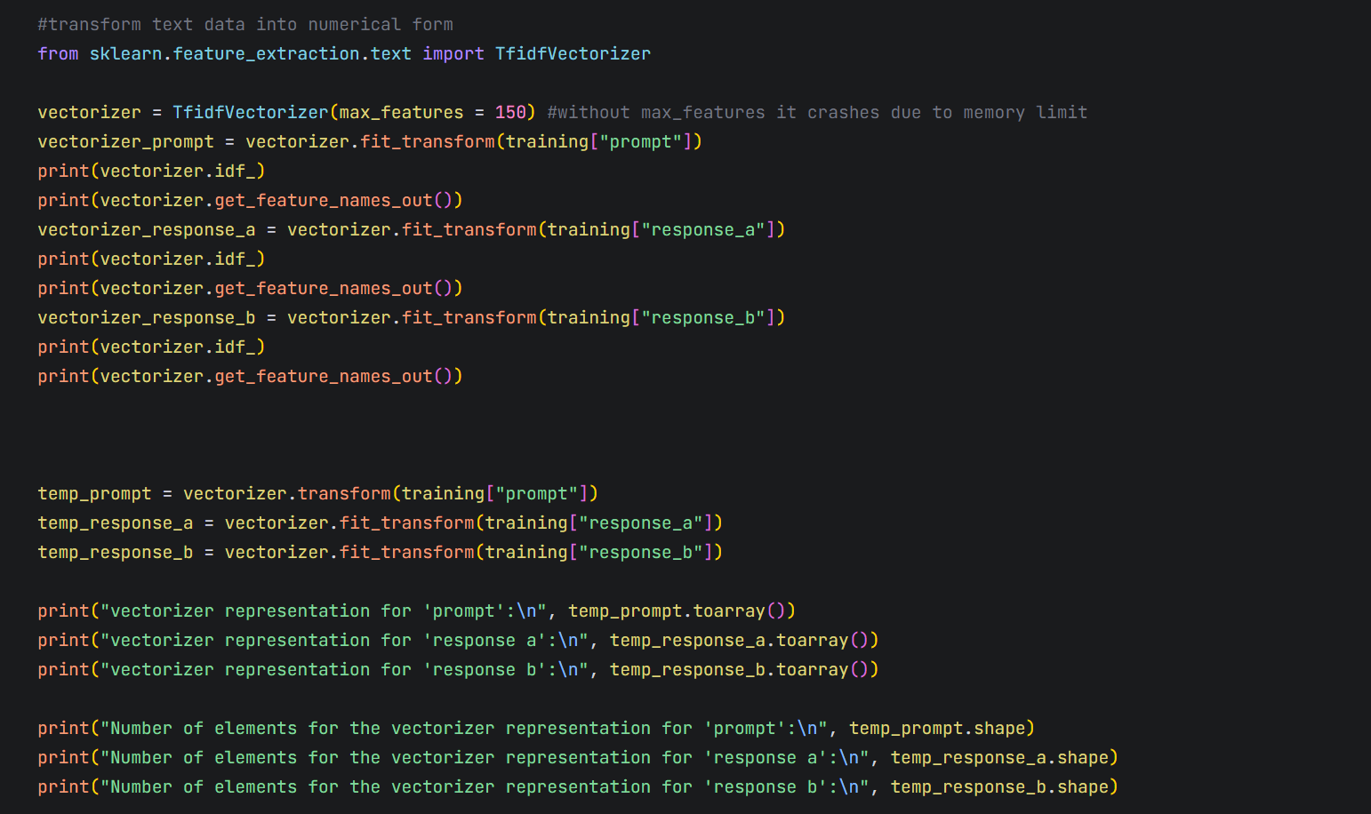
Task2
特征向量维度不一致
特征向量存在大量0值
原因：在文本编码过程中多次执行fit操作，导致特征空间不统一
解决：单次fit构建特征空间，基于全量文本集合执行一次fit，生成唯一通用的特征空间。
多次transform编码

Slide 4
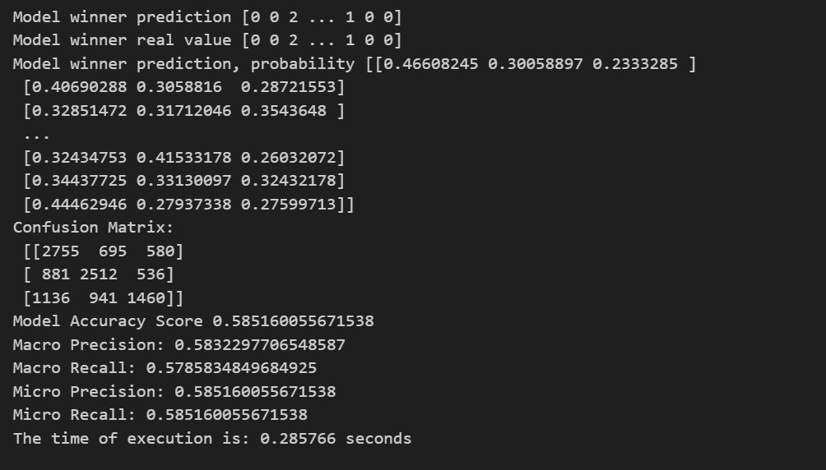
Task3
XGBoost logloss= 1.02332 rank 30

Slide 5

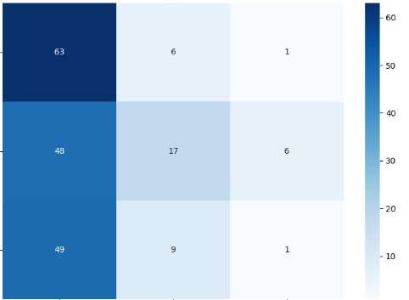
Task4
Ollama Inference Testing System
The local LLM calling framework has implemented the complete logic for invoking local large language models (e.g., llama3:8b) via the Ollama tool.
It includes the following features:
Encapsulates the ollama_predict function, which interacts with the Ollama service through HTTP API requests to http://localhost:11435/api/generate.
Supports specifying the model name via the --ollama_model parameter; by default, it uses the locally installed llama3:8b model.
Automatically processes the input prompt format (integrating user questions and answers from Model A/Model B) and outputs classification results (0/1/2).
Sample Size Control Mechanism
Optimized for testing efficiency, it implements two sample truncation methods:
"Brute-force truncation": Directly retains the first 100 samples using df.head(100) to quickly verify the workflow.
"Parameter control": Adds the --test_sample_num command-line parameter to support dynamic specification of the number of test samples (e.g., --test_sample_num 50 uses only 50 samples).
Batch Testing and Progress Tracking
Implements the logic for iterating through sample data, including:
Real-time output of progress (e.g., "Processed: 50/100") to facilitate tracking of the test status.
Next Week's Plan
Incorporate adjustments for LoRA parameters.
{
"total_samples": 1000,
"test_samples": 200,
"accuracy": 0.405,
"f1_score": 0.3177295666034538
}
分类报告:
precision recall f1-score support
0 0.3937 0.9000 0.5478 70
1 0.5312 0.2394 0.3301 71
2 0.1250 0.0169 0.0299 59
accuracy 0.4050 200
macro avg 0.3500 0.3855 0.3026 200
weighted avg 0.3633 0.4050 0.3177 200

Slide 6
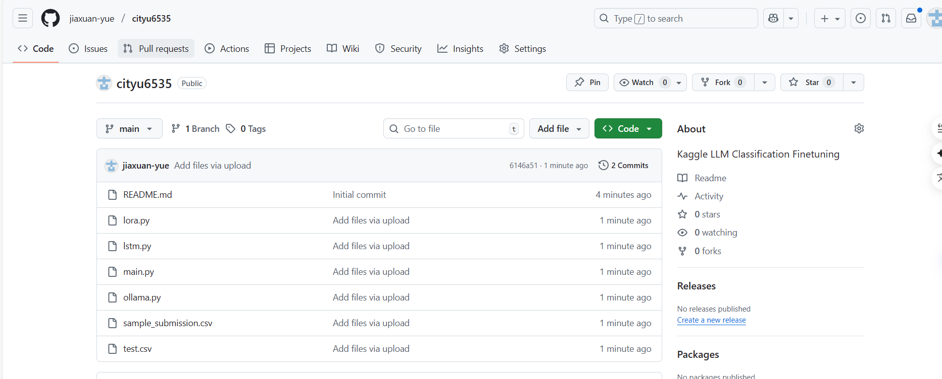
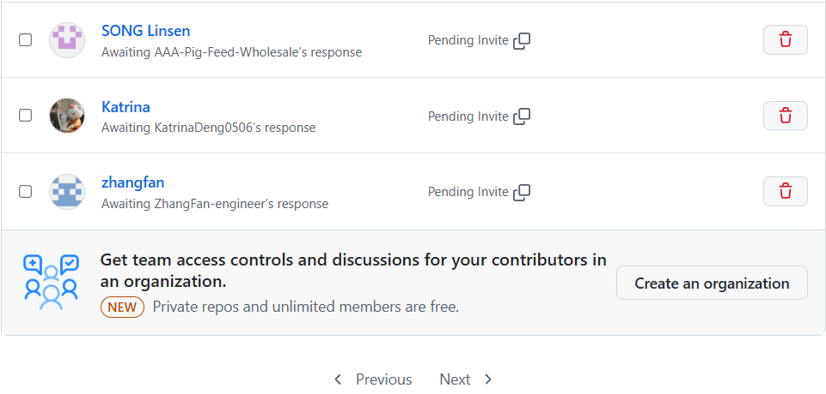
cooperation & exchange

Slide 7
THANKS!
Reporter：ZHANG FAN
Date：2025/10/10

