Slide 1

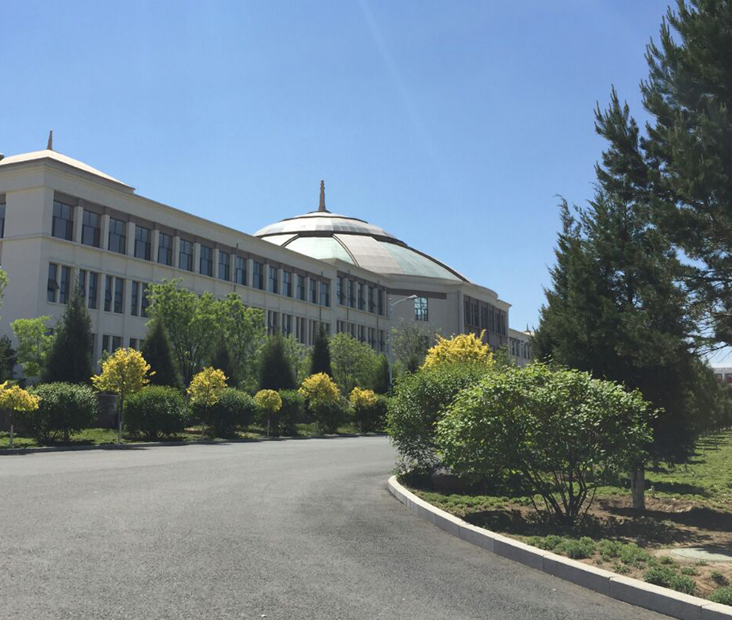

IT Ticket Management &
Python Code Analysis Web System
Group Members：
Jiaxuan Yue Jiahua ZHU Linsen SONG
Yanxi JIANG Baizhao CHEN Wenxin LUO
Leying Deng

Slide 2
Project Overview
01
Python Code Quality Analysis System
Supports pylint / flake8 / nested-loop detection
02
IT Ticket Management System
Admin + User functional workflows
03
Technology Stack
Backend Framework: Flask
Module System: Blueprint
Data Storage: JSON Files
Frontend: HTML Templates (rendered by Flask)
04
Key Features
Clean modular design
No external database required
Supports both developer tools & task management workflows

Slide 3
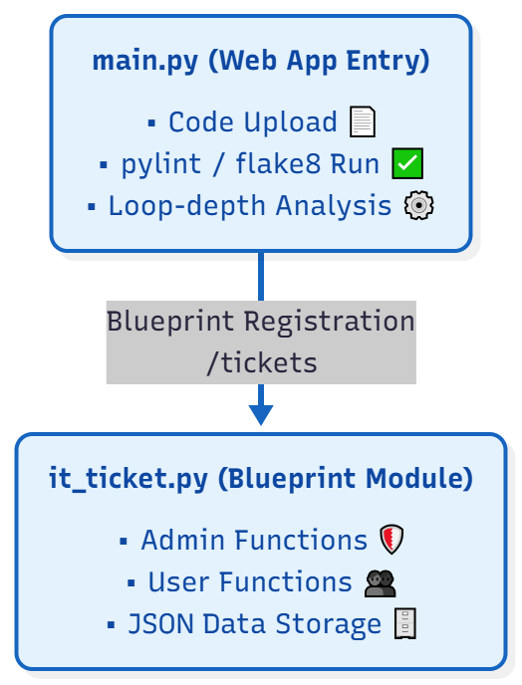
System Architecture
main.py is the primary entry of the web
application.
it_ticket.py is registered as a Blueprint at
/tickets.
Both modules share the same Flask server.

Slide 4
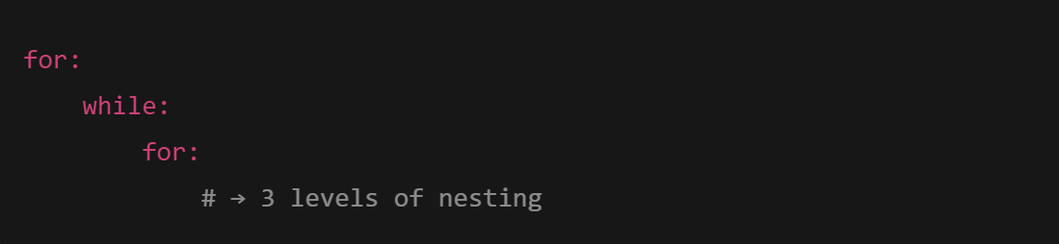
Code Analysis Module（main.py）
Purpose：A lightweight online Python code checking service.
Core Features：
  Upload Python File
    -- File saved into /uploads directory
  Select Check Types
    -- pylint: Code style & error detection
    -- flake8: Syntax & linting errors
    -- Loop analyzer: counts maximum nested loops
  Backend Execution
    -- Uses subprocess.run() to call system tools
    -- Results are displayed back in HTML
Loop Depth Analyzer Example：
  Detects patterns like:

Slide 5
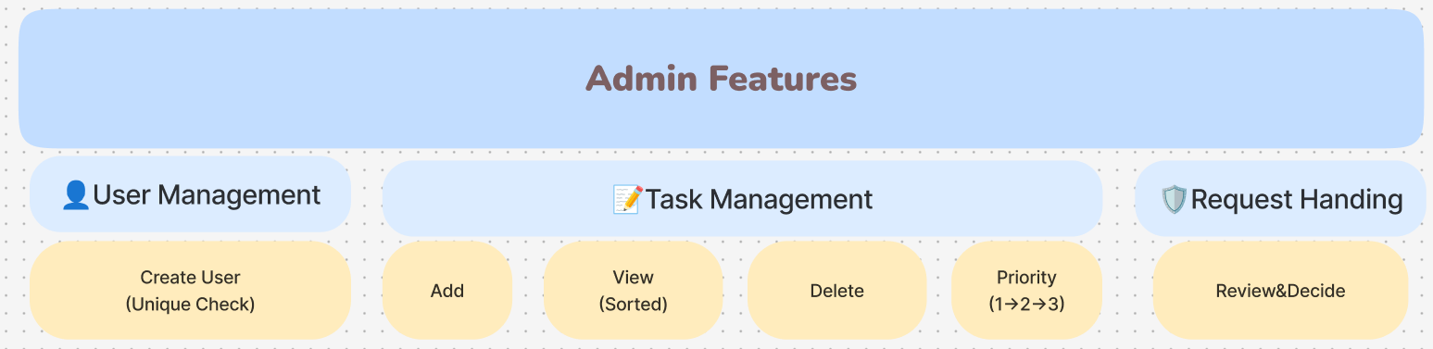
Admin Features
Create User
  Adds new user to users.json
  Prevents duplicate usernames
Add Task
  Fields:Title、Assigned User、Priority (1~3)
View Tasks
  Automatically sorted by priority
  Table-like presentation
Delete Task
  Removes by task ID
Change Task Priority
  Priority cycles through: 1 → 2 → 3 → 1
View & Handle User Requests
  Accepts or dismisses user-submitted task modifications

Slide 6
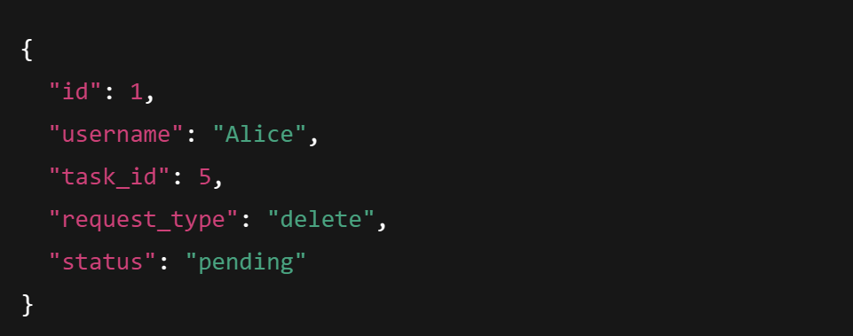
User Features
View Assigned Tasks
  Sorted by priority
  Displays on personal dashboard:/tickets/user/<username>
Submit Delete Request
  Generates a JSON record:
Submit Priority Change Request
  Same mechanism as above
  Request type changes to priority
Requests remain pending until admin action

Slide 7
Ticket System Overview
Module Purpose：Provide a minimal IT Task Management System with logical workflows.
Roles：
  Admin
    Manages users & tasks
    Handles pending user requests
  User
    Views personal tasks
    Submits requests (delete task / change priority)
Data Storage： JSON
File | Description
users.json | All users
tasks.json | Task list
requests.json | User requests

Slide 8
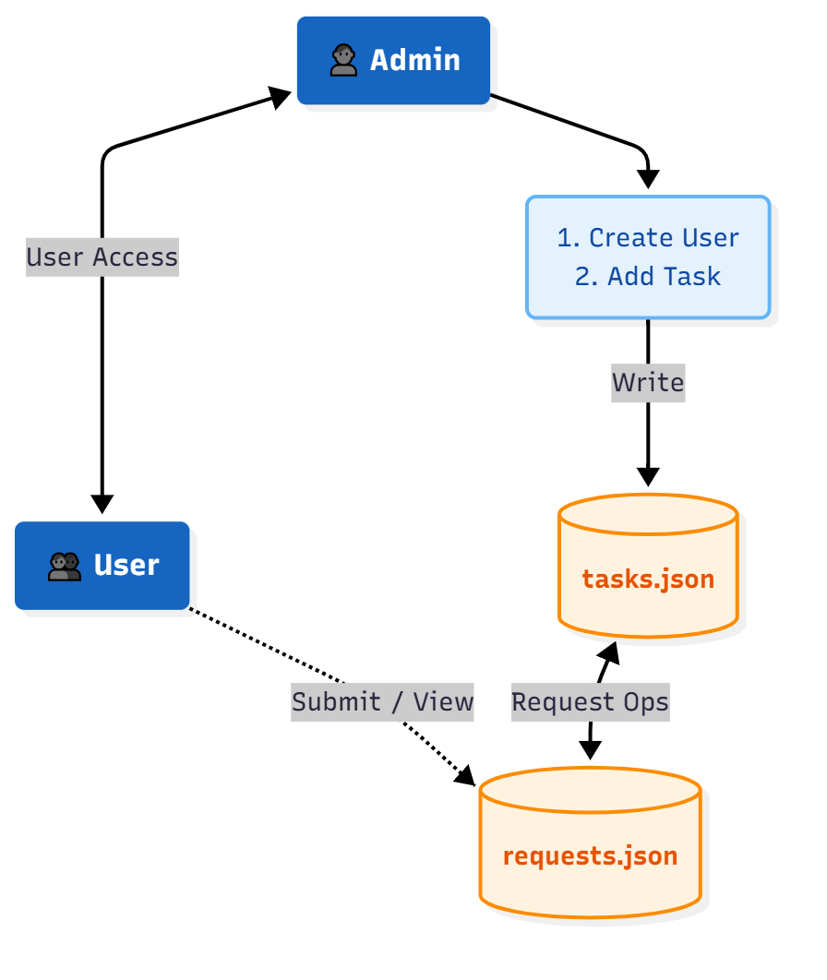
System Workflow
Admin controls task lifecycle
User can propose modifications
JSON files maintain persistent state

