Slide 1
Tech Talk -- KeDA
Kubernetes-based Event Driven Autoscaling

Slide 2
What is Keda
KEDA allows for fine grained autoscaling (including to/from zero) for event driven Kubernetes workloads. KEDA serves as a Kubernetes Metrics Server and allows users to define autoscaling rules using a dedicated Kubernetes custom resource definition.

Slide 3
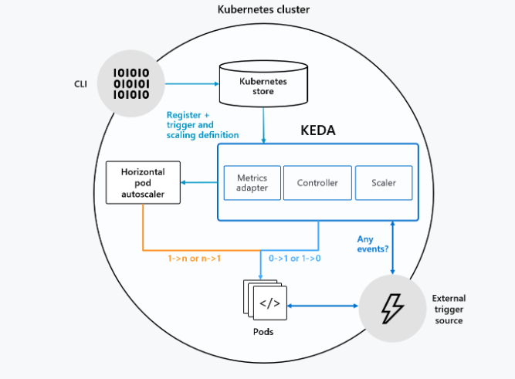
How KEDA works
Notes:
KEDA performs two key roles within Kubernetes. First, it acts as an agent to activate and deactivate a deployment to scale to and from zero on no events. This is one of the primary roles of the keda-operator container that runs when you install KEDA. Second, KEDA acts as a Kubernetes metrics server to expose rich event data like queue length or stream lag to the horizontal pod autoscaler to drive scale out. It is up to the deployment to then consume the events directly from the source. This preserves rich event integration and enables gestures like completing or abandoning queue messages to work out of the box. The metric serving is the primary role of the keda-operator-metrics-apiserver container that runs when you install KEDA.

Slide 4
Event sources and scalers
Apache Kafka Topic AWS Cloudwatch
AWS SQS Queue Azure Event Hubs
Azure Service Bus Azure Storage Queue
External Google Cloud Platform‎ Pub/Sub
Huawei Cloudeye Liiklus Topic
NATS Streaming Prometheus
RabbitMQ Queue Redis Lists https://keda.sh/#scalers

Slide 5
RabbitMQ Queue
Pre-requisites
Kubernetes cluster -- minikube
KEDA installed on the cluster – helm or deploy yaml (https://keda.sh/deploy/)
Setup
git repo: https://github.com/jiayanguo/kedaDemo

