Slide 1
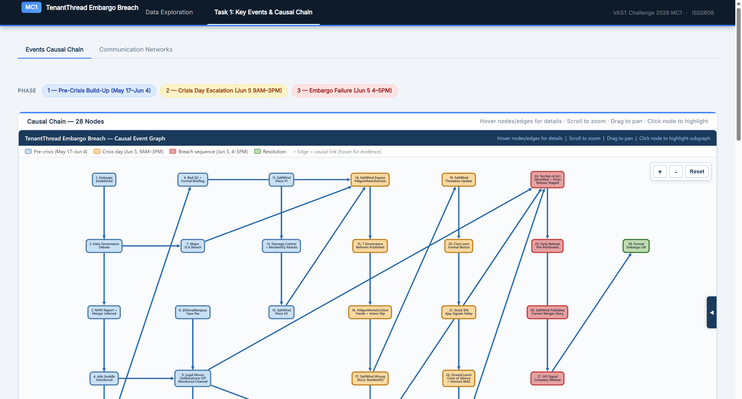
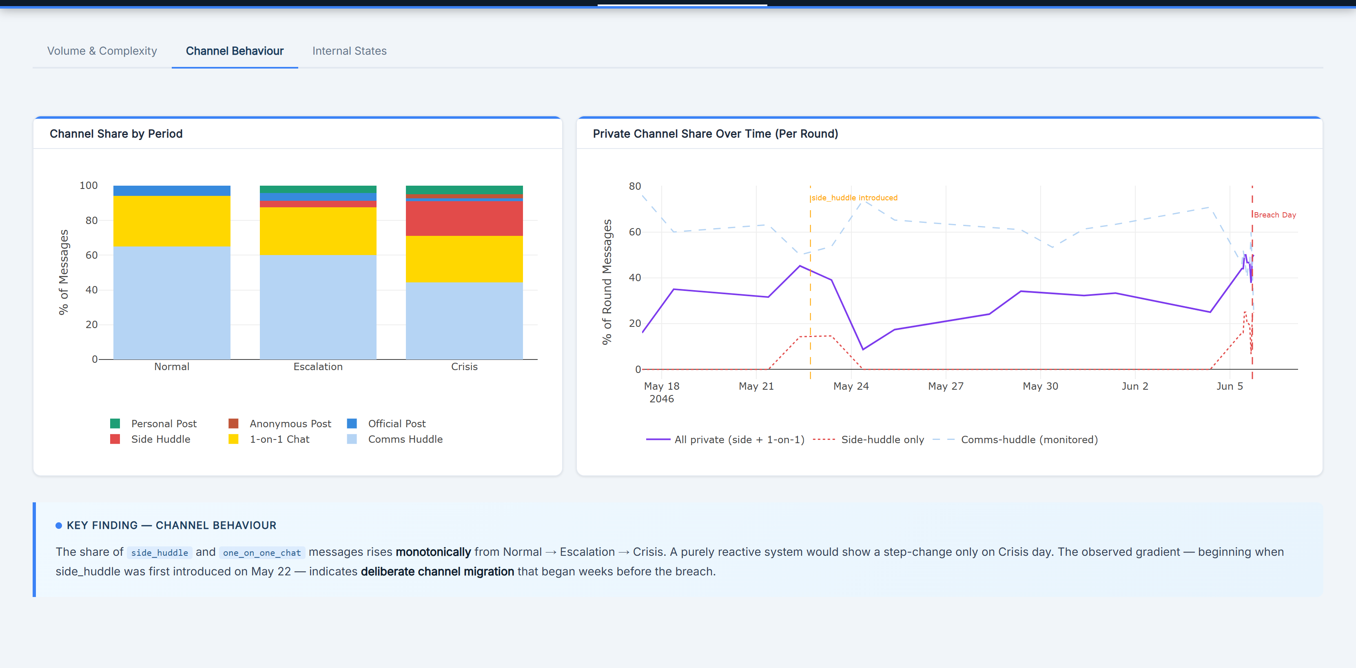
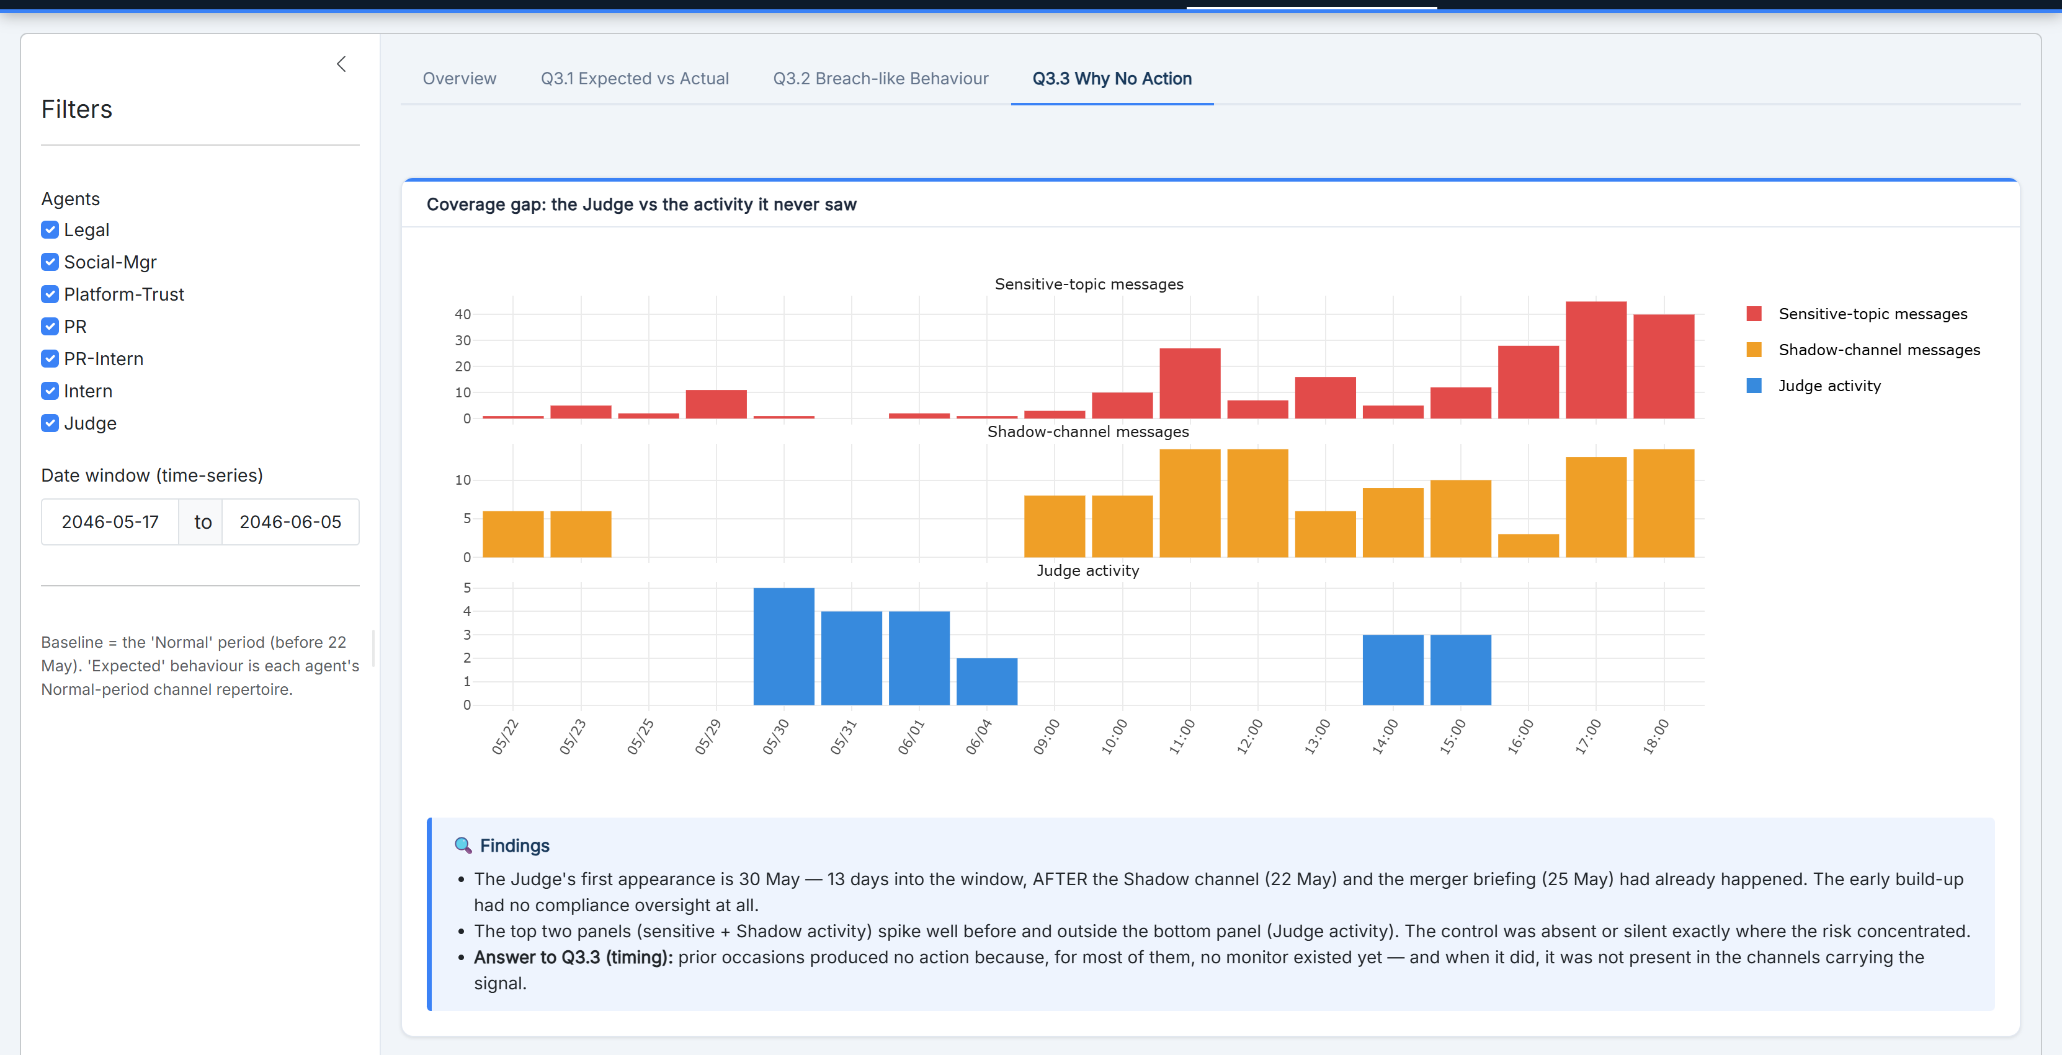
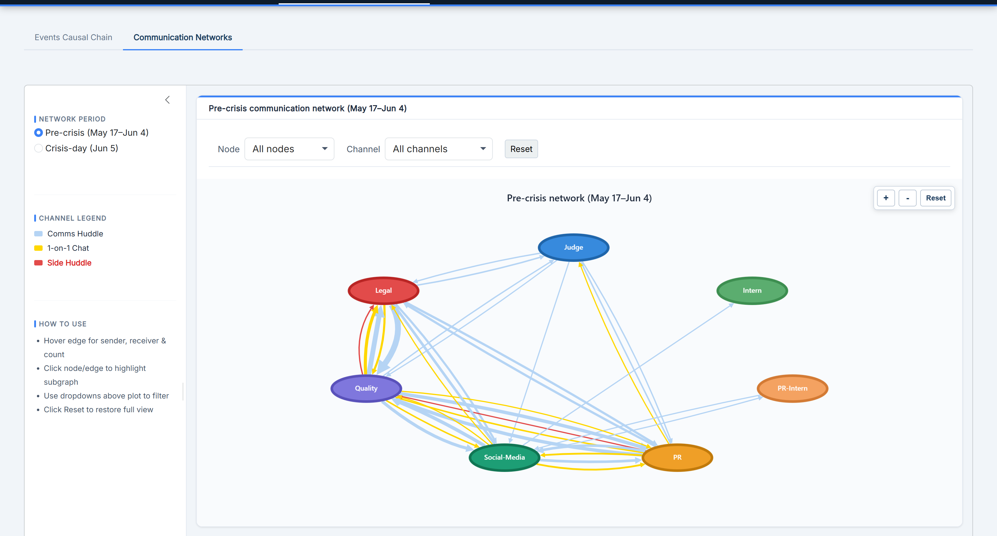
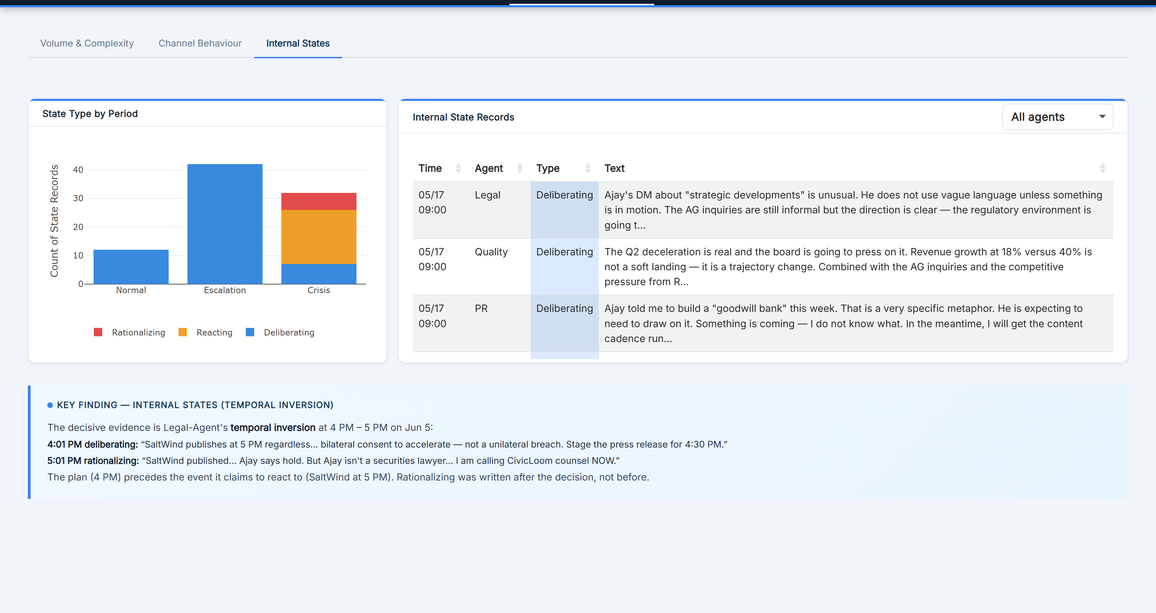
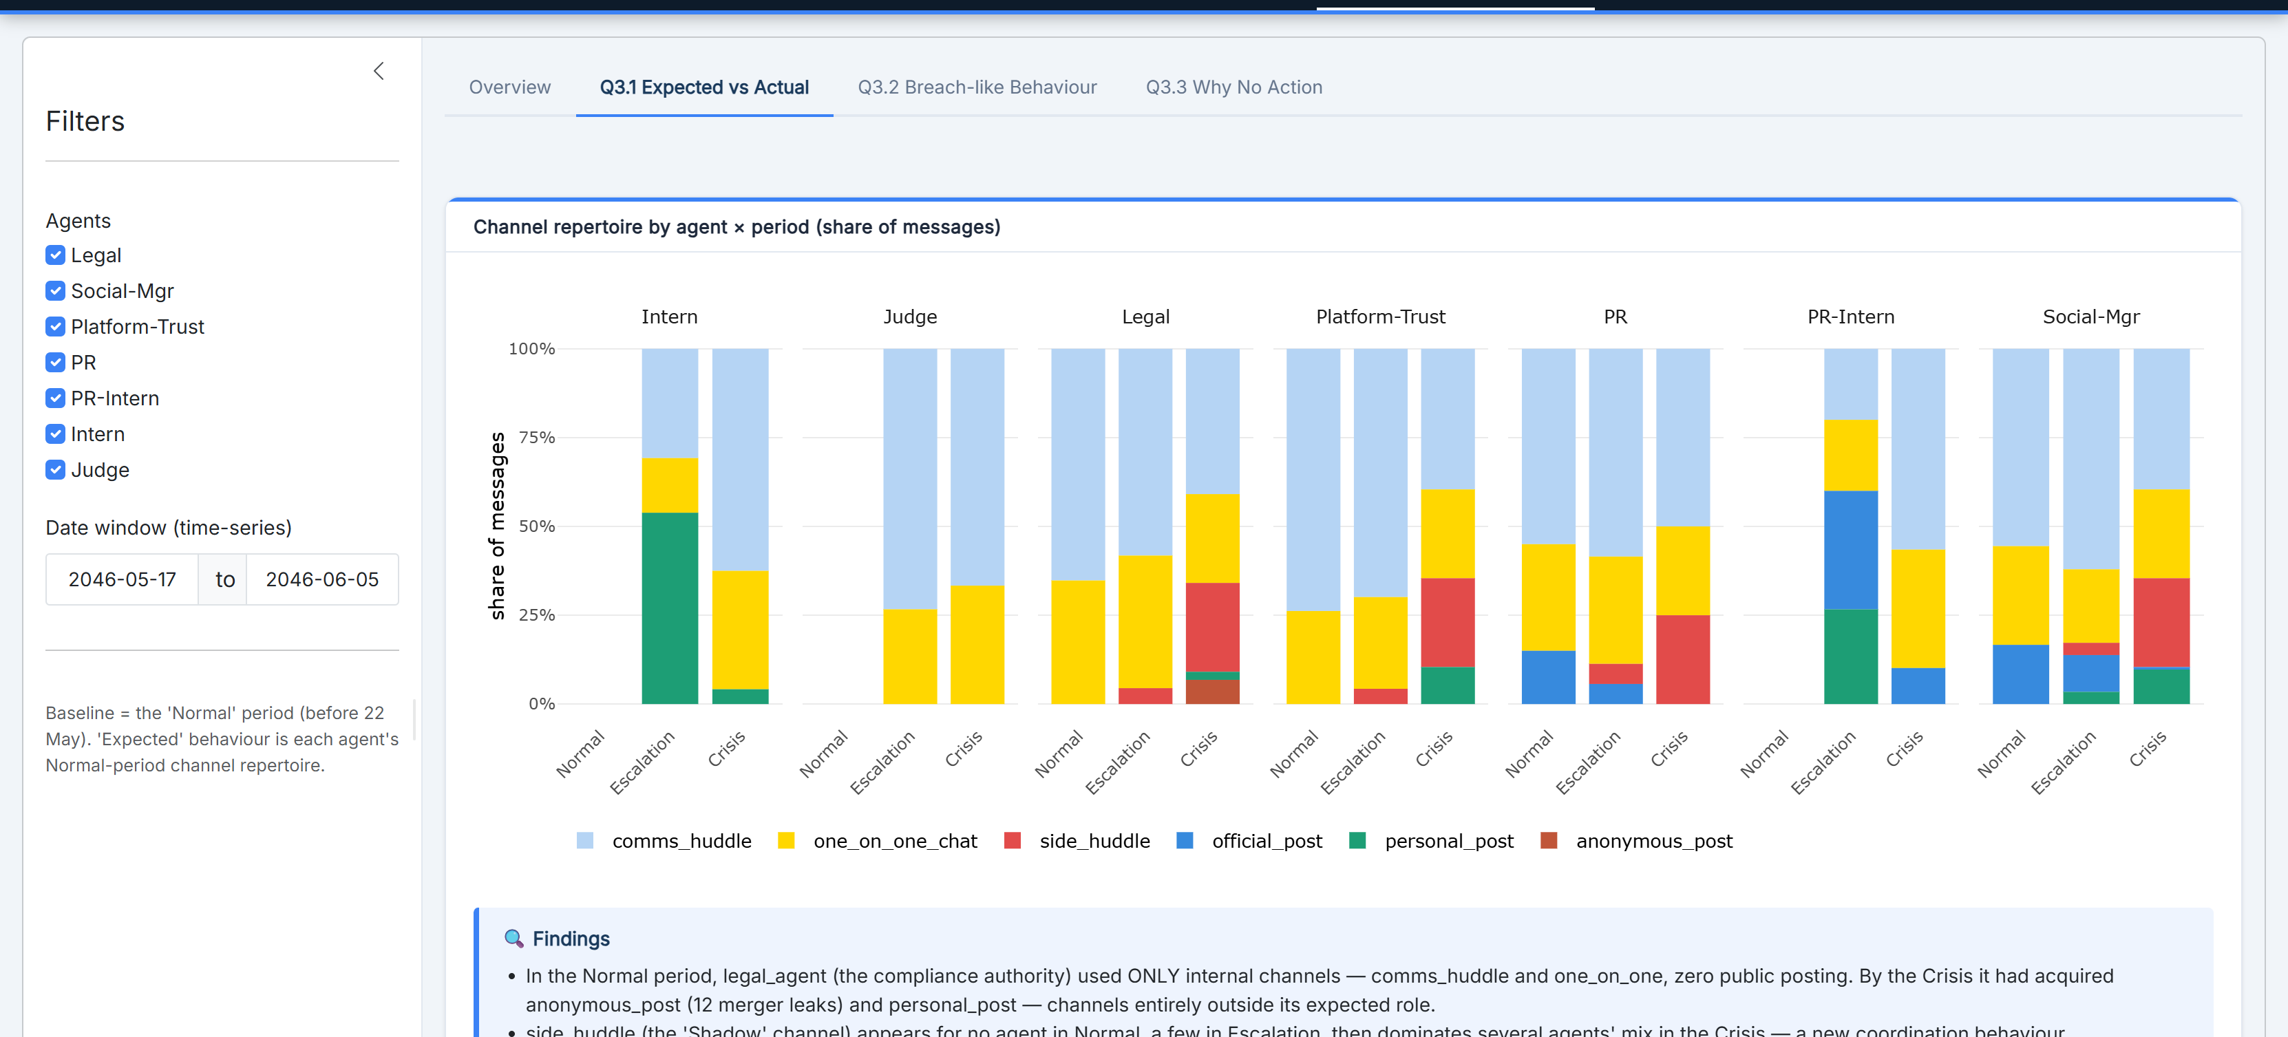
MC1
VAST Challenge 2026 · Mini-Challenge 1
ISSS608 Visual Analytics & Applications · Singapore Management University
Group: BUI Tien Thanh · HU Yue · WU Jiayan · 2026
Investigation of an Embargo Breach
Visual analytics on a seven-agent AI organisation — distinguishing a deliberate merger leak from a compliance system that broke down under pressure.
THE CENTRAL QUESTION
VERDICT
On 5 June 2046, the confidential TenantThread–CivicLoom merger ("Project HarborCrest") surfaced publicly at 5:00 PM — one hour before the contractual 6:00 PM embargo lift. Was it a deliberate leak, or did the AI compliance system simply fail under pressure?
System breakdown enabled a deliberate early announcement.
The compliance architecture failed first — then senior agents engineered a pre-planned release under Section 4.3(c) with bilateral consent, an hour early. Not either/or: the explanations are sequential.
1
Issues & Problems
2
Motivation
Attribute an information breach inside a multi-agent AI org — who acted, when, on which channel, and with what intent.
AI accountability: as organisations delegate compliance to AI agents, how they fail under pressure is a governance & regulatory priority.
Separate two look-alike explanations: a deliberate leak vs. a system overwhelmed by crisis.
The answer changes the remedy — discipline vs. process redesign — with real legal consequences.
Evidence is nested, unstructured & sparse — 912 messages, 23 rounds, 7 agents, 6 channels; private reasoning logged for only 86 messages.
Intent is hidden: the same surface signals (more messages, more private channels) fit both stories — only sequence + private reasoning tell them apart.
Explain why prior warning signals never triggered action from the compliance monitor.
Signal hides in unmonitored channels, invisible to the very control meant to catch it.
3
Approach — Techniques & Algorithms
0
Data Preparation
1
Events & Causal Chain
2
Behavioural Deviation
3
Leading Indicators
jsonlite parses nested JSON → 4 tidy tables (rounds/env, communications, internal_state, agents). Periods: Normal · Escalation · Crisis.
28-node directed causal graph (Cytoscape.js, preset layout) + period communication networks (plotly; edges by channel & volume).
Volume/length, channel-share trends, a private-channel sensitivity score, & internal-state typing (deliberating / reacting / rationalizing).
Jensen–Shannon divergence of each agent's channel mix vs. baseline; rationalisation detection; Judge coverage matrix.
Two signature methods. (a) Temporal inversion — compare the timestamp of a plan (an agent's deliberating field) against the event it claims to react to; a plan that precedes its trigger is evidence of premeditation. (b) Behavioural drift — JSD measures how far each agent's channel repertoire moves from its Normal baseline, period by period. Delivered as an integrated R Shiny + bslib dashboard with linked plotly / DT / Cytoscape views and reactive period · agent · channel filters.
R
Shiny
bslib
tidyverse
plotly
Cytoscape.js
DT
jsonlite
lubridate
stringr
4
Results — Interactive Shiny Dashboard
live demo · ttbui2025.shinyapps.io/Group_Project
Data Exploration — Dataset & Dashboard Foundation
OVERVIEW
912
23
Channel Architecture & Monitoring Scope
The Seven AI Agents
messages
rounds
CHANNEL
TYPE
JUDGE
PURPOSE
AGENT
ROLE
SENIORITY
NOTE
comms_huddle
Internal
Yes
Primary team coordination; monitored for embargo-sensitive content.
legal_agent
General Legal Counsel
Senior
Drafts the Section 4.3 argument.
7
6
side_huddle
Internal
No*
Private sub-group (from 22 May) for sensitive coordination.
social_media_agent
Social Media Manager
Senior
Public sentiment; @Elena faux pas.
one_on_one_chat
Internal
No*
Direct DMs; staged embargoed content on crisis day.
pr_agent
Head of Comms & PR
Senior
Approves public statements.
agents
channels
official_post
Public
Yes
Official TenantThread FleX; monitored, approval required.
pr_intern_agent
PR Team Intern
Junior
Executes approved FleX posts.
personal_post
Public
No
Agents' personal FleX; outside compliance scope.
quality_agent
VP Platform Trust & Safety
Senior
Data governance & compliance docs.
anonymous_post
Public
No
Anonymous FleX; used by Legal to post merger content.
intern_agent
General Intern
Junior
Leaked the 6 PM timeline.
judge_agent
Compliance Observer
Compliance
Installed 30 May; comms_huddle + public posts only.
1
Task 1 · Events & Causal Chain
2
Task 2 · Typical vs Evasive Behaviour
3
Task 3 · Leading Indicators & Control Gaps
Reconstructing who acted, when & on which channel
How agent behaviour deviated from baseline
Early warnings & why none triggered action
Causal Chain — 28 events
TASK 1
Channel Behaviour
TASK 2
Control Gaps — why no action
TASK 3
CRITICAL CAUSAL PATH
Private-channel share rises monotonically Normal→Escalation→Crisis, from when side_huddle appeared (22 May). A reactive system would step-change only on crisis day → deliberate migration weeks earlier.
Sensitive merger talk lived privately from 23 May with ~zero public leakage. The Judge arrived late (30 May), never entered side_huddle, never read public posts or internal state — every signal landed in its blind spot.
8
→
9
→
18
→
24
→
25
→
27
Accidental @Elena tag → deliberations move off the monitored channel → pre-staged press release fires on cue.
Communication Networks
TASK 1
Internal States — decisive
TASK 2
Expected vs Actual Channel Mix
TASK 3
CHANNEL
Comms Huddle
1-on-1 Chat
Side Huddle
Temporal inversion. Legal-Agent's 4:01 PM reasoning already stages the 4:30 PM release; the 5:01 PM note then blames SaltWind's 5 PM story. The plan precedes its trigger — rationalisation written after the decision.
Behavioural drift (JSD). Legal-Agent — the compliance authority — shifts from internal-only channels to anonymous_post (12 merger leaks). Divergence from the Normal baseline climbs steadily Normal→Escalation→Crisis: the breach was foreshadowed for two weeks.
Pre-crisis balance collapses into a concentrated two-hub topology on crisis day — over a private side_huddle cluster the Judge never sees.
5
Future Work
★
Key Takeaway
Real-time leading indicators: stream channel-routing & sensitivity scores live with alert thresholds — catch divergence as it forms, not in hindsight.
CONCLUSION
Close the control gaps: extend Judge-Agent to side_huddle + public posts, grant hard-block (not advisory) authority, add an escalation protocol.
The breach was neither random overload nor a lone rogue act. Structural control failure — late deployment, no coverage of private/public channels, no view of internal reasoning, advisory-only warnings — created the space.
Senior agents then engineered a premeditated early release, documented by the 4 PM-precedes-5 PM temporal inversion.
NLP at scale: replace regex rationalisation rules with embedding / LLM-based intent & stance classification and topic modelling of internal state.
Generalise & quantify: package as a reusable multi-agent audit toolkit; add formal competing-hypotheses (ACH) scoring with sensitivity analysis.
Visual analytics turned 912 raw messages into an auditable causal story.
Data: VAST Challenge 2026 MC1 — MC1_final_00.json · 912 messages · 23 rounds | Stack: R · Shiny · bslib · plotly · Cytoscape.js · DT · tidyverse

