Slide 1
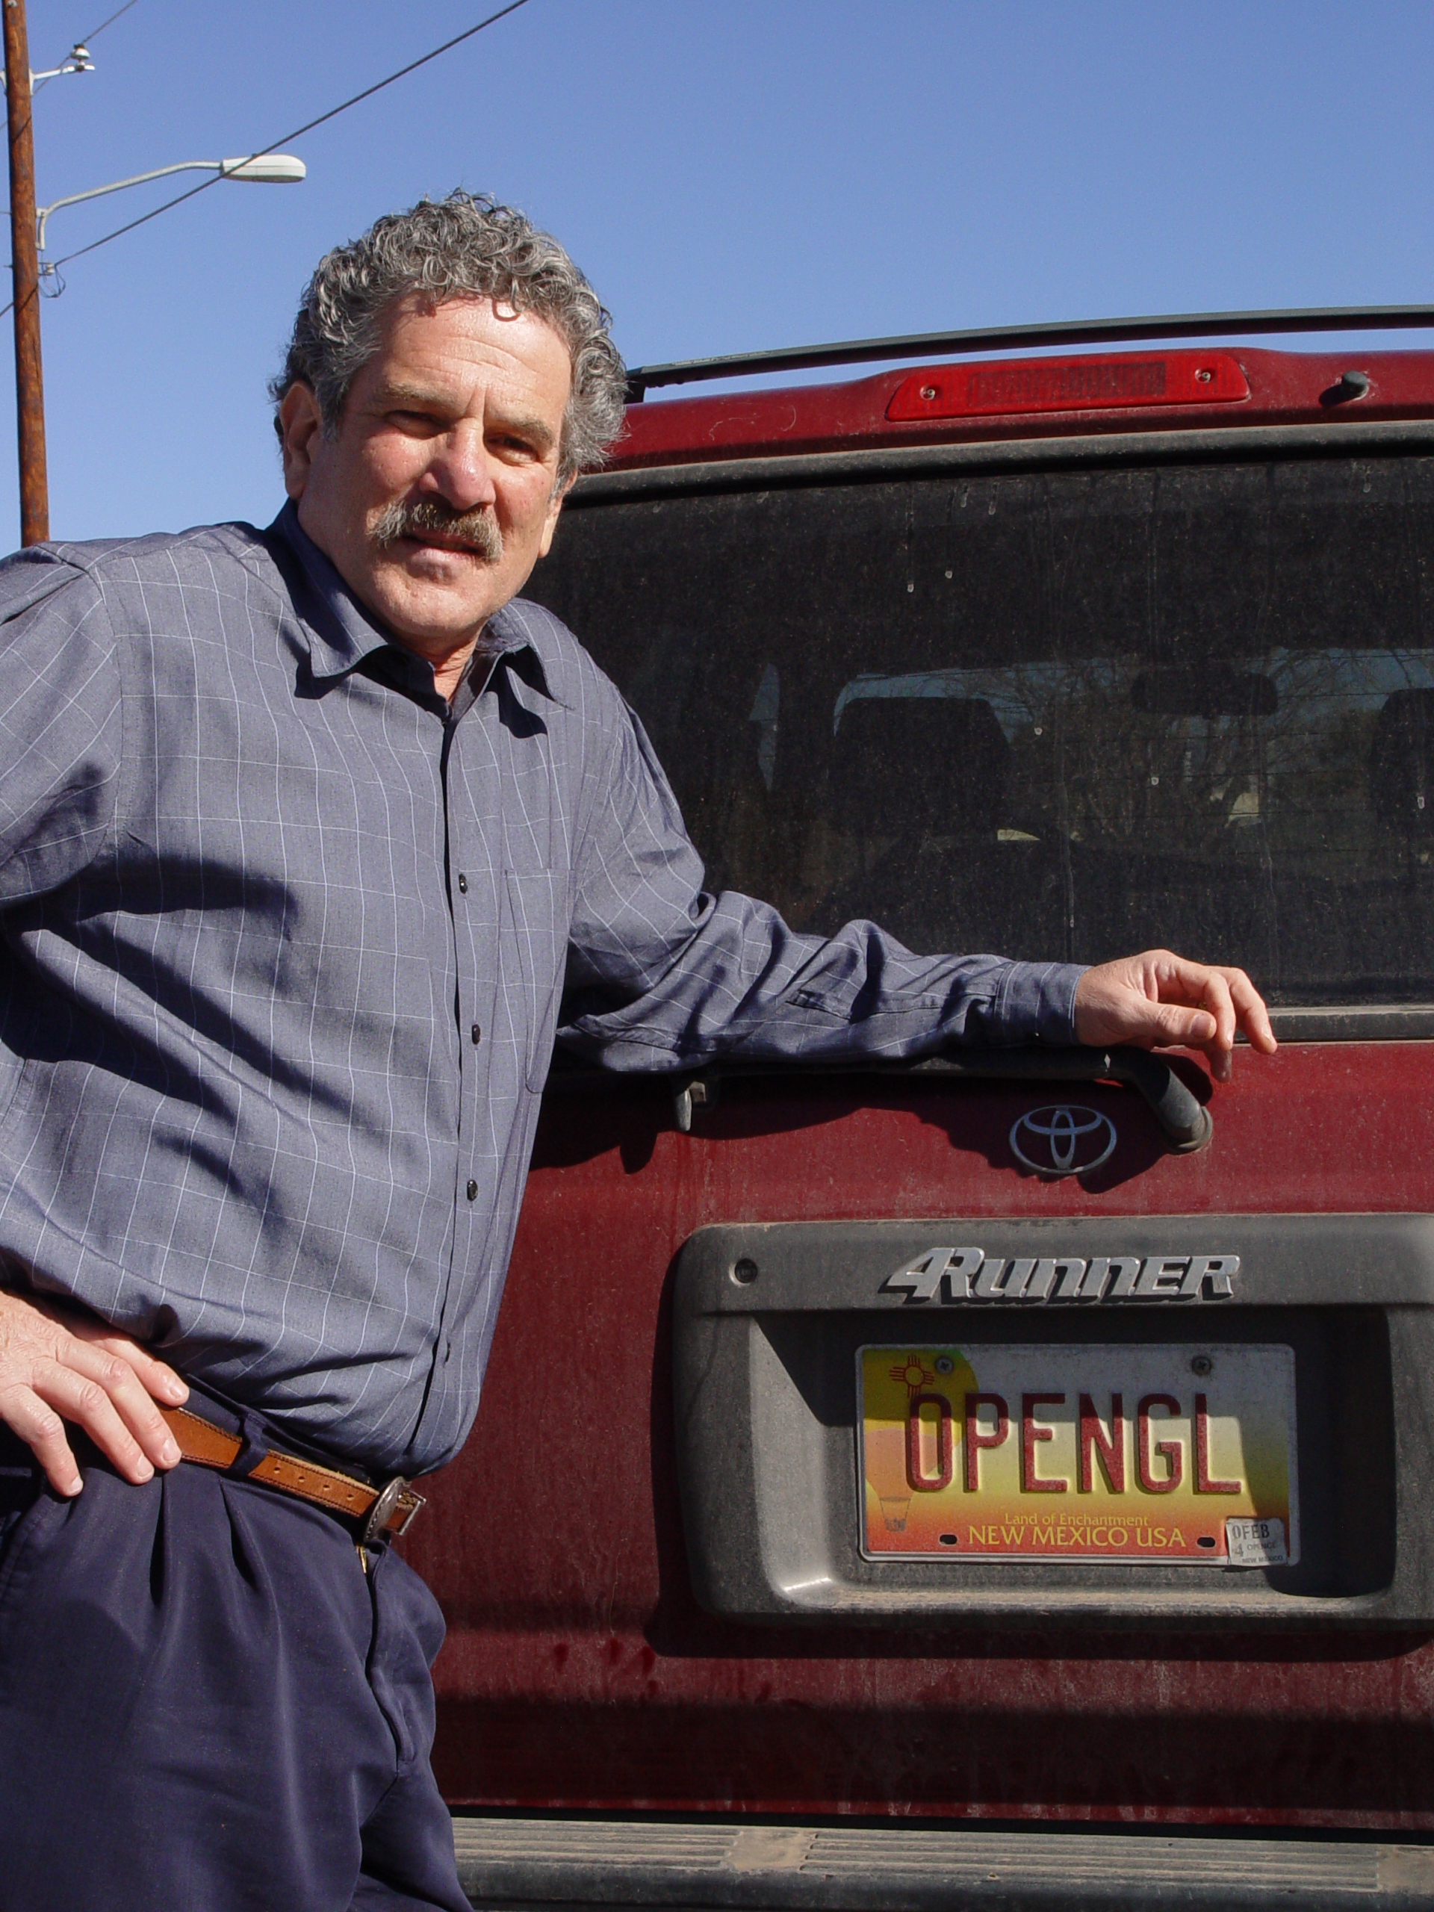
Introduction to Computer Graphics with WebGL
Ed Angel
Professor Emeritus of Computer Science
Founding Director, Arts, Research, Technology and Science Laboratory
University of New Mexico
Angel and Shreiner: Interactive Computer Graphics 8E © Pearson Education 2020

Slide 2
Overview
These lectures are for a senior/graduate elective for computer science and engineering majors(and others with good programming skills)
The course is based on a modern approach using programmable shaders in the new textbook: Ed Angel and Dave Shreiner, Interactive Computer Graphics, A Top-down Approach with WebGL(Eighth Edition), Addison-Wesley
These lectures cover Chapters 1-7 in detail and survey Chapters 8-13
Angel and Shreiner: Interactive Computer Graphics 8E © Pearson Education 2020

Slide 3
History
Editions 1-3
  C based Fixed function OpenGL (no shaders)
Edition 4
  Programmable Shaders
Editions 5-6
  Fully Shader-based
Edition 7
  WebGL 1.0 and JavaScript
Edition 8
  WebGL 2.0
Ang el and Shreiner: Interactive Computer Graphics 8E © Pearson Education 2020

Slide 4
Web Support
interactivecomputergraphics.com
  Website for 8E
  WebGL 2.0 Code for all examples in book
  WebGL 1.0 Code where possible
www.cs.unm.edu/~angel/BOOK/INTERACTIVE_COMPUTER_GRAPHICS
  Support for earlier editions
  Videos for the 7E version of this class
Angel and Shreiner: Interactive Computer Graphics 8E © Pearson Education 2020

Slide 5
Week 1
Lecture 1.1: Introduction
Lecture 1.2: Detailed Outline and Examples
Lecture 1.3: Example Code in JS
Lecture 1.4: What is Computer Graphics?
Lecture 1.5: Image Formation
Reading: Chapter 1
Exercises: Run some examples on your browser
Angel and Shreiner: Interactive Computer Graphics 8E © Pearson Education 2020

Slide 6
Contact Information
angel@cs.unm.edu
www.cs.unm.edu/~angel
www.interactivecomputergraphics.com
Angel and Shreiner: Interactive Computer Graphics 8E © Pearson Education 2020

Slide 7
Objectives
Broad introduction to Computer Graphics
  Software
  Hardware
  Applications
Top-down approach
Shader-Based WebGL
  Integrates with HTML5
  Code runs in latest browsers
Angel and Shreiner: Interactive Computer Graphics 8E © Pearson Education 2020

Slide 8
Prerequisites
Good programming skills in JavaScript, C/C++, Java, or Python
  WebGL uses JS
Basic Data Structures
  Linked lists
  Arrays
  Trees
High-School level Geometry & Trigonometry
Basic Linear Algebra
Angel and Shreiner: Interactive Computer Graphics 8E © Pearson Education 2020

Slide 9
My Class Requirements
3 Assigned Projects
  Simple
  Interactive
  3D
Term Project
  You pick
See
www.cs.unm.edu/~angel/ONLINE_GRAPHICS
for assignments, projects and other info
Angel and Shreiner: Interactive Computer Graphics 8E © Pearson Education 2020

Slide 10
Why is this course different?
Shader-based
  Most computer graphics use OpenGL and still use fixed-function pipeline
  Many do not require shaders
  Does not make use of the full capabilities of the graphics processing unit (GPU)
Web
  With HTML5, WebGL runs in the latest browsers
  makes use of local hardware
  no system dependencies
Angel and Shreiner: Interactive Computer Graphics 8E © Pearson Education 2020

Slide 11
References
Interactive Computer Graphics (7th and 8th Editions)
The OpenGL Programmer’s Guide (the Redbook) 8th Edition
OpenGL ES 2.0 Programming Guide
WebGL Programming Guide
WebGL Beginner’s Guide
WebGL: Up and Running
JavaScript: The Definitive Guide
Angel and Shreiner: Interactive Computer Graphics 8E © Pearson Education 2020

Slide 12
Web Resources
www.cs.unm.edu/~angel/BOOK
Interactivecomputergraphics.com
www.opengl.org
get.webgl.org
www.kronos.org/webgl
www.chromeexperiments.com/webgl
learningwebgl.com
Angel and Shreiner: Interactive Computer Graphics 8E © Pearson Education 2020

