Slide 1
Introduction to Computer Graphics with WebGL
Ed Angel
Professor Emeritus of Computer Science
Founding Director, Arts, Research, Technology and Science Laboratory
University of New Mexico
Angel and Shreiner: Interactive Computer Graphics 8E ©Pearson Education 2020

Slide 2
Lecture 1.3
Example: Draw a triangle
  Each application consists of (at least) two files
  HTML file and a JavaScript file
HTML
  describes page
  includes utilities
  includes shaders
JavaScript
  contains the graphics
Angel and Shreiner: Interactive Computer Graphics 8E ©Pearson Education 2020

Slide 3
Coding in WebGL
Can run WebGL on any recent browser
  Chrome
  Firefox
  Safari
  IE
Code written in JavaScript (JS)
JS runs within browser
  Use local resources
  Uses local GPU
Angel and Shreiner: Interactive Computer Graphics 8E ©Pearson Education 2020

Slide 4
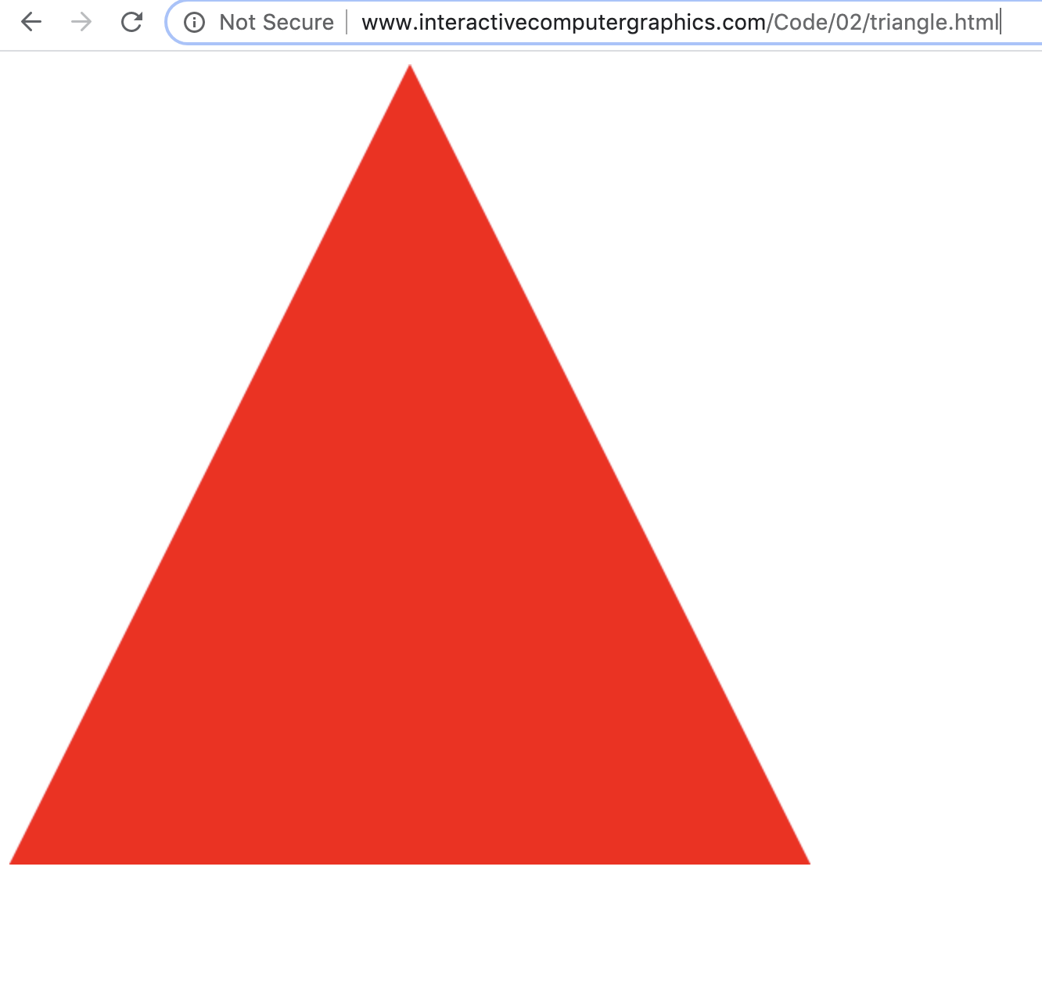
Example: triangle.html
Angel and Shreiner: Interactive Computer Graphics 8E ©Pearson Education 2020

Slide 5
Example Code: Vertex Shader
<html>
<script id="vertex-shader" type="x-shader/x-vertex">
#version 300 es
in vec4 aPosition;
void main()
{
gl_Position = aPosition;
}
</script>
Angel and Shreiner: Interactive Computer Graphics 8E ©Pearson Education 2020

Slide 6
HTML File:Fragment Shader
<script id="fragment-shader" type="x-shader/x-fragment">
#version 300 es
precision mediump float;
out vec4 fColor;
void main()
{
fColor = vec4( 1.0, 0.0, 0.0, 1.0 );
}
</script>
Angel and Shreiner: Interactive Computer Graphics 8E ©Pearson Education 2020

Slide 7
HTML File (cont)
<script type="text/javascript" src="../Common/initShaders.js"></script>
<script type="text/javascript" src="triangle.js"></script>
<canvas id="gl-canvas" width="512" height="512"> </canvas>
</html>
Angel and Shreiner: Interactive Computer Graphics 8E ©Pearson Education 2020

Slide 8
JS File
"use strict";
var gl;
var points;
window.onload = function init()
{
var canvas = document.getElementById( "gl-canvas" );
gl = canvas.getContext('webgl2');
if (!gl) { alert( "WebGL 2.0 isn't available" ); }
points = new Float32Array([
-1, -1 ,
0, 1 ,
1, -1]);
Angel and Shreiner: Interactive Computer Graphics 8E ©Pearson Education 2020

Slide 9
JS File (cont)
// Configure WebGL
//
gl.viewport( 0, 0, canvas.width, canvas.height );
gl.clearColor( 1.0, 1.0, 1.0, 1.0 );
// Load shaders and initialize attribute buffers
var program = initShaders( gl, "vertex-shader", "fragment-shader" );
gl.useProgram( program );
// Load the data into the GPU
var bufferId = gl.createBuffer();
gl.bindBuffer( gl.ARRAY_BUFFER, bufferId );
gl.bufferData( gl.ARRAY_BUFFER, points, gl.STATIC_DRAW );
Angel and Shreiner: Interactive Computer Graphics 8E ©Pearson Education 2020

Slide 10
JS File (cont)
// Associate out shader variables with our data buffer
var aPosition = gl.getAttribLocation( program, "aPosition" );
gl.vertexAttribPointer(aPosition, 2, gl.FLOAT, false, 0, 0 );
gl.enableVertexAttribArray(aPosition );
render();
};
function render() {
gl.clear( gl.COLOR_BUFFER_BIT );
gl.drawArrays( gl.TRIANGLES, 0, 3 );
}
Angel and Shreiner: Interactive Computer Graphics 8E ©Pearson Education 2020

Slide 11
Exercise
Run triangle.html from the class website
Load the triangle.html and triangle.js to your computer and run them from there
Edit the two files to change the color and display more than one triangle
Angel and Shreiner: Interactive Computer Graphics 8E ©Pearson Education 2020

Slide 12
WebGL 2.0 vs WebGL 1.0
For WebGL 1.0 version try triangle_v2.html at the same site
3 Differences
  WebGL uses an earlier version of GLSL which is the default
  attribute in vertex shader vs in variable
  gl_FragColor in fragment shader for output
Angel and Shreiner: Interactive Computer Graphics 8E ©Pearson Education 2020

Slide 13
JavaScript Notes
JavaScript (JS) is the language of the Web
  All browsers will execute JS code
  JavaScript is an interpreted object-oriented language
References
  Flanagan, JavaScript: The Definitive Guide, O’Reilly
  Crockford, JavaScript, The Good Parts, O’Reilly
  Many Web tutorials
Angel and Shreiner: Interactive Computer Graphics 8E ©Pearson Education 2020

Slide 14
JS Notes
Is JS slow?
  JS engines in browsers are getting much faster
  Not a key issues for graphics since once we get the data to the GPU it doesn’t matter how we got the data there
JS is a (too) big language
  We don’t need to use it all
  Choose parts we want to use
  Don’t try to make your code look like C or Java
Angel and Shreiner: Interactive Computer Graphics 8E ©Pearson Education 2020

Slide 15
JS Notes
Very few native types:
  numbers
  strings
  booleans
Only one numerical type: 32 bit float
  var x = 1;
  var x = 1.0; // same
  potential issue in loops
  two operators for equality == and ===
Dynamic typing
Angel and Shreiner: Interactive Computer Graphics 8E ©Pearson Education 2020

Slide 16
Scoping
Different from other languages
Function scope
variables are hoisted within a function
  can use a variable before it is declared
Note functions are first class objects in JS
Angel and Shreiner: Interactive Computer Graphics 8E ©Pearson Education 2020

Slide 17
JS Arrays
JS arrays are objects
  inherit methods
  var a = [1, 2, 3];
  is not the same as in C++ or Java
  a.length // 3
  a.push(4); // length now 4
  a.pop(); // 4
  avoids use of many loops and indexing
  Problem for WebGL which expects C-style arrays
Angel and Shreiner: Interactive Computer Graphics 8E ©Pearson Education 2020

Slide 18
Typed Arrays
JS has typed arrays that are like C arrays
var a = new Float32Array(3)
var b = new Uint8Array(3)
Generally, we prefer to work with standard JS arrays and convert to typed arrays only when we need to send data to the GPU with the flatten function in MV.js
Angel and Shreiner: Interactive Computer Graphics 8E ©Pearson Education 2020

Slide 19
A Minimalist Approach
We will use only core JS and HTML
  no extras or variants
No additional packages
  CSS
  JQuery
Focus on graphics
  examples may lack beauty
You are welcome to use other variants as long as I can run them from your URL
Angel and Shreiner: Interactive Computer Graphics 8E ©Pearson Education 2020

