Slide 1
Introduction to Computer Graphics with WebGL
Ed Angel
Professor Emeritus of Computer Science
Founding Director, Arts, Research, Technology and Science Laboratory
University of New Mexico
Angel and Shreiner: Interactive Computer Graphics 7E © Pearson Education 2020

Slide 2
What is Computer Graphics?
Computer graphics deals with all aspects of creating images with a computer
  Hardware
  Software
  Applications
Angel and Shreiner: Interactive Computer Graphics 7E © Pearson Education 2020

Slide 3

Example
Where did this image come from?
What hardware/software did we use to produce it?
Angel and Shreiner: Interactive Computer Graphics 7E © Pearson Education 2020

Slide 4
Preliminary Answer
Application: The object is an artist’s rendition of the sun for an animation to be shown in a domed environment (planetarium)
Software: Maya for modeling and rendering but Maya is built on top of OpenGL
Hardware: PC with graphics card for modeling and rendering
Angel and Shreiner: Interactive Computer Graphics 7E © Pearson Education 2020

Slide 5
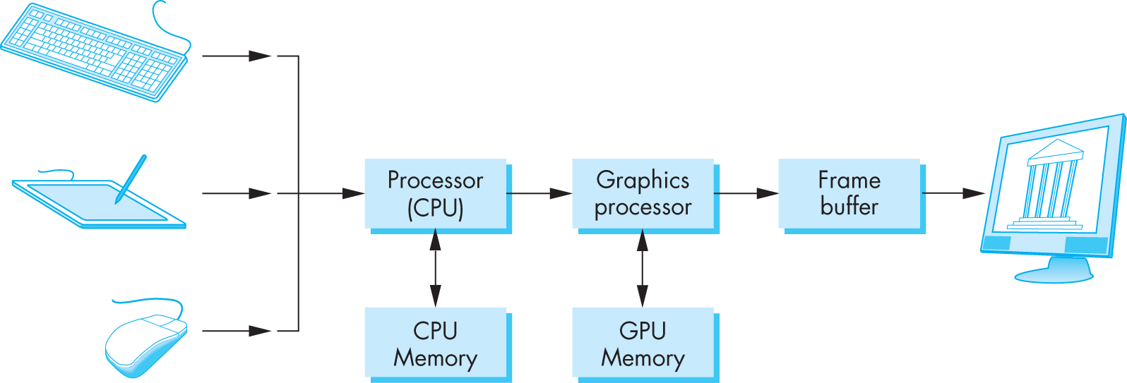
Basic Graphics System
Output device
Input devices
Image formed in frame buffer
Angel and Shreiner: Interactive Computer Graphics 7E © Pearson Education 2020

Slide 6
Computer Graphics: 1950-1960
Computer graphics goes back to the earliest days of computing
  Strip charts
  Pen plotters
  Simple displays using A/D converters to go from computer to calligraphic CRT
Cost of refresh for CRT too high
  Computers slow, expensive, unreliable
Angel and Shreiner: Interactive Computer Graphics 7E © Pearson Education 2020

Slide 7
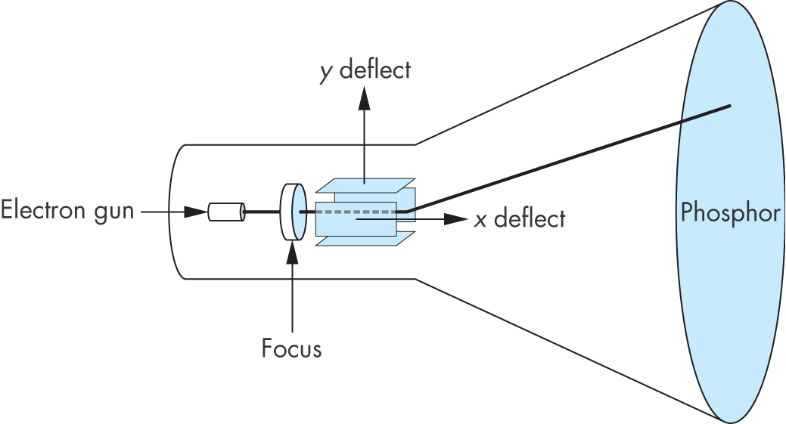
Cathode Ray Tube (CRT)
Can be used either as a line-drawing device (calligraphic) or to display contents of frame buffer (raster mode)
Angel and Shreiner: Interactive Computer Graphics 7E © Pearson Education 2020

Slide 8
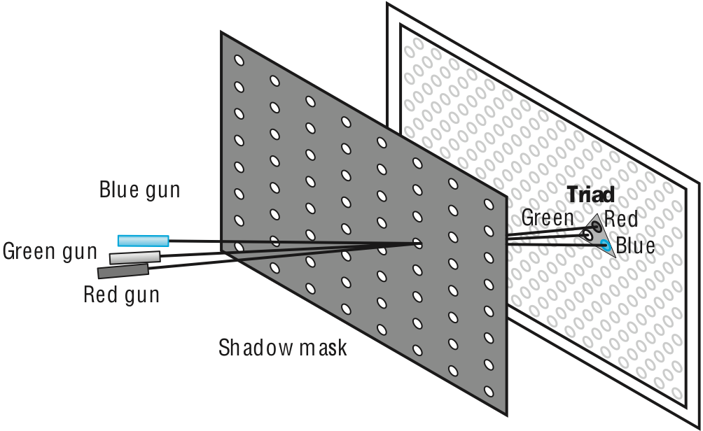
Shadow Mask CRT
Angel and Shreiner: Interactive Computer Graphics 7E © Pearson Education 2020

Slide 9
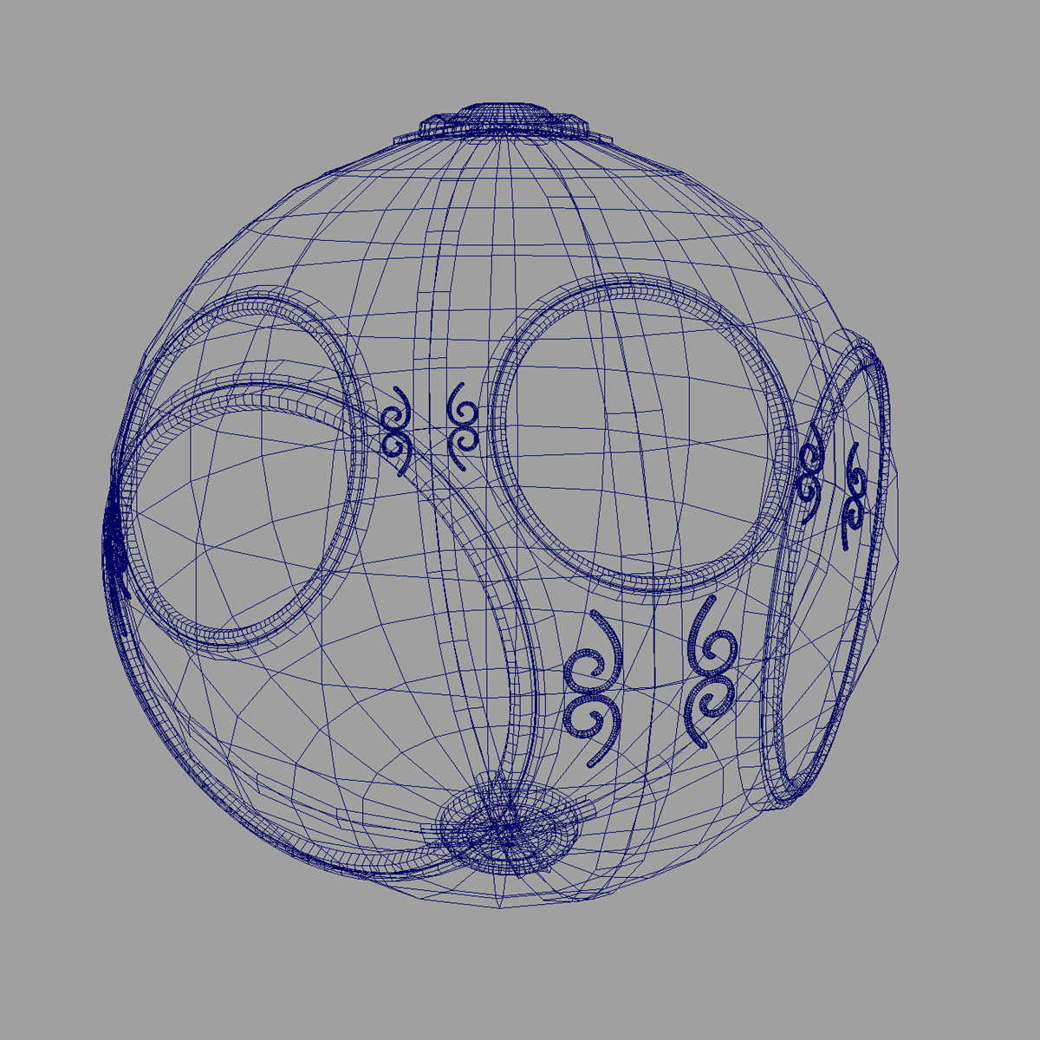
Computer Graphics: 1960-1970
Wireframe graphics
  Draw only lines
Sketchpad
Display Processors
Storage tube
wireframe representation
of sun object
Angel and Shreiner: Interactive Computer Graphics 7E © Pearson Education 2020

Slide 10
Sketchpad
Ivan Sutherland’s PhD thesis at MIT
  Recognized the potential of man-machine interaction
  Loop
    Display something
    User moves light pen
    Computer generates new display
  Sutherland also created many of the now common algorithms for computer graphics
Angel and Shreiner: Interactive Computer Graphics 7E © Pearson Education 2020

Slide 11
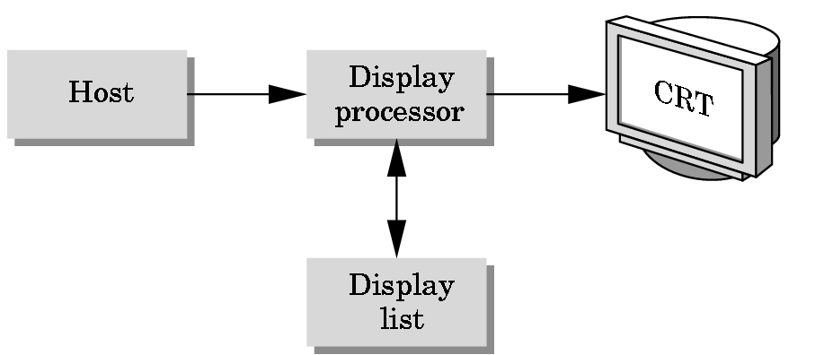
Display Processor
Rather than have the host computer try to refresh display use a special purpose computer called a display processor (DPU)
Graphics stored in display list (display file) on display processor
Host compiles display list and sends to DPU
Angel and Shreiner: Interactive Computer Graphics 7E © Pearson Education 2020

Slide 12
Computer Graphics: 1970-1980
Raster Graphics
Beginning of graphics standards
  IFIPS
    GKS: European effort
      Becomes ISO 2D standard
    Core: North American effort
      3D but fails to become ISO standard
Workstations and PCs
Angel and Shreiner: Interactive Computer Graphics 7E © Pearson Education 2020

Slide 13
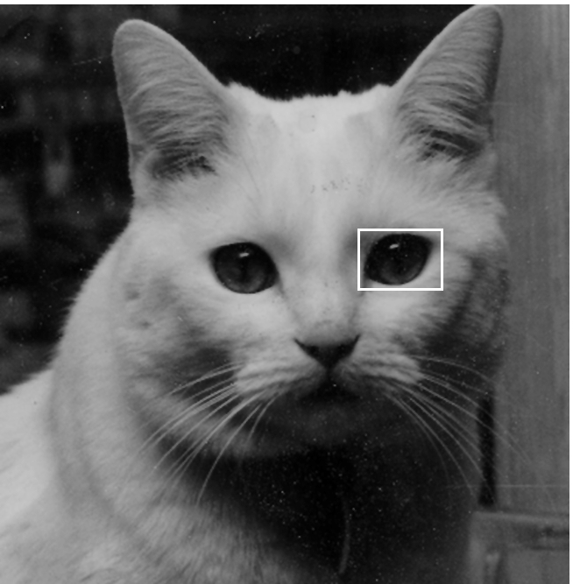
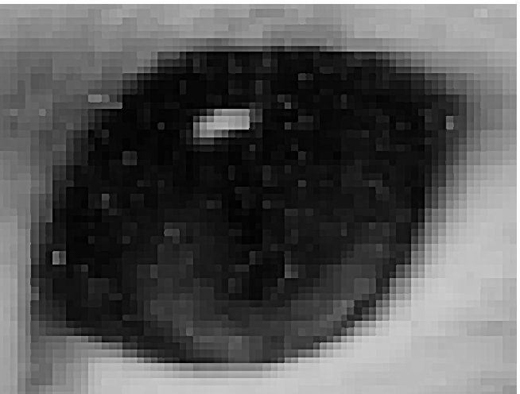
Raster Graphics
Image produced as an array (the raster) of picture elements (pixels) in the frame buffer
Angel and Shreiner: Interactive Computer Graphics 7E © Pearson Education 2020

Slide 14
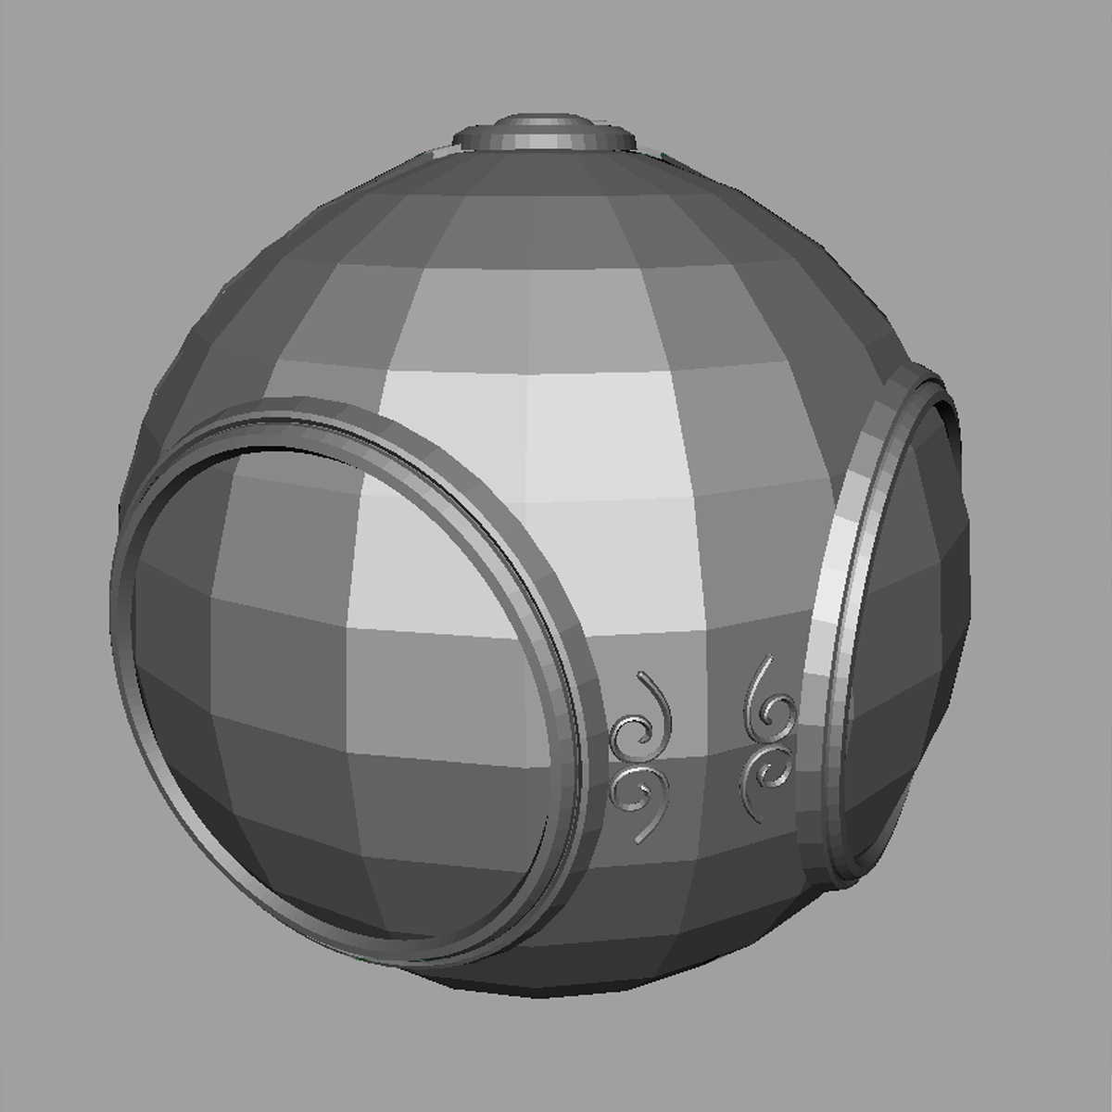
Raster Graphics
Allows us to go from lines and wire frame images to filled polygons
Angel and Shreiner: Interactive Computer Graphics 7E © Pearson Education 2020

Slide 15
PCs and Workstations
Although we no longer make the distinction between workstations and PCs, historically they evolved from different roots
  Early workstations characterized by
    Networked connection: client-server model
    High-level of interactivity
  Early PCs included frame buffer as part of user memory
    Easy to change contents and create images
Angel and Shreiner: Interactive Computer Graphics 7E © Pearson Education 2020

Slide 16



Computer Graphics: 1980-1990
Realism comes to computer graphics
smooth shading
environment
mapping
bump mapping
Angel and Shreiner: Interactive Computer Graphics 7E © Pearson Education 2020

Slide 17
Computer Graphics: 1980-1990
Special purpose hardware
  Silicon Graphics geometry engine
    VLSI implementation of graphics pipeline
Industry-based standards
  PHIGS
  RenderMan
Networked graphics: X Window System
Human-Computer Interface (HCI)
Angel and Shreiner: Interactive Computer Graphics 7E © Pearson Education 2020

Slide 18
Computer Graphics: 1990-2000
OpenGL API
Completely computer-generated feature-length movies (Toy Story) are successful
New hardware capabilities
  Texture mapping
  Blending
  Accumulation, stencil buffers
Angel and Shreiner: Interactive Computer Graphics 7E © Pearson Education 2020

Slide 19
Computer Graphics: 2000-2010
Photorealism
Graphics cards for PCs dominate market
  Nvidia, ATI
Game boxes and game players determine direction of market
Computer graphics routine in movie industry: Maya, Lightwave
Programmable pipelines
New display technologies
Angel and Shreiner: Interactive Computer Graphics 7E © Pearson Education 2020

Slide 20
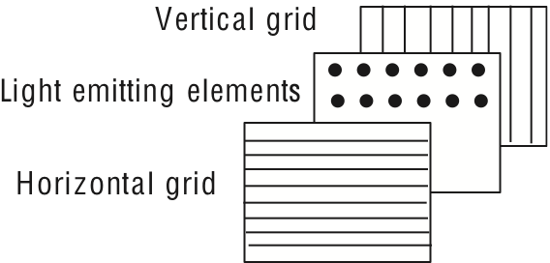
Generic Flat Panel Display
Angel and Shreiner: Interactive Computer Graphics 7E © Pearson Education 2020

Slide 21
Computer Graphics 2011-
Graphics is now ubiquitous
  Cell phones
  Embedded
OpenGL ES and WebGL
Alternate and Enhanced Reality
3D Movies and TV
Angel and Shreiner: Interactive Computer Graphics 7E © Pearson Education 2020

