Slide 1
Introduction to Computer Graphics with WebGL
Ed Angel
Professor Emeritus of Computer Science
Founding Director, Arts, Research, Technology and Science Laboratory
University of New Mexico
Angel and Shreiner: Interactive Computer Graphics 8E © APearson Education 2020

Slide 2
Hierarchical Modeling II
Ed Angel
Professor Emeritus of Computer Science
University of New Mexico
Angel and Shreiner: Interactive Computer Graphics 8E © APearson Education 2020

Slide 3
Objectives
Build a tree-structured model of a humanoid figure
Examine various traversal strategies
Build a generalized tree-model structure that is independent of the particular model
Angel and Shreiner: Interactive Computer Graphics 8E © APearson Education 2020

Slide 4
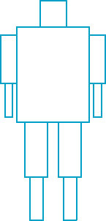
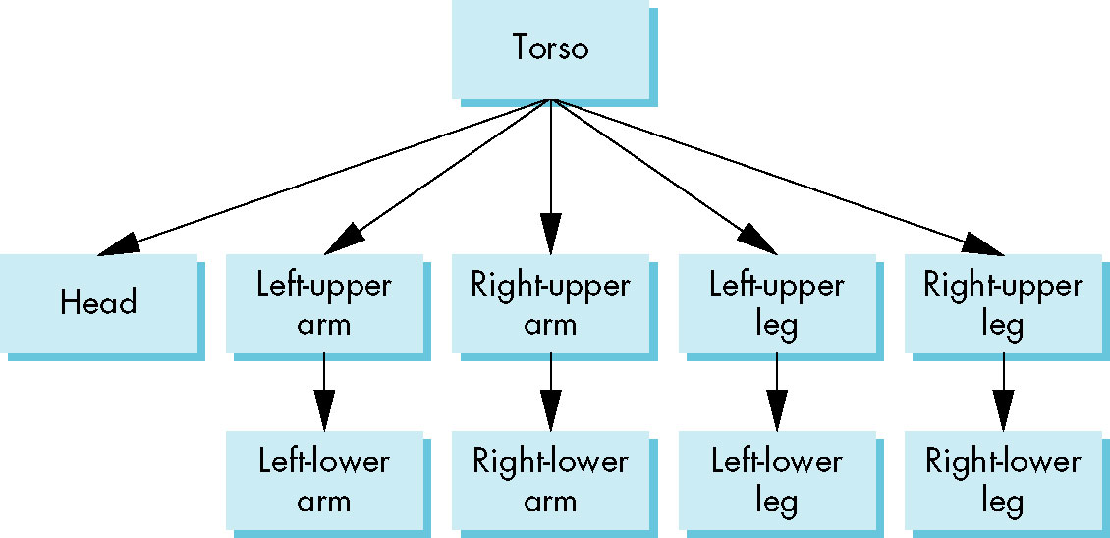
Humanoid Figure
Angel and Shreiner: Interactive Computer Graphics 8E © APearson Education 2020

Slide 5
Building the Model
Can build a simple implementation using quadrics: ellipsoids and cylinders
Access parts through functions
  torso()
  leftUpperArm()
Matrices describe position of node with respect to its parent
  M_{lla} positions left lower leg with respect to left upper arm
Angel and Shreiner: Interactive Computer Graphics 8E © APearson Education 2020

Slide 6
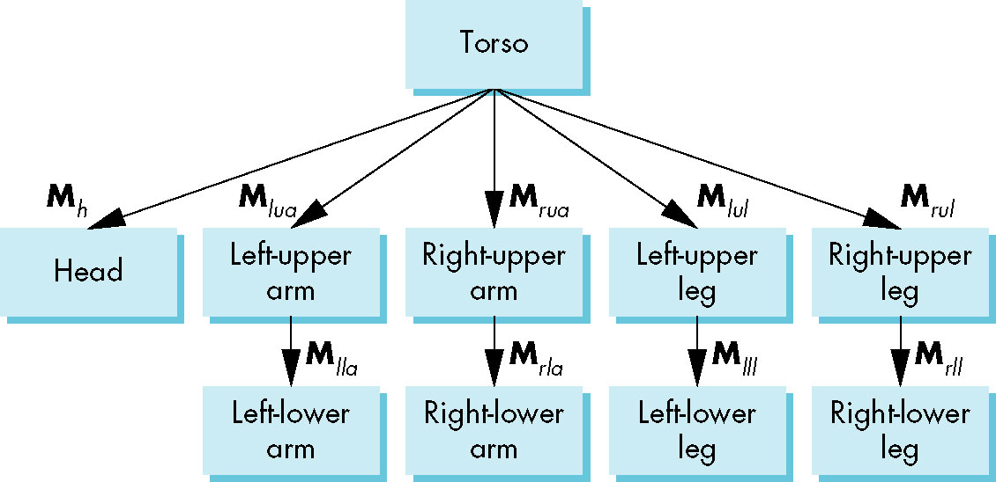
Tree with Matrices
Angel and Shreiner: Interactive Computer Graphics 8E © APearson Education 2020

Slide 7
Display and Traversal
The position of the figure is determined by 11 joint angles (two for the head and one for each other part)
Display of the tree requires a graph traversal
  Visit each node once
  Display function at each node that describes the part associated with the node, applying the correct transformation matrix for position and orientation
Angel and Shreiner: Interactive Computer Graphics 8E © APearson Education 2020

Slide 8
Transformation Matrices
There are 10 relevant matrices
  M positions and orients entire figure through the torso which is the root node
  M_{h} positions head with respect to torso
  M_{lua}, M_{rua}, M_{lul}, M_{rul} position arms and legs with respect to torso
  M_{lla}, M_{rla}, M_{lll}, M_{rll} position lower parts of limbs with respect to corresponding upper limbs
Angel and Shreiner: Interactive Computer Graphics 8E © APearson Education 2020

Slide 9
Stack-based Traversal
Set model-view matrix to M and draw torso
Set model-view matrix to MM_{h} and draw head
For left-upper arm need MM_{lua} and so on
Rather than recomputing MM_{lua} from scratch or using an inverse matrix, we can use the matrix stack to store M and other matrices as we traverse the tree
Angel and Shreiner: Interactive Computer Graphics 8E © APearson Education 2020

Slide 10
Traversal Code
figure() {
PushMatrix()
torso();
Rotate (…);
head();
PopMatrix();
PushMatrix();
Translate(…);
Rotate(…);
left_upper_arm();
PopMatrix();
PushMatrix();
save present model-view matrix
update model-view matrix for head
recover original model-view matrix
save it again
update model-view matrix
for left upper arm
recover and save original
model-view matrix again
rest of code
Angel and Shreiner: Interactive Computer Graphics 8E © APearson Education 2020

Slide 11
Analysis
The code describes a particular tree and a particular traversal strategy
  Can we develop a more general approach?
Note that the sample code does not include state changes, such as changes to colors
  May also want to push and pop other attributes to protect against unexpected state changes affecting later parts of the code
Angel and Shreiner: Interactive Computer Graphics 8E © APearson Education 2020

Slide 12
General Tree Data Structure
Need a data structure to represent tree and an algorithm to traverse the tree
We will use a left-child right sibling structure
  Uses linked lists
  Each node in data structure is two pointers
  Left: next node
  Right: linked list of children
Angel and Shreiner: Interactive Computer Graphics 8E © APearson Education 2020

Slide 13
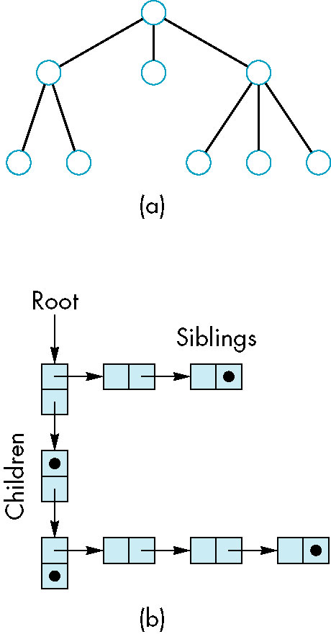
Left-Child Right-Sibling Tree
Angel and Shreiner: Interactive Computer Graphics 8E © APearson Education 2020

Slide 14
Tree node Structure
At each node we need to store
  Pointer to sibling
  Pointer to child
  Pointer to a function that draws the object represented by the node
  Homogeneous coordinate matrix to multiply on the right of the current model-view matrix
    Represents changes going from parent to node
    In WebGL this matrix is a 1D array storing matrix by columns
Angel and Shreiner: Interactive Computer Graphics 8E © APearson Education 2020

Slide 15
Creating a treenode
function createNode(transform,
render, sibling, child) {
var node = {
transform: transform,
render: render,
sibling: sibling,
child: child,
}
return node;
};
Angel and Shreiner: Interactive Computer Graphics 8E © APearson Education 2020

Slide 16
Initializing Nodes
function initNodes(Id) {
var m = mat4();
switch(Id) {
case torsoId:
m = rotate(theta[torsoId], 0, 1, 0 );
figure[torsoId] = createNode( m, torso, null, headId );
break;
case head1Id:
case head2Id:
m = translate(0.0, torsoHeight+0.5*headHeight, 0.0);
m = mult(m, rotate(theta[head1Id], 1, 0, 0))m = mult(m,
rotate(theta[head2Id], 0, 1, 0));
m = mult(m, translate(0.0, -0.5*headHeight, 0.0));
figure[headId] = createNode( m, head, leftUpperArmId, null);
break;
Angel and Shreiner: Interactive Computer Graphics 8E © APearson Education 2020

Slide 17
Notes
The position of figure is determined by 11 joint angles stored in theta[11]
Animate by changing the angles and redisplaying
We form the required matrices using rotate and translate
Because the matrix is formed using the model-view matrix, we may want to first push original model-view matrix on matrix stack
Angel and Shreiner: Interactive Computer Graphics 8E © APearson Education 2020

Slide 18
Preorder Traversal
function traverse(Id) {
if(Id == null) return;
stack.push(uModelViewMatrix);
uModelViewMatrix = mult(uModelViewMatrix, figure[Id].transform);
figure[Id].render();
if(figure[Id].child != null) traverse(figure[Id].child); uModelViewMatrix = stack.pop();
if(figure[Id].sibling != null) traverse(figure[Id].sibling);
}
var render = function() {
gl.clear( gl.COLOR_BUFFER_BIT );
traverse(torsoId);
requestAnimFrame(render);
}
Angel and Shreiner: Interactive Computer Graphics 8E © APearson Education 2020

Slide 19
Notes
We must save model-view matrix before multiplying it by node matrix
  Updated matrix applies to children of node but not to siblings which contain their own matrices
The traversal program applies to any left-child right-sibling tree
  The particular tree is encoded in the definition of the individual nodes
The order of traversal matters because of possible state changes in the functions
Angel and Shreiner: Interactive Computer Graphics 8E © APearson Education 2020

Slide 20
Dynamic Trees
Because we are using JS, the nodes and the node structure can be changed during execution
Definition of nodes and traversal are essentially the same as before but we can add and delete nodes during execution
In desktop OpenGL, if we use pointers, the structure can be dynamic
Angel and Shreiner: Interactive Computer Graphics 8E © APearson Education 2020

