Slide 1
Introduction to Computer Graphics with WebGL
Ed Angel
Professor Emeritus of Computer Science
Founding Director, Arts, Research, Technology and Science Laboratory
University of New Mexico
Angel and Shreiner: Interactive Computer Graphics 8E © Pearson Education 2020

Slide 2
Clipping
Ed Angel
Professor Emeritus of Computer Science
University of New Mexico
Angel and Shreiner: Interactive Computer Graphics 8E © Pearson Education 2020

Slide 3
Objectives
Clipping lines
First of implementation algorithms
Clipping polygons (next lecture)
Focus on pipeline plus a few classic algorithms
Angel and Shreiner: Interactive Computer Graphics 8E © Pearson Education 2020

Slide 4
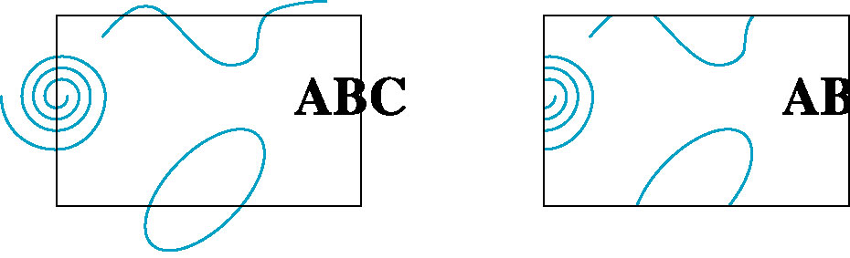
Clipping
2D against clipping window
3D against clipping volume
Easy for line segments polygons
Hard for curves and text
  Convert to lines and polygons first
Angel and Shreiner: Interactive Computer Graphics 8E © Pearson Education 2020

Slide 5
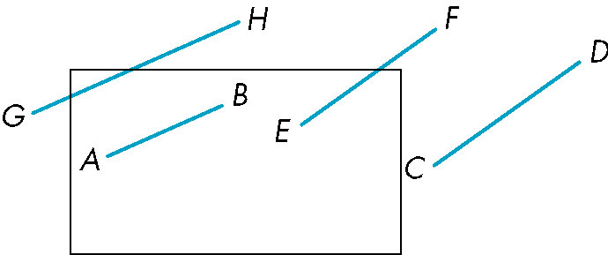
Clipping 2D Line Segments
Brute force approach: compute intersections with all sides of clipping window
  Inefficient: one division per intersection
Angel and Shreiner: Interactive Computer Graphics 8E © Pearson Education 2020

Slide 6
Cohen-Sutherland Algorithm
Idea: eliminate as many cases as possible without computing intersections
Start with four lines that determine the sides of the clipping window
y = y_{max}
x = x_{min}
x = x_{max}
y = y_{min}
Angel and Shreiner: Interactive Computer Graphics 8E © Pearson Education 2020

Slide 7
The Cases
Case 1: both endpoints of line segment inside all four lines
  Draw (accept) line segment as is
Case 2: both endpoints outside all lines and on same side of a line
  Discard (reject) the line segment
y = y_{max}
x = x_{min}
x = x_{max}
y = y_{min}
Angel and Shreiner: Interactive Computer Graphics 8E © Pearson Education 2020

Slide 8
The Cases
Case 3: One endpoint inside, one outside
  Must do at least one intersection
Case 4: Both outside
  May have part inside
  Must do at least one intersection
y = y_{max}
x = x_{min}
x = x_{max}
Angel and Shreiner: Interactive Computer Graphics 8E © Pearson Education 2020

Slide 9
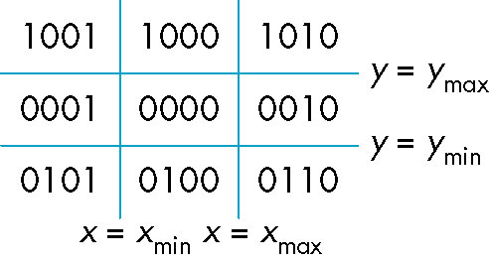
Defining Outcodes
For each endpoint, define an outcode
Outcodes divide space into 9 regions
Computation of outcode requires at most 4 subtractions
b₀b₁b₂b₃
b₀ = 1 if y > y_{max}, 0 otherwise
b₁ = 1 if y < y_{min}, 0 otherwise
b₂ = 1 if x > x_{max}, 0 otherwise
b₃ = 1 if x < x_{min}, 0 otherwise
Angel and Shreiner: Interactive Computer Graphics 8E © Pearson Education 2020

Slide 10
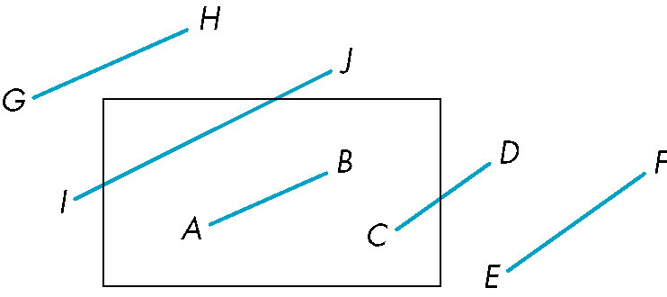
Using Outcodes
Consider the 5 cases below
AB: outcode(A) = outcode(B) = 0
  Accept line segment
Angel and Shreiner: Interactive Computer Graphics 8E © Pearson Education 2020

Slide 11
Using Outcodes
CD: outcode (C) = 0, outcode(D) ≠ 0
  Compute intersection
  Location of 1 in outcode(D) determines which edge to intersect with
  Note if there were a segment from A to a point in a region with 2 ones in outcode, we might have to do two interesections
Angel and Shreiner: Interactive Computer Graphics 8E © Pearson Education 2020

Slide 12
Using Outcodes
EF: outcode(E) logically ANDed with outcode(F) (bitwise) ≠ 0
  Both outcodes have a 1 bit in the same place
  Line segment is outside of corresponding side of clipping window
  reject
Angel and Shreiner: Interactive Computer Graphics 8E © Pearson Education 2020

Slide 13
Using Outcodes
GH and IJ: same outcodes, neither zero but logical AND yields zero
Shorten line segment by intersecting with one of sides of window
Compute outcode of intersection (new endpoint of shortened line segment)
Reexecute algorithm
Angel and Shreiner: Interactive Computer Graphics 8E © Pearson Education 2020

Slide 14
Efficiency
In many applications, the clipping window is small relative to the size of the entire data base
  Most line segments are outside one or more side of the window and can be eliminated based on their outcodes
Inefficiency when code has to be reexecuted for line segments that must be shortened in more than one step
Angel and Shreiner: Interactive Computer Graphics 8E © Pearson Education 2020

Slide 15
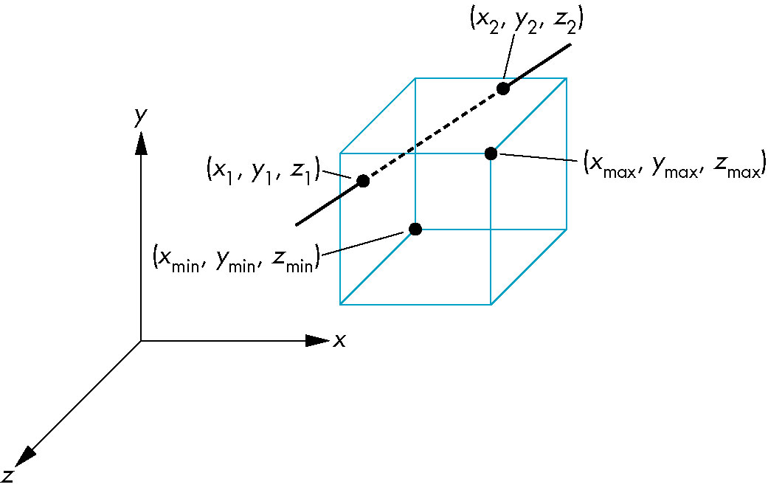
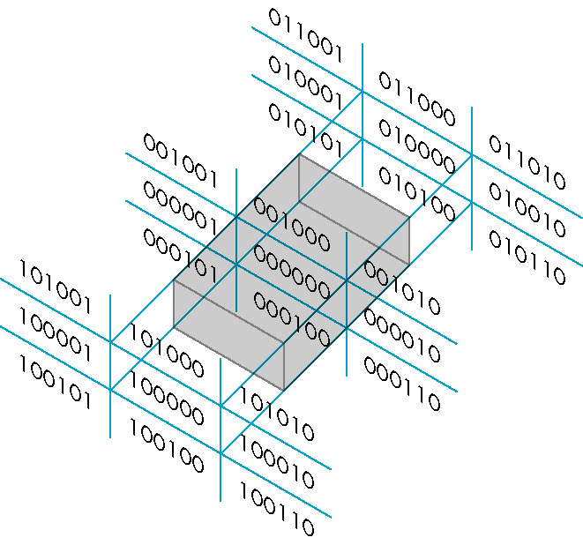
Cohen Sutherland in 3D
Use 6-bit outcodes
When needed, clip line segment against planes
Angel and Shreiner: Interactive Computer Graphics 8E © Pearson Education 2020

Slide 16
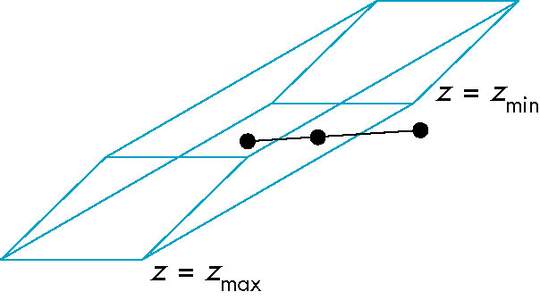
Clipping and Normalization
General clipping in 3D requires intersection of line segments against arbitrary plane
Example: oblique view
Angel and Shreiner: Interactive Computer Graphics 8E © Pearson Education 2020

Slide 17
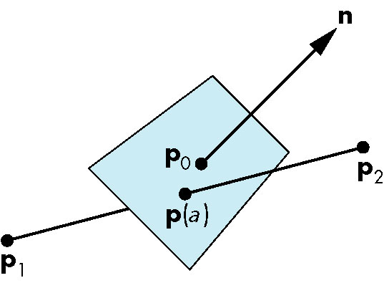
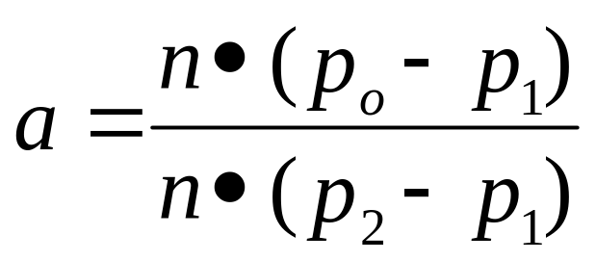
Plane-Line Intersections
Angel and Shreiner: Interactive Computer Graphics 8E © Pearson Education 2020

Slide 18
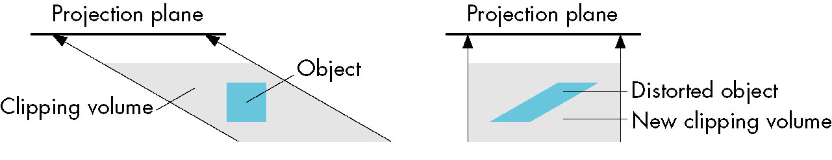
Normalized Form
top view
before normalization
after normalization
Normalization is part of viewing (pre clipping)
but after normalization, we clip against sides of
right parallelepiped
Typical intersection calculation now requires only
a floating point subtraction, e.g. is x > x_{max} ?
Angel and Shreiner: Interactive Computer Graphics 8E © Pearson Education 2020

