Slide 1
Introduction to Computer Graphics with WebGL
Ed Angel
Professor Emeritus of Computer Science
Founding Director, Arts, Research, Technology and Science Laboratory
University of New Mexico
E. Angel and D. Shreiner: Interactive Computer Graphics 7E © Pearson Education 2020

Slide 2
Rasterization
Ed Angel
Professor Emeritus of Computer Science
University of New Mexico
E. Angel and D. Shreiner: Interactive Computer Graphics 7E © Pearson Education 2020

Slide 3
Objectives
Survey Line Drawing Algorithms
  DDA
  Bresenham’s Algorithm
Aliasing and Antialiasing
E. Angel and D. Shreiner: Interactive Computer Graphics 7E © Pearson Education 2020

Slide 4
Rasterization
Rasterization (scan conversion)
  Determine which pixels that are inside primitive specified by a set of vertices
  Produces a set of fragments
  Fragments have a location (pixel location) and other attributes such color and texture coordinates that are determined by interpolating values at vertices
Pixel colors determined later using color, texture, and other vertex properties
E. Angel and D. Shreiner: Interactive Computer Graphics 7E © Pearson Education 2020

Slide 5
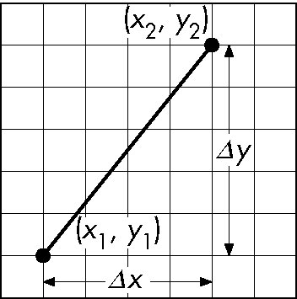
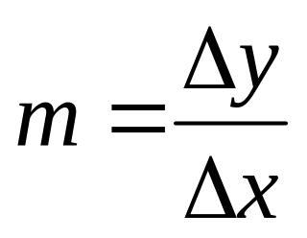
Scan Conversion of Line Segments
Start with line segment in window coordinates with integer values for endpoints
Assume implementation has a write_pixel function
y = mx + h
E. Angel and D. Shreiner: Interactive Computer Graphics 7E © Pearson Education 2020

Slide 6
DDA Algorithm
Digital Differential Analyzer
  DDA was a mechanical device for numerical solution of differential equations
  Line y=mx+ h satisfies differential equation
  dy/dx = m = Δy/Δx = y₂-y₁/x₂-x₁
Along scan line Δx = 1
for(x=x1; x<=x2,ix++) {
y+=m;
write_pixel(x, round(y), line_color)
}
E. Angel and D. Shreiner: Interactive Computer Graphics 7E © Pearson Education 2020

Slide 7
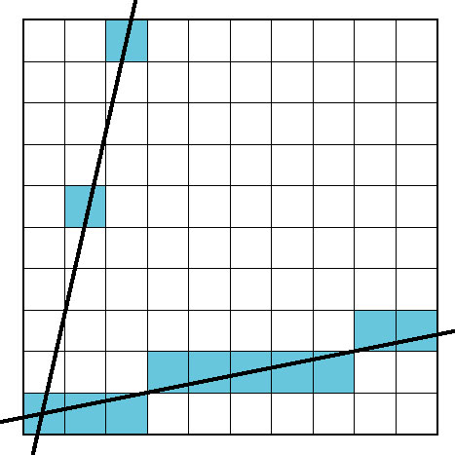
Problem
DDA = for each x plot pixel at closest y
  Problems for steep lines
E. Angel and D. Shreiner: Interactive Computer Graphics 7E © Pearson Education 2020

Slide 8
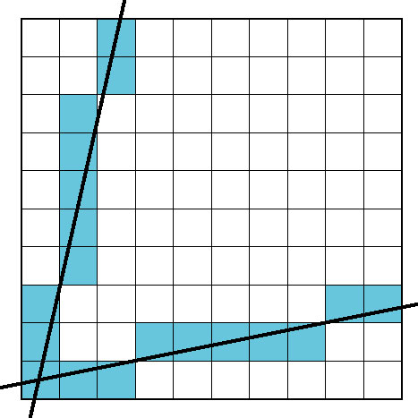
Using Symmetry
Use for 1 ≥ m ≥ 0
For m > 1, swap role of x and y
  For each y, plot closest x
E. Angel and D. Shreiner: Interactive Computer Graphics 7E © Pearson Education 2020

Slide 9
Bresenham’s Algorithm
DDA requires one floating point addition per step
We can eliminate all fp through Bresenham’s algorithm
Consider only 1 ≥ m ≥ 0
  Other cases by symmetry
Assume pixel centers are at half integers
If we start at a pixel that has been written, there are only two candidates for the next pixel to be written into the frame buffer
E. Angel and D. Shreiner: Interactive Computer Graphics 7E © Pearson Education 2020

Slide 10
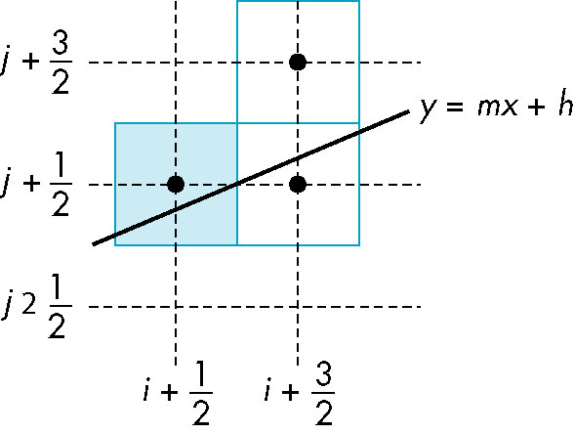
Candidate Pixels
1 ≥ m ≥ 0
candidates
last pixel
Note that line could have
passed through any
part of this pixel
E. Angel and D. Shreiner: Interactive Computer Graphics 7E © Pearson Education 2020

Slide 11
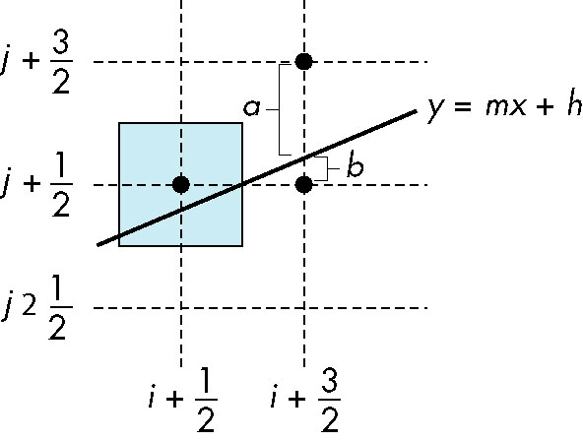
Decision Variable
d = Δx(b-a)
d is an integer
d > 0 use upper pixel
d < 0 use lower pixel
-
E. Angel and D. Shreiner: Interactive Computer Graphics 7E © Pearson Education 2020

Slide 12
Incremental Form
More efficient if we look at d_{k}, the value of the decision variable at x = k
d_{k+1}= d_{k} –2Δy, if d_{k} <0
d_{k+1}= d_{k} –2(Δy- Δx), otherwise
For each x, we need do only an integer
addition and a test
Single instruction on graphics chips
E. Angel and D. Shreiner: Interactive Computer Graphics 7E © Pearson Education 2020

Slide 13

Polygon Scan Conversion
Scan Conversion = Fill
How to tell inside from outside
  Convex easy
  Nonsimple difficult
  Odd even test
    Count edge crossings
  Winding number
odd-even fill
E. Angel and D. Shreiner: Interactive Computer Graphics 7E © Pearson Education 2020

Slide 14
Winding Number
Count clockwise encirclements of point
Alternate definition of inside: inside if winding number ≠ 0
winding number = 1
winding number = 2
E. Angel and D. Shreiner: Interactive Computer Graphics 7E © Pearson Education 2020

Slide 15
Filling in the Frame Buffer
Fill at end of pipeline
  Convex Polygons only
  Nonconvex polygons assumed to have been tessellated
  Shades (colors) have been computed for vertices (Gouraud shading)
  Combine with z-buffer algorithm
    March across scan lines interpolating shades
    Incremental work small
E. Angel and D. Shreiner: Interactive Computer Graphics 7E © Pearson Education 2020

Slide 16
Using Interpolation
C₁ C₂ C₃ specified by glColor or by vertex shading
C₄ determined by interpolating between C₁ and C₂
C₅ determined by interpolating between C₂ and C₃
interpolate between C₄ and C₅ along span
C₁
C₄
C₂
scan line
C₅
span
C₃
E. Angel and D. Shreiner: Interactive Computer Graphics 7E © Pearson Education 2020

Slide 17
Flood Fill
Fill can be done recursively if we know a seed point located inside (WHITE)
Scan convert edges into buffer in edge/inside color (BLACK)
flood_fill(int x, int y) {
if(read_pixel(x,y)= = WHITE) {
write_pixel(x,y,BLACK);
flood_fill(x-1, y);
flood_fill(x+1, y);
flood_fill(x, y+1);
flood_fill(x, y-1);
} }
E. Angel and D. Shreiner: Interactive Computer Graphics 7E © Pearson Education 2020

Slide 18
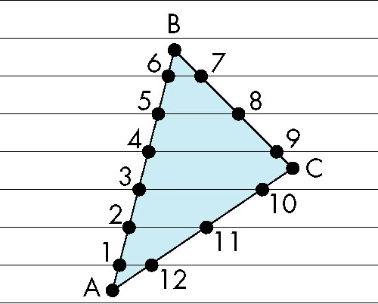
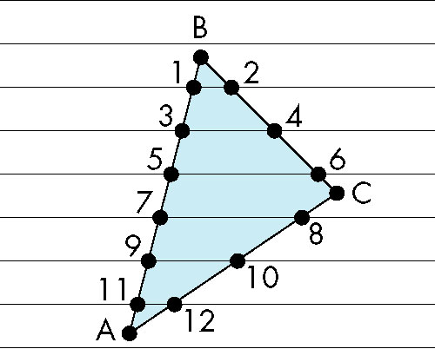
Scan Line Fill
Can also fill by maintaining a data structure of all intersections of polygons with scan lines
  Sort by scan line
  Fill each span
vertex order generated
by vertex list
desired order
E. Angel and D. Shreiner: Interactive Computer Graphics 7E © Pearson Education 2020

Slide 19
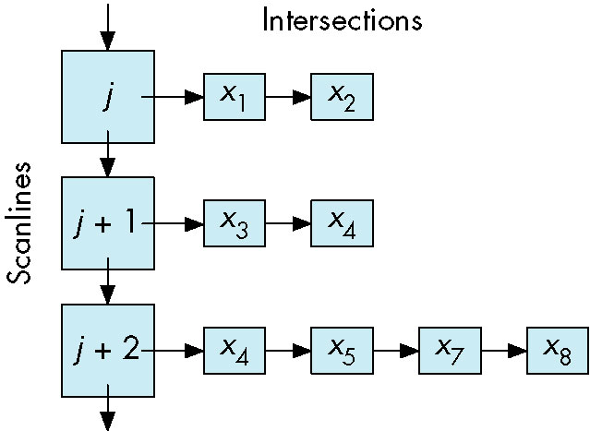
Data Structure
E. Angel and D. Shreiner: Interactive Computer Graphics 7E © Pearson Education 2020

Slide 20
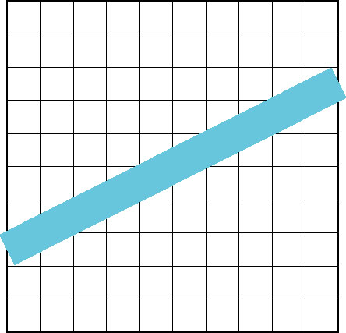
Aliasing
Ideal rasterized line should be 1 pixel wide
Choosing best y for each x (or visa versa) produces aliased raster lines
E. Angel and D. Shreiner: Interactive Computer Graphics 7E © Pearson Education 2020

Slide 21
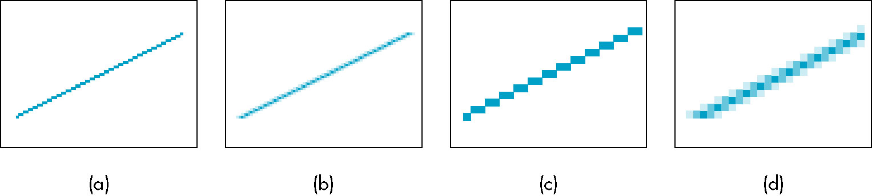
Antialiasing by Area Averaging
Color multiple pixels for each x depending on coverage by ideal line
original
antialiased
magnified
E. Angel and D. Shreiner: Interactive Computer Graphics 7E © Pearson Education 2020

Slide 22
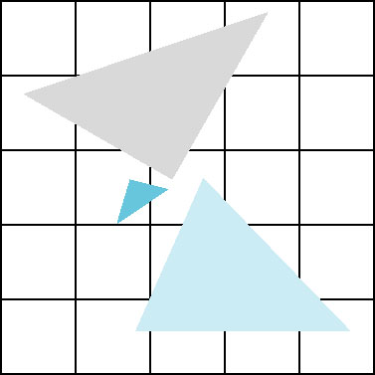
Polygon Aliasing
Aliasing problems can be serious for polygons
  Jaggedness of edges
  Small polygons neglected
  Need compositing so color
  of one polygon does not
  totally determine color of
  pixel
All three polygons should contribute to color
E. Angel and D. Shreiner: Interactive Computer Graphics 7E © Pearson Education 2020

