Slide 1
Introduction to Computer Graphics with WebGL
Ed Angel
Professor Emeritus of Computer Science
Founding Director, Arts, Research, Technology and Science Laboratory
University of New Mexico
Angel and Shreiner: Interactive Computer Graphics 8E © Pearson Education 2020

Slide 2
Display Issues
Ed Angel
Professor Emeritus of Computer Science
University of New Mexico
Angel and Shreiner: Interactive Computer Graphics 8E © Pearson Education 2020

Slide 3
Objectives
Consider perceptual issues related to displays
Introduce chromaticity space
  Color systems
  Color transformations
Standard Color Systems
Angel and Shreiner: Interactive Computer Graphics 8E © Pearson Education 2020

Slide 4
No Display Can Be Perfect
An analog display device such as a CRT takes digital input (pixels) and outputs a small spot of color
A Digital display such as a LCD display outputs discrete spots
The eye merges (filters) these spots
Sampling theory shows this process cannot be done perfectly
Angel and Shreiner: Interactive Computer Graphics 8E © Pearson Education 2020

Slide 5
Perception Review
Light is the part of the electromagnetic spectrum between ~350-750 nm
A color C(λ) is a distribution of energies within this range
The human visual system has three types of cones on the retina, each with its own spectral sensitivity
Consequently, only three values, the tristimulus values, are “seen” by the brain
Angel and Shreiner: Interactive Computer Graphics 8E © Pearson Education 2020

Slide 6
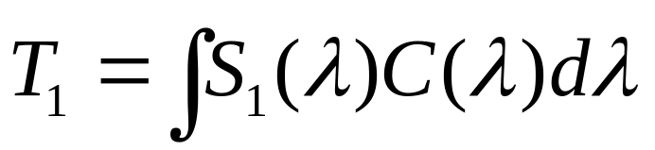
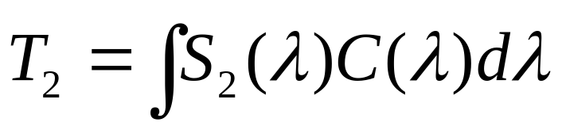
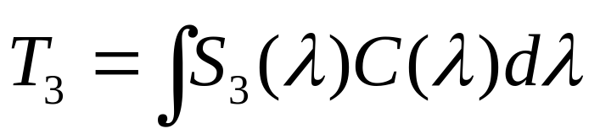
Tristimulus Values
The human visual center has three cones with sensitivity curves S₁(λ), S₂(λ), and S₃(λ)
For a color C(λ), the cones output the tristimulus values
C(λ)
optic nerve
T₁, T₂, T₃
cones
Angel and Shreiner: Interactive Computer Graphics 8E © Pearson Education 2020

Slide 7
Three Color Theory
Any two colors with the same tristimulus values are perceived to be identical
Thus a display (CRT, LCD, film) must only produce the correct tristimulus values to match a color
Is this possible? Not always
  Different primaries (different sensitivity curves) in different systems
Angel and Shreiner: Interactive Computer Graphics 8E © Pearson Education 2020

Slide 8
The Problem
The sensitivity curves of the human are not the same as those of physical devices
Human: curves centered in blue, green, and green-yellow
CRT: RGB
Print media: CMY or CMYK
Which colors can we match and, if we cannot match, how close can we come?
Angel and Shreiner: Interactive Computer Graphics 8E © Pearson Education 2020

Slide 9
Representing Colors
Consider a color C(λ)
It generates tristimulus values T₁, T₂, T₃
  Write C = (T₁, T₂, T₃ )
  Conventionally,we assume 1≥ T₁, T₂, T₃ ≥ 0 because there is a maximum brightness we can produce and energy is nonnegative
  C is a point in color solid
1
C
T₂
T₁
T₃
1
1
Angel and Shreiner: Interactive Computer Graphics 8E © Pearson Education 2020

Slide 10
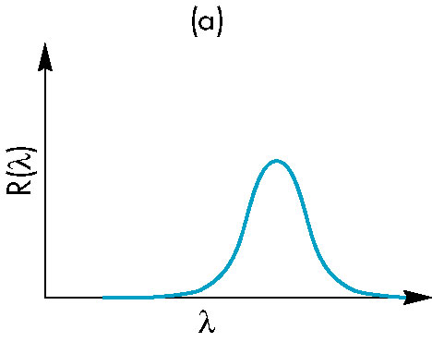
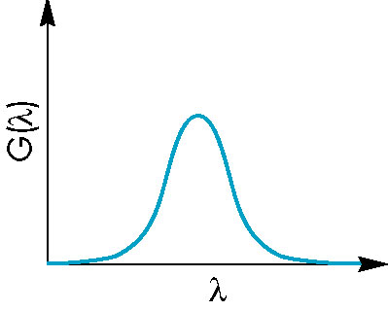
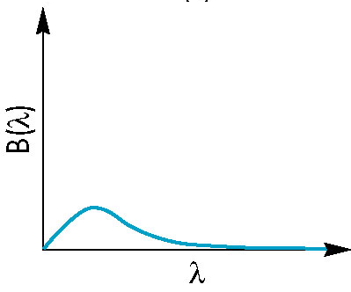
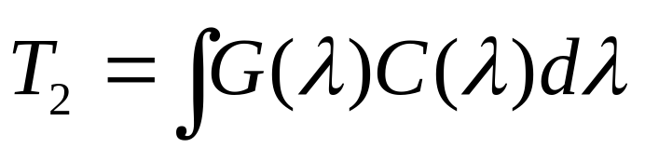
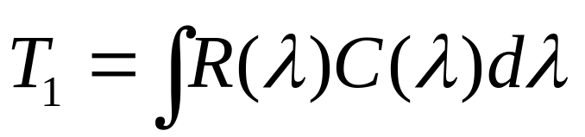
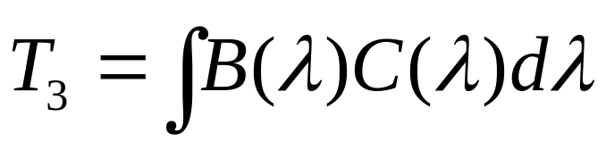
Producing Colors
Consider a device such as a CRT with RGB primaries and sensitivity curves
Tristimulus values
Angel and Shreiner: Interactive Computer Graphics 8E © Pearson Education 2020

Slide 11
Matching
This T₁, T₂, T₃ is dependent on the particular device
If we use another device, we will get different values and these values will not match those of the human cone curves
Need a way of matching and a way of normalizing
Angel and Shreiner: Interactive Computer Graphics 8E © Pearson Education 2020

Slide 12
Color Systems
Various color systems are used
  Based on real primaries:
    NTSC RGB
    UVW
    CMYK
    HLS
  Theoretical
    XYZ
Prefer to separate brightness (luminance) from color (chromatic) information
  Reduce to two dimensions
Angel and Shreiner: Interactive Computer Graphics 8E © Pearson Education 2020

Slide 13
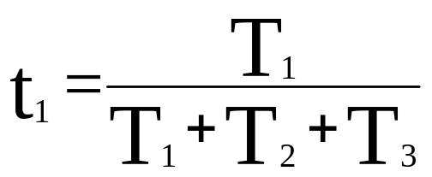
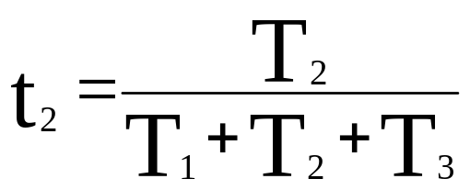
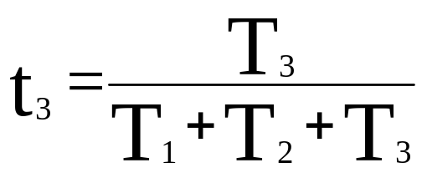
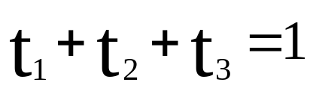
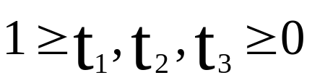
Tristimulus Coordinates
For any set of primaries, define
Note
Angel and Shreiner: Interactive Computer Graphics 8E © Pearson Education 2020

Slide 14
Maxwell Triangle
1
color solid
T₁ + T₂+T₃ =1
1
1
Project onto 2D: chromaticity space
1
t₁ + t₂ =1
t₁
possible colors
t₂
1
Angel and Shreiner: Interactive Computer Graphics 8E © Pearson Education 2020

Slide 15
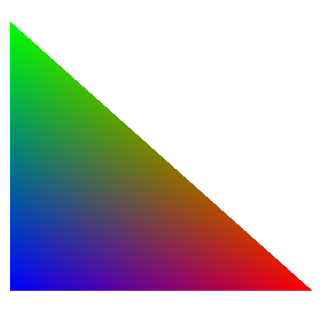
NTSC RGB
r+g+b=1
1
g
r+g=1
r
1
Angel and Shreiner: Interactive Computer Graphics 8E © Pearson Education 2020

Slide 16
Producing Other Colors
However colors producible on one system (its color gamut) is not necessarily producible on any other
Not that if we produce all the pure spectral colors in the 350-750 nm range, we can produce all others by adding spectral colors
With real systems (CRT, film), we cannot produce the pure spectral colors
We can project the color solid of each system into chromaticity space (of some system) to see how close we can get
Angel and Shreiner: Interactive Computer Graphics 8E © Pearson Education 2020

Slide 17
Color Gamuts
600 nm
spectral colors
printer colors
producible color on
CRT but not on printer
CRT colors
unproducible
color
750 nm
producible color on
both CRT and printer
350 nm
Angel and Shreiner: Interactive Computer Graphics 8E © Pearson Education 2020

Slide 18
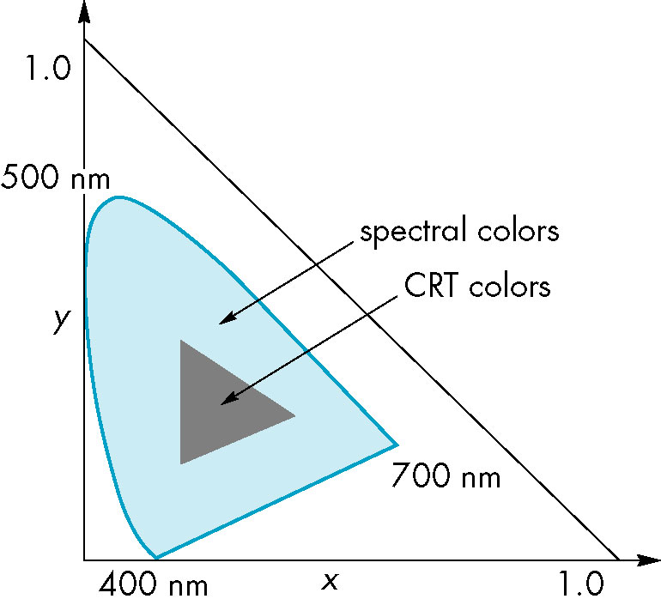
XYZ
Reference system in which all visible pure spectral colors can be produced
Theoretical systems as
there are no corresponding
physical primaries
Standard reference system
Angel and Shreiner: Interactive Computer Graphics 8E © Pearson Education 2020

Slide 19
Color Systems
Most correspond to real primaries
  National Television Systems Committee (NTSC) RGB matches phosphors in CRTs
Film both additive (RGB) and subtractive (CMY) for positive and negative film
Print industry CMYK (K = black)
  K used to produce sharp crisp blacks
  Example: ink jet printers
Angel and Shreiner: Interactive Computer Graphics 8E © Pearson Education 2020

Slide 20
Color Transformations
Each additive color system is a linear transformation of another
G’
G
C = (T₁, T₂, T₃) = (T’₁, T’₂, T’₃)
R’
in R’G’B’system
B
R
B’
in RGB system
Angel and Shreiner: Interactive Computer Graphics 8E © Pearson Education 2020

Slide 21
RGB, CMY, CMYK
Assuming 1 is max of a primary
C = 1 – R
M = 1 – G
Y = 1 – B
Convert CMY to CMYK by
K = min(C, M, Y)
C’ = C – K
M’ = M – K
Y’ = Y - K
Angel and Shreiner: Interactive Computer Graphics 8E © Pearson Education 2020

Slide 22
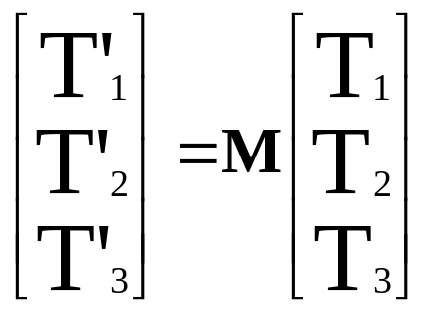
Color Matrix
Exists a 3 x 3 matrix to convert from representation in one system to representation in another
Example: XYZ to NTSC RGB
  find in colorimetry references
Can take a color in XYZ and find out if it is producible by transforming and then checking if resulting tristimulus values lie in (0,1)
Angel and Shreiner: Interactive Computer Graphics 8E © Pearson Education 2020

Slide 23
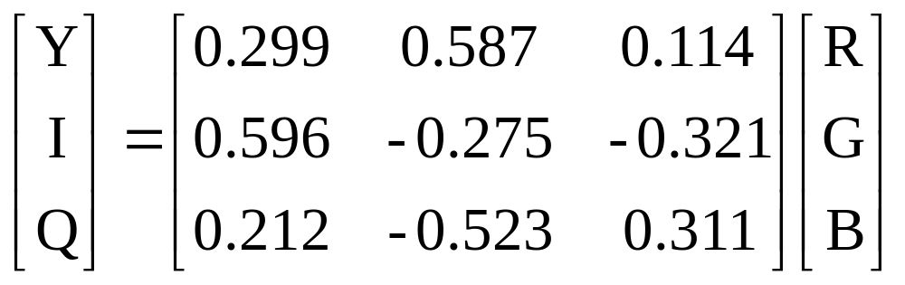
YIQ
NTSC Transmission Colors
Here Y is the luminance
  Arose from need to separate brightness from chromatic information in TV broadcasting
Note luminance shows high green sensitivity
Angel and Shreiner: Interactive Computer Graphics 8E © Pearson Education 2020

Slide 24
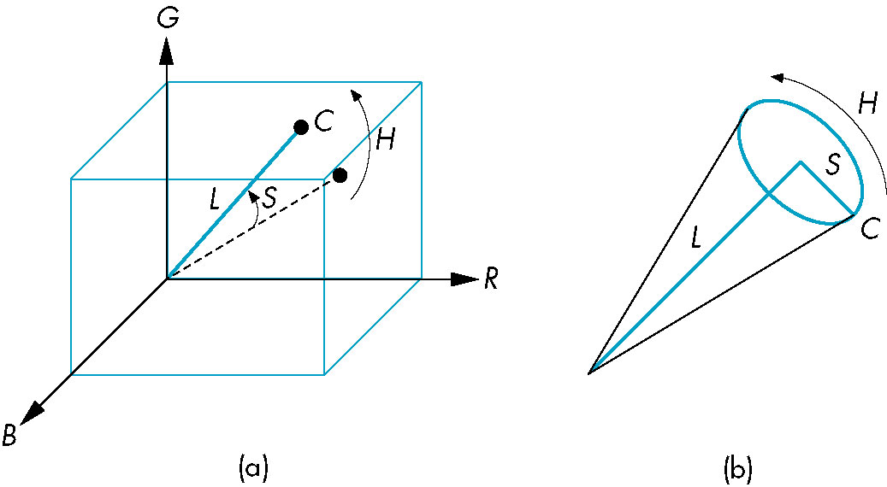
Other Color Systems
UVW: equal numerical errors are closer to equal perceptual errors
HLS: perceptual color (hue, saturation, lightness)
  Polar representation of color space
  Single and double cone versions
Angel and Shreiner: Interactive Computer Graphics 8E © Pearson Education 2020

Slide 25
Gamma
Intensity vs CRT voltage is nonlinear
  I = cV^{γ}
Can use a lookup table to correct
Human brightness response is logarithmic
  Equal steps in gray levels are not perceived equally
  Can use lookup table
CRTs cannot produce a full black
  Limits contrast ratio
Angel and Shreiner: Interactive Computer Graphics 8E © Pearson Education 2020

Slide 26
sRGB
Standard for Internet
Adjust colors to match standard gamma of panels
  match gamma over most of the range
  enhance less bright colors
OpenGL (soon WebGL?) can input sRGB and convert to RGB for processing and then back to sRGB
Angel and Shreiner: Interactive Computer Graphics 8E © Pearson Education 2020

