Slide 1
Introduction to Computer Graphics with WebGL
Ed Angel
Professor Emeritus of Computer Science
Founding Director, Arts, Research, Technology and Science Laboratory
University of New Mexico
Angel and Shreiner: Interactive Computer Graphics 8E © Pearson Educaion 2020

Slide 2
Rendering the Teapot
Ed Angel
Professor Emeritus of Computer Science
University of New Mexico
Angel and Shreiner: Interactive Computer Graphics 8E © Pearson Educaion 2020

Slide 3
Objectives
Look at rendering with WebGL
Use Utah teapot for examples
  Recursive subdivision
  Polynomial evaluation
  Adding lighting
Angel and Shreiner: Interactive Computer Graphics 8E © Pearson Educaion 2020

Slide 4
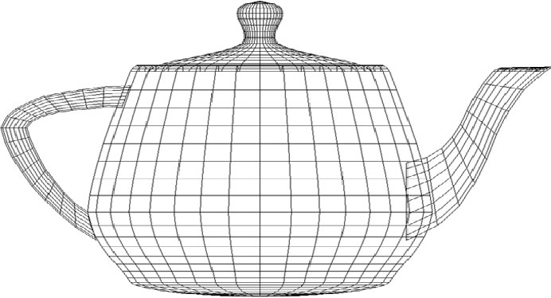
Utah Teapot
Most famous data set in computer graphics
Widely available as a list of 306 3D vertices and the indices that define 32 Bezier patches
Angel and Shreiner: Interactive Computer Graphics 8E © Pearson Educaion 2020

Slide 5
vertices.js
var numTeapotVertices = 306;
var vertices = [
vec3(1.4 , 0.0 , 2.4),
vec3(1.4 , -0.784 , 2.4),
vec3(0.784 , -1.4 , 2.4),
vec3(0.0 , -1.4 , 2.4),
vec3(1.3375 , 0.0 , 2.53125),
.
.
.
];
Angel and Shreiner: Interactive Computer Graphics 8E © Pearson Educaion 2020

Slide 6
patches.js
var numTeapotPatches = 32;
var indices = new Array(numTeapotPatches);
indices[0] = [0, 1, 2, 3,
4, 5, 6, 7,
8, 9, 10, 11,
12, 13, 14, 15
];
indices[1] = [3, 16, 17, 18,
.
.
];
Angel and Shreiner: Interactive Computer Graphics 8E © Pearson Educaion 2020

Slide 7
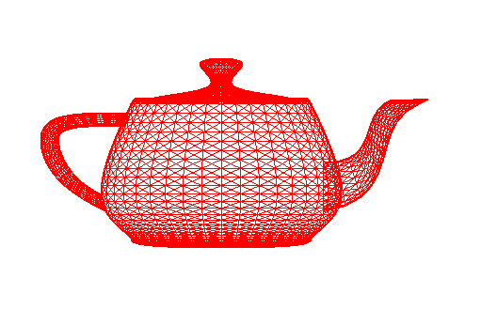
Evaluation of Polynomials
Angel and Shreiner: Interactive Computer Graphics 8E © Pearson Educaion 2020

Slide 8
Bezier Function
bezier = function(u) {
var b = [];
var a = 1-u;
b.push(u*u*u);
b.push(3*a*u*u);
b.push(3*a*a*u);
b.push(a*a*a);
return b;
}
Angel and Shreiner: Interactive Computer Graphics 8E © Pearson Educaion 2020

Slide 9
Patch Indices to Data
var h = 1.0/numDivisions;
patch = new Array(numTeapotPatches);
for(var i=0; i<numTeapotPatches; i++)
patch[i] = new Array(16);
for(var i=0; i<numTeapotPatches; i++)
for(j=0; j<16; j++) {
patch[i][j] = vec4([vertices[indices[i][j]][0],
vertices[indices[i][j]][2],
vertices[indices[i][j]][1], 1.0]);
}
Angel and Shreiner: Interactive Computer Graphics 8E © Pearson Educaion 2020

Slide 10
Vertex Data
for ( var n = 0; n < numTeapotPatches; n++ ) {
var data = new Array(numDivisions+1);
for(var j = 0; j<= numDivisions; j++) data[j] = new Array(numDivisions+1);
for(var i=0; i<=numDivisions; i++) for(var j=0; j<= numDivisions; j++) {
data[i][j] = vec4(0,0,0,1);
var u = i*h;
var v = j*h;
var t = new Array(4);
for(var ii=0; ii<4; ii++) t[ii]=new Array(4);
for(var ii=0; ii<4; ii++) for(var jj=0; jj<4; jj++)
t[ii][jj] = bezier(u)[ii]*bezier(v)[jj];
for(var ii=0; ii<4; ii++) for(var jj=0; jj<4; jj++) {
temp = vec4(patch[n][4*ii+jj]);
temp = scale( t[ii][jj], temp);
data[i][j] = add(data[i][j], temp);
}
}
Angel and Shreiner: Interactive Computer Graphics 8E © Pearson Educaion 2020

Slide 11
Quads
for(var i=0; i<numDivisions; i++)
for(var j =0; j<numDivisions; j++) {
points.push(data[i][j]);
points.push(data[i+1][j]);
points.push(data[i+1][j+1]);
points.push(data[i][j]);
points.push(data[i+1][j+1]);
points.push(data[i][j+1]);
index += 6;
}
}
Angel and Shreiner: Interactive Computer Graphics 8E © Pearson Educaion 2020

Slide 12
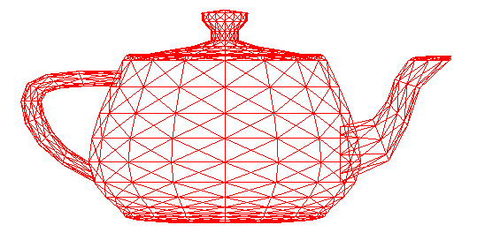
Recursive Subdivision
Angel and Shreiner: Interactive Computer Graphics 8E © Pearson Educaion 2020

Slide 13
Divide Curve
divideCurve = function( c, r , l){
// divides c into left (l) and right ( r ) curve data
var mid = mix(c[1], c[2], 0.5);
l[0] = vec4(c[0]);
l[1] = mix(c[0], c[1], 0.5 );
l[2] = mix(l[1], mid, 0.5 );
r[3] = vec4(c[3]);
r[2] = mix(c[2], c[3], 0.5 );
r[1] = mix( mid, r[2], 0.5 );
r[0] = mix(l[2], r[1], 0.5 );
l[3] = vec4(r[0]); return;
}
Angel and Shreiner: Interactive Computer Graphics 8E © Pearson Educaion 2020

Slide 14
Divide Patch
dividePatch = function (p, count ) {
if ( count > 0 ) {
var a = mat4();
var b = mat4();
var t = mat4();
var q = mat4();
var r = mat4();
var s = mat4();
// subdivide curves in u direction, transpose results, divide
// in u direction again (equivalent to subdivision in v)
for ( var k = 0; k < 4; ++k ) {
var pp = p[k];
var aa = vec4();
var bb = vec4();
Angel and Shreiner: Interactive Computer Graphics 8E © Pearson Educaion 2020

Slide 15
Divide Patch
divideCurve( pp, aa, bb );
a[k] = vec4(aa);
b[k] = vec4(bb);
}
a = transpose( a );
b = transpose( b );
for ( var k = 0; k < 4; ++k ) {
var pp = vec4(a[k]);
var aa = vec4();
var bb = vec4();
divideCurve( pp, aa, bb );
q[k] = vec4(aa);
r[k] = vec4(bb);
}
for ( var k = 0; k < 4; ++k ) {
var pp = vec4(b[k]);
var aa = vec4();

Slide 16
Divide Patch
var bb = vec4();
divideCurve( pp, aa, bb );
t[k] = vec4(bb);
}
// recursive division of 4 resulting patches
dividePatch( q, count - 1 );
dividePatch( r, count - 1 );
dividePatch( s, count - 1 );
dividePatch( t, count - 1 );
}
else {
drawPatch( p );
}
return;
}
Angel and Shreiner: Interactive Computer Graphics 8E © Pearson Educaion 2020

Slide 17
Draw Patch
drawPatch = function(p) {
// Draw the quad (as two triangles) bounded by
// corners of the Bezier patch
points.push(p[0][0]);
points.push(p[0][3]);
points.push(p[3][3]);
points.push(p[0][0]);
points.push(p[3][3]);
points.push(p[3][0]);
index+=6;
return;
}
Angel and Shreiner: Interactive Computer Graphics 8E © Pearson Educaion 2020

Slide 18
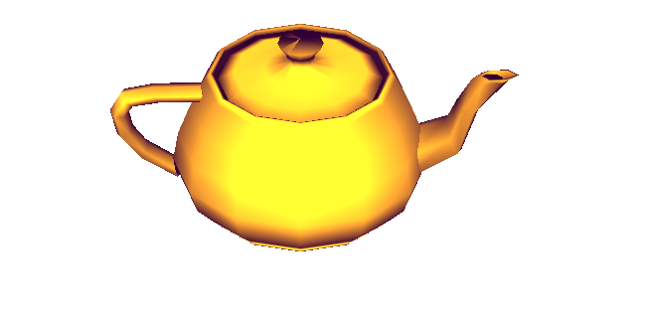
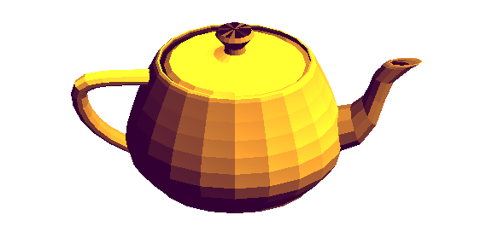
Adding Shading
Angel and Shreiner: Interactive Computer Graphics 8E © Pearson Educaion 2020

Slide 19
Using Face Normals
var t1 = subtract(data[i+1][j], data[i][j]);
var t2 =subtract(data[i+1][j+1], data[i][j]);
var normal = cross(t1, t2);
normal = normalize(normal);
normal[3] = 0;
points.push(data[i][j]); normals.push(normal);
points.push(data[i+1][j]); normals.push(normal);
points.push(data[i+1][j+1]); normals.push(normal);
points.push(data[i][j]); normals.push(normal);
points.push(data[i+1][j+1]); normals.push(normal);
points.push(data[i][j+1]); normals.push(normal);
index+= 6;
Angel and Shreiner: Interactive Computer Graphics 8E © Pearson Educaion 2020

Slide 20
Exact Normals
nbezier = function(u) {
var b = [];
b.push(3*u*u);
b.push(3*u*(2-3*u));
b.push(3*(1-4*u+3*u*u));
b.push(-3*(1-u)*(1-u));
return b;
}
Angel and Shreiner: Interactive Computer Graphics 8E © Pearson Educaion 2020

Slide 21
Geometry Shader
Basic limitation on rasterization is that each execution of a vertex shader is triggered by one vertex and can output only one vertex
Geometry shaders allow a single vertex and other data to produce many vertices
Example: send four control points to a geometry shader and it can produce as many points as needed for Bezier curve
Angel and Shreiner: Interactive Computer Graphics 8E © Pearson Educaion 2020

Slide 22
Tessellation Shaders
Can take many data points and produce triangles
More complex since tessellation has to deal with inside/outside issues and topological issues such as holes
Neither geometry or tessellation shaders supported by ES
ES 3.1 (just announced) has compute shaders
Angel and Shreiner: Interactive Computer Graphics 8E © Pearson Educaion 2020

