Slide 1
Introduction to Computer Graphics with WebGL
Ed Angel
Professor Emeritus of Computer Science
Founding Director, Arts, Research, Technology and Science Laboratory
University of New Mexico
Angel and Shreiner: Interactive Computer Graphics 8E © Pearson Education

Slide 2
Global Rendering
Ed Angel
Professor Emeritus of Computer Science
University of New Mexico
Angel and Shreiner: Interactive Computer Graphics 8E © Pearson Education

Slide 3
Introduction
WebGL is based on a pipeline model in which primitives are rendered one at time
  No shadows (except by tricks or multiple renderings)
  No multiple reflections
Global approaches based on the rendering equation
  Ray tracing
  Radiosity
  Photon mapping
  Path Tracing
Angel and Shreiner: Interactive Computer Graphics 8E © Pearson Education

Slide 4
The Rendering Equation
Use physical reasoning based on conservation of energy
Within a closed environment, the energy entering a surface must equal the energy leaving
Energy leaving in a given direction depends on the energy arriving from all directions
Angel and Shreiner: Interactive Computer Graphics 8E © Pearson Education

Slide 5

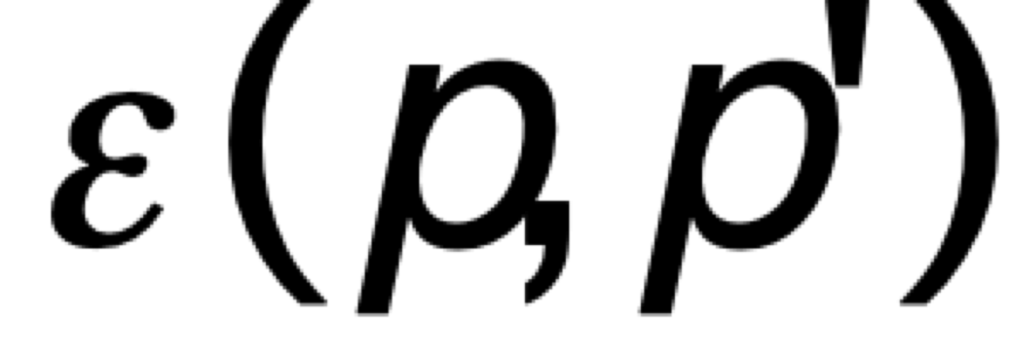
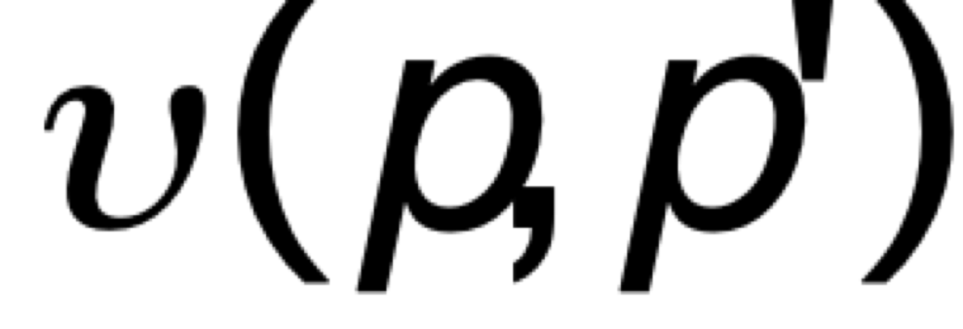

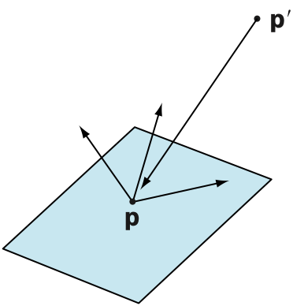
Rendering Equation (Kajia)
intensity from p arriving at p’
emission from p arriving at p’
occlusion term = 0 or 1/r²
bidirectional reflection distribution function (BRDF)
contribution from reflections from all other points
Angel and Shreiner: Interactive Computer Graphics 8E © Pearson Education

Slide 6
BRDF
The BRDF characterizes the material
  Generalization of reflection coefficient
General case requires is a 9 variable function at given frequency
  position
  direction of three vectors
Special cases lead to familiar methods
Angel and Shreiner: Interactive Computer Graphics 8E © Pearson Education

Slide 7
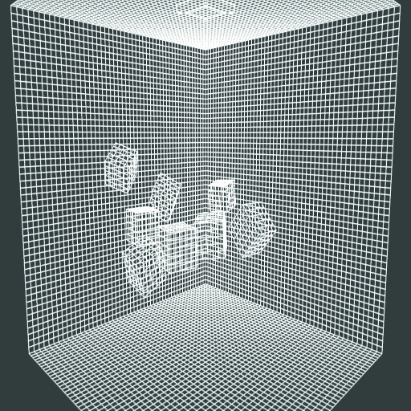
Radiosity
Assume all surfaces are perfectly diffuse
Light is scattered equally in all directions
Divide space into small patches
Angel and Shreiner: Interactive Computer Graphics 8E © Pearson Education

Slide 8
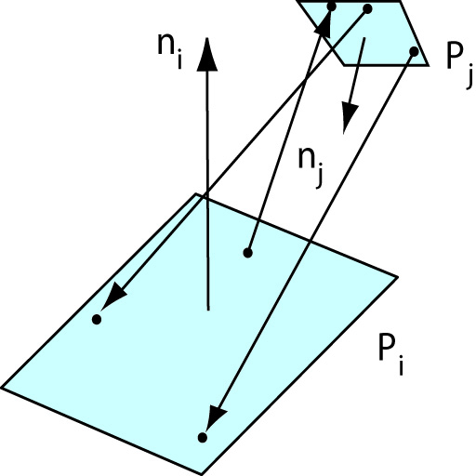
Form Factors
Need to compute the form factor between each pair of patches which describes effect of light from one patch onto the other
Angel and Shreiner: Interactive Computer Graphics 8E © Pearson Education

Slide 9
Radiosity Rendering
Once the form factors are computer each patch is a small diffuse patch
Final render now uses only diffuse term
As long as geometry is unchanges, subsequent renderings use same form factors
Angel and Shreiner: Interactive Computer Graphics 8E © Pearson Education

Slide 10
Monte Carlo Methods
Rendering equation cannot be solved analytically
One approach to take a probabilistic (Monte Carlo) approach
  Ray tracing
  Photon mapping
  Path tracing
Angel and Shreiner: Interactive Computer Graphics 8E © Pearson Education

Slide 11
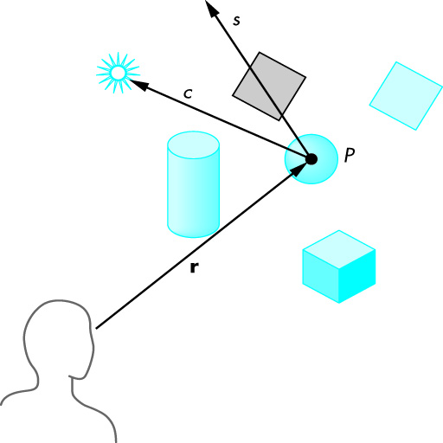
Ray Tracing
Follow rays of light from a point source
Can account for reflection and transmission
Angel and Shreiner: Interactive Computer Graphics 8E © Pearson Education

Slide 12
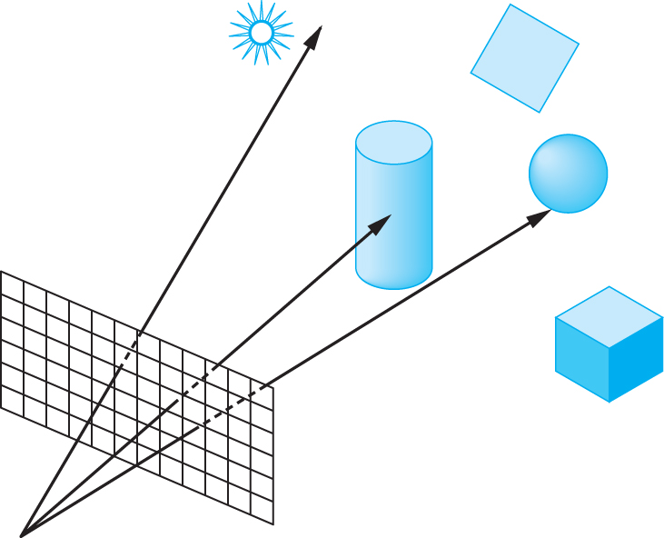
Ray Casting
Only rays that reach the eye matter
Reverse direction and cast rays
Need at least one ray per pixel
Angel and Shreiner: Interactive Computer Graphics 8E © Pearson Education

Slide 13
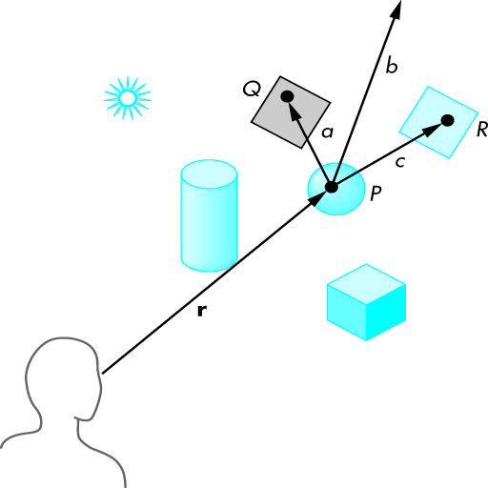
Path Tracing
Angel and Shreiner: Interactive Computer Graphics 8E © Pearson Education

Slide 14
Adding Rays
Basic limitation of ray tracing is the number of rays we can trace
Add more rays
  multitisampling
  stochastically
  adaptively
Angel and Shreiner: Interactive Computer Graphics 8E © Pearson Education

Slide 15
Photon Mapping
Instead of tracing rays trace photons
Send out stream of photons
When photons strike surface, they can be
  absorbed
  go off in multiple directions
Total number of photons limited by compute time required
Off line and stochastic
Angel and Shreiner: Interactive Computer Graphics 8E © Pearson Education

