Slide 1
Introduction to Computer Graphics with WebGL
Ed Angel
Professor Emeritus of Computer Science
Founding Director, Arts, Research, Technology and Science Laboratory
University of New Mexico
Angel and Shreiner: Interactive Computer Graphics 8E © Pearson Education 2020

Slide 2
Programming with WebGL
Part 3: Shaders
Ed Angel
Professor of Emeritus of Computer Science
University of New Mexico
Angel and Shreiner: Interactive Computer Graphics 8E © Pearson Education 2020

Slide 3
Objectives
Simple Shaders
  Vertex shader
  Fragment shaders
Programming shaders with GLSL
Finish first program
Angel and Shreiner: Interactive Computer Graphics 8E © Pearson Education 2020

Slide 4
Vertex Shader Applications
Moving vertices
  Morphing
  Wave motion
  Fractals
Lighting
  More realistic models
  Cartoon shaders
Angel and Shreiner: Interactive Computer Graphics 8E © Pearson Education 2020

Slide 5
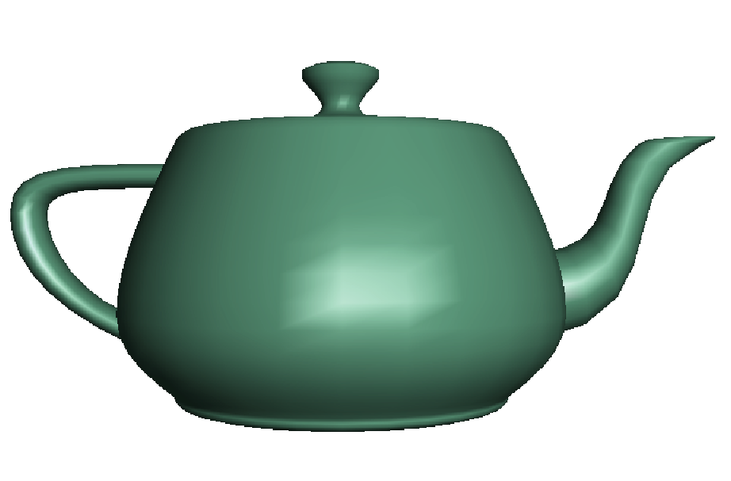
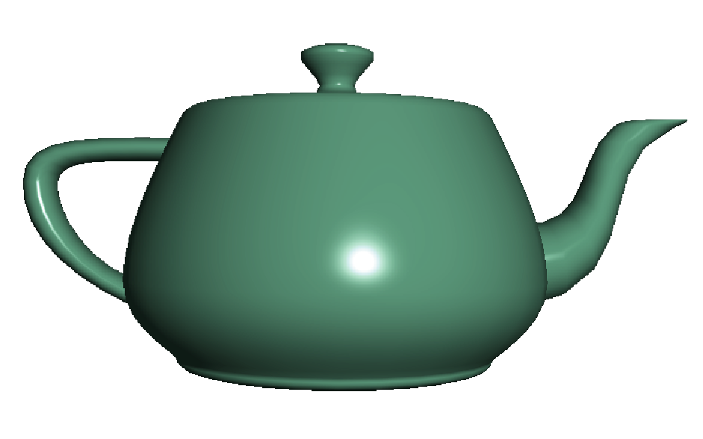
Fragment Shader Applications
Per fragment lighting calculations
per vertex lighting
per fragment lighting
Angel and Shreiner: Interactive Computer Graphics 8E © Pearson Education 2020

Slide 6



Fragment Shader Applications
Texture mapping
smooth shading
environment
mapping
bump mapping
Angel and Shreiner: Interactive Computer Graphics 8E © Pearson Education 2020

Slide 7
Writing Shaders
First programmable shaders were programmed in an assembly-like manner
OpenGL extensions added functions for vertex and fragment shaders
Cg (C for graphics) C-like language for programming shaders
  Works with both OpenGL and DirectX
  Interface to OpenGL complex
OpenGL Shading Language (GLSL)
Angel and Shreiner: Interactive Computer Graphics 8E © Pearson Education 2020

Slide 8
GLSL
OpenGL Shading Language
Part of OpenGL 2.0 and up
High level C-like language
New data types
  Matrices
  Vectors
  Samplers
As of OpenGL 3.1, application must provide shaders
Angel and Shreiner: Interactive Computer Graphics 8E © Pearson Education 2020

Slide 9




Simple Vertex Shader (WebGL 2.0)
#version 300 es
in vec4 vPosition;
void main(void)
{
gl_Position = vPosition;
}
Angel and Shreiner: Interactive Computer Graphics 8E © Pearson Education 2020

Slide 10



Simple Vertex Shader (WebGL 1.0)
attribute vec4 vPosition;
void main(void)
{
gl_Position = vPosition;
}
Angel and Shreiner: Interactive Computer Graphics 8E © Pearson Education 2020

Slide 11
Execution Model
Vertex data
Shader Program
GPU
Application
Program
Vertex
Shader
Primitive
Assembly
gl.drawArrays
Vertex
Angel and Shreiner: Interactive Computer Graphics 8E © Pearson Education 2020

Slide 12


Simple Fragment Program (WebGL 2.0)
#version 300 es
precision mediump float;
out fragColor;
void main(void)
{
fragColor = vec4(1.0, 0.0, 0.0, 1.0);
}
Angel and Shreiner: Interactive Computer Graphics 8E © Pearson Education 2020

Slide 13
Simple Fragment Program (WebGL 1.0)
precision mediump float;
void main(void)
{
gl_FragColor = vec4(1.0, 0.0, 0.0, 1.0);
}
Angel and Shreiner: Interactive Computer Graphics 8E © Pearson Education 2020

Slide 14
Execution Model
Application
Shader Program
Rasterizer
Fragment
Shader
Frame Buffer
Vertex
Fragment
Fragment
Color
Angel and Shreiner: Interactive Computer Graphics 8E © Pearson Education 2020

