Slide 1
Introduction to Computer Graphics with WebGL
Ed Angel
Professor Emeritus of Computer Science
Founding Director, Arts, Research, Technology and Science Laboratory
University of New Mexico
Angel and Shreiner: Interactive Computer Graphics 8E © Pearson Education 2020

Slide 2
Programming with WebGL
Part 6: Three Dimensions
Ed Angel
Professor Emeritus of Computer Science
University of New Mexico
Angel and Shreiner: Interactive Computer Graphics 8E © Pearson Education 2020

Slide 3
Moving to 3D
We can easily make the program three-dimensional by using three dimensional points and starting with a tetrahedron
var vertices = [
vec3( 0.0000, 0.0000, -1.0000 ),
vec3( 0.0000, 0.9428, 0.3333 ),
vec3( -0.8165, -0.4714, 0.3333 ),
vec3( 0.8165, -0.4714, 0.3333 )
];
subdivide each face
Angel and Shreiner: Interactive Computer Graphics 8E © Pearson Education 2020

Slide 4
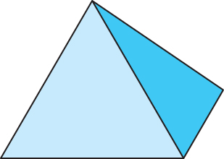
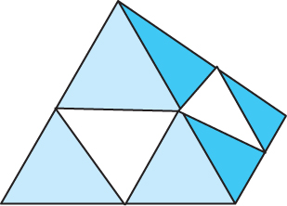
3D Gasket
We can subdivide each of the four faces
Appears as if we remove a solid tetrahedron from the center leaving four smaller tetrahedra
Code almost identical to 2D example
Angel and Shreiner: Interactive Computer Graphics 8E © Pearson Education 2020

Slide 5
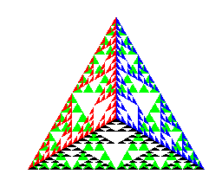
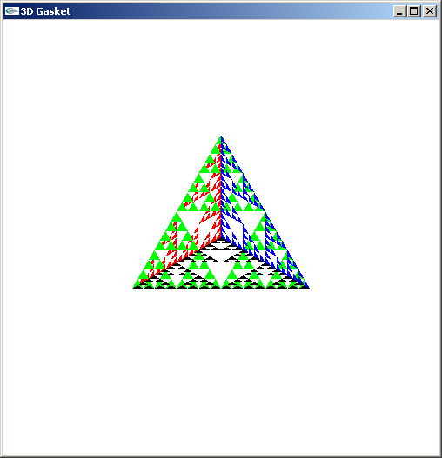
Almost Correct
Because the triangles are drawn in the order they are specified in the program, the front triangles are not always rendered in front of triangles behind them
get this
want this
Angel and Shreiner: Interactive Computer Graphics 8E © Pearson Education 2020

Slide 6
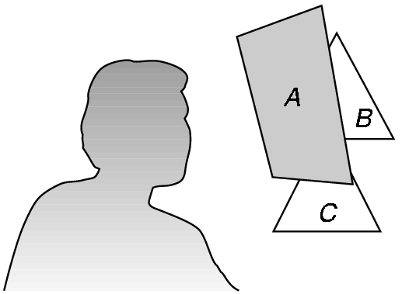
Hidden-Surface Removal
We want to see only those surfaces in front of other surfaces
OpenGL uses a hidden-surface method called the z-buffer algorithm that saves depth information as objects are rendered so that only the front objects appear in the image
Angel and Shreiner: Interactive Computer Graphics 8E © Pearson Education 2020

Slide 7
Using the z-buffer algorithm
The algorithm uses an extra buffer, the z-buffer, to store depth information as geometry travels down the pipeline
Depth buffer is required to be available in WebGL
It must be
  Enabled
    gl.enable(gl.DEPTH_TEST)
  Cleared in for each render
    gl.clear(gl.COLOR_BUFFER_BIT | gl.DEPTH_BUFFER_BIT)
Angel and Shreiner: Interactive Computer Graphics 8E © Pearson Education 2020

Slide 8
Surface vs Volume Subdvision
In our example, we divided the surface of each face
We could also divide the volume using the same midpoints
The midpoints define four smaller tetrahedrons, one for each vertex
Keeping only these tetrahedrons removes a volume in the middle
See text for code
Angel and Shreiner: Interactive Computer Graphics 8E © Pearson Education 2020

Slide 9
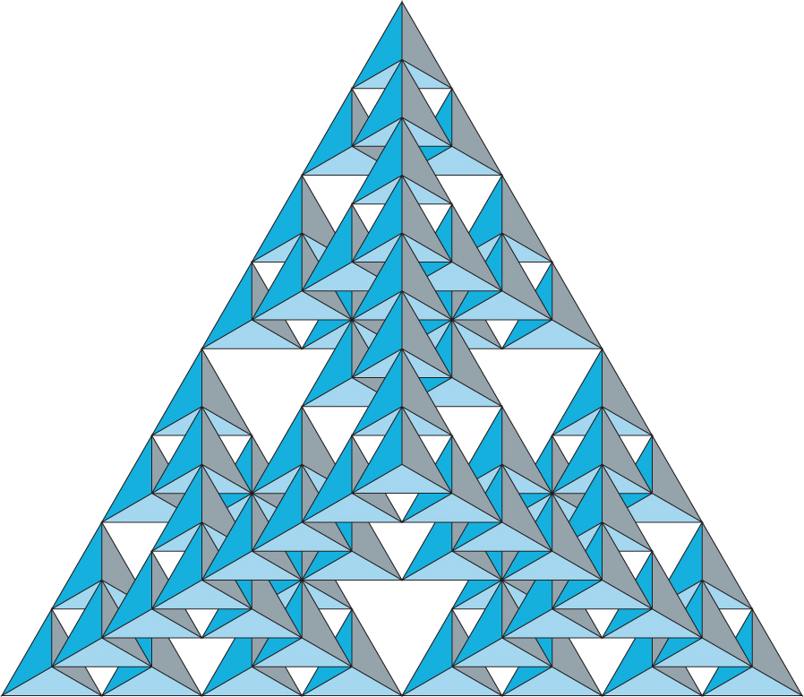
Volume Subdivision
Angel and Shreiner: Interactive Computer Graphics 8E © Pearson Education 2020

