Slide 1
Introduction to Computer Graphics with WebGL
Ed Angel
Professor Emeritus of Computer Science
Founding Director, Arts, Research, Technology and Science Laboratory
University of New Mexico
Angel and Shreiner: Interactive Computer Graphics 8E © Pearson Education 2020

Slide 2
Input and Interaction
Ed Angel
Professor Emeritus of Computer Science,
University of New Mexico
Angel and Shreiner: Interactive Computer Graphics 8E © Pearson Education 2020

Slide 3
Objectives
Introduce the basic input devices
  Physical Devices
  Logical Devices
  Input Modes
Event-driven input
Introduce double buffering for smooth animations
Programming event input with WebGL
Angel and Shreiner: Interactive Computer Graphics 8E © Pearson Education 2020

Slide 4
Project Sketchpad
Ivan Sutherland (MIT 1963) established the basic interactive paradigm that characterizes interactive computer graphics:
  User sees an object on the display
  User points to (picks) the object with an input device (light pen, mouse, trackball)
  Object changes (moves, rotates, morphs)
  Repeat
Angel and Shreiner: Interactive Computer Graphics 8E © Pearson Education 2020

Slide 5
Graphical Input
Devices can be described either by
  Physical properties
    Mouse
    Keyboard
    Trackball
  Logical Properties
    What is returned to program via API
      A position
      An object identifier
Modes
  How and when input is obtained
    Request or event
Angel and Shreiner: Interactive Computer Graphics 8E © Pearson Education 2020

Slide 6
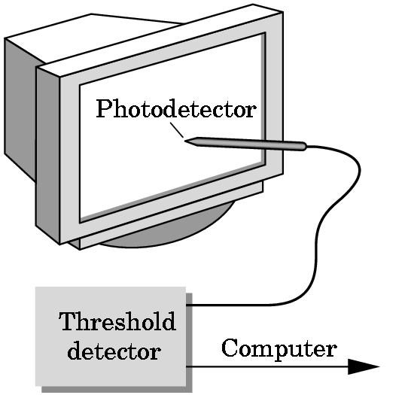
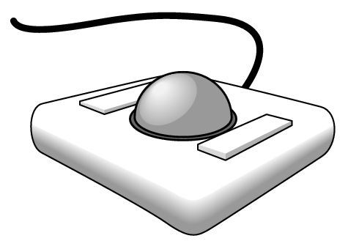
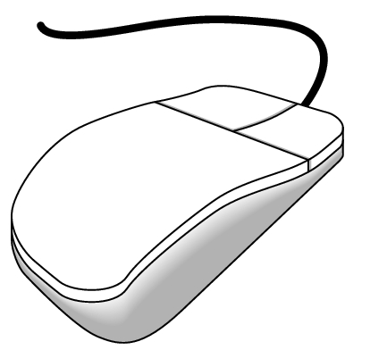
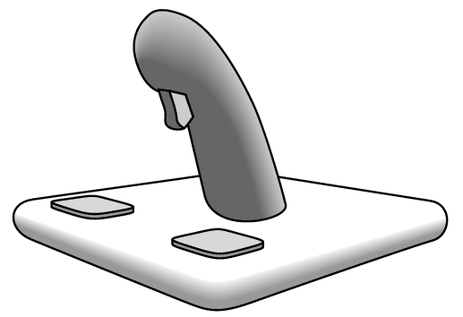

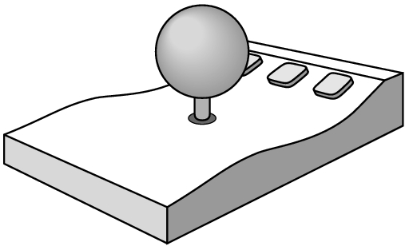
Physical Devices
mouse
trackball
light pen
data tablet
joy stick
space ball
Angel and Shreiner: Interactive Computer Graphics 8E © Pearson Education 2020

Slide 7
Incremental (Relative) Devices
Devices such as the data tablet return a position directly to the operating system
Devices such as the mouse, trackball, and joy stick return incremental inputs (or velocities) to the operating system
  Must integrate these inputs to obtain an absolute position
    Rotation of cylinders in mouse
    Roll of trackball
    Difficult to obtain absolute position
    Can get variable sensitivity
Angel and Shreiner: Interactive Computer Graphics 8E © Pearson Education 2020

Slide 8
Logical Devices
Consider the C and C++ code
  C++: cin >> x;
  C: scanf (“%d”, &x);
What is the input device?
  Can’t tell from the code
  Could be keyboard, file, output from another program
The code provides logical input
  A number (an int) is returned to the program regardless of the physical device
Angel and Shreiner: Interactive Computer Graphics 8E © Pearson Education 2020

Slide 9
Graphical Logical Devices
Graphical input is more varied than input to standard programs which is usually numbers, characters, or bits
Two older APIs (GKS, PHIGS) defined six types of logical input
  Locator: return a position
  Pick: return ID of an object
  Keyboard: return strings of characters
  Stroke: return array of positions
  Valuator: return floating point number
  Choice: return one of n items
Angel and Shreiner: Interactive Computer Graphics 8E © Pearson Education 2020

Slide 10
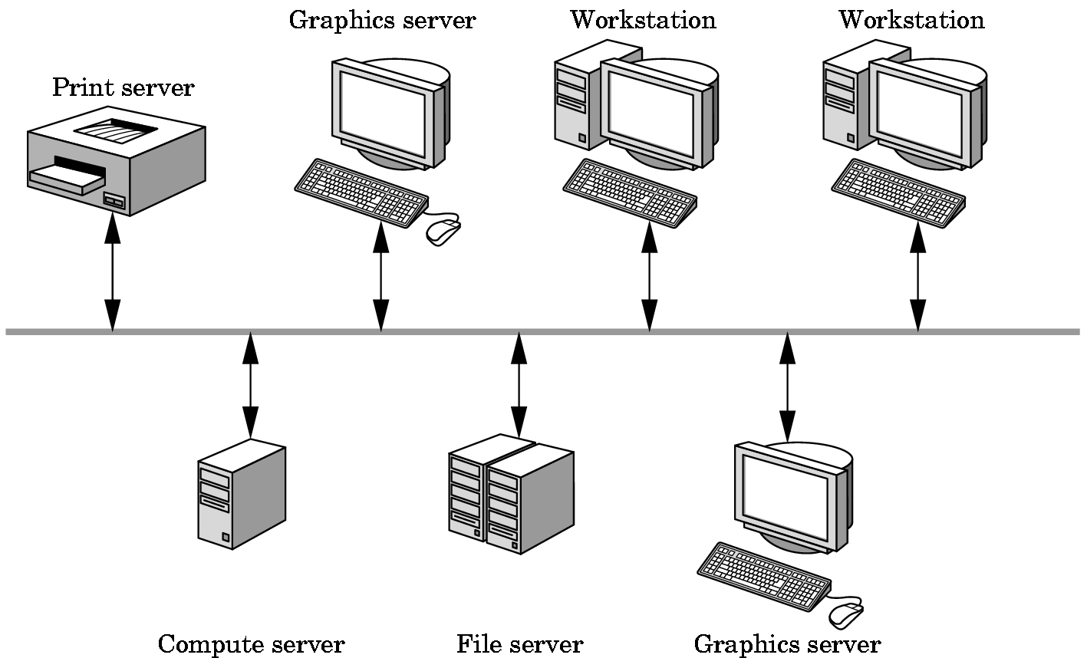
X Window Input
The X Window System introduced a client-server model for a network of workstations
  Client: OpenGL program
  Graphics Server: bitmap display with a pointing device and a keyboard
Angel and Shreiner: Interactive Computer Graphics 8E © Pearson Education 2020

Slide 11
Input Modes
Input devices contain a trigger which can be used to send a signal to the operating system
  Button on mouse
  Pressing or releasing a key
When triggered, input devices return information (their measure) to the system
  Mouse returns position information
  Keyboard returns ASCII code
Angel and Shreiner: Interactive Computer Graphics 8E © Pearson Education 2020

Slide 12
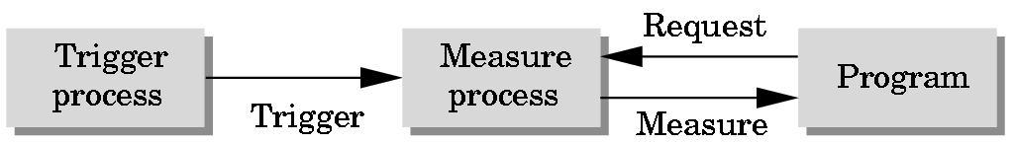
Request Mode
Input provided to program only when user triggers the device
Typical of keyboard input
  Can erase (backspace), edit, correct until enter (return) key (the trigger) is depressed
Angel and Shreiner: Interactive Computer Graphics 8E © Pearson Education 2020

Slide 13
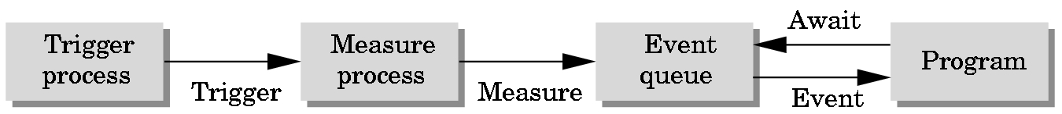
Event Mode
Most systems have more than one input device, each of which can be triggered at an arbitrary time by a user
Each trigger generates an event whose measure is put in an event queue which can be examined by the user program
Angel and Shreiner: Interactive Computer Graphics 8E © Pearson Education 2020

Slide 14
Event Types
Window: resize, expose, iconify
Mouse: click one or more buttons
Motion: move mouse
Keyboard: press or release a key
Idle: nonevent
  Define what should be done if no other event is in queue
Angel and Shreiner: Interactive Computer Graphics 8E © Pearson Education 2020

