Slide 1
Introduction to Computer Graphics with WebGL
Ed Angel
Professor Emeritus of Computer Science
Founding Director, Arts, Research, Technology and Science Laboratory
University of New Mexico
Angel and Shreiner: Interactive Computer Graphics 8E © Pearson Education 2020

Slide 2
Animation
Ed Angel
Professor Emeritus of Computer Science,
University of New Mexico
Angel and Shreiner: Interactive Computer Graphics 8E © Pearson Education 2020

Slide 3
Callbacks
Programming interface for event-driven input uses callback functions or event listeners
  Define a callback for each event the graphics system recognizes
  Browsers enters an event loop and responds to those events for which it has callbacks registered
  The callback function is executed when the event occurs
Angel and Shreiner: Interactive Computer Graphics 8E © Pearson Education 2020

Slide 4
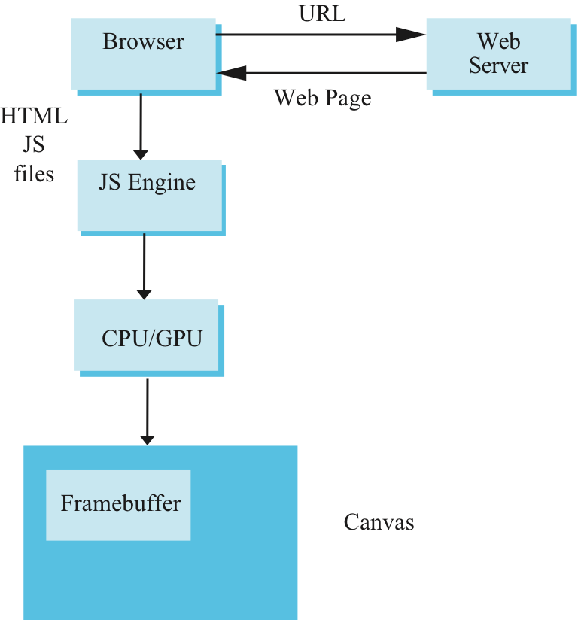
Execution in a Browser
Angel and Shreiner: Interactive Computer Graphics 8E © Pearson Education 2020

Slide 5
Execution in a Browser
Start with HTML file
  Describes the page
  May contain the shaders
  Loads files
Files are loaded asynchronously and JS code is executed
Then what?
Browser is in an event loop and waits for an event
Angel and Shreiner: Interactive Computer Graphics 8E © Pearson Education 2020

Slide 6
onload Event
What happens with our JS file containing the graphics part of our application?
  All the “action” is within functions such as init() and render()
  Consequently these functions are never executed and we see nothing
Solution: use the onload window event to initiate execution of the init function
  onload event occurs when all files read
  window.onload = init;
Angel and Shreiner: Interactive Computer Graphics 8E © Pearson Education 2020

Slide 7
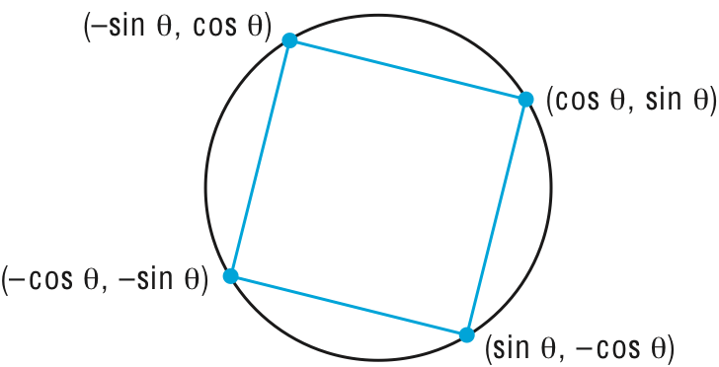
Rotating Square
Consider the four points
Animate display by rerendering with different values of θ
Angel and Shreiner: Interactive Computer Graphics 8E © Pearson Education 2020

Slide 8

Simple but Slow Method
for(var theta = 0.0; theta <thetaMax; theta += dtheta; {
vertices[0] = vec2(Math.sin(theta), Math.cos.(theta));
vertices[1] = vec2(Math.sin(theta), -Math.cos.(theta));
vertices[2] = vec2(-Math.sin(theta), -Math.cos.(theta));
vertices[3] = vec2(-Math.sin(theta), Math.cos.(theta));
gl.bufferSubData(…………………….
render();
}
Angel and Shreiner: Interactive Computer Graphics 8E © Pearson Education 2020

Slide 9
Better Way
Send original vertices to vertex shader
Send θ to shader as a uniform variable
Compute vertices in vertex shader
Render recursively
Angel and Shreiner: Interactive Computer Graphics 8E © Pearson Education 2020

Slide 10
Render Function
var thetaLoc = gl.getUniformLocation(program, ”uTheta");
function render()
{
gl.clear(gl.COLOR_BUFFER_BIT);
uTheta += 0.1;
gl.uniform1f(thetaLoc, uTheta);
gl.drawArrays(gl.TRIANGLE_STRIP, 0, 4);
render();
}
Angel and Shreiner: Interactive Computer Graphics 8E © Pearson Education 2020

Slide 11
requestAnimationFrame
Render function in previous slide will not work as desired
Stack overflow because render calls will pile up faster than a single render can be executed
The function requestAnimationFrame which is now part of JS will allow only one execution per refresh
Angel and Shreiner: Interactive Computer Graphics 8E © Pearson Education 2020

Slide 12
requestAnimationFrame
function render {
gl.clear(gl.COLOR_BUFFER_BIT);
uTheta += 0.1;
gl.uniform1f(thetaLoc, uTtheta);
gl.drawArrays(gl.TRIANGLE_STRIP, 0, 4);
requestAnimationFrame(render);
}
Angel and Shreiner: Interactive Computer Graphics 8E © Pearson Education 2020

Slide 13
Vertex Shader
in vec4 aPosition;
uniform float uTheta;
void main()
{
gl_Position.x = -sin(uTheta) * aPosition.x + cos(uTheta) * aPosition.y;
gl_Position.y = sin(uTheta) * aPosition.y + cos(uTheta) * aPosition.x;
gl_Position.z = 0.0;
gl_Position.w = 1.0;
}
Angel and Shreiner: Interactive Computer Graphics 8E © Pearson Education 2020

Slide 14
Double Buffering
Although we are rendering the square, it always into a buffer that is not displayed
Browser uses double buffering
  Always display front buffer
  Rendering into back buffer
  Need a buffer swap
Prevents display of a partial rendering
Angel and Shreiner: Interactive Computer Graphics 8E © Pearson Education 2020

Slide 15
Triggering a Buffer Swap
Browsers refresh the display at ~60 Hz
  redisplay of front buffer
  not a buffer swap
Trigger a buffer swap though an event
Two options for rotating square
  Interval timer
  requestAnimationFrame
Angel and Shreiner: Interactive Computer Graphics 8E © Pearson Education 2020

Slide 16
Interval Timer
Executes a function after a specified number of milliseconds
  Also generates a buffer swap
Note an interval of 0 generates buffer swaps as fast as possible
  Stack overflow
setInterval(render, interval);
Angel and Shreiner: Interactive Computer Graphics 8E © Pearson Education 2020

Slide 17
Add an Interval
function render()
{
setTimeout( function() {
requestAnimFrame(render);
gl.clear(gl.COLOR_BUFFER_BIT);
uTheta += 0.1;
gl.uniform1f(thetaLoc, uTheta);
gl.drawArrays(gl.TRIANGLE_STRIP, 0, 4);
}, 100);
}
Angel and Shreiner: Interactive Computer Graphics 8E © Pearson Education 2020

