Slide 1
Introduction to Computer Graphics with WebGL
Ed Angel
Professor Emeritus of Computer Science
Founding Director, Arts, Research, Technology and Science Laboratory
University of New Mexico
Angel and Shreiner: Interactive Computer Graphics 8E © Pearson Education 2020

Slide 2
Position Input
Ed Angel
Professor Emeritus of Computer Science
University of New Mexico
Angel and Shreiner: Interactive Computer Graphics 8E © Pearson Education 2020

Slide 3
Objectives
Learn to use the mouse to give locations
  Must convert from position on canvas to position in application
Respond to window events such as reshapes triggered by the mouse
Angel and Shreiner: Interactive Computer Graphics 8E © Pearson Education 2020

Slide 4

Window Coordinates
(0, 0)
h
(x_{w}, y_{w})
(w -1, h-1)
w
Angel and Shreiner: Interactive Computer Graphics 8E © Pearson Education 2020

Slide 5
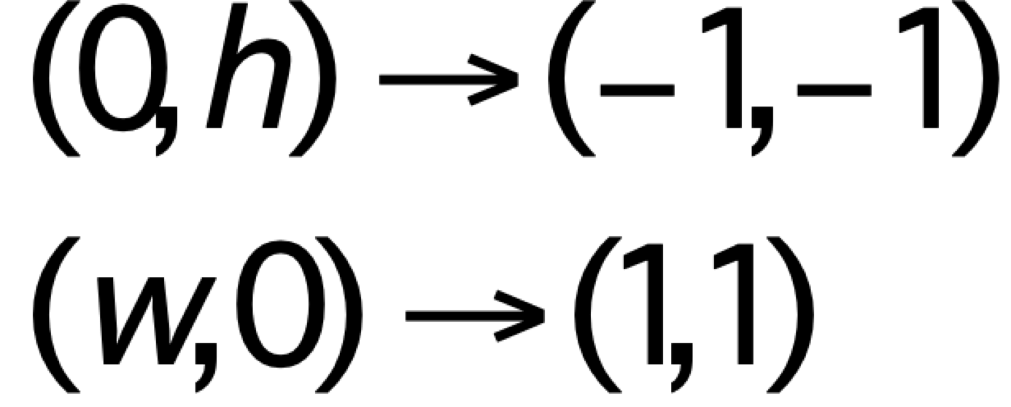
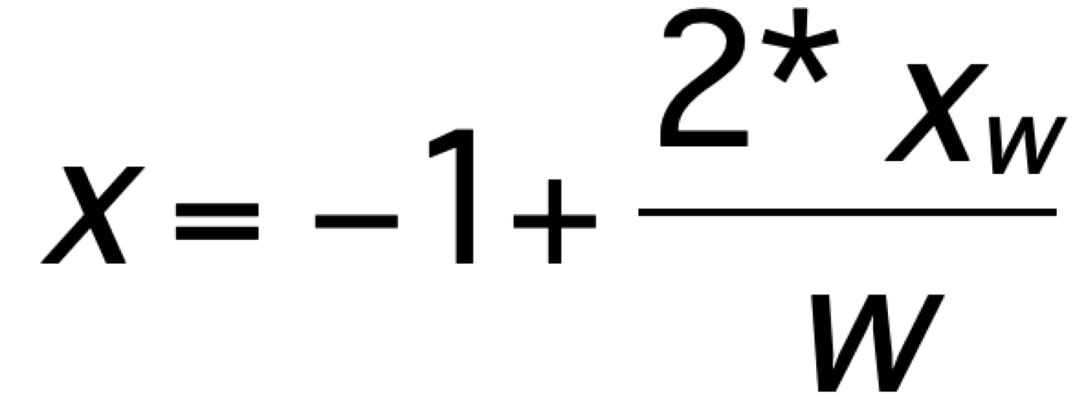
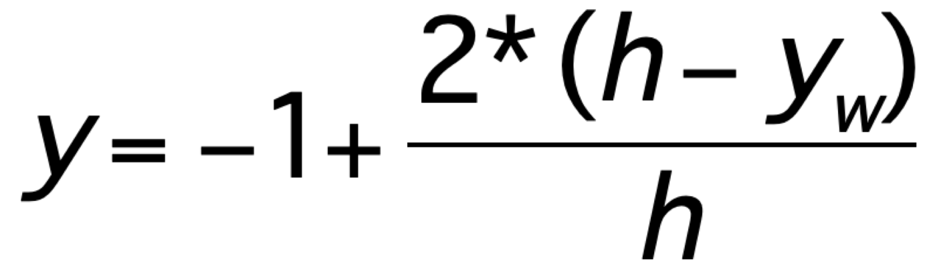
Window to Clip Coordinates
Angel and Shreiner: Interactive Computer Graphics 8E © Pearson Education 2020

Slide 6
Returning Position from Click Event
  Canvas specified in HTML file of size canvas.width x canvas.height
  Returned window coordinates are event.clientX and event.clientY
// add a vertex to GPU for each click
canvas.addEventListener("click", function() {
gl.bindBuffer(gl.ARRAY_BUFFER, vBuffer);
var t = vec2(-1 + 2*event.clientX/canvas.width,
-1 + 2*(canvas.height-event.clientY)/canvas.height);
gl.bufferSubData(gl.ARRAY_BUFFER,
sizeof[’vec2’]*index, t);
index++;
});
Angel and Shreiner: Interactive Computer Graphics 8E © Pearson Education 2020

Slide 7
CAD-like Examples
square.html: puts a colored square at location of each mouse click
triangle.html: first three mouse clicks define first triangle of triangle strip. Each succeeding mouse clicks adds a new triangle at end of strip
cad1.html: draw a rectangle for each two successive mouse clicks
cad2.html: draws arbitrary polygons
Angel and Shreiner: Interactive Computer Graphics 8E © Pearson Education 2020

Slide 8
Window Events
Events can be generated by actions that affect the canvas window
  moving or exposing a window
  resizing a window
  opening a window
  iconifying/deiconifying a window a window
Note that events generated by other application that use the canvas can affect the WebGL canvas
  There are default callbacks for some of these events
Angel and Shreiner: Interactive Computer Graphics 8E © Pearson Education 2020

Slide 9
Reshape Events
Suppose we use the mouse to change the size of our canvas
Must redraw the contents
Options
  Display the same objects but change size
  Display more or fewer objects at the same size
Almost always want to keep proportions
Angel and Shreiner: Interactive Computer Graphics 8E © Pearson Education 2020

Slide 10
onresize Event
Returns size of new canvas is available through window.innerHeight and window. innerWidth
Use innerHeight and innerWidth to change canvas.height and canvas.width
Example (next slide): maintaining a square display
Angel and Shreiner: Interactive Computer Graphics 8E © Pearson Education 2020

Slide 11
Keeping Square Proportions
window.onresize = function() {
var min = innerWidth;
if (innerHeight < min) {
min = innerHeight;
}
if (min < canvas.width || min < canvas.height) {
gl.viewport(0, canvas.height-min, min, min);
}
};
Angel and Shreiner: Interactive Computer Graphics 8E © Pearson Education 2020

