Slide 1
Introduction to Computer Graphics with WebGL
Ed Angel
Professor Emeritus of Computer Science
Founding Director, Arts, Research, Technology and Science Laboratory
University of New Mexico
Angel and Shreiner: Interactive Computer Graphics 8E © Pearson Education 2020

Slide 2
Homogeneous Coordinates
Ed Angel
Professor Emeritus of Computer Science,
University of New Mexico
Angel and Shreiner: Interactive Computer Graphics 8E © Pearson Education 2020

Slide 3
Objectives
Introduce homogeneous coordinates
Introduce change of representation for both vectors and points
Angel and Shreiner: Interactive Computer Graphics 8E © Pearson Education 2020

Slide 4
A Single Representation
If we define 0•P = 0 and 1•P =P then we can write
v=α₁v₁+ α₂v₂ +α₃v₃ = [α₁ α₂ α₃ 0 ] [v₁ v₂ v₃ P₀] ^{T}
P = P₀ + β₁v₁+ β₂v₂ +β₃v₃= [β₁ β₂ β₃ 1 ] [v₁ v₂ v₃ P₀] ^{T}
Thus we obtain the four-dimensional homogeneous coordinate representation
v = [α₁ α₂ α₃ 0 ] ^{T}
p = [β₁ β₂ β₃ 1 ] ^{T}
Angel and Shreiner: Interactive Computer Graphics 8E © Pearson Education 2020

Slide 5
Homogeneous Coordinates and Computer Graphics
Homogeneous coordinates are key to all computer graphics systems
  All standard transformations (rotation, translation, scaling) can be implemented with matrix multiplications using 4 x 4 matrices
  Hardware pipeline works with 4 dimensional representations
  For orthographic viewing, we can maintain w=0 for vectors and w=1 for points
  For perspective we need a perspective division
Angel and Shreiner: Interactive Computer Graphics 8E © Pearson Education 2020

Slide 6
Change of Coordinate Systems
Consider two representations of a the same vector with respect to two different bases. The representations are
a=[α₁ α₂ α₃ ]
b=[β₁ β₂ β₃]
where
v=α₁v₁+ α₂v₂ +α₃v₃ = [α₁ α₂ α₃] [v₁ v₂ v₃] ^{T}
=β₁u₁+ β₂u₂ +β₃u₃ = [β₁ β₂ β₃] [u₁ u₂ u₃] ^{T}
Angel and Shreiner: Interactive Computer Graphics 8E © Pearson Education 2020

Slide 7
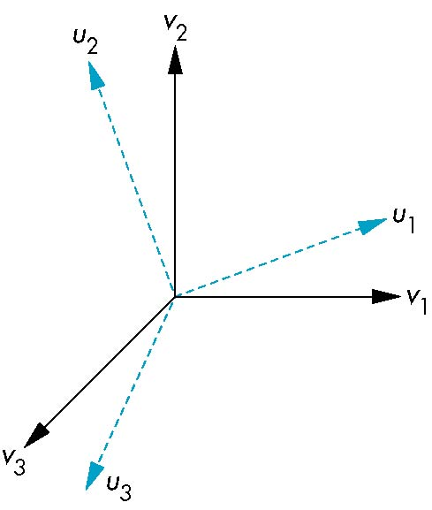
Representing second basis in terms of first
Each of the basis vectors, u1,u2, u3, are vectors that can be represented in terms of the first basis
v
u₁ = γ₁₁v₁+γ₁₂v₂+γ₁₃v₃
u₂ = γ₂₁v₁+γ₂₂v₂+γ₂₃v₃
u₃ = γ₃₁v₁+γ₃₂v₂+γ₃₃v₃
Angel and Shreiner: Interactive Computer Graphics 8E © Pearson Education 2020

Slide 8
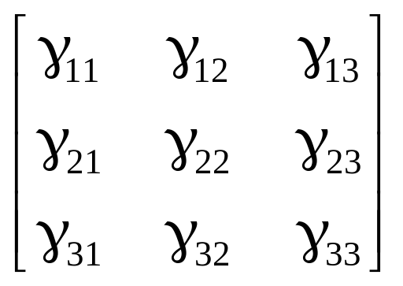
Matrix Form
The coefficients define a 3 x 3 matrix
and the bases can be related by
see text for numerical examples
M =
a=M^{T}b
Angel and Shreiner: Interactive Computer Graphics 8E © Pearson Education 2020

Slide 9
Change of Frames
We can apply a similar process in homogeneous coordinates to the representations of both points and vectors
Any point or vector can be represented in either frame
We can represent Q₀, u₁, u₂, u₃ in terms of P₀, v₁, v₂, v₃
u₂
u₁
v₂
Consider two frames:
(P₀, v₁, v₂, v₃)
(Q₀, u₁, u₂, u₃)
Q₀
P₀
v₁
u₃
v₃
Angel and Shreiner: Interactive Computer Graphics 8E © Pearson Education 2020

Slide 10
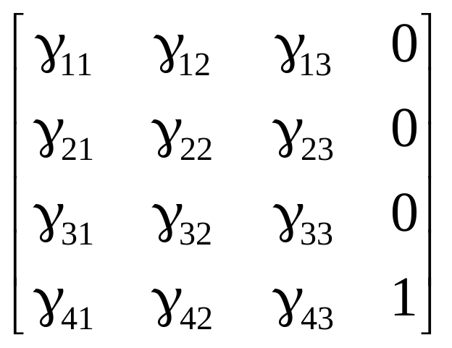
Representing One Frame in Terms of the Other
Extending what we did with change of bases
u₁ = γ₁₁v₁+γ₁₂v₂+γ₁₃v₃
u₂ = γ₂₁v₁+γ₂₂v₂+γ₂₃v₃
u₃ = γ₃₁v₁+γ₃₂v₂+γ₃₃v₃
Q₀ = γ₄₁v₁+γ₄₂v₂+γ₄₃v₃ +γ₄₄P₀
defining a 4 x 4 matrix
M =
Angel and Shreiner: Interactive Computer Graphics 8E © Pearson Education 2020

Slide 11
Working with Representations
Within the two frames any point or vector has a representation of the same form
a=[α₁ α₂ α₃ α₄ ] in the first frame
b=[β₁ β₂ β₃ β₄ ] in the second frame
where α₄ = β₄ = 1 for points and α₄ = β₄ = 0 for vectors and
The matrix M is 4 x 4 and specifies an affine transformation in homogeneous coordinates
a=M^{T}b
Angel and Shreiner: Interactive Computer Graphics 8E © Pearson Education 2020

Slide 12
Affine Transformations
Every linear transformation is equivalent to a change in frames
Every affine transformation preserves lines
However, an affine transformation has only 12 degrees of freedom because 4 of the elements in the matrix are fixed and are a subset of all possible 4 x 4 linear transformations
Angel and Shreiner: Interactive Computer Graphics 8E © Pearson Education 2020

Slide 13
The World and Camera Frames
When we work with representations, we work with n-tuples or arrays of scalars
Changes in frame are then defined by 4 x 4 matrices
In OpenGL, the base frame that we start with is the world frame
Eventually we represent entities in the camera frame by changing the world representation using the model-view matrix
Initially these frames are the same (M=I)
Angel and Shreiner: Interactive Computer Graphics 8E © Pearson Education 2020

Slide 14
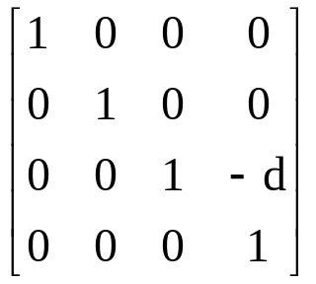
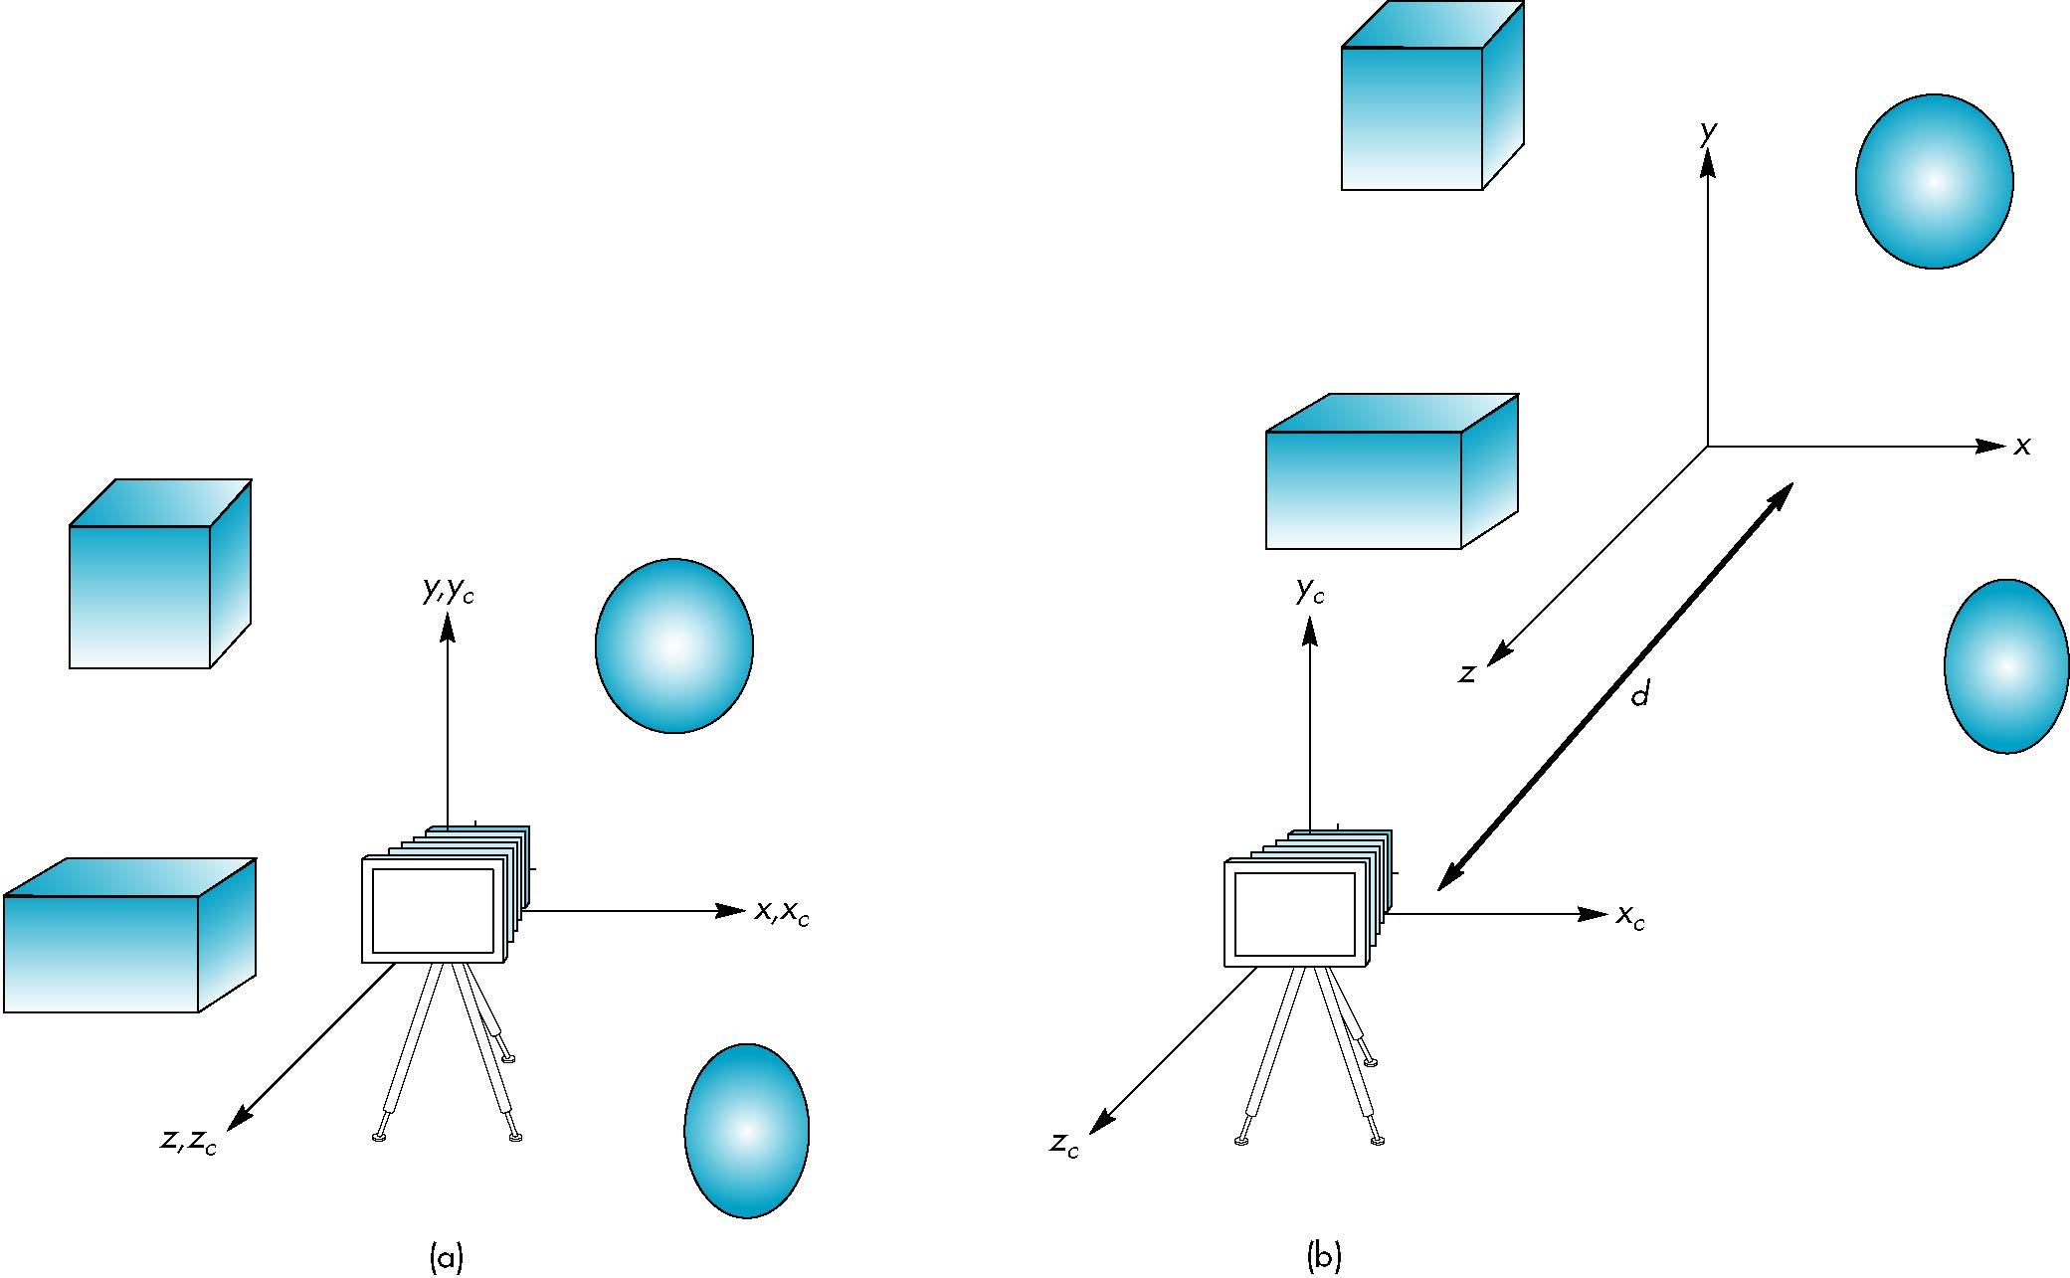
Moving the Camera
If objects are on both sides of z=0, we must move camera frame
M =
Angel and Shreiner: Interactive Computer Graphics 8E © Pearson Education 2020

