Slide 1
Introduction to Computer Graphics with WebGL
Ed Angel
Professor Emeritus of Computer Science
Founding Director, Arts, Research, Technology and Science Laboratory
University of New Mexico
Angel and Shreiner: Interactive Computer Graphics 8E © Pearson Education 2020

Slide 2
Computer Viewing
Positioning the Camera
Ed Angel
Professor Emeritus of Computer Science
University of New Mexico
Angel and Shreiner: Interactive Computer Graphics 8E © Pearson Education 2020

Slide 3
Objectives
Introduce the mathematics of projection
Introduce WebGL viewing functions in MV.js
Look at alternate viewing APIs
Angel and Shreiner: Interactive Computer Graphics 8E © Pearson Education 2020

Slide 4
From the Beginning
In the beginning:
  fixed function pipeline
  Model-View and Projection Transformation
  Predefined frames: model, object, camera, clip, ndc, window
After deprecation
  pipeline with programmable shaders
  no transformations
  clip, ndc window frames
MV.js reintroduces original capabilities
Angel and Shreiner: Interactive Computer Graphics 8E © Pearson Education 2020

Slide 5
Computer Viewing
There are three aspects of the viewing process, all of which are implemented in the pipeline,
  Positioning the camera
    Setting the model-view matrix
  Selecting a lens
    Setting the projection matrix
  Clipping
    Setting the view volume
Angel and Shreiner: Interactive Computer Graphics 8E © Pearson Education 2020

Slide 6
The WebGL Camera
In WebGL, initially the object and camera frames are the same
  Default model-view matrix is an identity
The camera is located at origin and points in the negative z direction
WebGL also specifies a default view volume that is a cube with sides of length 2 centered at the origin
  Default projection matrix is an identity
Angel and Shreiner: Interactive Computer Graphics 8E © Pearson Education 2020

Slide 7
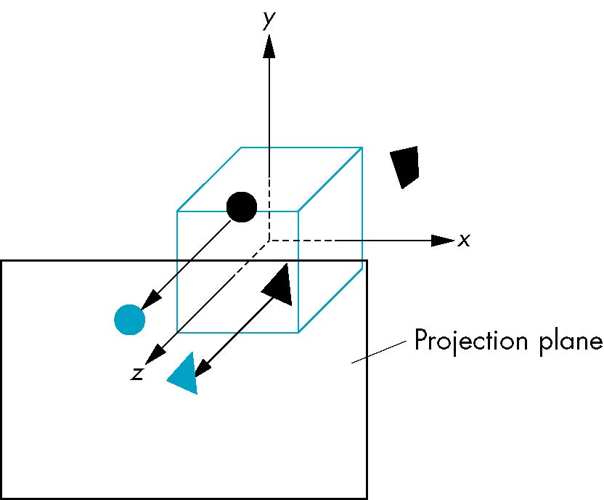
Default Projection
Default projection is orthogonal
clipped out
2
z=0
Angel and Shreiner: Interactive Computer Graphics 8E © Pearson Education 2020

Slide 8
Moving the Camera Frame
If we want to visualize objects with both positive and negative z values we can either
  Move the camera in the positive z direction
    Translate the camera frame
  Move the objects in the negative z direction
    Translate the world frame
Both of these views are equivalent and are determined by the model-view matrix
  Want a translation (translate(0.0,0.0,-d);)
  d > 0
Angel and Shreiner: Interactive Computer Graphics 8E © Pearson Education 2020

Slide 9
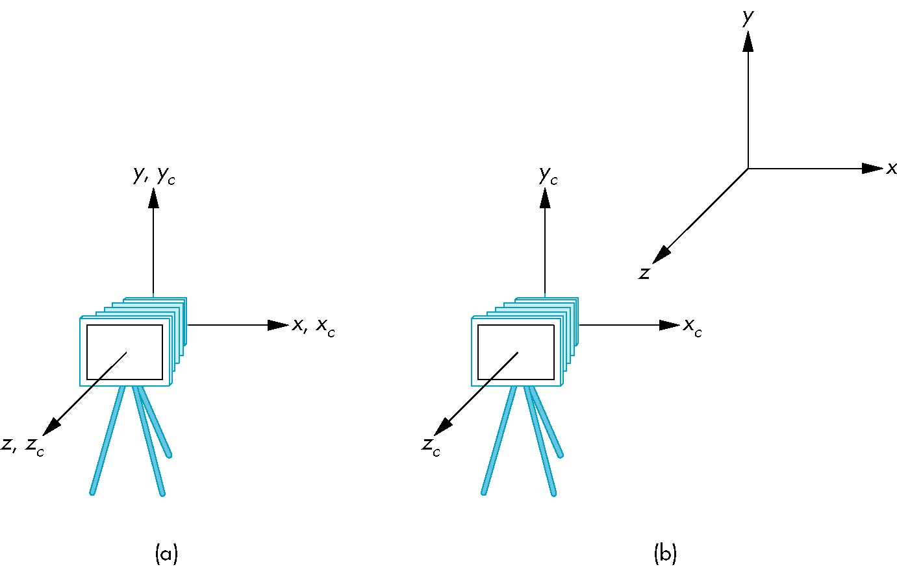
Moving Camera back from Origin
frames after translation by –d
d > 0
default frames
Angel and Shreiner: Interactive Computer Graphics 8E © Pearson Education 2020

Slide 10
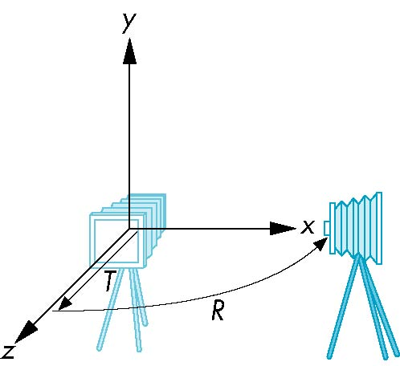
Moving the Camera
We can move the camera to any desired position by a sequence of rotations and translations
Example: side view
  Rotate the camera
  Move it away from origin
  Model-view matrix C = TR
Angel and Shreiner: Interactive Computer Graphics 8E © Pearson Education 2020

Slide 11
WebGL code
Remember that last transformation specified is first to be applied
// Using MV.js
var t = translate (0.0, 0.0, -d);
var ry = rotateY(90.0);
var m = mult(t, ry);
or
var m = mult(translate (0.0, 0.0, -d),
rotateY(90.0););
Angel and Shreiner: Interactive Computer Graphics 8E © Pearson Education 2020

Slide 12
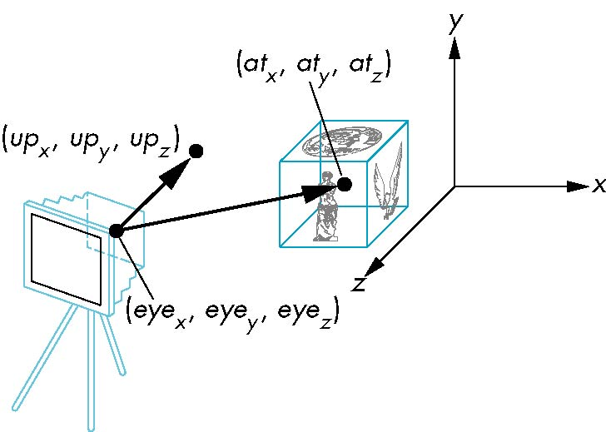
lookAt
LookAt(eye, at, up)
Angel and Shreiner: Interactive Computer Graphics 8E © Pearson Education 2020

Slide 13
The lookAt Function
The GLU library contained the function gluLookAt to form the required modelview matrix through a simple interface
Note the need for setting an up direction
Replaced by lookAt() in MV.js
  Can concatenate with modeling transformations
Example: isometric view of cube aligned with axes
var eye = vec3(1.0, 1.0, 1.0);
var at = vec3(0.0, 0.0, 0.0);
var up = vec3(0.0, 1.0, 0.0);
var mv = LookAt(eye, at, up);
Angel and Shreiner: Interactive Computer Graphics 8E © Pearson Education 2020

Slide 14
Other Viewing APIs
The LookAt function is only one possible API for positioning the camera
Others include
  View reference point, view plane normal, view up (PHIGS, GKS-3D)
  Yaw, pitch, roll
  Elevation, azimuth, twist
  Direction angles
Angel and Shreiner: Interactive Computer Graphics 8E © Pearson Education 2020

