Slide 1
Introduction to Computer Graphics with WebGL
Ed Angel
Professor Emeritus of Computer Science
Founding Director, Arts, Research, Technology and Science Laboratory
University of New Mexico
Angel and Shreiner: Interactive Computer Graphics 8E © Pearson Education 2020

Slide 2
Perspective Projection Matrices
Ed Angel
Professor Emeritus of Computer Science
University of New Mexico
Angel and Shreiner: Interactive Computer Graphics 8E © Pearson Education 2020

Slide 3
Objectives
Derive the perspective projection matrices used for standard WebGL projections
Angel and Shreiner: Interactive Computer Graphics 8E © Pearson Education 2020

Slide 4
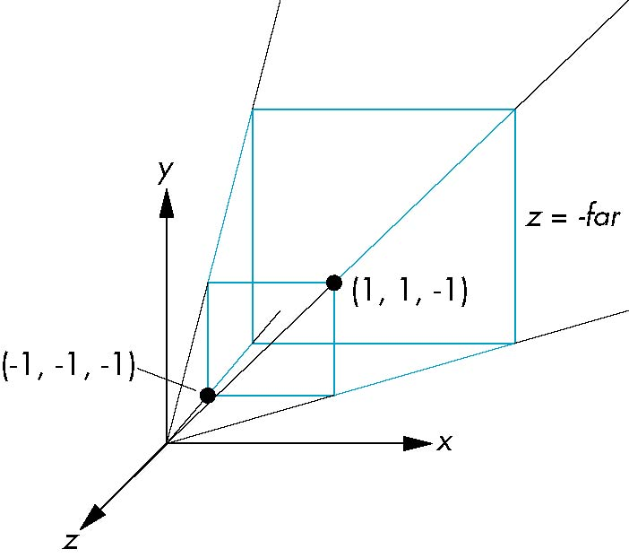
Simple Perspective
Consider a simple perspective with the COP at the origin, the near clipping plane at z = -1, and a 90 degree field of view determined by the planes
x = ±z, y = ±z
Angel and Shreiner: Interactive Computer Graphics 8E © Pearson Education 2020

Slide 5
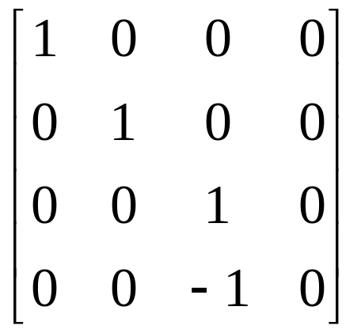
Perspective Matrices
Simple projection matrix in homogeneous coordinates
Note that this matrix is independent of the far clipping plane
M =
Angel and Shreiner: Interactive Computer Graphics 8E © Pearson Education 2020

Slide 6
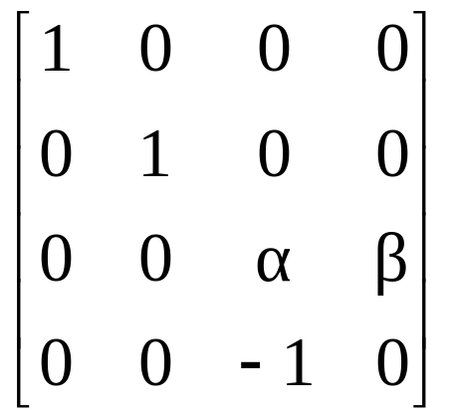
Generalization
N =
after perspective division, the point (x, y, z, 1) goes to
x’’ = x/z
y’’ = y/z
Z’’ = -(α+β/z)
which projects orthogonally to the desired point
regardless of α and β
Angel and Shreiner: Interactive Computer Graphics 8E © Pearson Education 2020

Slide 7
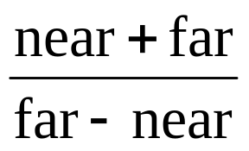
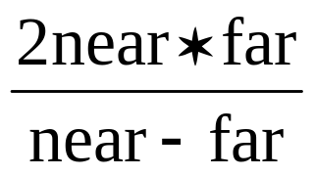
Picking α and β
If we pick
α =
β =
the near plane is mapped to z = -1
the far plane is mapped to z =1
and the sides are mapped to x = ± 1, y = ± 1
Hence the new clipping volume is the default clipping volume
Angel and Shreiner: Interactive Computer Graphics 8E © Pearson Education 2020

Slide 8
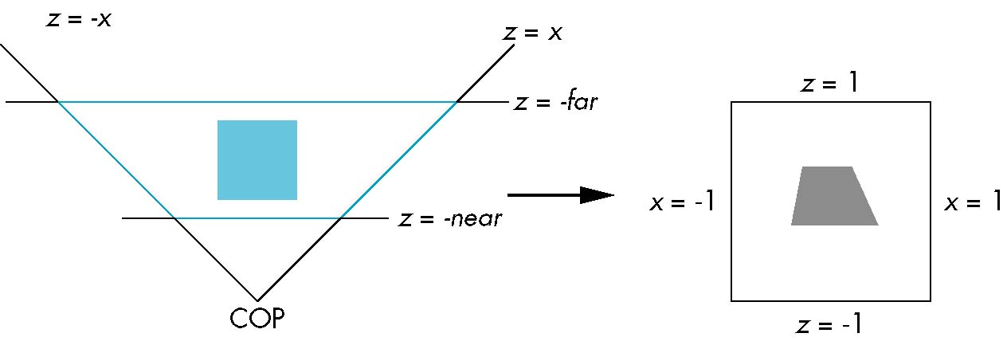
Normalization Transformation
distorted object
projects correctly
original clipping
volume
original object
new clipping
volume
Angel and Shreiner: Interactive Computer Graphics 8E © Pearson Education 2020

Slide 9
Normalization and Hidden-Surface Removal
Although our selection of the form of the perspective matrices may appear somewhat arbitrary, it was chosen so that if z₁ > z₂ in the original clipping volume then the for the transformed points z₁’ > z₂’
Thus hidden surface removal works if we first apply the normalization transformation
However, the formula z’’ = -(α+β/z) implies that the distances are distorted by the normalization which can cause numerical problems especially if the near distance is small
Angel and Shreiner: Interactive Computer Graphics 8E © Pearson Education 2020

Slide 10
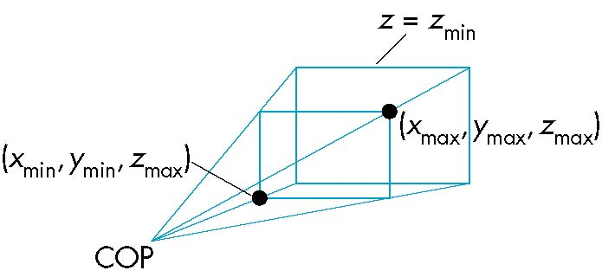
WebGL Perspective
gl.frustum allows for an unsymmetric viewing frustum (although gl.perspective does not)
Angel and Shreiner: Interactive Computer Graphics 8E © Pearson Education 2020

Slide 11
OpenGL Perspective Matrix
The normalization in Frustum requires an initial shear to form a right viewing pyramid, followed by a scaling to get the normalized perspective volume. Finally, the perspective matrix results in needing only a final orthogonal transformation
P = NSH
our previously defined
perspective matrix
shear and scale
Angel and Shreiner: Interactive Computer Graphics 8E © Pearson Education 2020

Slide 12
Why do we do it this way?
Normalization allows for a single pipeline for both perspective and orthogonal viewing
We stay in four dimensional homogeneous coordinates as long as possible to retain three-dimensional information needed for hidden-surface removal and shading
We simplify clipping
Angel and Shreiner: Interactive Computer Graphics 8E © Pearson Education 2020

Slide 13

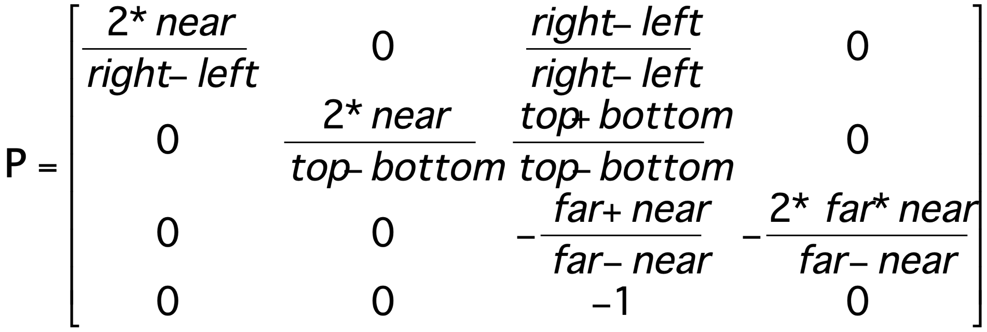
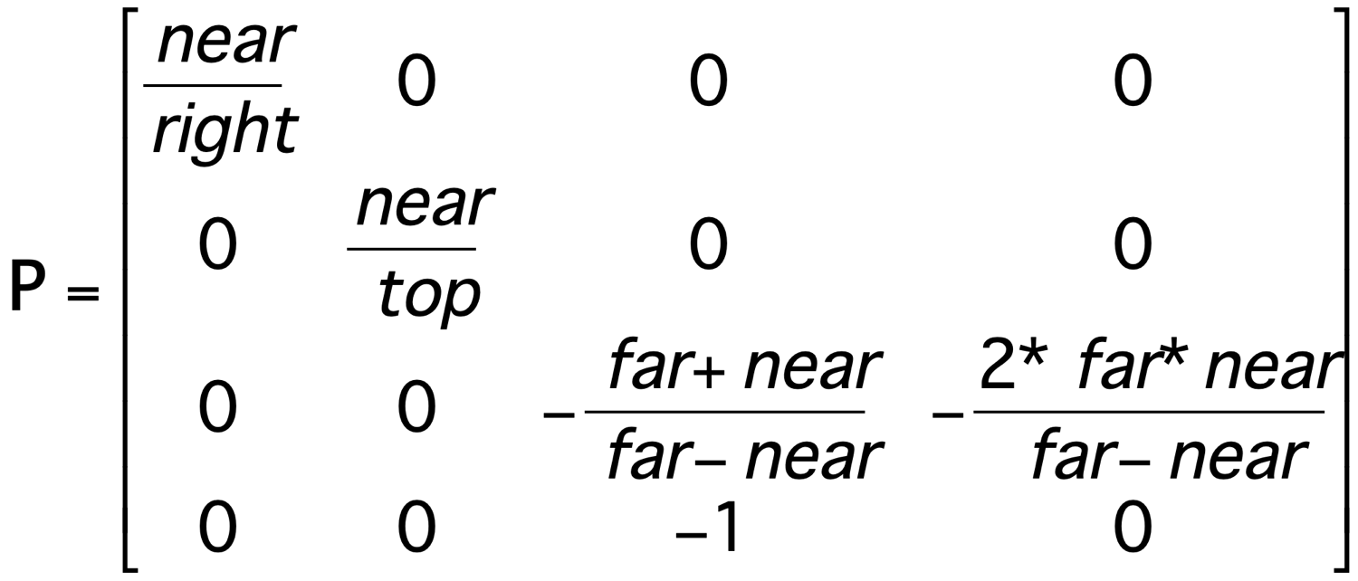
Perspective Matrices
frustum
perspective
Angel and Shreiner: Interactive Computer Graphics 8E © Pearson Education 2020

