Slide 1
Introduction to Computer Graphics with WebGL
Ed Angel
Professor Emeritus of Computer Science
Founding Director, Arts, Research, Technology and Science Laboratory
University of New Mexico
Angel and Shreiner: Interactive Computer Graphics 8E © Pearson Education 2020

Slide 2
BitBlt
Ed Angel
Professor Emeritus of Computer Science
University of New Mexico
Angel and Shreiner: Interactive Computer Graphics 8E © Pearson Education 2020

Slide 3
Objectives
Introduce reading and writing of blocks of bits or bytes
Prepare for later discussion compositing and blending
Angel and Shreiner: Interactive Computer Graphics 8E © Pearson Education 2020

Slide 4
Writing into Buffers
WebGL does not contain a function for writing bits into frame buffer
  Use texture functions instead
We can use the fragment shader to do bit level operations on graphics memory
Bit Block Transfer (BitBlt) operations act on blocks of bits with a single instruction
Angel and Shreiner: Interactive Computer Graphics 8E © Pearson Education 2020

Slide 5
BitBlt
Conceptually, we can consider all of memory as a large two-dimensional array of pixels
We read and write rectangular block of pixels
The frame buffer is part of this memory
memory
source
frame buffer
(destination)
writing into the frame buffer
Angel and Shreiner: Interactive Computer Graphics 8E © Pearson Education 2020

Slide 6
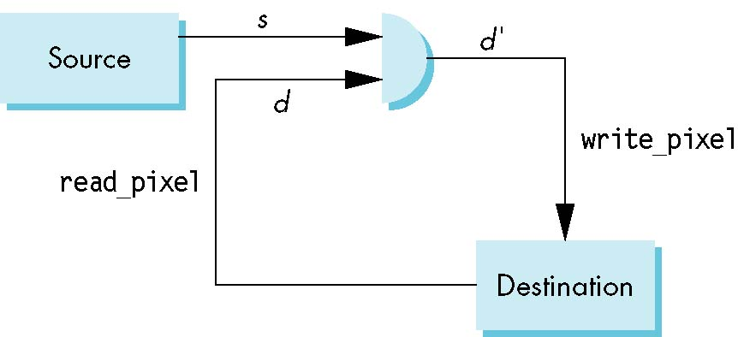
Writing Model
Read destination pixel before writing source
Angel and Shreiner: Interactive Computer Graphics 8E © Pearson Education 2020

Slide 7
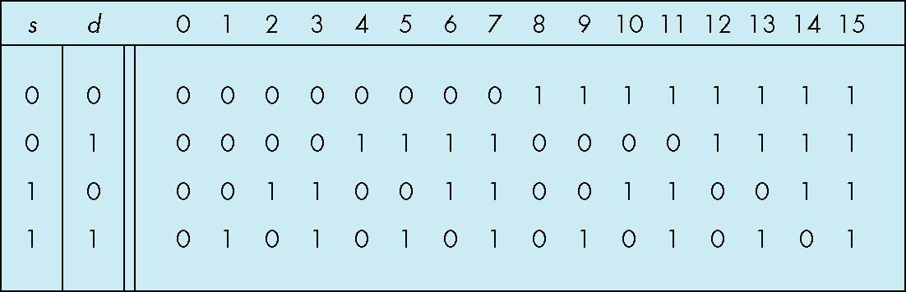
Bit Writing Modes
Source and destination bits are combined bitwise
16 possible functions (one per column in table)
replace
XOR
OR
Angel and Shreiner: Interactive Computer Graphics 8E © Pearson Education 2020

Slide 8
XOR mode
XOR is especially useful for swapping blocks of memory such as menus that are stored off screen
Same strategy used for rubber band lines and cursors
If S represents screen and M represents a menu
the sequence
S ← S ⊕ M
M ← S ⊕ M
S ← S ⊕ M
swaps S and M
Angel and Shreiner: Interactive Computer Graphics 8E © Pearson Education 2020

Slide 9
Cursor Movement
Consider what happens as we move a cursor across the display
We cover parts of objects
Must return to original colors when cursor moves away
Angel and Shreiner: Interactive Computer Graphics 8E © Pearson Education 2020

Slide 10
Rubber Band Line
Fix one point
Draw line to location of cursor
Must return state of crossed objects when line moves
Angel and Shreiner: Interactive Computer Graphics 8E © Pearson Education 2020

