Slide 1
Introduction to Computer Graphics with WebGL
Ed Angel
Professor Emeritus of Computer Science
Founding Director, Arts, Research, Technology and Science Laboratory
University of New Mexico
Angel and Shreiner: Interactive Computer Graphics 8E © Pearson Education 2020

Slide 2
WebGL Texture Mapping II
Ed Angel
Professor Emeritus of Computer Science
University of New Mexico
Angel and Shreiner: Interactive Computer Graphics 8E © Pearson Education 2020

Slide 3
Objectives
Introduce the WebGL texture functions and options
  texture objects
  texture parameters
  example code
Angel and Shreiner: Interactive Computer Graphics 8E © Pearson Education 2020

Slide 4
Using Texture Objects
specify textures in texture objects
set texture filter
set texture function
set texture wrap mode
set optional perspective correction hint
bind texture object
enable texturing
supply texture coordinates for vertex
  coordinates can also be generated
Angel and Shreiner: Interactive Computer Graphics 8E © Pearson Education 2020

Slide 5
Texture Parameters
WebGL has a variety of parameters that determine how texture is applied
  Wrapping parameters determine what happens if s and t are outside the (0,1) range
  Filter modes allow us to use area averaging instead of point samples
  Mipmapping allows us to use textures at multiple resolutions
  Environment parameters determine how texture mapping interacts with shading
Angel and Shreiner: Interactive Computer Graphics 8E © Pearson Education 2020

Slide 6
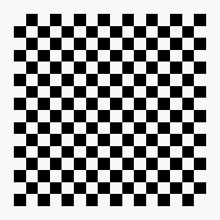
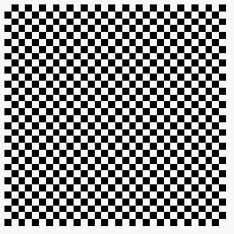

Wrapping Mode
Clamping: if s,t > 1 use 1, if s,t <0 use 0
Wrapping: use s,t modulo 1
  gl.texParameteri(gl.TEXTURE_2D,
  gl.TEXTURE_WRAP_S, gl.CLAMP )
  gl.texParameteri( gl.TEXTURE_2D,
  gl.TEXTURE_WRAP_T, gl.REPEAT )
t
s
gl.REPEAT
wrapping
gl.CLAMP
wrapping
texture
Angel and Shreiner: Interactive Computer Graphics 8E © Pearson Education 2020

Slide 7
Magnification and Minification
More than one texel can cover a pixel (minification) or
more than one pixel can cover a texel (magnification)
Can use point sampling (nearest texel) or linear filtering
( 2 x 2 filter) to obtain texture values
Texture
Polygon
Texture
Polygon
Magnification
Minification
Angel and Shreiner: Interactive Computer Graphics 8E © Pearson Education 2020

Slide 8
Filter Modes
Modes determined by
  gl.texParameteri( target, type, mode )
gl.texParameteri(gl.TEXTURE_2D, gl.TEXURE_MAG_FILTER,
GL_NEAREST);
gl.texParameteri(gl.TEXTURE_2D, gl.TEXURE_MIN_FILTER,
gl.LINEAR);
Angel and Shreiner: Interactive Computer Graphics 8E © Pearson Education 2020

Slide 9
Mipmapped Textures
Mipmapping allows for prefiltered texture maps of decreasing resolutions
Lessens interpolation errors for smaller textured objects
Declare mipmap level during texture definition
  gl.texImage2D(gl.TEXTURE_*D, level, … )
Angel and Shreiner: Interactive Computer Graphics 8E © Pearson Education 2020

Slide 10
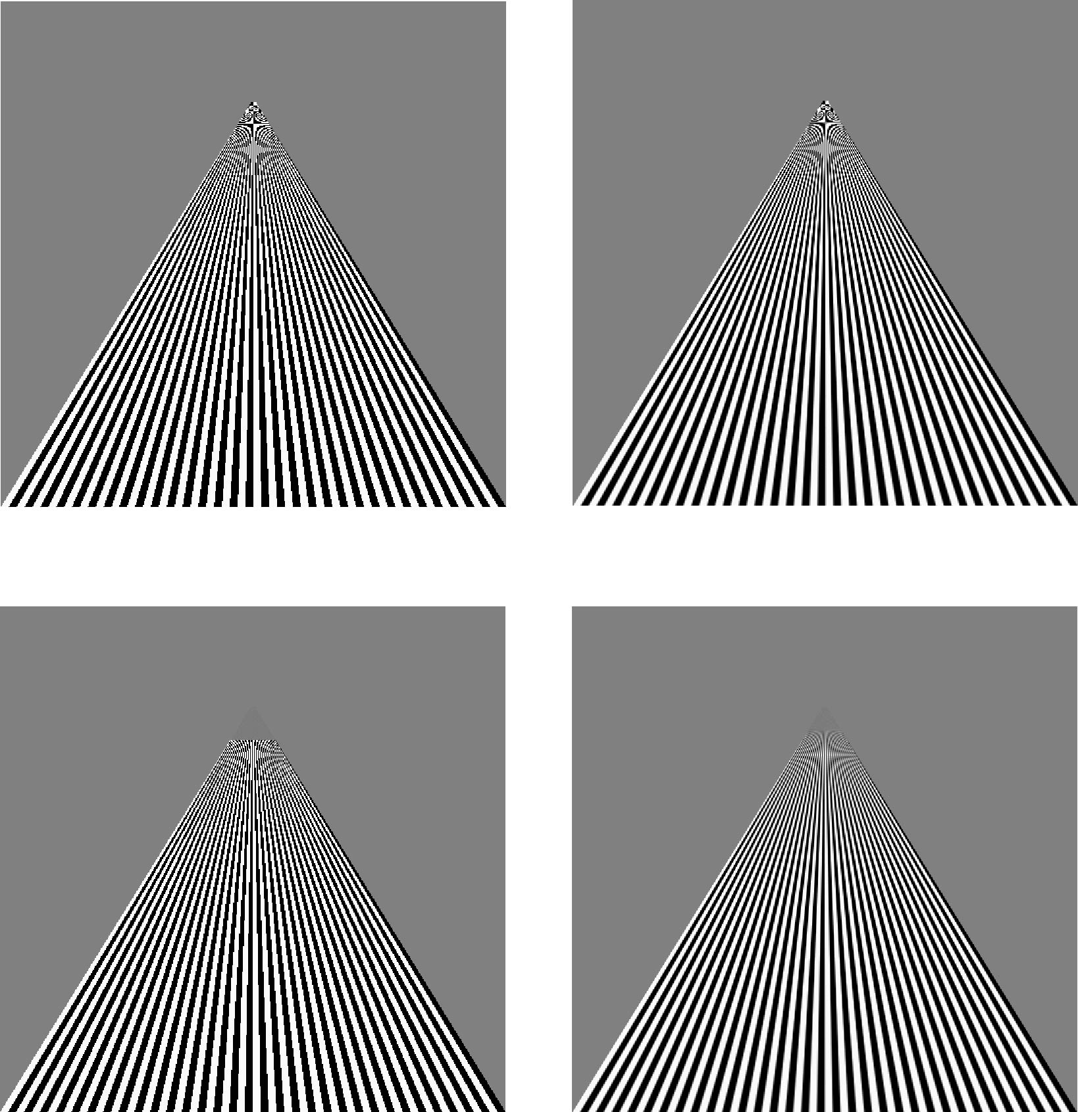
Example
point
sampling
linear
filtering
mipmapped
point
sampling
mipmapped
linear
filtering
Angel and Shreiner: Interactive Computer Graphics 8E © Pearson Education 2020

Slide 11
Applying Textures
Texture can be applied in many ways
  texture fully determines color
  modulated with a computed color
  blended with and environmental color
Fixed function pipeline has a function glTexEnv to set mode
  deprecated
  can get all desired functionality via fragment shader
Can also use multiple texture units
Angel and Shreiner: Interactive Computer Graphics 8E © Pearson Education 2020

Slide 12
Other Texture Features
Environment Maps
  Start with image of environment through a wide angle lens
    Can be either a real scanned image or an image created in OpenGL
  Use this texture to generate a spherical map
  Alternative is to use a cube map
Multitexturing
  Apply a sequence of textures through cascaded texture units
Angel and Shreiner: Interactive Computer Graphics 8E © Pearson Education 2020

Slide 13
Applying Textures
Textures are applied during fragments shading by a sampler
Samplers return a texture color from a texture object
in vec4 vColor; //color from rasterizer
in vec2 vTexCoord; //texture coordinate from rasterizer
uniform sampler2D aTexture; //texture object from application
void main() {
gl_FragColor = vColor * texture ( aTexture, vTexCoord );
}
Angel and Shreiner: Interactive Computer Graphics 8E © Pearson Education 2020

Slide 14
Vertex Shader
Usually vertex shader will output texture coordinates to be rasterized
Must do all other standard tasks too
  Compute vertex position
  Compute vertex color if needed
in vec4 aPosition; //vertex position in object coordinates
in vec4 aColor; //vertex color from application
in vec2 aTexCoord; //texture coordinate from application
out vec4 vColor; //output color to be interpolated
out vec2 vTexCoord; //output tex coordinate to be interpolated
Angel and Shreiner: Interactive Computer Graphics 8E © Pearson Education 2020

Slide 15
A Checkerboard Image
var image1 = new Uint8Array(4*texSize*texSize);
for ( var i = 0; i < texSize; i++ ) {
for ( var j = 0; j <texSize; j++ ) {
var patchx = Math.floor(i/(texSize/numChecks));
var patchy = Math.floor(j/(texSize/numChecks));
if(patchx%2 ^ patchy%2) c = 255;
else c = 0;
//c = 255*(((i & 0x8) == 0) ^ ((j & 0x8) == 0))
image1[4*i*texSize+4*j] = c;
image1[4*i*texSize+4*j+1] = c;
image1[4*i*texSize+4*j+2] = c;
image1[4*i*texSize+4*j+3] = 255;
}
}
Angel and Shreiner: Interactive Computer Graphics 8E © Pearson Education 2020

Slide 16
Cube Example
var texCoord = [
vec2(0, 0),
vec2(0, 1),
vec2(1, 1),
vec2(1, 0)
];
function quad(a, b, c, d) {
pointsArray.push(vertices[a]);
colorsArray.push(vertexColors[a]);
texCoordsArray.push(texCoord[0]);
pointsArray.push(vertices[b]);
colorsArray.push(vertexColors[a]);
texCoordsArray.push(texCoord[1]);
// etc
Angel and Shreiner: Interactive Computer Graphics 8E © Pearson Education 2020

Slide 17
Texture Object
function configureTexture( image ) {
var uTexture = gl.createTexture();
gl.bindTexture( gl.TEXTURE_2D, texture );
gl.pixelStorei(gl.UNPACK_FLIP_Y_WEBGL, true);
gl.texImage2D( gl.TEXTURE_2D, 0, gl.RGB,
gl.RGB, gl.UNSIGNED_BYTE, image );
gl.generateMipmap( gl.TEXTURE_2D );
gl.texParameteri( gl.TEXTURE_2D, gl.TEXTURE_MIN_FILTER,
gl.NEAREST_MIPMAP_LINEAR );
gl.texParameteri( gl.TEXTURE_2D, gl.TEXTURE_MAG_FILTER,
gl.NEAREST );
gl.activeTexture(gl.TEXTURE0);
gl.uniform1i(gl.getUniformLocation(program, ”uTexture"), 0);
}
Angel and Shreiner: Interactive Computer Graphics 8E © Pearson Education 2020

Slide 18
Linking with Shaders
var aTexCoord = gl.getAttribLocation( program, ”aTexCoord" );
gl.enableVertexAttribArray( aTexCoord );
gl.vertexAttribPointer( aTexCoord, 2, gl.FLOAT, false, 0, 0);
// Set the value of the fragment shader texture sampler variable
// ("texture") to the the appropriate texture unit. In this case,
// zero for GL_TEXTURE0 which was previously set by calling
// gl.activeTexture().
gl.uniform1i( glGetUniformLocation(program, ”uTexture"), 0 );
Angel and Shreiner: Interactive Computer Graphics 8E © Pearson Education 2020

