Slide 1
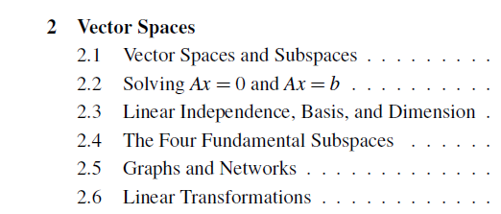
Chapter2 Vector Spaces

Slide 2
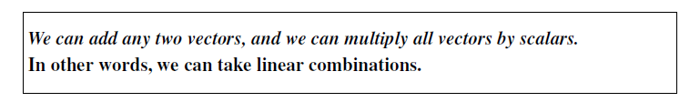
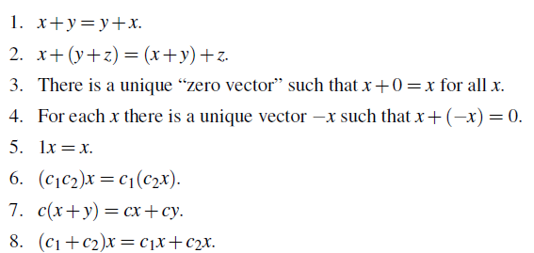
2.1 Vector Spaces

Slide 3


Examples of Spaces

Slide 4
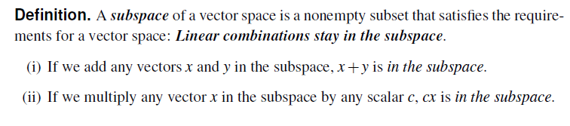
subspace

Slide 5


Column Space and Nullspace

Slide 6
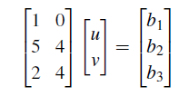
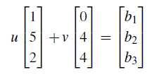
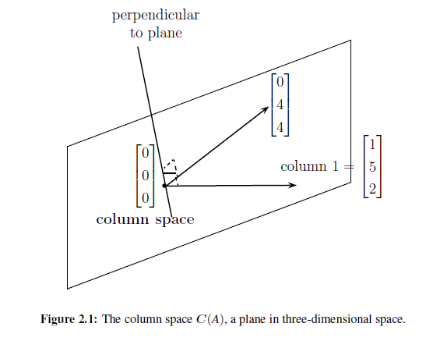

Slide 7
Problem Set 2.1
3,4,5,6,10,15,24,25,26.

Slide 8

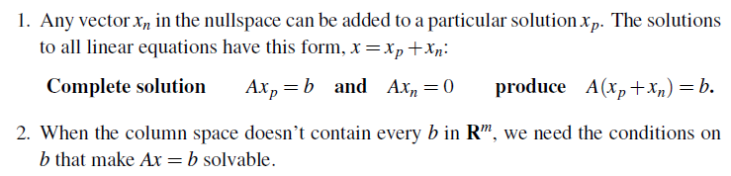
2.2 Solving Ax=0 and Ax=b

Slide 9

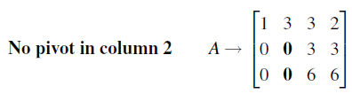
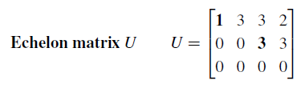
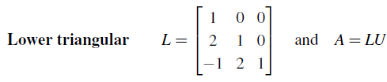

Slide 10
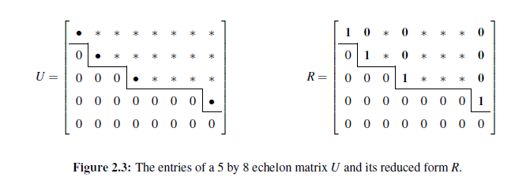

Echelon Form U and Row Reduced Form R

Slide 11
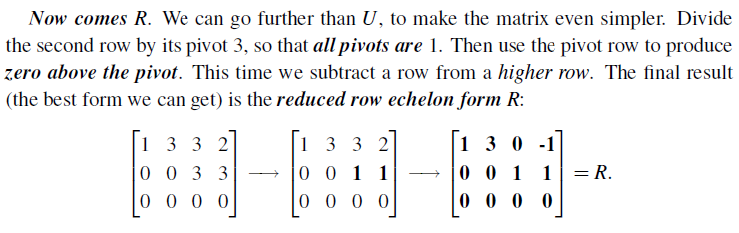
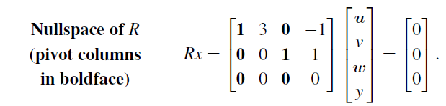

Slide 12
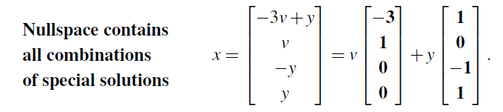
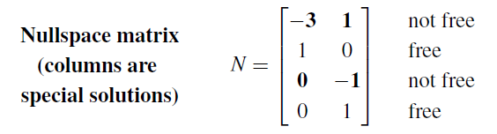

Slide 13
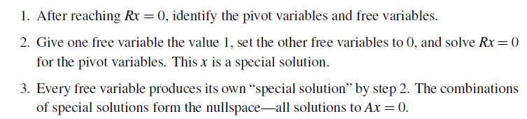

Pivot Variables and Free Variables

Slide 14

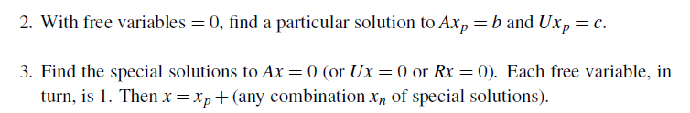
Solving Ax=b, Ux=c,and Rx=d

Slide 15
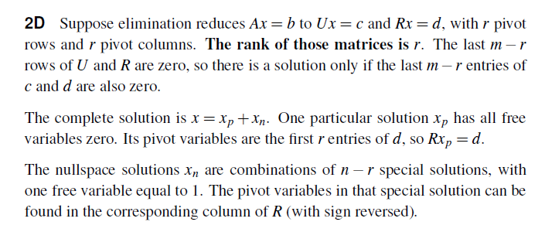

Slide 16
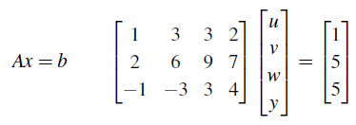
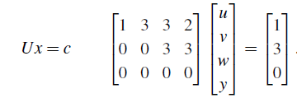
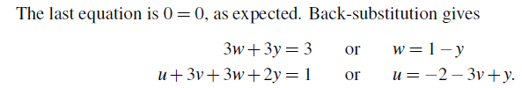
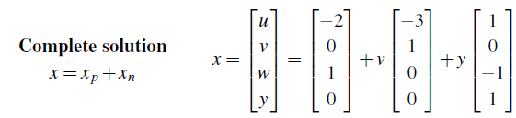

Slide 17
Problem Set 2.2
7,9,15,16,20,21,24,25,29,33,36,41,43,48,50,54,60.

Slide 18
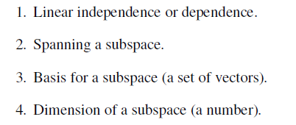
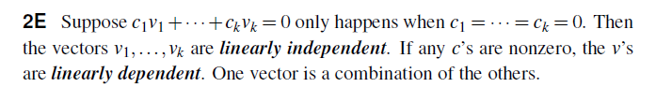
2.3 Linear Independence, Basis, and Dimension

Slide 19
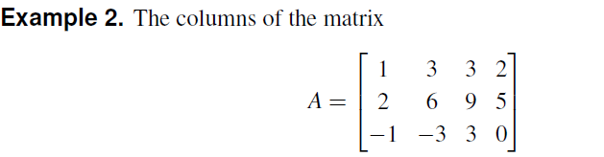
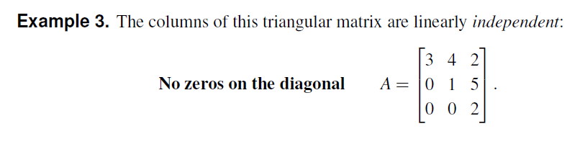

Slide 21
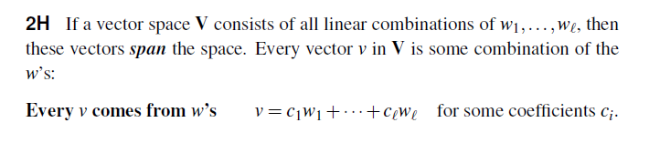
Spanning a Subspace
Example 7. The column space of A is exactly the space that is spanned by its columns.

Slide 22
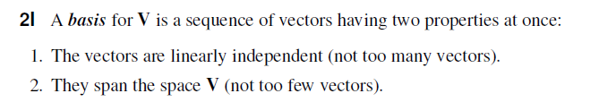
Basis for a Vector Space

Slide 23
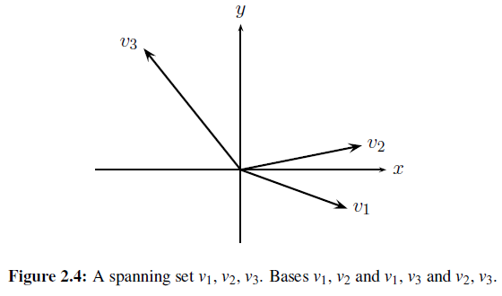

Dimension of a Vector Space

Slide 24
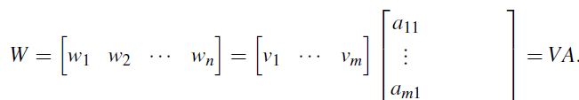
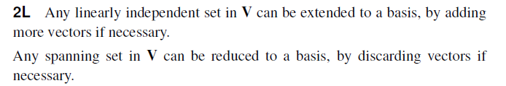

Slide 25
Problem Set 2.3
1,2,7,8,16,19,24,27,28,31,33,34.

Slide 26
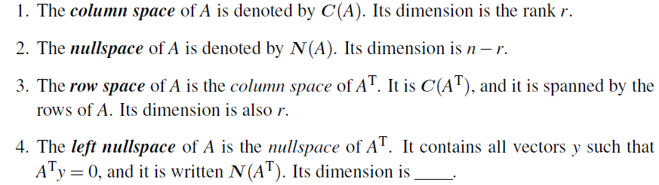
2.4 The Four Fundamental Subspaces

Slide 27
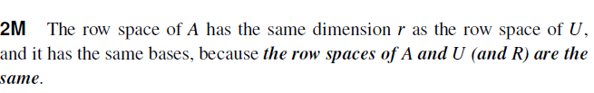
The row space of A

Slide 28
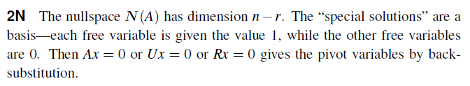
The nullspace of A

Slide 29
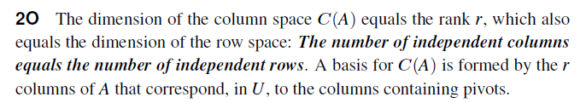
The column space of A
The reason is this: Ax = 0 exactly when Ux = 0.
The column space is sometimes called the range.

Slide 30
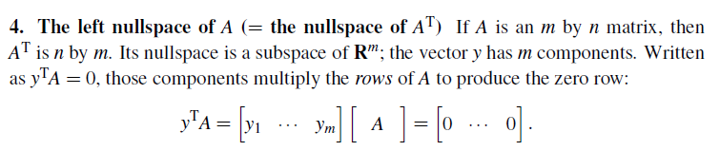
The left nullspace of A

Slide 31
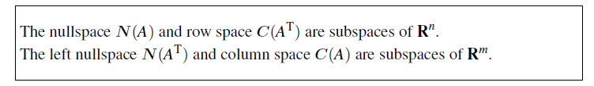

Slide 32
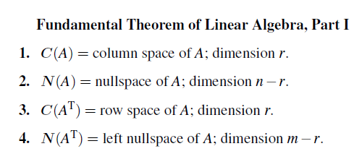
Fundamental Theorem of Linear Algebra

Slide 33

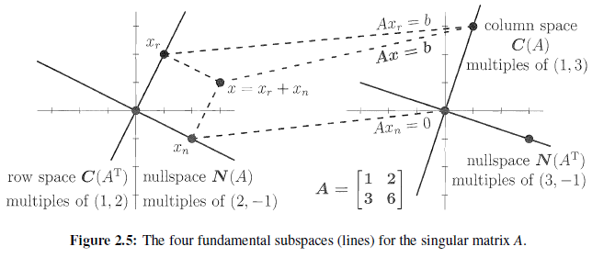

Slide 34
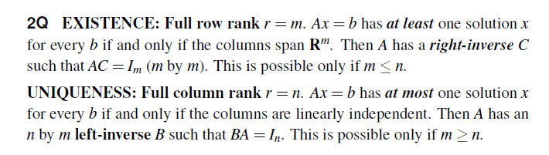

Existence of Inverses

Slide 35
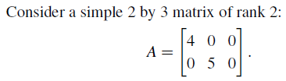
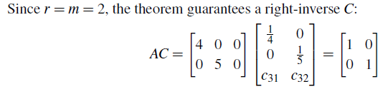



Slide 36
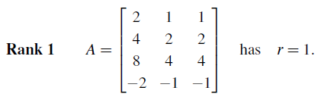

Matrices with Rank 1

Slide 37
Problem Set 2.4
3,5,10,16,25,27,29,38

Slide 38
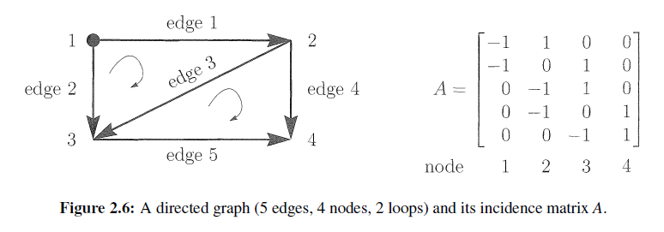
2.5 Graphs and Networks
A graph consists of a set of vertices or nodes, and a set of edges that connect them.
The graph in Figure 2.6 has 4 nodes and 5 edges.

Slide 39
Nullspace of A
The columns add up to the zero column.
The nullspace contains x = (1;1;1;1), since Ax = 0.
The nullspace of this incidence matrix is one-dimensional.
The rank is 4-1 = 3

Slide 40
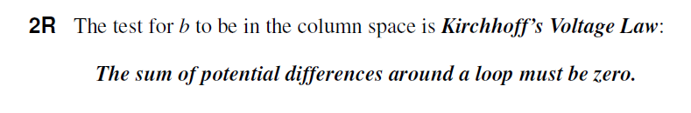
Column Space of A
The equation Ax = b asks: Given the differences b1, …,b5, find the actual potentials x1,…,x4.
For which differences b1, …,b5 can we solve Ax = b?

Slide 41
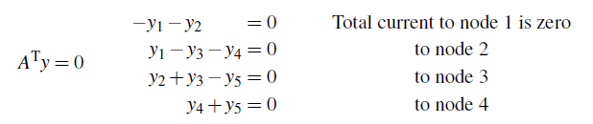

Left Nullspace of A

Slide 42
Row Space of A

Slide 43
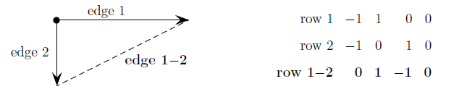
Spanning Trees and Independent Rows
At the end of elimination we have a full set of r independent rows.
Those r edges form a tree—a graph with no loops.

Slide 44
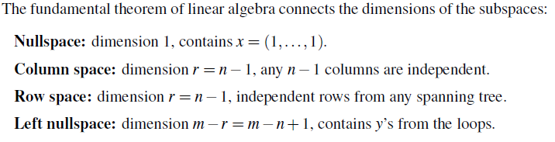

Slide 45


Networks and Discrete Applied Mathematics

Slide 46



Slide 47




Slide 48
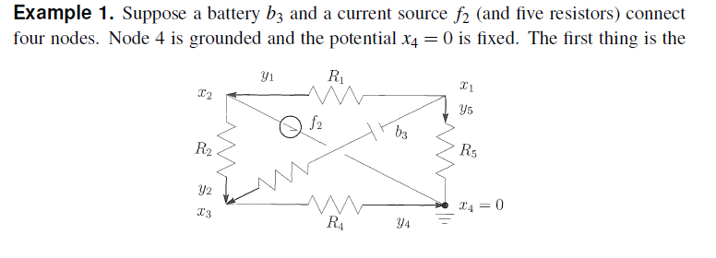
Example

Slide 49



Slide 50


Slide 51

2.6 Linear Transformations

Slide 52


4 Examples

Slide 53

Transformations Represented by Matrices

Slide 54


Example 1

Slide 55


Example 2

Slide 56


Slide 57


product of the transformations

Slide 58



Slide 59

Rotations, Projections, and Reflections

Slide 60



Slide 61
Problem Set 2.6
3,11,14,16,17,21,25,27,31,32,33,42,43,46,47,50.

Slide 62
Review Exercises
1.3, 1.5, 1.6, 1.13, 1.17, 1.18, 1.20, 1.23, 1.31, 1.33

