Slide 1




DATA SCIENCE FOR
CRYPTO MARKET VOLATILITY
|
Team: CryptoKoi
Notes:
1、Hello everyone. Today our team, CryptoKoi, will be presenting our project “Data Science for Crypto Market Volatility.”
In this project, we focus on understanding how crypto markets move over time, and how we can build a data-driven platform that helps investors make better timing decisions.

Slide 2







Team: CryptoKoi
Connor Yeh
Data Engineer
Kacey Zhu
Project Manager
Jiayi Yao
Risk Analyst
Qi Hu
Data Analyst
Yue Shen
Data Engineer
Notes:
2、Here is our team.
We have Jiayi as our Risk Analyst,
I’m Qi, the Data Analyst,
Connor and Yue are our Data Engineers,
and Kacey is our Project Manager.
Together, we combined financial insights, engineering skills, and analytics to build an end-to-end crypto analysis platform.

Slide 3

Agenda
Executive summary
Research objectives
Data Profile
Methodology & Tools
Insights
Recommendations
Lessons Learned
References
Notes:
3、Here is the structure of today’s presentation.
We’ll begin with the executive summary, then walk through our research objectives, the data profile, and our methodology.
After that, we’ll share our insights, recommendations, and lessons learned before finishing with references.

Slide 4
01 Executive summary
Notes:
This first section provides a quick overview of what problem we are solving and why this project matters.

Slide 5
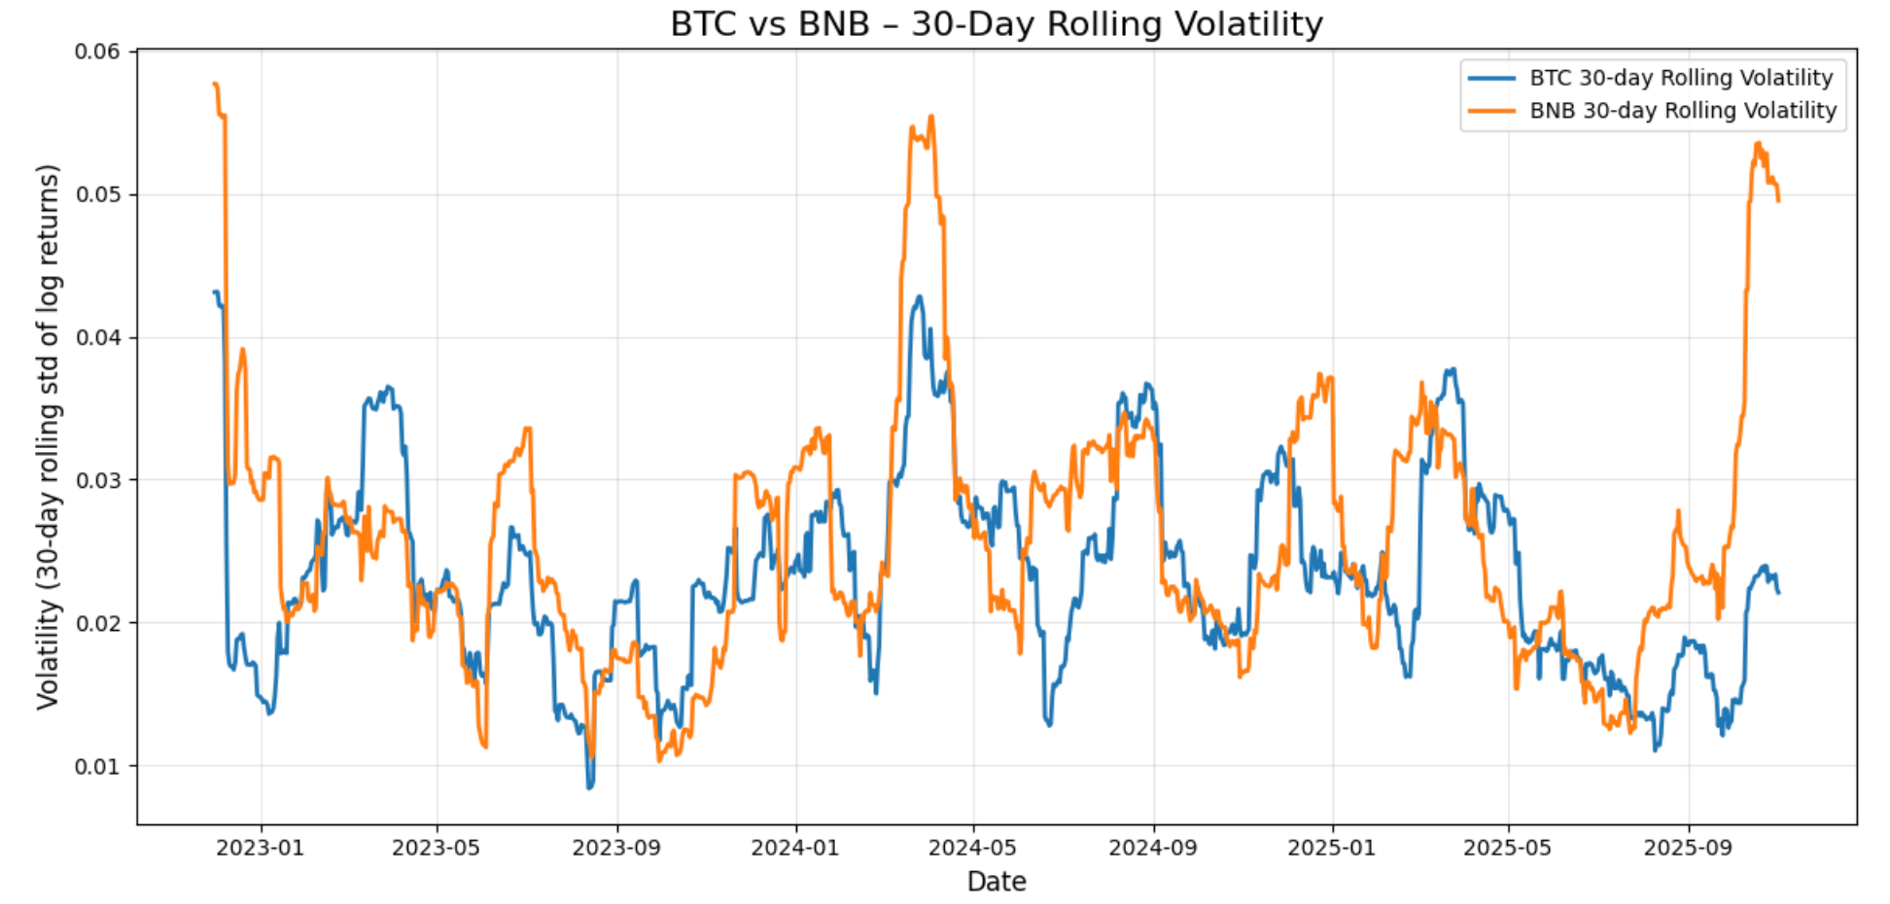
EXECUTIVE SUMMARY
Crypto price and volume patterns vary by hour, weekday, and season, yet investors lack data-driven timing guidance.
We organize BTC/BNB OHLCV data into a structured analytical database and identify when each asset is most suitable for high-risk vs. low-risk investors.
Notes:
first，Crypto markets behave very differently depending on the hour of the day, the weekday, and the season.
But investors usually don’t have clear, data-driven guidance on when to trade.
So in our project, we structured BTC and BNB OHLCV data into a clean analytical database.
With this structure, we analyze patterns in volatility and trading activity, and identify the optimal timing for high-risk versus low-risk investors.

Slide 6
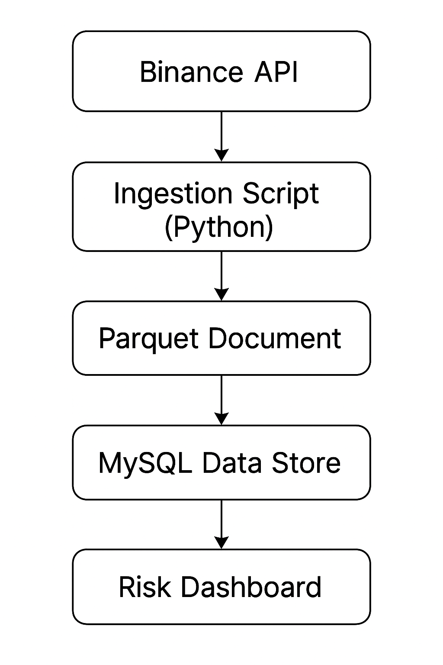

EXECUTIVE SUMMARY
Solution
Value Proposition
An integrated platform that provides:
Structures BTC/BNB OHLCV data for analytical use.
Provides time-based insights on volatility and trading activity.
Identifies optimal investment windows for high-risk and low-risk investors.
Enables investors and analysts to:
Understand hourly, weekly, and seasonal market patterns.
Compare BTC vs. BNB based on risk and activity levels.
Make data-driven, timing-based investment decisions.
Notes:
It organizes the raw Binance API data, provides time-based insights, and supports comparisons between BTC and BNB.
For investors and analysts, this helps answer three key questions:
• What are the hourly, weekly, and seasonal patterns?
• How do BTC and BNB differ in risk and activity?
• And when is the best time to invest, depending on the investor’s risk appetite?
and we can see look at the right side,This pipeline—from API extraction, to Parquet storage, to MySQL, to dashboards—creates a reliable foundation for deeper analytics later in the presentation.

Slide 7
EXECUTIVE SUMMARY
Solution
Value Proposition
An integrated platform that provides:
Structures BTC/BNB OHLCV data for analytical use
Provides time-based insights on volatility and trading activity
Identifies optimal investment windows for high-risk and low-risk investors
Enables investors and analysts to:
Understand weekly, and seasonal market patterns
Compare BTC vs. BNB based on risk and activity levels
Make data-driven, timing-based investment decisions
02 Research objectives
Notes:
Thanks QI, let’s move on to research objective.

Slide 8
RESEARCH OBJECTIVES
Problems to be solved：
Objective 1:
Objective 2:
What types of data will be present in the financial data set of virtual currencies? What kind of database and data structure is most suitable for conducting short-term and long-term business analyses?
When should high-risk and low-risk investors invest in BTC or BNB, based on time-based crypto trading patterns such as weekday, month, or season?
Notes:
Our project has two main research objectives.
The first is to understand what data exists in crypto OHLCV datasets and to build a database structure that supports business analysis.
The second is to study time-based trading patterns—such as weekday, month, and season—to identify when high-risk and low-risk investors should choose BTC or BNB.

Slide 9

RESEARCH OBJECTIVES
Data Source
Dataset Structure
Key Fields
Binance API – 30-minute OHLCV data
Assets: BTC/USDT and BNB/USDT
Time range: Nov 2022 – Oct 2025 (~3 years)
~52,627 rows × 13 attributes per asset
Columnar Parquet format (efficient for analytics)
Price: open, high, low, close
Volume: volume, quote_asset_volume
Market activity: num_trades, taker_buy_base / taker_buy_quote
Timestamp: open_time, close_time
Asset | Rows | Columns | Years
BTC | 52627 | 13 | 3
BNB | 52627 | 13 | 3
Notes:
Now I’ll explain the dataset we use.
The data comes from Binance and includes 30-minute OHLCV records for BTC and BNB from 2022 to 2025.
Each asset has around fifty-two thousand rows and thirteen columns, stored in Parquet format for fast processing.
The key information includes prices, volumes, market activity, and timestamps.

Slide 10
EXECUTIVE SUMMARY
Solution
Value Proposition
An integrated platform that provides:
Structures BTC/BNB OHLCV data for analytical use
Provides time-based insights on volatility and trading activity
Identifies optimal investment windows for high-risk and low-risk investors
Enables investors and analysts to:
Understand weekly, and seasonal market patterns
Compare BTC vs. BNB based on risk and activity levels
Make data-driven, timing-based investment decisions
03 Data Profile
Notes:
Let’s move on to data profile

Slide 11
DATA PROFILE
Aggregations
Computed 30-minute log returns.
Generated 30-day rolling volatility.
Derived VWAP & daily aggregated OHLC metrics.
Created daily summary table (fact_ohlcv_daily) for high-level analytics.
Outliers & Anomalies
No missing OHLCV values across BTC/BNB datasets.
Removed duplicated candles based on (symbol, interval, open_time).
Zero-volume rows handled using VWAP adjustment.
Verified integrity: no negative prices, no null volumes.
Methods
BTC and BNB datasets share identical schema.
No merging/joining needed; analyzed independently.
Notes:
Here is a quick overview of our data quality checks and processing.
First, we confirmed that there were no missing OHLCV values and removed duplicated candles based on symbol, interval, and open time.
Zero-volume rows were adjusted using VWAP, and we verified that all prices and volumes were valid.
We then created several useful metrics, including 30-minute log returns, 30-day rolling volatility, VWAP, and daily aggregated OHLC values.
Finally, since BTC and BNB share the same schema, we analyzed them independently but with the same method.

Slide 12
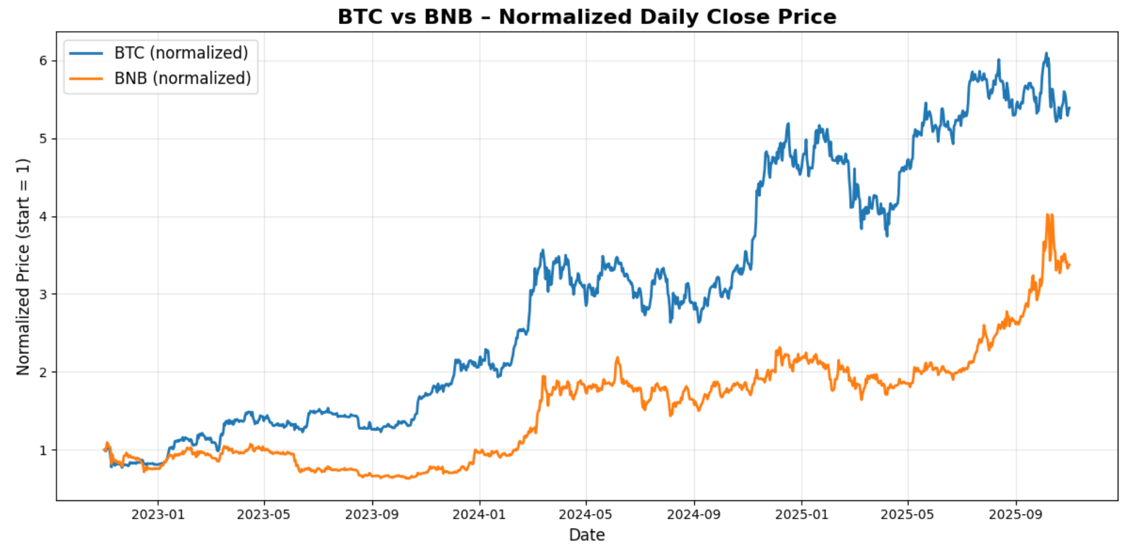
DATA PROFILE
BTC and BNB follow similar overall trends, but BTC exhibits significantly stronger growth and higher volatility, indicating greater risk and forecasting value.
Notes:
This chart gives us a simple view of how BTC and BNB have moved over time.
Both assets move in a similar overall direction, but BTC shows much stronger growth and higher volatility.This means BTC carries higher potential returns but also higher risk, which is important for our later analysis on investor timing.

Slide 13
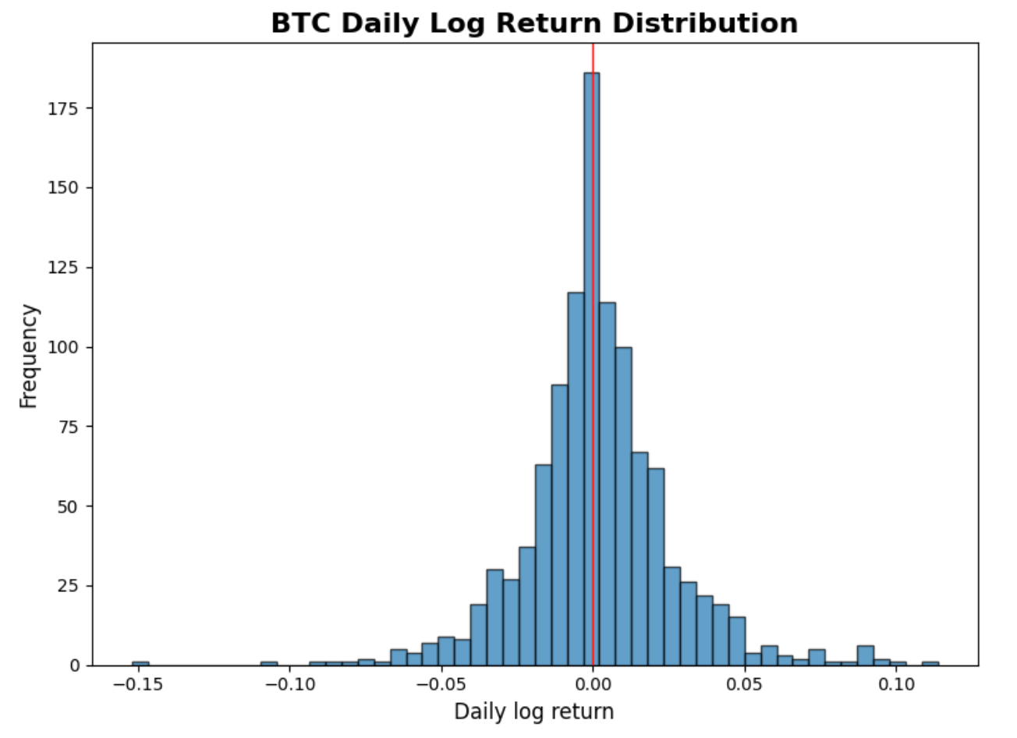

DATA PROFILE
BTC daily returns cluster near zero but display clear fat-tailed behavior, highlighting the asset’s exposure to extreme price movements.
Notes:
This chart gives us a clear view of BTC’s daily log returns.
Most returns stay close to zero, but the distribution has obvious fat tails.
This means BTC sometimes experiences very large price movements, which shows a higher level of risk.
Understanding this behavior helps us evaluate how BTC behaves under different market conditions.

Slide 14
04 Methodology & Tools

Slide 15
DATABASE TYPE & RATIONALE
OLTP vs OLAP
– OLTP systems optimize fast writes & transactions (e.g., Binance API raw ingestions).
– OLAP systems optimize analytical queries, aggregations, and historical reporting.
Why OLAP for this project?
– The dataset is time-series OHLCV data requiring historical lookback and analytical queries.
– We perform aggregations (daily candles), dimensional modeling, and reporting → OLAP fits.

Slide 16
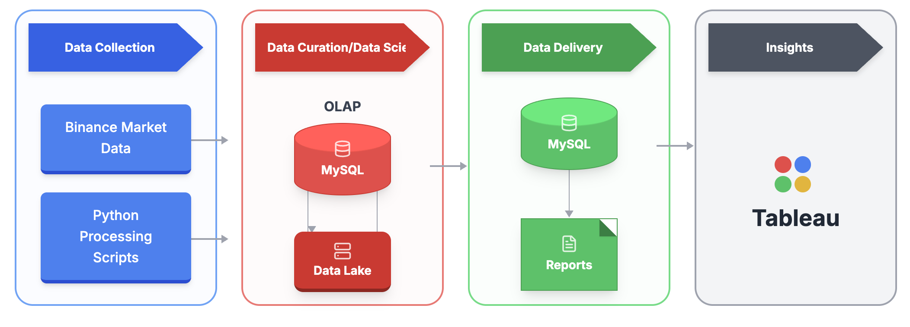
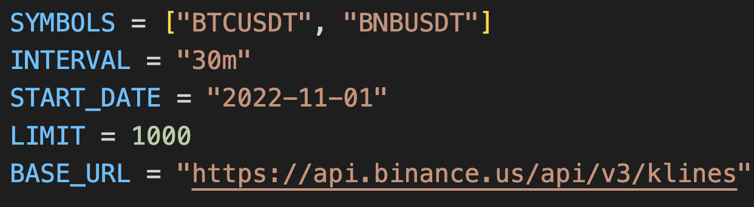
DATA PLATFORM
Our process！

Slide 17
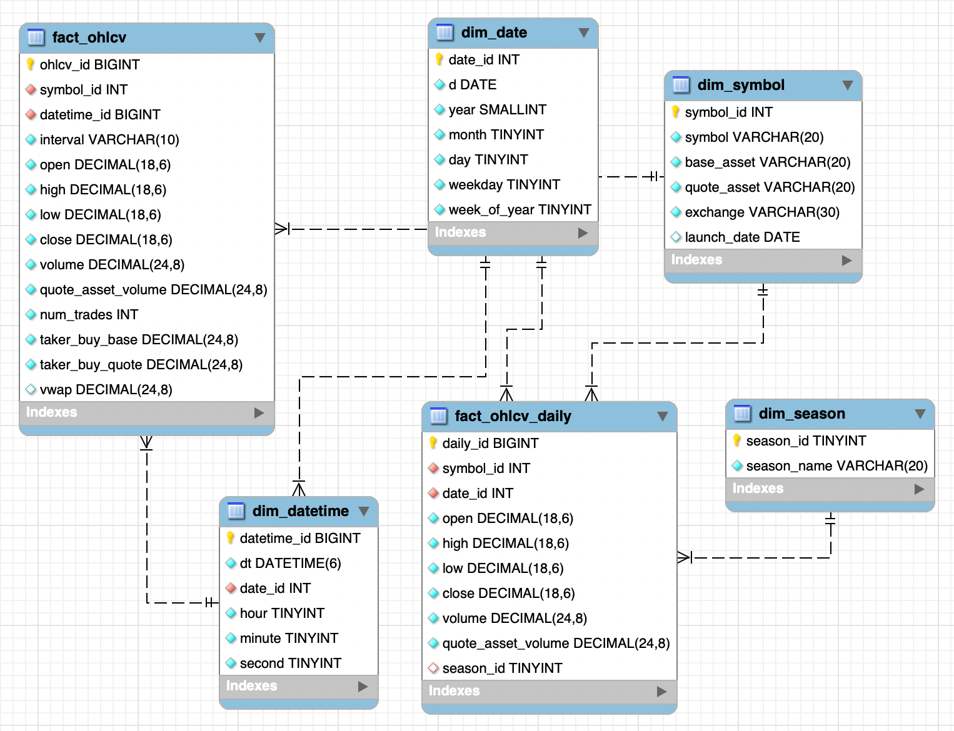

DATA MODELING & SCHEMA DESIGN
Overview of Star Schema：
Two fact tables store 30-minute and daily OHLCV metrics.
Dimension tables (symbol, date, time, season) provide analytical context.
Supports multi-dimensional analysis across symbols, time, and seasons.
Simple, extensible structure ideal for BI dashboards and ML forecasting.

Slide 18
AUTOMATED DATA PIPELINE:
From Binance API to MySQL Warehouse
Data Extraction
Python script retrieves OHLCV data for multiple crypto pairs (BTCUSDT, BNBUSDT).
Uses Binance /klines endpoint with pagination logic to fetch historical 30-minute candles.
Converts timestamps and cleans numeric fields.
Raw OHLCV data stored as Parquet files.
Load Into MySQL
Second Python script loads Parquet into MySQL:
Populates dim_symbol, dim_date, dim_datetime.
Inserts normalized OHLCV records into fact_ohlcv.
VWAP generated column handled inside MySQL.
Daily Aggregation
SQL job aggregates 30-minute candles into daily OHLCV in fact_ohlcv_daily:
Computes open, high, low, close, volume, quote volume.
Adds season_id by joining with dim_date to support seasonal analytics.

Slide 19
05 Insights

Slide 20

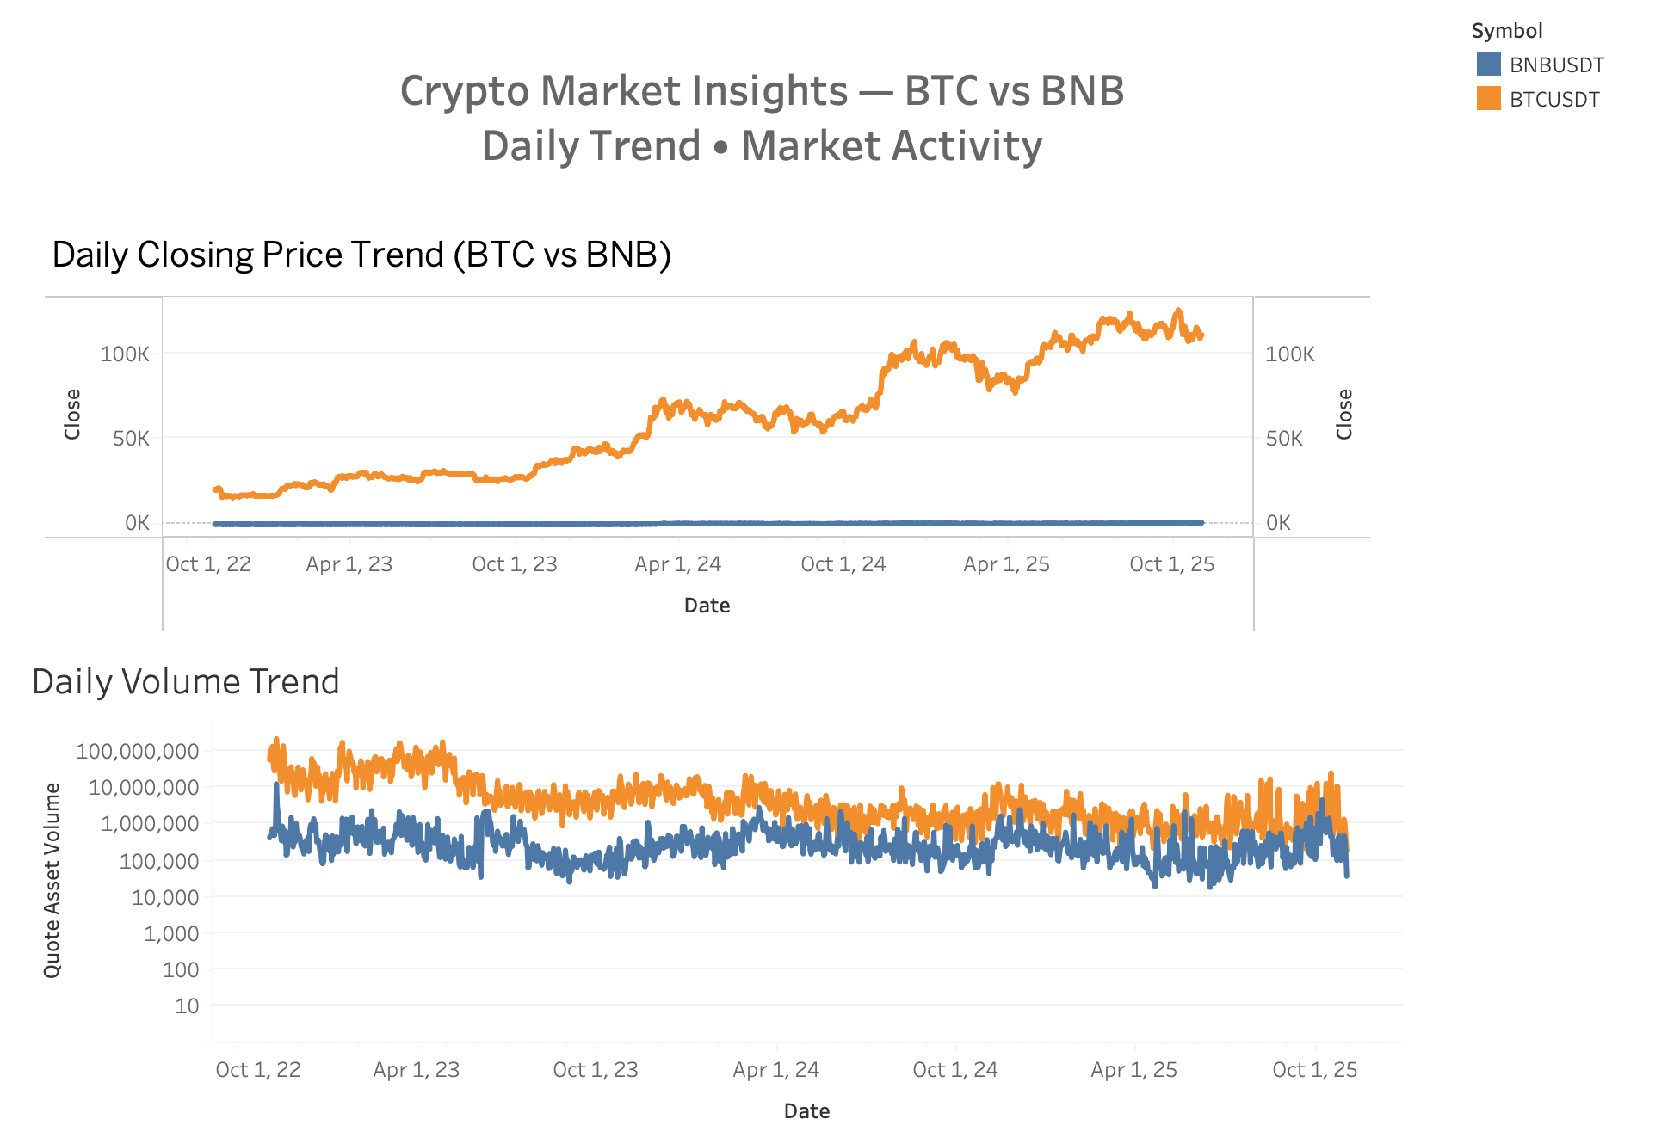

INSIGHTS & DASHBOARDS
Key Insights
BTC exhibits significantly higher price volatility across all time periods, while BNB remains more stable.
BNB shows consistently lower trading volume, suggesting a smaller but more stable user base.
Market activity (volume) has gradually declined for both assets, indicating potential market cooling or reduced speculative trading.
Notes:
We want to share the insights we found by using tableau desktop. Let us start with the daily trends.
Here, we compare BTC and BNB on price and trading volume.
First, BTC shows much higher price volatility.
The price moves a lot more every day, while BNB is more stable.
Second, BNB consistently has lower trading volume.
This suggests a smaller, but more stable user base.
Finally, market activity has been slowing down for both coins.
Volume keeps dropping, which may reflect cooling demand or less speculative trading.

Slide 21
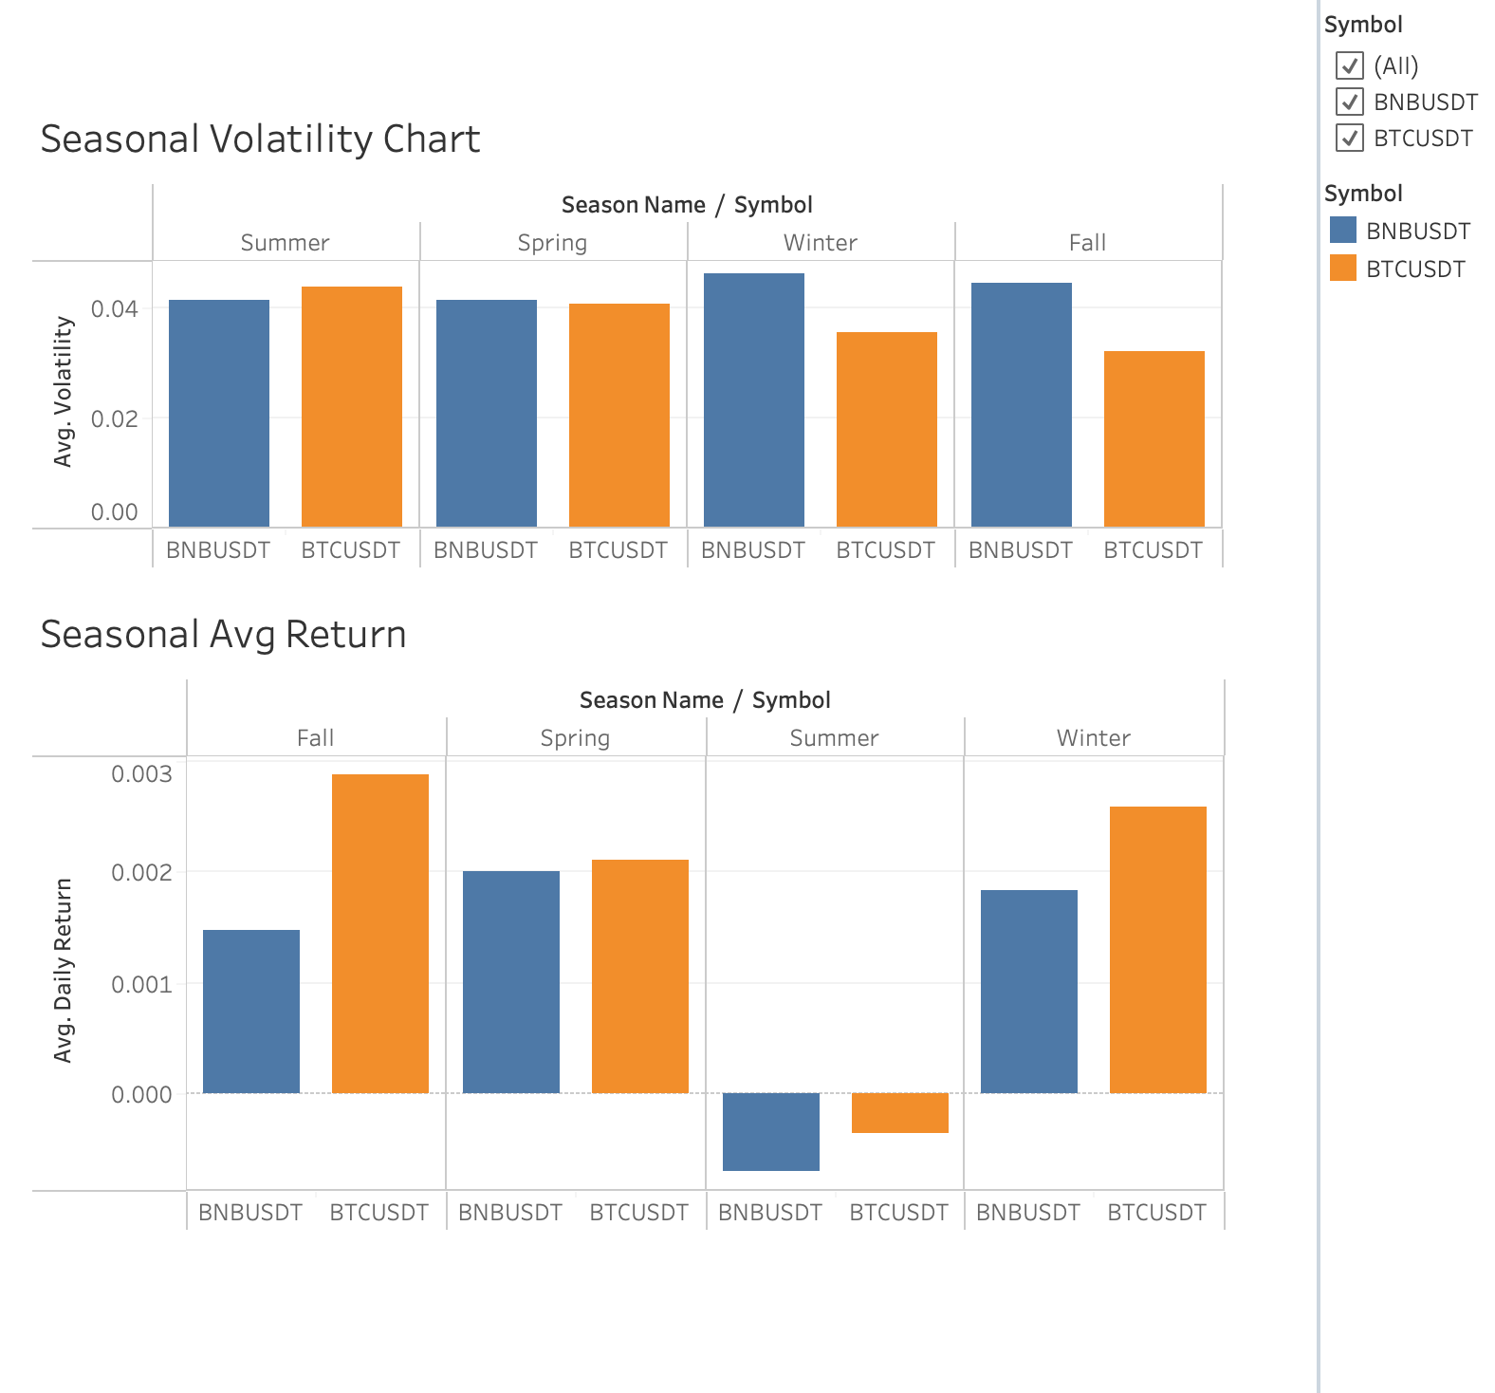
INSIGHTS & DASHBOARDS
BTC and BNB follow completely different seasonal patterns. BTC volatility is lowest in Winter and Fall, suggesting more stable price behavior in colder seasons. BNB volatility peaks in Winter and Fall, showing the opposite seasonal pattern compared to BTC.
BTC’s average daily return is higher than BNB’s average daily return in Fall, Spring, Summer, and Winter.
BTC delivers its highest returns in Fall (+0.29%) and Winter (+0.26%), while BNB performs well in Spring season (+0.20%).
Both BTC and BNB show negative average daily returns in Summer, making it the least favorable season for investors.
Notes:
Next, let’s look at seasonality. BTC and BNB show completely different seasonal patterns.
For BTC, volatility is lowest in Winter and Fall.
That means BTC is more stable in colder seasons.
For BNB, volatility peaks in Winter and Fall.
So it actually follows the opposite pattern compared to BTC.
In terms of returns, BTC outperforms BNB in every season.
Fall and Winter deliver the strongest returns for BTC.
BNB performs best in Spring.
And Summer is the weakest season for both coins.
Average returns are negative in Summer, which makes it the least favorable season to invest.

Slide 22
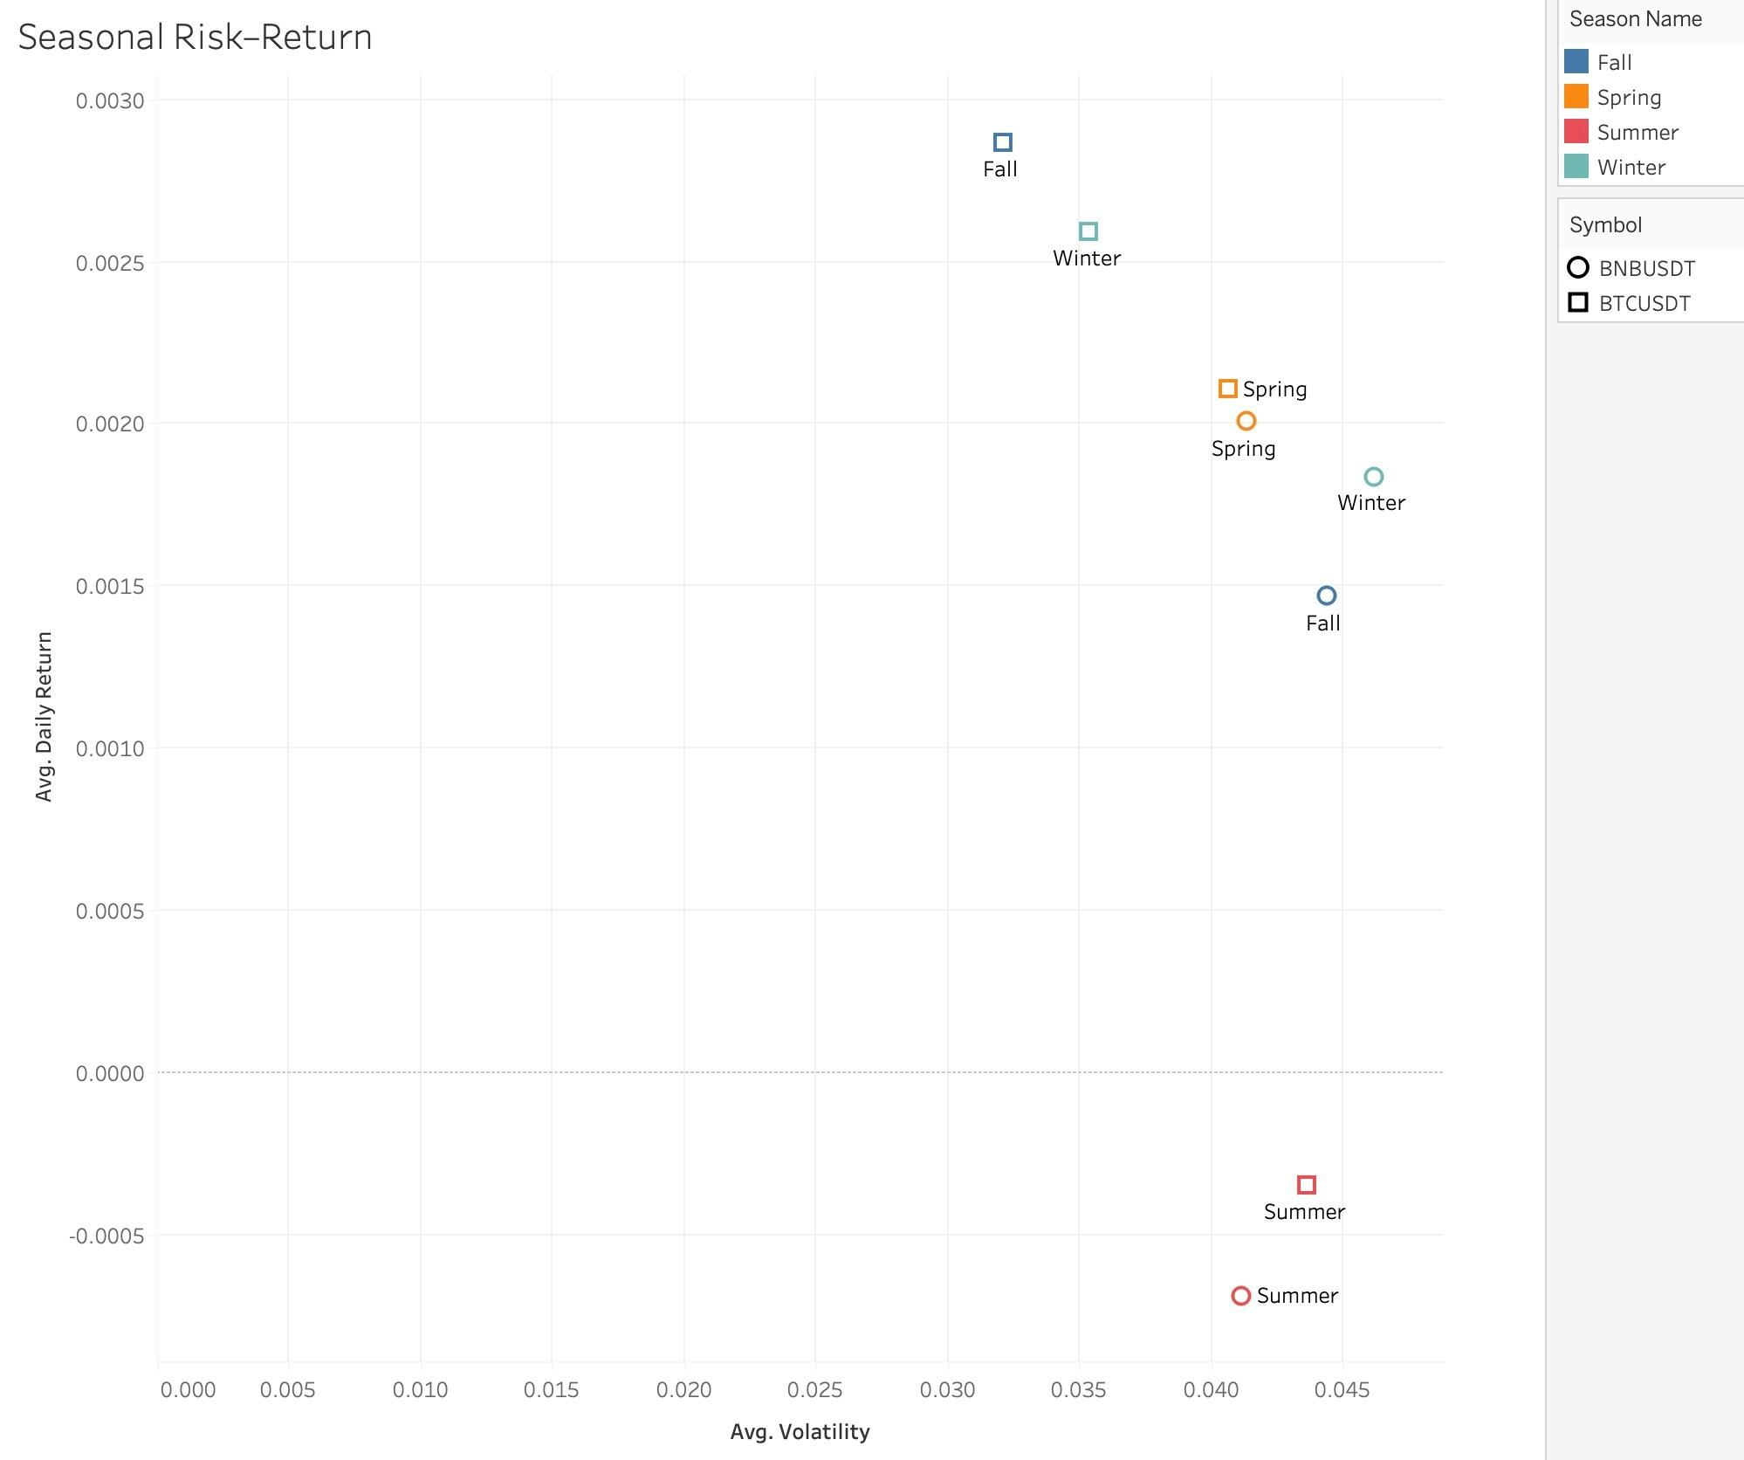
INSIGHTS & DASHBOARDS
BNB shows a “high-risk, low-return” profile, it does not deliver higher returns to justify the risk. The average seasonal returns are generally lower than BTC.
For low-risk investors, BTC is a better option, and Fall is the best risk-return season for investment.
Summer is clearly unattractive: it combines the highest volatility with negative average returns. Neither low-risk nor high-risk investors are really rewarded in Summer.
Notes:
This chart combines risk and returns into one view.
BNB shows a ‘high-risk, low-return’ profile.
It takes more risk, but does not give higher returns.
BTC gives a better trade-off between risk and return, especially in Fall.
So for low-risk investors, BTC in the Fall season is the most attractive choice.
Summer again stands out as unattractive.
It has the highest risk and negative returns.
Neither high-risk nor low-risk investors are rewarded in Summer.

Slide 23
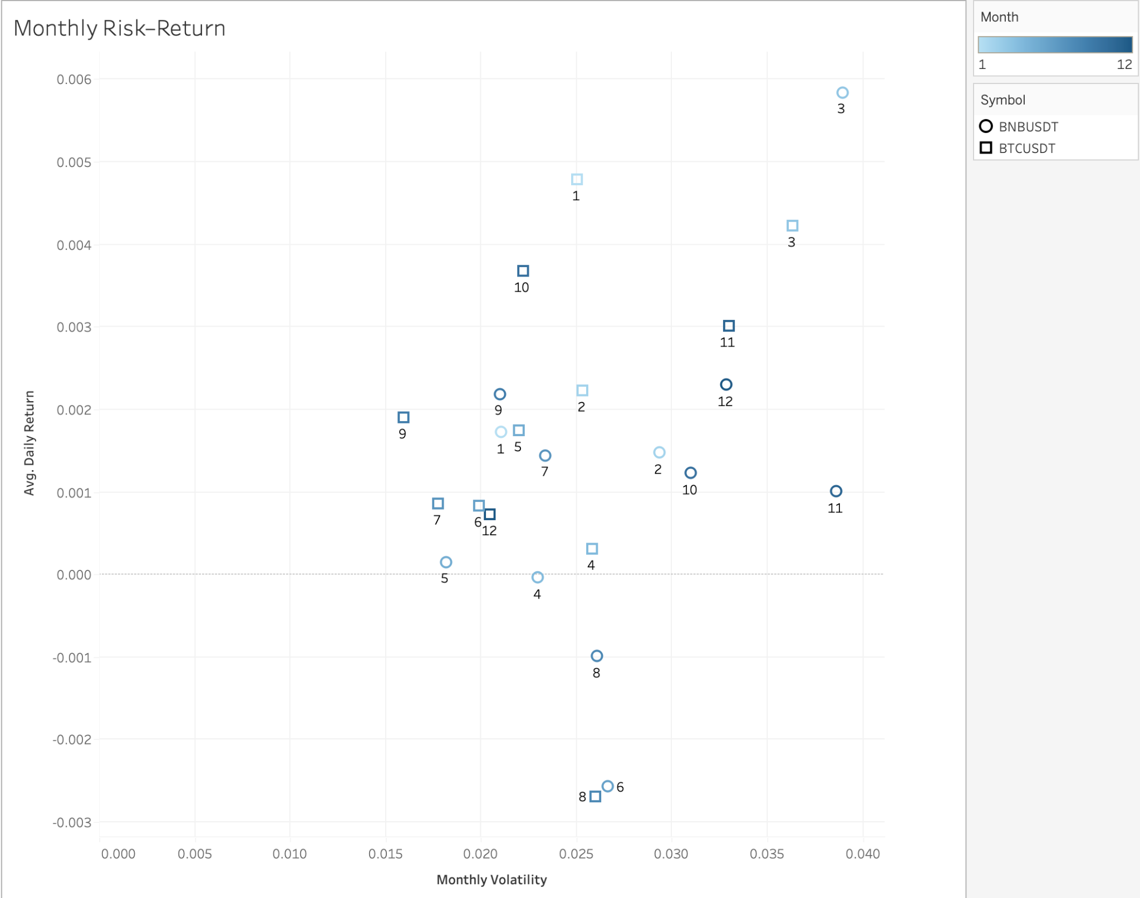
INSIGHTS & DASHBOARDS
Monthly performance is highly dispersed, especially for BNB. In March, BNB has the highest daily return and also the highest volatility.
Both BTC and BNB show weaker performance from June to August (summer seasons), with lower or negative returns.
For a similar level of volatility, BTC tends to produce higher or more stable returns than BNB.
Notes:
Now we move to monthly performance.
Monthly results are highly scattered, especially for BNB.
In March, BNB reaches both its highest return and its highest volatility.
From June to August, which is the summer period, both BTC and BNB show weaker performance.
Returns are lower or even negative.
We also observe that for the same level of volatility, BTC tends to produce higher or more stable returns than BNB.

Slide 24
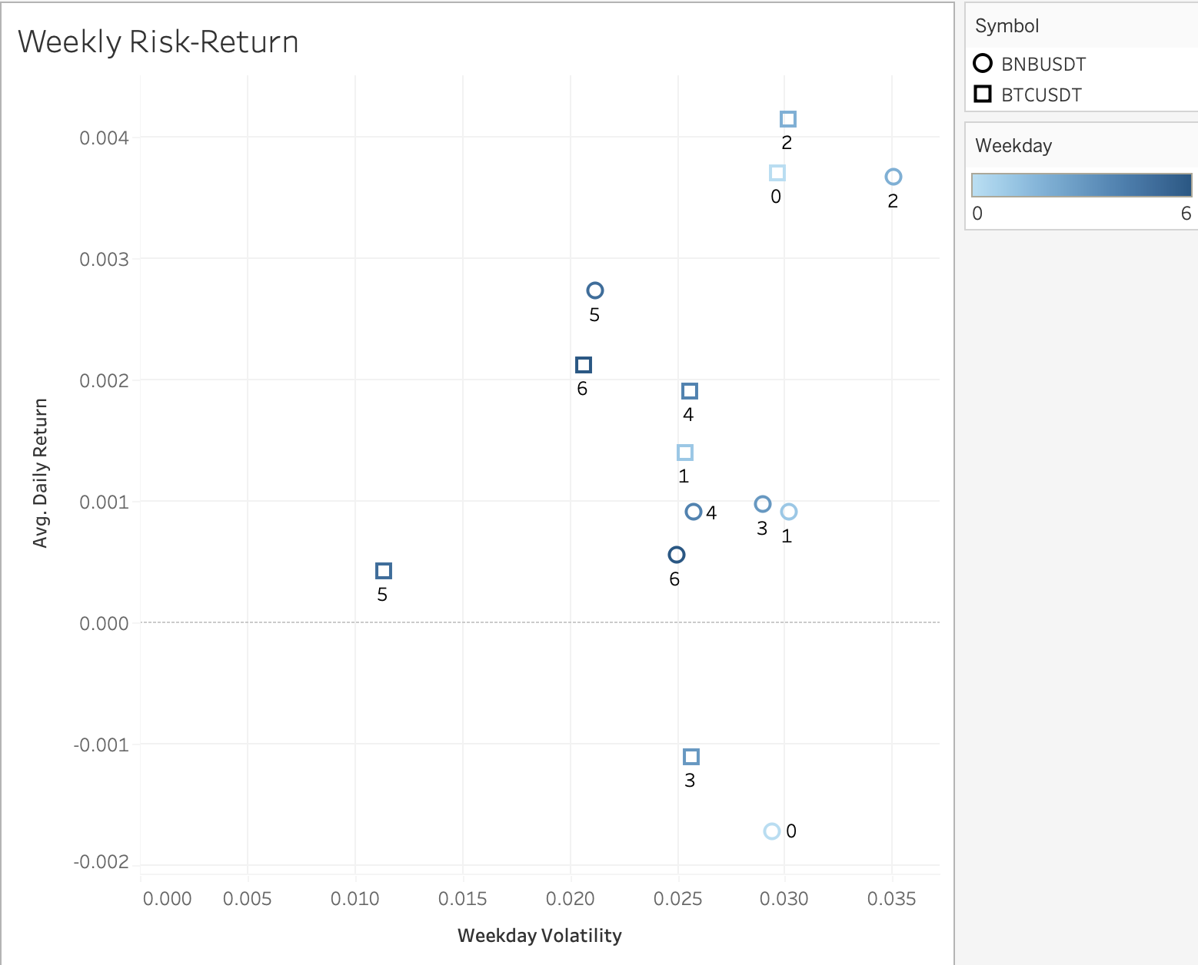
INSIGHTS & DASHBOARDS
For both BTC and BNB, Wednesday (2) clearly has the highest returns with highest weekday volatility.
Monday (0) shows the widest performance gap between BTC and BNB. BTC delivers positive high returns, while BNB shows negative returns.
Notes:
Finally, let’s look at weekly patterns. In the graph, we use number 0 to represent Monday, and 1 to represent Tuesday, and so on.
We can see.. for both BTC and BNB, Wednesday shows the strongest performance.
It has the highest returns along with higher weekday volatility.
Monday shows the widest performance gap between the two coins.
BTC gives a strong positive return on Monday,
while BNB actually shows negative returns.
This difference makes Monday an important day for investors to watch.

Slide 25
06 Recommendations
Notes:
So based on our project, here are some recommendations

Slide 26
DESIGN CONSIDERATIONS
MySQL OLAP Warehouse：
OHLCV is structured time-series data requiring historical lookbacks and aggregations; MySQL with a star schema provides efficient analytical performance.
Robust Pipeline Architecture：
API → Parquet → MySQL → Tableau is clean, maintainable, and easily extendable to additional trading pairs.
Parquet as an Intermediate Layer：
Columnar compression enables fast reads and efficient storage, while supporting future cloud data-lake migration.
Notes:
In terms of our design considerations,
We chose MySQL as an OLAP warehouse because our OHLCV data is highly structured and requires historical lookbacks, aggregations, and star-schema queries. A relational OLAP system performs these tasks much more efficiently than NoSQL or an OLTP engine.
Overall, our pipeline—Python to Parquet to MySQL to Tableau—is clean, maintainable, and easy to scale to more trading pairs. And since the data structure is consistent, we don’t see an immediate need for a NoSQL solution.
We also used Parquet as an intermediate storage layer—it’s compact, fast for column-based analytics, and gives us flexibility to move to a cloud data lake in the future.

Slide 27
CORRECTIVE MEASURES
Enhance Data Quality Checks
Automate the Pipeline instead of manually executing Python scripts:
Optimize Schema and Indexing:
Currently, the pipeline places too much trust in API data. To improve, we can add duplicate detection, schema validation, and anomaly identification to improve pipeline reliability, enhance the stability of forecasting and also make the pipeline more automated.
The current process is manual ingestion. We can use Airflow or Prefect to schedule 30-minute ingestions and daily aggregations, enabling near real-time updates.
Further improve query performance for fact_ohlcv and fact_ohlcv_daily.
Notes:
We have 3 corrective measures.
Right now, the pipeline works well, but we can strengthen it by adding more data quality checks such as duplicate detection, schema validation, and anomaly alerts.
We also recommend automating the pipeline using Airflow or Prefect so the system can refresh 30-minute candles and daily aggregates automatically, making the dashboard near real-time.
Finally, we can further optimize the schema and indexing to improve analytical query performance.

Slide 28
SCOPE FOR IMPROVEMENT
Cloud Architecture Expansion: Move storage to S3/GCS and adopt Snowflake/BigQuery for scalable analytics.
Enhance Database Design & Data Governance:
Improve indexing, time-based partitioning, and automated data validation to ensure high performance, strong data integrity, and production-level reliability.
Add More Market Indicators:
Incorporate order-book depth, funding rates, liquidation data and sentiment signals to enhance data integrity and also makes the dashboard closer to real transaction scenarios.
Notes:
For future improvement.
A major next step is enhance database design & data governance. for example, we can improve indexing, time-based partitioning, and automated data validation to ensure high performance, strong data integrity, and production-level reliability.
Another key measure is scaling the system to the cloud, for example using S3 or GCS for storage and Snowflake or BigQuery for scalable analytics.
In the long term, we can also adding more market signals, such as order-book depth, funding rates, and sentiment features to enhance data integrity and also makes the dashboard closer to real transaction scenarios.

Slide 29
07 Lessons Learned

Slide 30
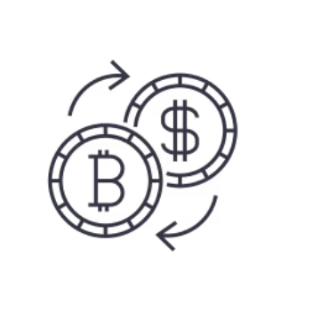



LESSONS LEARNED
Technical & Engineering Learnings | Data Pipeline & Integration
Star schema enables efficient time-series analytics. Parquet improves storage efficiency and ingestion speed. Separating raw and aggregated facts improves scalability. | Pipeline design must align with BI needs. Data validation is essential, even with clean APIs. Automation enables near real-time analytics.
Notes:
something we learned from this project, was mainly about technical design and data pipeline integration.
On the technical side, a star schema works very well for time-series OHLCV analytics.
Using Parquet improves both storage efficiency and ingestion speed.
Separating raw and aggregated tables also makes the system more scalable.
On the pipeline side, design must align with BI needs to avoid rework.
Even with clean APIs, data validation is still necessary.
And finally, automation is essential for near real-time analytics.

Slide 31
08 References

Slide 32
REFERENCES
Binance API Documentation – Market Data (OHLCV / Klines)
Google Dataset Search – Open Financial Datasets
MySQL Official Documentation – OLAP & Index Optimization
Parquet Columnar Storage Format – Apache Foundation
Tableau Desktop – Data Visualization Platform
Course Materials: Data Engineering Platforms (MSCA 31012)
Public Crypto Market Research & Volatility Studies

Slide 33
THANK YOU!
Team: CryptoKoi

