Slide 1
documentation
For the colab notebook for data analytics

Slide 2
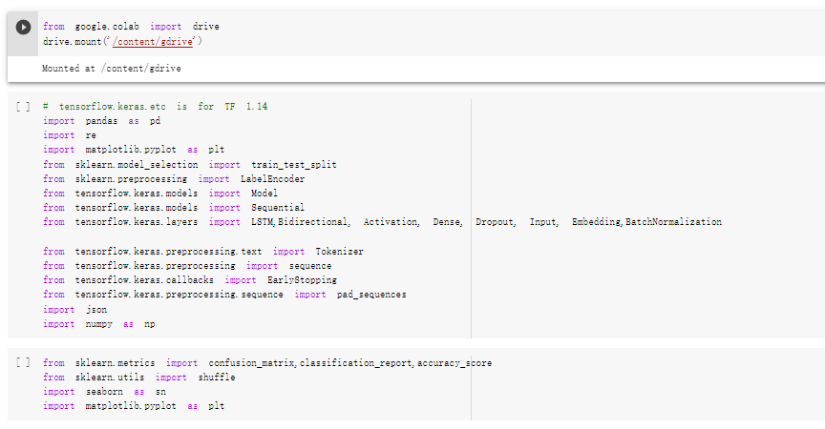
Mount and load libraries

Slide 3
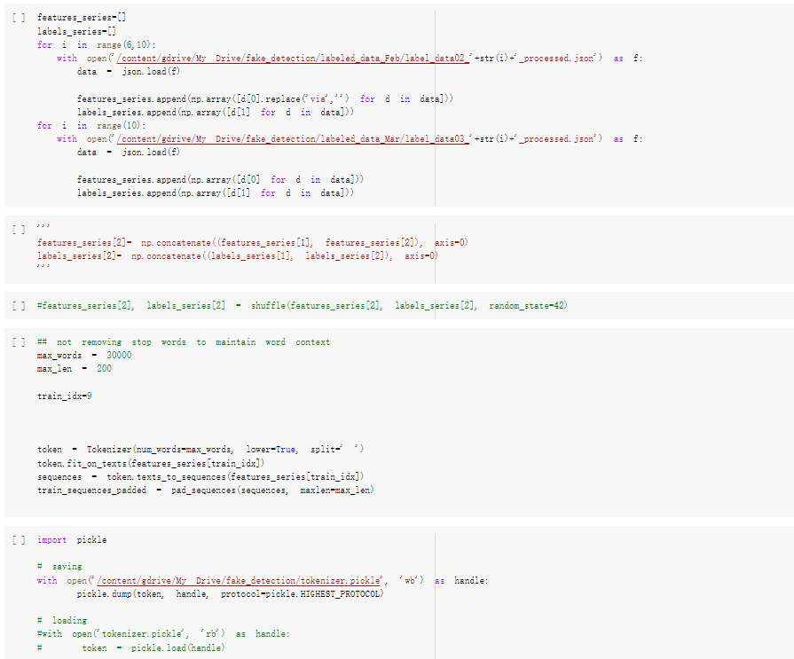
Data loading
Load data according
to months and period
you need into a list.
Thus, you can use
the index to select
which elements are
training and testing
Data
Select training element
(period)
Save your tokenizer

Slide 4
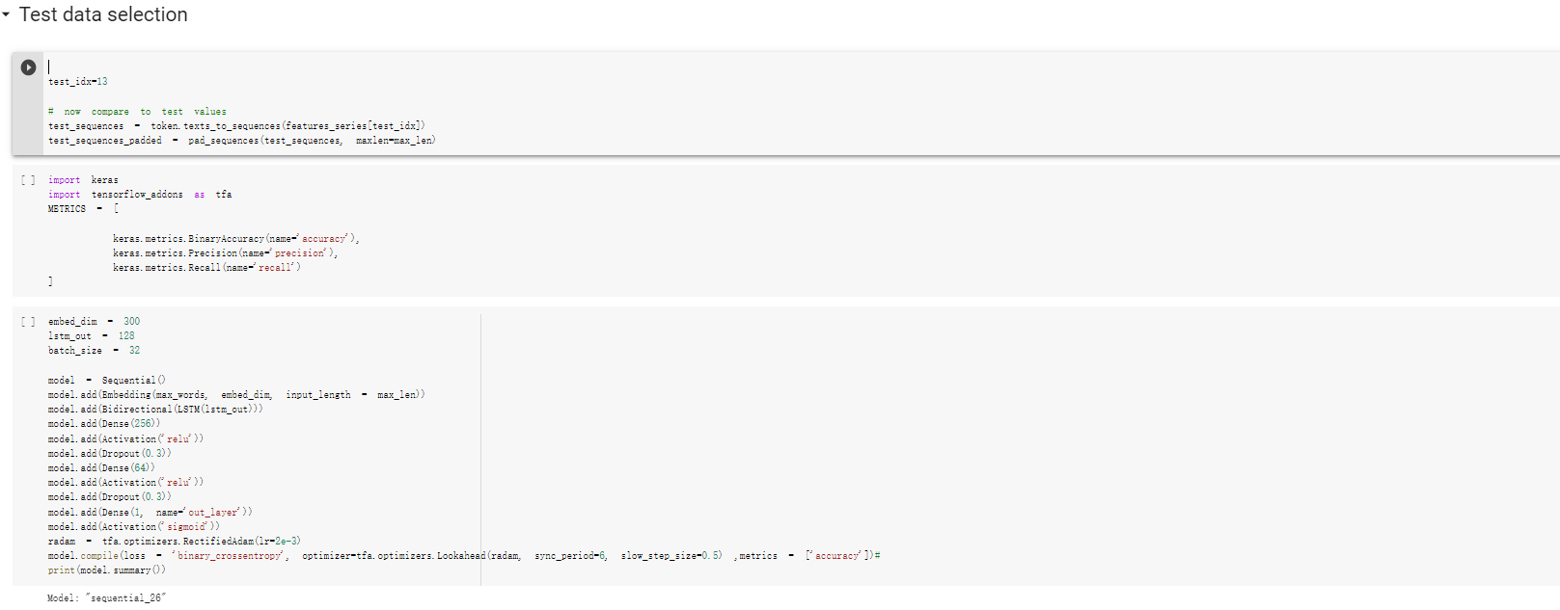
Select test element (testing period) and set RNN

Slide 5
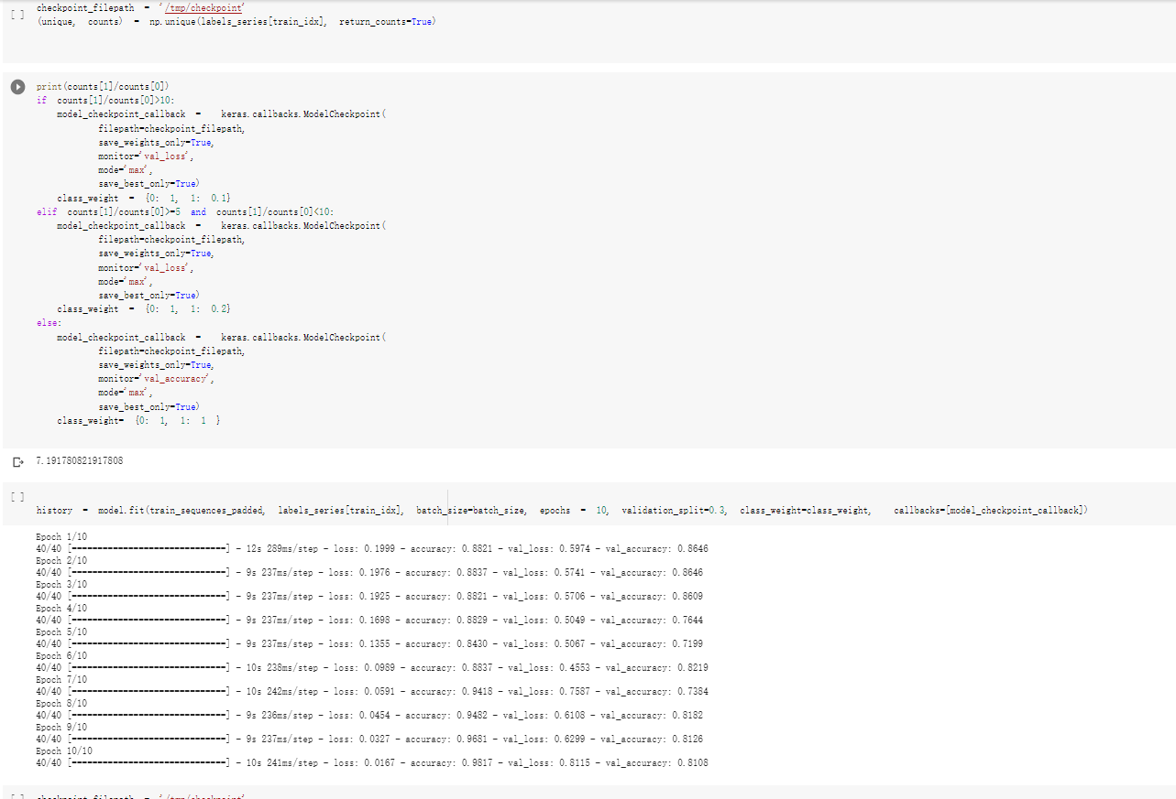
Set checkpoint and train it! Load the check point to get your model

Slide 6
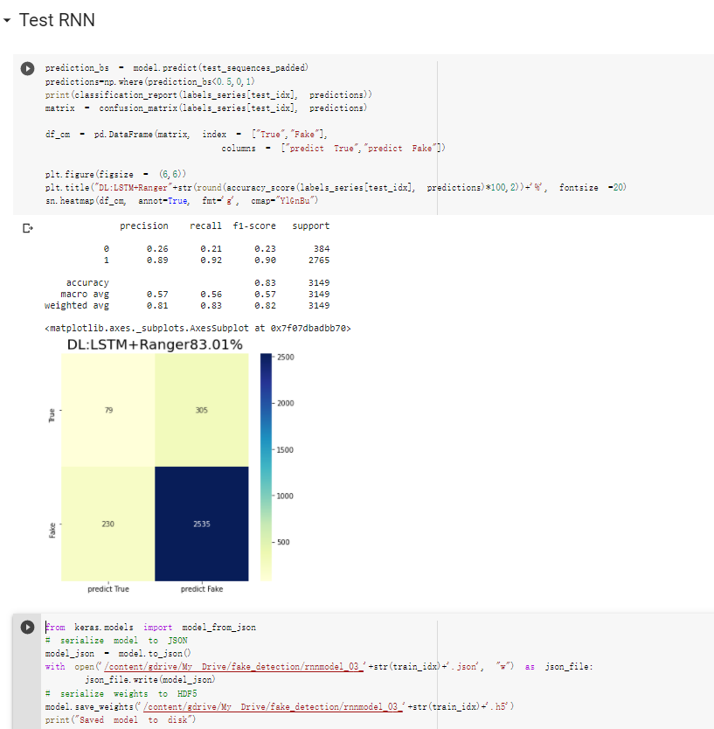
Test it and save the model

Slide 7
Repeat CNN part just like RNN(LSTM)

Slide 8
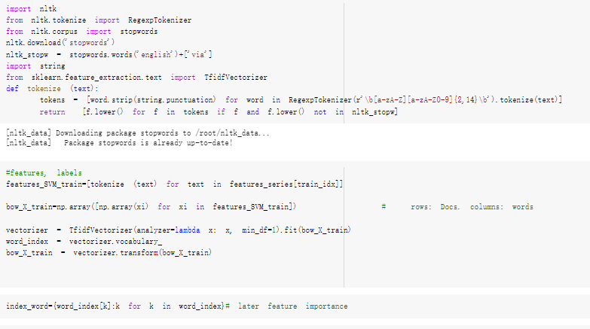
ML data and library preparing

Slide 9
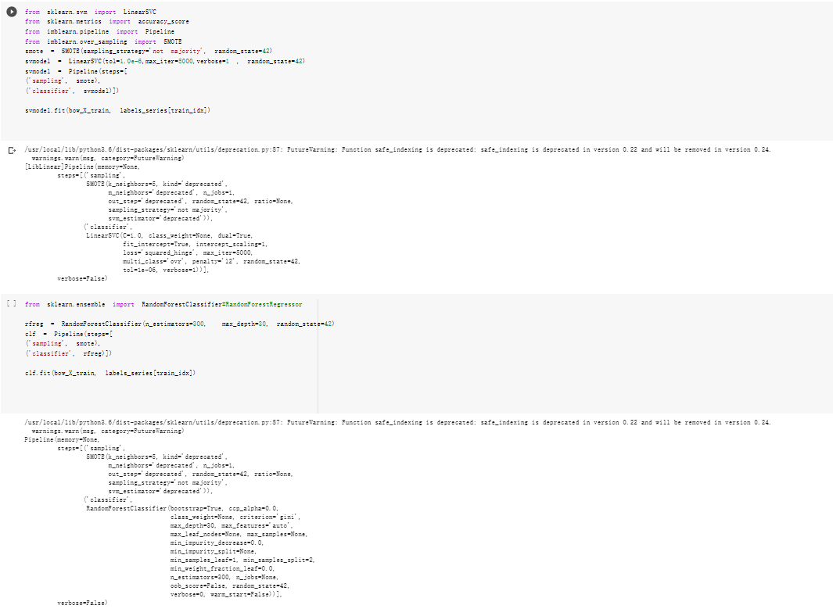
Train
SVM
And
Random
Forest
With
SMOTE

Slide 10
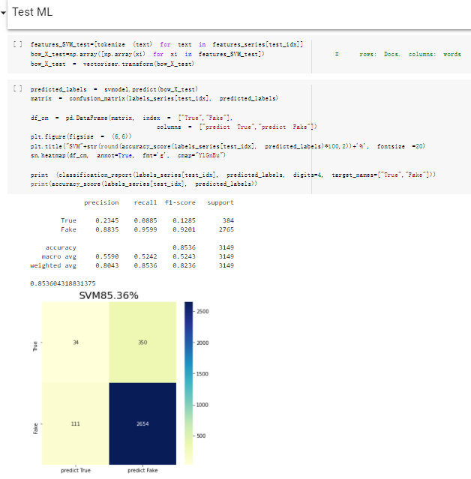
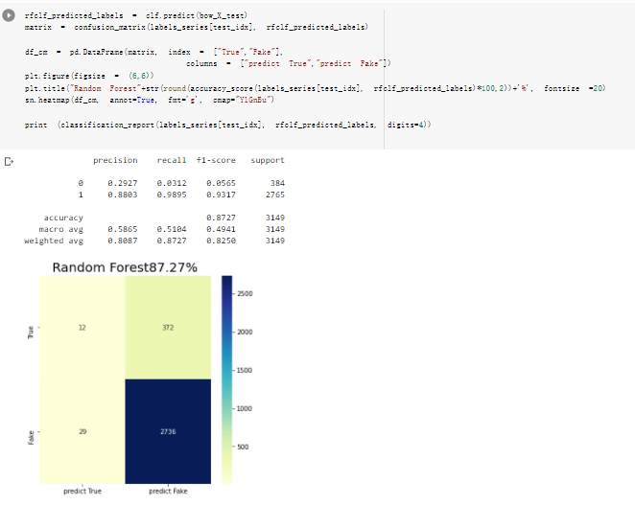
Test SVM and Random Forest

Slide 11
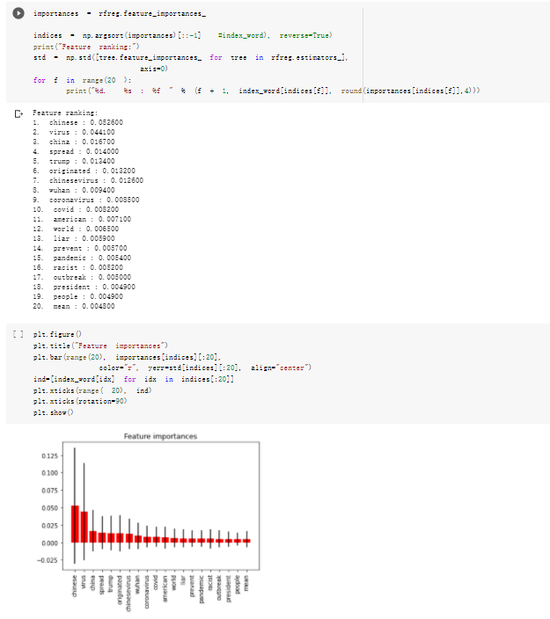
See Random Forest Feature Importance

Slide 12
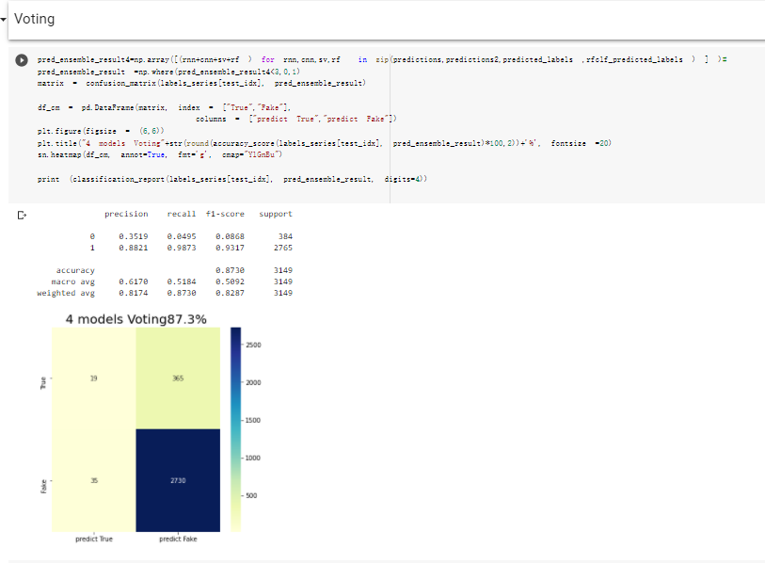
Voting

Slide 13
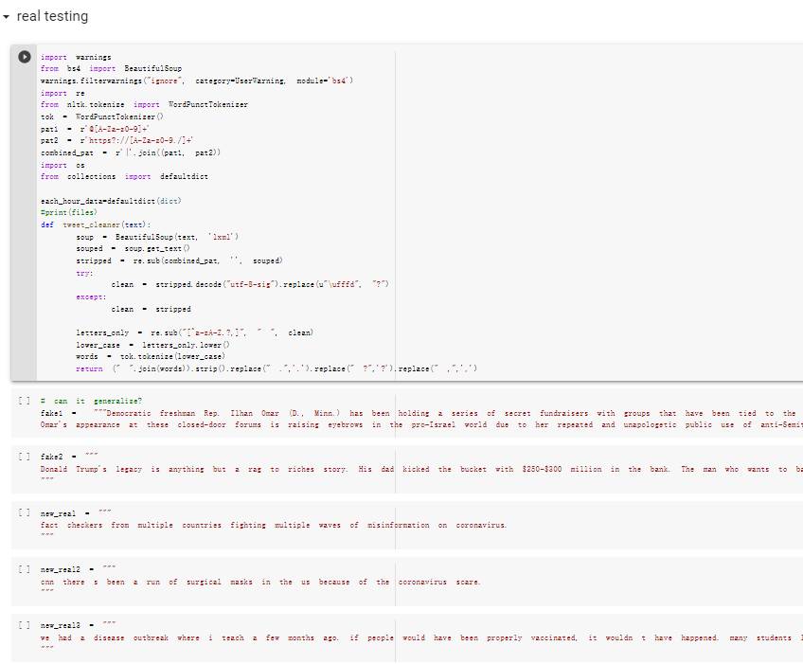
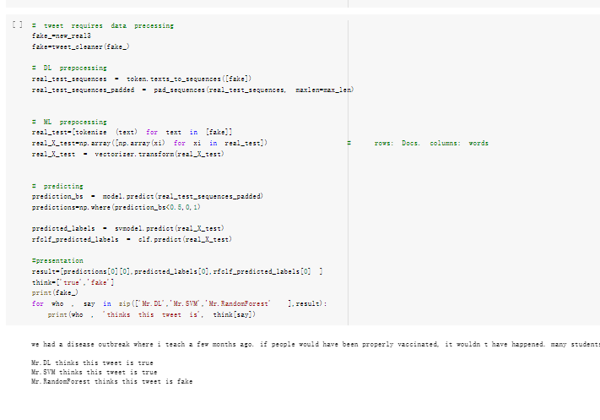
Later part is for testing for later real deployment

