Slide 1
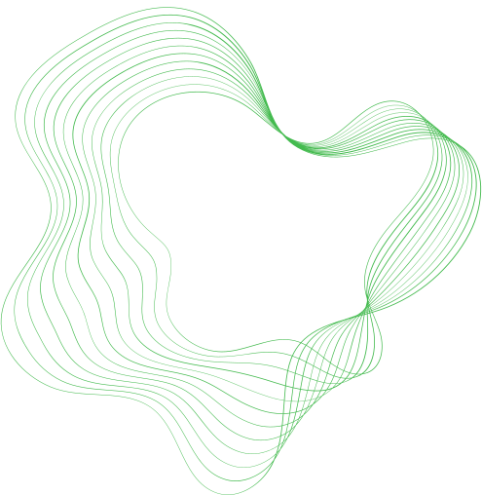

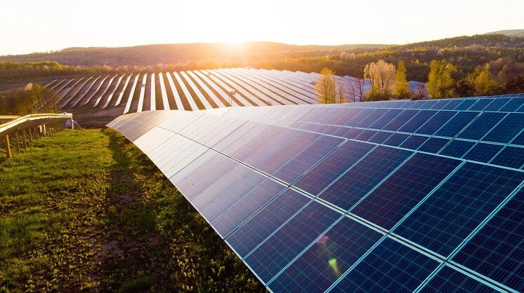

PVProtect
SOFTWARE ENGINEERING PROJECT
Lluís Giménez, Ilia Lecha, JiaYing Liu & Pablo Pérez

Slide 2


CONTENT
PROJECT DOMAIN
PROJECT SOLUTION
ARCHITECTURE
USE CASE DIAGRAM
ACTIVITY & SEQUENCE DIAGRAM
CLASS DIAGRAM
CONCLUSIONS

Slide 3
PROJECT DOMAIN

Slide 4


1-BRIEF OVERVIEW
The use of solar panels increased
Switch ON / OFF
Sustainable source of energy
Loss of efficiency
PVProtect

Slide 5

2-HOW DOES IT WORK?
Real time factors:
Battery
Consumption
Production
Fire emergency
Key point: Minimize the usage of the solar panel while maximizing self consumption

Slide 6

3-DECISION MAKING
OFF | ON
LOW PRODUCTIVITY | BATTERY NOT FULLY CHARGED
HIGH PRODUCTION/CONSUMPTION RATIO (BATTERY 100%) | PRODUCTION/CONSUMPTION RATIO ≤ 1
FIRE EMERGENCY | NO FIRE EMERGENCY

Slide 7


4- USERS FOCUSED
Companies & Factories
Homeowners

Slide 8
5- OUR SERVICES
01
02
03
04
05
06
CONNECT & DISCONNECT THE PANEL
MEASUREMENT OF THE ENERGY PROVIDED BY THE PANEL
WARNINGS
MONEY SAVED
PANEL'S
ON/OFF
PERFORMANCE OF THE PANEL

Slide 9
PROJECT SOLUTION

Slide 10
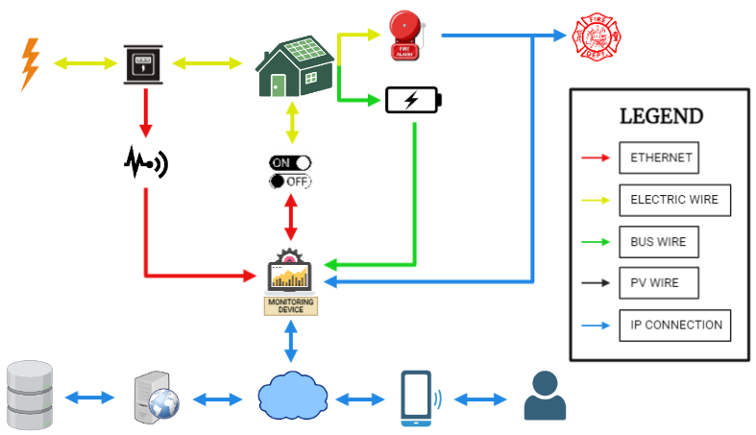
6- ARCHITECTURE
01
02
03
04
05
06

Slide 11




7- CLASS DIAGRAM
SYSTEM
MONITORING DEVICE
WEB SERVER

Slide 12
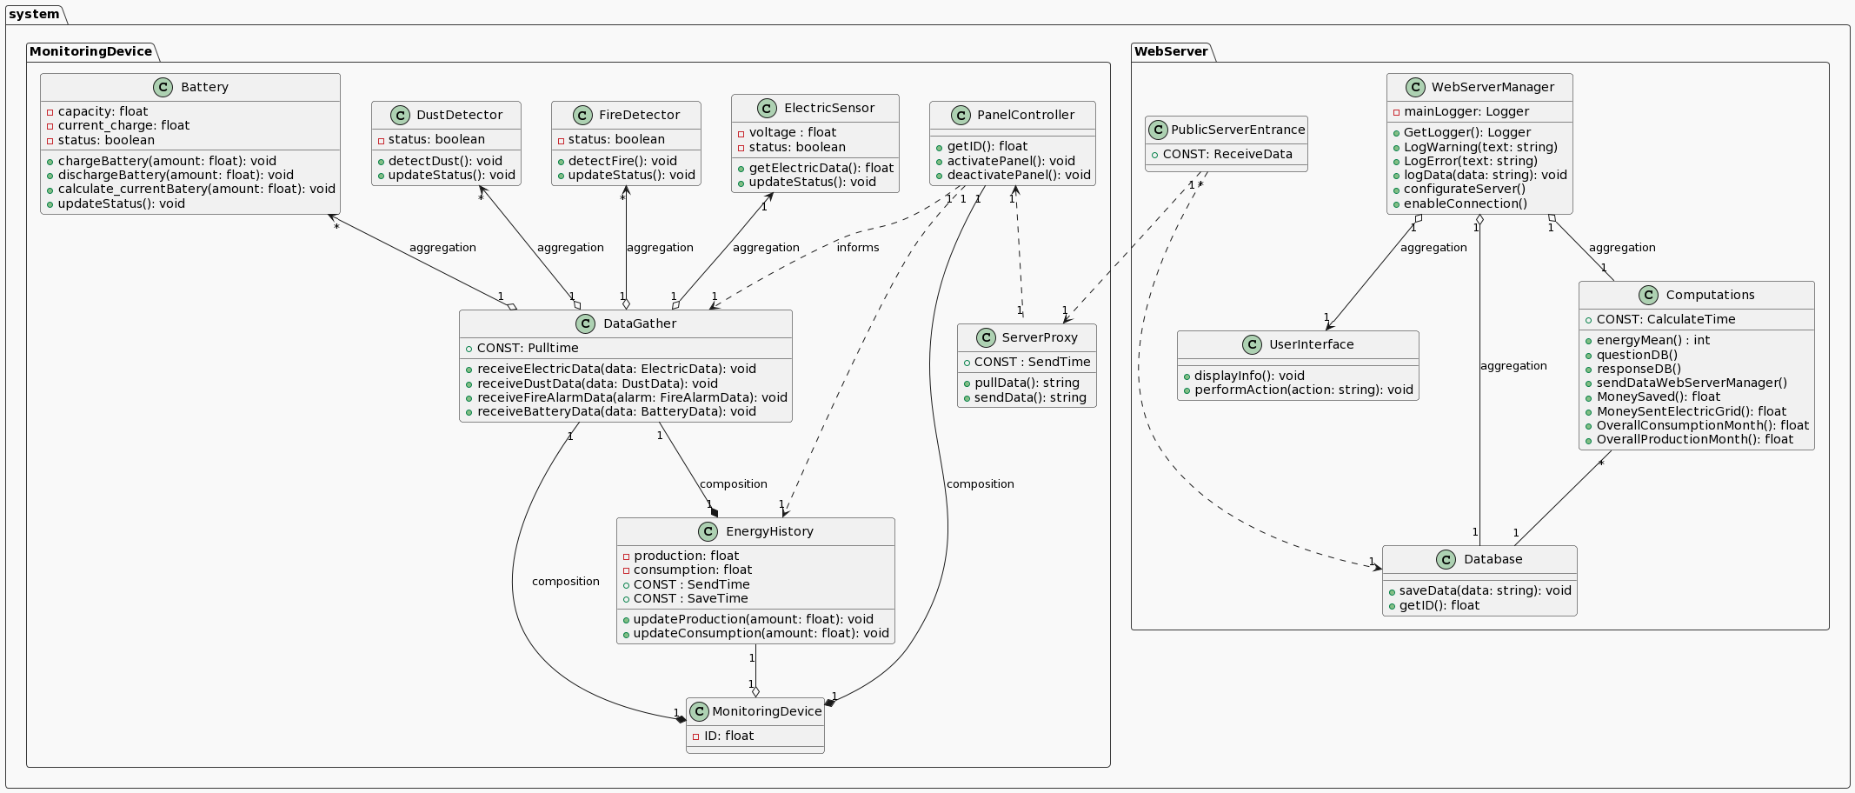
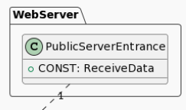
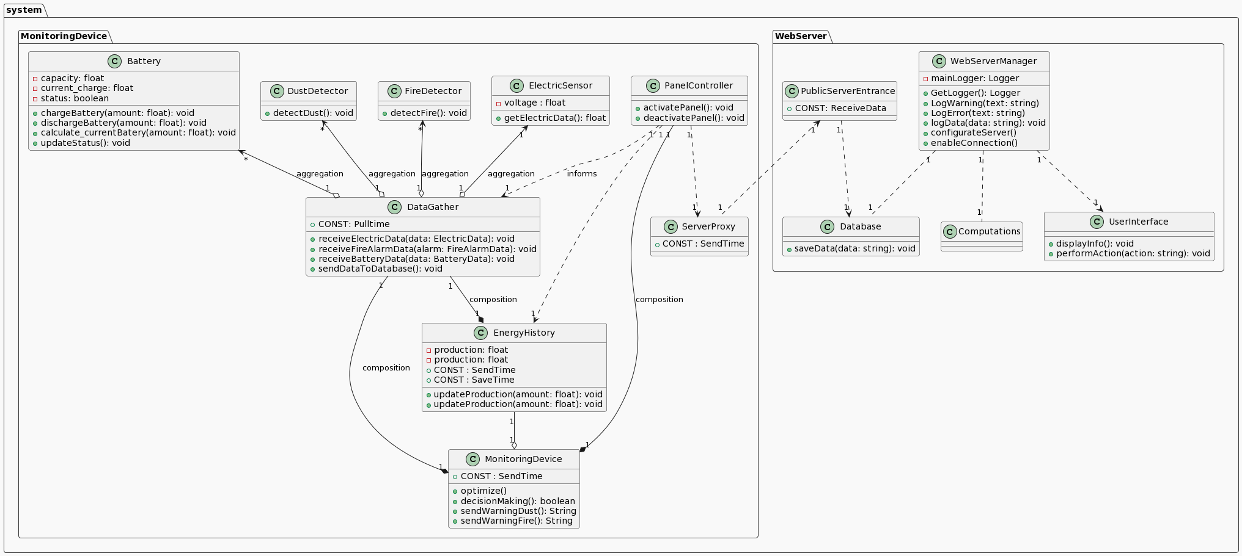
7- CLASS DIAGRAM

Slide 13
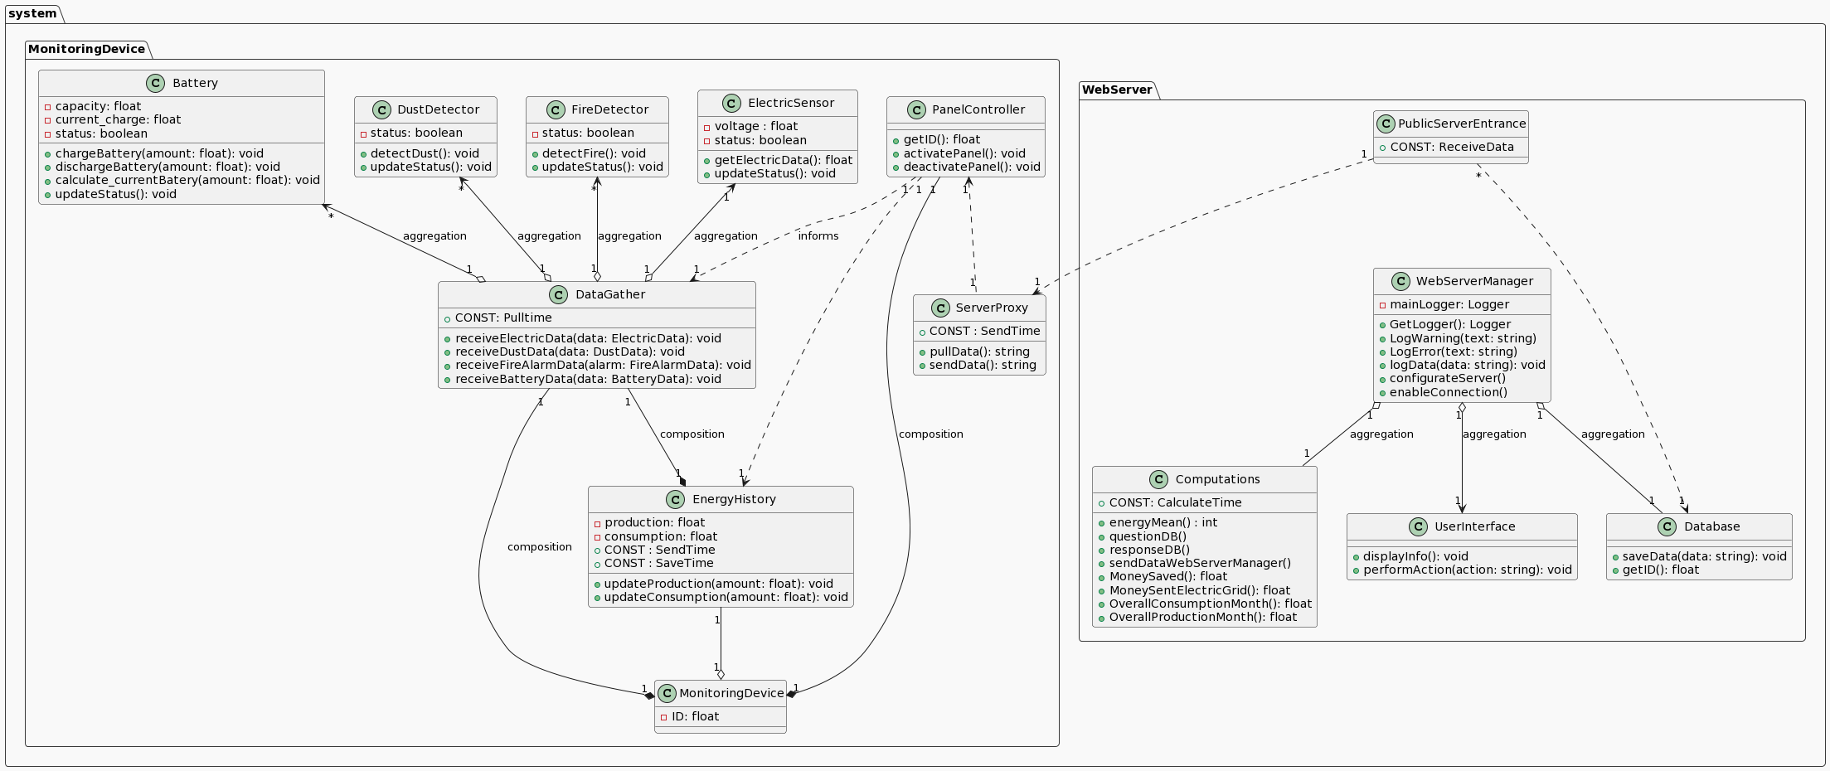
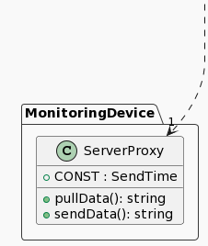
7- CLASS DIAGRAM

Slide 14
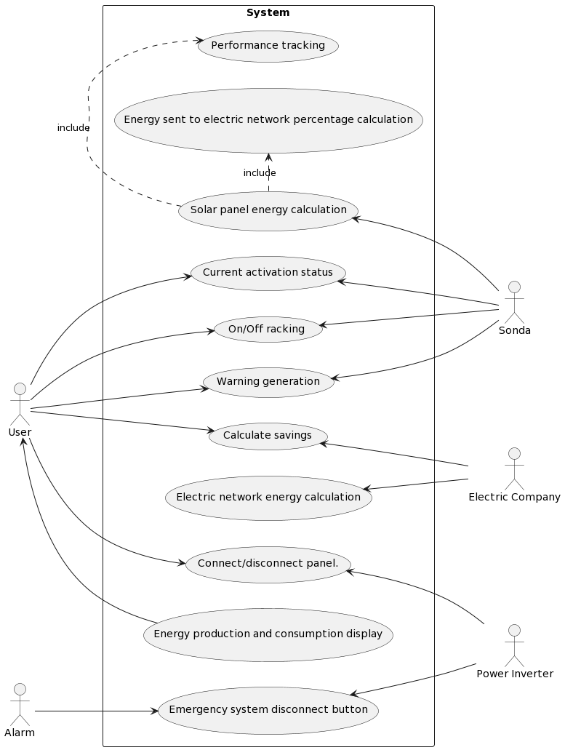
8-USE CASE DIAGRAM

Slide 15
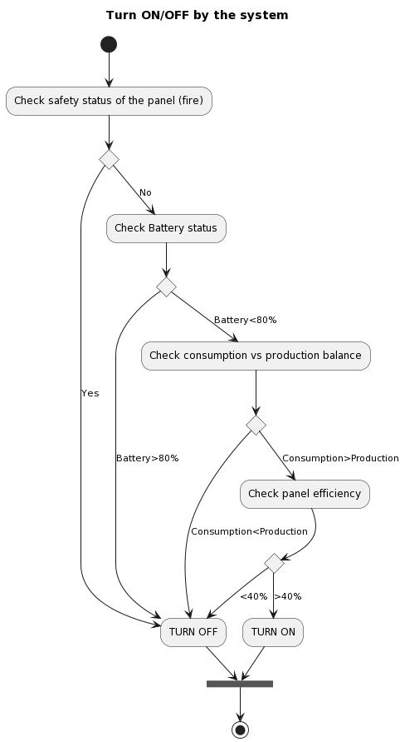
9-ACTIVITY
DIAGRAM

Slide 16
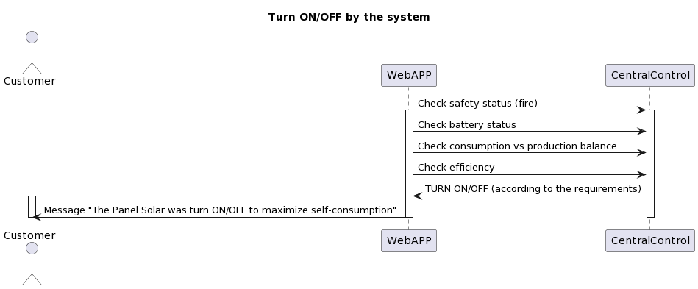
10-SEQUENCE DIAGRAM

Slide 17
CONCLUSION

Slide 18


THANK'S FOR WATCHING

