Slide 1

Decision Tree
Ali Nazari

Slide 2
Overview
In this lecture, we describe tree-based methods
Works both for regression and classification
Very simple and intuitive learning algorithm
It is based on segmentation of the predictor space into set of simpler regions
The segmentation rules can be summarized in a tree decision tree

Slide 3
Overview
In this lecture, we describe tree-based methods
Works both for regression and classification
Very simple and intuitive learning algorithm
It is based on segmentation of the predictor space into set of simpler regions
The segmentation rules can be summarized in a tree decision tree
They are not competitive compared to the best supervised learning techniques
We will introduce ensembles (bagging and boosting)
Ensemble: grow multiple trees, and combine their prediction into a single prediction
Ensembles typically result in dramatic improvements in prediction accuracy
Ensembles prediction is not that easy to interpret

Slide 4
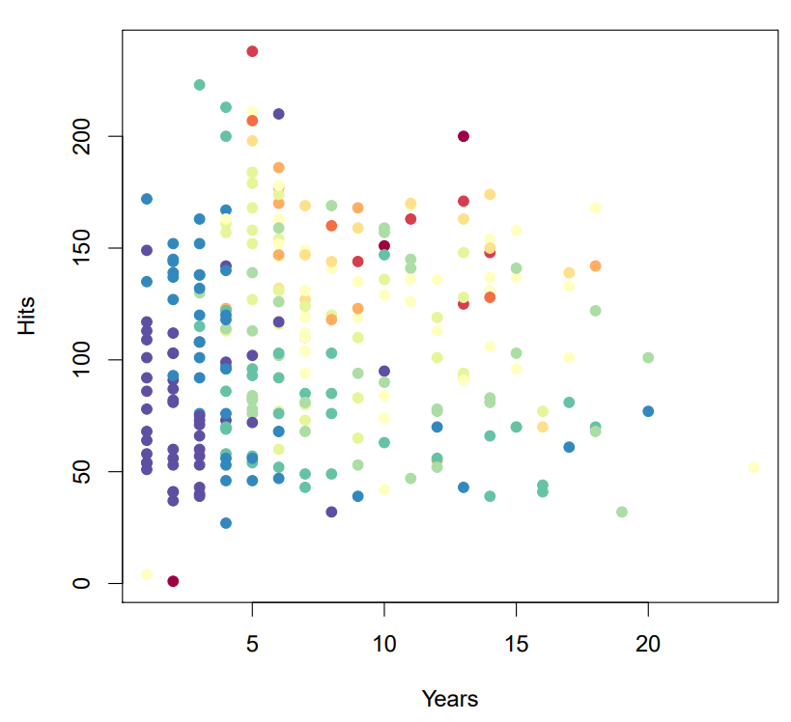
Decision Tree
Baseball Salary Data
Salary is color coded from low (blue, green) to high (yellow, red)
How do we classify each data point?
Source: A Introduction to Statistical Learning with Application in R, Trever Hastie and Rob Tibshirani

Slide 5
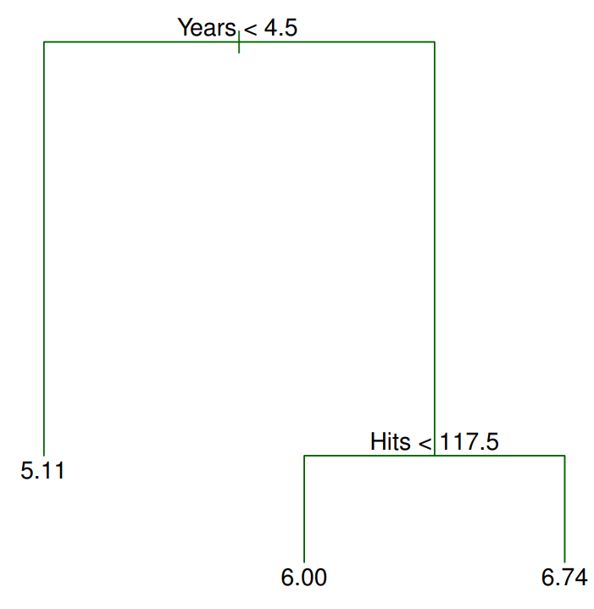
Decision Tree
A tree structure to predict the log salary of a baseball player based on
Number of years experience in leagues
Number of hits he made in the previous year
Source: A Introduction to Statistical Learning with Application in R, Trever Hastie and Rob Tibshirani

Slide 6
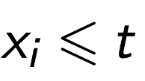
Decision Tree
A general tree structure consists of:
root node, internal split nodes, terminal nodes
Each node has either 2 children or 0 children (binary trees):
split nodes (root and internal nodes):
a decision is made based on value of a feature
For numerical variables, it splits always of the form
For categorical features, it partitions values to 2 groups
Source: A Introduction to Statistical Learning with Application in R, Trever Hastie and Rob Tibshirani

Slide 7

Decision Tree
The decision tree segments the players into three regions of predictor space
$R_{1}=\left\{X\right|Years<4.5\}$
$R_{2}=\left\{X\right|Years≥4.5, Hits<117.5\}$
$R_{3}=\left\{X\right|Years≥4.5, Hits≥117.5\}$
Source: A Introduction to Statistical Learning with Application in R, Trever Hastie and Rob Tibshirani

Slide 8
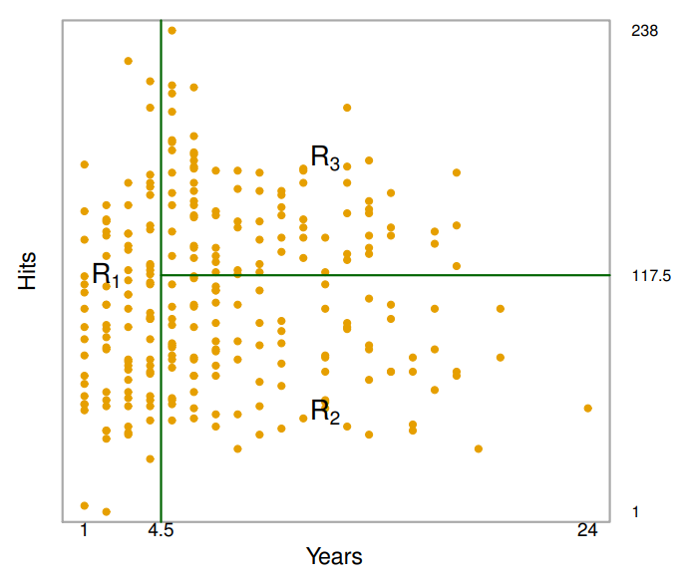
Decision Tree
The decision tree segments the players into three regions of predictor space
$R_{1}=\left\{X\right|Years<4.5\}$
$R_{2}=\left\{X\right|Years≥4.5, Hits<117.5\}$
$R_{3}=\left\{X\right|Years≥4.5, Hits≥117.5\}$
Source: A Introduction to Statistical Learning with Application in R, Trever Hastie and Rob Tibshirani

Slide 9
Decision Tree
Years is the most important feature in determining salary
For the less experienced players, the number of last year hits play little role
For the more experienced players (Years>4.5):
The number of Hits during last year affect the salary
Players who made more hits last year tend to have higher salary
Compared to linear regression model, it is very easy to display, interpret and explain
Source: A Introduction to Statistical Learning with Application in R, Trever Hastie and Rob Tibshirani

Slide 10
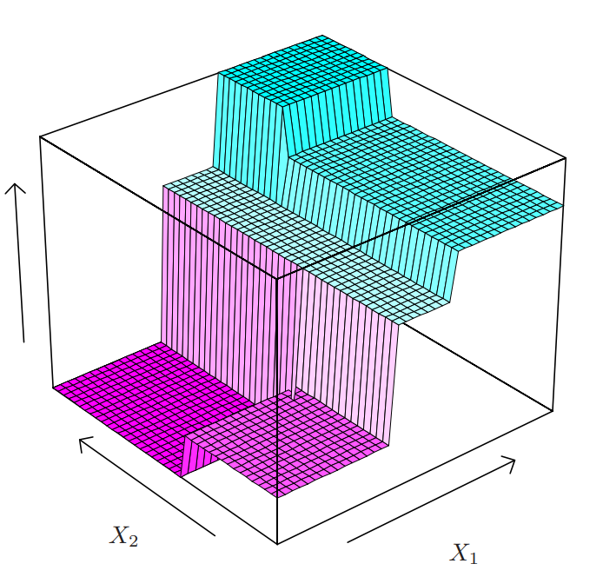











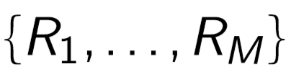


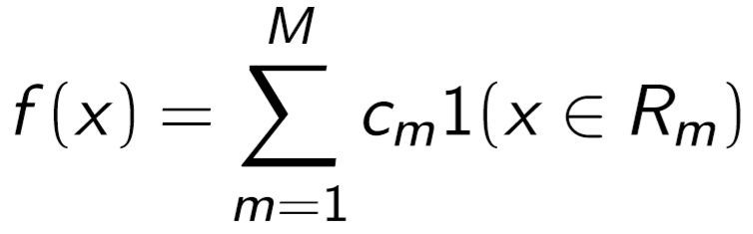
Regression trees
Consider a binary tree on 2-dimensional space
The decision tree partitions the input space into regions where
For every observation that falls into the same rectangle, we make the same prediction
Source: A Introduction to Statistical Learning with Application in R, Trever Hastie and Rob Tibshirani

Slide 11

Regression trees
How do we pick the predicted value $c_{m}$ in each region?
Source: David Rosenberg lecture notes- Foundations of Machine Learning, Bloomberg ML EDU 2017

Slide 12

Regression trees
How do we pick the predicted value $c_{m}$ in each region?
mean of the response values for all training data that fall into the region
for squared error loss function ($L_{2}$ Norm), it is optimal
median of the response values for all training data that fall into the region
for absolute error loss function ($L_{1}$ Norm), it is optimal
Source: David Rosenberg lecture notes- Foundations of Machine Learning, Bloomberg ML EDU 2017

Slide 13
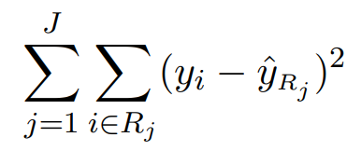

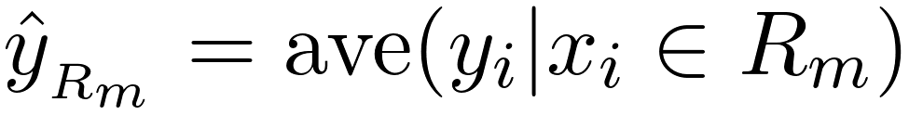
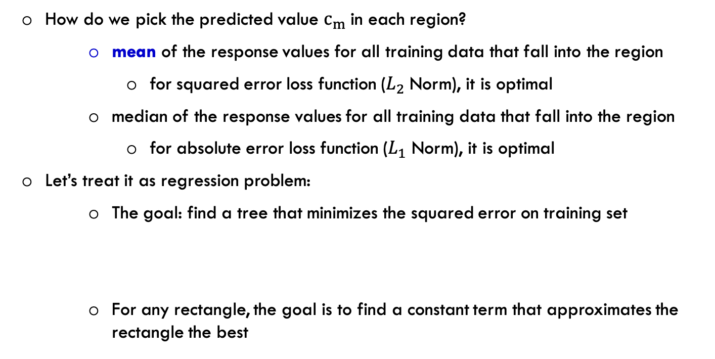
Regression trees
How do we pick the predicted value $c_{m}$ in each region?
mean of the response values for all training data that fall into the region
for squared error loss function ($L_{2}$ Norm), it is optimal
median of the response values for all training data that fall into the region
for absolute error loss function ($L_{1}$ Norm), it is optimal
Let’s treat it as regression problem:
The goal: find a tree that minimizes the squared error on training set
For any rectangle, the goal is to find a constant term that approximates the rectangle the best
Source: David Rosenberg lecture notes- Foundations of Machine Learning, Bloomberg ML EDU 2017

Slide 14
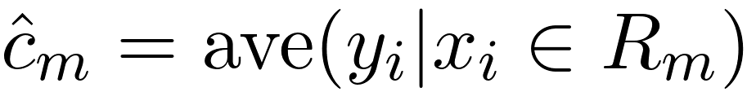

Regression trees
How do we pick the predicted value $c_{m}$ in each region?
mean of the response values for all training data that fall into the region
for squared error loss function ($L_{2}$ Norm), it is optimal
median of the response values for all training data that fall into the region
for absolute error loss function ($L_{1}$ Norm), it is optimal
Let’s treat it as regression problem:
The goal: find a tree that minimizes the squared error on training set
For any rectangle, the goal is to find a constant term that approximates the rectangle the best
Source: David Rosenberg lecture notes- Foundations of Machine Learning, Bloomberg ML EDU 2017

Slide 15


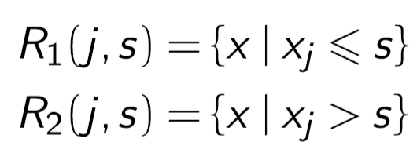
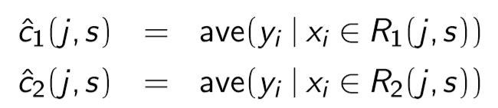
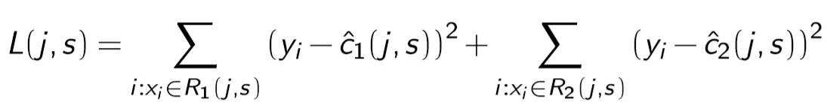
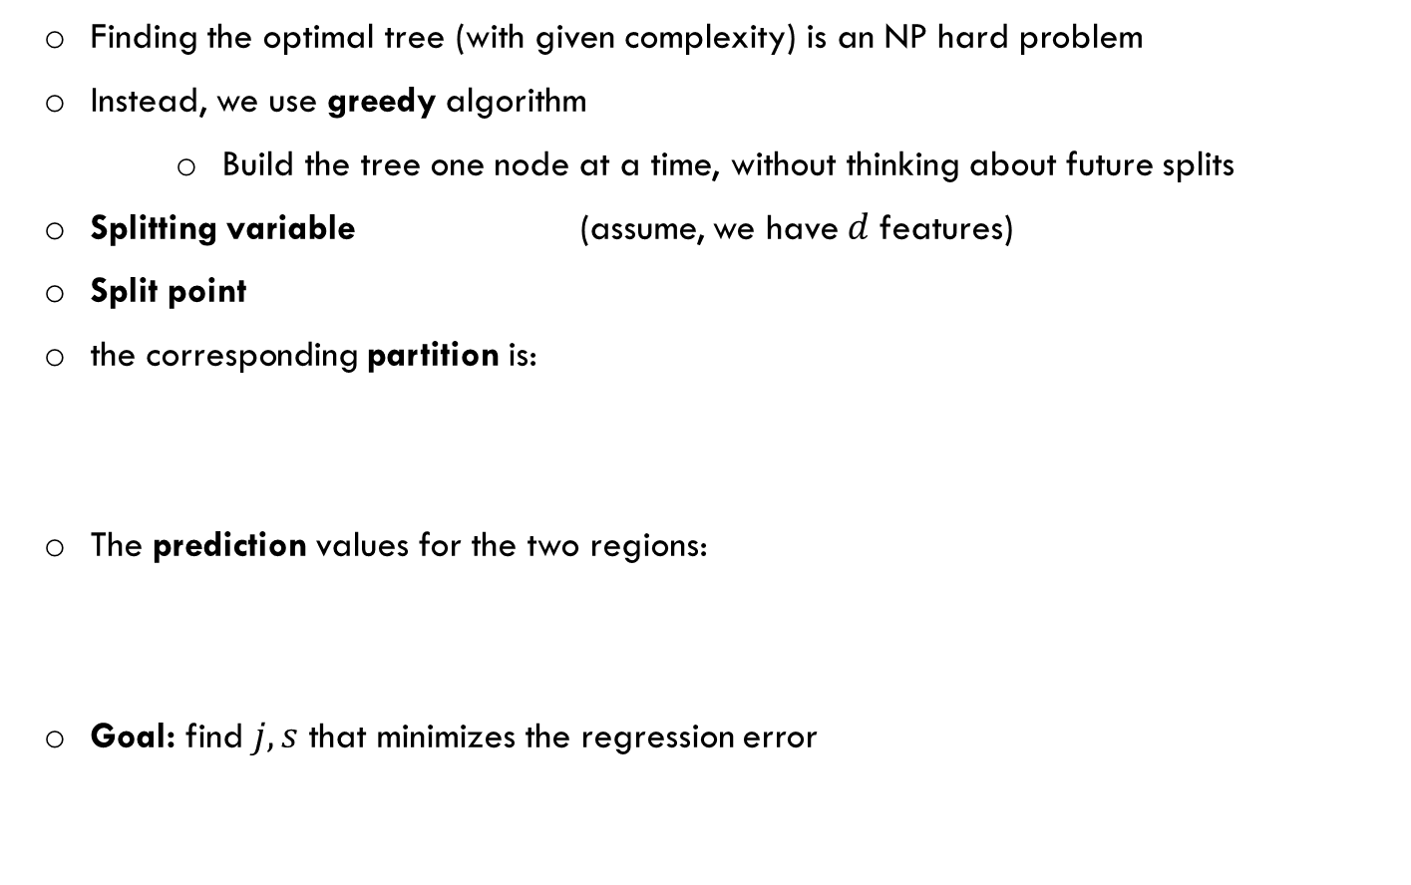
Regression trees
Finding the optimal tree (with given complexity) is an NP hard problem
Instead, we use greedy algorithm
Build the tree one node at a time, without thinking about future splits
Splitting variable (assume, we have$d$ features)
Split point
the corresponding partition is:
The prediction values for the two regions:
Goal: find $j,s$ that minimizes the regression error
Source: David Rosenberg lecture notes- Foundations of Machine Learning, Bloomberg ML EDU 2017

Slide 16


Regression trees
Let’s concentrate on the case that we only have one feature $x$
$$y$$
$$x$$

Slide 17
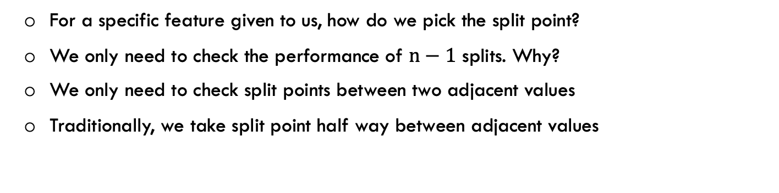
Regression trees
$$y$$
$$x$$
For a specific feature given to us, how do we pick the split point?
We only need to check the performance of $n−1$ splits. Why?
We only need to check split points between two adjacent values
Traditionally, we take split point half way between adjacent values

Slide 18
Regression trees
$$y$$
$$x$$
For a specific feature given to us, how do we pick the split point?
We only need to check the performance of $n−1$ splits. Why?
We only need to check split points between two adjacent values
Traditionally, we take split point half way between adjacent values

Slide 19
Regression trees
$$y$$
$$x$$
For a specific feature given to us, how do we pick the split point?
We only need to check the performance of $n−1$ splits. Why?
We only need to check split points between two adjacent values
Traditionally, we take split point half way between adjacent values

Slide 20
Regression trees
$$y$$
$$x$$
For a specific feature given to us, how do we pick the split point?
We only need to check the performance of $n−1$ splits. Why?
We only need to check split points between two adjacent values
Traditionally, we take split point half way between adjacent values

Slide 21

Regression trees
$$y$$
$$x$$
For a specific feature given to us, how do we pick the split point?
We find the squared error loss for each of the $n−1$ splits, and pick the one that gives us the lowest loss

Slide 22
Tree building process
We take greedy heuristic that is known as recursive binary splitting
Start with an empty decision tree
Split the training data using the best feature
For each feature, the best splitting point is determined, and the corresponding loss is calculated
Among the features, we select the one that gives us the best loss
We split based on the selected feature and its best splitting point
Recurse
The further we are from the root node, the faster the splitting is

Slide 23


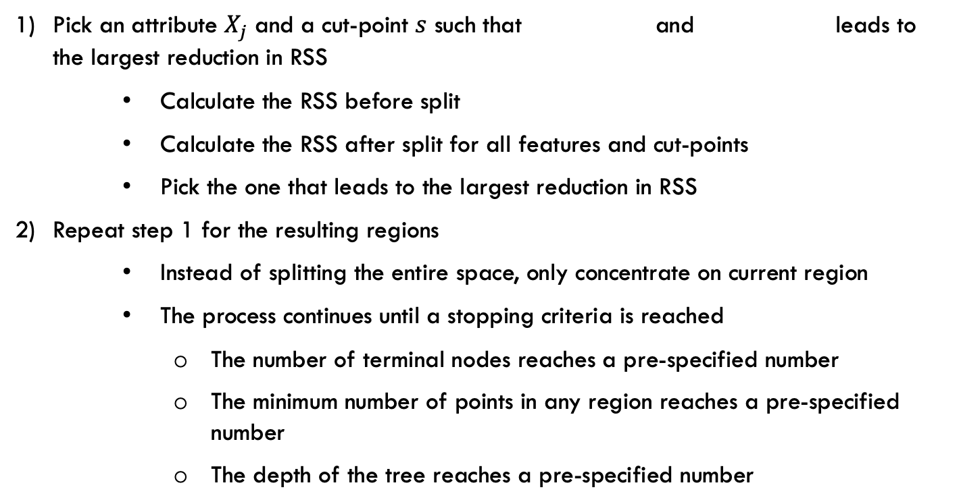
Constructing a decision tree
Pick an attribute $X_{j}$ and a cut-point $s$ such that and leads to the largest reduction in RSS
Calculate the RSS before split
Calculate the RSS after split for all features and cut-points
Pick the one that leads to the largest reduction in RSS
Repeat step 1 for the resulting regions
Instead of splitting the entire space, only concentrate on current region
The process continues until a stopping criteria is reached
The number of terminal nodes reaches a pre-specified number
The minimum number of points in any region reaches a pre-specified number
The depth of the tree reaches a pre-specified number

Slide 24
Constructing a decision tree
Pick an attribute $X_{j}$ and a cut-point $s$ such that and leads to the largest reduction in RSS
Calculate the RSS before split
Calculate the RSS after split for all features and cut-points
Pick the one that leads to the largest reduction in RSS
Repeat step 1 for the resulting regions
Instead of splitting the entire space, only concentrate on current region
The process continues until a stopping criteria is reached
The number of terminal nodes reaches a pre-specified number
The minimum number of points in any region reaches a pre-specified number
The depth of the tree reaches a pre-specified number
CART is using backward pruning. It first build a big tree, and then it prunes it back greedily all the way to the root ( by assessing performance on validation set)

Slide 25
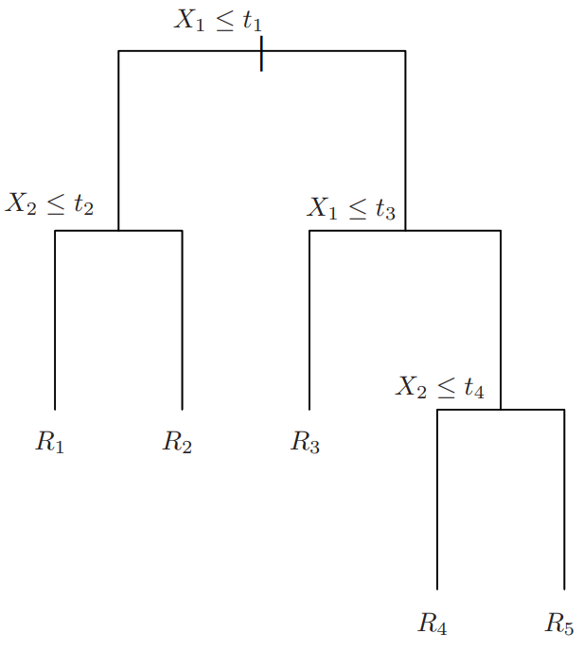


Regression trees- Prediction
Now, that tree is built, we can predict the target value for new instances
The process is the same for classification and regression
We predict the response for a given test observation
First, find the region to which the test observation belongs
$$x$$
$$x$$
Source: A Introduction to Statistical Learning with Application in R, Trever Hastie and Rob Tibshirani

Slide 26
Regression trees- Prediction
Now, that tree is built, we can predict the target value for new instances
The process is the same for classification and regression
We predict the response for a given test observation
First, find the region to which the test observation belongs
For regression: return the average of the target over all training point in that region
$$x$$
$$x$$
Source: A Introduction to Statistical Learning with Application in R, Trever Hastie and Rob Tibshirani

Slide 27

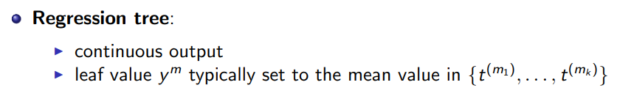
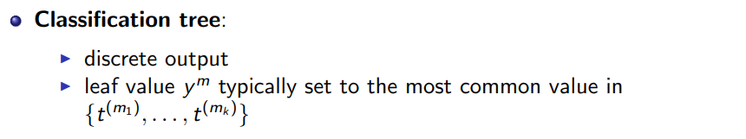
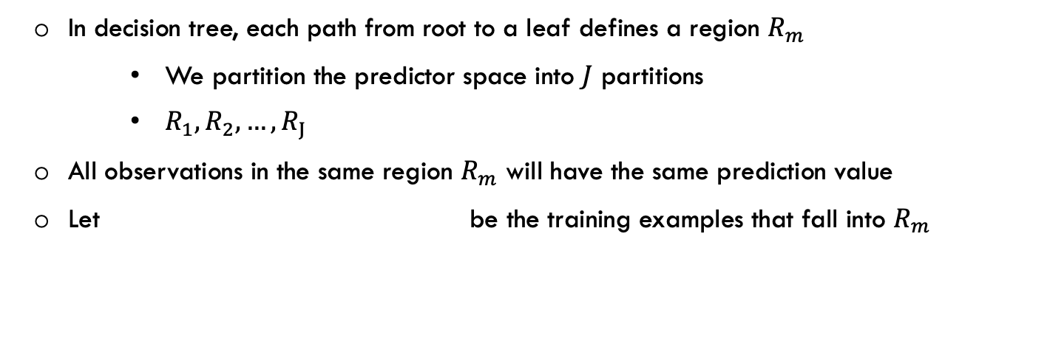
Decision Tree: Classification and Regression
In decision tree, each path from root to a leaf defines a region $R_{m}$
We partition the predictor space into $J$ partitions
$R_{1},R_{2},…,R_{J}$
All observations in the same region $R_{m}$ will have the same prediction value
Let be the training examples that fall into $R_{m}$
Source: Slide credit: R grosse

Slide 28
Tree complexity
Find the simplest tree that fits the observation
Not too small
Need to handle important but possibly subtle distinctions in data
Not too big
Computational efficiency (avoid redundant, spurious features)
Avoid overfitting training data
Human interpretability
Hyafil & Rivest’76

Slide 29
Decision Tree Classification
Decision tree classification is very similar to regression, except that it is used to predict a qualitative response (category) instead of a continuous variable
Width < 7cm?
10
8
6
4
Yes
No
Height (cm)
Height < 5cm?
Height < 8cm?
Yes
No
Yes
No
4 6 8 10
Width (cm)

Slide 30
Decision tree classification- Impurity measure
Notice that the features still can be numerical or categorical
Again, we need to find best features to split on and the best split point
Intuitively, a good classification tree has more pure leaf nodes
The goal is to find splitting variables and split points minimizing node impurity measure
A small value indicates that a node contains mostly observation from a single class

Slide 31
How to pick a good Split
Classification tree
A: 100
B: 49
A: 50
B: 0
A: 50
B: 49
Is it a good split?

Slide 32
How to pick a good Split: Error rate
Classification tree
Similar to tree regression, lets find a split that minimizes some loss function
Why not pick the best split based on error rate ( the average of 0/1 loss)?
A: 100
B: 49
A: 50
B: 0
A: 50
B: 49

Slide 33
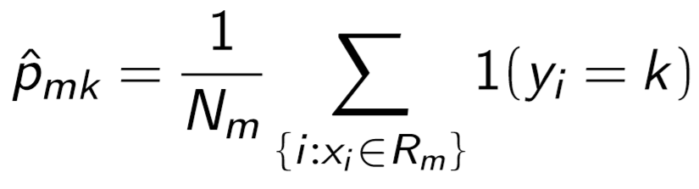
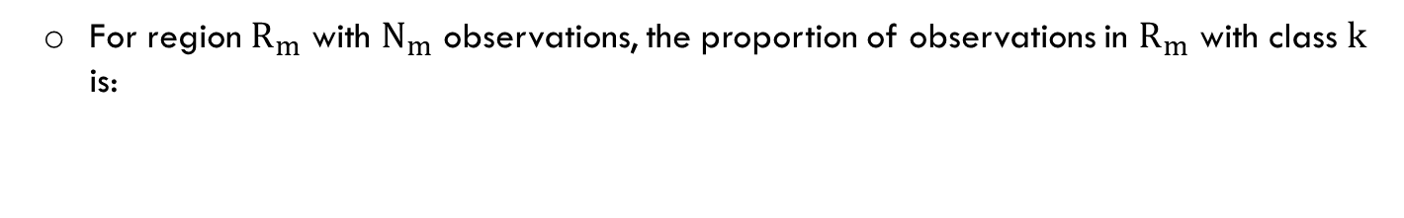
How to pick a good Split: Error rate
For region $R_{m}$ with $N_{m}$ observations, the proportion of observations in $R_{m}$ with class $k$ is:
A: 100
B: 49
A: 50
B: 0
A: 50
B: 49

Slide 34
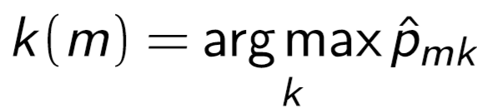
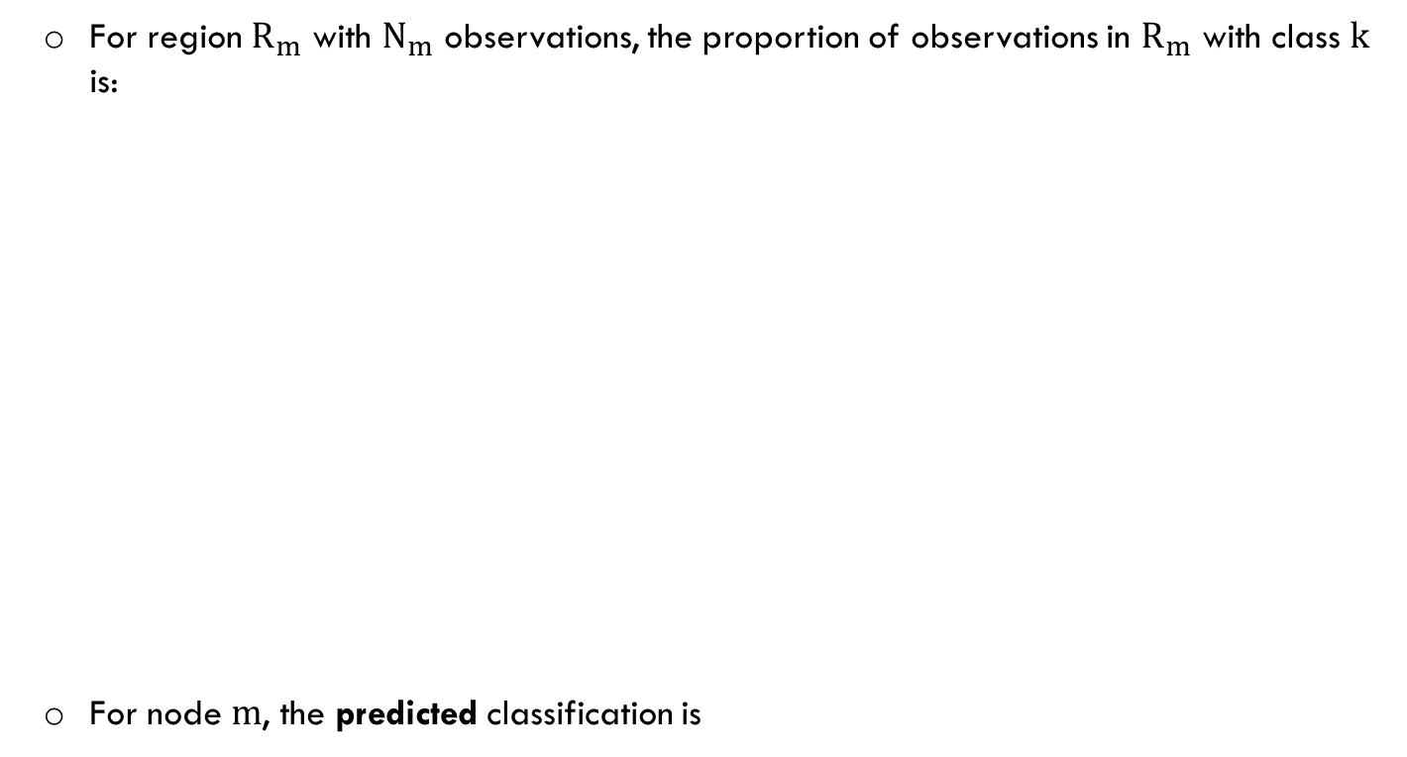
How to pick a good Split: Error rate
For region $R_{m}$ with $N_{m}$ observations, the proportion of observations in $R_{m}$ with class $k$ is:
For node $m$, the predicted classification is
A: 100
B: 49
A: 50
B: 0
A: 50
B: 49

Slide 35

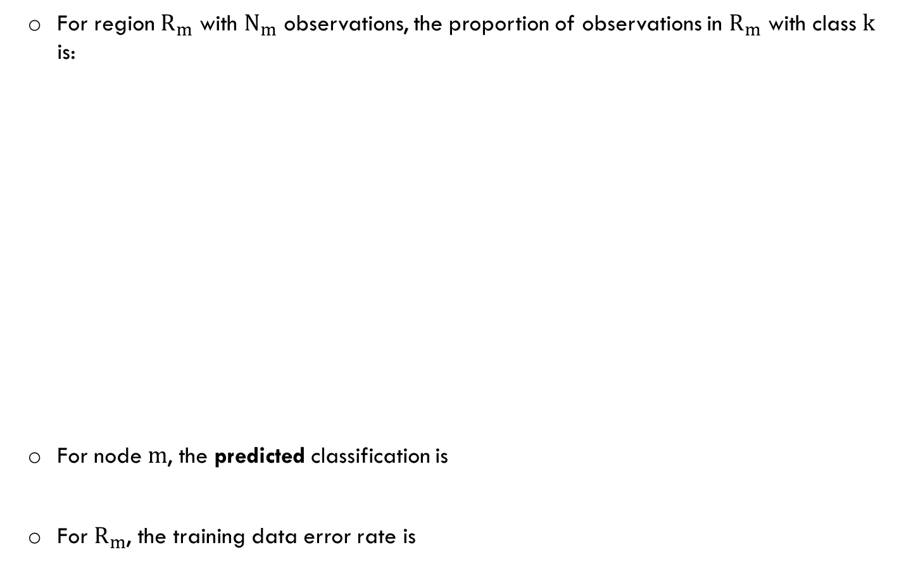
How to pick a good Split: Error rate
For region $R_{m}$ with $N_{m}$ observations, the proportion of observations in $R_{m}$ with class $k$ is:
For node $m$, the predicted classification is
For $R_{m}$, the training data error rate is
A: 100
B: 49
A: 50
B: 0
A: 50
B: 49

Slide 36
How to pick a good Split: Error rate
For region $R_{m}$ with $N_{m}$ observations, the proportion of observations in $R_{m}$ with class $k$ is:
A: 100
B: 49
A: 50
B: 0
A: 50
B: 49

Slide 37
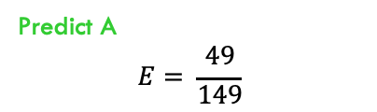
How to pick a good Split: Error rate
For region $R_{m}$ with $N_{m}$ observations, the proportion of observations in $R_{m}$ with class $k$ is:
A: 100
B: 49
Predict A
$$E= \frac{49}{149}$$
A: 50
B: 0
A: 50
B: 49

Slide 38

How to pick a good Split: Error rate
For region $R_{m}$ with $N_{m}$ observations, the proportion of observations in $R_{m}$ with class $k$ is:
A: 100
B: 49
Predict A
$$E= \frac{49}{149}$$
A: 50
B: 0
A: 50
B: 49
Predict A
$$E=0$$

Slide 39
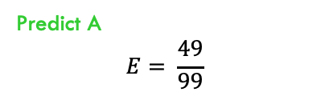
How to pick a good Split: Error rate
For region $R_{m}$ with $N_{m}$ observations, the proportion of observations in $R_{m}$ with class $k$ is:
A: 100
B: 49
Predict A
$$E= \frac{49}{149}$$
A: 50
B: 0
A: 50
B: 49
Predict A
$$E=0$$
Predict A
$$E= \frac{49}{99}$$

Slide 40
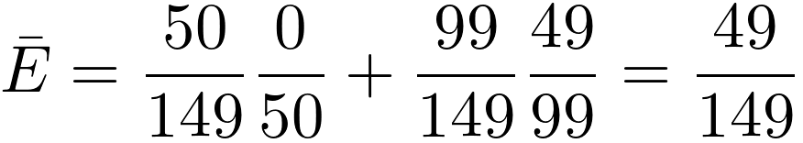
How to pick a good Split: Error rate
For region $R_{m}$ with $N_{m}$ observations, the proportion of observations in $R_{m}$ with class $k$ is:
A: 100
B: 49
Predict A
$$E= \frac{49}{149}$$
A: 50
B: 0
A: 50
B: 49
Predict A
$$E=0$$
Predict A
$$E= \frac{49}{99}$$

Slide 41
How to pick a good Split: Error rate
For region $R_{m}$ with $N_{m}$ observations, the proportion of observations in $R_{m}$ with class $k$ is:
A: 100
B: 49
Predict A
$$E= \frac{49}{149}$$
A: 50
B: 0
A: 50
B: 49
Predict A
$$E=0$$
Predict A
$$E= \frac{49}{99}$$
Is it a good split? There is no improvement in terms of average error rate
But, we all agree, the split is pretty informative

Slide 42
How to pick a good Split
So, for the classification task, the error rate is not a good impurity measure to determine the best split
What determines a good split vs bad split
Deterministic: If the points in the leaf have the same type
Uniform distribution: All classes in the leaf have same empirical probability
How about distributions in between?
Does the number of instances matter in the leaf?
If accuracy is very high, but the number of points are not many??
There are two famous measures to pick a good split
Gini Index
Information gain
Source: Slide credit: R grosse

Slide 43
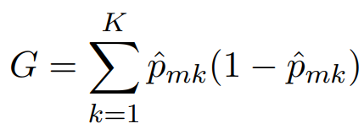
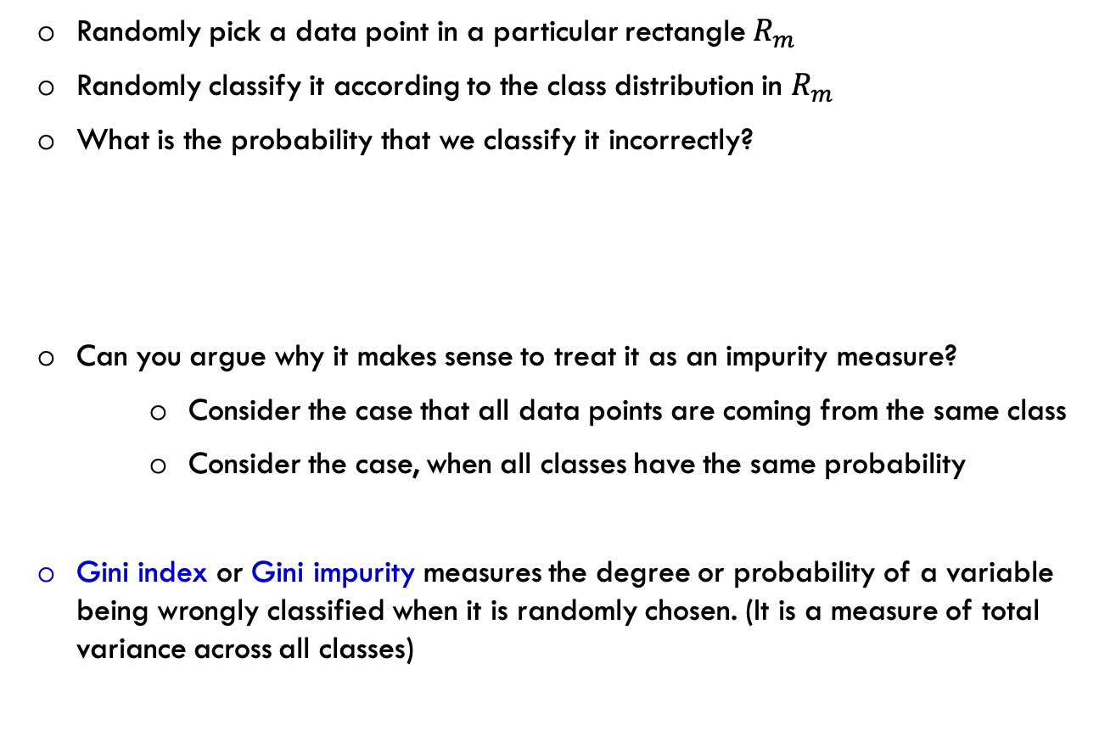
Gini Index
Randomly pick a data point in a particular rectangle $R_{m}$
Randomly classify it according to the class distribution in $R_{m}$
What is the probability that we classify it incorrectly?
Can you argue why it makes sense to treat it as an impurity measure?
Consider the case that all data points are coming from the same class
Consider the case, when all classes have the same probability
Gini index or Gini impurity measures the degree or probability of a variable being wrongly classified when it is randomly chosen. (It is a measure of total variance across all classes)

Slide 44
Information theory background
To understand the information gain measure, we need to study some basic concepts in information theory
Information theory studies the quantification, storage and transmission of information
Key measures in information theory:
Entropy: The amount of uncertainty involved in the value of a random variable or the outcome of random process
Mutual Information:
A measure of statistical dependence
It quantifies the amount of information that one variable has about another variable
A more complicated version of linear correlation
It can measure any kind of relationship between random variables
Linear, and nonlinear

Slide 45
Information theory basics
Consider the following two sequences:
The outcome of flipping two coins
H
H
T
H
H
H
H
T
H
H
T
H
H
T
H
H
H
T
T
H
T
H
H
T
H
T
T
H
H
T
H
T

Slide 46
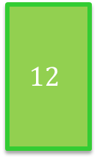
Information theory basics
Consider the following two sequences:
The outcome of flipping two coins
Out of 16: 12 are Heads and 4 are Tails
Out of 16: 8 are Heads and 8 are Tails
H
H
T
H
H
H
H
T
H
H
T
H
H
T
H
H
H
T
T
H
T
H
H
T
H
T
T
H
H
T
H
T
$$12$$
8
8
4

Slide 47
Information theory basics
Consider the following two sequences:
The outcome of flipping two coins
If I ask you about the next outcome of each coin, which one are you more uncertain about?
Out of 16: 12 are Heads and 4 are Tails
Out of 16: 8 are Heads and 8 are Tails
H
H
T
H
H
H
H
T
H
H
T
H
H
T
H
H
H
T
T
H
T
H
H
T
H
T
T
H
H
T
H
T
$$12$$
8
8
4

Slide 48
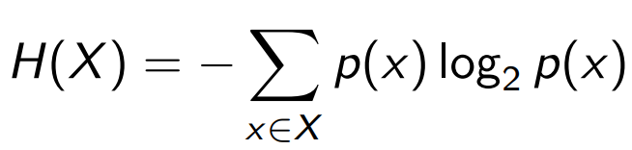
Information theory basics
Let’s define a quantity that measures the amount of uncertainty of each sequence
Entropy is a measure of uncertainty defined as

Slide 49
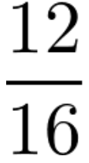
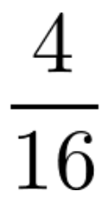
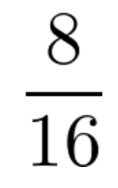
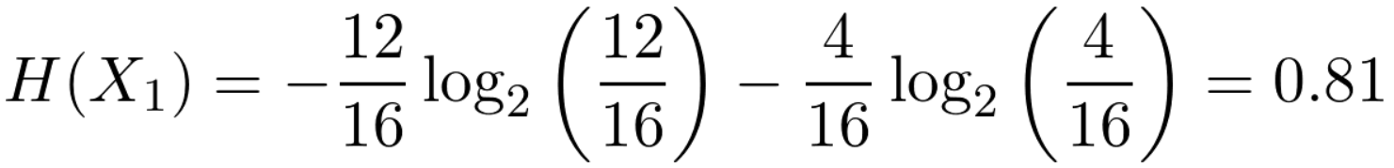
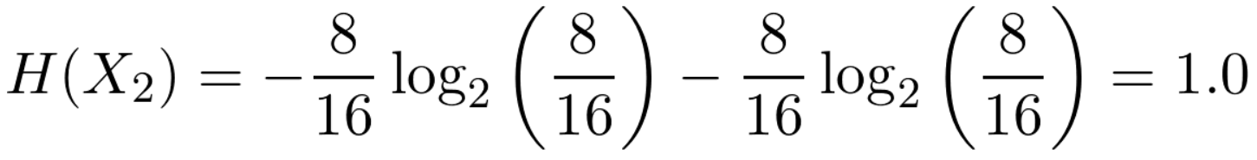
Information theory basics
Let’s define a quantity that measures the amount of uncertainty of each sequence
Entropy is a measure of uncertainty defined as

Slide 50
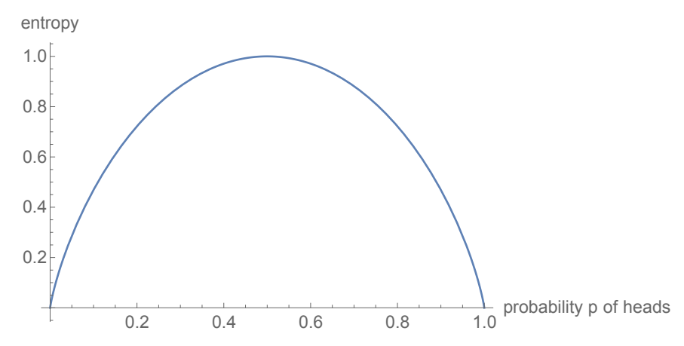
Entropy
High Entropy
Variable has a uniform like distribution
Histogram is flat
Sampled instances are less predictable
Low Entropy
Distribution of variables has many peaks and valleys
Histogram has many lows and highs
Sampled instances are more predictable
Source: Slide credit: R grosse

Slide 51
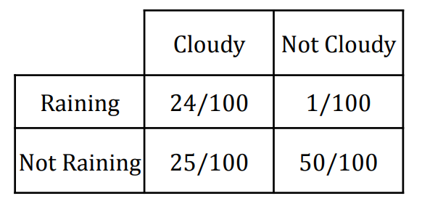


Entropy of a Joint Distribution
Consider the following two variables X and Y
The entropy of the joint distribution is defined as follows
Source: Slide credit: R grosse

Slide 52
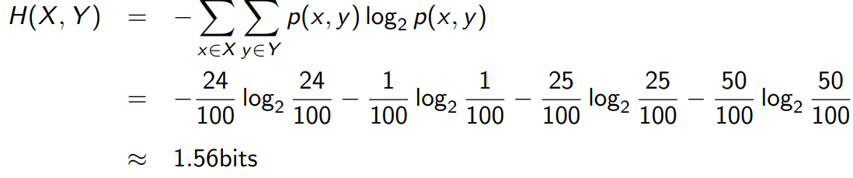
Entropy of a Joint Distribution
Consider the following two variables X and Y
The entropy of the joint distribution is defined as follows
Source: Slide credit: R grosse

Slide 53
Specific Conditional Entropy
Consider the following two variables X and Y
The entropy (uncertainty) of cloudiness, given that it is raining?
Source: Slide credit: R grosse

Slide 54
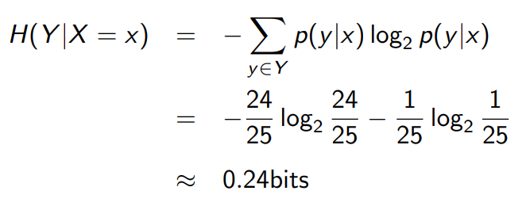
Specific Conditional Entropy
Consider the following two variables X and Y
The entropy (uncertainty) of cloudiness, given that it is raining?
specific conditional entropy
Source: Slide credit: R grosse

Slide 55
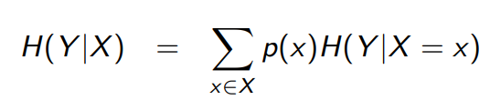
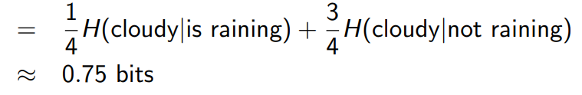
Conditional Entropy
Consider the following two variables X and Y
The conditional entropy of cloudiness, given the knowledge of whether or not it is raining?
conditional entropy
Source: Slide credit: R grosse

Slide 56

Conditional Entropy
Consider the following two variables X and Y
The conditional entropy of cloudiness, given the knowledge of whether or not it is raining?
conditional entropy
Source: Slide credit: R grosse

Slide 57


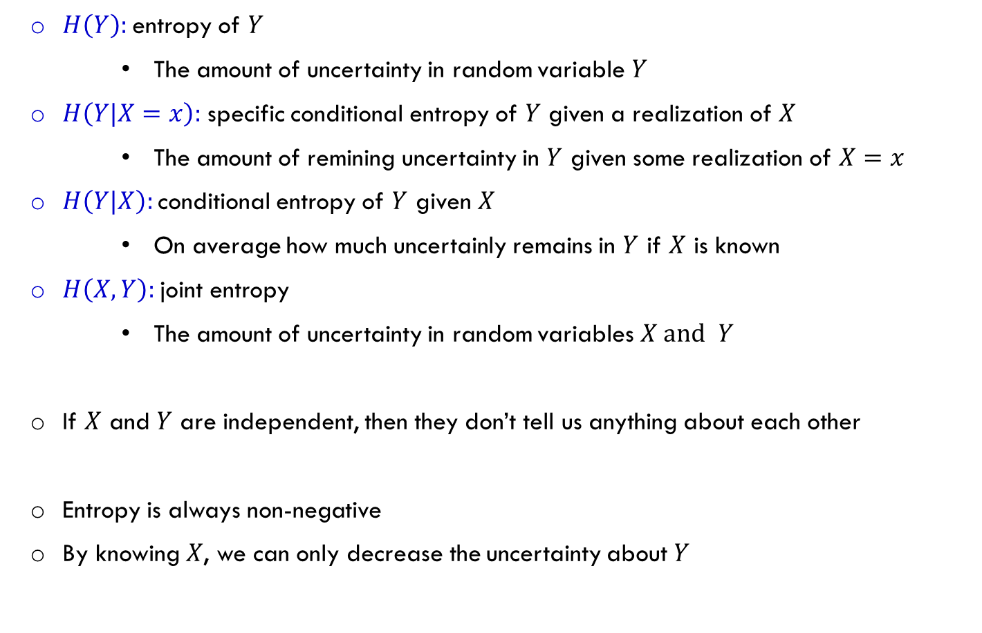
Entropy Recap
$H\left(Y\right):$entropy of $Y$
The amount of uncertainty in random variable $Y$
$H\left(Y|X=x\right):$ specific conditional entropy of $Y$ given a realization of $X$
The amount of remining uncertainty in $Y$ given some realization of $X=x$
$H\left(Y|X\right):$conditional entropy of $Y$ given $X$
On average how much uncertainly remains in $Y$ if $X$ is known
$H\left(X, Y\right):$joint entropy
The amount of uncertainty in random variables $X \text{and} Y$
If $X$ and $Y$ are independent, then they don’t tell us anything about each other
Entropy is always non-negative
By knowing $X$, we can only decrease the uncertainty about $Y$
Source: Slide credit: R grosse

Slide 58
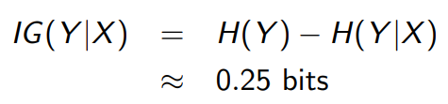

Information Gain
How much information do we gain about $Y$ by knowing the value of $X$
How much information about cloudiness do we get by discovering whether it is raining?
It is equivalent to the difference between:
Uncertainty of $Y$
Uncertainty of $Y$ given the value of $X$ is revealed
Information gain
Source: Slide credit: R grosse

Slide 59


Information Gain
How much information do we gain about $Y$ by knowing the value of $X$
If $X$ is completely uninformative about $Y:$
If $X$ is completely informative about $Y$:
Source: Slide credit: R grosse

Slide 60
Decision Tree- Information gain
Information gain measures the informativeness of a variable
This is exactly what we desire in a feature in decision tree
Source: Slide credit: R grosse

Slide 61
Decision Tree- Information gain
Information gain measures the informativeness of a variable
This is exactly what we desire in a feature in decision tree
What is the information gain of this split
A: 100
B: 49
A: 50
B: 0
A: 50
B: 49
Source: Slide credit: R grosse

Slide 62

Decision Tree- Information gain
Information gain measures the informativeness of a variable
This is exactly what we desire in a feature in decision tree
What is the information gain of this split
A: 100
B: 49
A: 50
B: 0
A: 50
B: 49
Source: Slide credit: R grosse

Slide 63

Decision Tree- Information gain
Information gain measures the informativeness of a variable
This is exactly what we desire in a feature in decision tree
What is the information gain of this split
A: 100
B: 49
A: 50
B: 0
A: 50
B: 49
Source: Slide credit: R grosse

Slide 64

Decision Tree- Information gain
Information gain measures the informativeness of a variable
This is exactly what we desire in a feature in decision tree
What is the information gain of this split
A: 100
B: 49
A: 50
B: 0
A: 50
B: 49
Source: Slide credit: R grosse

Slide 65
Decision Tree- Information gain
Information gain measures the informativeness of a variable
This is exactly what we desire in a feature in decision tree
What is the information gain of this split
A: 100
B: 49
A: 50
B: 0
A: 50
B: 49
Source: Slide credit: R grosse

Slide 66



Decision tree classification- Impurity measure
Intuitively, a good classification tree has more pure leaf nodes
The goal is to find splitting variables and split points minimizing node impurity measure
misclassification error rate:
Gini index:
Entropy:
$$H$$

Slide 67


Decision tree classification- Impurity measure
Consider binary classification and let $p$ be relative frequency of class 1
The impurity measures as a function of $p$
Gini and entropy are more effective, they push for more pure nodes, not just optimizing the error rate
As we saw, a good split may not change misclassification rate at all
Source: David Rosenberg lecture notes- Foundations of Machine Learning, Bloomberg ML EDU 2017

Slide 68
Constructing a classification decision tree
Pick an attribute to split at a non-terminal node. How?
choose the attribute, and a cut point that maximizes the information gain
Split the training set into groups based on attribute value
For each group:
If the group doesn’t have any point, return majority from parent
Else If all the examples are in the same class, return class
Else, go back to step 1
The tree construction is a greedy recursive approach in which we are building tree
node by node
Source: Slide credit: R grosse

Slide 69




Decision tree overfit
Often performs well for training data, likely overfit the data,
Bad out-of-sample performance
For smaller trees, we have less chance of overfitting
One solution is that we grow the tree as long as the decrease in RSS due to each split exceed some threshold
smaller tree might be too short-sighted
A seemingly worthless split early on, might be followed by a very good split
$$5$$
$$5$$
$$5$$
$$5$$
$$−5$$
$$−5$$
$$−5$$
$$−5$$
$$1$$
$$5$$
$$5$$
$$5$$
$$5$$
$$−5$$
$$−5$$
$$−5$$
$$−5$$
$$5$$
$$5$$
$$5$$
$$5$$
$$−5$$
$$−5$$
$$−5$$
$$−5$$
$$−5$$
$$−5$$
$$−5$$
$$−5$$
$$5$$
$$5$$
$$5$$
$$5$$
$$0$$
$$−5$$
$$−5$$
$$−5$$
$$−5$$
$$5$$
$$5$$
$$5$$
$$5$$
$$−5$$
$$−5$$
$$−5$$
$$−5$$
$$5$$
$$5$$
$$5$$
$$5$$
$$0$$
$$1$$
Source: A Introduction to Statistical Learning with Application in R, Trever Hastie and Rob Tibshirani

Slide 70
Decision tree overfit
Often performs well for training data, likely overfit the data,
Bad out-of-sample performance
For smaller trees, we have less chance of overfitting
One solution is that we grow the tree as long as the decrease in RSS due to each split exceed some threshold
smaller tree might be too short-sighted
A seemingly worthless split early on, might be followed by a very good split
As a result, not a good solution
$$5$$
$$5$$
$$5$$
$$5$$
$$−5$$
$$−5$$
$$−5$$
$$−5$$
$$1$$
$$5$$
$$5$$
$$5$$
$$5$$
$$−5$$
$$−5$$
$$−5$$
$$−5$$
$$5$$
$$5$$
$$5$$
$$5$$
$$−5$$
$$−5$$
$$−5$$
$$−5$$
$$−5$$
$$−5$$
$$−5$$
$$−5$$
$$5$$
$$5$$
$$5$$
$$5$$
$$0$$
$$−5$$
$$−5$$
$$−5$$
$$−5$$
$$5$$
$$5$$
$$5$$
$$5$$
$$−5$$
$$−5$$
$$−5$$
$$−5$$
$$5$$
$$5$$
$$5$$
$$5$$
$$0$$
$$1$$
Source: A Introduction to Statistical Learning with Application in R, Trever Hastie and Rob Tibshirani

Slide 71

Tree pruning
A better approach is to grow a very large tree $T_{0},$ and then prune it back to obtain a subtree
Stop only when each node
Has zero error, or,
Has more than some minimum number of observations (C=5)
For an internal node, pruning means eliminating all descendents of it, till it become a leaf node
Source: A Introduction to Statistical Learning with Application in R, Trever Hastie and Rob Tibshirani

Slide 72


Tree pruning
Source: A Introduction to Statistical Learning with Application in R, Trever Hastie and Rob Tibshirani

Slide 73


Tree pruning
Source: A Introduction to Statistical Learning with Application in R, Trever Hastie and Rob Tibshirani

Slide 74





Cost complexity pruning
Suppose we want to prune $T_{0}$
Clearly, for any
Let use $|T|$ as the number of leaves in $T$ ( a measure of complexity)
The cost complexity criterion with parameter is
Source: A Introduction to Statistical Learning with Application in R, Trever Hastie and Rob Tibshirani

Slide 75


Cost complexity pruning
Suppose we want to prune $T_{0}$
Clearly, for any
Let use $|T|$ as the number of leaves in $T$ ( a measure of complexity)
The cost complexity criterion with parameter is
number of leaves in $T$
Source: A Introduction to Statistical Learning with Application in R, Trever Hastie and Rob Tibshirani

Slide 76


Cost complexity pruning
Suppose we want to prune $T_{0}$
Clearly, for any
Let use $|T|$ as the number of leaves in $T$ ( a measure of complexity)
The cost complexity criterion with parameter is
The goal is to find a tree with a low-cost complexity
A trade-off between the subtree’s complexity and its fit to the training data
Cost complexity pruning:
For each $α$, find the subtree T minimizing (on training data)
Use cross-validation to find the right choice of $α$
number of leaves in $T$
Source: A Introduction to Statistical Learning with Application in R, Trever Hastie and Rob Tibshirani

