Slide 1



REAL: A Representative Error-Driven Approach for Active Learning
Cheng Chen^{1,2}, Yong Wang², Lizi Liao², Yueguo Chen¹, Xiaoyong Du¹

Slide 2





Active Learning (AL)
Pool-based sampling
Most informative instances

Slide 3
Background-Uncertainty
Uncertainty-based AL selects the most uncertain instances for the model.

Slide 4
Background-Diversity
Diversity-based AL aims to maximize the diversity of sampled instances.

Slide 5
Motivation-REAL
Erroneous instances are more informative for AL [1,2].
REAL selects representative errors near decision boundary.
pseudo error
least confidence
[1] Choi et al., Vab-al: Incorporating class imbalance and difficulty with variational bayes for active learning, CVPR’2021
[2] Krempl et al., Optimised probabilistic active learning (opal) for fast, non-myopic, cost-sensitive active classification. ML’2015

Slide 6
Contributions
REAL: a new AL sampling algorithm dedicated to representative errors.
New SOTA result on five text classification benchmarks.
Insights on error distribution:
most errors are along the decision boundary;
REAL’s active selections align well with that of ground-truth errors.
Notes:
A new AL sampling algorithm, REAL, that explores selecting representative errors from the unlabeled pool.
We show Real consistently beats all the best-performing baselines on five text classification benchmark datasets in terms of both accuracy and F1-macro scores.
We empirically investigate error distribution and find that
most errorsare distributed along the decision boundary;
the distribution of selections made by Real align well with that of ground-truth errors.

Slide 7
REAL: Representative Error-Driven Active Learning
K-Means clustering
Assign pseudo labels
Find pseudo errors
Add least confidence

Slide 8
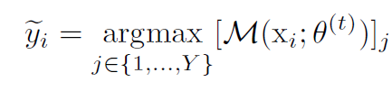
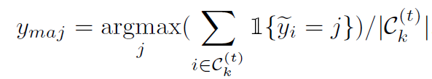


REAL - Pseudo Error Identification
The predicted label for an individual instance:
The pseudo label of cluster:
The instances that are not predicted as are defined as pseudo errors in the corresponding cluster .

Slide 9



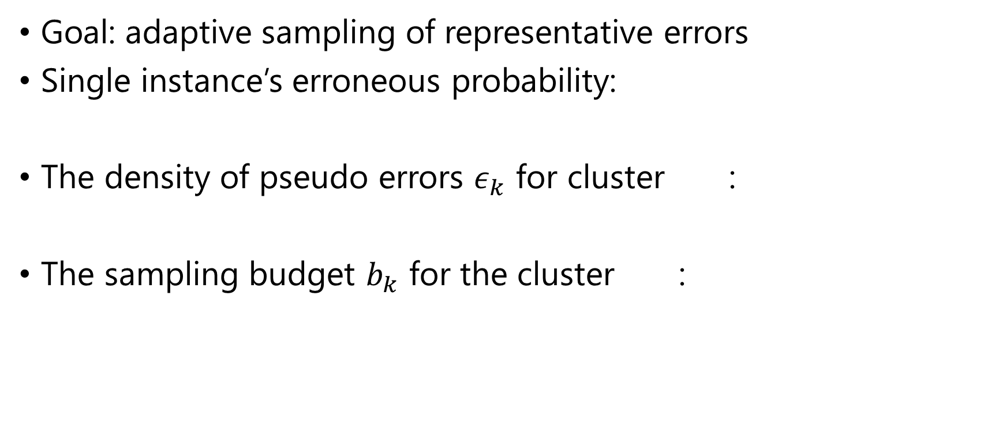
REAL - Adaptive Sampling
Goal: adaptive sampling of representative errors
Single instance’s erroneous probability:
The density of pseudo errors $ε_{k}$ for cluster :
The sampling budget $b_{k}$ for the cluster :

Slide 10
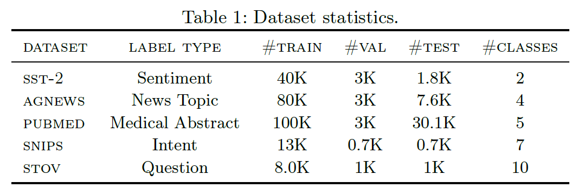
Experiments
Task: AL for text classification
Model: RoBERTa-base
Datasets:
Eight baselines

Slide 11
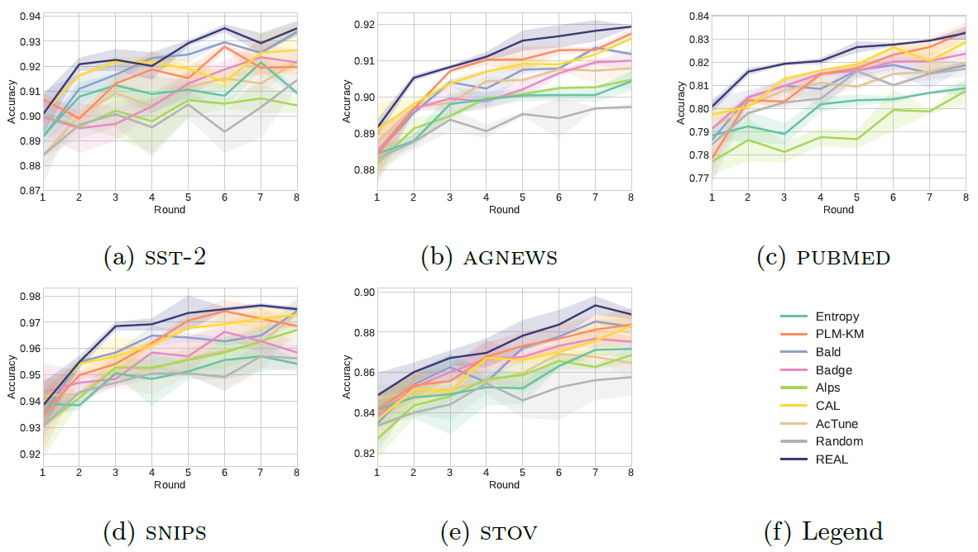
Results - Accuracy

Slide 12
Results:
Error Rate
REAL: A Representative Error-Driven Approach for Active Learning

Slide 13
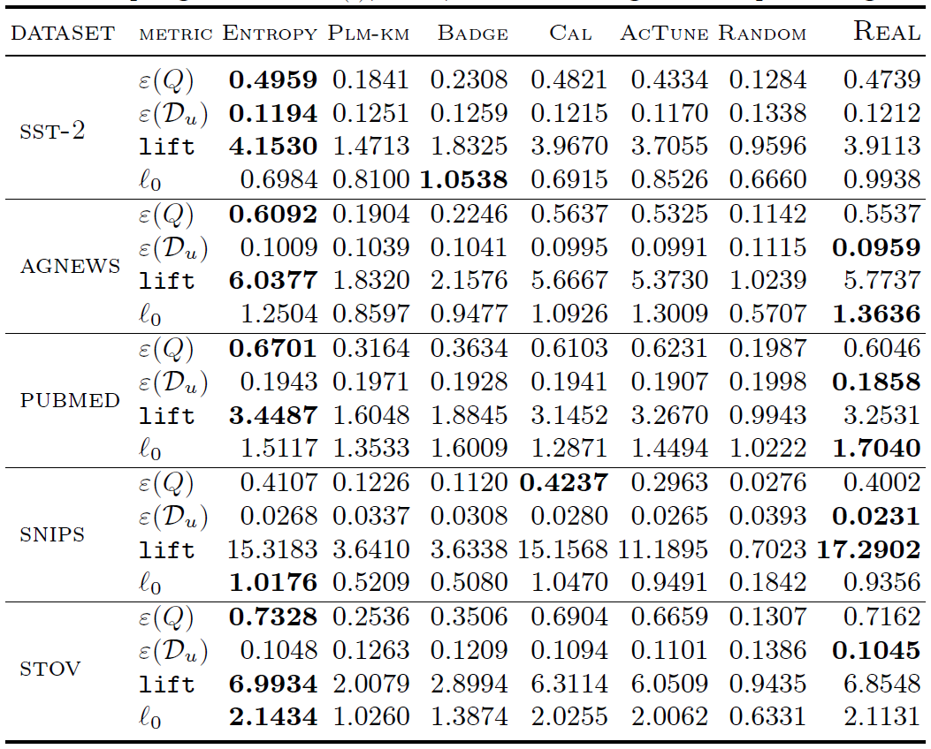




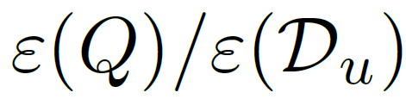

Results:
Error Rate
Error rate of the actively selected instances .
Error rate of the whole unlabeled pool (as test set).
Average first step training loss for the the actively selected instances .

Slide 14
Results:
Error Rate
Error rate of the actively selected instances .
Error rate of the whole unlabeled pool (as test set).
Average first step training loss for the the actively selected instances .

Slide 15
Results:
Error Rate
Error rate of the actively selected instances .
Error rate of the whole unlabeled pool (as test set).
Average first step training loss for the the actively selected instances .

Slide 16
Results:
Error Rate
Error rate of the actively selected instances .
Error rate of the whole unlabeled pool (as test set).
Average first step training loss for the the actively selected instances . [3]
[3] Yoo et al., Learning Loss for Active Learning, CVPR’2019

Slide 17
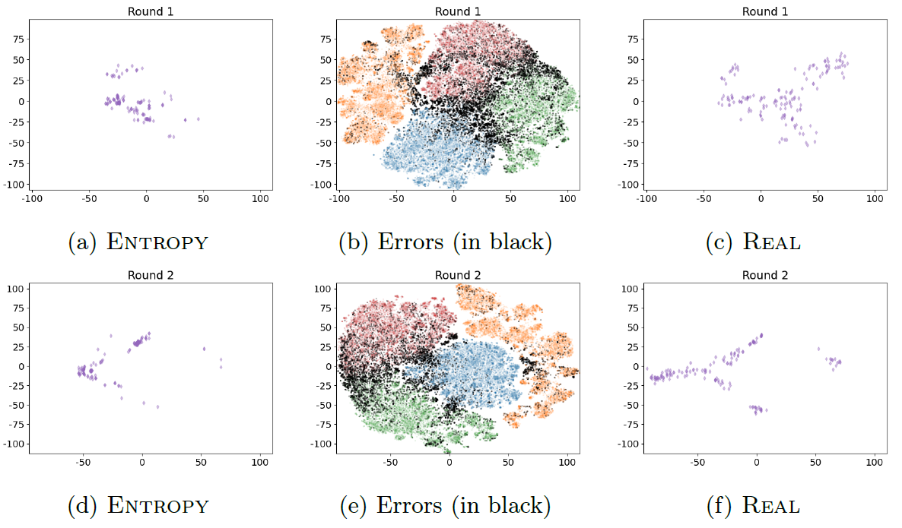
Results – Representative Errors

Slide 18
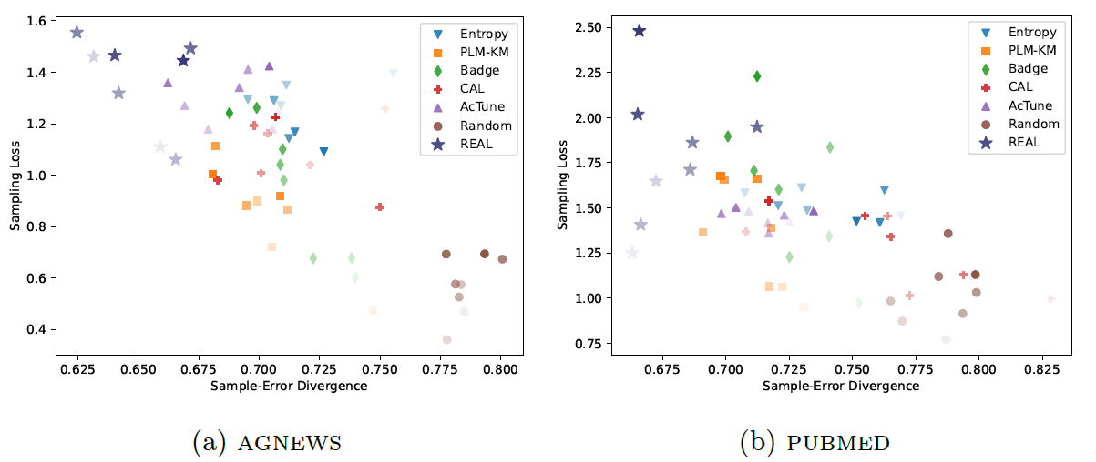
Results – Representative Errors

Slide 19
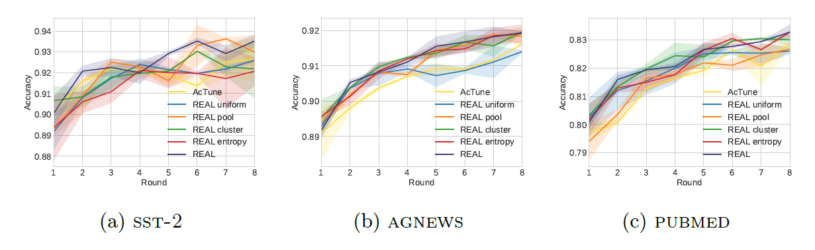
Ablation Study
Most variants of REAL still performs well

Slide 20
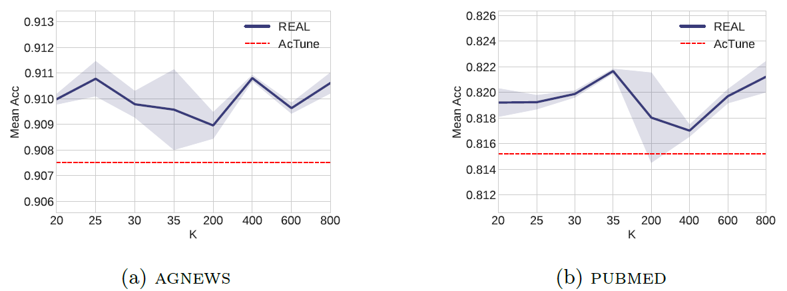
Hyperparameter
Mean acc under a wide range of #clusters
Notes:
Mean acc under a wide range of #clusters K for Real against the best
baseline AcTune on our largest two datasets

Slide 21
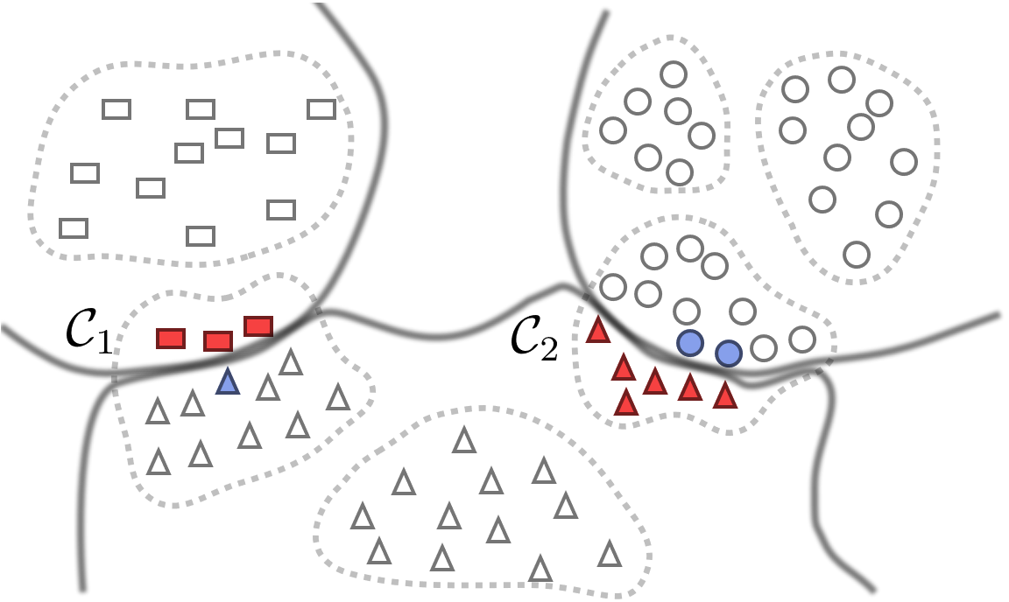
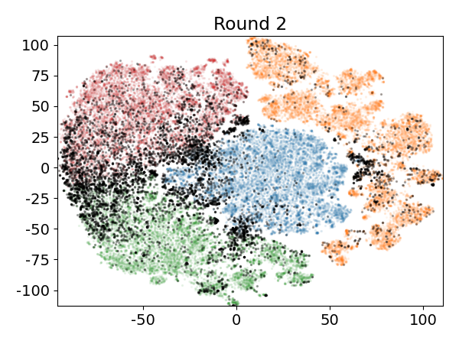
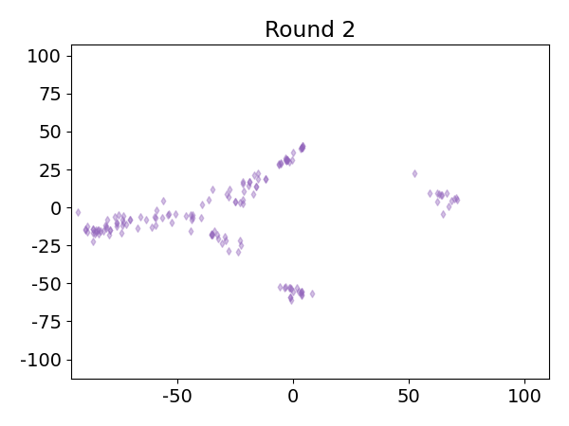
Takeaways
REAL: a new AL sampling algorithm for Representative Errors
Key: adaptive budget allocation
Most unlabeled errors lie around the decision boundary
Finding those errors for labeling can improve AL
Notes:
Questions:
Dataset details explained
Figure background

Slide 22

Thank you for your attention!
Q & A
REAL: A Representative Error-Driven Approach for Active Learning
Cheng Chen^{1,2}, Yong Wang², Lizi Liao², Yueguo Chen¹, Xiaoyong Du¹
Code & data: https://github.com/withchencheng/ECML_PKDD_23_Real
Contact me: chchen@ruc.edu.cn

