Slide 1
13th Oct Week Meeting

Slide 2
What I have done?
1 overleaf project content update(ing)
2 Learn some missing knowledge
3 A tool for measuring model performance has been initially built. The data processing phase has been completed, and we are ready to enter the SPP step. (not fully done)
4 The transfer learning part of LSTM is still being coded.(not fully done)
5 Read the LORA and imu literature

Slide 3
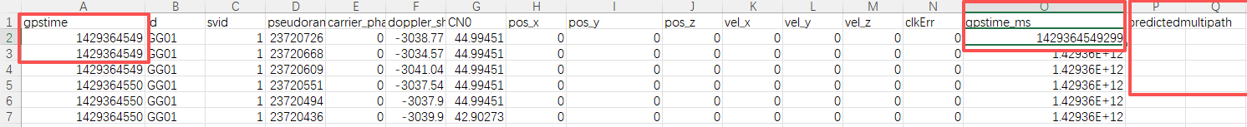
Question:Data alignment issues
1. The two GPS times are incomplete

Slide 4
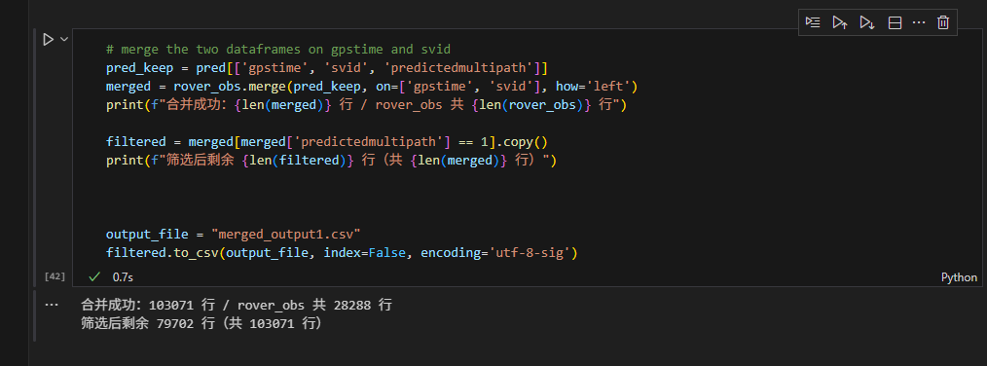
Why are there 79,702 rows left when I filter 1, but my LSTM prediction file only has 28,288 rows? Why is there an excess?
Is it because the data has the same GPS time?

Slide 5
Questions
\for_real\Case x_xxxxxx are simulation data in different situations.
RWD_20250422\D1T4 are real-world data from satellites, receiver and the testing car position data.

Slide 6
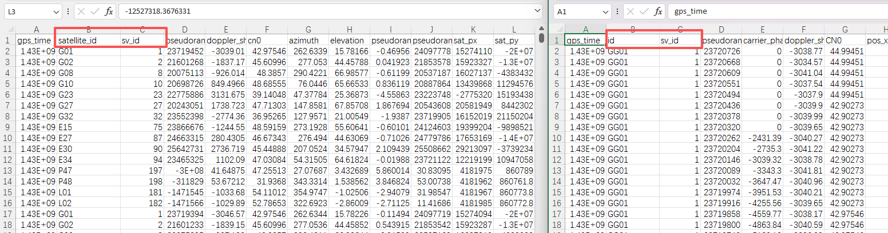
Question
1. What are the differences between Satellite ID and SV_ID within observation_data_case5.csv and rover_obs_full.csv?

Slide 7
How we validated the accuracy of our final model Our real-world data is unlabeled
Verify the model's effect on improving positioning accuracy in real environments.

Slide 8
Model Evaluation
Data Proecessing
Merge two documents
Import them to SPP position calculation
Compare the output with pos document
RSME 均方根
1 合并是根据哪个合并 数据不一样啊
2 我们要想评估模型的性能 应该是需要做一个 比较吧 这个 方式行么
3 如果可以的话 评估的逻辑
4 最后数据是有差别的 但是 结果是可行的么 ？ 合并后的3000，但是汽车的位置 1000多，这个情况怎么办？

Slide 9
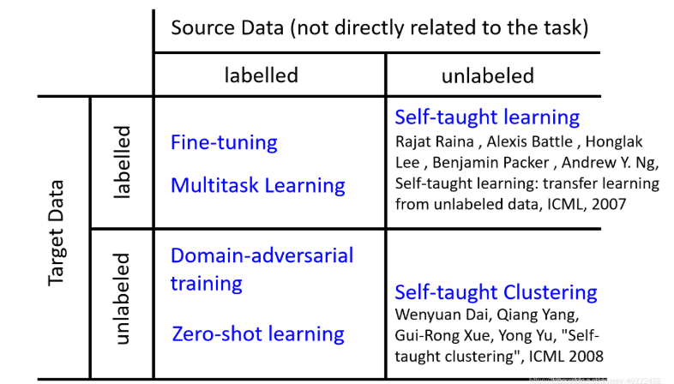
Source：https://blog.csdn.net/weixin_49272172/article/details/115979017

Slide 10
Question
1. I adjusted the value of epoch, changed it to 50, and final result becomes 16% instead of 5%.

Slide 11
Transfer learning这一部分 还没有 做出来 但是 正在编写

Slide 12
Transfer-learning
1. I am a bit stuck in theoretical knowledge, so I need to learn more deeply.
2. I would like to try fine-tuning, tuning the classifier head, and freezing the main weights.
3. Based on the form from the last page, I want to try Domain Adversarial Training.

Slide 13
Tartan IMU: A Light Foundation Model for Inertial Positioning in Robotics
1 And what exactly can we understand about this IMU data model?
2 Domain adaptation?
3 LORA is kind of like transfer learning.

Slide 14
1 Is there a PPT template for IRT so that I can use the template to make a report?
2 How do we ultimately measure our model performance?
3 As long as we can perform better than the baseline classification, right?
4 How long does it take to reproduce the paper you learned?

Slide 15
1 Review and learn theoretical knowledge. This is very important.
2 Continue to improve performance evaluation content
3 Continue to use transfer learning to see the effect and think deeply about the LORA method
4 Complete overleaf
5 Continue to complete the establishment of a feasibility project(transfer learning and the estimation tool)

