Slide 1

Array Data Structure Guide
Arrays are fundamental data structures that store elements in contiguous memory. They allow efficient access and are widely used in programming. This guide covers key concepts and operations for working with arrays.

Slide 2
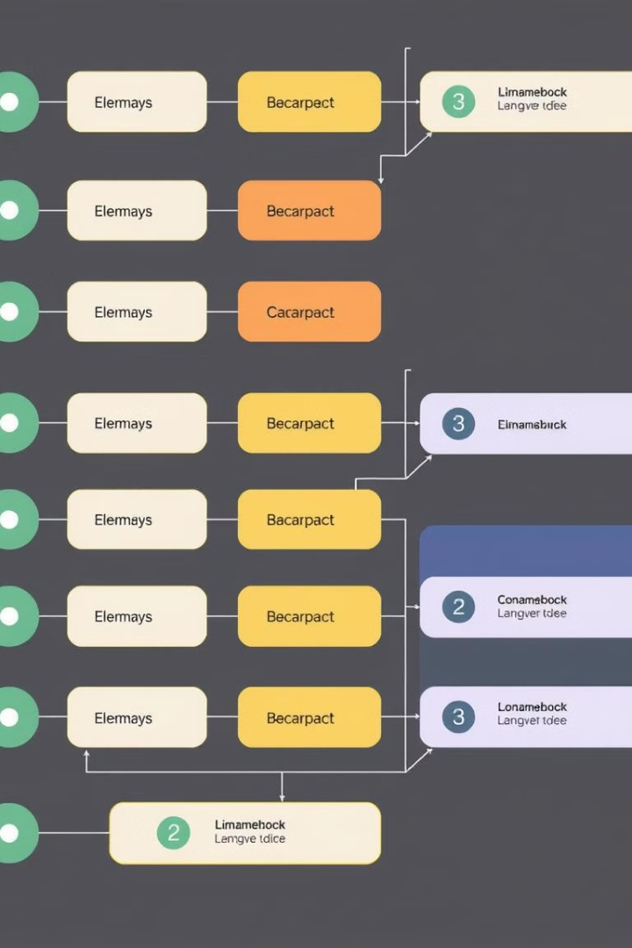
What is an Array?
Definition
An array is a collection of items of the same data type stored at contiguous memory locations.
Indexing
Elements are identified by their index, starting from 0.
Fixed Size
Arrays have a fixed size that is determined when they are created.

Slide 3
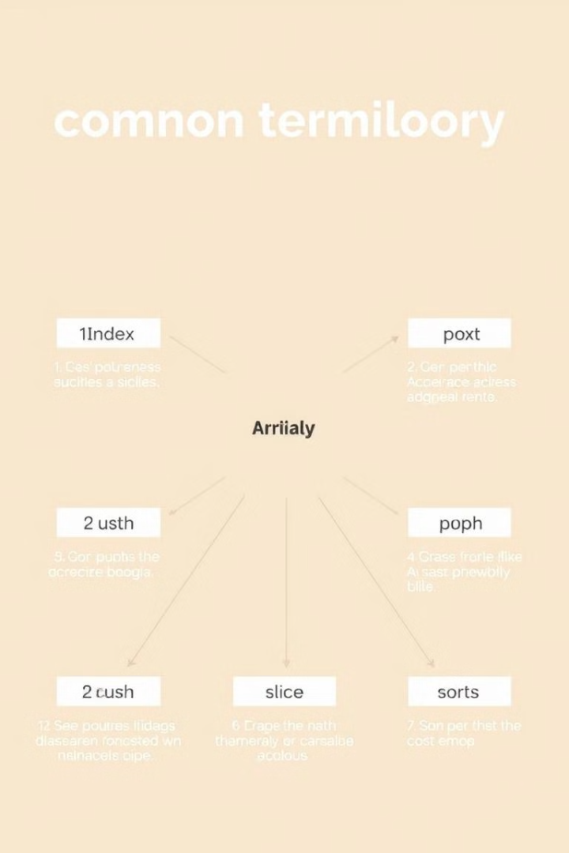
Basic Terminology
1
Array Index
The position of an element in the array, starting from 0.
2
Array Element
An individual item stored at a specific index in the array.
3
Array Length
The total number of elements that can be stored in the array.

Slide 4

Memory Representation
1
Contiguous Storage
Array elements are stored in adjacent memory locations.
2
Address Calculation
Element addresses can be calculated using the base address and index.
3
Efficient Access
Allows for fast retrieval of elements using their index.

Slide 5
Array Declaration
C++
Java
Python
int arr[5];
int[] arr;
arr = []

Slide 6
Array Initialization
C++
Java
Python
int arr[] = {1, 2, 3, 4, 5};
int[] arr = {1, 2, 3, 4, 5};
arr = [1, 2, 3, 4, 5]

Slide 7

Importance of Arrays
Efficient Storage
Arrays store multiple elements of the same type efficiently.
Fast Access
Elements can be accessed quickly using their index.
Simplicity
Arrays are easy to understand and use in programming.
Foundation
Many other data structures are built using arrays.

Slide 8
Types of Arrays: Size
Fixed-Size Arrays
Dynamic Arrays
Size is determined at creation and cannot be changed.
Size can be changed during program execution.

Slide 9
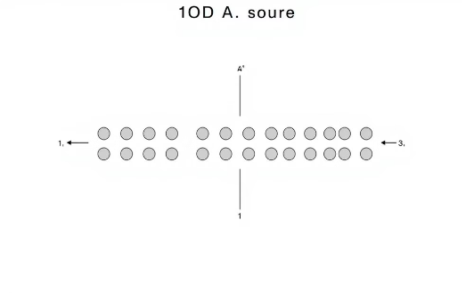
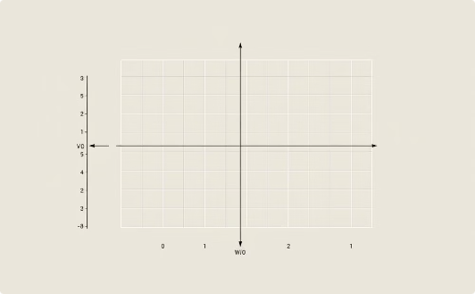
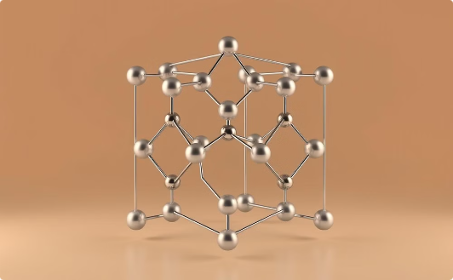
Types of Arrays: Dimensions
One-Dimensional Array
Two-Dimensional Array
Three-Dimensional Array
Linear collection of elements.
Table-like structure with rows and columns.
Cube-like structure with multiple layers.

Slide 10
One-Dimensional Arrays
1
Definition
Linear collection of elements accessed by a single index.
2
Usage
Commonly used for lists, sequences, and vectors.
3
Access
Elements accessed using arr[i] notation.

Slide 11
Two-Dimensional Arrays
1
Definition
Array of arrays, forming a table-like structure.
2
Usage
Used for matrices, grids, and 2D game boards.
3
Access
Elements accessed using arr[i][j] notation.

Slide 12
Three-Dimensional Arrays
1
Definition
Array of 2D arrays, forming a cube-like structure.
2
Usage
Used for 3D simulations, volumetric data, and complex data structures.
3
Access
Elements accessed using arr[i][j][k] notation.

Slide 13
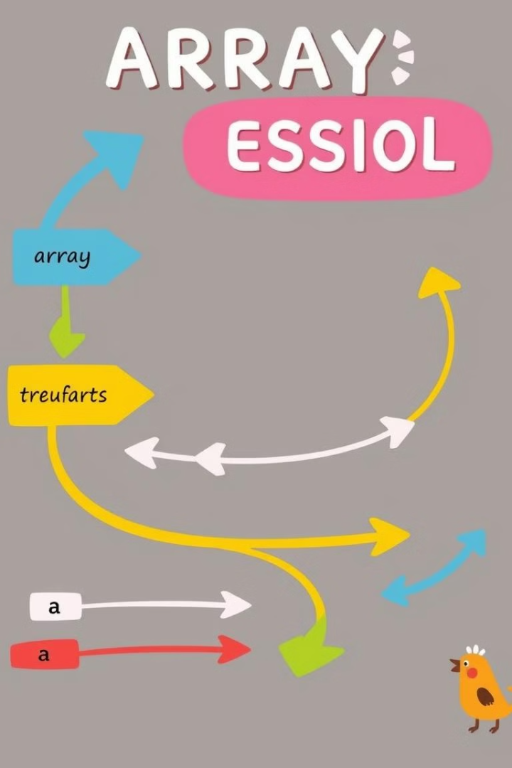
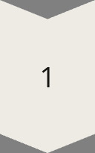
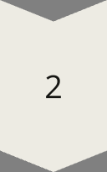
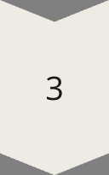
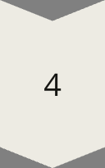
Array Traversal
Start
Begin at the first element (index 0).
Iterate
Move through each element sequentially.
Process
Perform an operation on each element.
End
Stop after reaching the last element.

Slide 14
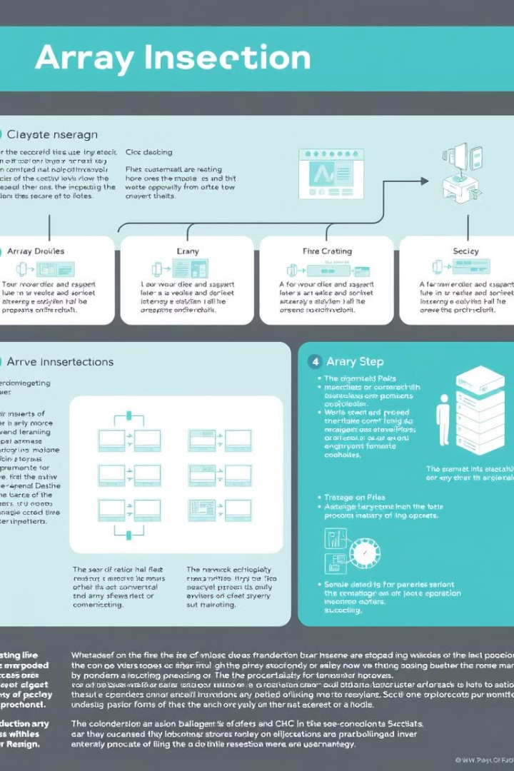
Insertion in Array
1
Find Position
Determine where to insert the new element.
2
Shift Elements
Move existing elements to make space.
3
Insert
Place the new element at the desired position.

Slide 15
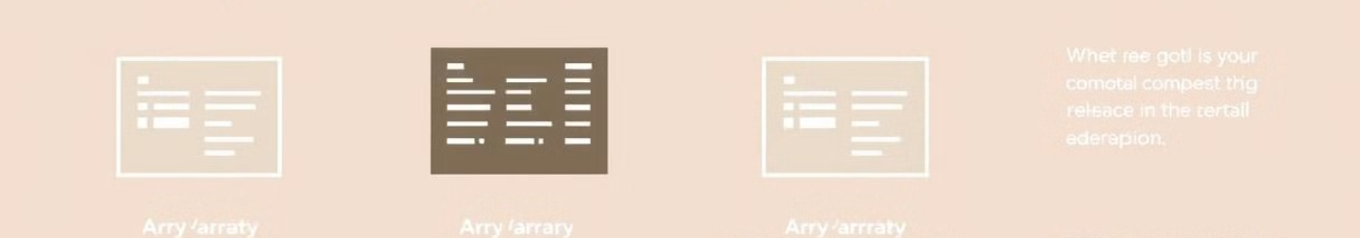
Deletion in Array
Find Element
1
Locate the element to be deleted.
2
Remove
Delete the element from its position.
Shift Elements
3
Move remaining elements to fill the gap.

Slide 16
Searching in Array
Linear Search
Binary Search
Sequentially check each element until a match is found.
For sorted arrays, use divide-and-conquer to find elements quickly.

Slide 17
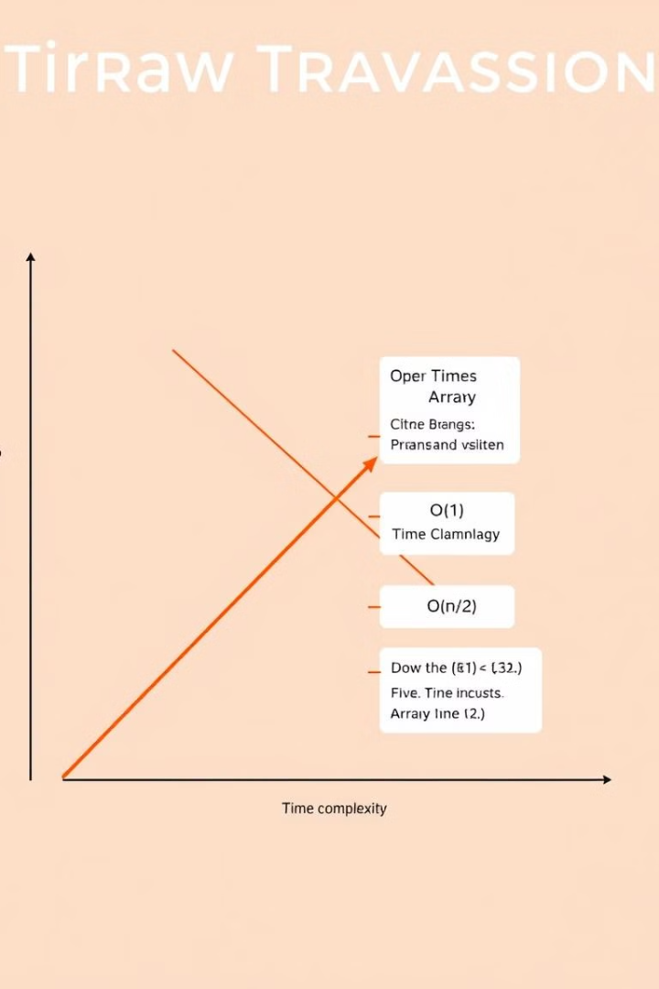
Time Complexity: Traversal
Best Case
Average Case
Worst Case
Ω(N)
θ(N)
O(N)

Slide 18
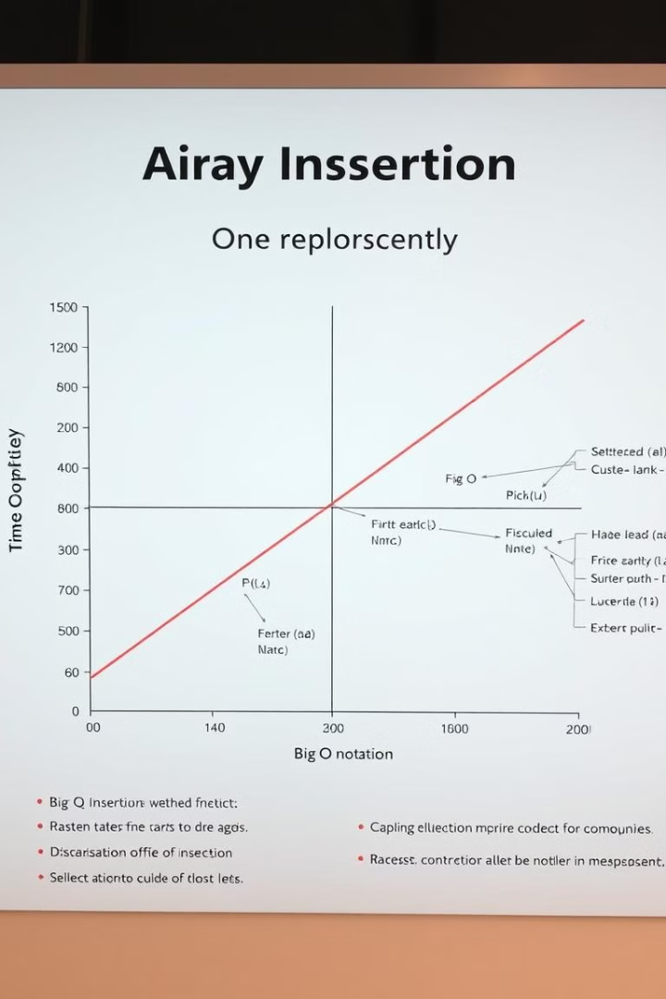
Time Complexity: Insertion
Best Case
Average Case
Worst Case
Ω(1)
θ(N)
O(N)

Slide 19
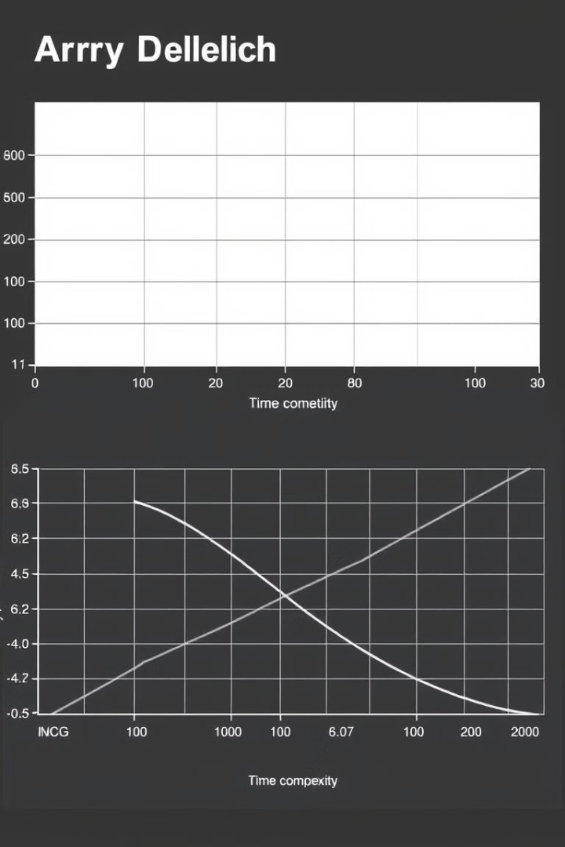
Time Complexity: Deletion
Best Case
Average Case
Worst Case
Ω(1)
θ(N)
O(N)

Slide 20
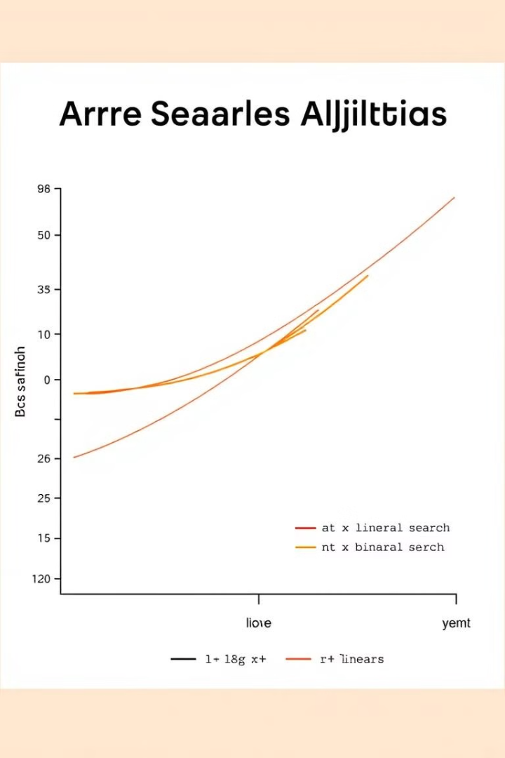
Time Complexity: Searching
Best Case
Average Case
Worst Case
Ω(1)
θ(N)
O(N)

Slide 21
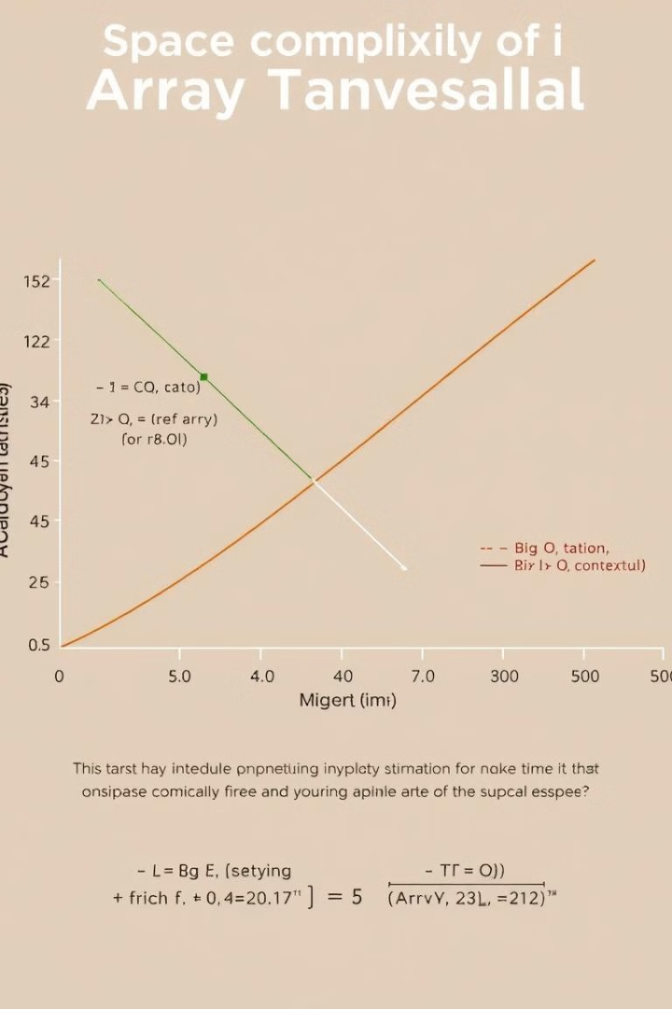
Space Complexity: Traversal
Best Case
Average Case
Worst Case
Ω(1)
θ(1)
O(1)

Slide 22
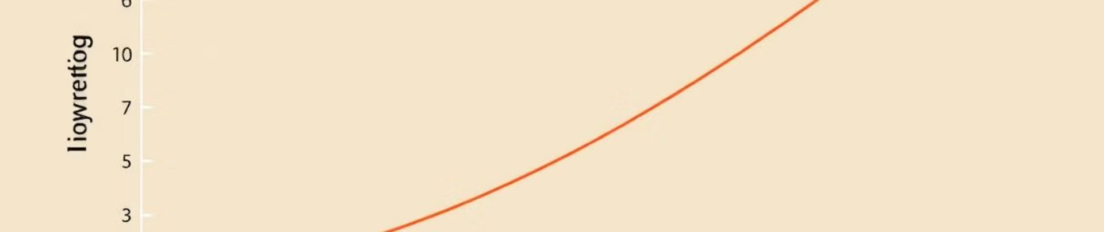
Space Complexity: Insertion
Best Case
Average Case
Worst Case
Ω(1)
θ(N)
O(N)

Slide 23
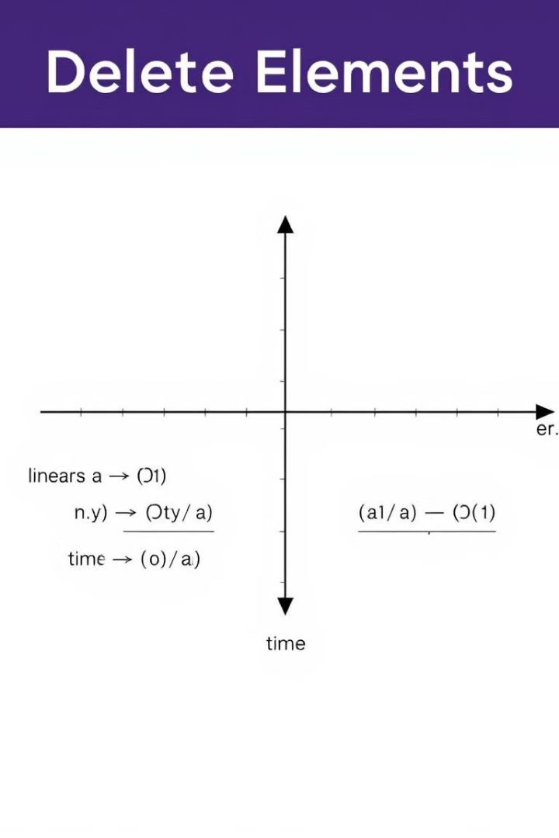
Space Complexity: Deletion
Best Case
Average Case
Worst Case
Ω(1)
θ(N)
O(N)

Slide 24
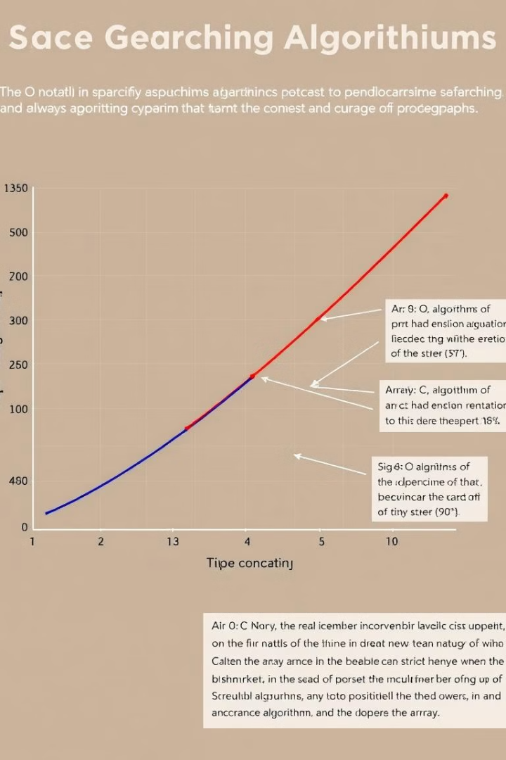
Space Complexity: Searching
Best Case
Average Case
Worst Case
Ω(1)
θ(1)
O(1)

Slide 25
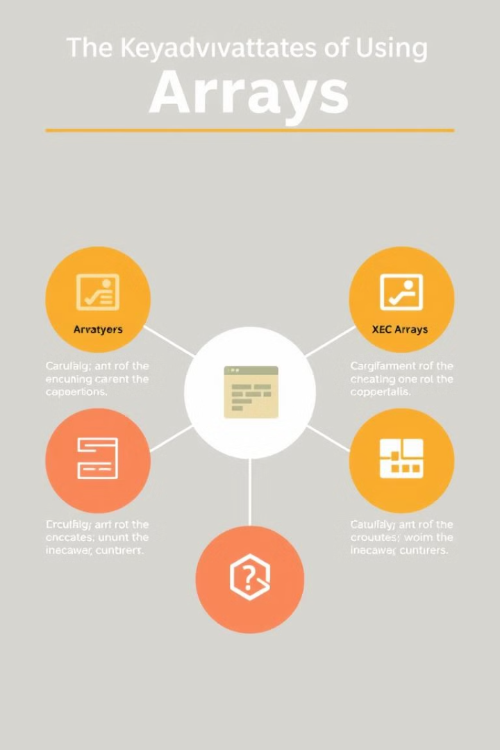
Advantages of Arrays
1
Random Access
Elements can be accessed directly using their index.
2
Cache Locality
Contiguous memory allocation improves performance.
3
Simplicity
Arrays are easy to understand and implement.
4
Base for Other Structures
Many data structures are built using arrays.

Slide 26
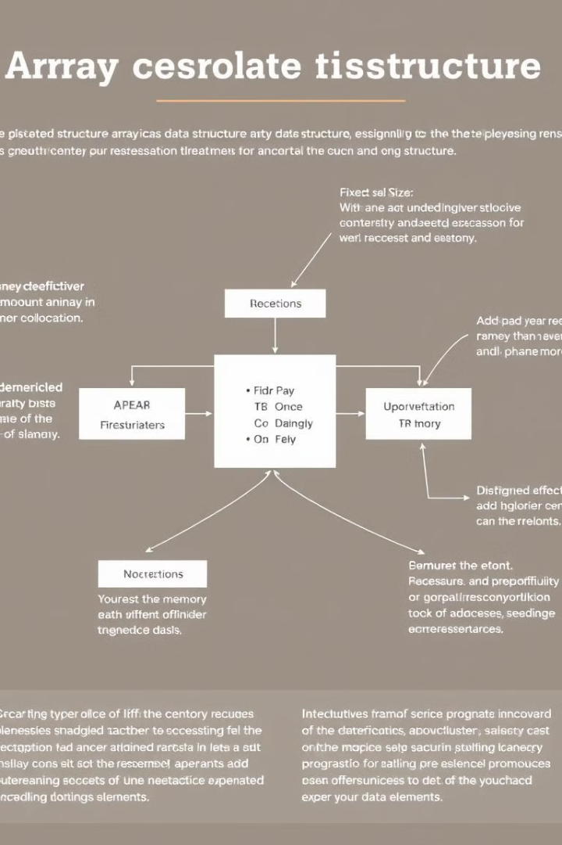
Disadvantages of Arrays
1
Fixed Size
Size cannot be changed after creation for static arrays.
2
Insertion and Deletion
These operations can be costly, especially for large arrays.
3
Homogeneous Elements
Arrays can only store elements of the same data type.
4
Memory Waste
Memory may be wasted if the array is not fully utilized.

Slide 27




Applications of Arrays
Database Records
Arrays are used to implement database records.
Lookup Tables
Arrays are used in computer lookup tables.
Other Data Structures
Arrays are used to implement other data structures.

Slide 28

Interview Questions: Arrays
1
Reversing an Array
Implement a function to reverse the elements of an array.
2
Finding Duplicates
Write a program to find duplicate elements in an array.
3
Rotating an Array
Implement array rotation by a given number of positions.
4
Subarray Sum
Find a subarray with a given sum in an array.

Slide 29
Array vs. Linked List
Array
Linked List
Contiguous memory, fixed size, fast random access.
Non-contiguous memory, dynamic size, sequential access.

Slide 30

Conclusion
Fundamental
Arrays are a fundamental data structure in computer science.
Versatile
They are used in various applications and algorithms.
Efficient
Arrays provide efficient storage and access to elements.
Essential Knowledge
Understanding arrays is crucial for programming and interviews.

