Slide 1
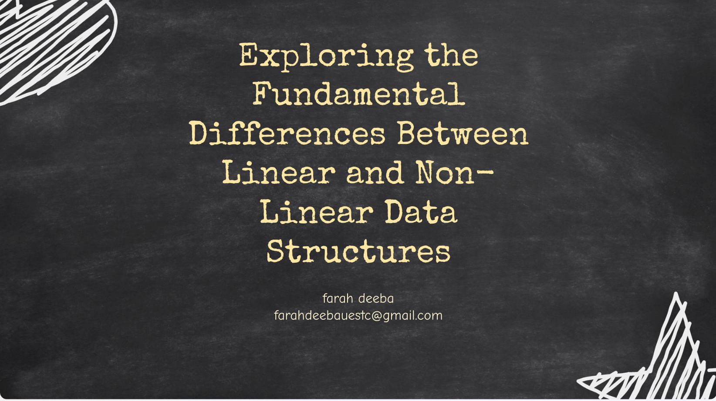

Slide 2
Table of Contents
Introduction
What is Linear Data Structure?
Characteristics of Linear Data Structure
Types of Linear Data Structure
What is Non-linear Data Structure?
Characteristics of Non-linear Data Structures
Types of Non-linear Data Structures
Linear vs Non-linear Data Structures

Slide 3
Understanding the difference between linear and non-linear data structures is essential in computer science. Linear data structures, like arrays and linked lists, store data sequentially, while non-linear data structures, like trees and graphs, organize data hierarchically or in interconnected networks.
Let’s discuss in detail: linear vs non-linear data structures.

Slide 4
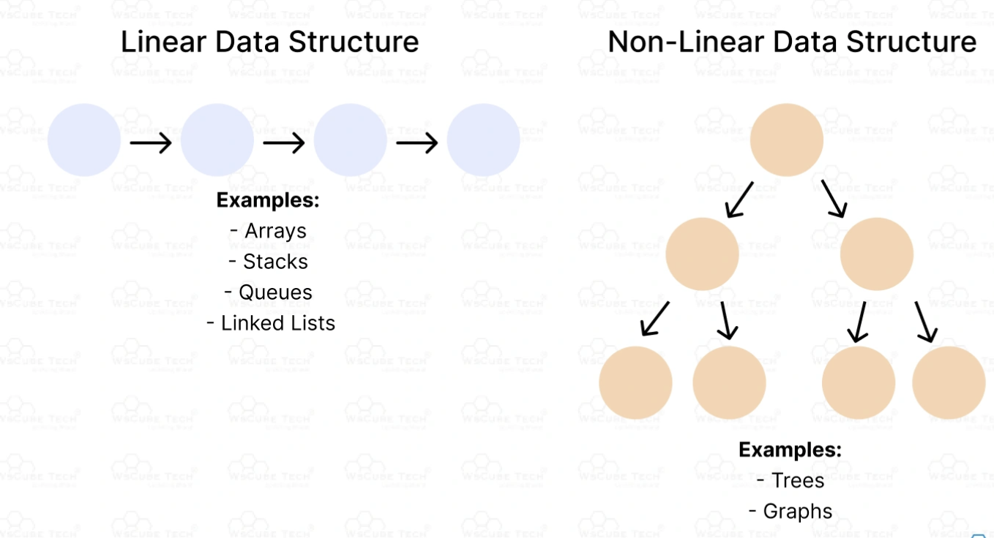

Slide 5
What is Linear Data Structure?
A linear data structure is a way of organizing data where elements are arranged in a straight line, one after another. This means that each element is connected to the one before it and the one after it, forming a simple sequence.

Slide 6
Characteristics of Linear Data Structure
Sequential Order: Elements are stored in a specific order, one after the other. You can easily move from one element to the next
.
Single Level: All elements are on the same level, forming a single, continuous sequence.
Contiguous Memory Allocation: In some linear data structures like arrays, elements are stored next to each other in memory.
Simple Traversal: It is easy to go through each element one by one, starting from the first element and ending at the last.

Slide 7
Types of Linear Data Structure
. Arrays
An array is a collection of elements stored in contiguous memory locations. All elements in an array are of the same data type.
Characteristics:
Fixed size, determined at the time of array creation.
Direct access to elements using an index (0-based indexing).
Example:
arr = [1, 2, 3, 4, 5] # Array with 5 elements
print(arr[2]) # Accessing the third element

Slide 8
2. Linked Lists
A linked list is a collection of nodes where each node contains data and a reference (or link) to the next node in the sequence.
Types:
Singly Linked List: Each node points to the next node.
Doubly Linked List: Each node points to both the next and the previous nodes.
Circular Linked List: The last node points back to the first node.

Slide 9
3. Stacks
A stack is a linear data structure that follows the Last In, First Out (LIFO) principle. Elements are added and removed from the same end, called the "top".
Characteristics:
Only the top element can be accessed, added, or removed.
Useful for tasks like reversing a string, parsing expressions, etc.

Slide 10
4. Queues
A queue is a linear data structure that follows the First In, First Out (FIFO) principle. Elements are added at the rear and removed from the front.
Characteristics:
Elements are processed in the order they were added.
Useful for tasks like task scheduling, managing requests in a server, etc.

Slide 11
What is Non-linear Data Structure?
A non-linear data structure is a type of data structure where elements are not arranged sequentially or in a linear order. Instead, they are organized in a hierarchical or interconnected manner, forming complex relationships between elements.
This structure allows for more flexible and efficient data organization, especially for representing relationships and hierarchical data.

Slide 12
Characteristics of Non-linear Data Structures
1. Hierarchical Structure:
Elements are arranged in a hierarchy, with a parent-child relationship. This is especially true for tree data structures.
Examples: Trees, where nodes represent elements, and edges represent relationships between nodes.
2. Multiple Levels:
Non-linear data structures can have multiple levels of elements, unlike linear data structures which have a single level.
Example: A tree with multiple levels of nodes

Slide 13
3. Dynamic Relationships:
Elements can have multiple connections, creating complex relationships.
Examples: Graphs, where nodes can be connected to many other nodes, forming networks.
4. Efficient Data Retrieval:
Non-linear data structures allow for efficient data retrieval and manipulation, particularly when dealing with hierarchical data.
Example: Searching for an element in a balanced binary search tree is faster compared to a linear search in an array.

Slide 14
5. Non-contiguous Memory Allocation:
Elements in non-linear data structures are typically stored in non-contiguous memory locations. This allows for flexible and dynamic storage.
Example: Nodes in a linked list or tree are stored in different memory locations and connected via pointers.
6. Traversal Methods:
Various traversal methods are used to navigate through non-linear data structures.
Examples: Depth-First Search (DFS) and Breadth-First Search (BFS) for graphs, In-order, Pre-order, and Post-order for trees.

Slide 15
7. Complex Operations:
Operations like insertion, deletion, and traversal can be more complex compared to linear data structures due to the hierarchical or networked nature.
Example: Balancing a binary search tree after insertion or deletion.

Slide 16
Types of Non-linear Data Structures
.1 Trees
A tree is a hierarchical data structure consisting of nodes, with a single node acting as the root. Each node has zero or more child nodes, forming a parent-child relationship.
Characteristics:
Hierarchical structure with a root node.
Each node can have multiple children but only one parent.
No cycles, forming a single connected component.

Slide 17
Main Types:
Binary Tree: Each node has at most two children (left and right).
Binary Search Tree (BST): A binary tree where the left child contains values less than the parent node, and the right child contains values greater than the parent node.
AVL Tree: A self-balancing binary search tree where the height difference between left and right subtrees is at most one.
B-tree: A self-balancing tree data structure that maintains sorted data and allows for efficient insertion, deletion, and search operations.

Slide 18
2. Graphs
A graph is a collection of nodes (vertices) connected by edges. Graphs can be used to represent various networks such as social networks, computer networks, and transportation systems.
Characteristics:
Nodes (vertices) connected by edges.
Can be directed (edges have direction) or undirected (edges do not have direction).
Can be weighted (edges have weights) or unweighted (edges do not have weights).
Can contain cycles or be acyclic.

Slide 19
Types:
Directed Graph (Digraph): Edges have a direction.
Undirected Graph: Edges do not have a direction.
Weighted Graph: Edges have weights representing costs or distances.
Unweighted Graph: Edges do not have weights.

Slide 20
3. Heaps
A heap is a specialized tree-based data structure that satisfies the heap property. In a max-heap, the key at the root must be the maximum among all keys present in the binary heap. In a min-heap, the key at the root must be the minimum.
Characteristics:
Complete binary tree.
The root node is either the maximum (max-heap) or minimum (min-heap) element.
Used primarily in implementing priority queues.

Slide 21
Types:
Max-Heap: The parent node is always greater than or equal to its children.
Min-Heap: The parent node is always less than or equal to its children.

Slide 22
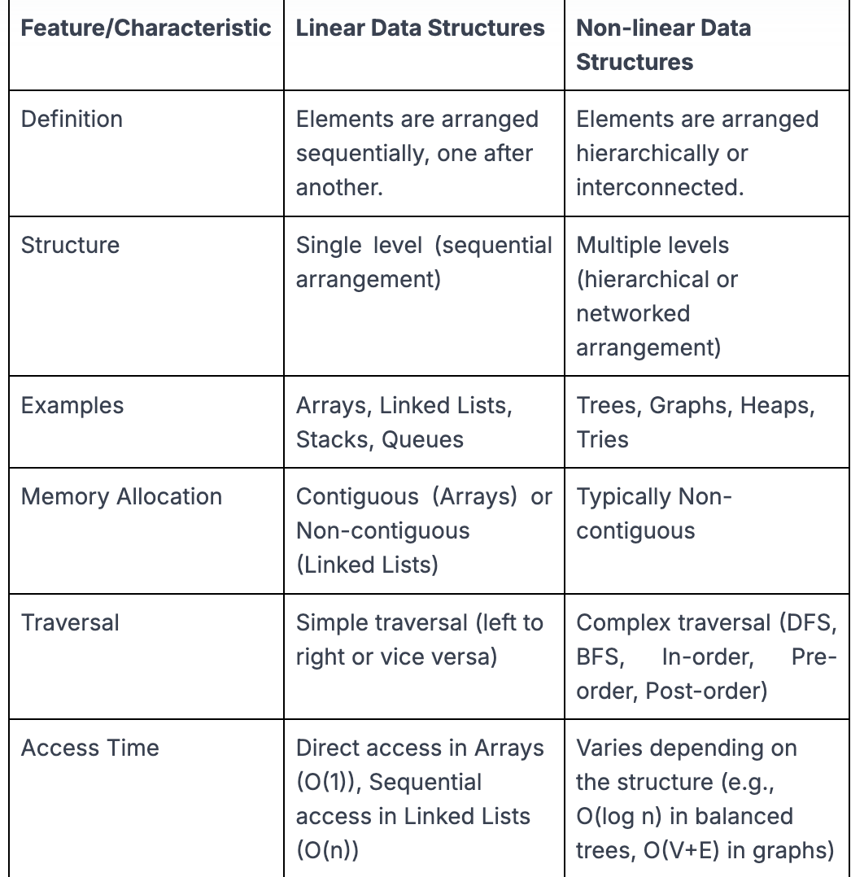
Linear vs Non-linear Data Structures
Below is the tabular comparison to understand the difference between linear data structure and non-linear data structure:

Slide 23
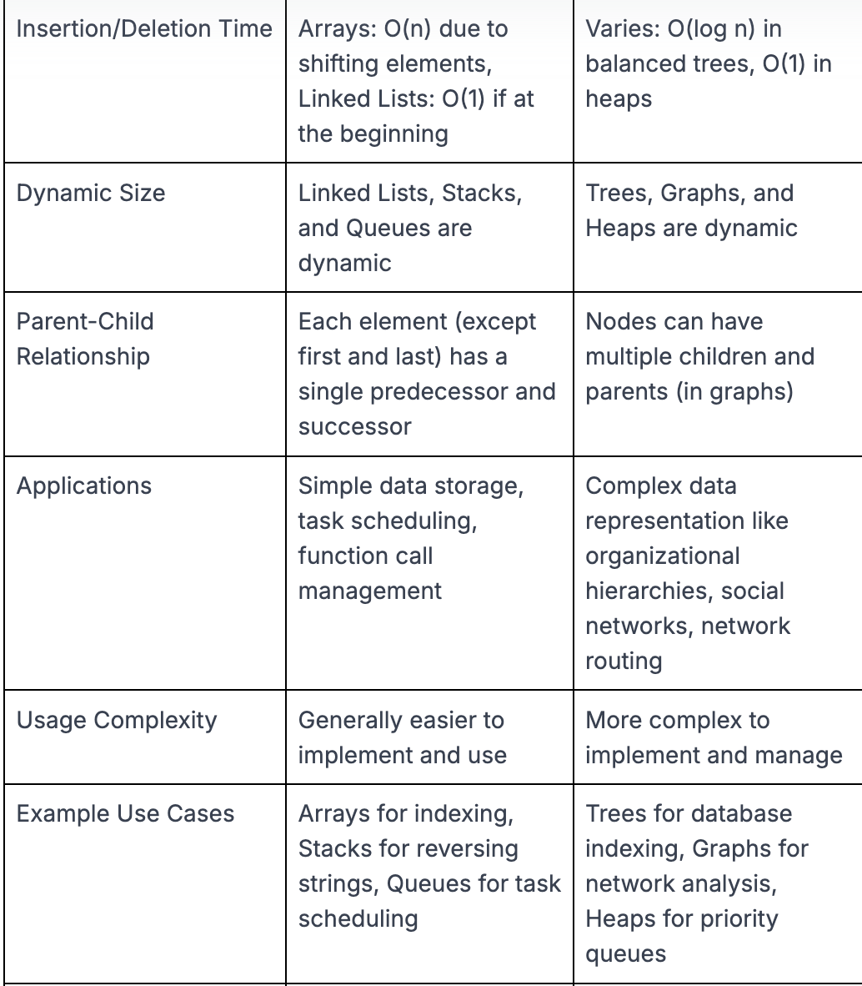

Slide 24
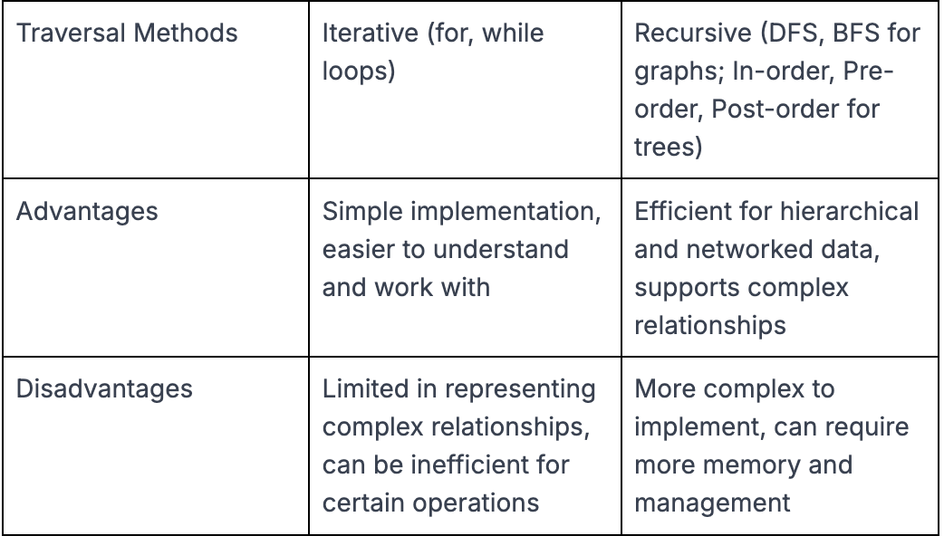

Slide 25
Asymptotic Notation in Data Structure
Introduction
What is Asymptotic Notation? (Definition)
Types of Asymptotic Notation in Data Structure
How to Calculate Asymptotic Notation of Algorithm?
Simplifying Terms and Ignoring Lower Order Terms
Common Asymptotic Notations and Their Importance
Best, Worst, and Average Case Analysis
Applications of Algorithm Asymptotic Notation
Limitations of Asymptotic Notation

Slide 26
Understanding how to measure the efficiency of algorithms is crucial in computer science. Asymptotic Notation in Data Structure helps describe the running time or space requirements of an algorithm as the input size grows.
Let’s learn the basics of asymptotic notation, including Big O, Omega, and Theta notations. Here, we have provided clear explanations and practical examples to help you understand how to analyze and compare the performance of different algorithms effectively.

Slide 27
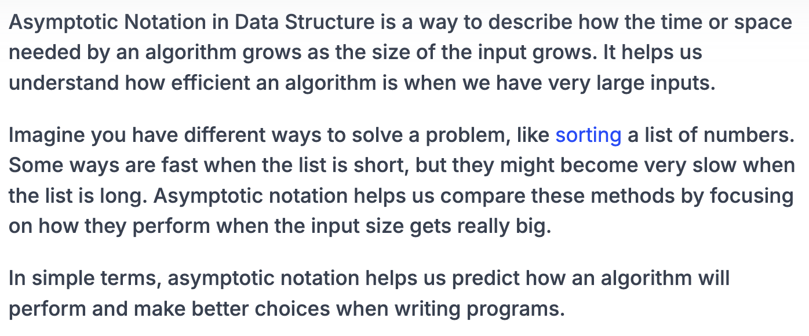
What is Asymptotic Notation? (Definition)

Slide 28
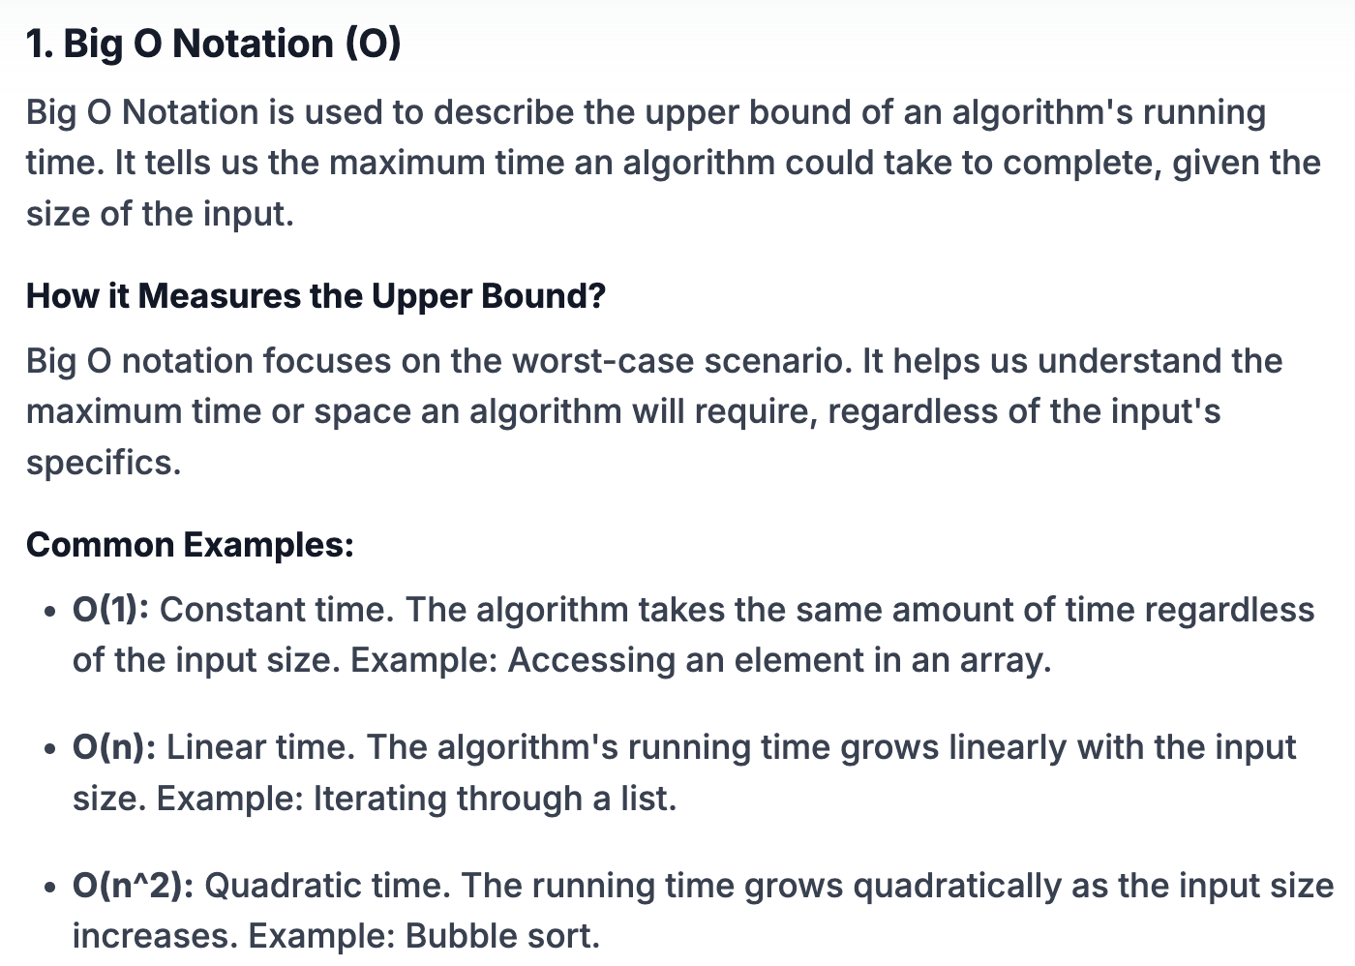
Types of Asymptotic Notation in Data Structure

Slide 29
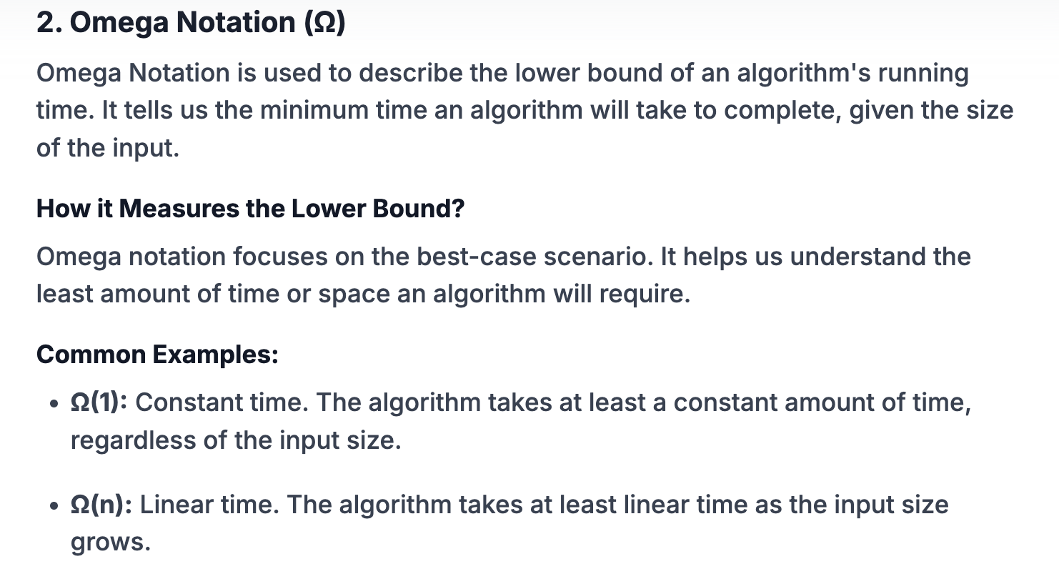

Slide 30
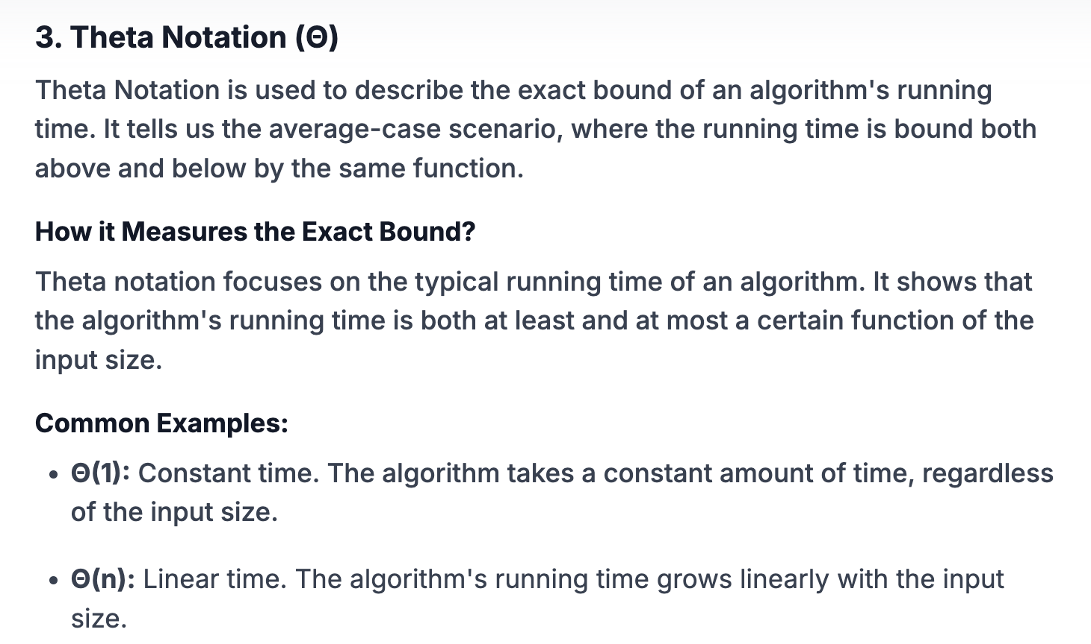

Slide 31
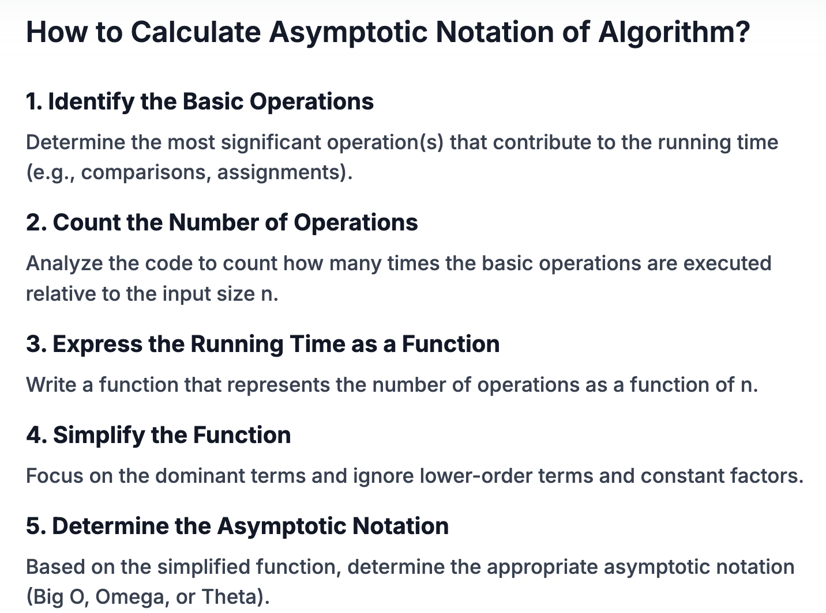

Slide 32
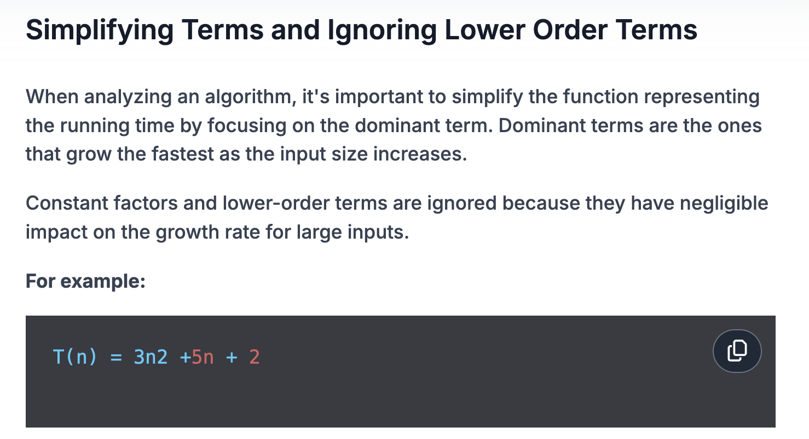

Slide 33
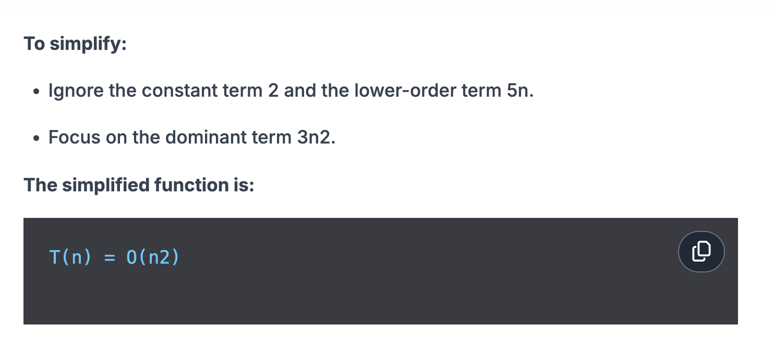

Slide 34
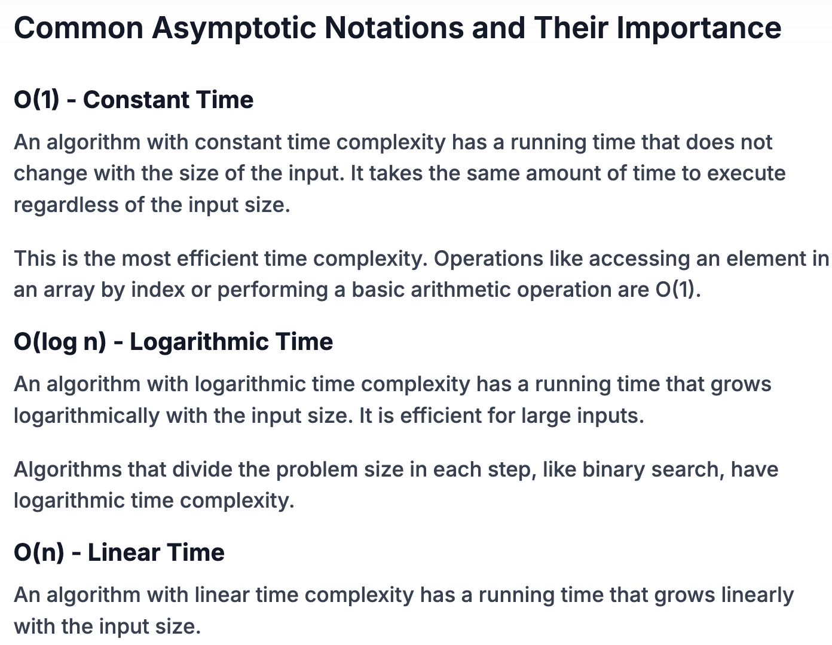

Slide 35
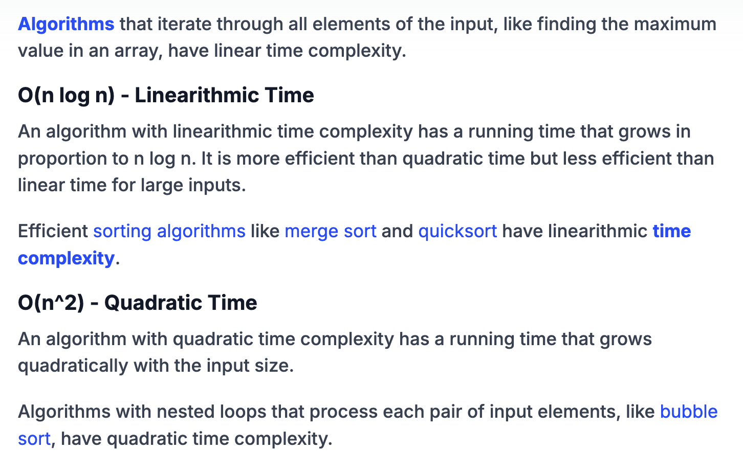

Slide 36
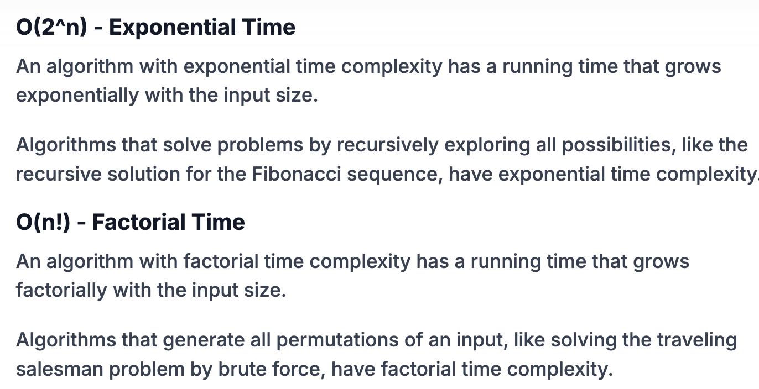

Slide 37
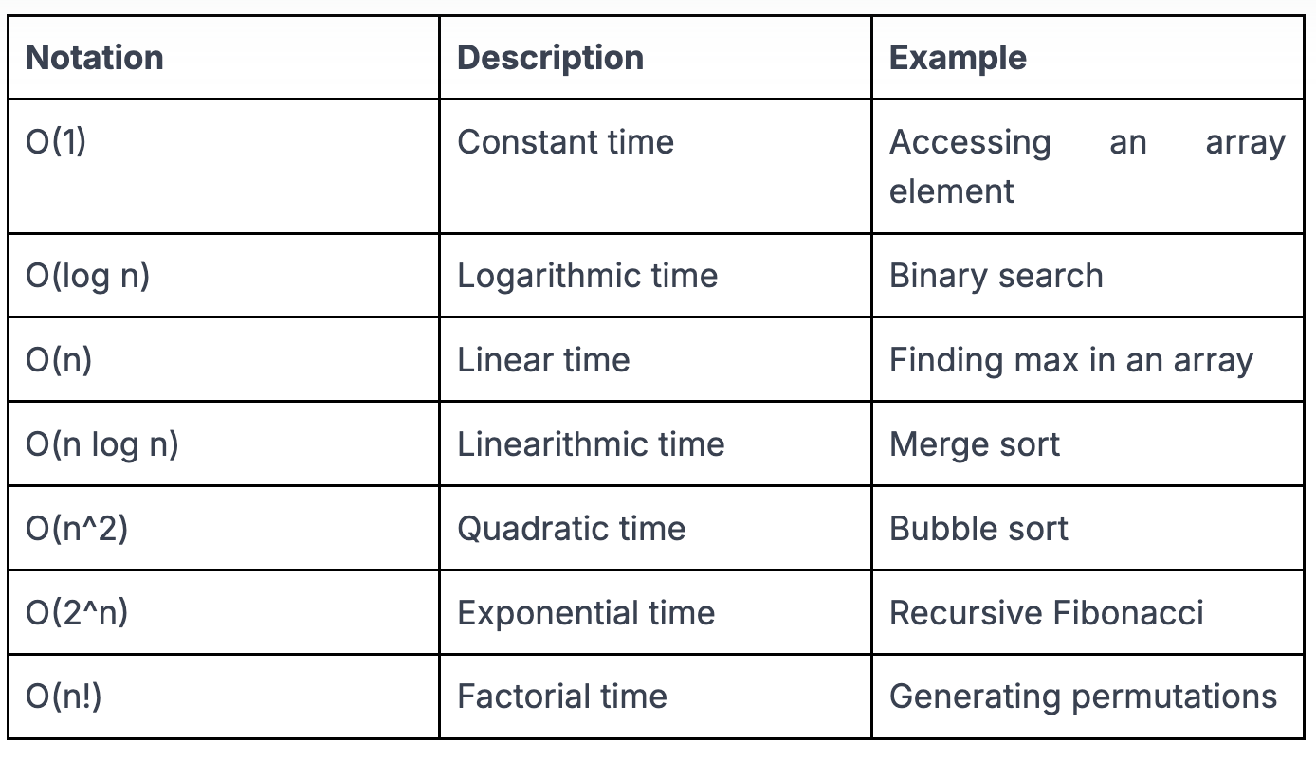

Slide 38
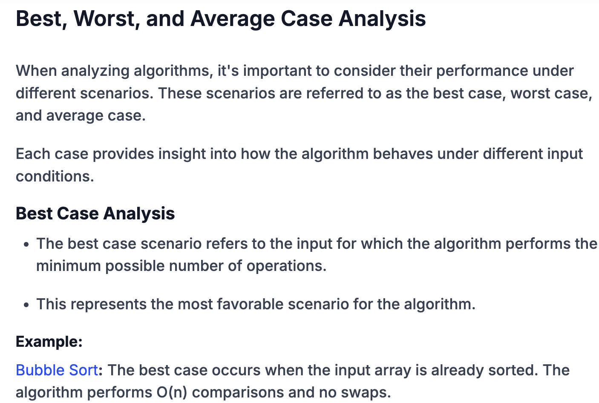

Slide 39
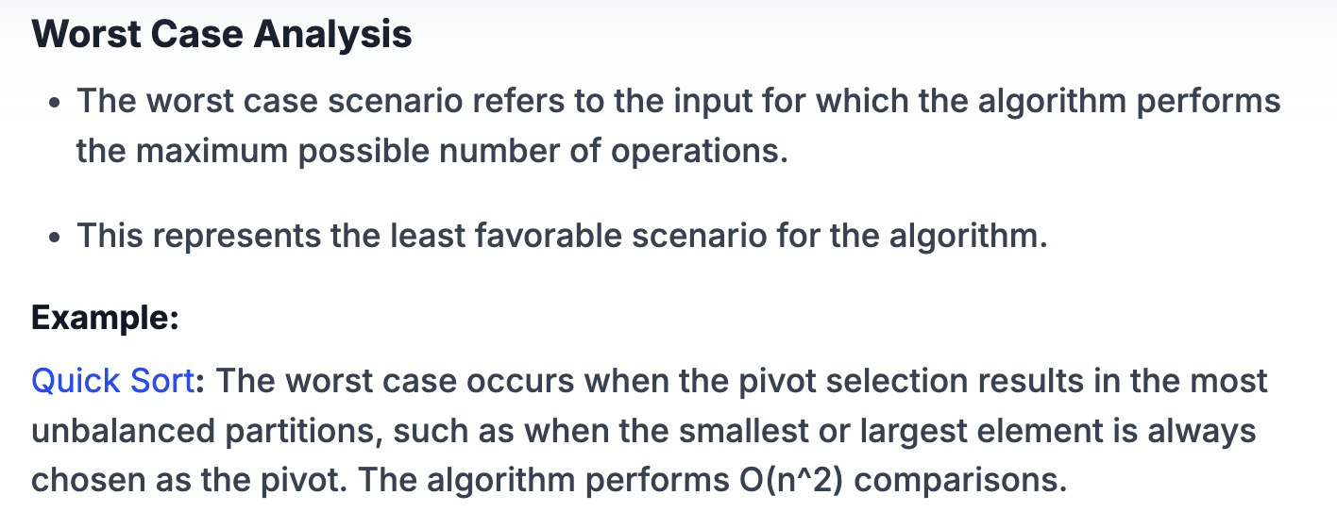

Slide 40
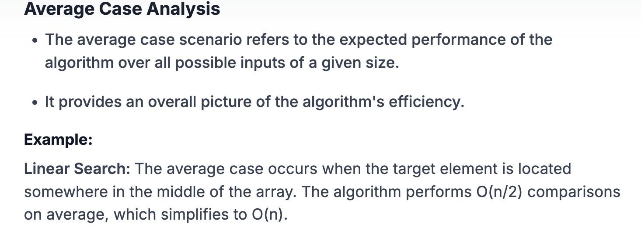

Slide 41
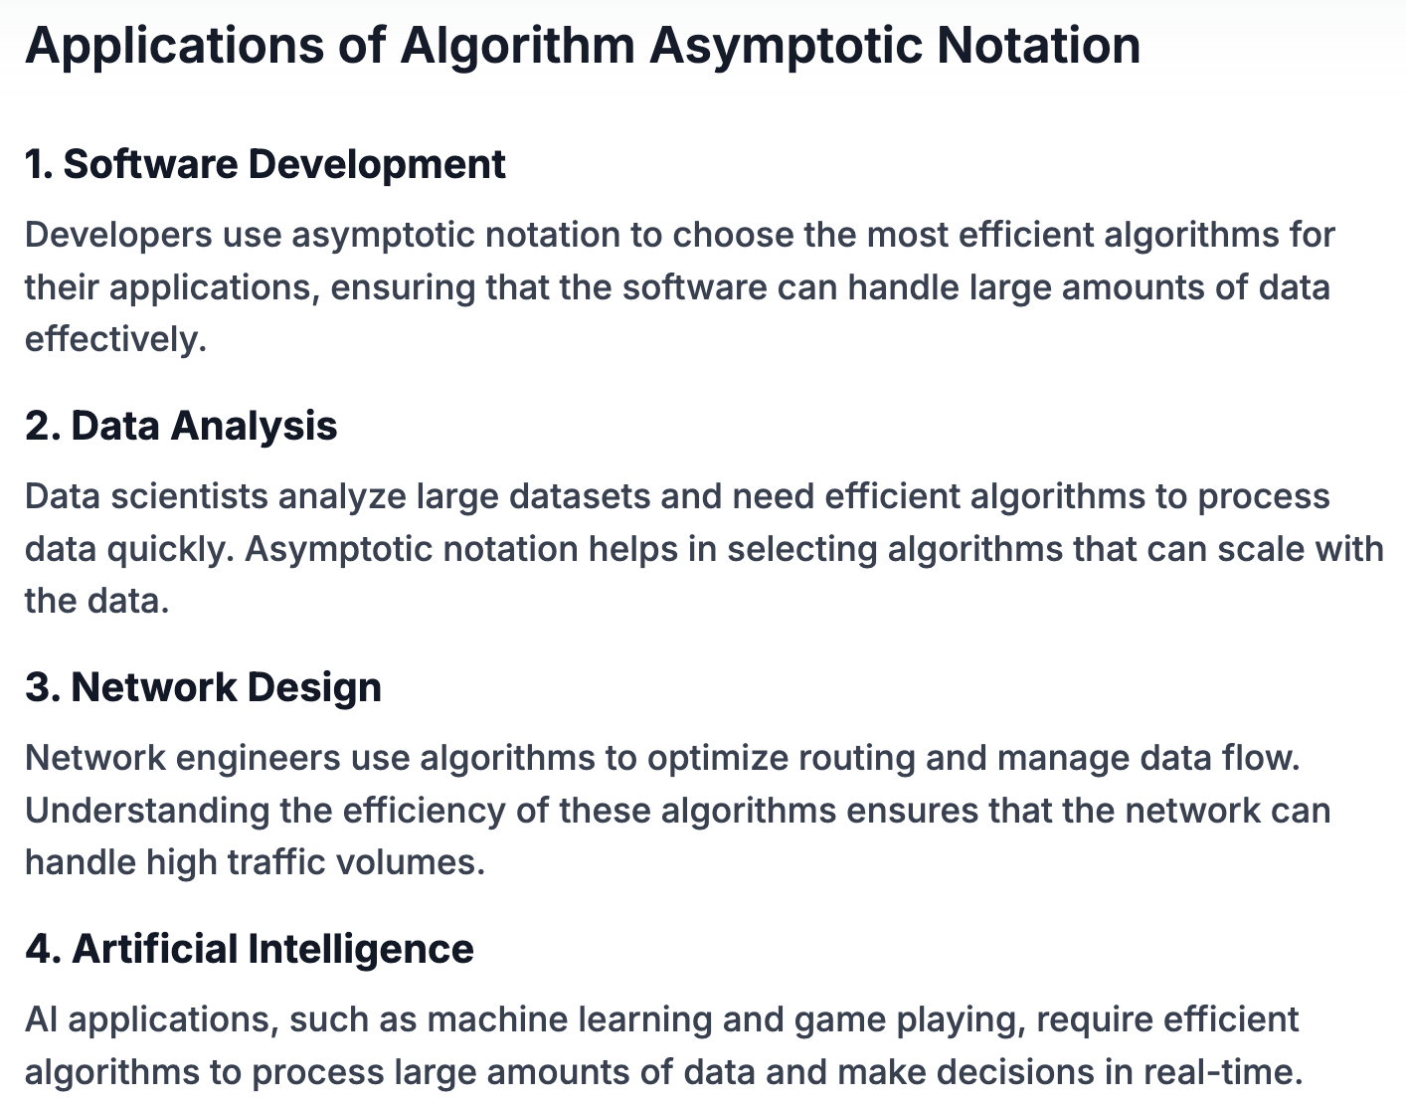

Slide 42
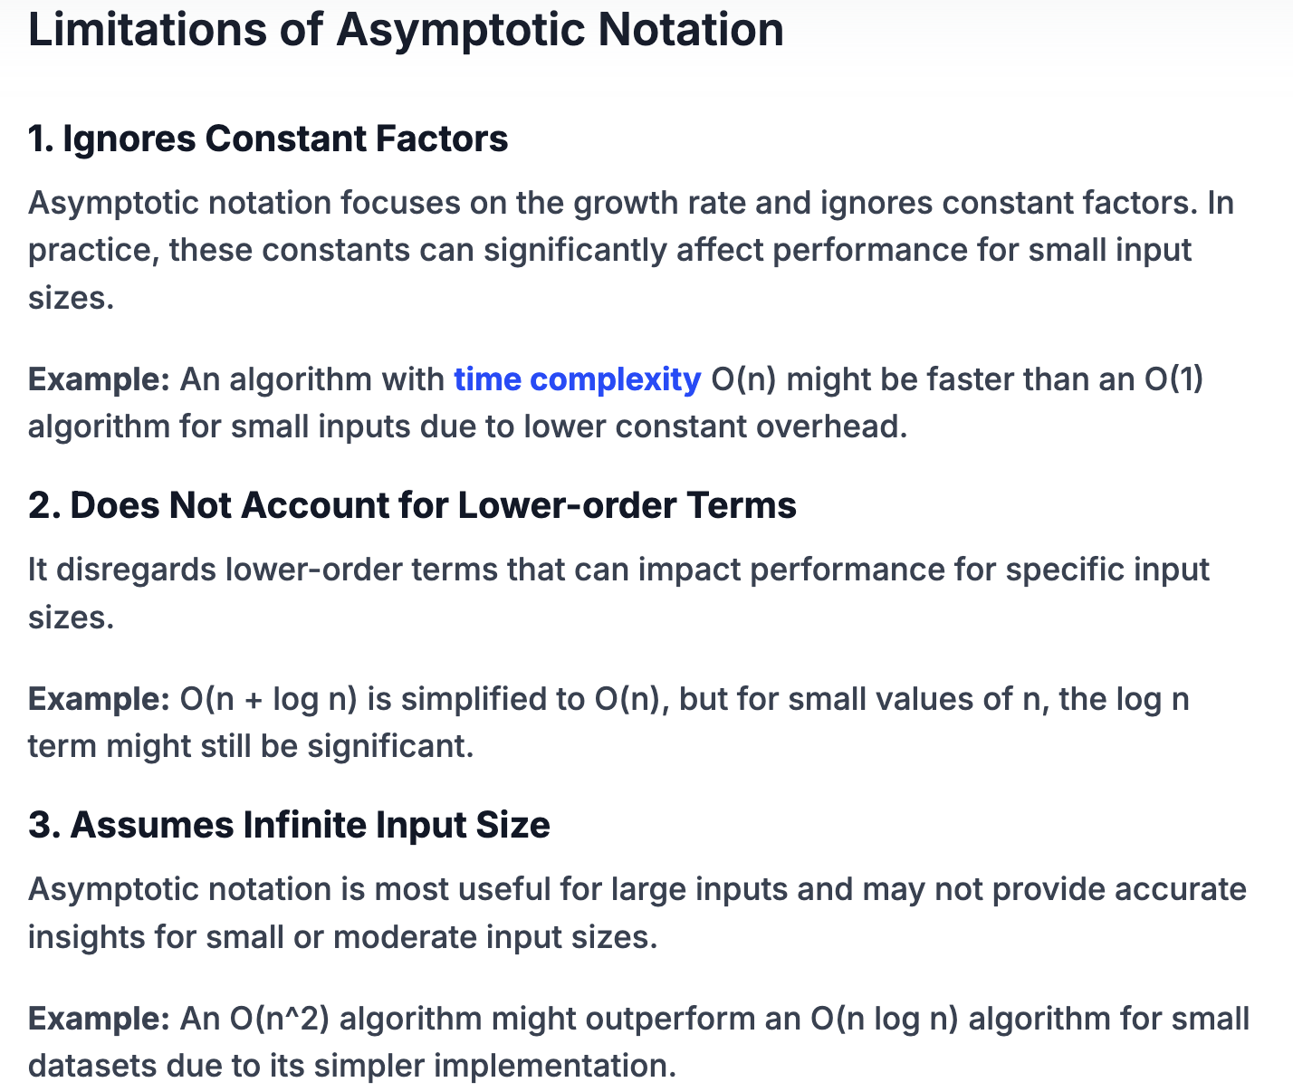

Slide 43
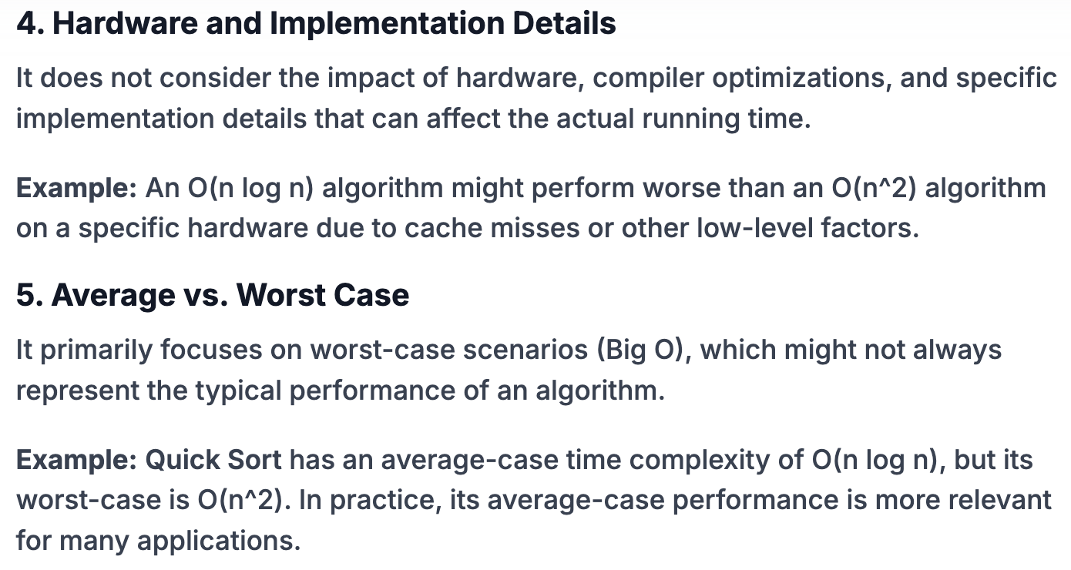

Slide 44
What is asymptotic analysis?
Asymptotic analysis is a method used to describe the efficiency of an algorithm as the input size grows. It focuses on the growth rate of the algorithm's running time or space requirements, providing a way to compare the performance of different algorithms in a theoretical, platform-independent manner.

Slide 45
Why is asymptotic analysis important?
Asymptotic analysis helps to understand and compare the performance of algorithms for large input sizes. It provides a way to predict how an algorithm will scale, enabling developers to choose the most efficient algorithm for their needs. This is crucial for optimizing software and ensuring that applications run efficiently, especially with large datasets.

Slide 46
What does Big O notation represent?
Big O notation represents the upper bound of an algorithm's running time. It provides a worst-case scenario, showing the maximum amount of time or space an algorithm will require as the input size grows. For example, O(n) indicates that the running time grows linearly with the input size.

Slide 47
How is Omega (Ω) notation different from Big O notation?
Omega (Ω) notation represents the lower bound of an algorithm's running time. It provides the best-case scenario, showing the minimum amount of time or space an algorithm will require as the input size grows. For example, Ω(n) indicates that the running time grows at least linearly with the input size.
Why is Big O notation commonly used compared to other notations?
Big O notation is commonly used because it provides a worst-case scenario, which is useful for guaranteeing that an algorithm will not exceed a certain time or space complexity. This is important for ensuring performance reliability and making sure that systems meet required performance standards under all conditions.

Slide 48
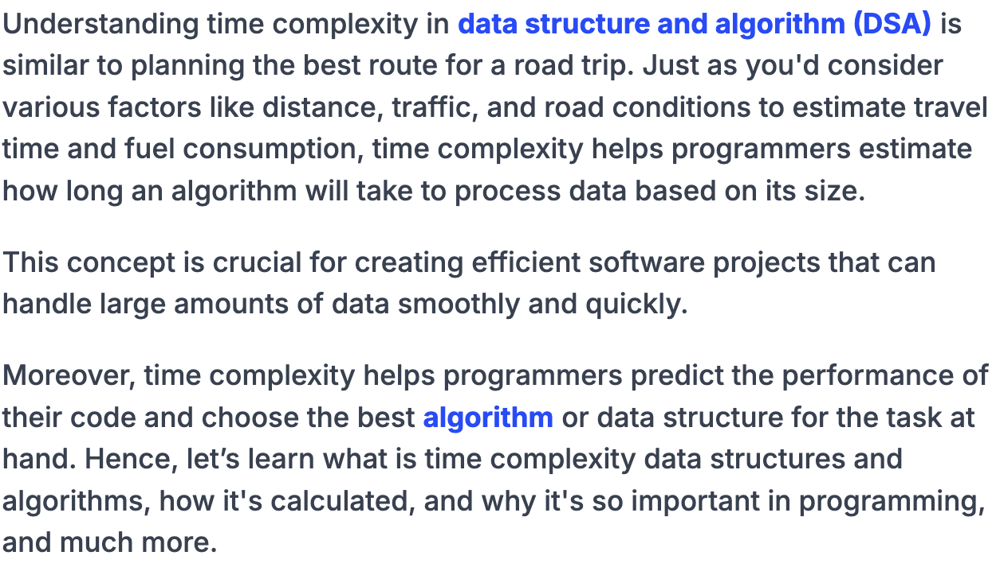
Time Complexity in Data Structure and Algorithms (Types, Examples)

Slide 49
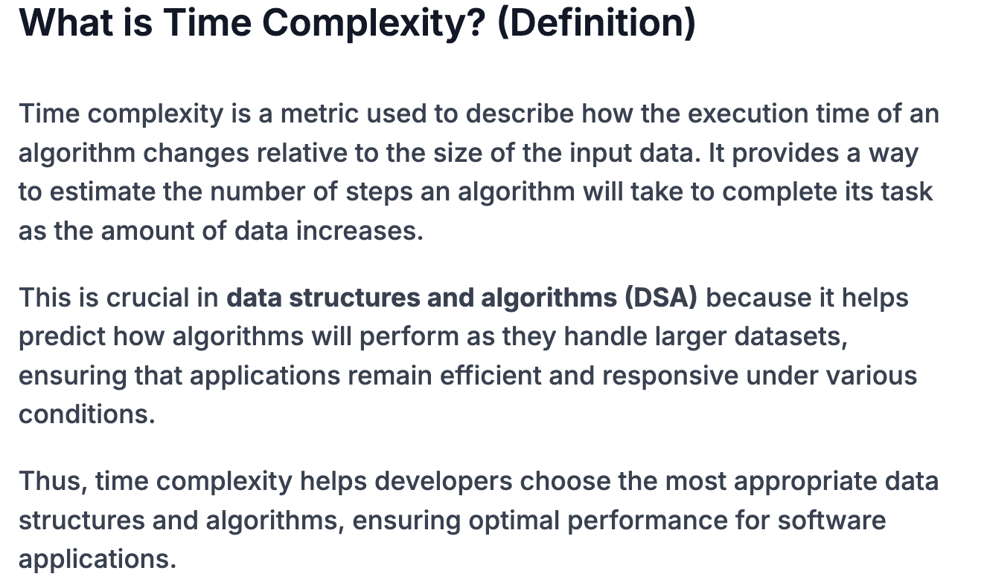

Slide 50
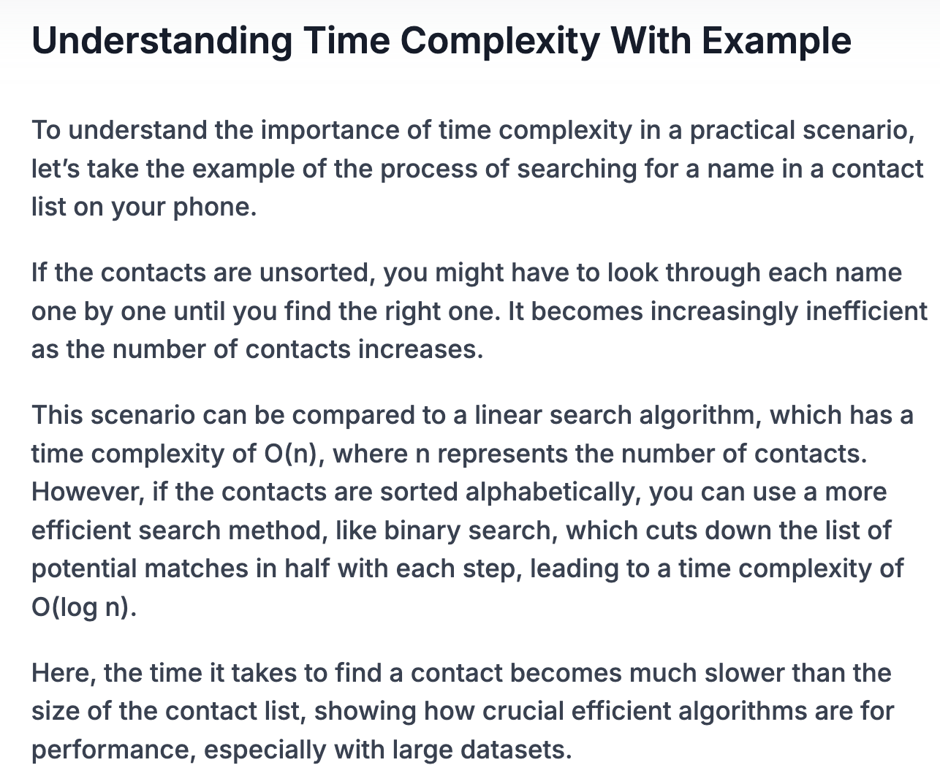

Slide 51
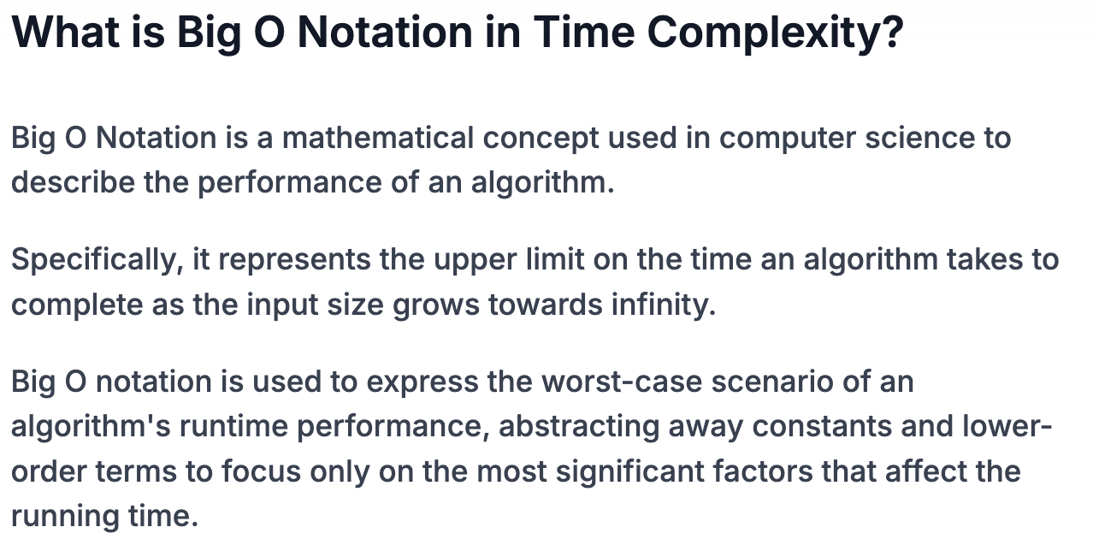

Slide 52
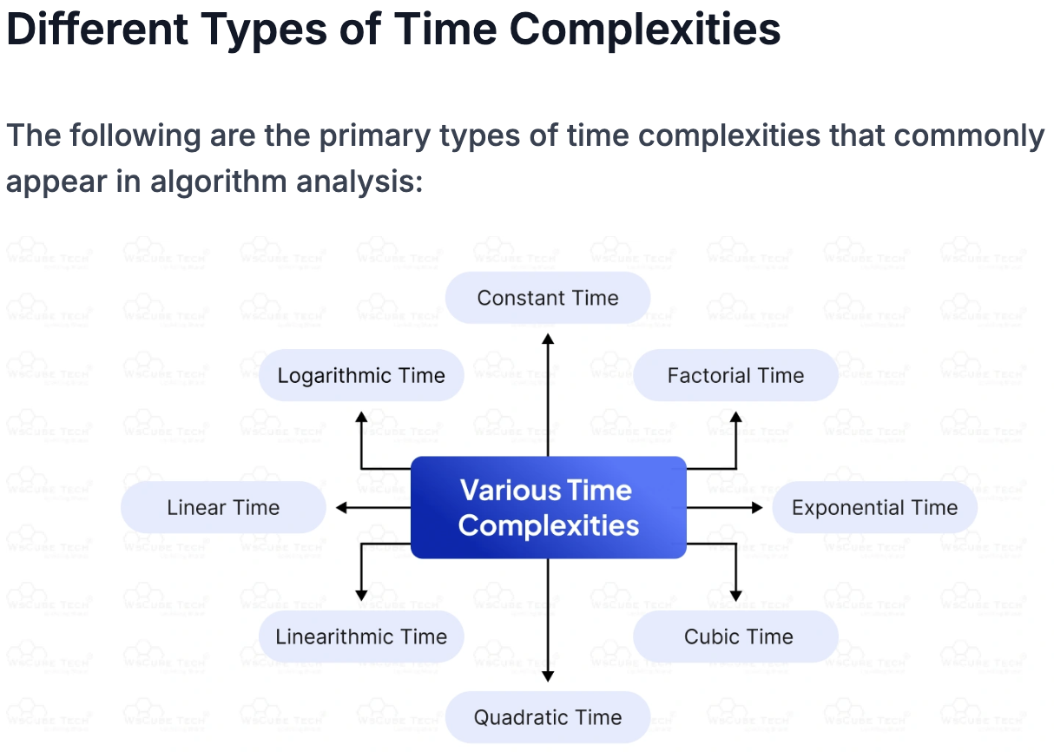

Slide 53
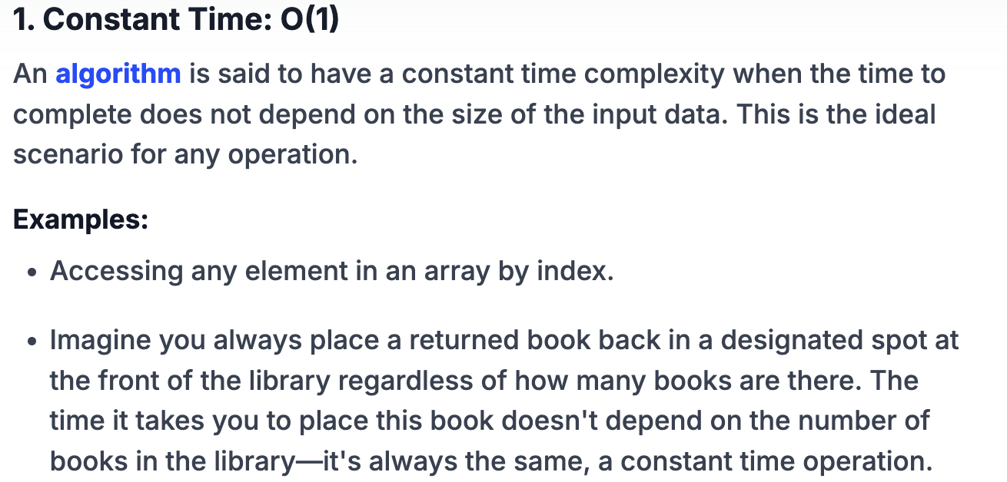

Slide 54
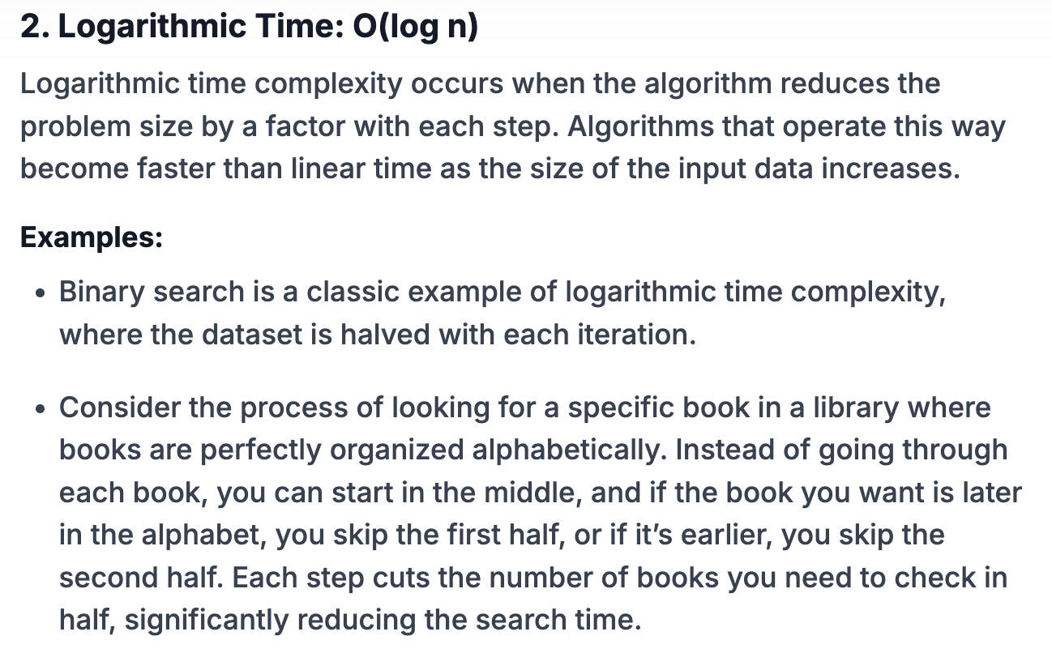

Slide 55
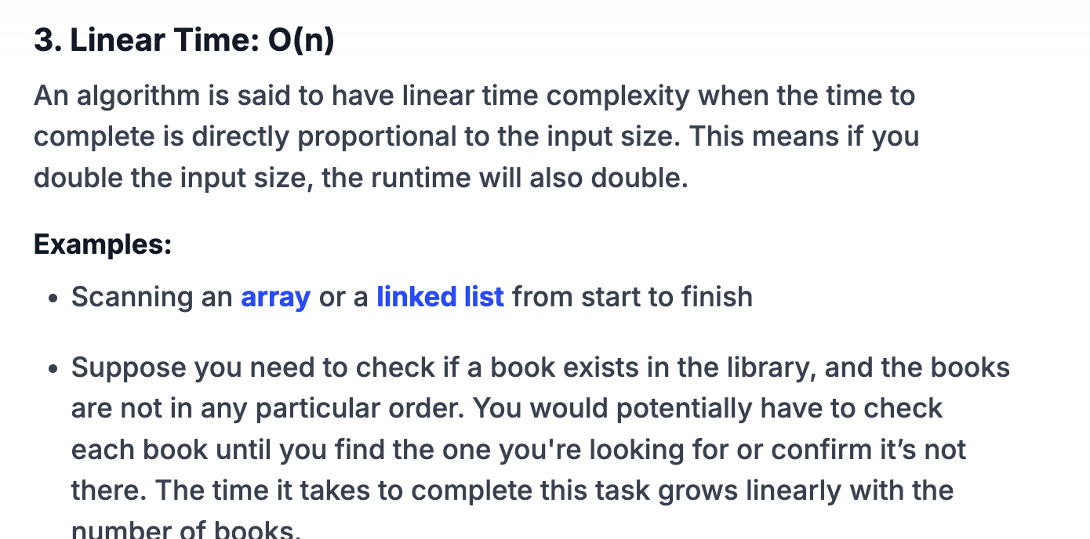

Slide 56
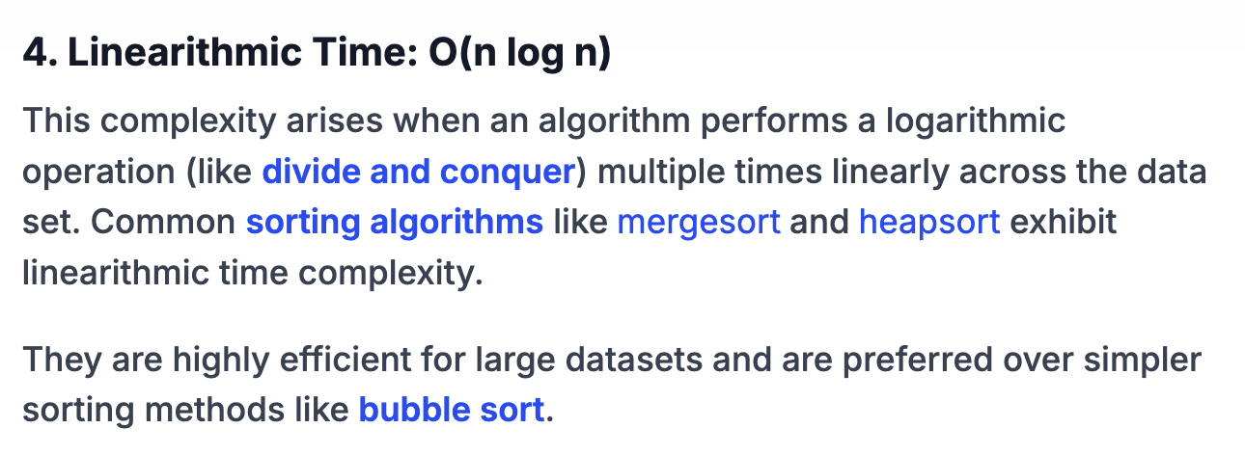

Slide 57
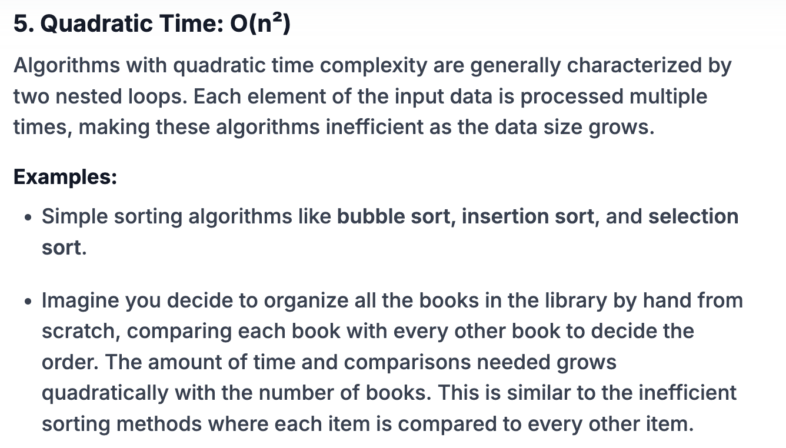

Slide 58
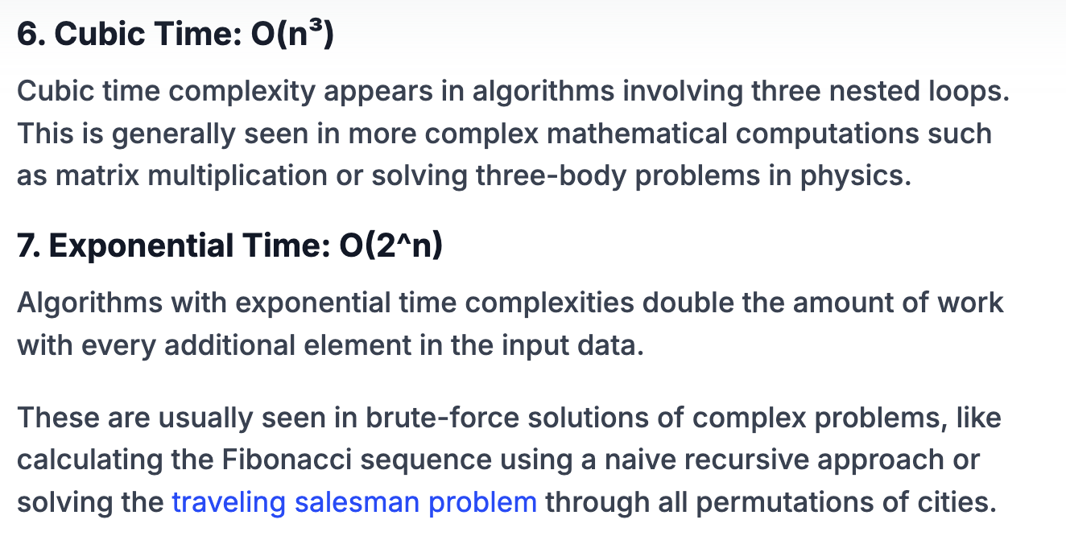

Slide 59
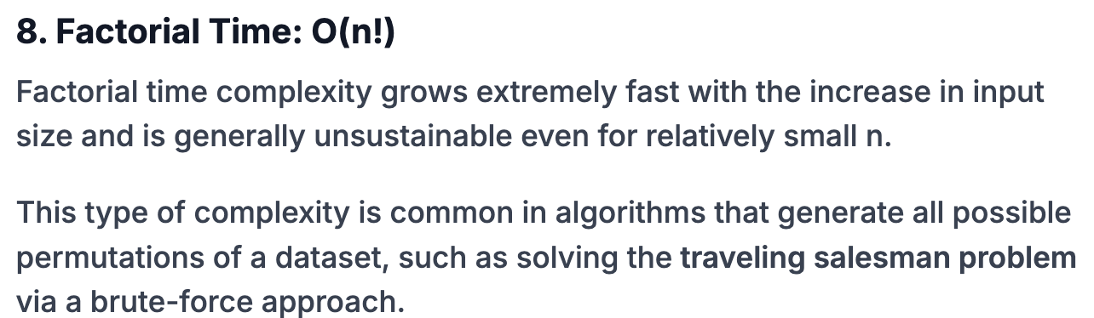

Slide 60
Factors Affecting Time Complexity in DSA
1. Algorithmic Strategy
The design and strategy of the algorithm significantly impact its time complexity. Different approaches can vary widely in efficiency:
2. Input Size
The number of inputs to an algorithm is the most direct factor affecting its time complexity.
Larger data sets increase the number of operations an algorithm must perform, which can linearly or exponentially increase the required computational time, depending on the algorithm.
3. Data Structure Used
The choice of data structure affects how data can be accessed and manipulated, which in turn affects the algorithm's performance.

Slide 61
Arrays allow random access, which can be very efficient for lookup operations but may slow down operations that involve insertion or deletion.
Linked Lists excel in scenarios where frequent insertions and deletions are necessary, as they can perform these operations more efficiently than array-based structures.
Hash Tables provide average-case constant time complexity for access, insert, and delete operations, making them extremely efficient for operations that require frequent searches.

Slide 62
Time Complexity of All Data Structures
1. Best Case Complexity
The Best Case Complexity of an algorithm is the scenario where the algorithm performs the minimum possible number of steps on an input. This complexity measures the algorithm’s behavior under the most favorable conditions.
Example: Let’s take the example of the Bubble Sort algorithm. If the input array is already sorted, that's the best case for Bubble Sort. In this scenario, the algorithm only needs to pass through the array once to check for swaps, making the best-case time complexity O(n), where n is the number of elements in the array.
The table below represents the best time complexity of data structures for various operations:

Slide 63
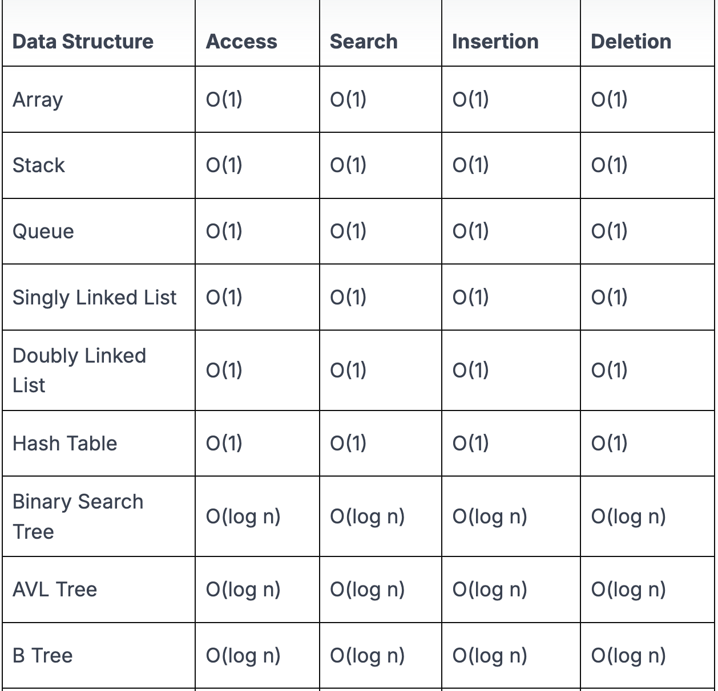
Time Complexity of All Data Structures
Best Case Complexity

Slide 64
2. Worst Case Complexity
The Worst Case Complexity means the scenario where the algorithm performs the maximum number of steps on an input. This is a critical measure as it provides an upper bound on the runtime and guarantees that the algorithm will not exceed this time under any circumstances.
Example: Continuing with the Bubble Sort example, the worst case occurs when the array is sorted in reverse order. In this situation, every possible swap will be made, which means the algorithm will make n-1 comparisons and swaps for each of the n elements in the array, leading to a time complexity of O(n²).
The table below represents the worst-case time complexity of different data structures for various operations:

Slide 65
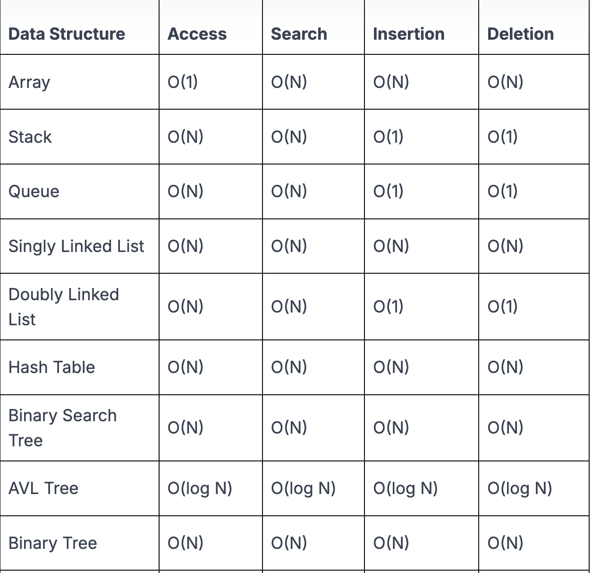
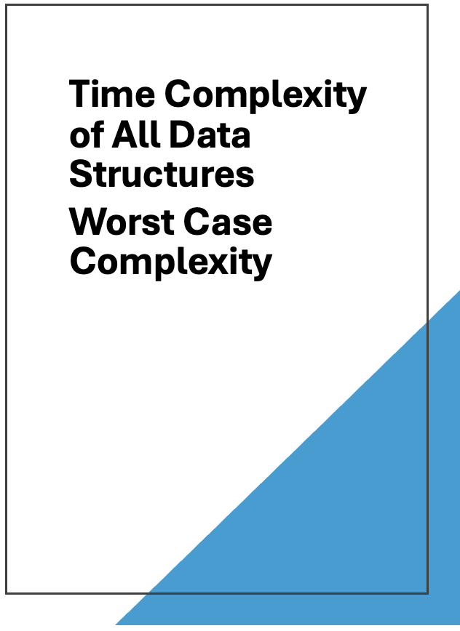

Slide 66
3. Average Case Complexity
The Average Case Complexity considers the algorithm's performance over all possible inputs of a given size. This complexity gives a more realistic measure of the algorithm's performance as it accounts for all scenarios that might occur, assuming all inputs are equally likely to happen.
Example: For Bubble Sort, calculating the average case complexity involves considering the average number of comparisons and swaps needed when the inputs are randomly ordered.
This results in a time complexity close to O(n²), similar to the worst case but often with slightly lower constants or lower-order terms.
The table below presents the average time complexity of various operations across different data structures:

Slide 67
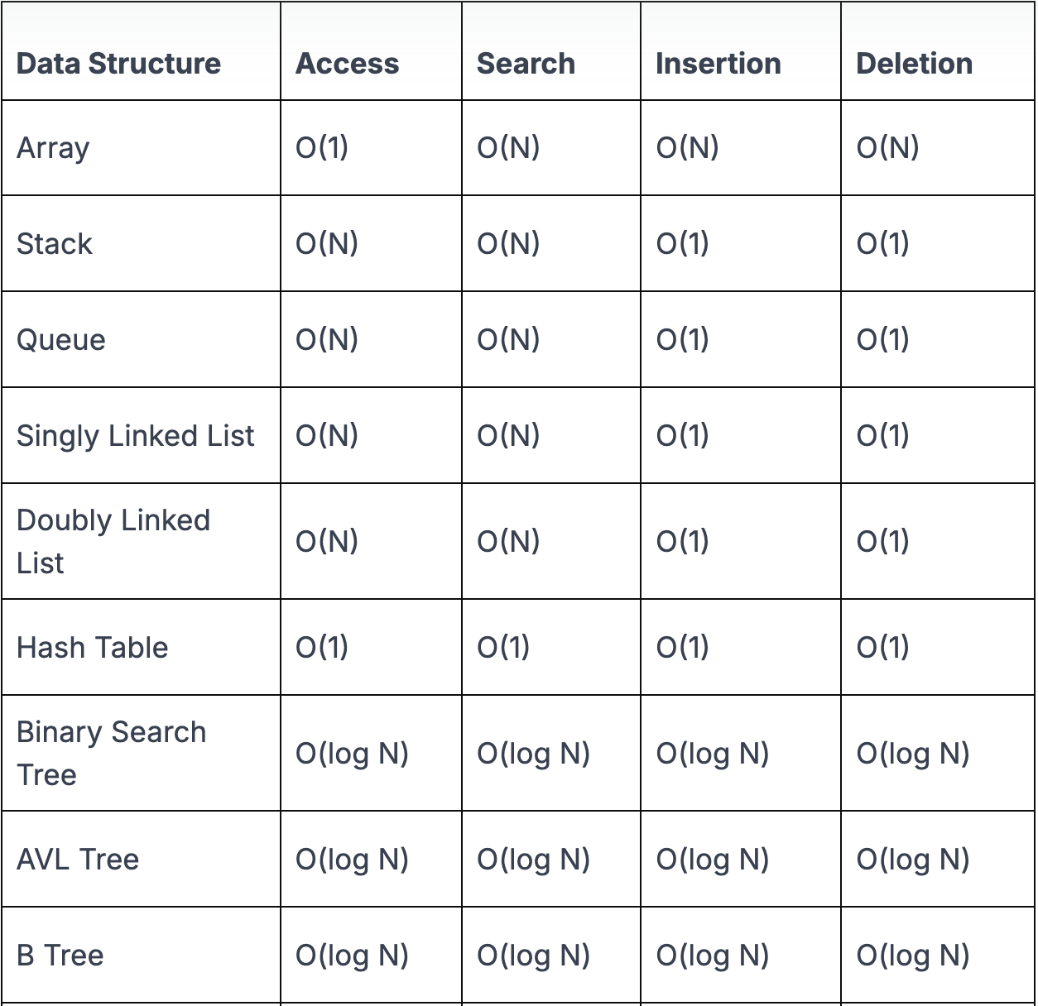
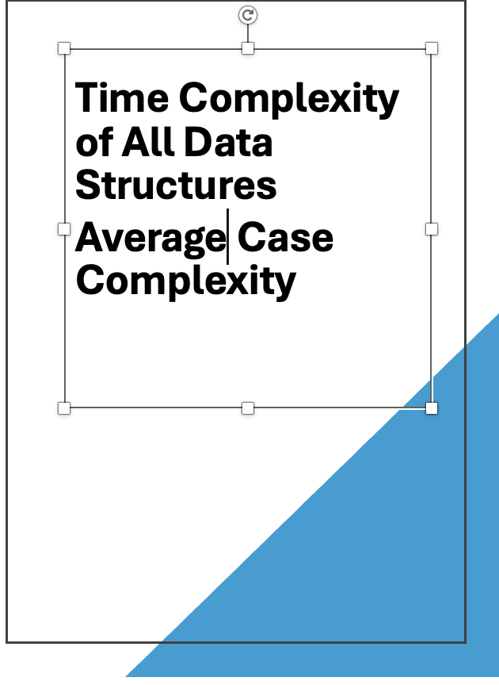

Slide 68
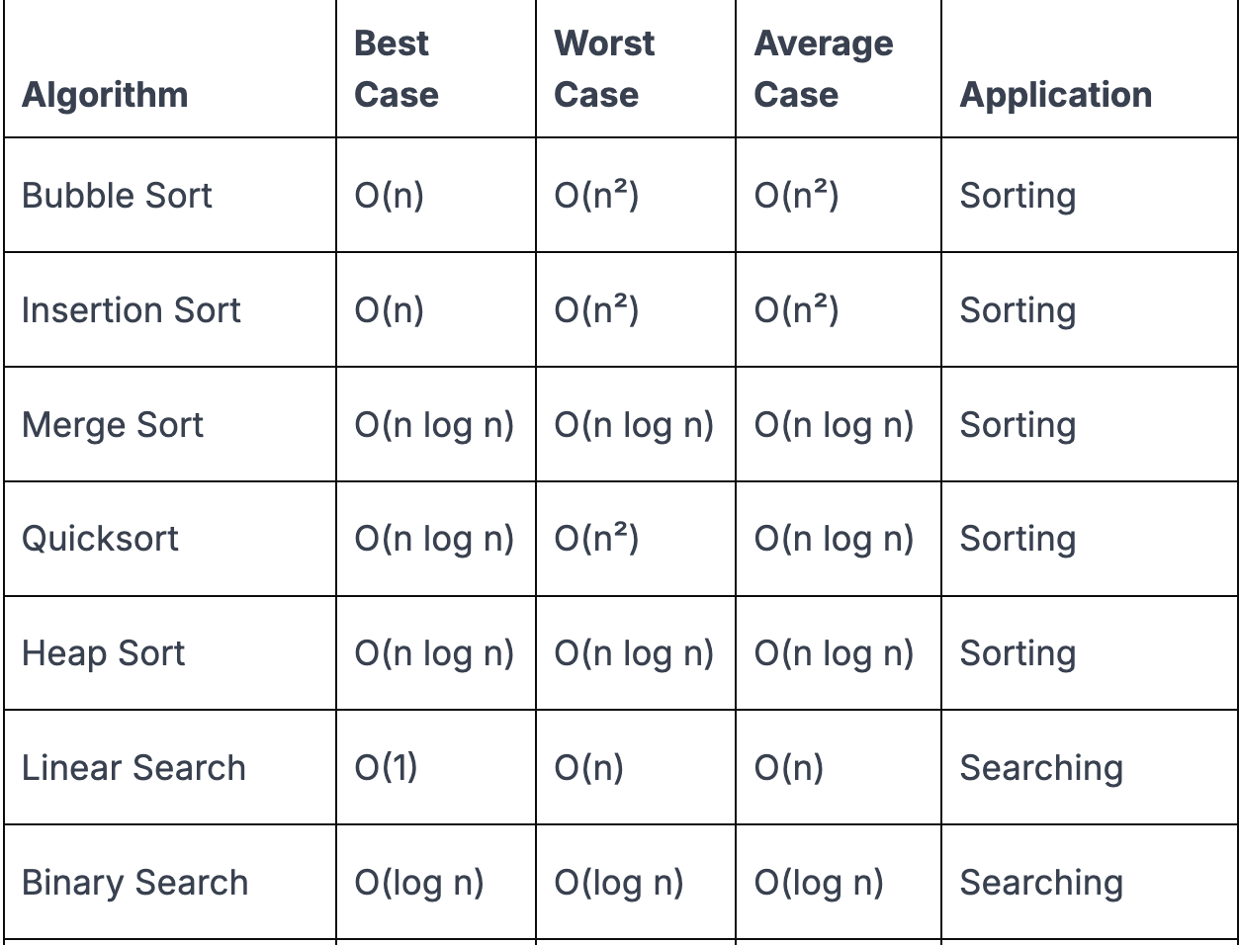
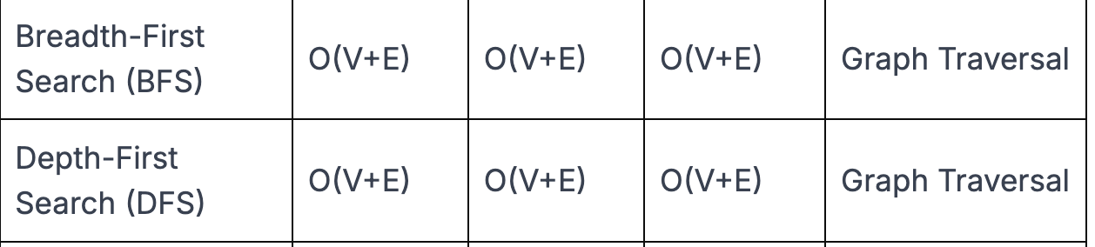
Time Complexity of Algorithms
Now, let’s discuss the time complexity of different algorithms
used in DSA:

