Slide 1
Linked List
Linked List in Python

Slide 2
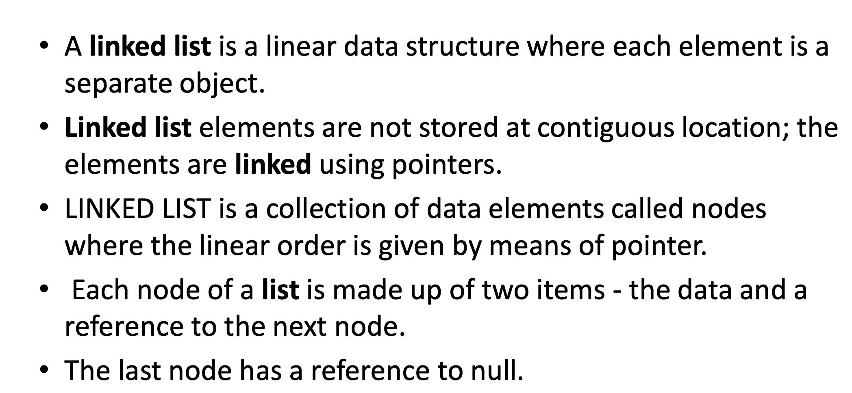

Slide 3
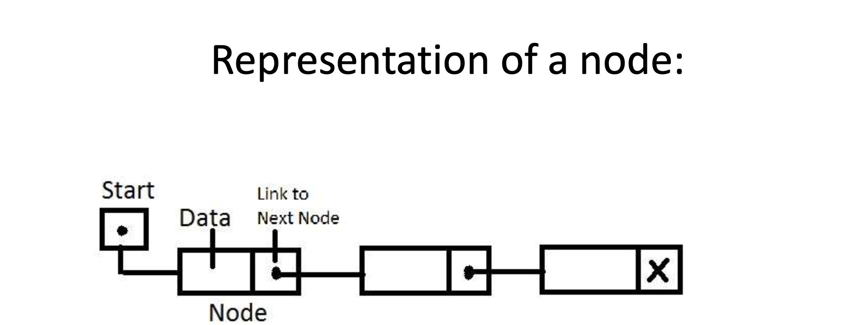

Slide 4
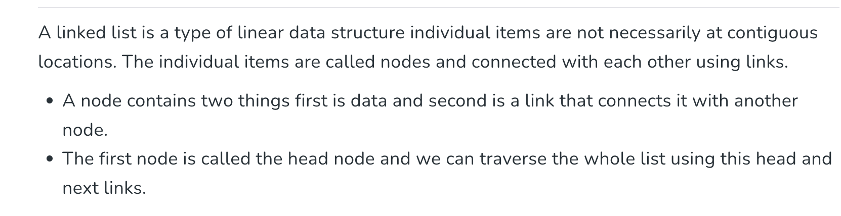

Slide 5
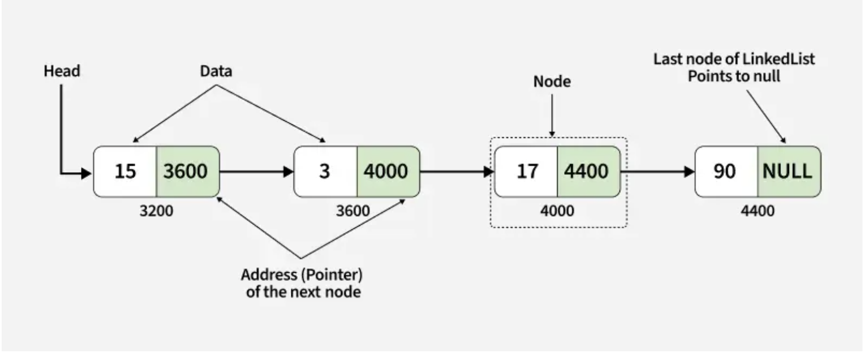

Slide 6
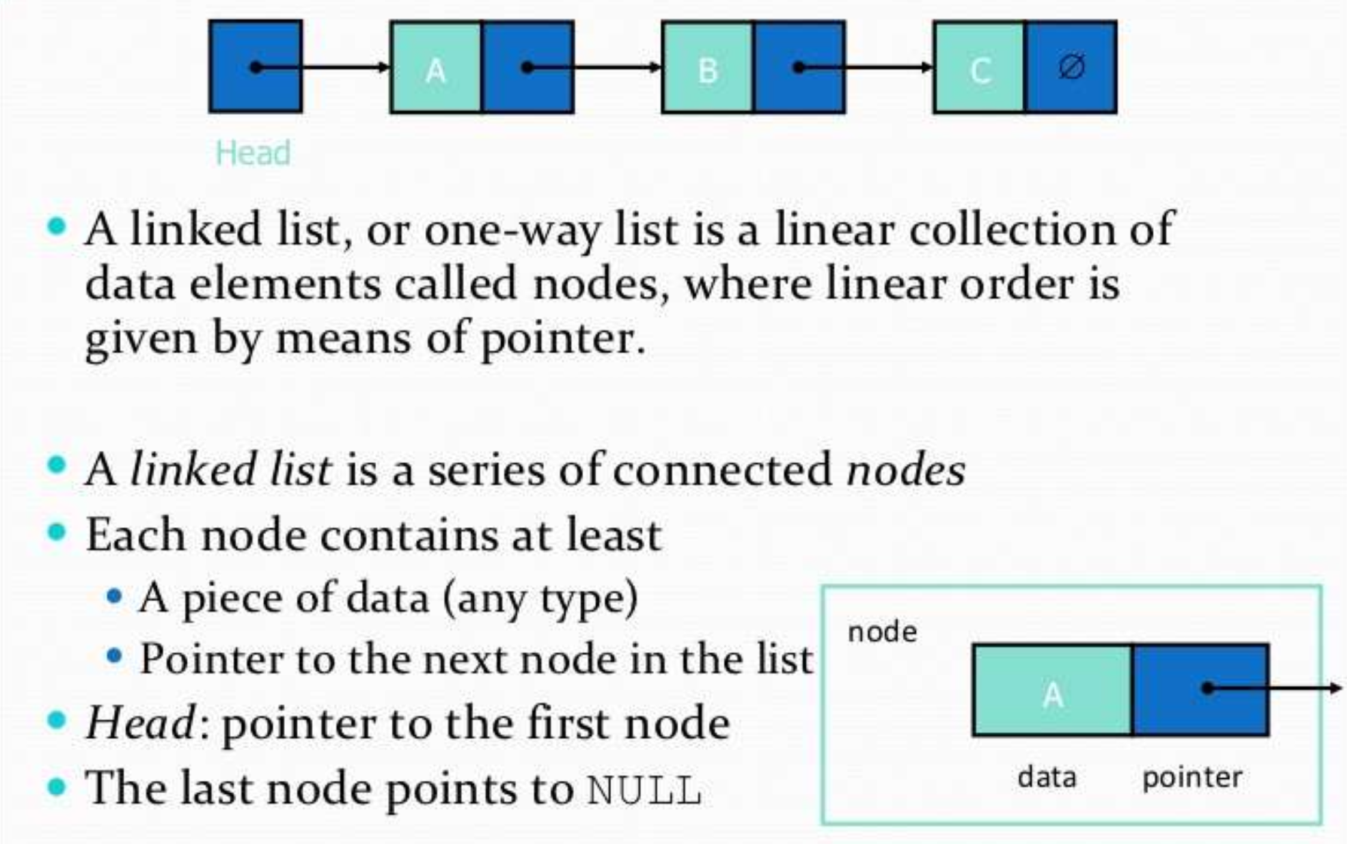

Slide 7
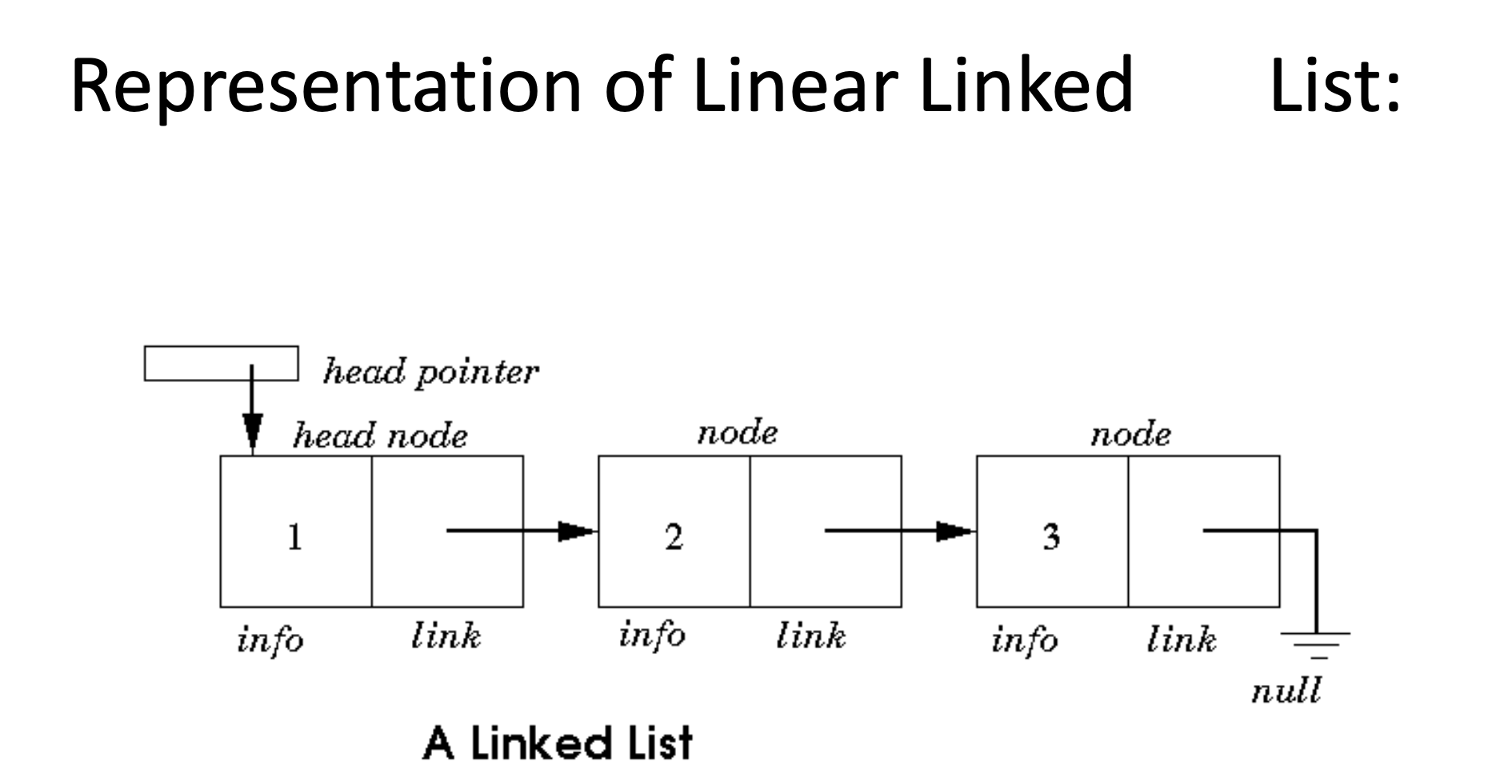

Slide 8
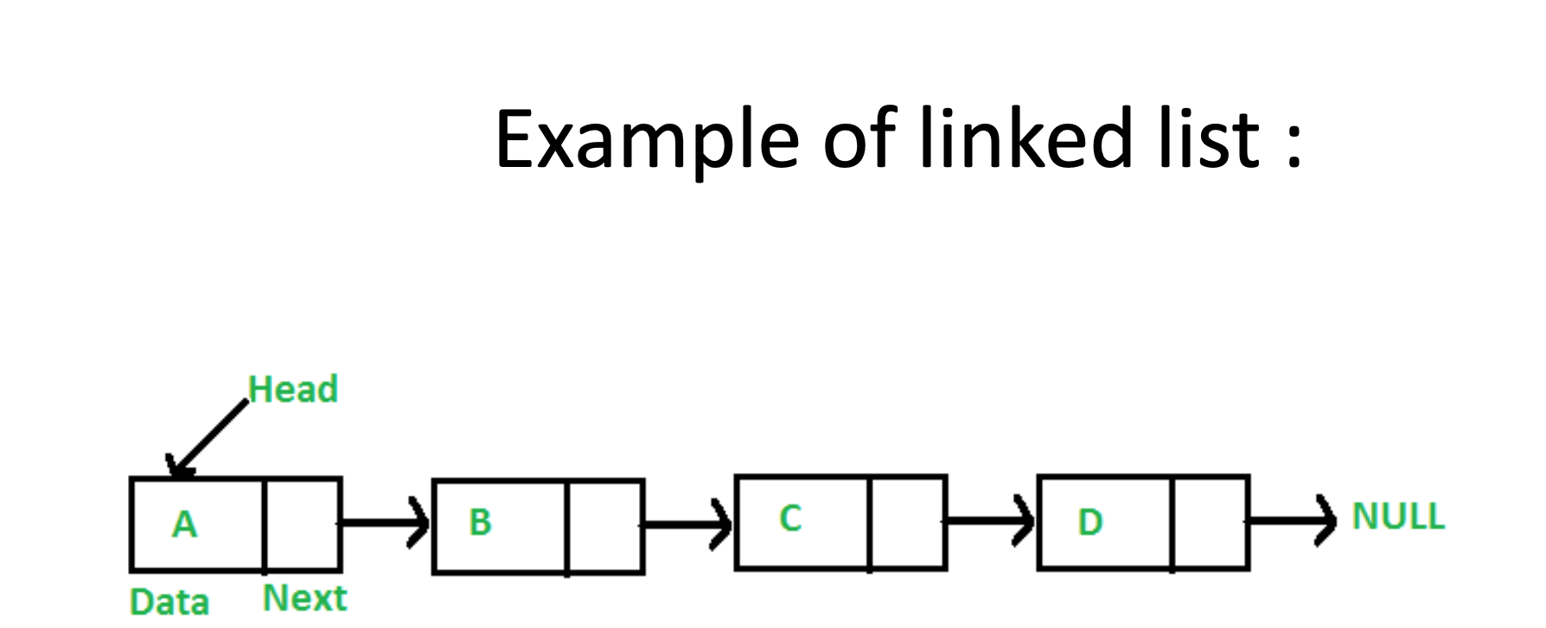

Slide 9
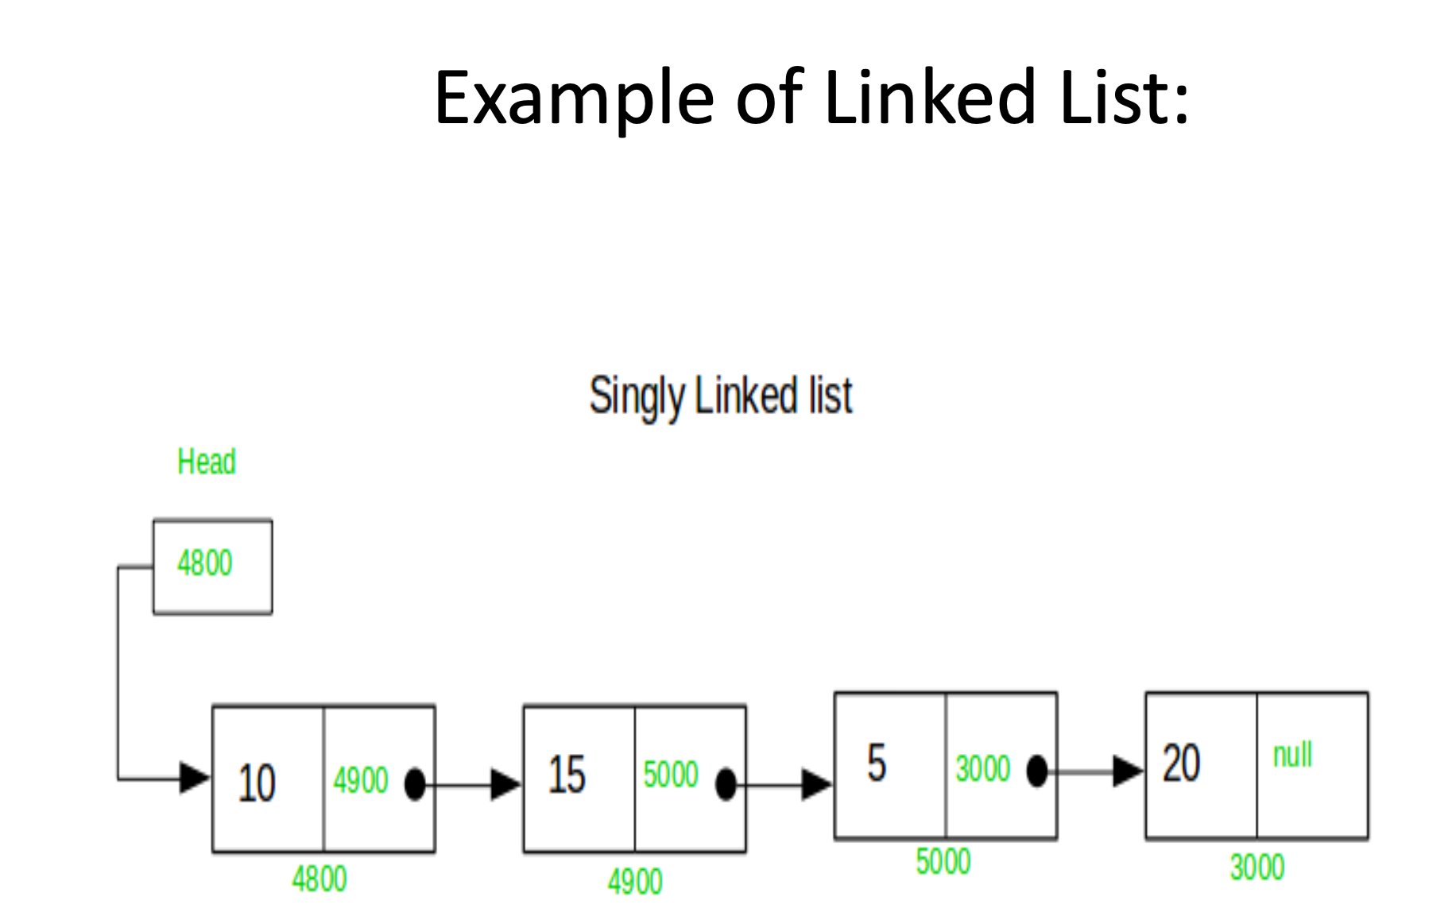

Slide 10
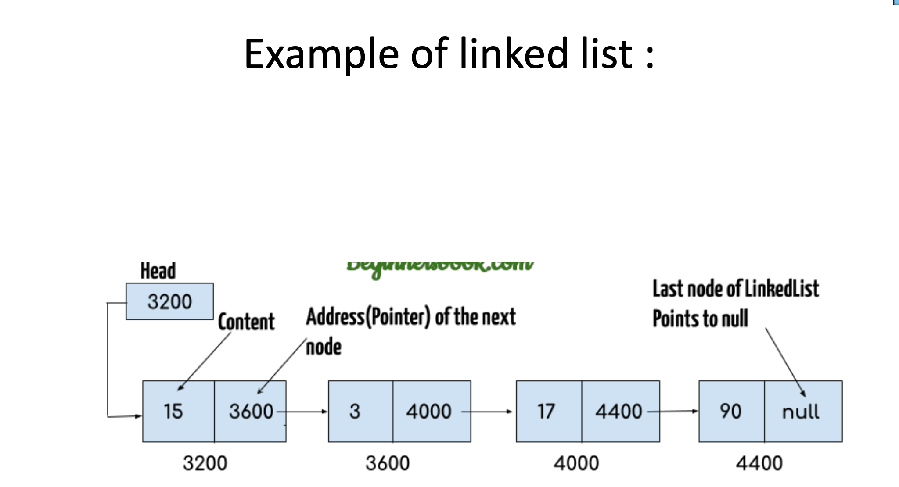

Slide 11
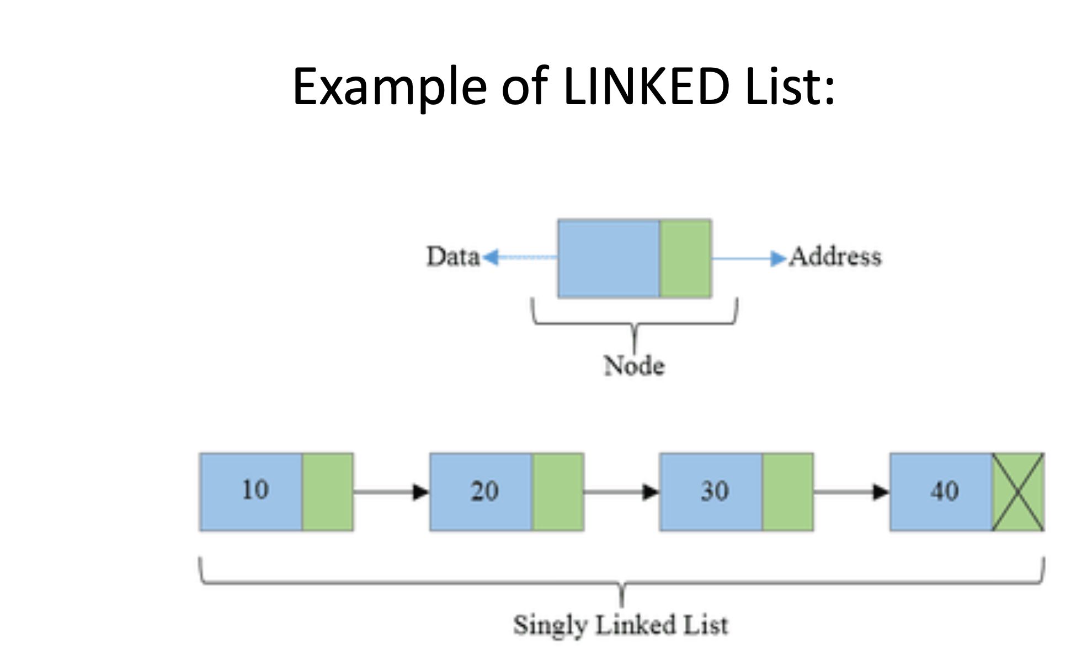

Slide 12
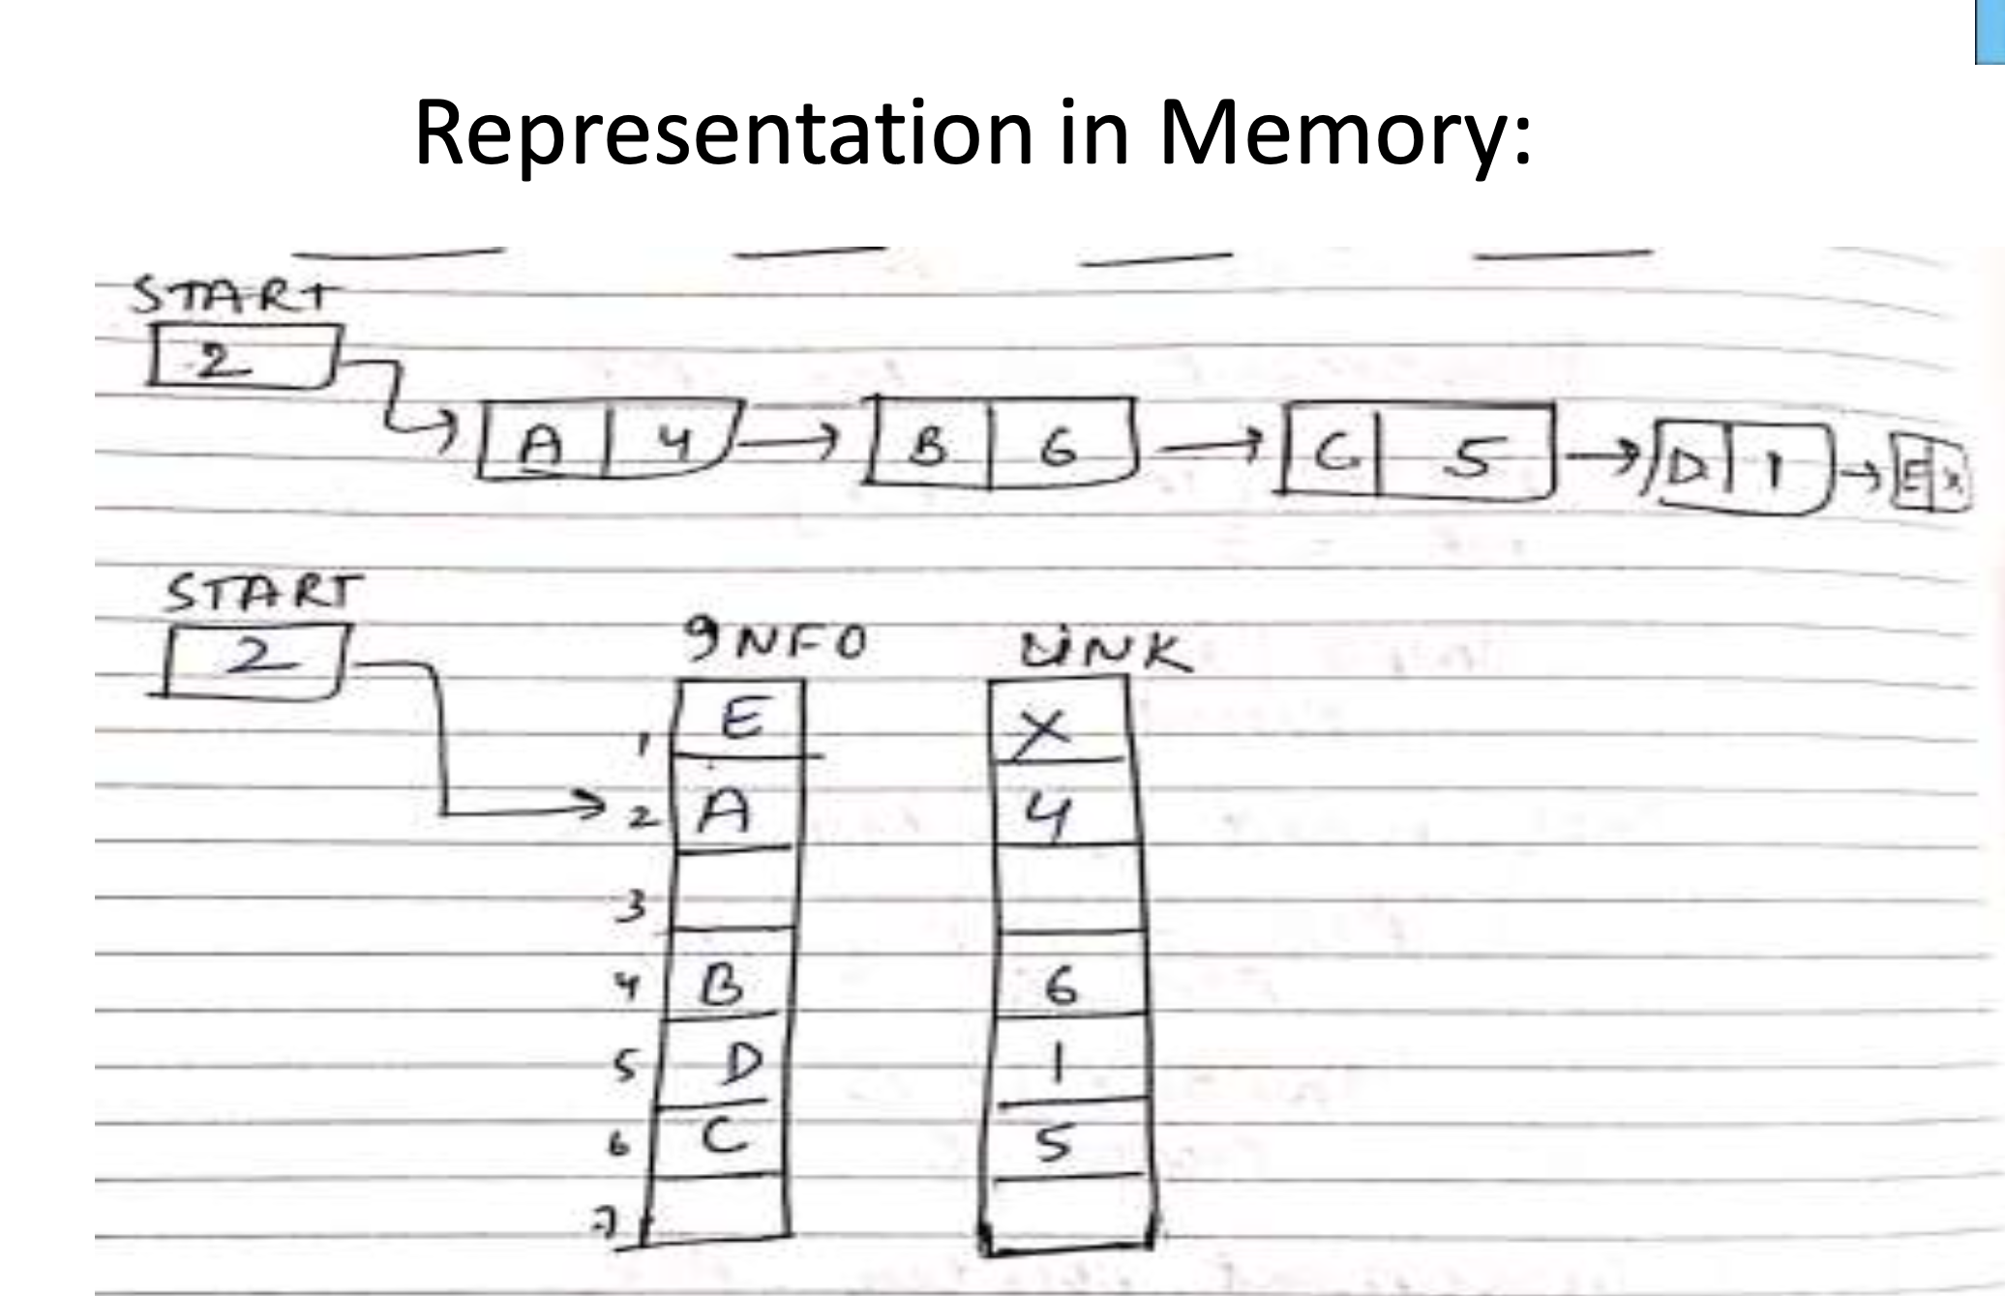

Slide 13
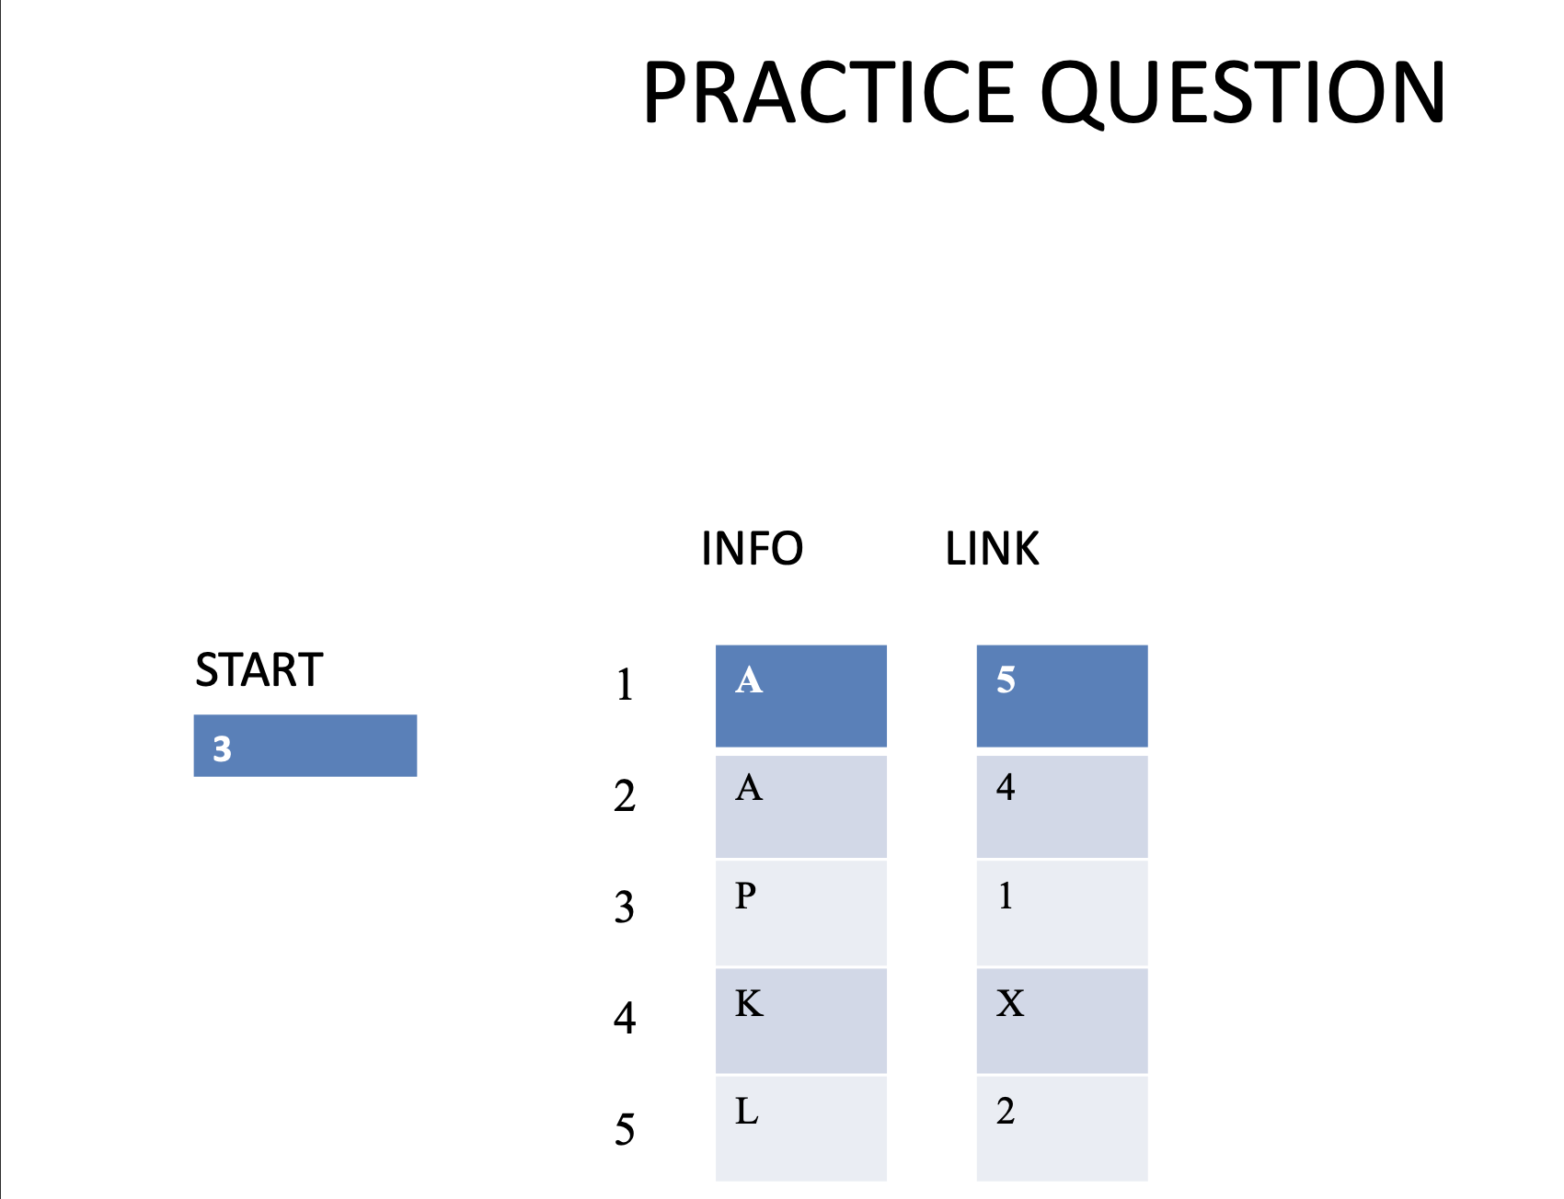

Slide 14

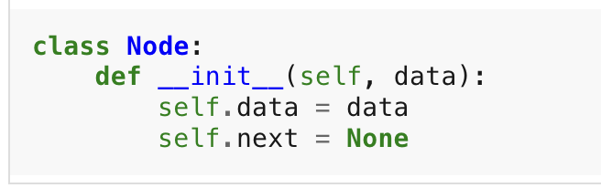

Slide 15
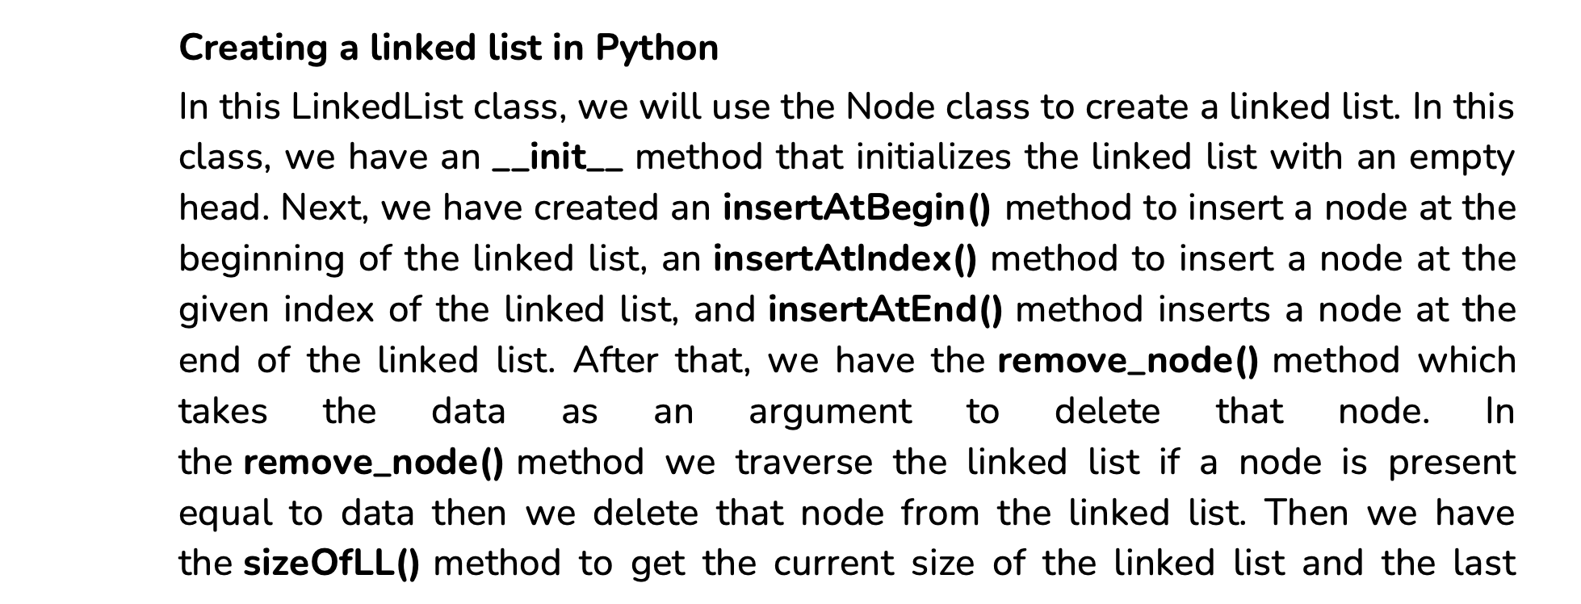

Slide 16
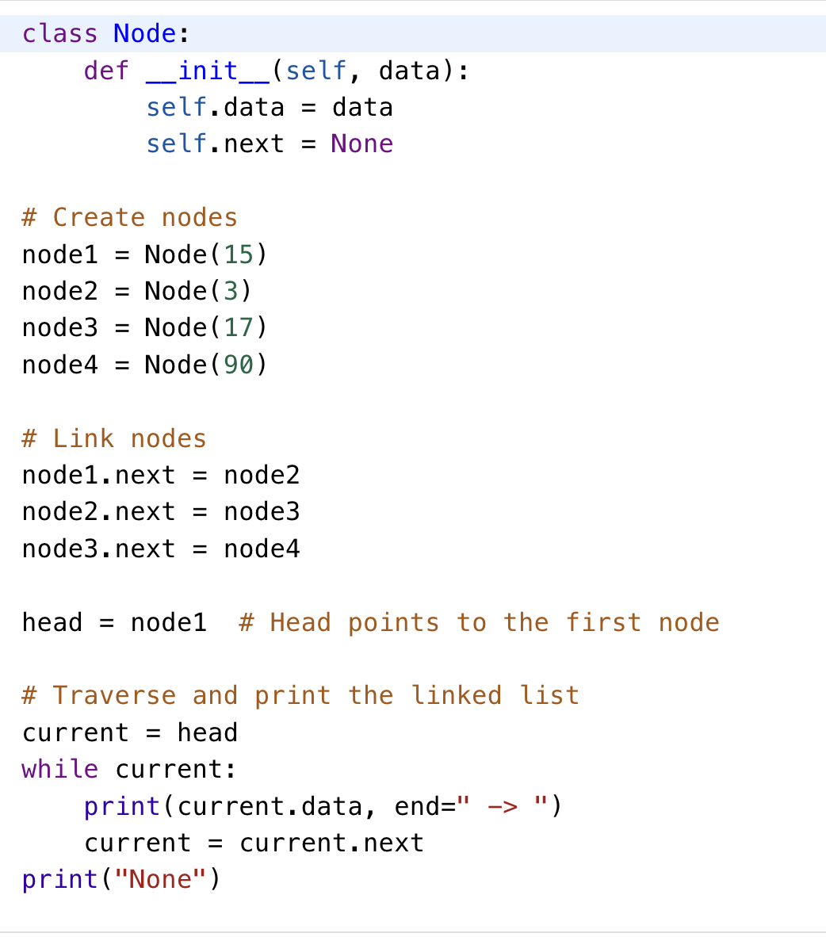
Implementation of Simple 4 Nodes Linked List
Example: Below is a simple example to create a singly linked list with three nodes containing integer data.

Slide 17
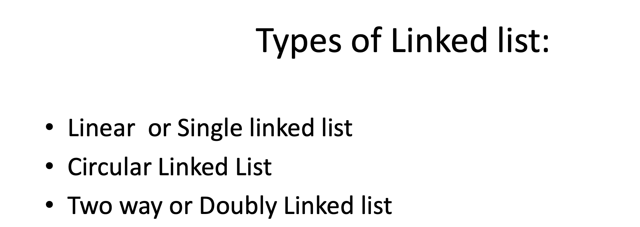

Slide 18

Singly Linked List
A singly linked list is a fundamental data structure, it consists of nodes where each node contains a data field and a reference to the next node in the linked list. The next of the last node is null, indicating the end of the list. Linked Lists support efficient insertion and deletion operations.

Slide 19
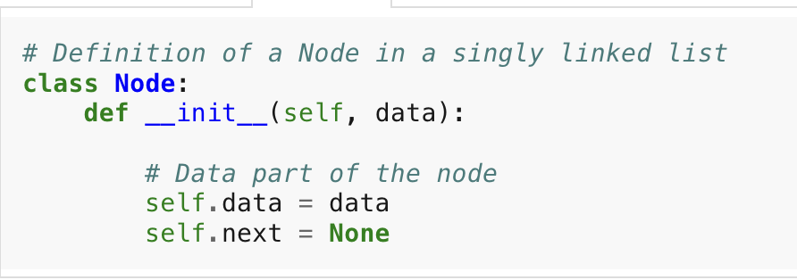
Understanding Node Structure
In a singly linked list, each node consists of two parts: data and a pointer to the next node. This structure allows nodes to be dynamically linked together, forming a chain-like sequence.
In this example, the Node class contains an integer data field (data) to store the information and a pointer to another Node (next) to establish the link to the next node in the list.

Slide 20
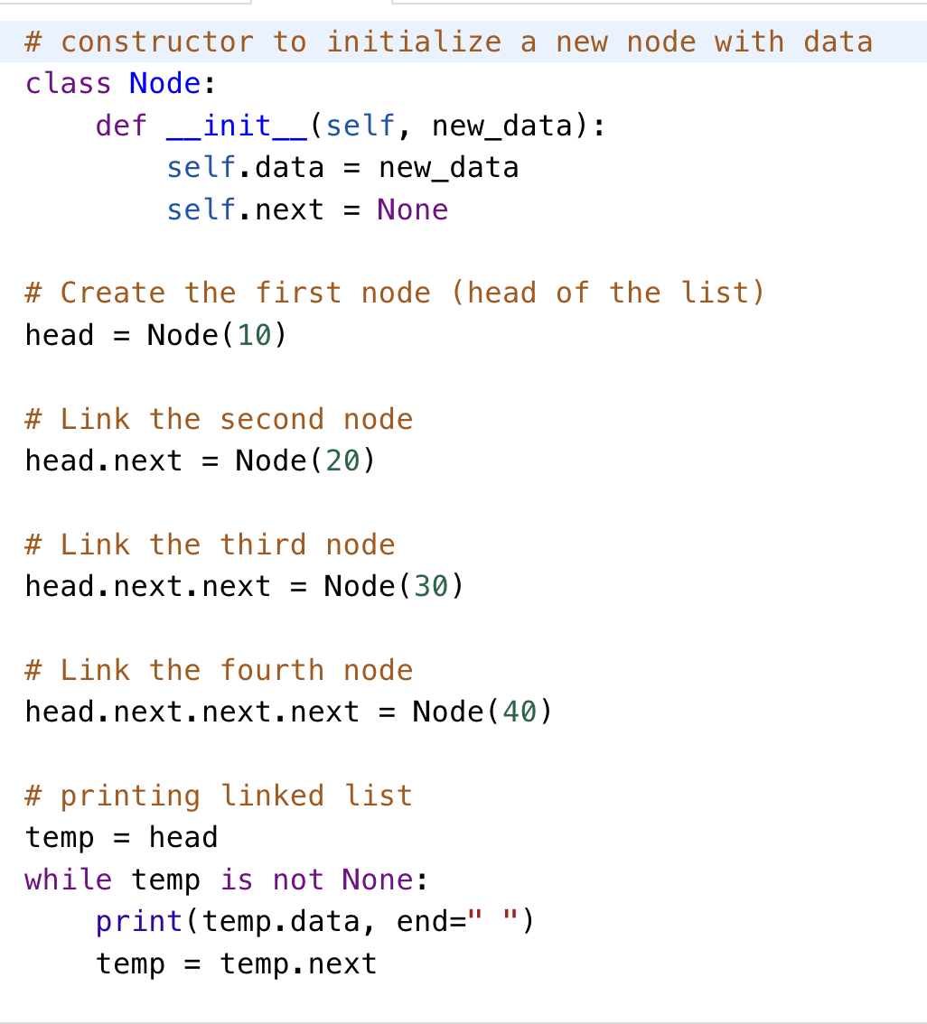
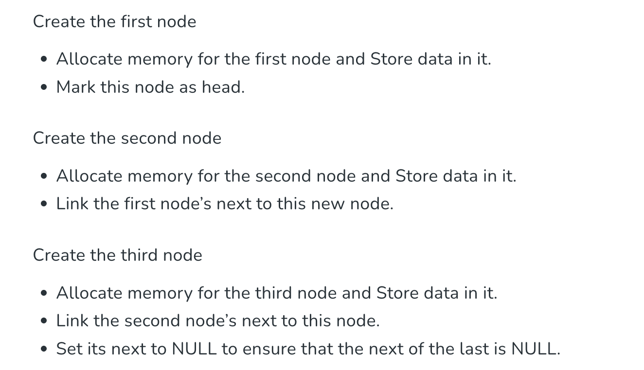
Creating an Example Linked List of Size 3 to Understand Working

Slide 22
Common Operation in Linked List
A linked list supports several operations. Here are the most common ones:
Traversal : Traversing singly linked list
Insertion : At the beginning, At the end and At a specific position
Deletion : From beginning, From end and From a specific position
Searching : Find whether a given key exists in the list
Updating (Modification) : Modify contents of linked list.
Reversal : Reverse the linked list and make the last node as new head.

Slide 23
Insert a Node at Front of a Linked List/Insertion at Beginning in Linked List
Insertion at Beginning in Linked List
This method inserts the node at the beginning of the linked list.
In this method, we create a new_node with the given data and check if the head is an empty node or not if the head is empty then we make the new_node as head and return else
we insert the head at the next new_node and make the head equal to new_node.

Slide 24
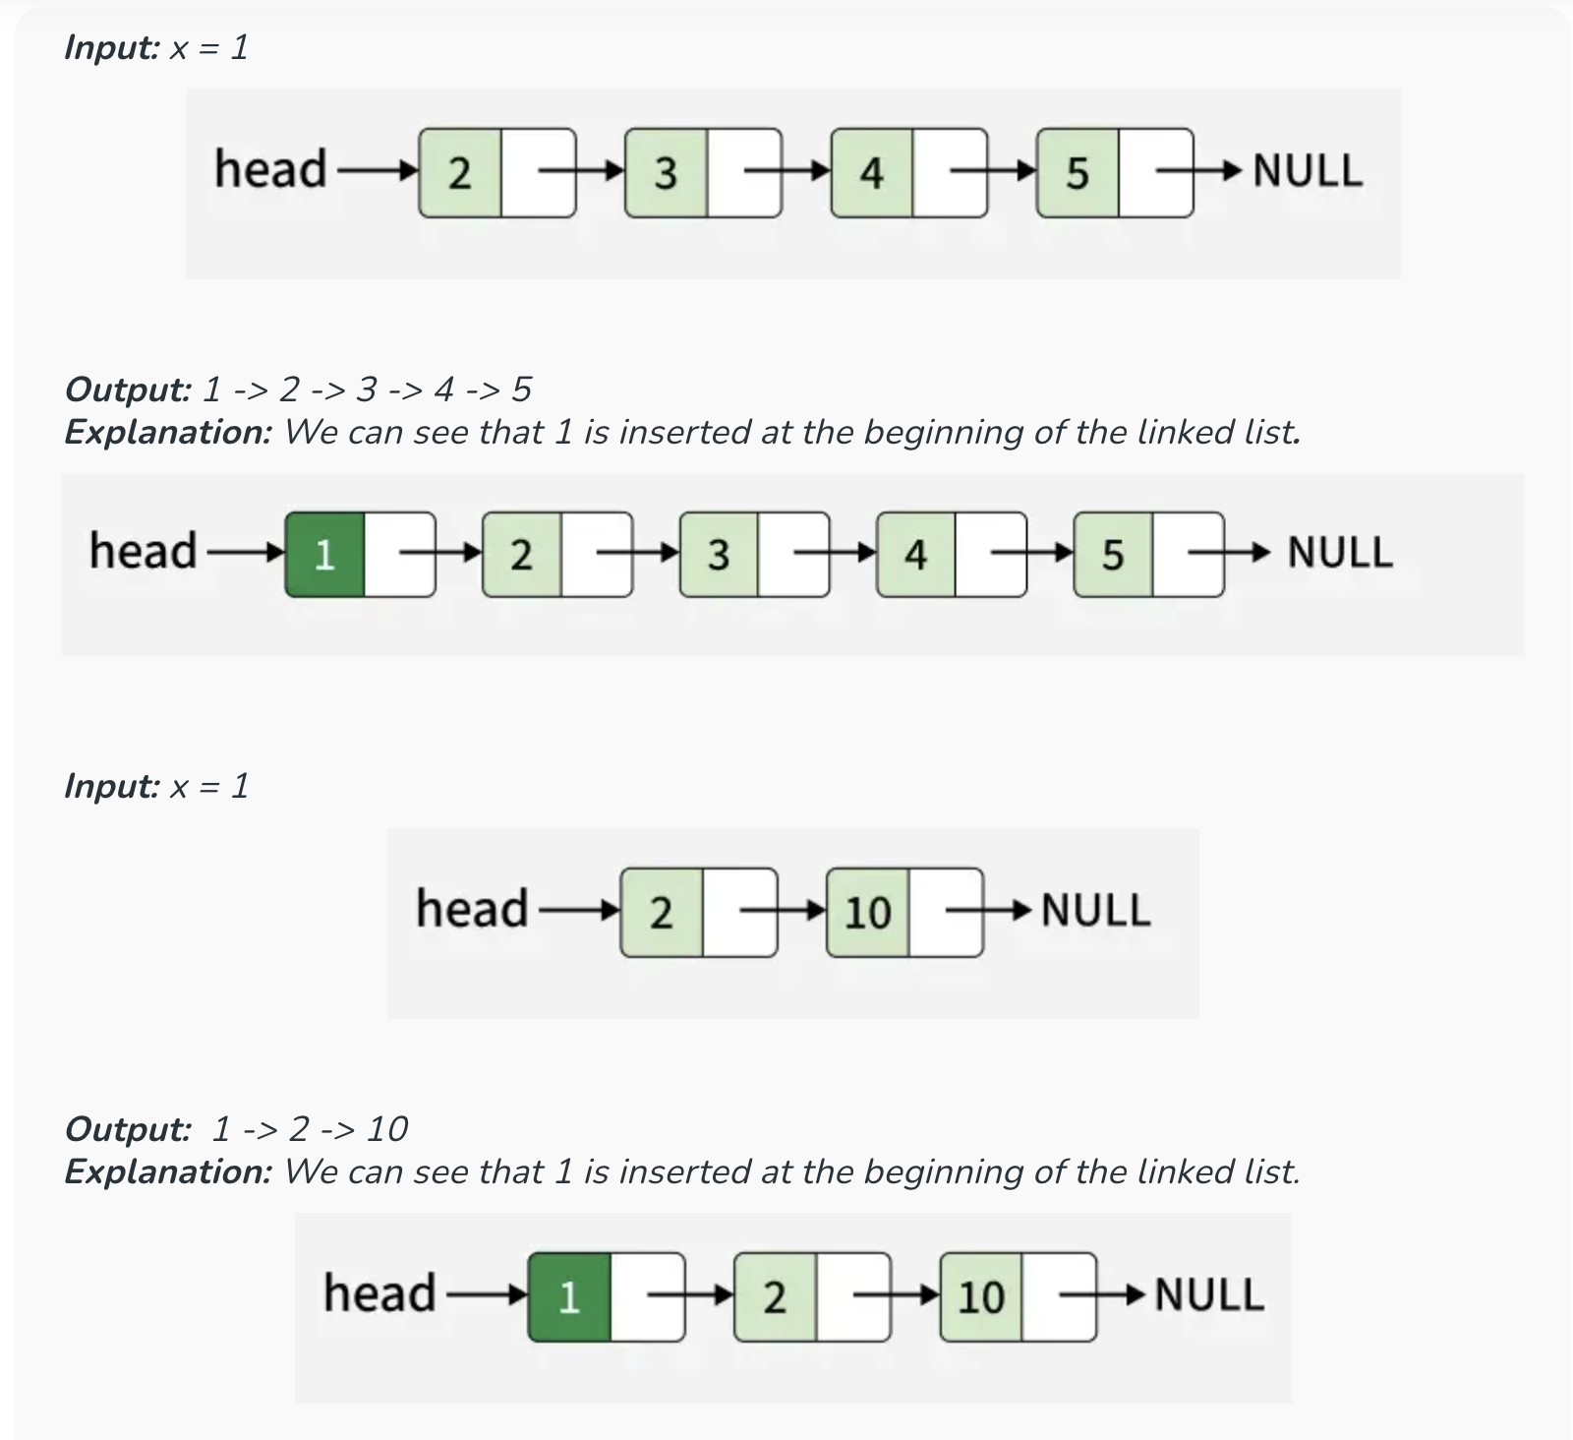

Slide 25
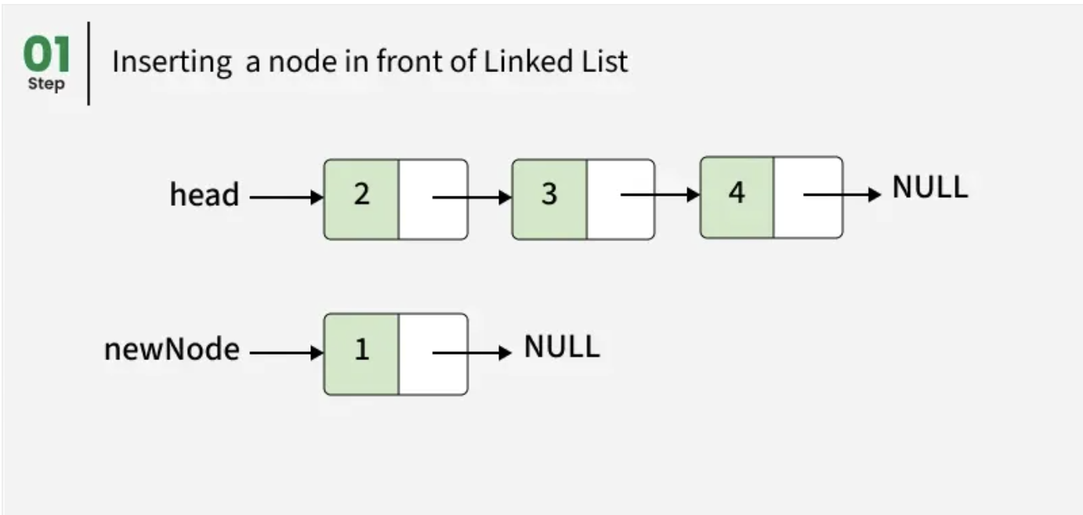
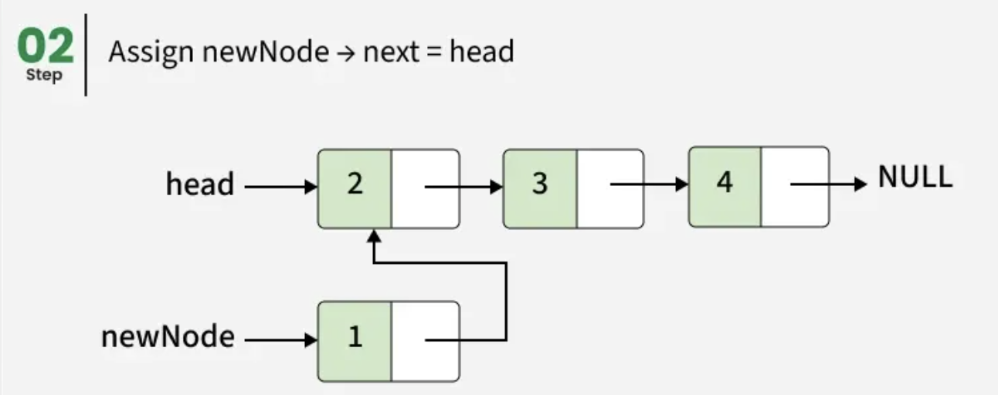
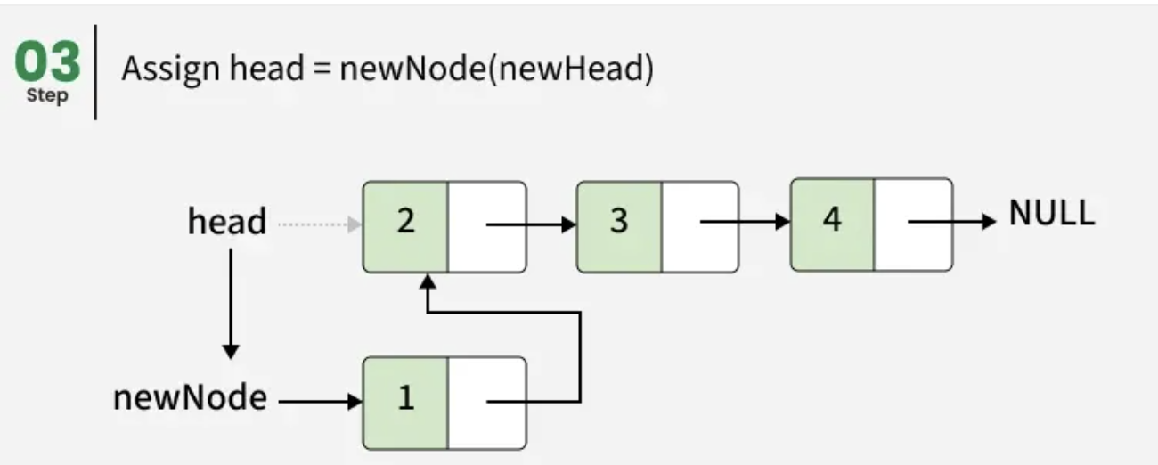
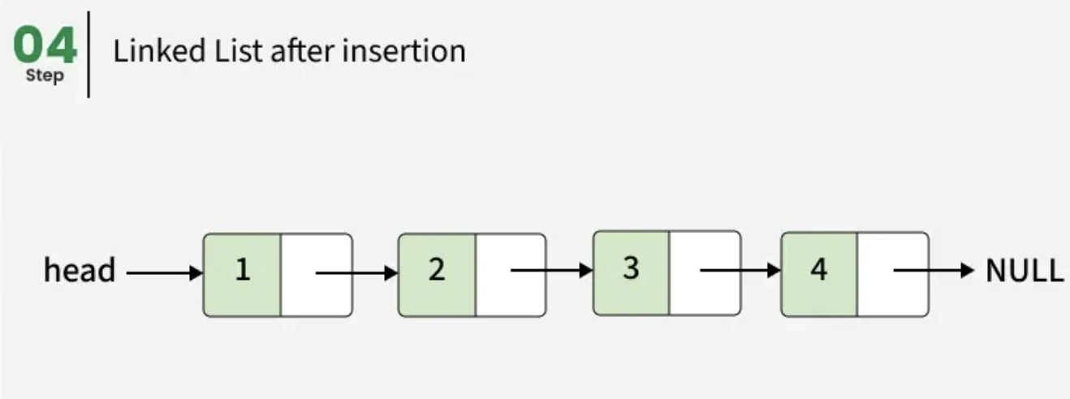
Approach:

Slide 26
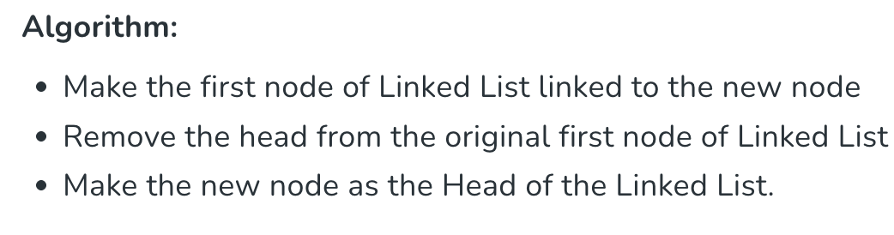

Slide 27
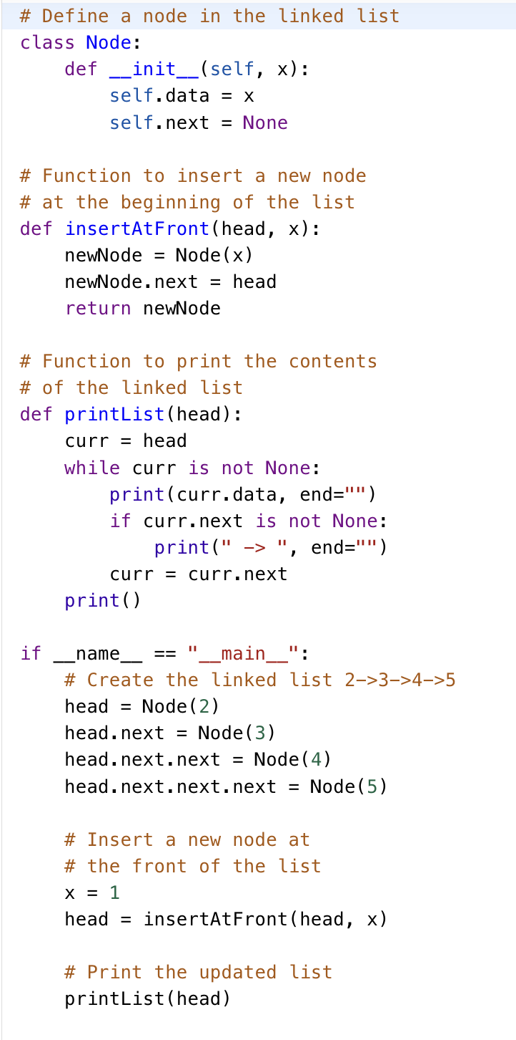

Slide 28
Time Complexity: O(1), We have a pointer to the head and we can directly attach a node and update the head pointer. So, the Time complexity of inserting a node at the head position is O(1).

Slide 29
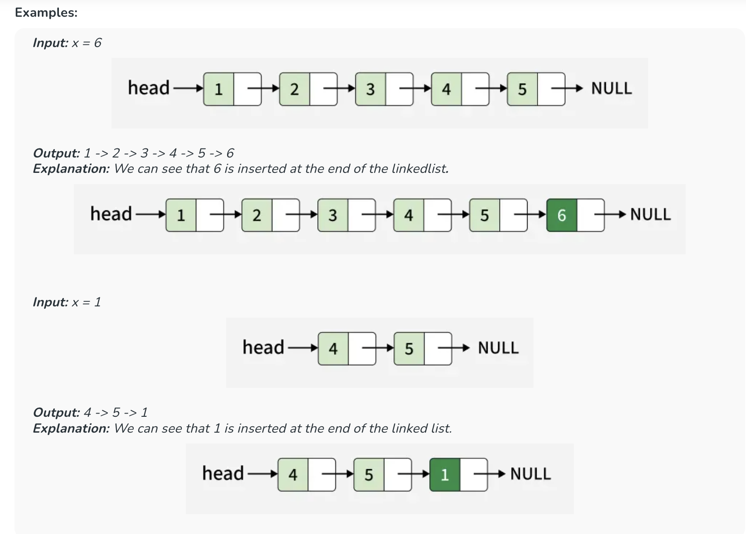
Insert Node at the End of a Linked List

Slide 30
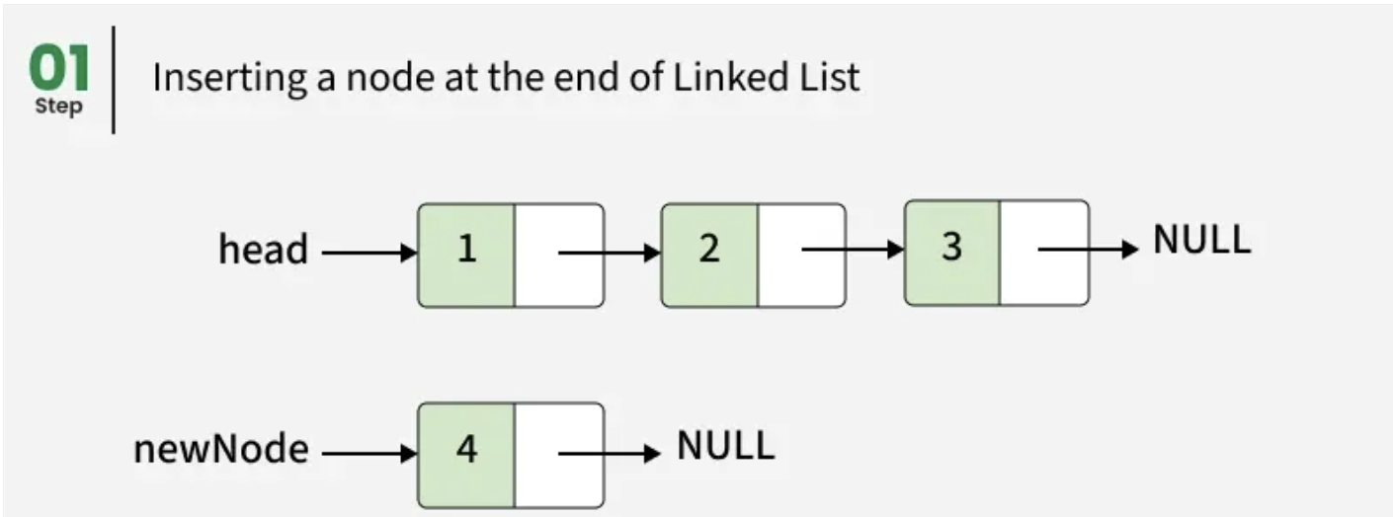
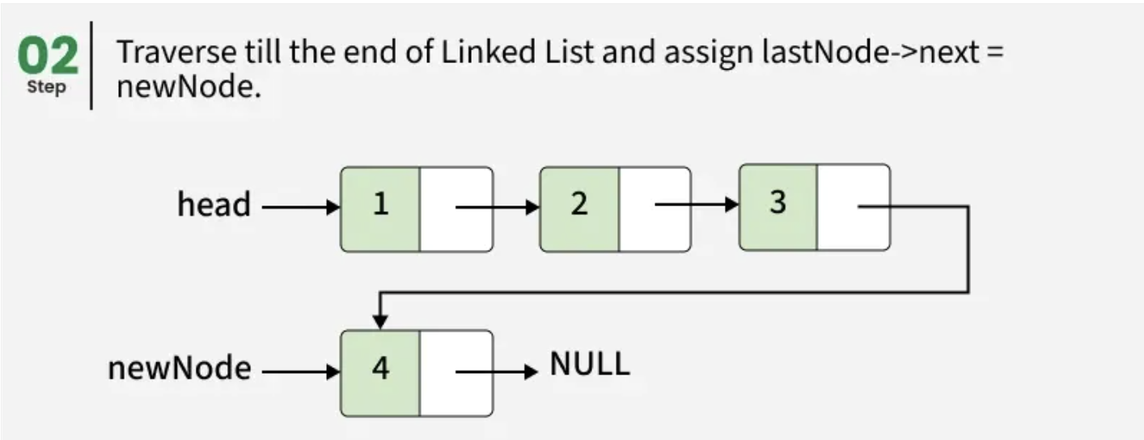
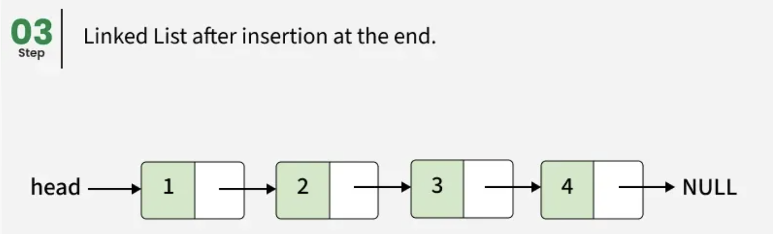
Approach:
Inserting at the end involves traversing the entire list until we reach the last node. We then set the last node's next reference to point to the new node, making the new node the last element in the list.

Slide 31
Following is the approach to add a new node at the end of the linked list:
Create a new node and set its next pointer as NULL since it will be the last node.
Store the head reference in a temporary variable
If the Linked List is empty, make the new node as the head and return
Else traverse till the last node
Change the next pointer of the last node to point to the new node

Slide 32
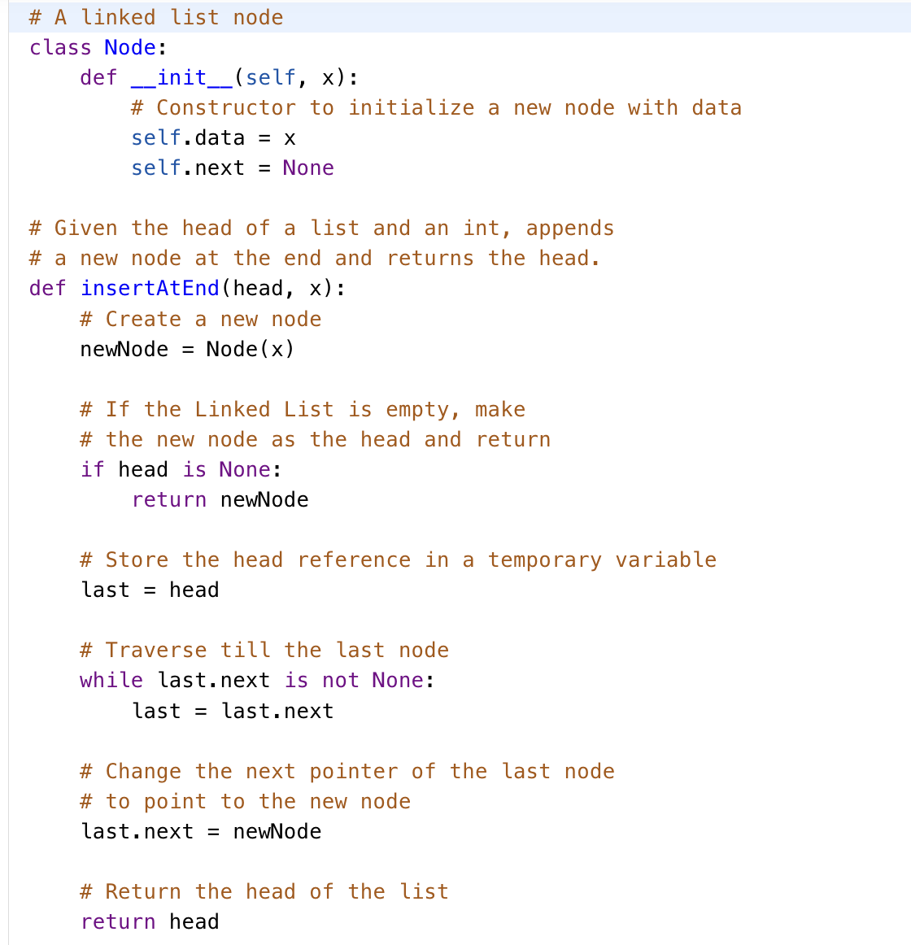

Slide 33
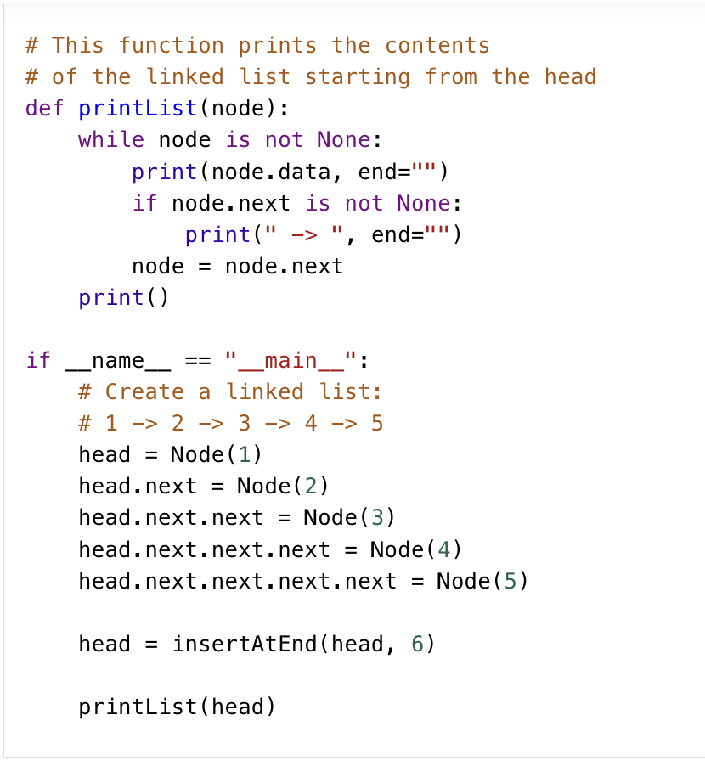

Slide 34
Time Complexity: O(n) where n is the length of the linked list
Auxiliary Space: O(1)

Slide 35
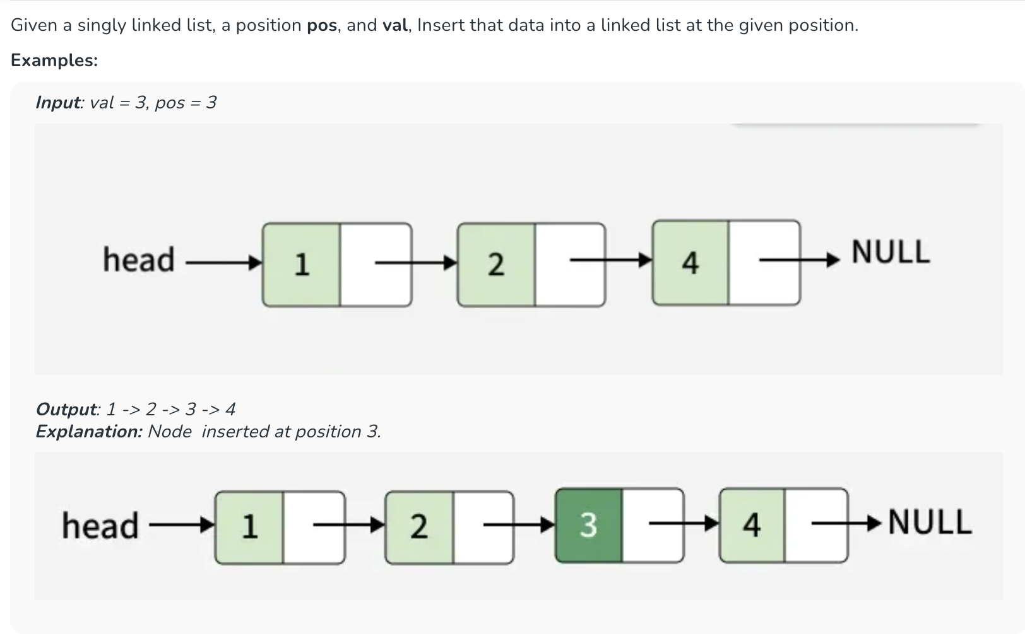
Insert in a Singly Linked List

Slide 36
The idea is to create a new node, traverse to the node just before the given position, and update the links to insert the new node into the list.
Initialize curr to head and create a new node with the given val.
Traverse the linked list until curr reaches the node just before the given position.
Set the new node's next link to curr's next node.
Update curr's next link to the new node.
Return the head of the modified linked list.

Slide 37
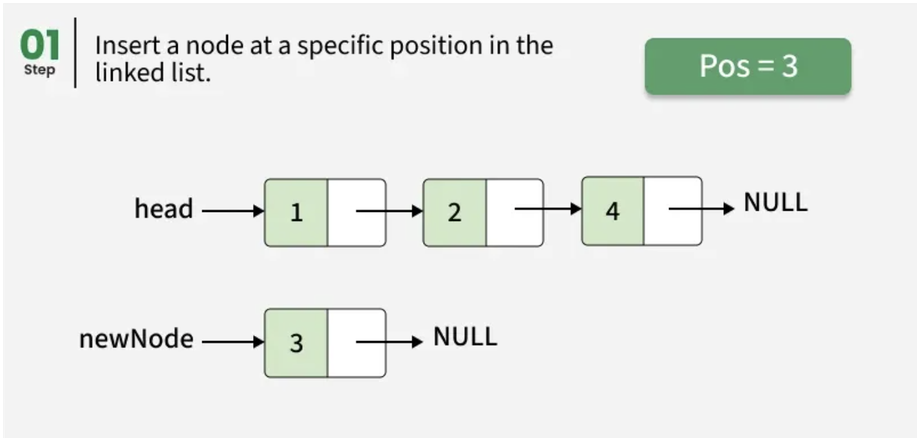
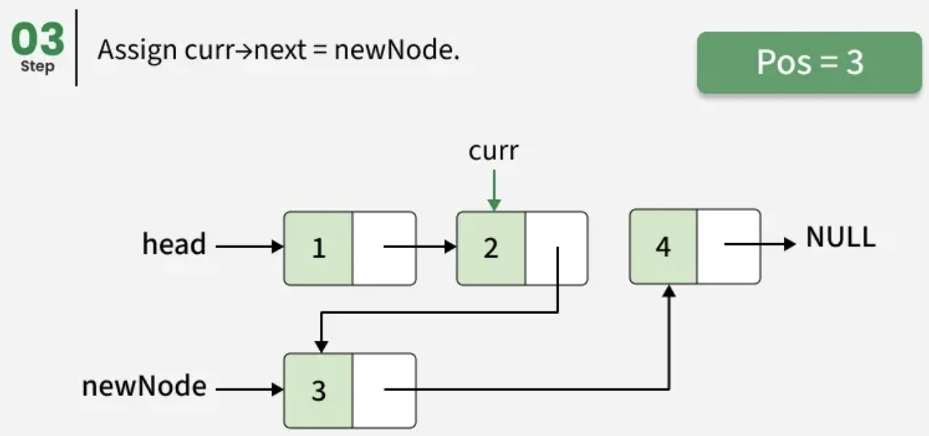
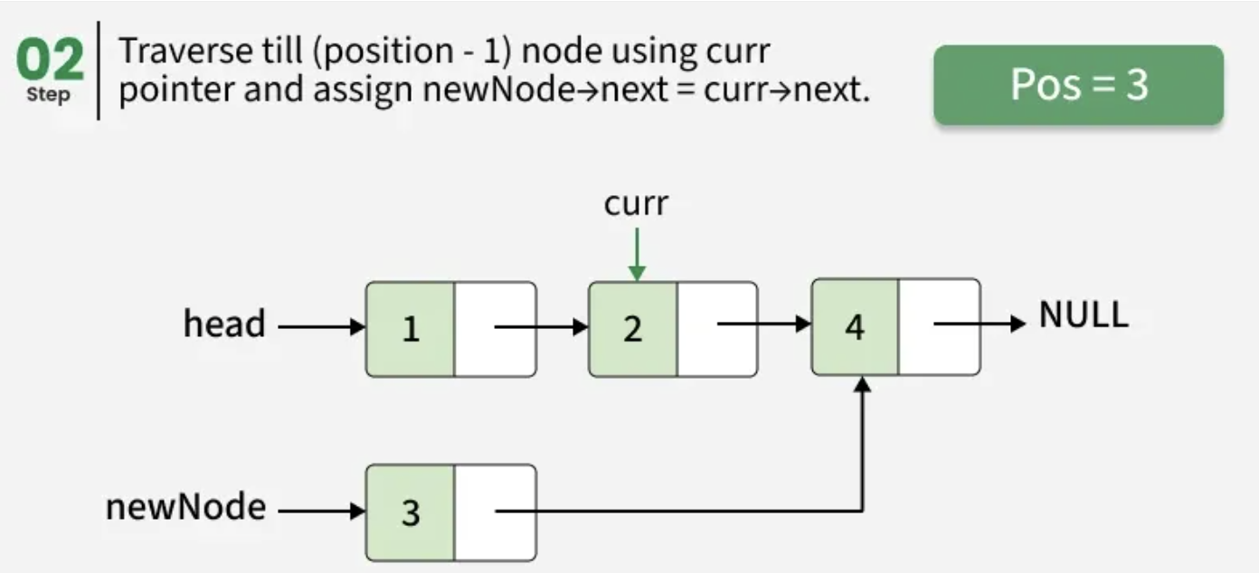
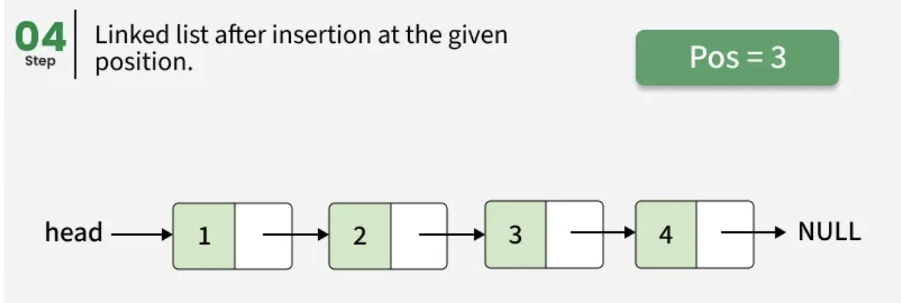

Slide 38
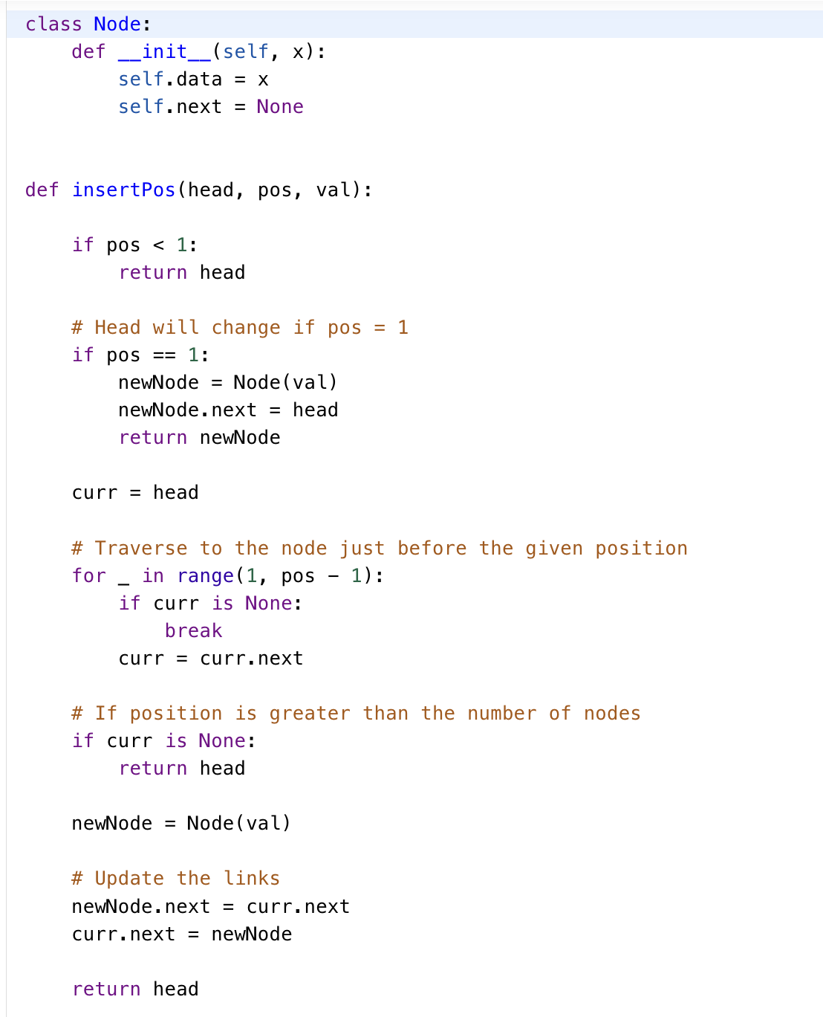

Slide 39
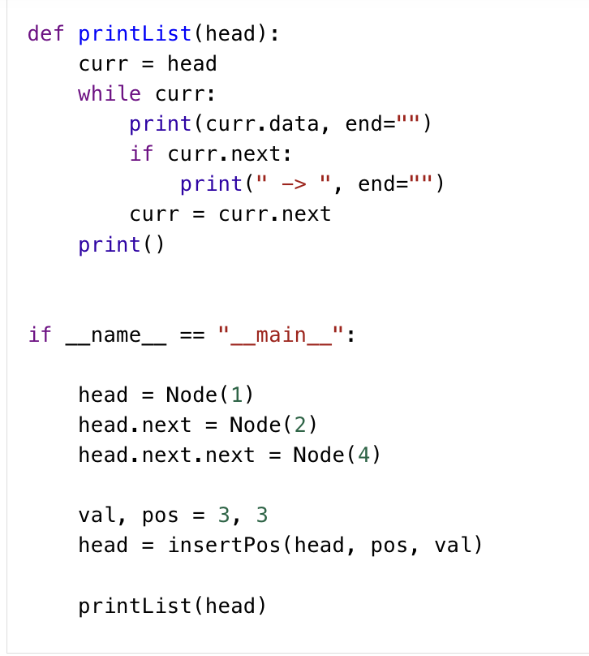

Slide 40
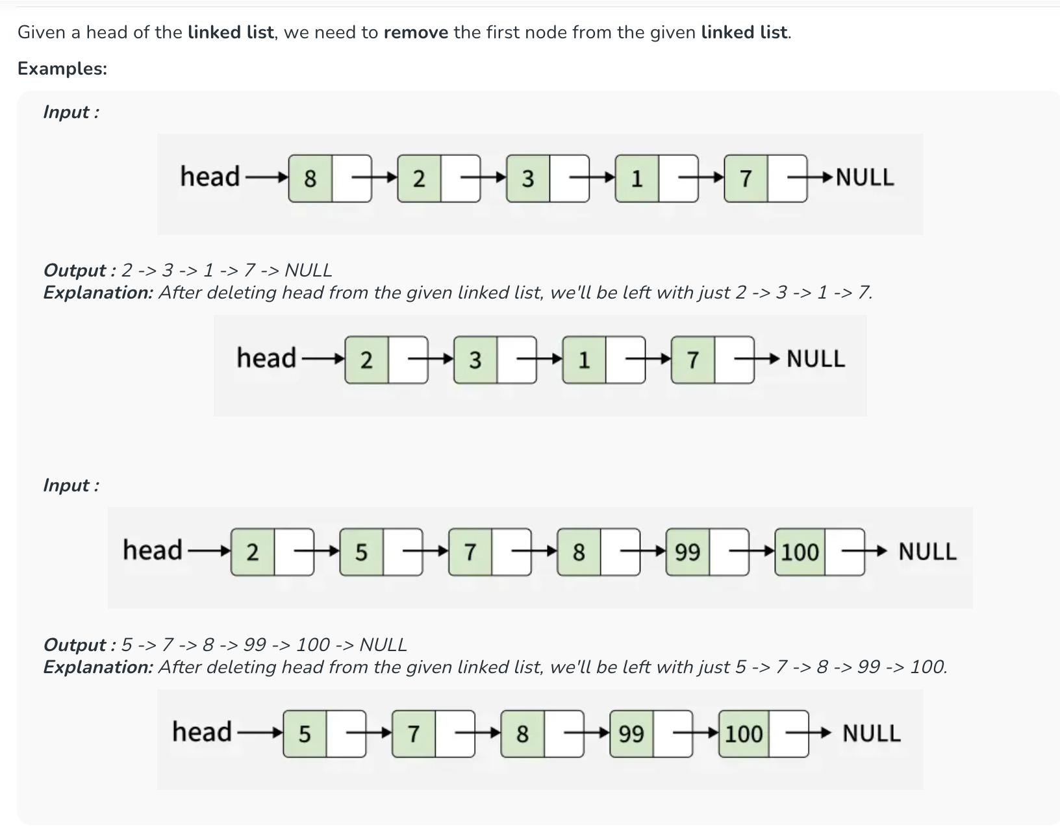
Deletion at beginning (Removal of first node) in a Linked List

Slide 41
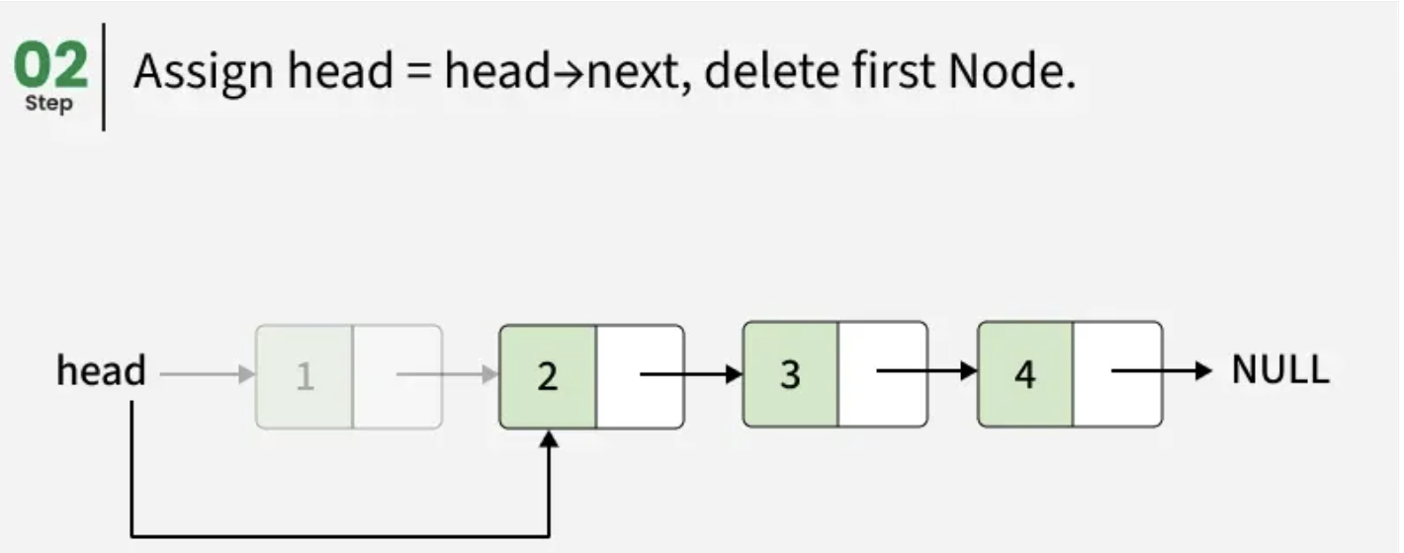
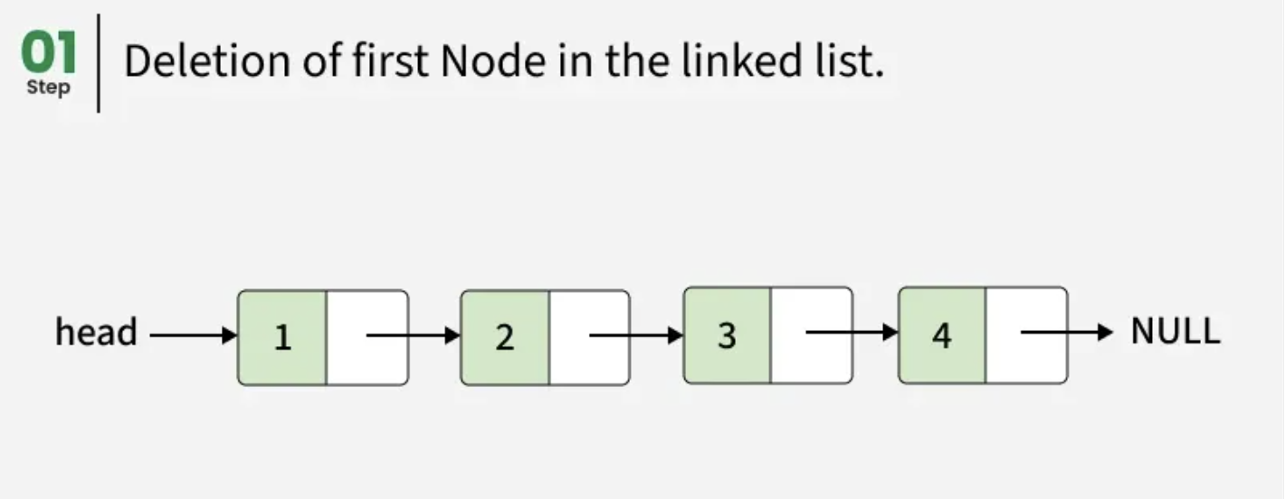
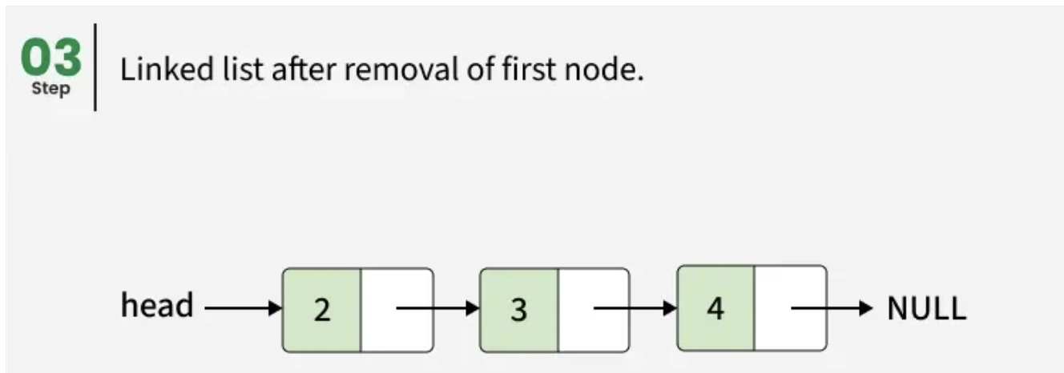
By Shifting head node to next node of head - O(1) Time and O(1) Space
To remove the first node of a linked list, store the current head in a temporary variable (temp), move the head pointer to the next node, delete the temporary head node and finally , return the new head of the linked list.

Slide 42
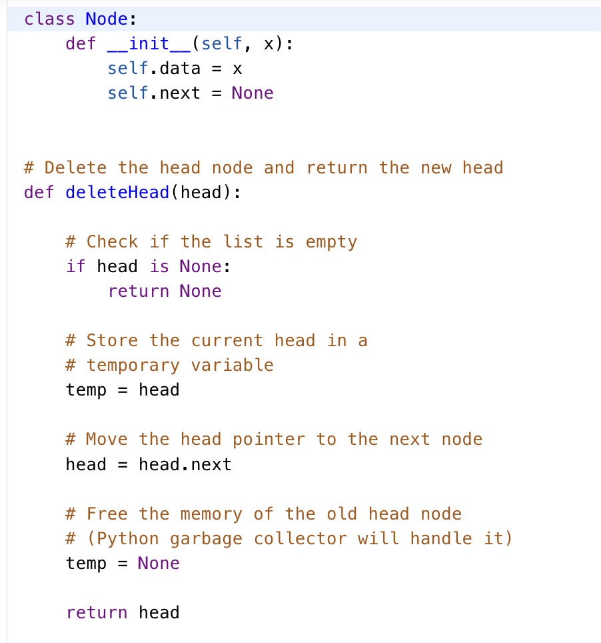

Slide 43
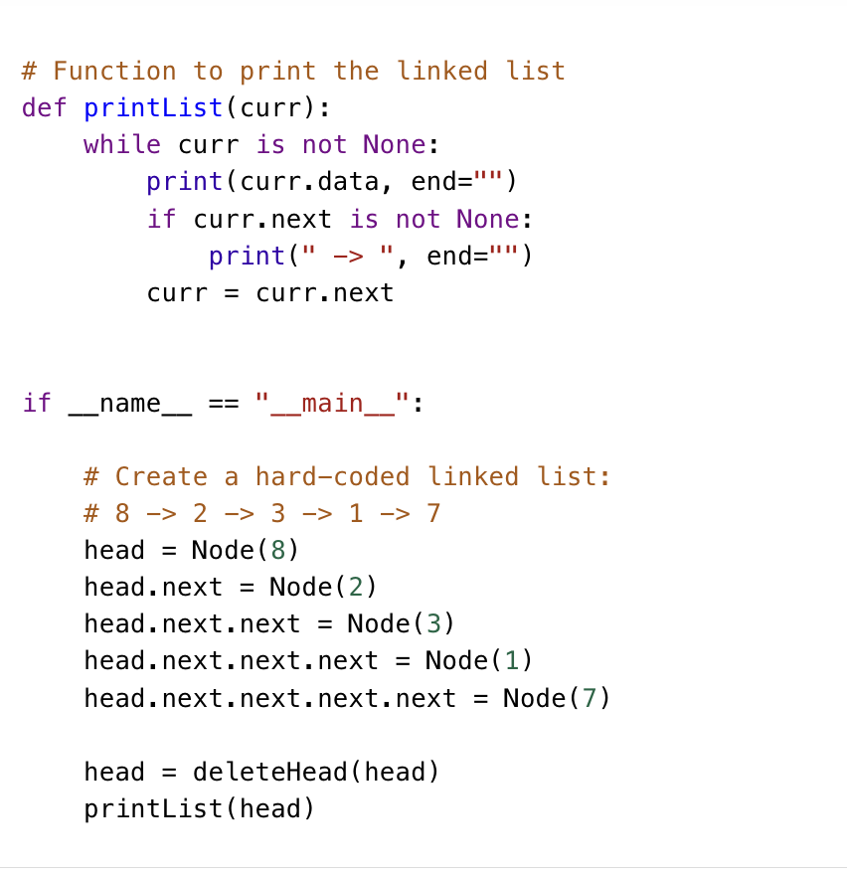
Time Complexity: O(1), because the operation to delete the head node is performed in constant time.
Space Complexity: O(1)

Slide 44
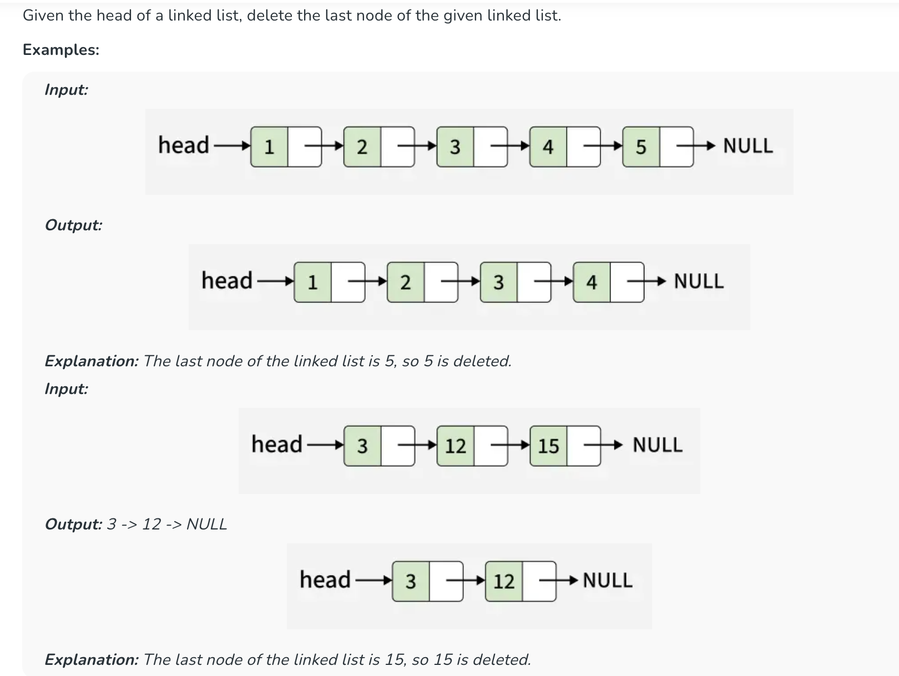
Deletion at end (Removal of last node) in a Linked List

Slide 45
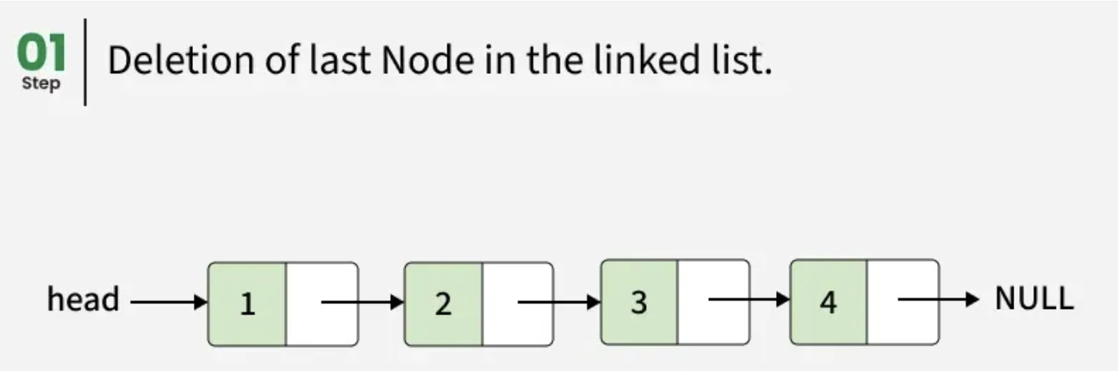
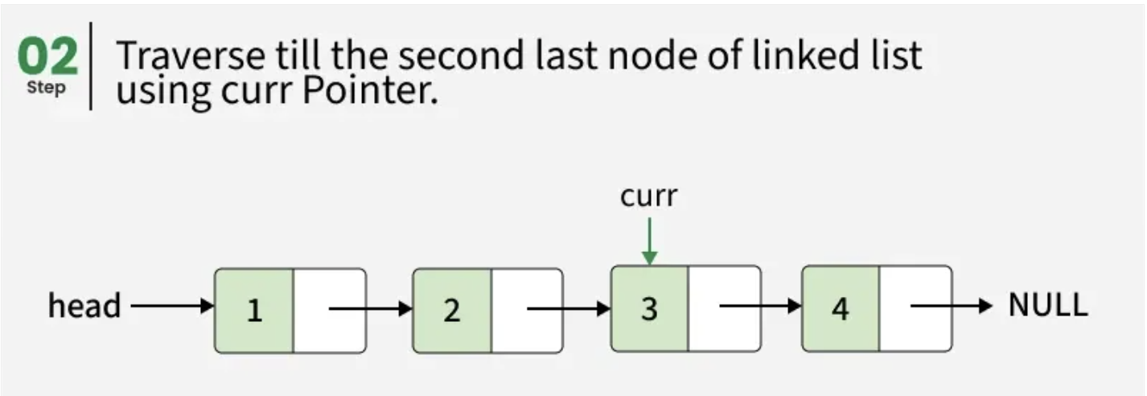
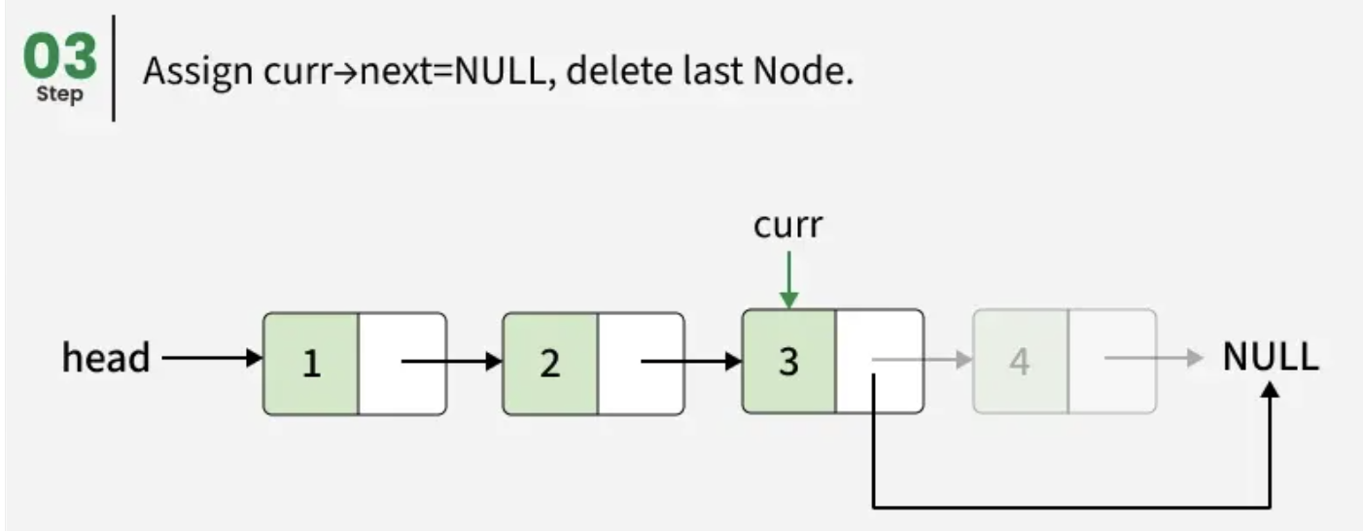
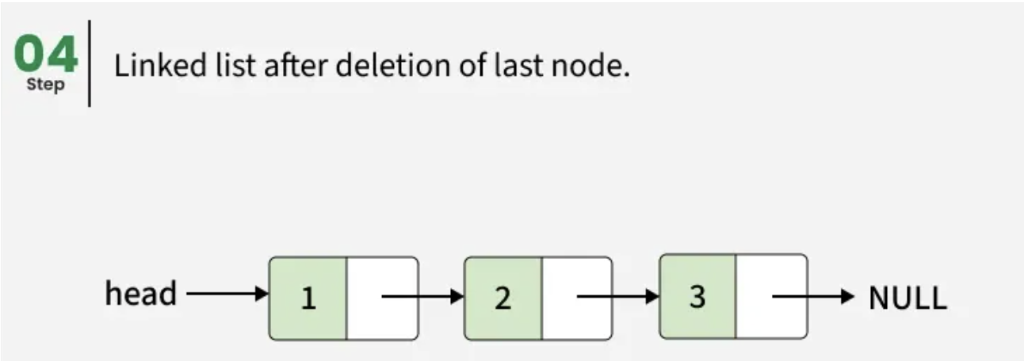
Approach:
To perform the deletion operation at the end of linked list, we need to traverse the list to find the second last node, then set its next pointer to null. If the list is empty then there is no node to delete or has only one node then point head to null.

Slide 46
Step-by-step approach:
Check if list is empty then return NULL.
If the list has only one node then delete it and return NULL.
Traverse the list to find the second last node.
=> Set the next pointer of second last node to NULL.

Slide 47


Slide 48

Time Complexity: O(n), traversal of the linked list till its end, so the time complexity required is O(n).
Auxiliary Space: O(1)

Slide 49

Delete Node by Position

Slide 50
The idea is to traverse the linked list and store the address of every node in an array. This allows direct access to the node at position x. Then, update the links to remove the node and delete it.
Working of Approach:
Traverse the linked list and store all node pointers in an array.
If x == 1, delete the head node.
Otherwise, access the previous and current nodes using the array.
Update the previous node's next pointer.
Delete the node and return the updated head.

Slide 51


Slide 52


Slide 53

Search an element in a Linked List

Slide 54

The idea is to traverse the linked list starting from the head. At each node, check if its value matches the given key; if it does, return true. Otherwise, move to the next node and continue the process until the end of the list. If the key is not found after the traversal, return false.

Slide 55


