Slide 1
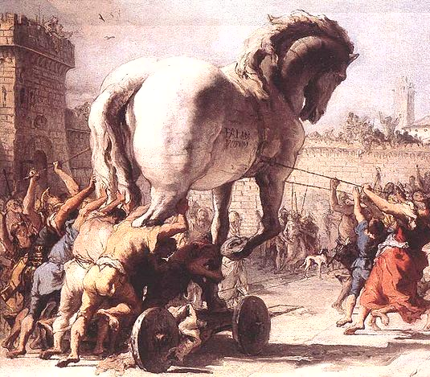
ch10
The Trojan War
Greek and Roman Mythology
授課老師：簡士捷 副教授
Chien, Shih-Chieh Associate Professor
National Taipei University of Business
Unless noted, the course materials are licensed under Creative Commons Attribution-NonCommercial-ShareAlike 3.0 Taiwan (CC BY-NC-SA 3.0)

Slide 2
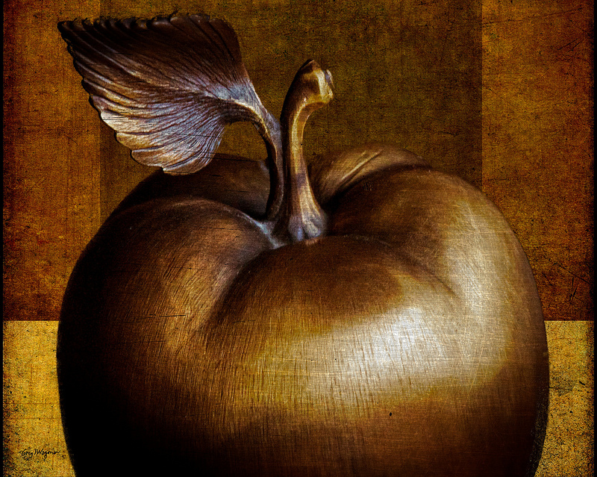
THE JUDGMENT OF PARIS
Prologue
Flickr sciondriver

Slide 3
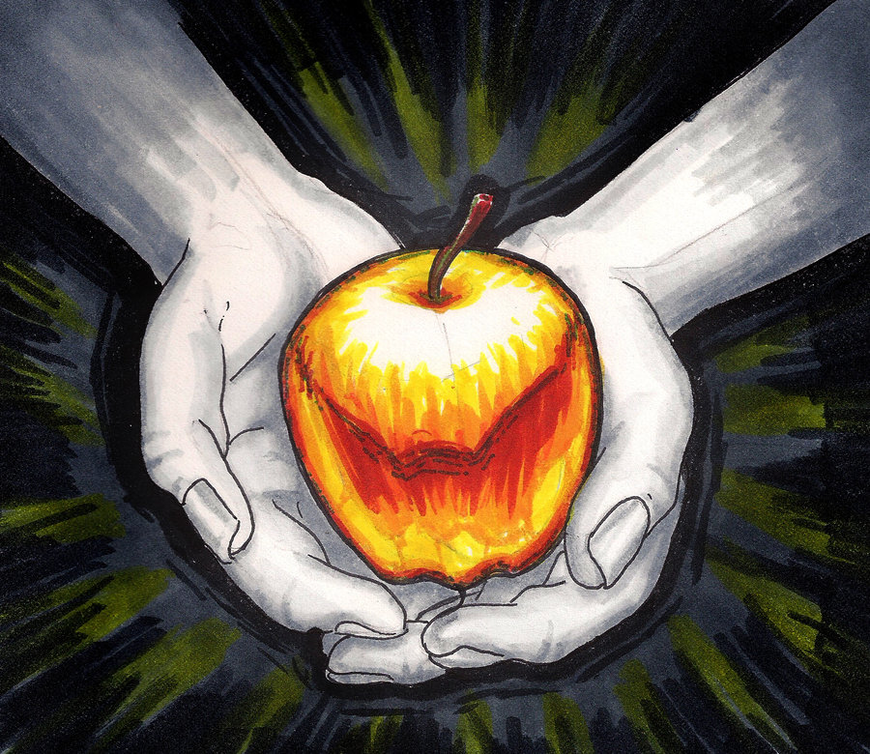
The vicious goddess of Discord, Eris, determined to make a trouble.
A golden apple marked “the fairest” caused the quarrel between Athena, Aphrodite, and Hera.
deviantART WorldsEdge

Slide 4
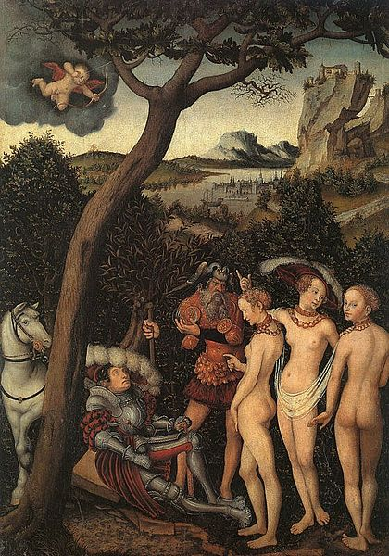
Zeus assigned Paris as the judge. The candidates all tried to bribe him.
They promised Paris to let him
Hera: become the Lord of Europe and Asia
Athena: lead the Trojans to victory against the Greeks
Aphrodite: have the fairest woman
Paris awarding the golden apple

Slide 5
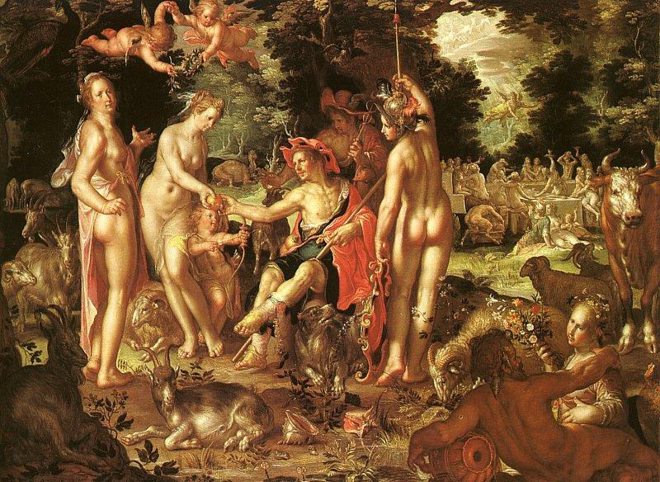
Paris chose to take Aphrodite’s bribe and awarded her the golden apple.

Slide 6
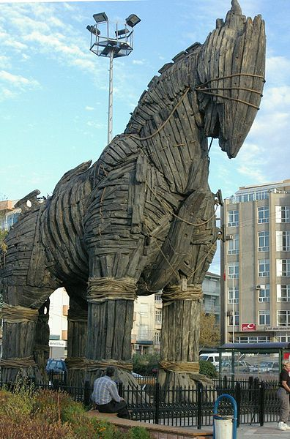
THE TROJAN WAR
Wikipedia Ross Burgess

Slide 7
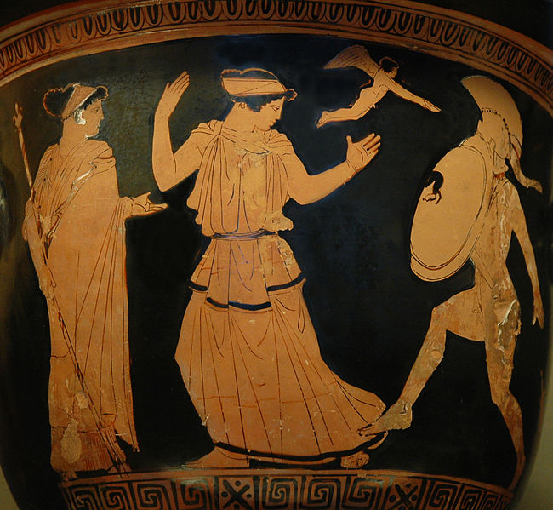
Helen, the daughter of Zeus and Leda, was said to be the most beautiful woman at that time.
Her husband was Menelaus, the brother of Agamemnon and also the King of Sparta.
Aphrodite helped Paris to rape Helen away.

Slide 8
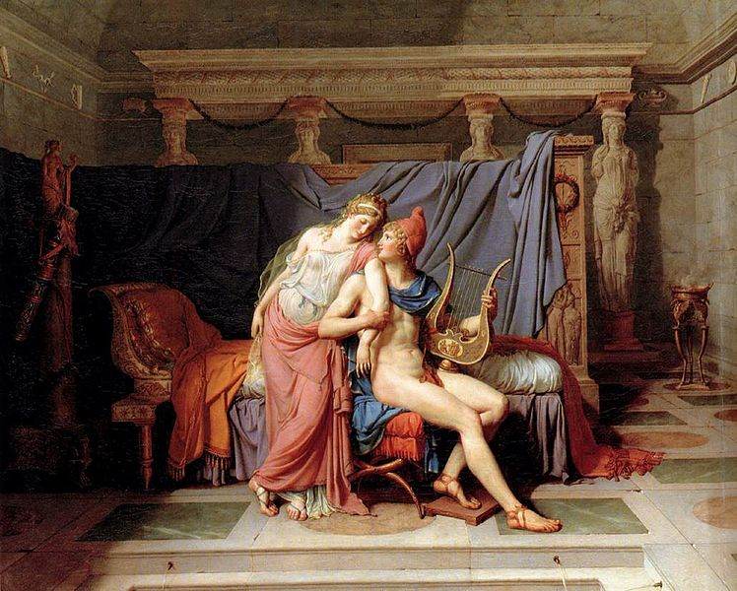
Paris and Helen

Slide 9
In order to avoid being involved in the war, Odysseus pretended to be crazy by sowing the field with salt. However, the messenger put his son on the way. Odysseus turned his direction and proved his wits still him. However reluctant, he was forced to join the Army.

Slide 10
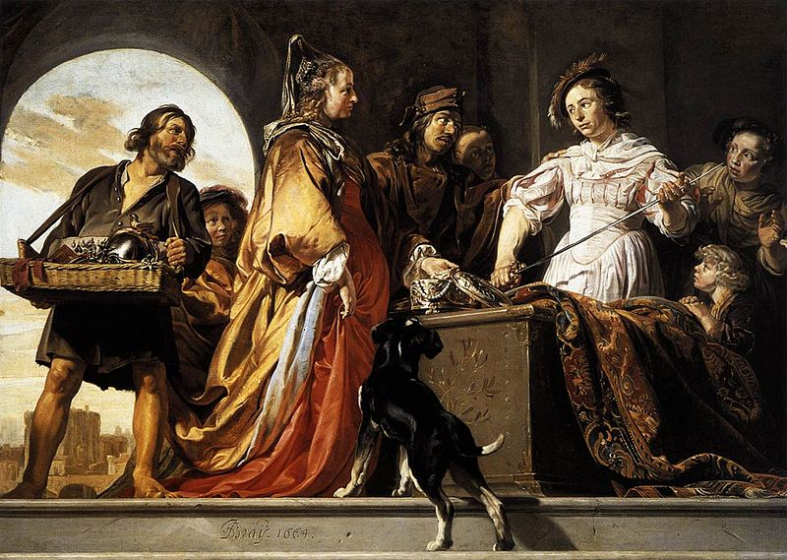
The Discovery of Achilles among the Daughters of Lycomedes (Achilles joined)
Menelaus called upon all Greece to help him, Odysseus and Achilles were included as well.

Slide 11
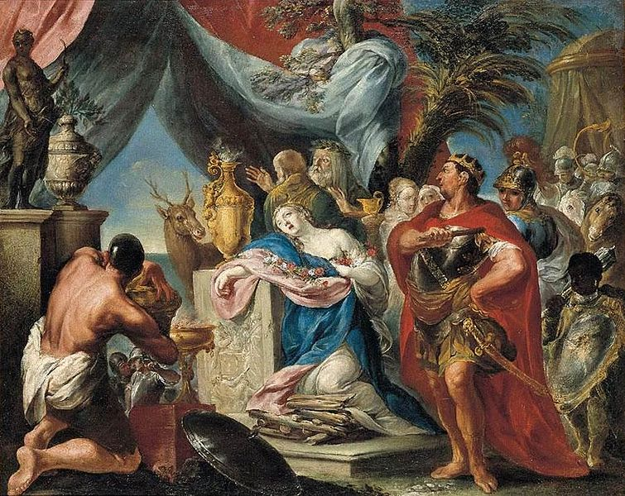
The Army was ready. However, Calchas declared that Artemis was angry for her beloved hare was slain by the Greeks. Agamemnon needed to sacrifice his eldest daughter to appease Artemis.
Agamemnon yielded.
The sacrifice of Iphigenia

Slide 12
For nine years the war continued. Then a quarrel flared between Achilles and Agamemnon.
REASON:
Chryseis, daughter of Apollo’s priest, had been carried off and given to Agamemnon. Apollo heard the priest’s prayer and made many men in Greek Army sickened and died. Achilles asked Agamemnon to return the daughter. Agamemnon was furious and took Achilles’ prize of honor, maiden Briseis, as revenge. Achilles swore that Agamemnon would pay for the dead. (P.191)

Slide 13
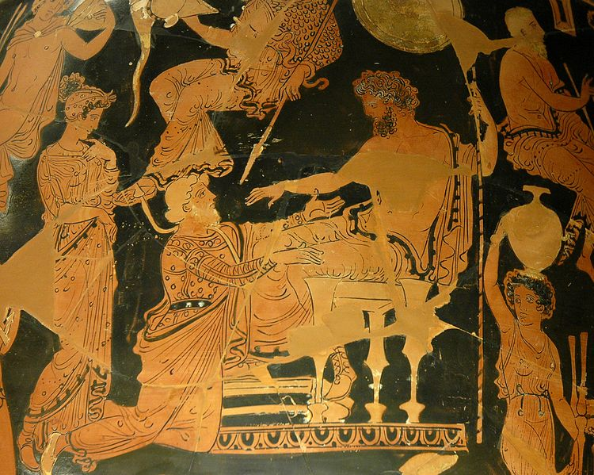
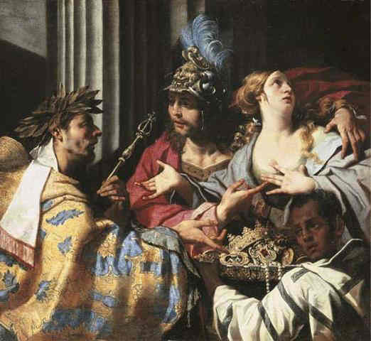
Chryseis Returned to her Father Chryses
Wikispaces Luca Ferrari

Slide 14
The gods were ranged against each other
Trojans
Greeks
Aphrodite
Ares
Apollo
Zeus (but trying to be neutral)
Thetis (Achilles’ mother)
Hera
Athena
Poseidon

Slide 15
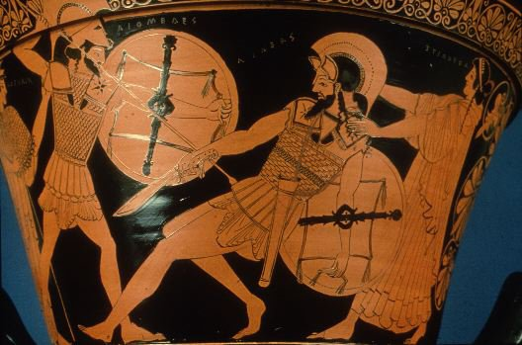
During the war, gods were all involved in the battlefield.
On the Greek side, with Achilles gone, the two greatest champions were Ajax and Diomedes.
Diomedes almost killed Aeneas, son of Aphrodite.
Duel of Diomedes & Aeneas in the Trojan War, with Aphrodite & Athena

Slide 16
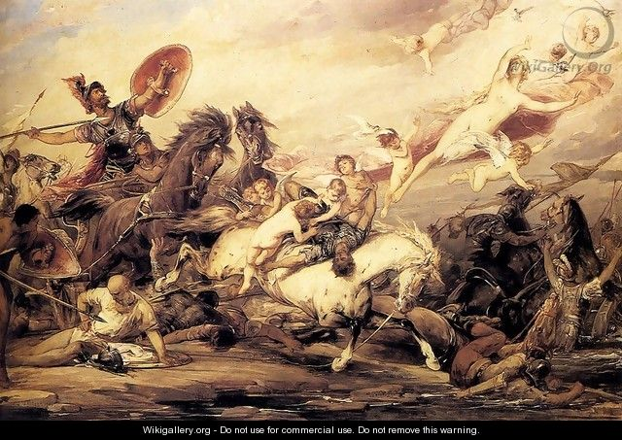
Diomedes Wounding Aphrodite When She Tries To Recover The Body Of Aeneas
Even Aphrodite got hurt in the war.

Slide 17
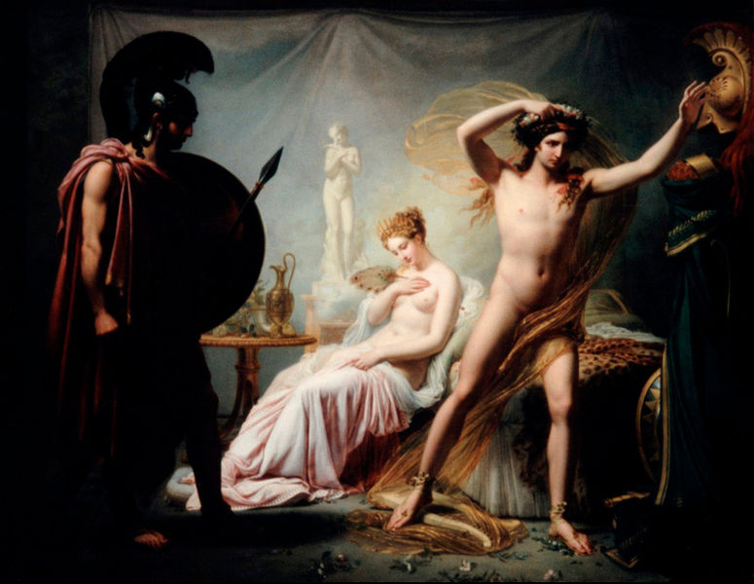
Hector leaving his wife, Andromache, for the war.

Slide 18
Zeus recalled his promise to Thetis to avenge Achilles’ wrong. He ordered all the other immortals to stay in Olympus while he went down to the earth to help Trojans. That night, Trojans almost won the war.
Nestor urged Agamemnon to implore Achilles back. Agamemnon agreed and sent Odysseus to find Achilles. However, Achilles refused to go back.

Slide 19
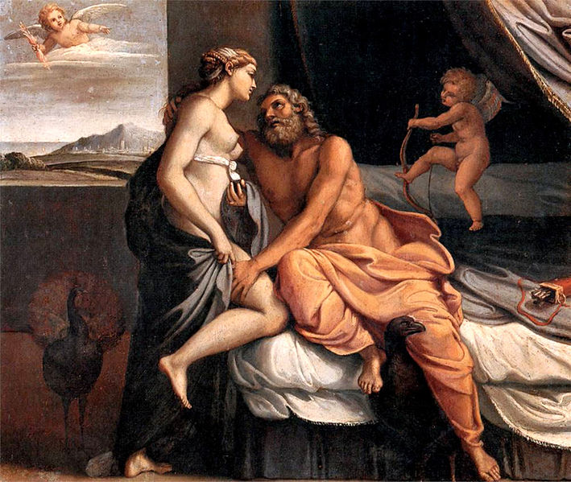
Trojans kept winning. Hera therefore came up with a plan to seduce Zeus and made him fall asleep and forget the Trojans.
At once the battle turned in favor of the Greeks. (P.195)
Hera seducing Zeus

Slide 20
It was not until Zeus woke up that the tide of battle turned against the Greeks again.
Hector was revived and endowed wuth surpassing power by Apollo. He became almost invincible and he even killed Patroclus in Achilles’ armor. (Achilles refused to fight for men who disgraced him. Therefore, Patroclus borrowed his armor to fight in the battlefield.)
Hector took away Achilles’ armor. It seems as though he had also taken on Achilles’ strength, and no Greek can stand before him. (P.197)

Slide 21
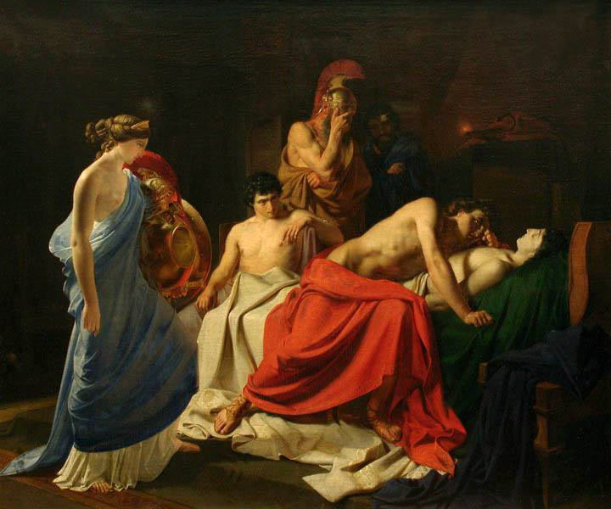
Achilles mourns over the body of Patroclus

Slide 22
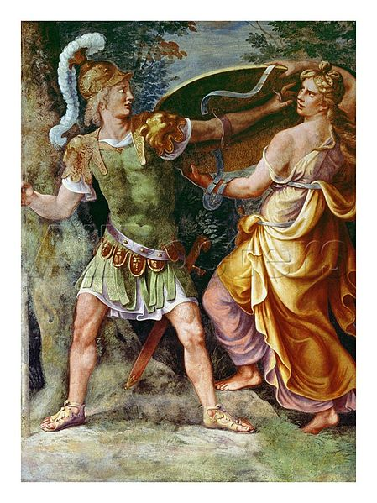
To revenge, Achilles returned to the war with Thetis bringing him arms forged by Hephaestus. Trojans were badly defeated by Achilles.
Thetis giving Achilles armors

Slide 23
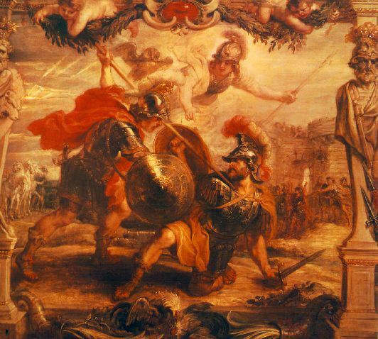
With Athena by him, Achilles killed Hector (Apollo left Hector to his fate).
Achilles killed Hector by aiming at an opening in the armor near the throat.
Athena was by Achilles’ side helping him.

Slide 24
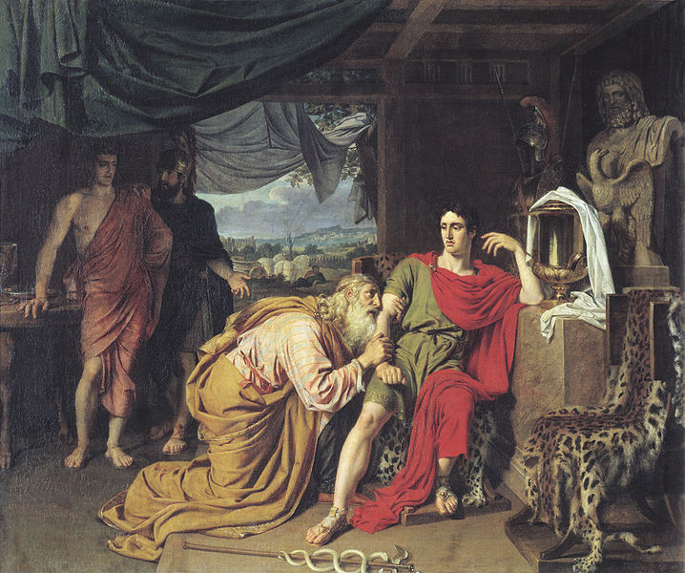
After Hector died, Achilles abused his dead body with indignation. This action displeased Olympians, especially Zeus.
Hector’s father, Priam, begged Achilles to returned the dead body.

Slide 25
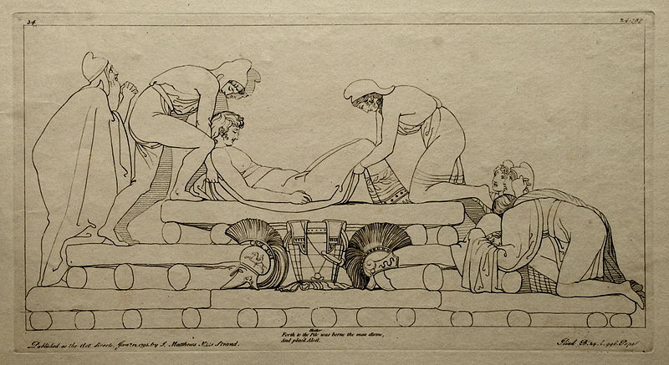
Achilles got moved by Priam’s grief and agreed to return Hector’s dead body. Also, Achilles promised no war during Hector’s funeral.
Hector’s funeral

Slide 26
For nine days the Trojans lamented for Hector. They fired the body and gathered the bones into a golden urn, shrouding them in soft purple.
This was the funeral of Hector, tamer of horses.
And with this the Iliad ends.

Slide 27
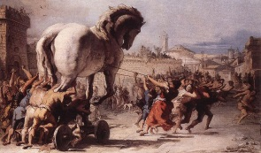
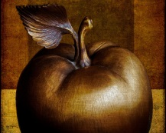

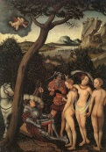
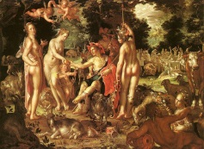

Work | License | Author/Source
 |  | Wikipedia Giovanni Domenico Tiepolo (1727–1804) http://commons.wikimedia.org/wiki/File:Giovanni_Domenico_Tiepolo_-_The_Procession_of_the_Trojan_Horse_in_Troy_-_WGA22382.jpg 2013/09/29 visited
 |  | Flickr sciondriver http://www.flickr.com/photos/minidriver/8550064356/ 2013/09/29 visited
 |  | deviantART WorldsEdge http://worldsedge.deviantart.com/art/The-Golden-Apple-338970621 2013/09/29 visited
 |  | Wikipedia Lucas Cranach the Elder (1472–1553) http://en.wikipedia.org/wiki/File:Lucas_cranach_judgement_of_paris.jpg 2013/09/29 visited
 |  | Wikipedia Joachim Wtewael (1566–1638) http://en.wikipedia.org/wiki/File:Joachim_Wtewael_-_The_Judgment_of_Paris_-_WGA25907.jpg/2013/09/29 visited
 |  | Wikipedia Ross Burgess http://commons.wikimedia.org/wiki/File:Trojan_horse_%C3%87anakkale.jpg 2013/09/29 visited

Slide 28


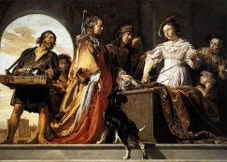



Work | License | Author/Source
 |  | Wikipedia Menelaus Painter (name vase) http://en.wikipedia.org/wiki/File:Helen_Menelaus_Louvre_G424.jpg 2013/09/29 visited
 |  | Wikipedia Jacques-Louis David (1748–1825) http://commons.wikimedia.org/wiki/File:Jacques-Louis_David_-_The_Loves_of_Paris_and_Helen_-_WGA6057.jpg/2013/09/29 visited
 |  | Wikipedia Jan de Bray (1627–1697) http://en.wikipedia.org/wiki/File:Bray_Achilles_discovered_by_Ulysses.jpg 2013/09/29 visited
 |  | Wikipedia Felice Torelli (1667–1748) http://commons.wikimedia.org/wiki/File:Felice_Torelli_-_The_Sacrifice_of_Iphigenia_-_WGA23010.jpg/2013/09/29 visited
 |  | Wikipedia Painter of Athens 1714 http://en.wikipedia.org/wiki/File:Chryses_Agamemnon_Louvre_K1.jpg 2013/09/29 visited
 |  | Wikispaces Luca Ferrari http://trojanwarsummary.wikispaces.com/ 2013/09/29 visited

Slide 29

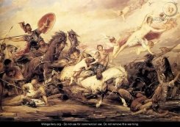




Work | License | Author/Source
 |  | Wikipedia Dr. Yasas Bandara http://en.wikipedia.org/wiki/File:Diomedes_attacking_Aeneas.jpg 2013/09/29 visited
 |  | wikigallery.org Arthur Heinrich Wilhelm Fitger http://www.wikigallery.org/wiki/painting_90978/Arthur-Heinrich-Wilhelm-Fitger/page-1/2013/09/29 visited
 |  | Wikipedia Pierre Coude François Delorme (1783-1859) http://commons.wikimedia.org/wiki/File:Hector1-4225.jpg 2013/09/29 visited
 |  | Wikipedia Annibale Carracci (1560–1609) http://commons.wikimedia.org/wiki/File:Jupiter_et_Junon_2_by_Annibale_Carracci.jpg/2013/09/29 visited
 |  | Wikipedia Nikolai Ge (1831–1894) http://en.wikipedia.org/wiki/File:Nikolay_Ge_002.jpeg 2013/09/29 visited
 |  | Wikipedia Giulio Romano (1499–1546) http://commons.wikimedia.org/wiki/File:Thetis_Giving_Achilles_His_Arms.jpg 2013/09/29 visited

Slide 30


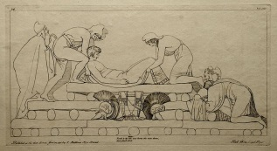
Work | License | Author/Source
 |  | Wikipedia: Author Unknown http://en.wikipedia.org/wiki/File:Slays_Hector.jpg 2013/09/29 visited
 |  | Wikipedia Alexander Andreyevich Ivanov (1806–1858) http://commons.wikimedia.org/wiki/File:Alexandr_Ivanov_005.jpg 2013/09/29 visited
 |  | Wikipedia H.-P.Haack http://commons.wikimedia.org/wiki/File:(34)_Flaxman_Ilias_1793,_gestochen_1795,_184_x_346_mm.jpg/2013/09/29 visited

