Slide 1
Ch11
The Fall of Troy
Greek and Roman Mythology
授課老師：簡士捷 副教授
Chien, Shih-Chieh Associate Professor
National Taipei University of Business
Unless noted, the course materials are licensed under Creative Commons Attribution-NonCommercial-ShareAlike 3.0 Taiwan (CC BY-NC-SA 3.0)

Slide 2
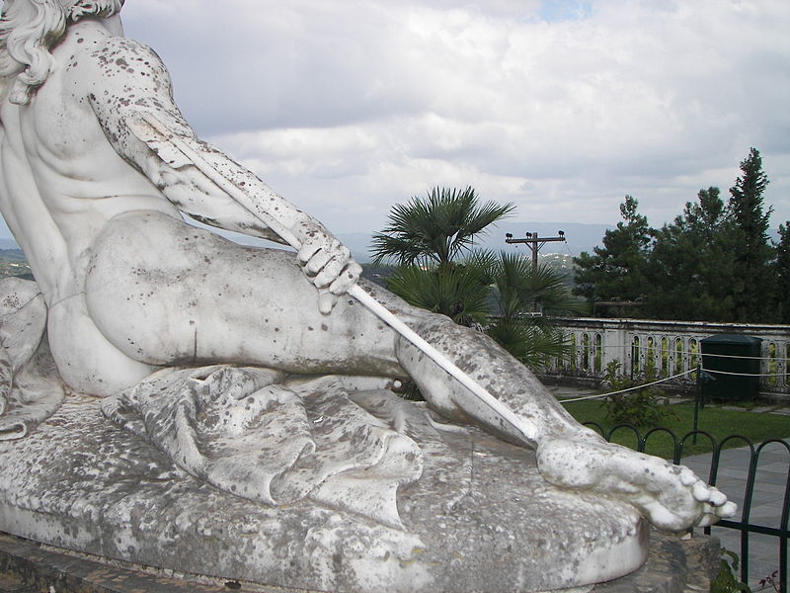
With Hector’s death, Achilles knew that his own death was near, too.
Apollo guided Paris to shoot Achilles at his heel (the only part on Achilles that bears no power of Styx).
Achilles fell and died.
Wikipedia Dr.K.

Slide 3
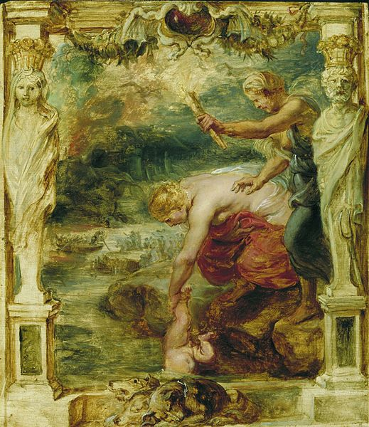
Thetis dipping Achilles in the waters of the river Styx

Slide 4
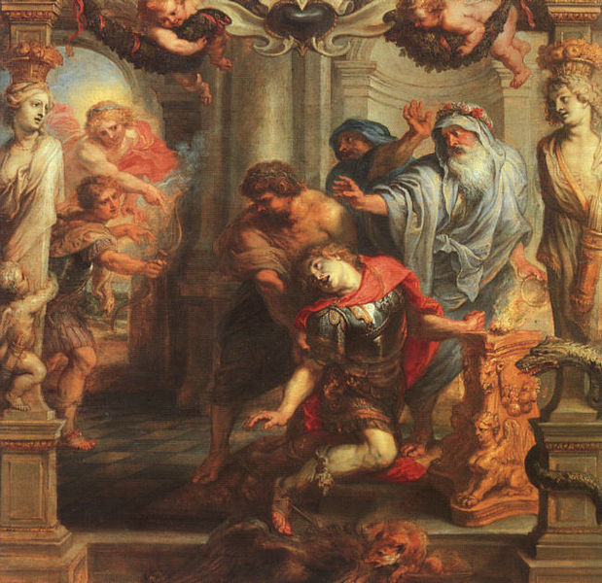
Death of Achilles

Slide 5
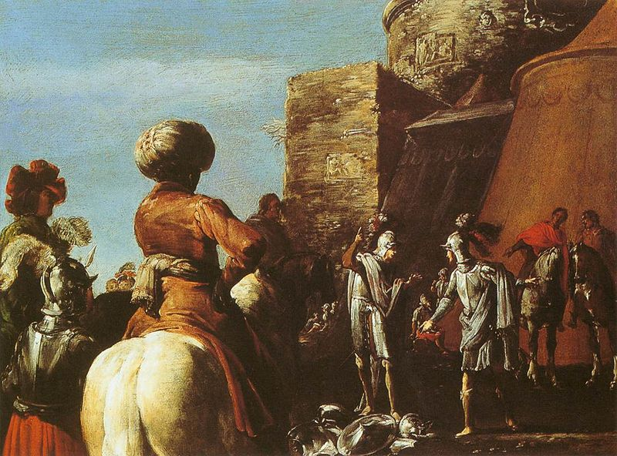
When it was decided that Odysseus could get Achilles’ arms, Ajax got furious and determined to kill Agamemnon and Menelaus. However, Athena struck him with madness.
The Quarrel between Ajax and Odysseus

Slide 6
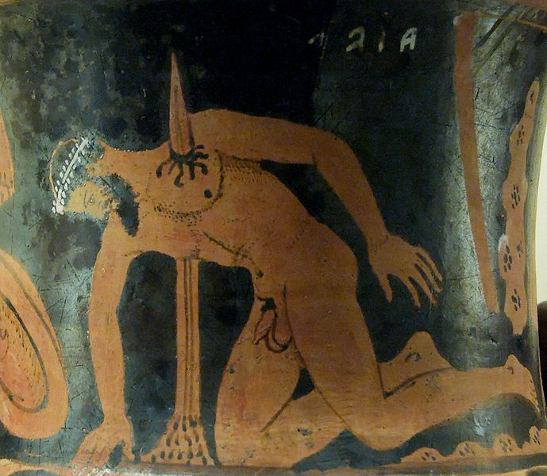
Being struck with madness, Ajax thought the flocks and herds were the Army and the huge ram was Odysseus. He slaughtered the animals and beat the ram savagely. When his finally sobered up, Ajax felt ashamed and committed suicide.
Ajax’s suicide

Slide 7
The death of Achilles and Ajax dismayed the Greeks. It was rumored that Troy would not fall until someone fought against the Trojans with the bow and arrows of Hercules.
Therefore, the Greeks went to find Philoctetes (with whom Hercules’ bow and arrows were given) and brought him back to the war.
Returning to the war, Philoctetes shot Paris dead.

Slide 8
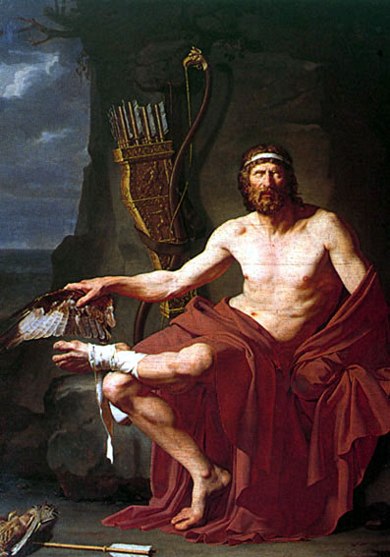
Philoctetes with Hercules’ bow and arrows
(He was bitten by a serpent on his way to Troy)

Slide 9
Paris' first wife - the nymph Oenone - refused to help Paris whom were fatally wounded by the Greek warrior Philoctetes during the siege of Troy.

Slide 10
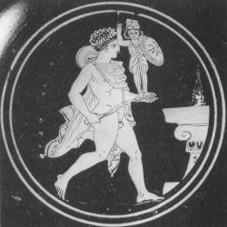
The Greeks also heard that a Pallas Athena image, Palladium, would preserve Troy from falling. Thereby, Diomedes stole the image away. The Greek Army got inspired and encouraged.
Diomedes with the Palladion

Slide 11
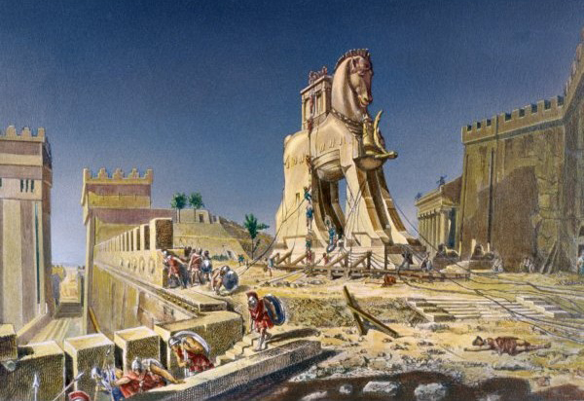
In the end, Odysseus came up with a good idea to send the Greek Army into the city.
He had a skillful wood worker make a huge wooden horse, hiding warriors in it.

Slide 12
He ordered to create a scene to make Trojans believe that the Greek Army had sailed home because Athena got angry with their stealing of Palladium.
The wooden horse was made for Athena. To avoid Trojans from taking it into the city, they created it huge. It was said that if the horse got destroyed then Athena would get angry.
Conversely, people would get Athena’s bless if the horse was dragged into the city and worshipped.

Slide 13
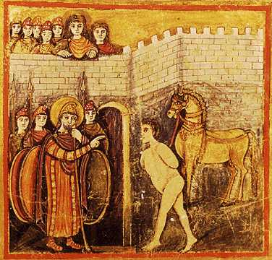
Odysseus appointed Sinon to stay persuading the Trojans to accept the horse.

Slide 14
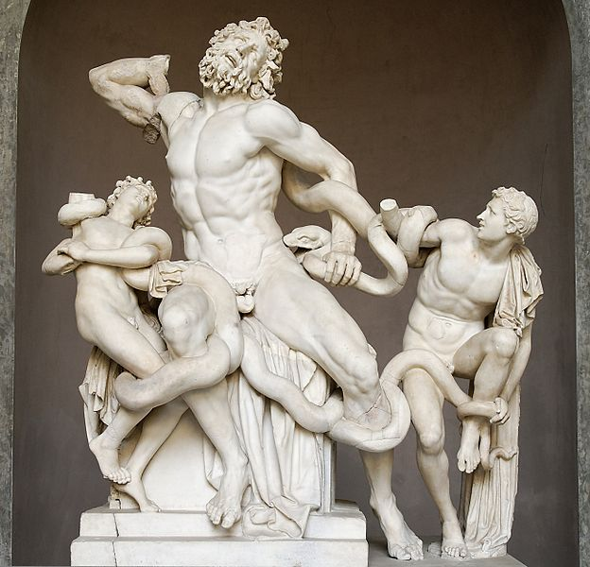
The priest, Laocoon, and his two son disbelieved Sinon’s story. Poseidon therefore sent two serpents from the sea wrapped them to death.
Laocoön and His Sons

Slide 15
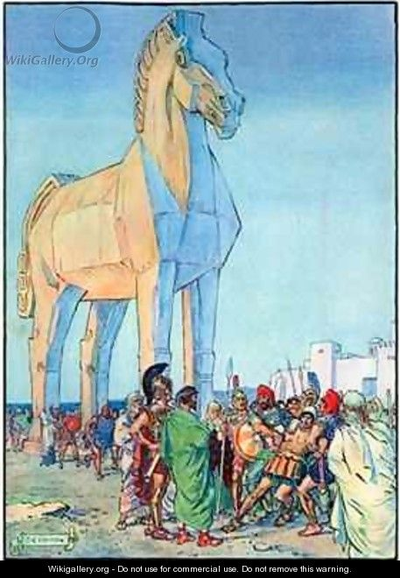
There could be no further hesitation among Trojans. They thought Laoccon was punished for opposing the entry of the horse.
The horse entered the city.

Slide 16
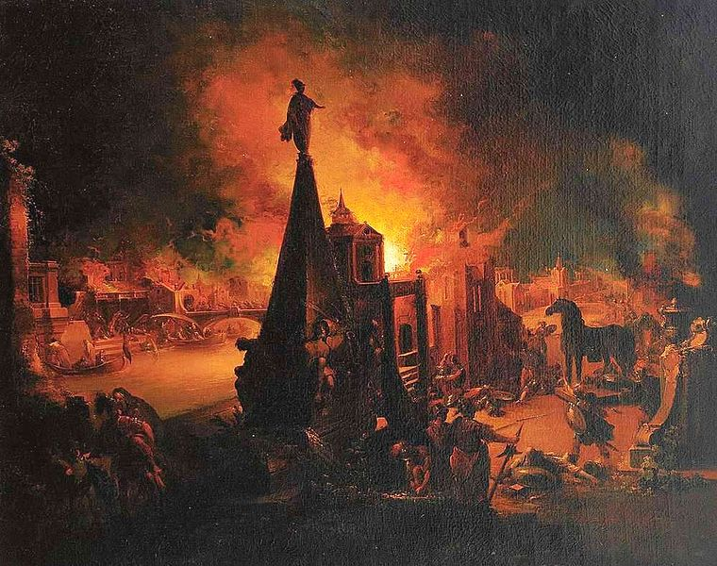
At night, the door in the horse opened. The Greek Army slaughtered in Troy.
Troy fell and burned.

Slide 17
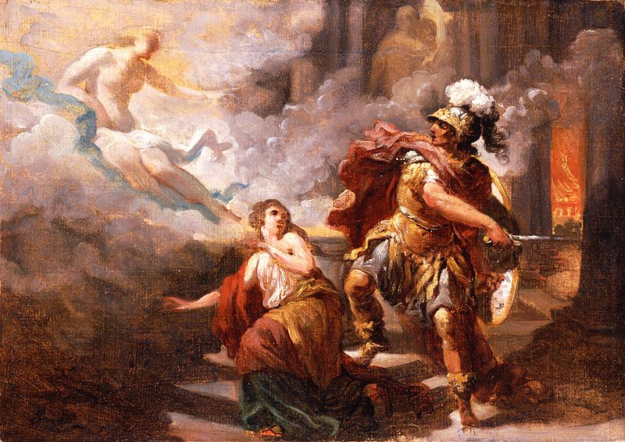
Aphrodite’s son, Aeneas, escaped.
Aphrodite saved Helen from Aeneas’ killing and returned her to Menelaus. (She was the only god appeared to help Trojans that day)
Venus Saves Helen from Aeneas

Slide 18
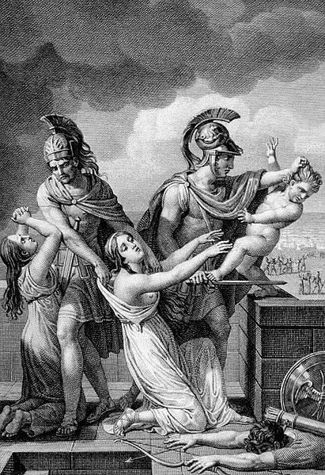
The Trojan War ended in the death of Hector’s son.
Astyanax (Hector's son) thrown off wall of Troy

Slide 19
Q&A
Among the heroes joined in the Trojan War, who do you admire the most? Please share your opinions with us.
Do you think Helen was to be blamed for Trojan War? Why?
What do you learn from the story of Trojan War?

Slide 20
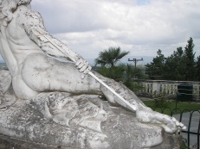
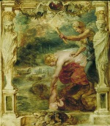
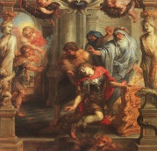



Work | License | Author/Source
 |  | Wikipedia Dr.K. http://en.wikipedia.org/wiki/File:Detail_of_Achilles_thniskon.JPG 2013/10/04 visited
 |  | Wikipedia Peter Paul Rubens (1577–1640) http://en.wikipedia.org/wiki/File:Peter_Paul_Rubens_181.jpg 2013/10/04 visited
 |  | Wikipedia Peter Paul Rubens (1577–1640) http://commons.wikimedia.org/wiki/File:Death_of_Achilles_-_Peter_paul_Rubens.jpg/2013/10/04 visited
 |  | Wikipedia Leonaert Bramer (1596–1674) http://commons.wikimedia.org/wiki/File:Leonaert_Bramer_-_The_Quarrel_between_Ajax_and_Odysseus_-_WGA03085.jpg 2013/10/04 visited
 |  | Wikipedia Jastrow (2006) http://en.wikipedia.org/wiki/File:Ajax_suicide_BM_F480.jpg 2013/10/04 visited
 |  | Wikipedia Jean Germain Drouais (1763–1788) http://commons.wikimedia.org/wiki/File:Philoctetes.jpg 2013/10/04 visited

Slide 21


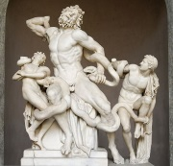


Work | License | Author/Source
 |  | Wikipedia Dr. Yasas Bandara http://en.wikipedia.org/wiki/File:Diomedes_with_the_Palladium_approaches_an_altar.jpg/2013/10/04 visited
 |  | Wikipedia Henri Motte. http://commons.wikimedia.org/wiki/File:Beware_of_Greeks_bearing_gifts.jpg 2013/10/04 visited
 |  | Wikipedia: Author Unknown http://en.wikipedia.org/wiki/File:RomanVirgilFolio101r.jpg 2013/10/04 visited
 |  | Wikipedia Artist : Hagesandros, Athenedoros, and Polydoros Photographer Marie-Lan Nguyen (2009) http://en.wikipedia.org/wiki/File:Laocoon_Pio-Clementino_Inv1059-1064-1067.jpg/2013/10/04 visited
 |  | Wikigallery.org Charles Edmund Brock http://www.wikigallery.org/wiki/painting_287907/Charles-Edmund-Brock/page-1 2013/10/04 visited
 |  | Wikipedia Johann Georg Trautmann (1713–1769 http://commons.wikimedia.org/wiki/File:J_G_Trautmann_Das_brennende_Troja.jpg/2013/10/04 visited

Slide 22
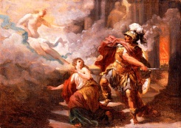
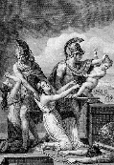
Work | License | Author/Source
 |  | Wikipedia Jacques Sablet (Switzerland, Morges, 1749-1803) http://commons.wikimedia.org/wiki/File:Helen_Saved_by_Venus_from_the_Wrath_of_Aeneas_LACMA_M.2000.179.27.jpg/2013/10/04 visited
 |  | Wikipedia: Author Unknown http://en.wikipedia.org/wiki/File:Astianax.jpg 2013/10/04 visited

