Slide 1
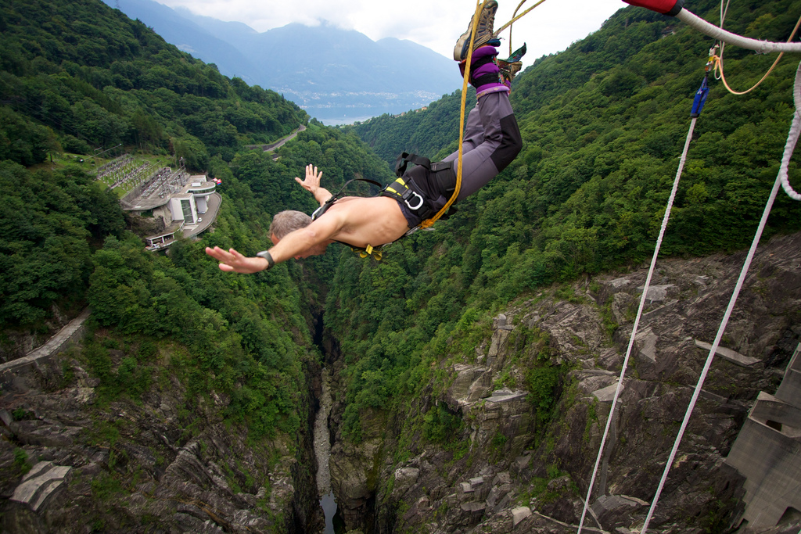
Ch7
Four Great Adventures
Greek and Roman Mythology
授課老師：簡士捷 副教授
Chien, Shih-Chieh Associate Professor
National Taipei University of Business
Flickr Nicolas●B
Unless noted, the course materials are licensed under Creative Commons Attribution-NonCommercial-ShareAlike 3.0 Taiwan (CC BY-NC-SA 3.0)

Slide 2
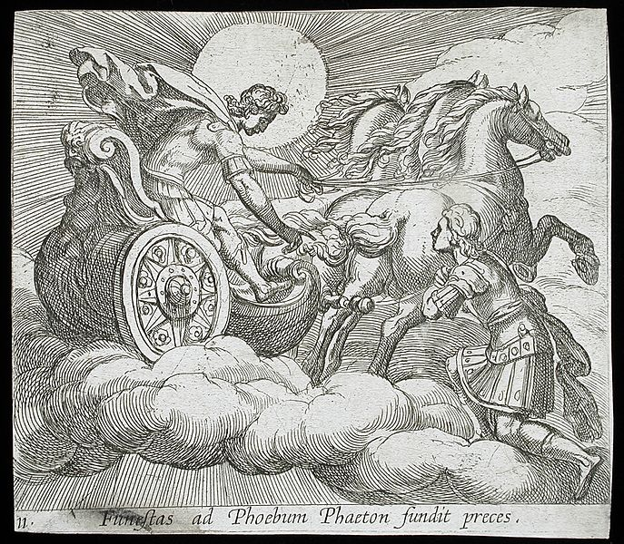
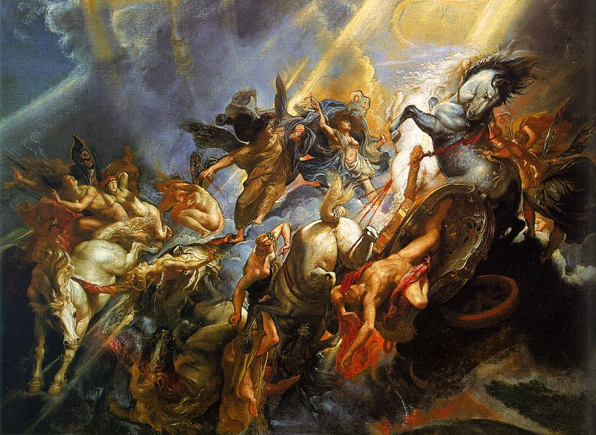
Phaëton
The Sun God Helios’s mortal son.
He insisted in driving the Sun’s chariot.
However, he couldn’t control the horses, causing the chariot to burn the mountains, shrink rivers, and turn springs into stream.

Slide 3
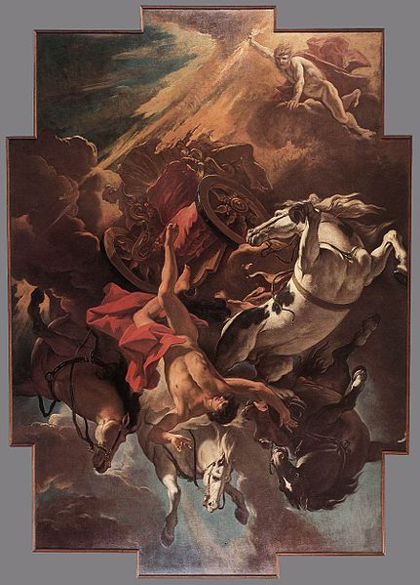
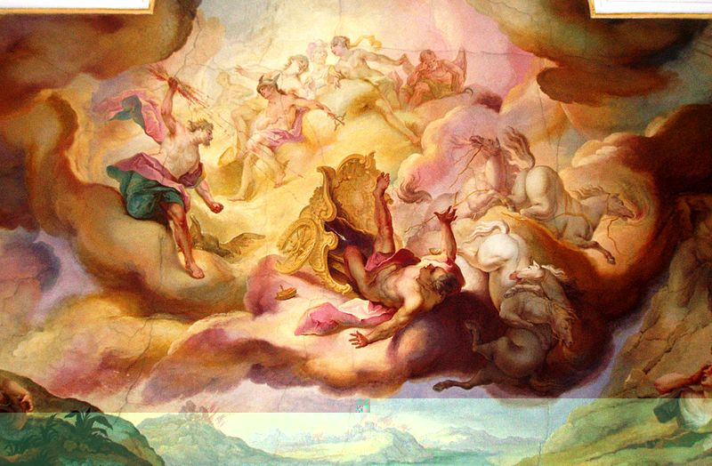
The Fall of Phaëton
Having no other choices, Jove seized his thunderbolt and struck Phaëton dead.

Slide 4
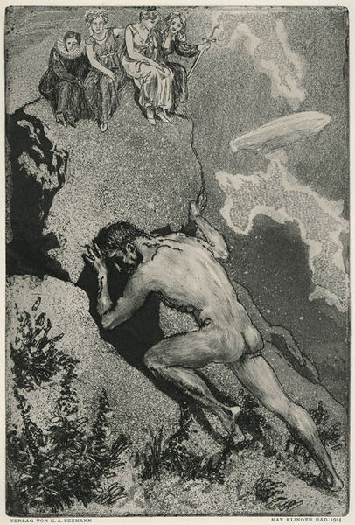
Pegasus and Bellerophon
Sisyphus was punished to forever try to roll a stone uphill because he once betrayed a secret of Zeus.
Glaucus was the son of Sisyphus. He made gods furious because he fed his horses human flesh.
Bellerophon was said to be Glaucus’ son.
Sisyphus rolling the stone

Slide 5
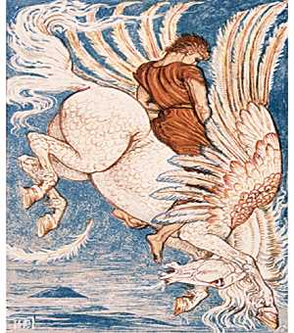
With Athena’s assistance (golden bridle), Bellerophon got to tame Pegasus, a marvelous horse which had sprung from Gorgon’s blood when Perseus killed her.

Slide 6
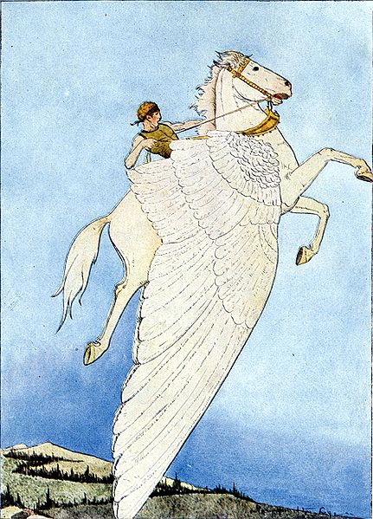
With Pegasus, Bellerophon accomplished many tasks King Proetus gave him.
Finally, Proetus was impressed by Bellerophon’s courage and good fortune, marrying his daughter to Bellerophon. (P. 142)

Slide 7
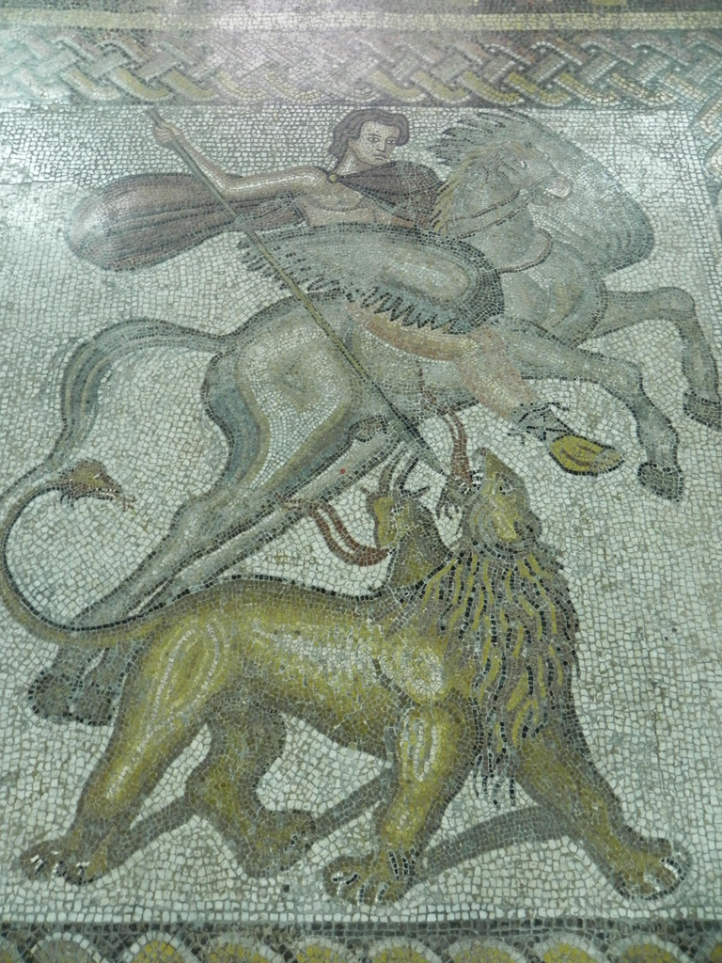
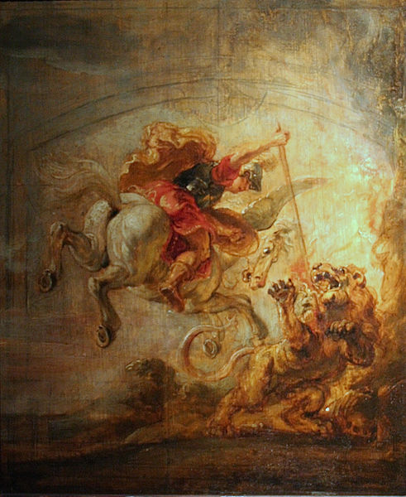
Bellerophon on Pegasus killing the Chimaera
Flickr mmarftrejo

Slide 8
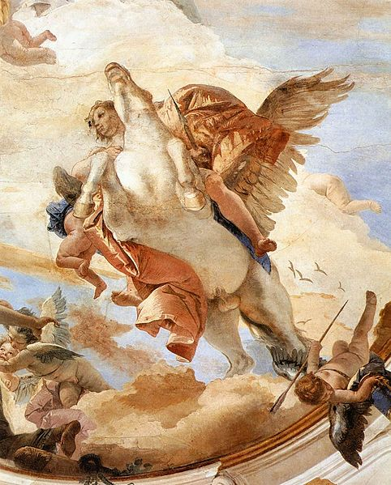
Bellerophon’s eager ambition and his great success led him to think “thoughts too great for man.” He tried to ride Pegasus up to Olympus, believing he could get a place there with the immortals. (P.142)

Slide 9
Pegasus refused to take Bellerophon. He was hated by all gods and was banished to wander alone until his death.
It was Zeus that provided Pegasus shelter in the heavenly stalls of Olympus and took care of it.

Slide 10
Otus and Ephialtes
These twin brothers were giants, sons of Poseidon.
They wanted to prove themselves the gods’ superiors.
Once they even imprisoned Ares.
Zeus got ready to kill the twins but Poseidon came to beg for their lives.

Slide 11
Otus and Ephialtes, Ares in chains
Ephialtes was in love with Artemis. The twin brothers thought it interesting to capture Artemis.
However, they mistakenly killed each other under Artemis’s trick.

Slide 12
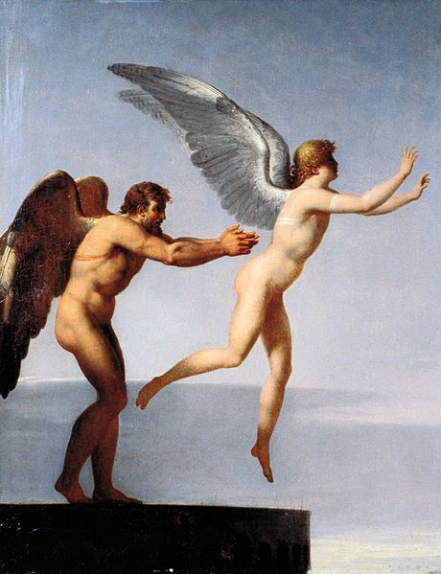
Daedalus
Daedalus was the architect who had contrived the Labyrinth for the Minotaur in Crete.
King Minos wanted to kill him. Daedalus, therefore, built wings for his son (Icarus) and himself.

Slide 13
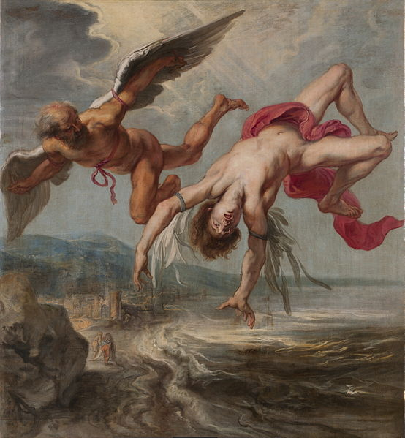
However, Icarus flew too high, and too close to the sun that his wings melted. While Daedalus flew safely to Sicily, Icarus fell and died in the sea.
Daedalus was kindly received by the King. Minos came to Sicily to seize Daedalus but was slain in the contest.

Slide 14
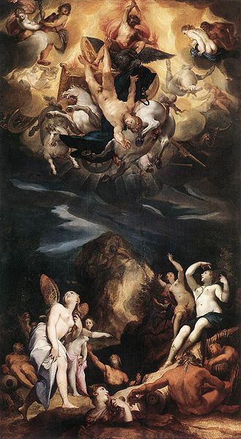
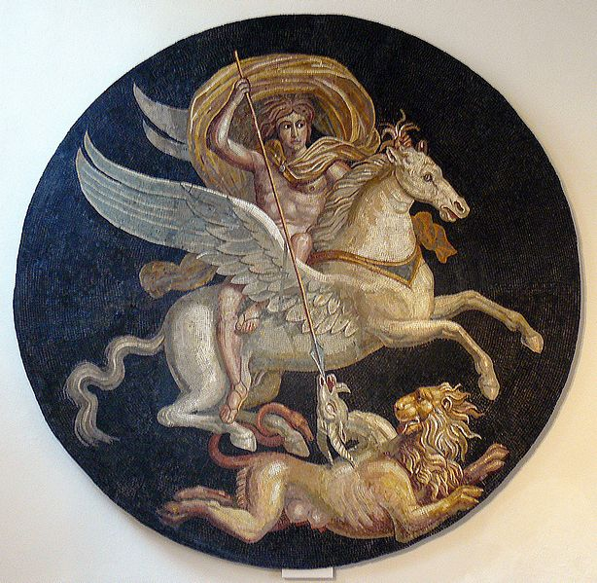
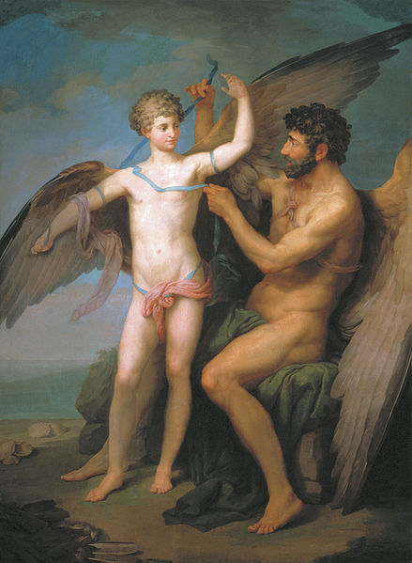
Q & A
Please identify each image with its corresponding story.
A.
B.
C.

Slide 15
How to define an adventure? What are the features of an adventure? How are the adventures in Western literature different from those in the Eastern literature? Please provide examples.

Slide 16

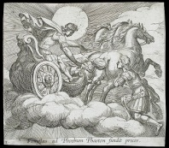

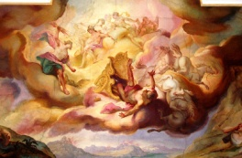
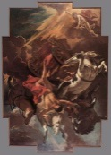

Work | License | Author/Source
 |  | Flickr Nicolas●B http://www.flickr.com/photos/nicolas-baltenneck/4914580852/ 2013/09/22 visited
 |  | Wikipedia Wilhelm Janson (Holland, Amsterdam), Antonio Tempesta (Italy, Florence, 1555-1630) http://commons.wikimedia.org/wiki/File:Phaeton_Before_Apollo_LACMA_65.37.95.jpg/2013/09/22 visited
 |  | Wikipedia Peter Paul Rubens (1577–1640) http://commons.wikimedia.org/wiki/File:Rubens_Fall_of_Phaeton.jpg 2013/09/22 visited
 |  | Wikipedia Rensi http://commons.wikimedia.org/wiki/File:Sturz_des_Phaeton,_Deckengem%C3%A4lde_von_Johann_Michael_Franz_in_Eichst%C3%A4tt.jpg/2013/09/22 visited
 |  | Wikipedia Sebastiano Ricci (1659–1734) http://commons.wikimedia.org/wiki/File:Sebastiano_Ricci_-_Fall_of_Phaeton_-_WGA19423.jpg/2013/09/22 visited
 |  | Wikipedia Caravaggio (1573–1610) http://commons.wikimedia.org/wiki/File:Sisifus_the_faculties.jpg 2013/09/22 visited

Slide 17


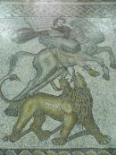

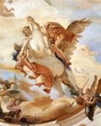
Work | License | Author/Source
 |  | Wikipedia Walter Crane (1845–1915) http://commons.wikimedia.org/wiki/File:Pegasus_Walter_Crane.jpg 2013/09/22 visited
 |  | Wikipedia: Author Unknown http://commons.wikimedia.org/wiki/File:Bellerofon_och_Pegasus,_Nordisk_familjebok.png/2013/09/22 visited
 |  | Wikipedia Mary Hamilton Frye http://en.wikipedia.org/wiki/File:The-Winged-Horse.jpg 2013/09/22 visited
 |  | Flickr mmarftrejo http://www.flickr.com/photos/mmarftrejo/5463884017/ 2013/09/22 visited
 |  | Wikipedia Peter Paul Rubens (1577–1640) http://commons.wikimedia.org/wiki/File:Peter_Paul_Rubens_-_Bell%C3%A9rophon,_mont%C3%A9_sur_P%C3%A9gase_transperce_la_Chim%C3%A8re.JPG/2013/09/22 visited
 |  | Wikipedia Giovanni Battista Tiepolo (1696–1770) http://commons.wikimedia.org/wiki/File:Giovanni_Battista_Tiepolo_-_Bellerophon_on_Pegasus_(detail)_-_WGA22316.jpg/2013/09/22 visited

Slide 18

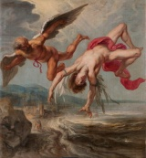



Work | License | Author/Source
 |  | Wikipedia Charles Paul Landon (1760 – 1826) http://commons.wikimedia.org/wiki/File:Landon-IcarusandDaedalus.jpg 2013/09/22 visited
 |  | Wikipedia Jacob Peter Gowy http://commons.wikimedia.org/wiki/File:Gowy-icaro-prado.jpg 2013/09/22 visited
 |  | Wikipedia Joseph Heintz the Elder (1564–1609) http://commons.wikimedia.org/wiki/File:Heintz-The_Fall_of_Phaeton.jpg 2013/09/22 visited
 |  | Wikipedia Pyotr Ivanovich Sokolov (1753—1791) http://commons.wikimedia.org/wiki/File:D%C3%A9dalo_e_%C3%8Dcaro_-_Pyotr_Ivanovich_Sokolov.jpg/2013/09/22 visited
 |  | Wikipedia Félix Potuit http://commons.wikimedia.org/wiki/File:Bell%C3%A9rophon_Autun.jpg 2013/09/22 visited

