Slide 1

Web Development Workshop
Notes:
Project HeartCode is the SMU CSP event which I will be conducting web development workshop for

Slide 2
Content
CSS
JavaScript Plugins

Slide 3
CSS
Cascading Style Sheets

Slide 4
What is CSS?
Language for specifying how documents are presented
Bring colour and design to the web page you created

Slide 5
How does CSS affect HTML?
Web browsers apply CSS rules to the HTML
CSS rules formed from
1. set of properties and values
update how the content is display
2. Selector
select the elements to apply

Slide 6
CSS Syntax
Selector
{
Property
:
Value
;
}

Slide 7
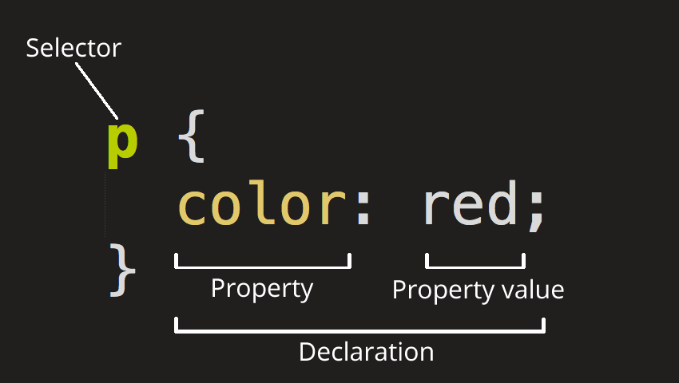
CSS Syntax

Slide 8
CSS Selector
ELEMENT Selector
CLASS Selector
ID Selector
Determine by HTML tag name
h1 , h2 , p , a , table , img
Determine by dot (.) symbol in CSS file
.blueText { color : blue } | class = “blueText”
Determine by hash (#) symbol in CSS file
#redText { color : red } | id= “redText”
Mix Style : h1 # redText

Slide 9
Different type of CSS Style & their Priority
Inline Element
In Head Section of HTML
External CSS File
<h1 style = “ color : red “> HELLO </h1>
<style>
h1 { color : red; }
</style>
<link rel=“stylesheet” href=“style.css” />

Slide 10
Ordering of CSS Style
Within style sheet, won’t affect
Order of including the style sheet matters
HTML will be read from top-down approach. **
Latest CSS include will overwrite previous style if conflicting
Notes:
HTML is been process in a top-down approach. When it read the link tag, it will read in a top down and apply the style as it process the style sheet. Hence if two different style sheet make changing the style of the same element. The last link tag, will rewrite the previous style sheet. You could see HTML process thing step by step, hence the latest step applied will be shown to the end-user.
Order of rules within the style sheet won’t affect, as the HTML is the determine factor of which rule will be applied first.

Slide 11
HTML Element used with styling
<div> … </div>
Division or Section
Group block elements together
<span> … </span>
inline container for phrasing content

Slide 12
Create External Styles Sheet
Create a new file
Name it style.css
Extension end with .css

Slide 13
Applying Styles Sheet to HTML
link between html with external resource
<link rel="stylesheet" href=“assets/css/style.css">

Slide 14
Colors
background-color: cyan;
color: #000; (font color only)
Color value specific by :
color name
HEX value
RGB / RGBA value
Notes:
RGBA – Red Green Blue Alpha.
Alpha refers to the gradient of the color
More details of the color can be read from : https://developer.mozilla.org/en-US/docs/Web/CSS/color_value

Slide 15
Opacity
specifies the opacity/transparency of an element
property can take a value from 0.0 - 1.0
The lower value, the more transparent
Example :
opacity : 0.5;
Notes:
RGBA – Red Green Blue Alpha.
Alpha refers to the gradient of the color
More details of the color can be read from : https://developer.mozilla.org/en-US/docs/Web/CSS/color_value

Slide 16
Layouts
Margin
Padding
Position
Text-align

Slide 17
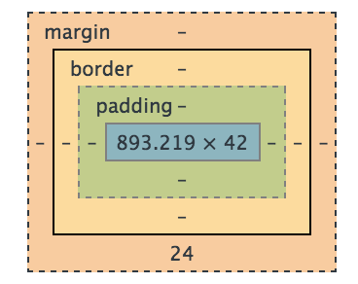
CSS Box Model
Content – The content of the box, where text and images appears
Padding – Clears an area around the content. The padding is affected by the background and color of the box
Border – A border that goes around the padding and content. The border is affected by the background color of the box.
Margin – The empty area around the border. The margin is completely transparent, no background color

Slide 18
Layout: Margin & Padding
Margin : space outside
Padding : space inside
Values declared using in px, % , or auto
Value are declared for all 4 sides
Notes:
Other ways to declare the value :
margin : 10px;
margin : 10px; 5px; (top&bottom, right&left)
margin : 10px; 20px; 5px; (top,righ&left,bottom)
margin : 10px 5px; 15px; 20px; (clockwise from the top)

Slide 19
Layout: Position
Absolute
Starts from the left hand corner of the page
Relative
Starts from where the element currently is
Top & left properties are used to move the position

Slide 20
Layout: text-align
text-align : center | left | right | justify
Same as the alignment in MS Word

Slide 21
Sizing and Border
Content size
height | width : % | px | auto
Content border
border : size style color
Example: border : 2px dashed yellow;
border-radius
Example: border-radius : 20px;
Notes:
Border is applied to all 4 sides.
If want to customise each side, could use the following :
border-top
border-left
border-right
border-bottom
Border-radius is for the rounded corners of the boxes.
Ways to declare border radius :
/* 1st value is top left and bottom right corners,
2nd value is top right and bottom left */
border-radius: 20px 10px;
/* 1st value is top left corner, 2nd value is top right
and bottom left, 3rd value is bottom right */
border-radius: 20px 10px 50px;
/* top left, top right, bottom right, bottom left */
border-radius: 20px 10px 50px 0;

Slide 22
Font
Font-family : specific the font family to use in order from left to right
Font-size : side of the font
Font-style : normal | italic | oblique
Font-weight : thickness of the font. (bold)
Notes:
Example of value :
Font-family : "Trebuchet MS", Helvetica, sans-serif;
Font-size : % | px |medium|xx-small|x-small|small|large|x-large|xx-large|smaller|larger
Font-style : normal|italic|oblique
Font-weight : 100-900 or bold
Example of single line declaration :
Font: italic bold 20px Georgia, serif;
Font-family order is important, with the right being the most general font. When the 1st font on the left is not supported by the client browser, it will applied the next font on the right

Slide 23
Display
Block
Inline
none

Slide 24

Property for Anchor element
How to change the style?
Use text-decoration: none;

Slide 25
Exercise – CSS
Include the style sheet to the html pages
Modify style.css
Complete the style sheet

Slide 26
Text-Transform
text-transform : lowercase | uppercase | capitalizes;
/* lowercase
this will be transformed to lowercase. */
p {text-transform: lowercase; }
/* uppercase
THIS WILL BE TRANSFORMED TO UPPERCASE */
p {text-transform: uppercase; }
/* capitalizes
This Will Be Transformed To Capitalize All Words */
p {text-transform: capitalizes ; }

Slide 27
CSS Animate Effects
:hover
transition property
/* mouse over link */ /* selected link */
a:hover { color: green; } a:active { color: yellow; }
div {
transition: <property> <duration> <timing-function> <delay>;
}
div { transition: width 0.5s ease 1s; }
Notes:
Transition property normally goes along with ‘:hover ‘ or ‘:before and :after’
The transition provide the effect of how one style (rules) applied to another style (rules), in which it created the animation effect of it. This transition will be similar to powerpoint slides transition effects.

Slide 28
Transition Property
Property
Duration
Delay
Timing-function
specify the names of CSS properties to which a transition effect should be applied. [ all (default) , none, <specific CSS property name> ]
specifies the number of seconds or milliseconds a transition animation should take to complete [ 0ms , 0s (default) ]
specifies the amount of time to wait before the start of transition effect
Establish an acceleration curve, so the speed of the transition can vary over its duration. [ ease (default) , ease-in , ease-out , linear , ]

Slide 29
CSS Responsive
Makes your web page look good on all devices
Using @media rule
Apply the CSS style based on the condition of the rule
@media screen and (max-width: 760px) { }

Slide 30
Other External Library
Font awesome http://fontawesome.io/
animate.css https://daneden.github.io/animate.css/
wow.js http://mynameismatthieu.com/WOW/
Commonly used
Make use of the style and design created by others.
Includes in the class attributes of the HTML elements
Based on the documentation/ example given on their sites

Slide 31
JS
JavaScript

Slide 32

What is JavaScript?

Slide 33
What is JavaScript?
To program the behaviour of web pages.
Add interactivity and effects to websites.

Slide 34
How to Includes JS?
Similar to CSS
Internal JavaScript
External JavaScript
JavaScript are normally placed in the body segment
Normally Placed at the bottom of the pages
Order of JavaScript library matters as well
Notes:
Why does JS are placed in the body instead of the head segment?
1. To Speed up the loading time of the pages, when HTML DOM are loaded. It will load the head segment first before loading the body. The white blank pages we see when we visit any browser, that the loading time for the head resources.
Why does JS Script tend to be place at the bottom of the pages?
1. HTML is execute in a top-down order approach. That includes the js scripts.
2. If the script is place above the element (id=A) and calles the element(id=A) within the script then it will not work. Cause when it execte the script, it could not find the element (id=A).

Slide 35
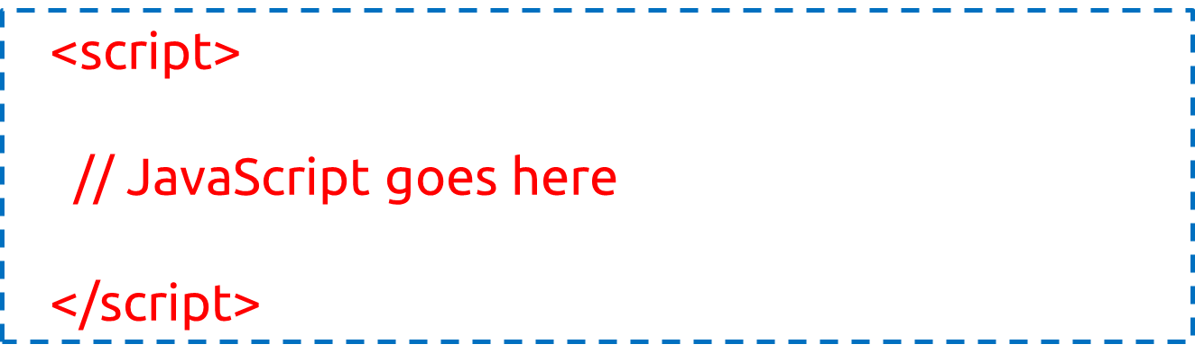
Internal JavaScript
Written within the HTML
Using <script> elements
Notes:
Do you wonder why we do not have type="text/javascript" inside the <script> tag? This is not required in HTML5. JavaScript is the default scripting language in HTML5 and in all modern browsers!

Slide 36

External JavaScript
Has “ .js “ filename extension. E.g. script.js
Using <script> tag to include the js file

Slide 37
PLUGINS
Animations Effect
Owl Carousel Slider

Slide 38
Animation Effects
Animated.css
CSS only Library
https://daneden.github.io/animate.css/
WOW.js
Add on of JavaScript to animated.css
http://mynameismatthieu.com/WOW/
Notes:
WOW.js is used in addition to animated.css to includes more effects. It provides effects when scrolling down.
Animated.css load and run the animation effect once the html pages is loaded. However, WOW.js run the animation effect when the screen is scroll to the item area.
WOW.js provide more setting to the animation as well, such as the duration and delay. With its advance setting

Slide 39
Animated.css
Include the following stylesheet (Animated.css) <link rel="stylesheet“ href="https://cdnjs.cloudflare.com/ajax/libs/animate.css/3.5.2/animate.min.css">
Add the class “animated” to the element
Add the class “infinite” for infinite loop
Add the class name of the effect to the same element
Full List of animation effect is found on their website
Example : <h1 class="animated infinite bounce">Example</h1>

Slide 40
WOW.js
Include Animated.css & WOW.js https://cdnjs.cloudflare.com/ajax/libs/wow/1.1.2/wow.min.js
Add the following script to activate WOW.js <script> new WOW().init(); </script>
Add the class “wow” to the element followed by animation effect name
Animation effect name is from Animated.css
Example <h1 class="wow bounceInUp"> Example </h1>
Notes:
Animated.css link is on previous slides

Slide 41
WOW.js Advanced Options
data-wow-duration: Change the animation duration
data-wow-delay: Delay before the animation starts
data-wow-offset: Distance to start the animation (related to the browser bottom)
data-wow-iteration: Number of times the animation is repeated
Add the following attributes to the HTML element.
Example:
<h1 class="wow slideInLeft" data-wow-duration="2s" data-wow-delay="5s"> Example </h1>

Slide 42
Smooth Scroll
Used on navigation to another link within the same page
Animation of scrolling the page to the new link
Default effect is jump there directly

Slide 43
Smooth Scroll
Save the JS from https://kryogenix.org/code/browser/smoothscroll/smoothscroll.js
Include smoothscroll.js to the HTML page
Using id and ‘#’ to navigate within same page
Example:
<a href=“#aboutUs”> Link to About Us </a>
<h1 id=“aboutUs”> Content of About Us </h1>
Notes:
Documentation and more usage of smooth scroll can be found at https://github.com/galambalazs/smoothscroll-for-websites/wiki

Slide 44
Owl Carousel Slider
https://owlcarousel2.github.io/OwlCarousel2/
Image Sliders Plugins
Notes:
https://owlcarousel2.github.io/OwlCarousel2/index.html

Slide 45
How to use Carousel Slider?
Search the following at cdnjs.com and add those link to HTML
JQuery
OwlCarousel2
Notes:
Jquery : <script src="https://cdnjs.cloudflare.com/ajax/libs/jquery/3.1.1/jquery.min.js"></script>
Carousel JS : <script src="https://cdnjs.cloudflare.com/ajax/libs/OwlCarousel2/2.2.1/owl.carousel.js"></script>
Carousel CSS : <link rel="stylesheet" href="https://cdnjs.cloudflare.com/ajax/libs/OwlCarousel2/2.2.1/assets/owl.carousel.min.css" />
<link rel="stylesheet" href="https://cdnjs.cloudflare.com/ajax/libs/OwlCarousel2/2.2.1/assets/owl.theme.default.min.css" />

Slide 46
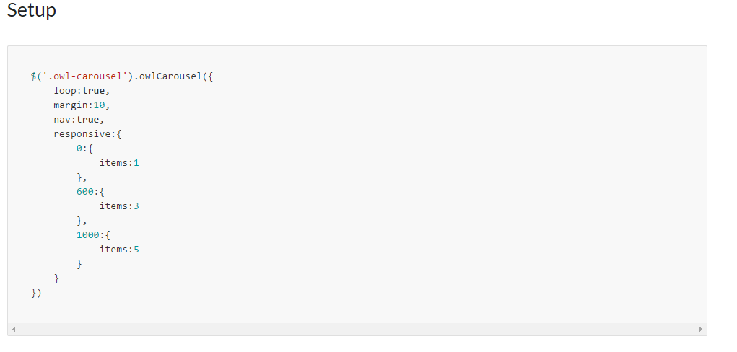
How to use Carousel Slider?
From owlcarousel2 website, Select Demos -> Basic
Copy the ‘Setup’ over to your own script tag at HTML
Notes:
The setup is to initialise the behaviour of the carousel, it is use to set the options for it. More options are added to this script. Hence, this script is needed for the carousel to function.
The data type for the object is object / dict, hence for every new property/option, it is separated by a comma
Example of including option for auto-play of the slider: <script>
$('.owl-carousel').owlCarousel({
loop:true, // this option specific whether the slides goes in a loop or stop at last item
margin:10,
nav:true, // this option set whether to display the next and previous button
responsive:{ // this will change the number of item to display
0:{ // if the width of the screen is more then 0px, it will display the number of item stated
items:1
},
600:{ // if the width of the screen is more then 600px, it will display the number of item stated
items:3
},
1000: { // if the width of the screen is more then 1000px, I twill display the number of item stated
Item:5
} // if you view it at full screen on laptop, it should display 5. if you resize your screen to half, it should display 3. and on mobile, it should display 1
},
autoplay:true, // this include new option for autoplay.
autoplayTimeout:3000, // additional setting to autoplay. Take note that each other is separated by a comma. The option name and value are separate by a :
autoplayHoverPause:false // this option set whether to pause the autoplay when you hover over the slider. More option can be found on their documentation, and is mentioned on next slides
})
</script>

Slide 47
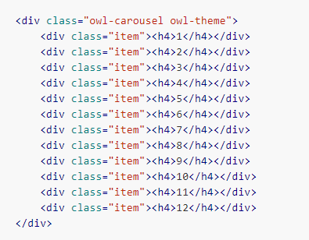
How to use Carousel Slider?
Copy the HTML Segment into your HTML document
Edit the content with the <div class=“item”>
For more options, go to Docs -> Options to include more setting to it
Notes:
Follow the template on the HTML segment. Change the content within the <div class=“item”> [Change this content ]</div> .
The content item within the div, is the display item. So if you want to do a simple slide, you could change the h4 tag to an image tag. And if you want to includes caption in the slider, add in other tag into the item. Such as h3 or p tag.
Example of Slider for Bootstrap thumbnail images:
<div class="owl-carousel owl-theme">
<div class="item">
<!-- content for slider are placed within the div -->
<!-- start of thumbnail.-->
<div class="thumbnail">
<img src="https://source.unsplash.com/random" class="img-responsive"/>
<div class="caption">
<h3>Photo 1</h3>
<p>Description of Photo 1</p>
</div>
</div>
<!-- end thumbnail -->
</div>
<div class="item">
<!-- start of thumbnail -->
<div class="thumbnail">
<img src="https://source.unsplash.com/random" class="img-responsive"/>
<div class="caption">
<h3>Photo 2</h3>
<p>Description of Photo 2</p>
</div>
</div>
<!-- end thumbnail -->
</div>
<div class="item">
<!-- start of thumbnail -->
<div class="thumbnail">
<img src="https://source.unsplash.com/random" class="img-responsive"/>
<div class="caption">
<h3>Photo 3</h3>
<p>Description of Photo 3</p>
</div>
</div>
<!-- end thumbnail -->
</div>
<div class="item">
<!-- start of thumbnail -->
<div class="thumbnail">
<img src="https://source.unsplash.com/random" class="img-responsive"/>
<div class="caption">
<h3>Photo 4</h3>
<p>Description of Photo 4</p>
</div>
</div>
<!-- end thumbnail -->
</div>
<div class="item">
<!-- start of thumbnail -->
<div class="thumbnail">
<img src="https://source.unsplash.com/random" class="img-responsive"/>
<div class="caption">
<h3>Photo 5</h3>
<p>Description of Photo 5</p>
</div>
</div>
<!-- end thumbnail -->
</div>
<div class="item">
<!-- start of thumbnail -->
<div class="thumbnail">
<img src="https://source.unsplash.com/random" class="img-responsive"/>
<div class="caption">
<h3>Photo 6</h3>
<p>Description of Photo 6</p>
</div>
</div>
<!-- end thumbnail -->
</div>
</div> <!-- end of row for content -->

Slide 48
Exercise – CSS
Modify the index.html to complete the animation effects

Slide 49

Thanks you!
Any Questions?
Can contact me directly if you have any (:

