Slide 1
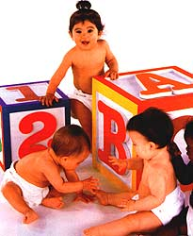
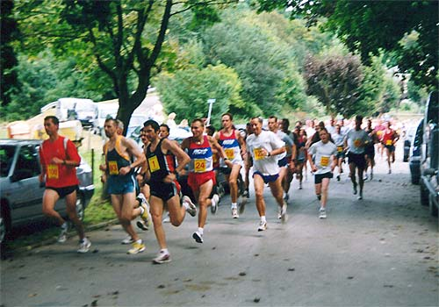
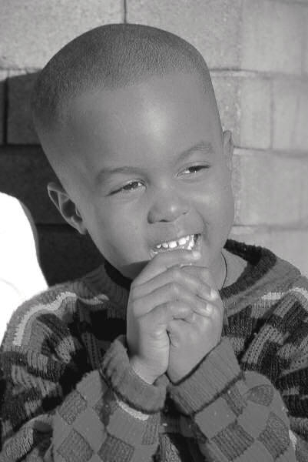




Psychology 1504
Positive Psychology

Slide 2
House keeping
Feedback or questions
In case of an emergency…
… we’ll take a PP-break
Powerpoints and videotape on website
Active note-taking
Overlap with 1508?

Slide 3
The Road to Positive Psychology
Humanistic Psychology (50’s)
The Third Force
Reaction to behaviorism
Reaction to psychoanalysis
Lacked rigorous methodology

Slide 4
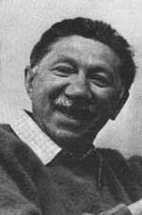
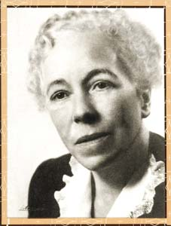
Meet the Grandparents
Abraham Maslow (1908-1970)
Karen Horney (1885-1952)

Slide 5
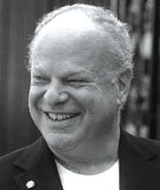

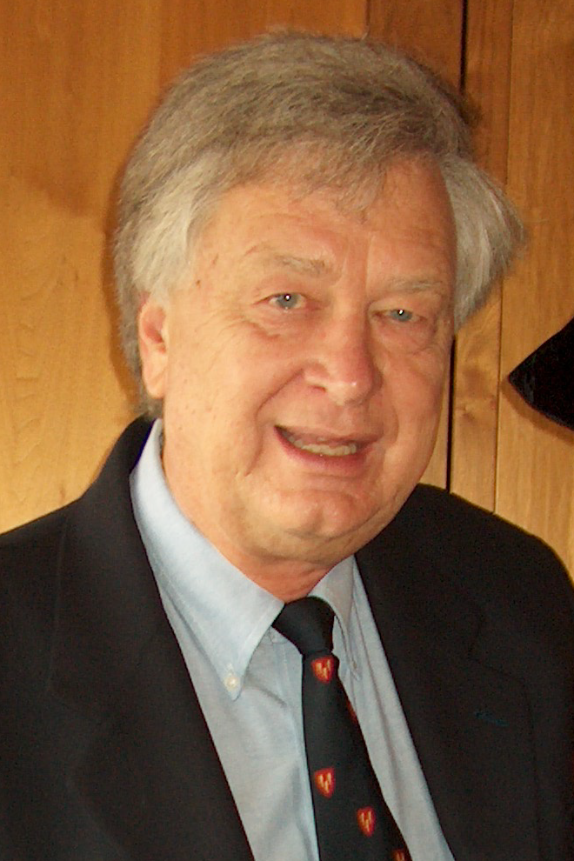
Meet the Parents
Martin Seligman
Ellen Langer
Philip Stone

Slide 6

Meet 1504

Slide 7
It is not merely about information
It is also about transformation
Covering less; uncovering more

Slide 8
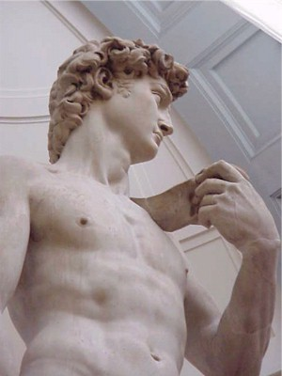
“The soul grows by subtraction, not addition.”
Thoreau
“In pursuit of knowledge, every day something is acquired; in pursuit of wisdom, every day something is dropped.”
Lao Tzu

Slide 9
Information is not enough
“What is wrong is not the great discoveries of science—information is always better than ignorance, no matter what information or what ignorance. What is wrong is the belief behind the information, the belief that information will change the world. It won’t.” Archibald MaCleish

Slide 10
Information is not enough
“Humanistic philosophy [offers] a new conception of learning, of teaching, and of education. Stated simply, such a concept holds that the function of education, the goal of education—the human goal, the humanistic goal, the goal so far as human beings are concerned—is ultimately the ‘self-actualization’ of a person, the becoming fully human, the development of the fullest height that the human species can stand up to or that the particular individual can come to. In a less technical way, it is helping the person to become the best that he is able to become.” Abraham Maslow

Slide 11
It is not about providing definitive answers concerning the good life
It is about identifying the right questions
Education is the quest for information and transformation, and therefore must begin with a question.
“Children enter school as question marks and leave as periods.” Neil Postman

Slide 12


Slide 13

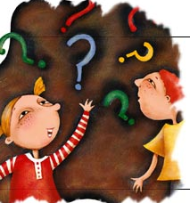
“The one real object of education is to leave a man in the condition of continually asking questions.” Bishop Creighton

Slide 14
The Question of Questions
How can we help ourselves and others—individuals, communities, and society—become happier?

Slide 15
It is not a survey of positive psychology
It is a selective exploration of the ‘question of questions.’
Cross cultural psychology
Eclectic
Studying others and ourselves

Slide 16
It is not English 10a or Math 55
It is about rigorous fun
“I would not give a fig for the simplicity on this side of complexity, but I would give my life for the simplicity on the other side of complexity.” Oliver Wendell Holmes
A different kind of effort
Change is hard
Rigorous fun???

Slide 17
Final Project
20-30 minute Presentation
Any topic within positive psychology
Written text (10-15 pages double spaced)
Slides (word or powerpoints)
Include:
Reference to research
Optional: stories, film clips, exercises, etc
Why a presentation?
Teaching as learning
Spread goodness…

Slide 19

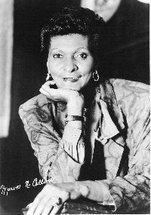

Why Positive Psychology?

Slide 20
Psychological Abstracts (1967-2000)
Anger: 5,584
Anxiety: 41,416
Depression: 54,040
Joy: 415
Happiness: 1,710
Life satisfaction: 2,582
Ratio: 21/1

Slide 21
Focusing on the Negative
“The science of psychology has been far more successful on the negative than on the positive side; it has revealed to us much about man’s shortcomings, his illnesses, his sins, but little about his potentialities, his virtues, his achievable aspirations, or his psychological height. It is as if psychology had voluntarily restricted itself to only half its rightful jurisdiction, and that the darker, meaner half.” Abraham Maslow

Slide 22
Accentuating the Positive
“The aim of Positive Psychology is to catalyze a change in psychology from a preoccupation only with repairing the worst things in life to also building the best qualities in life.” Martin Seligman

Slide 23
Psychology Needs Help
21/1 ratio is unhealthy…
… but it reflects reality
depression 10 times higher today than 1960
mean age for depression today is 14.5 (compared to 29.5 in 1960)

Slide 24
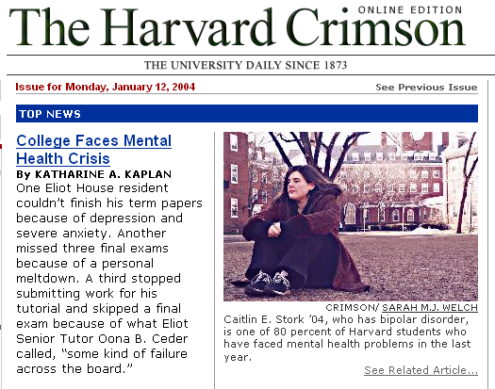

Slide 25
Does Psychology Need Help?
21/1 ratio of studies is unhealthy…
… but it reflects reality
depression 10 times higher today than 1960
mean age for depression today is 14.5 (compared to 29.5 in 1960)
80% of Harvard students depressed at least once last year
45% of college students nationwide depressed; 94% overwhelmed (Kadison, 2005)

Slide 26
Why More “Positive” Research?
Psychology as creative rather than merely reactive
Happiness is not the negation of unhappiness
Prevention through cultivating the positive

Slide 27

Unhappiness Spiral
“Negative” Research
Negative Experiences

Slide 28

Happiness Spiral
“Positive” Research
Heisenberg Uncertainty Principle
Positive Experiences

Slide 29
“Human systems grow in the direction of what they persistently ask questions about.”
Cooperrider and Whitney

Slide 30
Happiness isn’t the Negation of Unhappiness
neurosis, anger, anxiety, wellbeing, satisfaction, joy
depression, psychosis excitement, happiness
_______________________ 0 ____________________ +
Disease Model Health Model
Focus on weaknesses Focus on strengths
Overcoming deficiencies Building competencies
Avoiding pain Seeking pleasure
Running from unhappiness Pursuing happiness
Neutral state (0) as ceiling No ceiling
Tensionless as ideal Creative tension as ideal

Slide 31
Prevention through cultivating positive
Illness as the absence of health (vs. health as the absence of illness)
“It [neurosis] is a falling short of what one could have been, and even, one could say, of what one should have been, biologically speaking, that is, if one had grown and developed in an unimpeded way. Human and personal possibilities have been lost. The world has been narrowed, and so has consciousness. Capacities have been inhibited.” Abraham Maslow

Slide 32
“We have discovered that there are human strengths that act as buffers against mental illness: courage, future-mindedness, optimism, interpersonal skill, faith, work ethic, hope, honesty, perseverance, the capacity for flow and insight, to name several... We have shown that learning optimism prevents depression and anxiety in children and adults, roughly halving their incidence over the next two years... Similarly, I believe, that if we wish to prevent drug abuse in teenagers who grow up in a neighborhood that puts them at risk, that the effective prevention is not remedial. Rather it consists of identifying and amplifying the strengths that these teens already have.” Martin Seligman

Slide 33
Prevention through cultivating positive
Illness as the absence of health (vs. health as the absence of illness)
“It [neurosis] is a falling short of what one could have been, and even, one could say, of what one should have been, biologically speaking, that is, if one had grown and developed in an unimpeded way. Human and personal possibilities have been lost. The world has been narrowed, and so has consciousness. Capacities have been inhibited.” Abraham Maslow
Stronger “psychological immune system”
Mental health at Harvard

Slide 34
The Power of Positive Psychology: Studying At-Risk Population
Traditional psychology (Post-WWII)
“Why do these individuals fail?”
Positive psychological approach (1980s-)
“What makes some individuals succeed despite unfavorable circumstances?”

Slide 35
Resilience
“A class of phenomena characterized by patterns of positive adaptation in the context of significant adversity or risk.”
Masten & Reed
Superkids?
Ordinary characteristics, extraordinary results
Social support

Slide 36
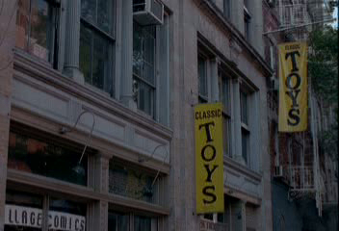

Slide 37
Resilience
“A class of phenomena characterized by patterns of positive adaptation in the context of significant adversity or risk.”
Masten & Reed
Superkids?
Ordinary characteristics, extraordinary results
Social support
Optimism and self-esteem
Faith and a sense of meaning
Prosocial behavior
Focusing on strengths
Set goals
A role model

Slide 38


Slide 39

Role models
Optimism and faith
Blame to responsibility
Deficiencies focus to strengths focus

Slide 40
Passive Victim Vs. Active Agent
___________________________________________
self pity
blame
frustration
anger
confidence
responsibility
hope and optimism
forgive/forget

Slide 41
“The message of the Positive Psychology movement is to remind our field that it has been deformed. Psychology is not just the study of disease, weakness, and damage; it also is the study of strength and virtue. Treatment is not just fixing what is wrong; it also is building what is right. Psychology is not just about illness or health; it is about work, education, insight, love, growth, and play. And in this quest for what is best, Positive Psychology does not rely on wishful thinking, self-deception or hand-waving; instead it tries to adapt what is best in the scientific method to the unique problems that human behavior presents in all its complexity.” Martin Seligman

Slide 42
Bibliography and Recommendations
Excellent website: www.psychologymatters.org
Antonovsky (1979). Health, Stress, and Coping. San Fransisco: Jossey-Bass.
Masten, A. S. & Reed, M. J. (2002). Resilience in development. In C. R. Snyder and S. J. Lopez (Eds.), Handbook of Positive Psychology, 528-540. Oxford University Press.
Seligman, M. E. P., & Csikszentmihalyi, M. (2000). Positive Psychology. American Psychologist, 55, 5-14.
Sheldon, K. M. & King, L (2001). Why Positive Psychology Is Necessary. American Psychologist, 56, 216-217.
Snyder, C. R. & Lopez, S. J. (Eds.) (2002). Handbook of Positive Psychology, 528-540. Oxford University Press.
Collins, M. & Tamarkin, C. (1990). Marva Collins’ Way. Putnam: New York.
Werner, E. & Smith, R. (2001). Journeys from Childhood to Midlife: Risk, Reilience and Recovery. Cornell University Press.

